Slide 1
Information Technology Report
Dave Pagliai
Manager, IT Support Services

Slide 2
Incident Report Highlights
Service Availability – April
Retail Market IT systems met all SLA targets
Incidents & Maintenance – April
04/12/15 – Planned Maintenance (Site Failover – Retail processing, MarkeTrak, Retail API)
04/28/15 – Find ESIID slow response (11 minutes)
04/28/15 – Find Transaction for historic searches (greater than 1 year) unavailable (15 minutes, unplanned maintenance)
MarkeTrak
API QueryList response time increased after a database upgrade in March
ERCOT has a support case open with the vendor to determine root cause and provide remediation
Supplemental AMS Interval Data Report Issue
No impacts to report posting in April
A long term solution has been developed and release to ERCOT’s test environment, and is scheduled for R3 Production release (late June)

Slide 3
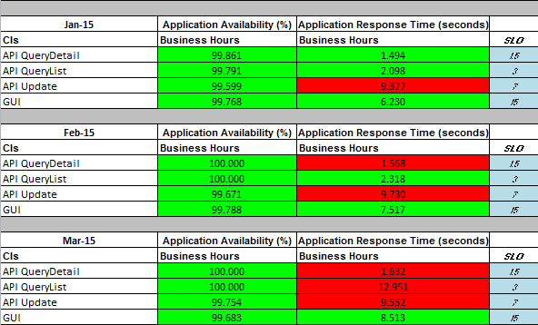
MarkeTrak Performance

Slide 4
Premature Transitioning of MarkeTrak Issues
ERCOT’s MarkeTrak application prematurely transitioned issues of all subtypes
This occurred on February 4 , 11, and 24, 2015
Investigation determined that a database parameter was getting changed by the MarkeTrak application
On February 12, ERCOT implemented monitoring for this condition (database parameter change), so early detection and correction could be achieved. This monitoring aided in timely identification of the issue when it reoccurred on February 24.
On February 24, ERCOT implemented a system change in an attempt to prevent the impact of the database parameter change, should it reoccur
A report was created and added to the MarkeTrak User Interface to help identify impacted issues (Premature Transition of MarkeTrak Issues).
No re-occurrence of the issue since 02/24/15
Vendor root cause investigation:
Unable to reproduce the issue under multiple scenarios
No other customers have reported this issue

