Slide 1

2015
Inadvertent Switch & Customer Rescission
Market Training

Slide 2
Agenda
Welcome & Introductions
Antitrust Admonition
Inadvertent Gain/Loss (IGL) Overview
  Causes of IAS & Impacts to customer experience
  Prevention of IAS
IAS Resolution Process Walkthrough
Reconciliation & Verification Process
Customer Rescission Walkthrough
Market Challenge & Closing
Adjourn

Slide 3
Antitrust Admonition
ERCOT strictly prohibits Market Participants and their employees who are participating in ERCOT activities from using their participation in ERCOT activities as a forum for engaging in practices or communications that violate the antitrust laws. The ERCOT Board has approved guidelines for members of ERCOT Committees, Subcommittees and Working Groups to be reviewed and followed by each Market Participant attending ERCOT meetings. If you have not received a copy of these Guidelines, an electronic version is available at http://www.ercot.com/about/governance/index.html. Please remember your ongoing obligation to comply with all applicable laws, including the antitrust laws.
Disclaimer
All presentations and materials submitted by Market Participants or any other Entity to ERCOT staff for this meeting are received and posted with the acknowledgement that the information will be considered public in accordance with the ERCOT Websites Content Management Operating Procedure.

Slide 4
Inadvertent
Gain/Loss (IGL)
Overview

Slide 5
What is an IGL?
An Inadvertent Gain/Loss (IGL) is an unauthorized change of a customer’s Retail Electric Provider
Commonly referred to as either an Inadvertent Gain (IAG) or Inadvertent Loss (IAL), an inadvertent situation occurs when a customer or a premise is changed to a REP that is different than their expected REP of choice.
When resolving IGL issues, the ultimate goal is to return the Customer to their REP of choice in a quick and efficient manner with minimal inconvenience to the Customer.

Slide 6
Key Documents
PUC Substantive Rules
    http://www.puc.texas.gov/agency/rulesnlaws/subrules/electric/Electric.aspx
    §25.495. Unauthorized Change of Retail Electric Provider
    §25.30 Complaints
    §25.471. General Provisions of Customer Protection Rules
    §25.474. Selection of Retail Electric Provider
    §25.485. Customer Access and Complaint Handling

Slide 7
Key Documents
    §25.495. Unauthorized Change of Retail Electric Provider
    Either the original REP (Losing REP) or the switching REP (Gaining REP) shall file a MarkeTrak issue as promptly as possible
    Affected REPs, ERCOT, and TDSP shall take all actions necessary to return the customer to the original REP as quickly as possible
      Original REP (Losing REP) does not need to obtain further authorization from the customer
    Affected REPs, ERCOT, and TDSP shall take all actions necessary to bill correctly all charges
      Gaining REP shall pay all transmission and distribution charges associated with returning the customer to the Losing REP
      Gaining REP shall refund within 5 days all charges paid by the customer for the time period the Losing REP regains and ultimately rebills the customer
      The customer shall pay no more than the price at which the customer would have been billed had the unauthorized switch or move-in not occurred
      The REP that ultimately bills the customer is responsible for the non-bypassable charges and wholesale consumption for the customer

Slide 8
Key Documents
ERCOT Retail Market Guide
http://www.ercot.com/mktrules/guides/retail/current
7.3 Inadvertent Gain Process
  7.3.1 Escalation Process
  7.3.2 Competitive Retailer’s Inadvertent Gain Process
    7.3.2.1 Buyer’s Remorse
    7.3.2.2 Prevention of Inadvertent Gains
    7.3.2.3 Resolution of Inadvertent Gains
    7.3.2.4 Valid Reject/Unexecutable Reasons
    7.3.2.5 Invalid Reject/Unexecutable Reasons
    7.3.2.6 Out-of-Sync Conditions
    7.3.2.7 No Losing Competitive Retailer of Record
  7.3.3 Charges Associated with Returning the Customer
  7.3.4 Transmission and/or Distribution Service Provider Inadvertent Gain Process
    7.3.4.1 Inadvertent Dates Greater than 150 days
    7.3.4.2 Inadvertent Order is Pending
    7.3.4.3 Third Party has Gained Electric Service Identifier (Leapfrog Scenario)
    7.3.4.4 Transmission and/or Distribution Service Provider Billing
  7.3.5 Customer Rescission after Completion of a Switch Transaction
    7.3.5.1 Additional Valid Reasons for Rejection of a Rescission-based Issue

Slide 9
Key Documents
ERCOT Retail Market Guide
Section 7.3 Inadvertent Gain Process
Guidelines for ensuring that inadvertently gained ESI IDs are returned to the Losing Rep in a quick and efficient manner with minimal inconvenience to the Customer as required by PUC Subst. Rule 25.495 Unauthorized Change of Retail Electric Provider
Escalation Process
Each Market Participant is responsible for its own compliance with the PUCT rules and RMG procedures/timelines.
Each Market Participant shall have escalation contacts within MarkeTrak
MarkeTrak will send escalation emails to the escalation contacts whenever an issue has remained in a ‘New’ or ‘Pending’ state for more than 3 calendar days

Slide 10
Key Documents
ERCOT Retail Market Guide- continued
CRs, both Losing and Gaining Reps, must investigate the matter and provide all necessary/relevant information – customer name, service address, meter number
An untimely rescission is not treated as an inadvertent gain or loss
The IGL process shall not be used to resolve an issue which an authorized enrollment causes a breach of contract between Customer and Losing Rep
Utilize the Cancel w/ Approval MarkeTrak to prevent an IGL if within one Retail Business Day prior to MVI or switch
If future dated MVI or switch and earlier than one Retail Business Day prior to transaction, utilize 814_08 Cancel Request
    814_08 Cancel w/ approval IGL MarkeTrak
    DOT – 1 DOT
    Date of Transition

Slide 11
Key Documents
ERCOT Retail Market Guide – continued
Do not issue a MVO on an ESI ID that was gained in error
Do not issue an Inadvertent Loss MarkeTrak until the Gaining Rep’s transaction has completed
The Losing Rep ultimately determines the reinstatement date
Reinstatement date shall be at the earliest DOL + 1 (Date of Loss) and at the latest 10 days from the date the MarkeTrak was submitted
The Losing Rep shall submit the BDMVI (back-dated move in) 814_16 no later than 12 days after submittal of the MarkeTrak and shall be dated with the ‘proposed regain date’ as agreed in the MarkeTrak
The MT will auto-close if remains untouched for 20 days from the date the TDSP selects ‘Ready to Receive’
Reinstatement date
DOL DOL+1 MT date +10

Slide 12
Key Documents
ERCOT Retail Market Guide – continued
Be mindful of the Valid and Invalid Reject/Unexecutable reasons
Each Rep shall be responsible for all non-bypassable TDSP charges and wholesale consumption costs for the periods that the Rep bills the customer
If a lights out in error situation occurs (the Gaining Rep issues a MVO or DNP) the Losing Rep may submit a Redirect Fee MarkeTrak within 3 Retail Business Days following an 810_02 from the TDSP. Keep in mind, not all TDSPs have MVI fees for standard meters.
TDSP shall not issue billing corrections more than 150 days in the past from the date of receipt of the BDMVI due to settlement issues. Losing Rep must resubmit the BDMVI with a new date.
Leapfrog Scenario – when a legitimate third party transaction has occurred to an inadvertently gained ESI ID or if the BDMVI’s proposed regain date is more than 2 Retail Business Days prior to scheduled transaction, TDSP shall respond this is no longer an inadvertent issue.

Slide 13
Key Documents
MarkeTrak User Guide
http://www.ercot.com/content/services/client_svcs/mktrk_info/MarkeTrak%2520User%2520Guide[1]%20(2).zip
2.1 Day to Day Issues – Inadvertent Gain
2.1.1 Required Fields for Inadvertent Gain
2.1.2 Definition of Inadvertent Gain
2.1.3 Submitting an Inadvertent Gain
2.1.4 Submitting a Customer Rescission Issue
2.1.5 Redirect Fees Subtype

Slide 14
How does an IGL occur?
An Inadvertent Gain or Loss can occur under various circumstances:
Incorrect information provided by the Customer during enrollment – service address or ESI ID
Incorrect information entered by the REP during enrollment
Unauthorized enrollments – slamming
Confusing enrollment processes by REPs

Slide 15


Slide 16
Who does an IGL impact?
Customer
Gaining REP
TDU
Losing REP
ERCOT

Slide 17

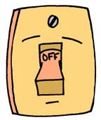

How is the market impacted?
Poor customer experience
Worst customer experience
Customer confusion
Delayed billings
PUCT complaints
Lights Out in Error situation (LOIE)
Resource commitments – staff to process MTs
Cost implications
  IAG fees
  Consumption costs – Date of Loss (DOL)
  Redirect fees
  Lost sales

Slide 18
Lights Out in Error Situations
Which transaction initiates the LOIE?
  Q: MVI or SWITCH?
  A: MVI
Which transaction results in a LOIE?
  Q: DNP or MVO?
  A: MVO
Worst customer experience

Slide 19
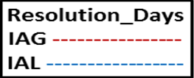
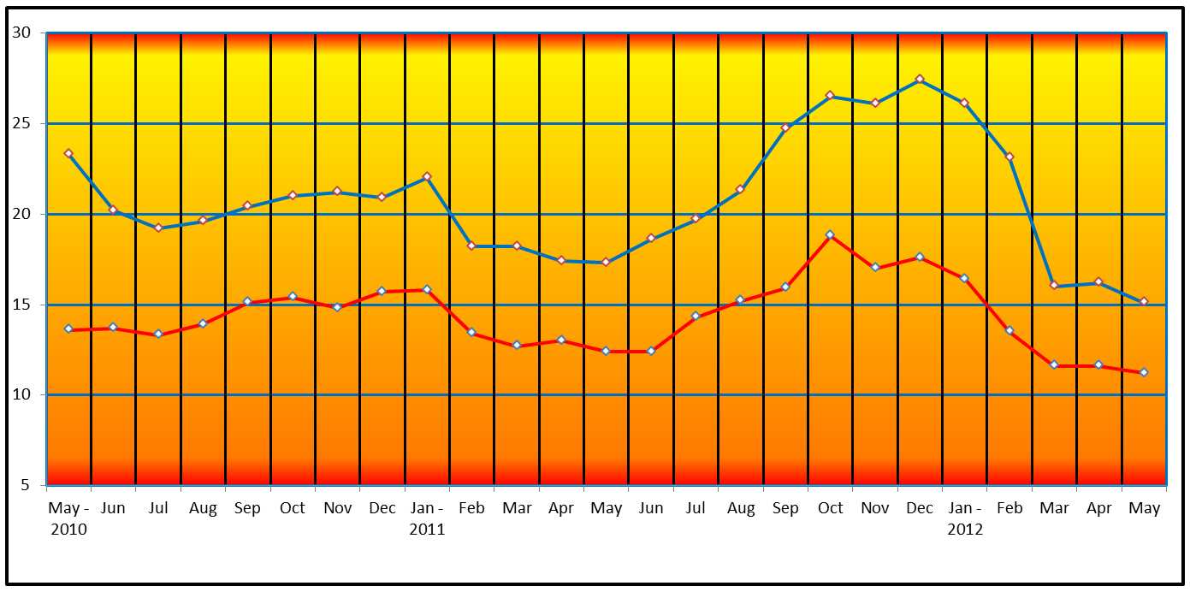
Has the market improved?
Resolution Days – Valid Inadvertent Issues by Close Date - yesterday

Slide 20
Has the market improved?
Resolution Days: Valid Inadvertent/Rescission Issues by Closed Date

Slide 21

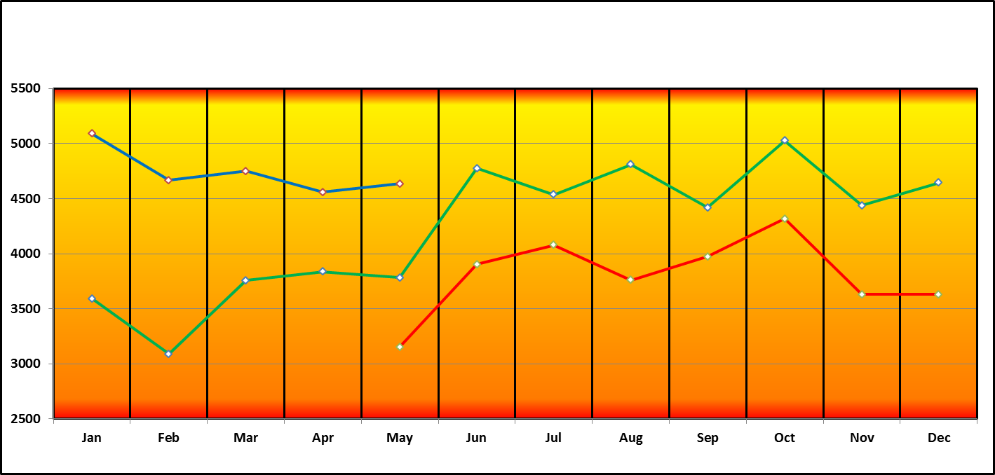
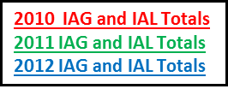
Has the market improved?

Slide 22
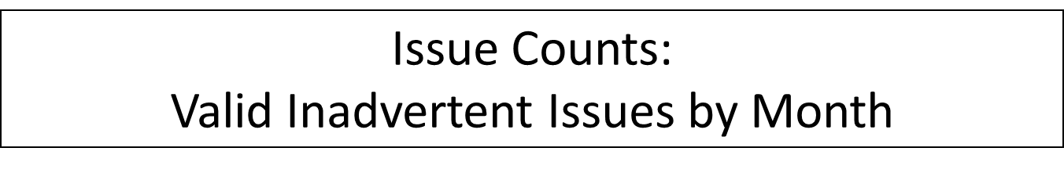
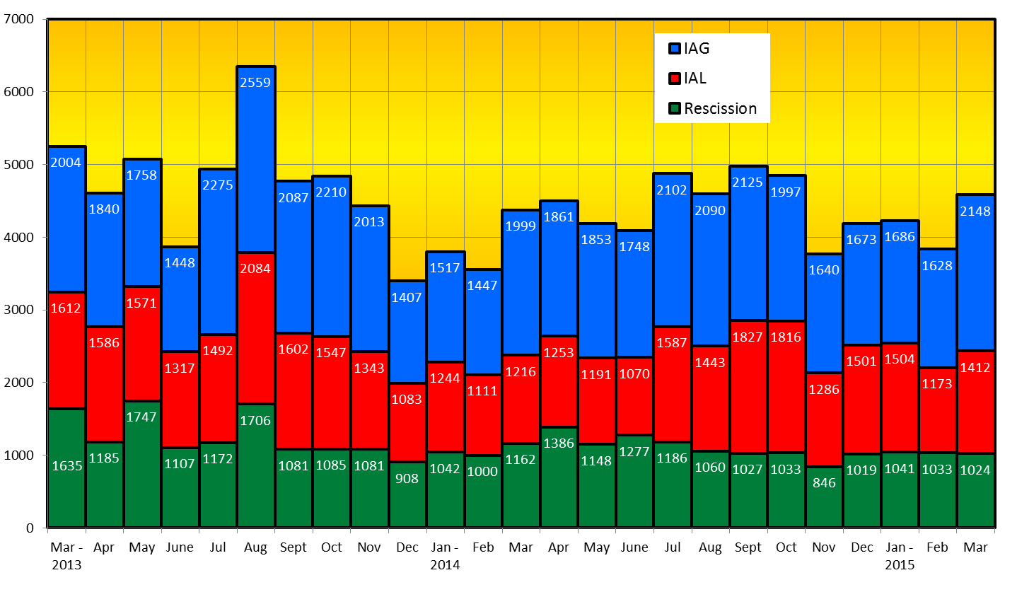
Has the market improved?

Slide 23
Common IGL Issues/Potential Gaps

Slide 24
IGL Issues- Move Outs
ISSUE
PROPOSAL/SOLUTION
MVOs are being submitted for IGL situations
  To correct an error
  Customer does not occupy premise
  Customer wants to “cancel” service
Losing CR MT agents are indicating customer no longer resides at premise and for Gaining CR to issue a MVO for IGL resolution
MVOs should never be submitted to correct a situation
  Ensure agent understanding of flow of transactions
  Ask probing questions to ensure proper customer action is taken such as “Do you currently live here?”
Gaining CRs should not issue MVOs for esi ids which they inadvertently gained – Losing CR should regain esi id, then issue MVO if necessary

Slide 25
IGL Issues – Broken IGLs
ISSUE
PROPOSAL/SOLUTION
Broken IGLs
  3rd party transaction has occurred possibly creating leagfrog situation which nullifies or unexecutes IGL situation
  Gaining CR is left with charges they may not be able to recover
Identification of IGLs in progress for ESI IDs
  Flag ESI IDs to ensure subsequent transactions are not submitted to the market until the IGL is completed
Utilize the applicable market approved process to regain a lost ESI ID

Slide 26
IGL Issues – Not meeting SLAs
ISSUE
PROPOSAL/SOLUTION
Not receiving responses on MTs or escalated MTs
    What is the response expectation?
  “Unexecuted” MTs are not “accepted” and “closed” by the Gaining CRs
Market participants must update their “rolodex” with the appropriate escalation contacts
    It is strongly encouraged one of those contacts be a departmental mailbox
    Responses for MTs are suggested within three calendar days
IGL MTs that have been “unexecuted” will not follow the “auto-close” workflow and must be manually accepted to close

Slide 27
IGL Issues – BDMVIs
ISSUE
PROPOSAL/SOLUTION
Delays experienced in the submittal of BDMVIs
  Leaves Gaining CR at risk for a leapfrog situation
Regain date does not match the regain date agreed within the MT by the Losing CR
  Gaining CR responsible for additional consumption
  BDMVIs should be submitted within three business days of TDSP transitioning “ready to receive”, no later than 20 days per RMG 7.3.2.3.1
  Regain date should match the agreed upon date within the IGL MT and shall be within 12 days of the MT submission per RMG 7.3.2.3.1(4)

Slide 28
IGL Issues – Current Occupant
ISSUE
PROPOSAL/SOLUTION
Losing REP responds to an IGL indicating “their customer no longer occupies the premise” and attempts to ‘unexecute’- this is NOT a valid reason for unexecuting MT per RMG 7.3.2.5 Invalid Reject/Unexecutable Reasons
  Losing REP should regain esi id and initiate a “current occupant” process
    Establish service (ROR)
    Send required notification to premise requesting service be established
    If unable to establish responsible party after a minimum of 11 days, ROR may submit 814_24 MVO

Slide 30
Inadvertent Gain
Walkthrough
(CR)

Slide 31
Inadvertent Gain
  An inadvertent issue begins upon the discovery of an Inadvertent Gain or Move-In transaction submission. Upon identification of an Inadvertent Gain or Move-in, the CR will check the transaction status via the ERCOT MIS.
    If transaction Status is pending, and the Inadvertent CR is the submitting CR, then the CR will cancel their submitting transaction either by submitting an EDI cancel transaction or by submitting a Cancel with Approval MarkeTrak issue.
    For other Status types or if the CR was not the submitter of the transaction, the CR will log a MarkeTrak Inadvertent issue.
    CR’s will work together in a manner outlined in Section 7.2 of the Retail Market Guide (RMG) to determine appropriate resolution.
    If the CR/TDSP resolution requires a backdated move-in being generated by the Original CR, then the date should be at least the Gaining CR start date plus 1 day to avoid creating transaction business process exceptions at ERCOT and the TDSP.
    The submitter should include any details, (Customer name and/or meter number), which may expedite resolution of the issue.

Slide 32
Inadvertent Gain
  ERCOT’s Receipt of Inadvertent Gain Issue
    Confirm the pending or actual change of CR relationship.
    Assign CR2 and the TDSP to the MarkeTrak issue.
    ERCOT will transition the MarkeTrak issue to the parties involved with CR2 as the Responsible MP.
    CR2 is responsible for selecting Begin Working to transition the item into a State of In Progress.
    The Original CR must wait for the TDSP to select Ready to Receive prior to sending the EDI to regain the account.
  Examples of Invalid Inadvertent Gain Issues where ERCOT will select Invalid IAG and populate the Invalid IAG Reason field with the reason the issue could not be worked:
    Invalid ESI ID
    Wrong or Invalid Tran ID
    Invalid Order Type (order something other than MVI or Switch)
    Submitter selected Gaining and is not the Gaining CR
    Submitter selected Losing and is not the Losing CR
    ESI ID was De-Energized prior to completion of MVI
    The Losing and Gaining CR are the same
    Losing CR has left the Market
    Gaining CR has left the Market
    Order was Cancelled – No IAG
    Other

Slide 33
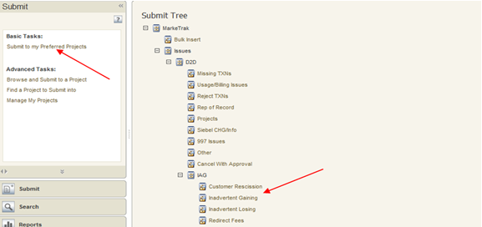
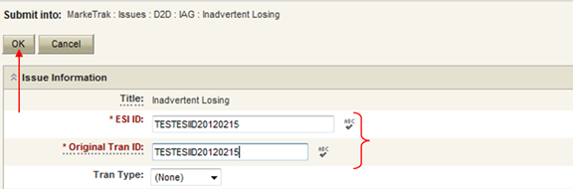
Inadvertent Gain
  Submitting an Inadvertent Gain – CR Submits as the Gaining CR
    From the Submit Tree, select IAG – Inadvertent Gaining
    CR1 (Gaining/Original CR) will enter all required information.
      ESIID
      Original Tran ID – The original tran id of the other CR’s enrollment. (BGN06 of the 814_06).

Slide 34
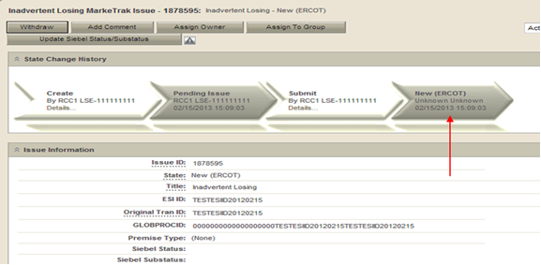
Inadvertent Gain
  CRITICAL: The Comments field is technically optional; however, not providing the required information referenced in RMG Section 7.3.2(1) could result in a delay of issue resolution. Please include any additional information in this box.
        Customer Name
        Meter Number
        Any other pertinent information that will help expedite resolution
    Select OK to create the IAG – Inadvertent Gaining MarkeTrak Issue. The issue enters the state of New (ERCOT) and is visible only by the Submitting CR and ERCOT.
    The Submitting CR has the option to Withdraw the issue at this point
    ERCOT will select Begin Working to provide the Gaining CR Start Date, if the Gaining CR is still the rep of record (Gaining CR ROR), assign CR2 (Gaining CR) and TDSP. ERCOT will then select “OK” to move the issue to CR2 (Gaining CR).

Slide 35
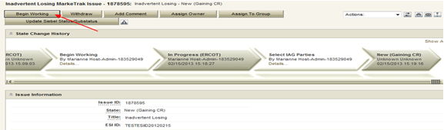

Inadvertent Gain
    CR2 (Losing CR) will select Begin Working and Issue details and Investigate Market Conditions to determine the appropriate regain date.
    If CR2 (Losing/Original CR) determines that an Inadvertent Gain has NOT taken place, they have the option to select “Unexecutable” to stop the Inadvertent Gain process. Invalid IAG Reason is required, enter one of the following:
      3rd party CR involved
      Authorized Enrollment Confirmed
      Duplicate Issue
      Other (should require comments)

Slide 36
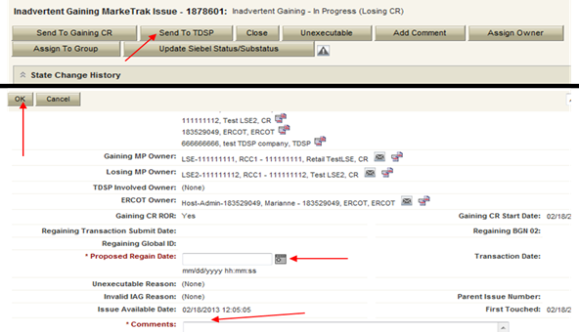
Inadvertent Gain
    If CR2 (Losing/Original CR) determines they will need more information from CR2 (Gaining CR), then they will need to select Send to Gaining CR. This transition allows both CR’s to talk back and forth while transitioning the issue back and forth before a resolution is made.
    If CR2 (Losing/Original CR) determines that an Inadvertent Gain has taken place, they will select Send to TDSP, enter the proposed regain date, add comments and select “OK” to move the issue to the TDSP. A validation will occur on the Proposed Regain Date: Validate that the date is less than “Submit Date” + 10 days. If not the following error message will be displayed “Proposed Regain Date is greater than 10 Calendar days from the submittal of MarkeTrak Issue, please update with valid Proposed Regain date.”

Slide 37
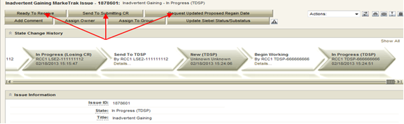
Inadvertent Gain
    The TDSP will select Begin Working, investigate the issue details, then select one of the following:
      Ready to Receive – The TDSP would select this transition to send the issue back to CR1 (Losing/Original CR). It is extremely important that CR1 (Losing/Original CR) wait for the TDSP to select Ready to Receive indicating TDSP’s systems have been prepared to receive the Original MP’s transaction before the EDI is actually sent. If not, the EDI will be rejected at the TDSP.
      Send To Submitting CR – The TDSP would select this transition if they needed further information from CR1 (Losing/Original CR).
      Request Updated Proposed Regain Date – The TDSP would select this transition if they do not agree with the proposed regain date that was provided. They would suggest a new date and send the issue back to CR1 (Losing/Original CR).

Slide 38
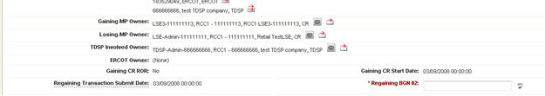
Inadvertent Gain
    CR2 (Losing/Original CR) will select Begin Working then select Provide Regaining BGN 02. CR2 (Losing/Original CR) will provide the Regaining BGN02 and then select “OK”. When the regaining transactions process into ERCOT’s registration system, the Regaining Transaction Submit Date, Regaining BGN Requested Date and Regaining BGN Priority Code will be auto-populated on the MarkeTrak issue.
    All parties should continue to monitor MIS and internal systems for the successful delivery and completion of the EDI transaction being sent by CR1 (Losing/Original CR) to the Market to regain a premise and resolve the associated Inadvertent Gain MarkeTrak issue.
    Once the regaining transaction has been successfully sent to the Market by CR2 (Losing/Original CR), Siebel will automatically:
      Check Regaining Transaction Siebel Status every 30 minutes using the BGN 02 from the new initiating transaction
      Update the issue with the current Regaining Transaction Siebel Status
      Assign the state of Complete with the Submitting MP as the Responsible Party once the Regaining Transaction Siebel Status is Complete.
      Issues remaining in a state of ‘Regaining Transaction Submitted (PC)’ for 14 calendar days will be transitioned by MarkeTrak to a state of ‘New (Losing CR Re-Submit)’ with the following comment: “Regaining Transaction has been idle for too long. Please review and re-submit transaction.”

Slide 39
Inadvertent Loss
Walkthrough
(CR)

Slide 40
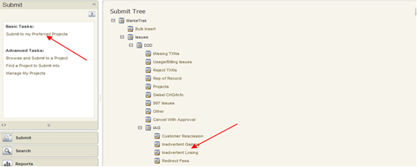
Inadvertent Loss
  Submitting an Inadvertent Loss – CR Submits as the Losing CR
    From the Submit Tree, select IAG – Inadvertent Losing
    CR1 (Losing/Original CR) will enter all required information.
      ESIID
      Original Tran ID – The original tran id of the other CR’s enrollment. (BGN06 of the 814_06).

Slide 41
Inadvertent Loss
  CRITICAL: The Comments field is technically optional; however, not providing the required information referenced in RMG Section 7.3.2(1) could result in a delay of issue resolution. Please include any additional information in this box.
        Customer Name
        Meter Number
        Any other pertinent information that will help expedite resolution
    Select OK to create the IAG – Inadvertent Losing MarkeTrak Issue. The issue enters the state of New (ERCOT) and is visible only by the Submitting CR and ERCOT.
    The Submitting CR has the option to Withdraw the issue at this point
    ERCOT will select Begin Working to provide the Gaining CR Start Date, if the Gaining CR is still the rep of record (Gaining CR ROR), assign CR2 (Gaining CR) and TDSP. ERCOT will then select “OK” to move the issue to CR2 (Gaining CR).

Slide 42
Inadvertent Loss
    CR2 (Gaining CR) will select Begin Working and investigate the Inadvertent Gain issue details to determine if CR1 (Losing/Original CR) should regain ESI ID as of their date of loss.
    If CR2 (Gaining CR) determines that an Inadvertent Gain has NOT taken place, they have the option to select “Unexecutable” to stop the Inadvertent Gain process. Invalid IAG Reason is required, enter one of the following:
      3rd party CR involved
      Authorized Enrollment Confirmed
      Duplicate Issue
      Other (should require comments)

Slide 43
Inadvertent Loss
    If CR2 (Gaining CR) determines that an Inadvertent Gain has taken place, they will select Agree, enter comments and select “OK” to move issue to CR1 (Losing/Original CR). Selecting Agree indicates the Gaining CR is agreeing to all fees associated with transitioning the premise back to the Losing CR.
    CR1 (Losing/Original CR) will select Begin Working and Investigate Market Conditions to determine the appropriate regain date. The regain date shall be a day beyond the date of loss or any subsequent date chosen by the Losing/Original CR but no greater than 10 days past the date the MarkeTrak issue was logged.
    CR1 (Losing/Original CR) will select Send to TDSP, enter the proposed regain date, add comments and select “OK” to move the issue to the TDSP. A validation will occur on the Proposed Regain Date: Validate that the date is less than “Submit Date” + 10 days. If not the following error message will be displayed “Proposed Regain Date is greater than 10 Calendar days from the submittal of MarkeTrak Issue, please update with valid Proposed Regain date.”
    If CR1 (Losing/Original CR) determines that an Inadvertent Gain has NOT taken place, they have the option to select Unexecutable.

Slide 44
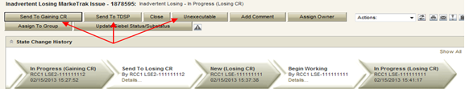

Inadvertent Loss
    If CR1 (Losing/Original CR) determines they will need more information from CR2 (Gaining CR), then they will need to select Send to Gaining CR. This transition allows both CRs to talk back and forth while transitioning the issue back and forth before a resolution is made.
    The TDSP will select Begin Working, investigate the issue details, then select one of the following:
      Ready to Receive – The TDSP would select this transition to send the issue back to CR1 (Losing/Original CR). It is extremely important that CR1 (Losing/Original CR) wait for the TDSP to select Ready to Receive indicating TDSP’s systems have been prepared to receive the Original MP’s transaction before the EDI is actually sent. If not, the EDI will be rejected at the TDSP.
      Send To Submitting CR – The TDSP would select this transition if they needed further information from CR1 (Losing/Original CR).
      Request Updated Proposed Regain Date – The TDSP would select this transition if they do not agree with the proposed regain date that was provided. They would suggest a new date and send the issue back to CR1 (Losing/Original CR).

Slide 45
Inadvertent Loss
    CR1 (Losing/Original CR) will select Begin Working then select Provide Regaining BGN 02. CR1 (Losing/Original CR) will provide the Regaining BGN02 and then select “OK”. When the regaining transactions process into ERCOT’s registration system, the Regaining Transaction Submit Date, Regaining BGN Requested Date and Regaining BGN Priority Code will be auto-populated on the MarkeTrak issue.
    All parties should continue to monitor MIS and internal systems for the successful delivery and completion of the EDI transaction being sent by CR1 (Losing/Original CR) to the Market to regain a premise and resolve the associated Inadvertent Gain MarkeTrak issue.
    Once the regaining transaction has been successfully sent to the Market by CR1 (Losing/Original CR), Siebel will automatically:
      Check Regaining Transaction Siebel Status every 30 minutes using the BGN 02 from the new initiating transaction
      Update the issue with the current Regaining Transaction Siebel Status
      Assign the state of Complete with the Submitting MP as the Responsible Party once the Regaining Transaction Siebel Status is Complete.
      Issues remaining in a state of ‘Regaining Transaction Submitted (PC)’ for 14 calendar days will be transitioned by MarkeTrak to a state of ‘New (Losing CR Re-Submit)’ with the following comment: “Regaining Transaction has been idle for too long. Please review and re-submit transaction.”

Slide 46
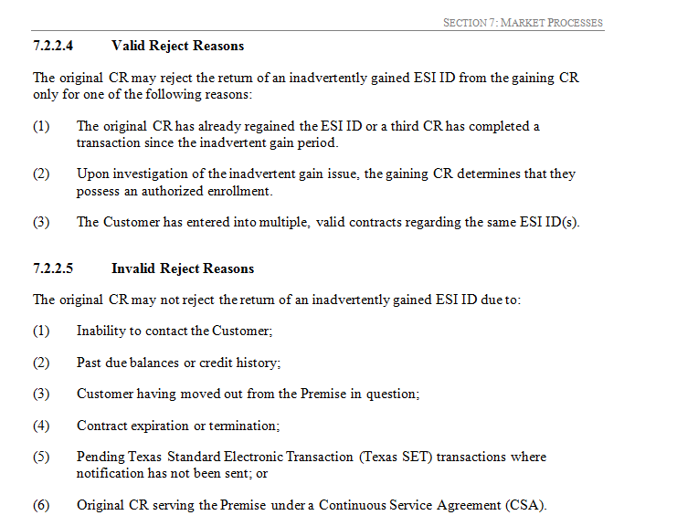
Key Things to Remember
Provide as much information when opening Inadvertent Gain/Loss MarkeTrak in order to help facilitate quick resolution to the issue.
  Suggested Information includes
  Customer Name (Always)
  Meter Number (If available)
  Any other pertinent information you may have that is crucial to help resolve issue.
  Regain date should be:
  DOL +1
  DOL less than or equal to 10 days from date MT was submitted
  Valid/Invalid Reasons for MarkeTrak to be rejected or marked as Unexecutable:

Slide 48
Best Practices:
Reconciliation & Verification Process

Slide 49
Reconciliation & Verification
All parties involved in any Inadvertent Gain related MarkeTrak issue should build in some sort of Reconciliation and Verification process to thoroughly research the status of the Inadvertent Gain related MarkeTrak issue that they are involved in and also to verify the status of any associated transaction.

Slide 50
Reconciliation & Verification
In other words…
In addition to researching that an actual Inadvertent Gain has taken place, also verify the state/status of the actual issue and what action needs to take place from what party.
Verify the current status of the account and research the transactions that may impact the resolution of the issue.
Perform a reconciliation of the transactions sent to the Market to ensure that the transactions are being sent, received and processed successfully and as expected and agreed upon by all parties.
Ultimate goal is to return the Customer to their REP of choice quickly and efficiently with minimal inconvenience to the Customer.

Slide 51
Reconciliation & Verification
All parties have a role in researching the issues on their end, however for the Losing CR/Original, the following verification process can assist in making the resolution of an Inadvertent Gain MarkeTrak run smoothly when the following checks are performed:
Any Subsequent transactions in the Market?
  Yes – Submit a Cancel W/Approval issue to STOP the TXN if possible
  No – Proceed to the next step
Any Holds?
  Yes – Submit 650_01O
  No - Proceed to the next step
Proposed Regain Date > Gaining CR Start Date? (not less than or equal to)
  Yes – Update
  No – Proceed “Send to TDSP”

Slide 52
Reconciliation & Verification
Once the Losing CR/Original completes their research, the issue is sent to the TDSP and a similar verification process takes place which also assists in making the resolution of an Inadvertent Gain MarkeTrak run smoothly:
Any Subsequent transactions in the Market?
  Yes – Send back to CRs to research account further
  No – Proceed to the next step
Any Holds?
  Yes – Send back to CR to remove Deferred Payment Plan HOLD
  No - Proceed to the next step
Proposed Regain Date > Gaining CR Start Date? (not less than or equal to)
  Yes – Send back to CR to update the Proposed Regain Date field
  No – Proceed

Slide 53
Reconciliation & Verification
Once those preliminary checks are made, the TDSP will go on to perform the following steps:
Check for Permit Requirements and override if any exist
Add ESIID, Original CR and Proposed Regain Date to Safety Net and verify loaded correctly
Update MarkeTrak issues with comments indicating readiness

Slide 54
Reconciliation & Verification
Once the TDSP completes their portion of the research, the issue is sent back to the Losing CR/Original who will send an EDI transaction to actually resolve the issue in the Market and thus more verification will need to take place:
Ensure that the MarkeTrak issue is in a State of “New (Losing CR Submit)”
Any Subsequent transactions in the Market?
  Yes – Cancel W/Approval if possible
  No – Proceed
Send EDI for the Proposed Regain Date that the Original CR entered within the issue
Verify the EDI was processed successfully by consulting the ERCOT Market Information System (MIS) as well as any internal systems used for verifying transactions.

Slide 55
Reconciliation & Verification
The backdated MVI can be verified as successful per the receipt of an 814_05 Accept
The backdated MVI can be verified as a REJECT from ERCOT if there is an 814_05 Reject Status/Action Reject Addition FRG
The backdated MVI can be verified as a REJECT from the TDSP if there is an 814_05 Reject Status/Action Reject Addition “MISSING BACKDATED ORDER FOR OPEN SN FROM MMDDYY”
Add the Regaining BGN information into the MarkeTrak issue only after verifying that it was successfully received
DO NOT click the “Send to TDSP” transition as this will prevent the issue from Auto-completion

Slide 57
Customer Rescission
Walkthrough

Slide 58
Right of Rescission
PUCT Subst. Rule 25.474(j) - Right of Rescission
A REP shall promptly provide the applicant with the terms of service document after the applicant has authorized the REP to provide service to the applicant and the authorization has been verified. For switch requests, the REP shall offer the applicant a right to rescind the terms of service without penalty or fee of any kind for a period of three federal business days after the applicant's receipt of the terms of service document. The provider may assume that any delivery of the terms of service document deposited first class with the United States Postal Service will be received by the applicant within three federal business days. Any REP receiving an untimely notice of rescission from the applicant shall inform the applicant that the applicant has a right to select another REP and may do so by contacting that REP. The REP shall also inform the applicant that the applicant will be responsible for charges from the REP for service provided until the applicant switches to another REP. The right of rescission is not applicable to an applicant requesting a move-in.

Slide 59
Right of Rescission
In other words…
Applicable to Switch requests only, not Move-Ins.
After receiving the Terms of Service, Customer is allowed three (3) federal business days to rescind without penalty or fees.
    If Customer requests rescission outside of the 3 federal business day window, it is no longer a rescission and will be considered an Inadvertent Switch – at which time penalties and/or fees may be applied.
Ultimate goal is to return the Customer to their REP of choice quickly and efficiently with minimal inconvenience to the Customer.

Slide 60
Rescission vs. Inadvertent Switch
Although Customer Rescission is part of the Inadvertent Switch ‘family’ within the MarkeTrak tool, resolution of a Customer Rescission does not follow the same criteria nor follow the same completion timeline.
The research and investigation normally pursued during resolution of an Inadvertent Switch is not utilized when resolving Customer Rescission.
If/when the customer requests rescission (within the 3 federal business day window), the ‘losing’ REP must promptly regain the Customer – no questions asked.

Slide 61
Customer Rescission & RMGRR129
Due to the expeditious nature of Customer Rescission requests, RMGRR129 – Revision to Customer Rescission Completion Timeline was created to provide additional guidelines regarding specific timing and responsibilities for a Competitive Retailer (CR) to complete a Customer Rescission MarkeTrak issue.

Slide 62
RMGRR129 – What are the changes?
Once a Customer Rescission MarkeTrak (MT) issue has been submitted, the losing CR has two (2) business days to agree to the Customer Rescission MT issue.
Once the Transmission and/or Distribution Service Provider (TDSP) has updated the MT issue to “Ready to Receive”, the losing CR has another two (2) business days to send a backdated 814_16, Move-In Request.

Slide 63
Customer Rescission Walkthrough
Only the gaining CR in a rescission scenario may utilize the rescission-based MarkeTrak process to initiate reinstatement of a customer to its original CR.
In order for an issue to be submitted through this subtype, it must be submitted on or before the twenty-fifth (25th) calendar day following ERCOT’s established First Available Switch Date (FASD).
Should a matter of rescission need to be resolved, but a Customer Rescission issue has not been submitted for this purpose within the specified timeframe the two CRs should work to resolve this issue through the Inadvertent Gaining subtype.

Slide 64
Rescission Walkthrough – Gaining CR
The Gaining CR selects the Submit tab.
From the Submit Tree, select Customer Rescission.
Note: The submitter should include any details (ex. customer name) in the comments section which may expedite resolution of the issue.

Slide 65
Rescission Walkthrough – Gaining CR
The following fields must be populated:
ESI ID
Original Tran ID

Slide 66
Rescission Walkthrough - Validations
ERCOT validates ESI ID, submission timeframe and valid originating transaction.
Upon passing validation, MarkeTrak issue is created and ERCOT updates the issue with the following information:
      Losing CR Name and Duns
      TDSP Name and Duns
      Gaining CR ROR = Y or N
      Gaining CR Start Date
      Regain Date – auto populated by ERCOT.
      (Gaining CR Start Date +1 calendar day)
MarkeTrak issue is assigned to the state of ‘New (Losing CR)’ with the Losing CR as the Responsible Party.
[Starts the 2 BD clock for Losing CR to Agree]
Losing CR user selects ‘Begin Working’.

Slide 67
Rescission Walkthrough – Losing CR
MarkeTrak issue is assigned to the state of ‘In Progress (Losing CR)’ with the Losing CR as the Responsible Party.
Losing CR selects ‘Send to TDSP’.
[Implies “Agreement” & ends the 2 BD clock]

Slide 68
Rescission Walkthrough – TDSP
Issue is in a state of ‘New (TDSP)’ with TDSP as Responsible MP.
TDSP selects ‘Begin Working’.
Issue is in a state of ‘In Progress (TDSP)’ with TDSP as Responsible MP.

Slide 69
Rescission Walkthrough - TDSP
TDSP selects ‘Ready to Receive’
[Starts the 2 BD clock for Losing CR to submit BDMVI]

Slide 70
Rescission Walkthrough – Losing CR
Issue is in a state of ‘New (Losing CR Submit)’ with the Losing CR as Responsible MP.
Losing CR selects ‘Begin Working’.
Issue is in a state of ‘In Progress (Submit Regaining)’ with the Losing CR as Responsible MP.

Slide 71
Rescission Walkthrough – Losing CR
Losing CR selects ‘Provide Regaining BGN02’.

Slide 72
Rescission Walkthrough – Losing CR
Losing CR populates all required information:
      Regaining Transaction Submit Date
      Regaining BGN 02

Slide 73
Rescission Walkthrough - Resolution
Issue is in a state of ‘Regaining Transaction Submitted (PC)’ with the Gaining (Submitting CR) as Responsible MP.
Once the regaining transaction (Backdated 814_16 MVI) has been successfully sent by (Losing/Original CR), Siebel will automatically:
      Check Regaining Transaction Siebel Status every 30 minutes using the BGN 02 from the new initiating transaction.
      Update the issue with the current Regaining Transaction Siebel Status.
The issue will move to a state of ‘Complete’ with the Submitting MP as the Responsible Party once the Regaining Transaction Siebel Status is Complete.
[Ends the 2 business day clock for the Losing CR]

Slide 74
Rescission Walkthrough - Exceptions
If the regaining transaction remains in a Siebel status other than Complete in the ERCOT Registration System for greater than five calendar days, the issue will automatically transition back to the Losing CR, and an email generated to notify the Losing CR of the transition.
If the regaining Siebel status is still Scheduled status, the Losing CR should repopulate the regaining BGN field with the same information.
If the Siebel status is blank within the MarkeTrak issue, the Losing CR should verify the status of the regaining transaction and submit/repopulate a new transaction if necessary.
This functionality is to ensure the issue is not closed before the premise has been regained, due to the time restriction on submission of new issues within this subtype.

Slide 75
Rescission Walkthrough – Re-submit

Slide 76
Rescission Walkthrough – Re-submit

Slide 78
Market Challenge

Slide 79
IGLs – Where we have been

Slide 80

IGLs – Where we are today

Slide 81


Why is this important to the market?
The competitive ERCOT market is mature, and viewed by some as the model to emulate.
Maturity allows the opportunity to refine processes, seek efficiencies, and improve the customer experience.
Bad customer experience
PUCT complaints
Consumes significant resources for REPs, TDSPs, ERCOT, and PUCT

Slide 82

Market Challenge
Let’s clean up the slop !!

Slide 83
Market Challenge
REP actions cause a significant volume of IGLs (e.g., incorrect transactions, sales tactics).
REPs should be willing to be accountable to each other regarding IGLs, working together to drive solutions to the market.
Goals
Collectively, by the end of 2015, reduce IGLs by 50% from today’s volume
Speed up the resolution cycle = minimize the customer impact as much as possible

Slide 84
How can we get there…
What can we all do to reduce the number of Inadvertent Gains/Losses in the market?
Analyzing why they occurred – trending, categorizing, and root causing
Execute techniques for preventing them going forward
Streamline management of MarkeTraks
Reporting to measure success

Slide 85
How can we get there…
Analyzing why they occurred…
  Review the data and categorize root causes of the issue, such as:
    Customer issue/error (wrong address)
    Agent issue/error (wrong address)
    System issue (order not processing)
    Error by other REP (losses)
    Back office error
    Web portal error ( house panel esi id vs apartment)
  Each of these root causes may be further broken down and addressed accordingly:
    Coaching, coaching, coaching for offending agents who fail to comply with approved processes (issuance of MVOs to correct errors)
    Internal reporting identifying offending REPs and reaching out to offenders with opportunities to solution gaps in processes
    Education of agents on proper transactions

Slide 86
How can we get there…
Execute techniques for preventing them going forward…
Confirm service address via ERCOT, meter number, etc.
  simply restating prior to authorization of enrollment (Third Party Verification)
  ensure self-service web portals have proper validations (an apartment unit that may inadvertently enroll the house meter)
Alerts on ESI IDs for which an IGL is in progress to ensure improper transactions do not occur to break IGL or create a lights out situation
Issuance of proper transaction – utilize a Cancel w/Approval MT, if applicable, in lieu of an IGL situation
Clear enrollment processes by sales forces
Continued TDSP intervention –TDSP becomes aware of a possible Inadvertent situation and reaches out to impacted REPs
    Names not matching on switch transactions
    Safety net process whereby TDSP will not accept any transactions that do not match date of safety net or MarkeTrak

Slide 87
How can we get there…
Streamline management of MarkeTraks…
Utilize customized MarkeTrak reporting features to organize “your buckets” into the following categories to allow for prioritization of your daily work such as:
  “ready to receive” – will display any MTs requiring BDMVIs
  “unexecuted” – gains – requiring closure
  “unexecuted” – losses – requiring closure
  “begin working” – gains
  “begin working” - losses

Slide 88
Market Challenge
Reporting to measure success…
Performance Measurement Requirements
For each month, ERCOT shall report
    The number of inadvertent gains for each REP
    The number of losses due to inadvertent gains for each REP
    The number of rescissions for each REP
    The ratio of inadvertent gains to completed enrollments for the Gaining REP
  SUGGESTION:
  Present at RMS the top offenders (anonymously)
  with the largest ratio of IAGs to enrollments
2008
Recommendation

Slide 89



Market Challenge
How will the market be impacted?
Together we can make it a ...

Slide 91
Presenters
Overview & Market Challenge - John Schatz, TXUE
IAS Process Walkthrough - Tomas Fernandez, NRG
Reconciliation & Verification Process- Corde Nuru, CenterPoint Energy
Customer Rescission - Jim Lee, AEP Texas

