Slide 1
Review of Integration of the Requirements of MOD-025-2 Standard with ERCOT Protocols and Operating Guides
S. Looney, Luminant Energy Company
For Presentation to ROS, May 7, 2015

Slide 2
Introduction/Purpose
Identify areas of misalignment between MOD-025-2 and ERCOT Protocols and Guides.
Looking for ROS recommendation for the best way to address conflicting or redundant requirements between ERCOT Protocols and Guides with MOD-025-2.
Develop process for harmonizing other Protocols with future NERC standards.

Slide 3
Real Power Testing – MOD-025-2
Real Power is tested every 5 years in conjunction with Reactive Power testing, output level held for 1 hour.
Intended that Real Power test be performed at the same time as the full load Reactive Power testing however separate testing is allowed.
First verification must be a staged test, subsequent testing may be submission of operating data.

Slide 4
Issues Related to Real Power Testing
Does the MOD-025 Real Power Testing requirement R1 make the unannounced testing unnecessary?
Would the VDI and Emergency Operations Settlement be applicable to MOD-025 Real Power Testing?
Is unannounced testing still required given that ERCOT calculates GREDP for every Resource for every 5 minute clock interval which would detect a Resource’s ability to reach its telemetered HSL?

Slide 5
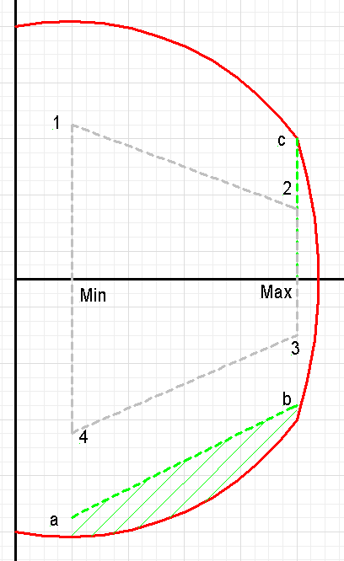
Reactive Power Testing
ERCOT Requirements:
Lagging: At Max Load, reactive at c
Leading: Load anywhere between Min and Max, corresponding reactive between a and b
(Both Tests held for 15 minutes)
3. Two year periodicity
NERC Requirement (MOD-025)
Lagging: At Max Load, reactive at 2 for 1 hour and reactive at 1 for a moment
Leading: At Min Load, reactive at 4 for a moment and at Max Load, reactive at 3 for a moment
3. Five year periodicity
Points 1, 2, 3 & 4: 50% of the CURL
Points a, b & c: 90% of the CURL

Slide 6
Issues Related to Reactive Testing
Reactive test required by the ERCOT Operating Guides has many differences from MOD-025-2.
Applicable size for aggregate generation
Periodicity of tests
Duration of tests
Passing criteria
Test procedure
ERCOT Protocols and Operating Guides should add requirements when there is a documented reliability concern.
If Operating Guides and Protocols are unchanged, Generation Resource Operators will be required to maintain multiple test procedures and testing records.
Could introduce compliance risk with no real improvement in reliability.
Consider using historical operating data for tests where possible because all the cost of testing is paid by the GO’s and GOP’s in the energy only market.

Slide 7
Future Study Topics
Anticipating analogous concerns with pending implementation of other NERC standards
MOD-026
MOD-027
VAR-002
PRC-024

Slide 8
Additional Reference Information

Slide 9
Real Power Testing – Existing ERCOT Requirements
Current Protocol Section 8.1.1.2 provides for a VDI to be given to the QSE for an unannounced test.
Resource is given a specified time period to reach HSL, determined by where the Generator is loaded at the initialization of the test.
Must hold the output at the HSL for 30 minutes.
May be considered for additional compensation under Section 6.6.9, Emergency Operations Settlement.
If the Resource fails to reach and hold its telemetered HSL for 30 minutes, the Resource must lower its HSL reported in the COP until a retest has demonstrated the reported capability.

Slide 10
MOD-025-2 Requirement R1

Slide 11
MOD-025-2 Requirement R2

