Slide 1
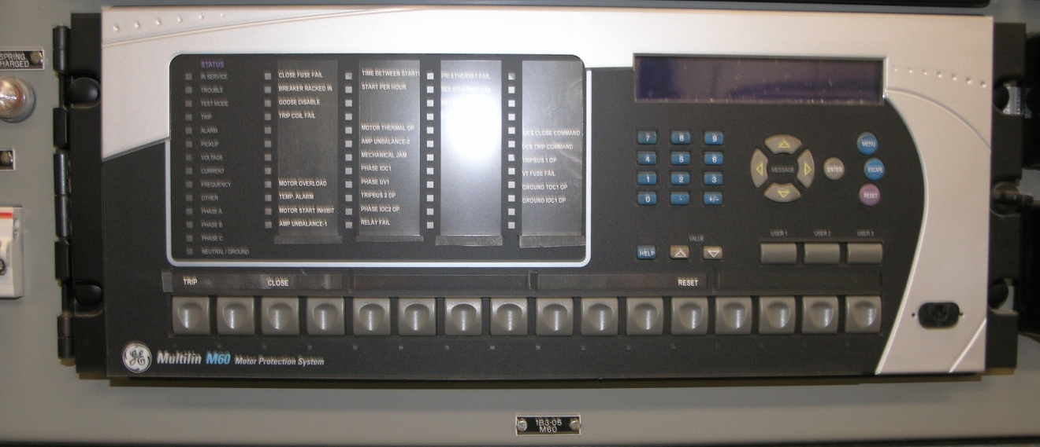
Application for Permanent Metering Exemption
Fayette Power Project Backfeed

Slide 2
ROS Request
ERCOT Protocols Section 10.14 allows resources to seek a permanent metering exception and requires TAC and ERCOT Board approvals
Two other metering exemptions have been reviewed by ROS and ultimately approved
Calpine’s Channel Energy Center
NextEra Energy NoTrees
We are seeking ROS endorsement of LCRA and Austin Energy’s (AE) permanent site-specific exemption from compliance with Metering Protocols Section 10.3.2.3(2)(b) and 10.3.3.2(5)

Slide 3
History
Fayette Power Project (FPP) consists of three units. FPP Units 1 and 2 were built in 1980 and FPP Unit 3 was built in 1988
Separate interconnection agreements, RARFs and EPS Metering plans
In 2013, FPP completed a major scrubber installation project, which include installing new switchgear and feeders. This facilitated backfeed options to increase plant reliability among the units.

Slide 4
Purpose of Backfeed
The purpose of the FPP Backfeed Project is to improve the power plant reliability by providing an additional source of power for shutdown and startup conditions
During maintenance outages, it is desirable to go on backfeed to allow maintenance of the Standby Auxiliary equipment. If the Standby Auxiliary system failed, there would be no power to FPP Unit 3 other than batteries and emergency generators

Slide 5
ERCOT
Short Term: ERCOT has already granted a Temporary Exemption to 10.3.2.3(2)(b) and 10.3.2.3(5). This allows backfeed among the units
Long Term: LCRA & AE request a TAC and Board Permanent Exemption
ERCOT believes the FPP exemption is a unique situation and is not opposed

