Slide 1
SCR775 Wireframes

Slide 2
Launch
Link added under “Day-Ahead and Real-Time Displays”
Display opens in a new window

Slide 3
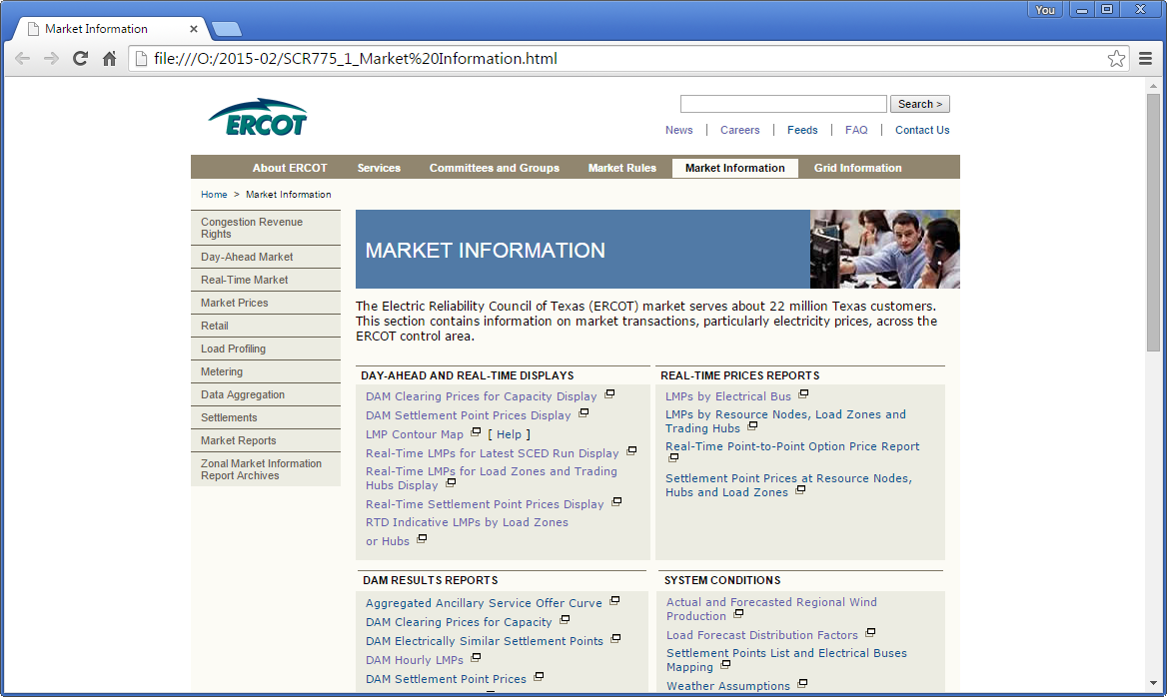

Slide 4
Display
Drop-down menu changes display data; font-size follows date selector in other displays
Table and “Help?” link formatting follow current display style sheets
SCED timestamp is right-justified to edge of table, clears drop-down menu, 8px padding above/below; font size follows drop-down menu and date selector in other displays

Slide 5
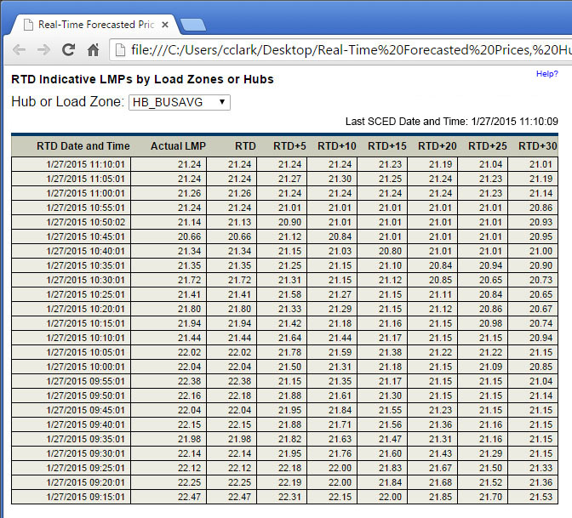
Standard Scenario: without SCED timestamp column, with RTD (current) and with 6 interval view

Slide 6
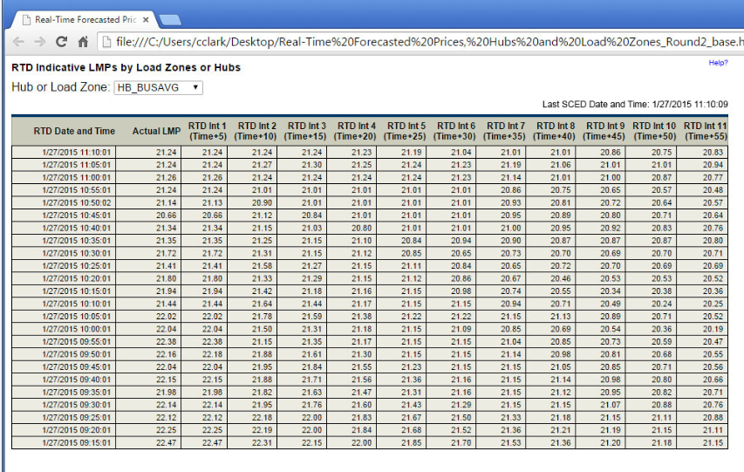
Standard Scenario: without SCED timestamp column, with updated columns labels and 11 interval view

