Slide 1
ERCOT Planning Overview
ERCOT Planning

Slide 2
Objectives
Discuss what resource adequacy entails.
Understand the objective of the Capacity, Demand and Reserve Report (CDR)
Understand the objective of the Seasonal Assessment of Resource Adequacy (SARA)
Identify the remaining reliability issues requiring Constraint Management Plans (CMP) for 2015
Understand the Panhandle export stability limit and its possible effects on operations

Slide 3
ERCOT System Planning
Transmission Planning
RTP
LTSA
RPG Reviews
GINR Studies
RMR Studies
Dynamic Studies
Resource Adequacy
CDR Study
SARA Study
Loss of Load Study
Drought Model
Generation Availability
Risk Analysis
Load Forecasting
Near-term Forecasting
Long-term Forecasting
Meteorology
Load Profiling

Slide 4
What is Resource Adequacy?
Resource adequacy is the ability to provide sufficient resource capacity to meet peak load requirements
  “Sufficient” resources includes a capacity reserve margin to account for weather variation, generation outages and load forecast error
  The traditional focus is the ability to supply resources for the ERCOT system’s annual peak load hour
  ERCOT comes up with an advisory minimum capacity reserve margin needed to maintain a low probability of involuntary load shedding (1 event in 10 years)
  Comparing the forecasted reserve margins reported in ERCOT’s reliability assessments with the minimum capacity reserve margin is a gauge of resource adequacy

Slide 5
Capacity, Demand, and Reserves Report
Provides estimated ERCOT system-wide capacity reserve margins for ten years (Summer and Winter Peak Season)
  Peak load forecast based on expected (normal) weather conditions
  Load resources and utility demand response programs counted
  Existing resource counted based on status and capacity.
    Seasonal sustainable capacity ratings (Summer / Winter)
    Capacity contribution of Wind, Hydro, DC Ties, PUNs and Solar (future) resources based on historical performance during peak periods
    Switchable, Retired, Mothballed resources accounted for based on reported availability from Resource Entities
  Planned resources with executed SGIA, air emissions permits and water supplies (if required) counted based on projected in-service dates

Slide 6
December 2014 CDR Summer Expectations
Current “minimum planning reserve margin” is 13.75%
ERCOT region exceeds minimum PRM criterion through 2018

Slide 7
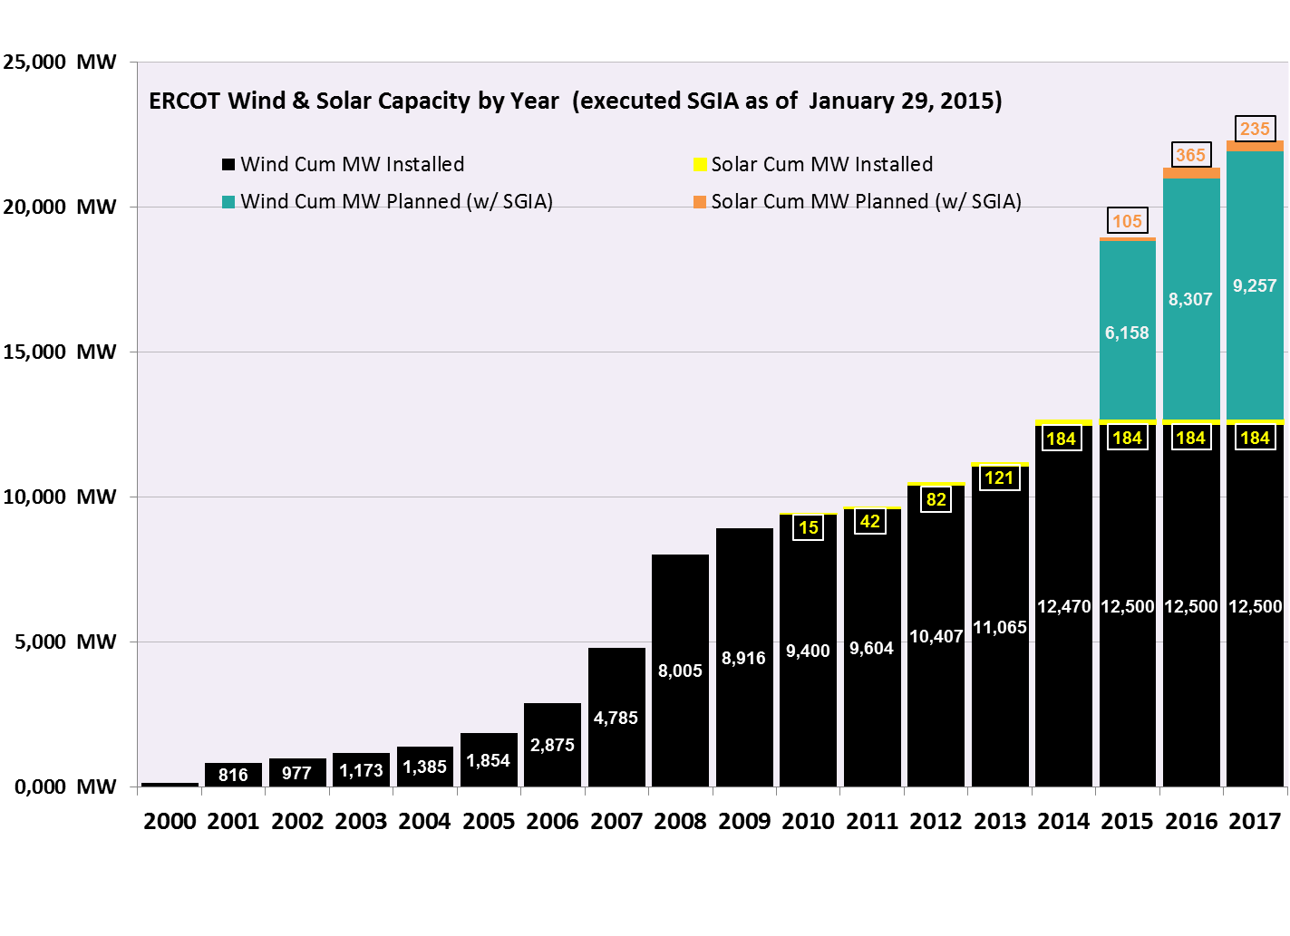
Renewables Being Added at a Rapid Pace…
Not included in the chart are over 14,800 MW of planned wind and 5,900 MW of planned solar capacity for which interconnection requests have been made but no interconnection agreement have been executed yet.
Notes:
Not included here are over 14,000 MW and 6,100 MW of planned wind and solar capacity, respectively, for which interconnection requests have been made, but have not executed an interconnection agreement.

Slide 8
…Resulting in Fewer Dispatchable Resources like Gas and Coal

Slide 9
Seasonal Assessment of Resource Adequacy (SARA)
  A deterministic scenario-based view of near-term resource adequacy (for two upcoming seasons-Spring Summer, Fall or Winter)
    Focuses on sufficient operating reserves to avoid Energy Emergency Alerts (EEAs)
  Incorporates A) seasonal peak load forecast and B) latest available information on resource outages
  Illustrates a range of likely resource adequacy outcomes including extreme weather/unit outage scenarios
  Increasing emphasis on forecasting winter resource adequacy due to weather-related gas curtailments

Slide 10
2014-15 Winter SARA (Final)
Item | Winter 2014/2015 | Forecasted Season Peak Load | Extreme Load/Expected Generation Outages | Extreme Load/Extreme Generation Outages
1 | Total Resources (MW) | 77,350
2 | Peak Demand (MW) | 52,837
3 | Reserve Capacity (MW) | 24,513
4 | Extreme Peak Load Adjustment (MW) | -- | 6,805 | 6,805
5 | Maintenance/Forced Outages | 7,880 | 11,524 | 16,552
6 | Uses of Reserve Capacity (MW) [4+5] | 7,880 | 18,329 | 23,357
7 | Capacity Available for Operating Reserves [3-6] | 16,633 | 6,184 | 1,156 *
* Less than 2,300 MW available for Operating Reserves indicates risk of EEA1

Slide 11
Regional Transmission Plan (RTP) - Objective
Regional Transmission Plan is developed annually by ERCOT in coordination with the RPG and the TSPs
Annual assessment to identify transmission needs of ERCOT system over next six years
Projects identified to meet the ERCOT/NERC reliability requirements (Reliability projects) and to reduce system congestion (Economic projects) that meet the ERCOT economic criteria
The RTP system upgrades identified need to be further reviewed by the appropriate TPs to determine the need for an earlier in-service year

Slide 12
2014 Regional Transmission Plan (RTP) - Process
Case Conditioning
Future projects review and update
Reliability Analysis
Run N-1 SCOPF to obtain initial list of overloads
Economic Analysis
Run economic analysis
Future generation review and update (addition and retirement)
Load comparison and adjustment
Transmission outages, DC tie dispatch, and SOL updates
Run G-1 + N-1 and X-1 + N-1 screening to identify generator and transformer outages to study
Add, or improve existing, transmission projects to mitigate overloads
Add or improve projects that meet the economic criteria

Slide 13
2014 Regional Transmission Plan (RTP) – Overview of Results
117 reliability improvements identified
  40% resulted from, or were impacted by, the new X-1+N-1 criteria
Large number of unresolved reliability issues for 2015

Slide 14
Planned Improvements
Map Index | Transmission Improvement | In-service Year
1 | Temple Switch – Bell County East 345 kV line upgrade | 2015
2 | New Lobo –North Edinburg 345 kV line (Valley Import) | 2016
3 | New North Edinburg – Loma Alta 345 kV line (Cross Valley) | 2016
4 | New Fowlerton 345 kV station with 345/ 138 kV transformer | 2017
5 | Add second Jewett 345/ 138 kV transformer | 2017
6 | Add second Jordan 345/ 138 kV transformer | 2017
7 | Add second Twin Buttes 345/ 138 kV transformer | 2017
8 | McDonald Road – Spraberry 138/ 69 kV line upgrade | 2017
9 | New South McAllen 345 kV station with 345/ 138 kV transformer | 2017
10 | Tradinghouse – Sam Switch 345 kV line upgrade | 2017
11 | New Jones Creek 345 kV station with two 345/ 138 kV transformers | 2017
12 | Houston Import Project | 2018
13 | Venus – Navarro 345 kV line upgrade | 2019
14 | Big Brown – Navarro 345 kV line upgrade | 2019
15 | Trinidad – Watermill 345 kV line upgrade | 2019
16 | San Antonio Transmission System Addition Project | 2019
17 | Jack County 345/138 kV transformer addition | 2020

Slide 15
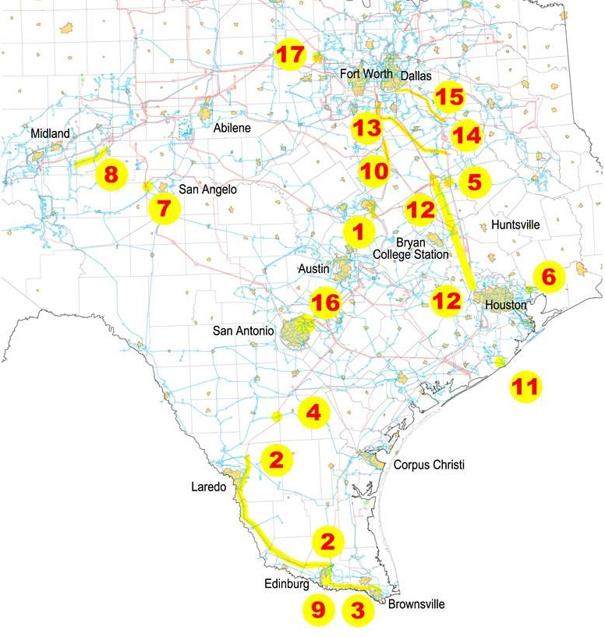
Planned Improvements

Slide 16
2015 Reliability Issues Needing Constraint Management Plans (CMP)
Map Index | Transmission Element
1 | Bosque Switch – Olsen TNP 138 kV line
2 | Olsen TNP 138/69 kV transformer
3 | Collin Switch – Frisco138 kV line
4 | Flat Top TNP – Barilla Tap 138kV tie
5 | McDonald – Spraberry 138 kV lines
6 | Big Lake 138/69 kV transformer
7 | Big Lake – Big Lake Phillips Tap 69 kV line
8 | San Angelo Concho – San Angelo Mathis Field 69 kV line
9 | Wink – Odessa Basin SS 69 kV line
10 | Twin Buttes 345/138 kV transformer
11 | Campwood – Montell - Uvalde 69 kV line
12 | Skywest – Driver 138 kV line
13 | Alice – San Diego 69 kV line
14 | Freer – San Diego 69 kV line
15 | Asherton – Carrizo Springs 69 kV line
16 | Asherton 138/69 kV transformer
17 | Pleasanton 138/69 kV transformer
18 | Howard – Somerset 138 kV line
Notes:
A lot of these issues are in West and South Texas.

Slide 17
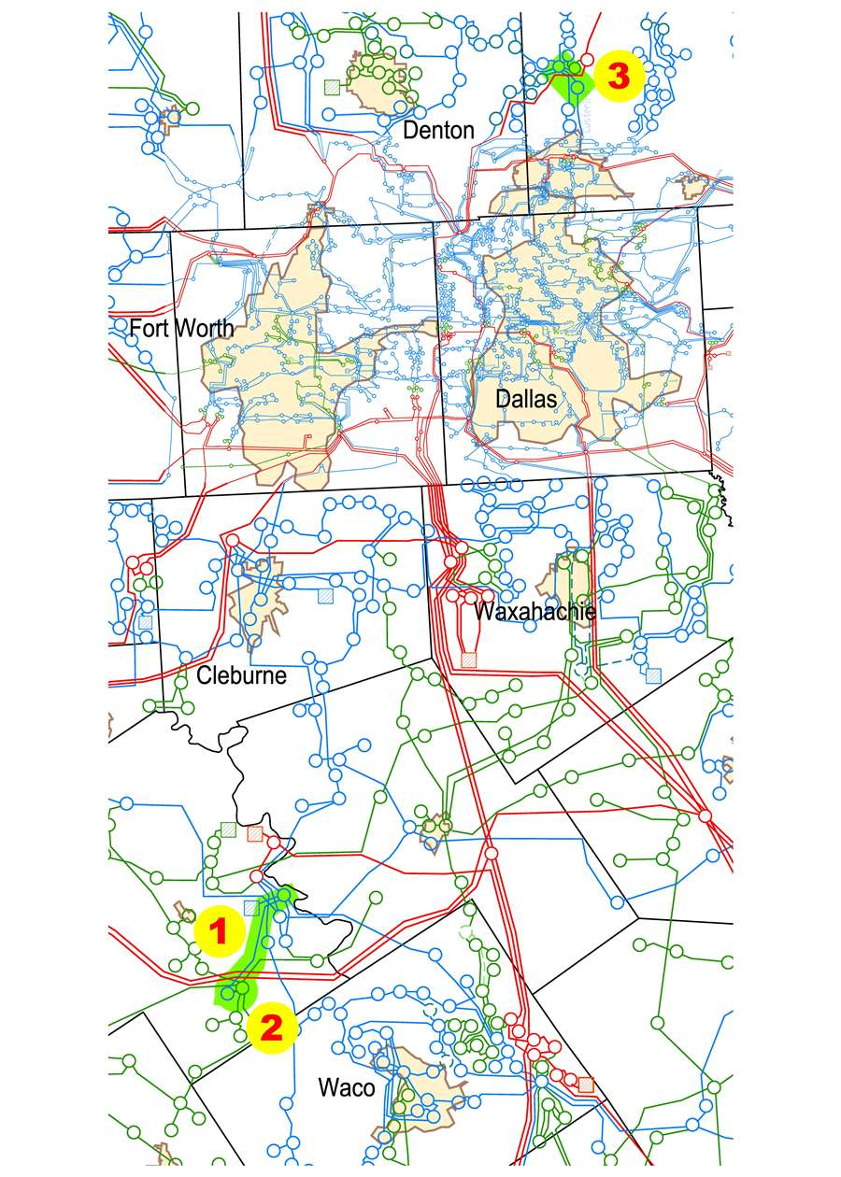
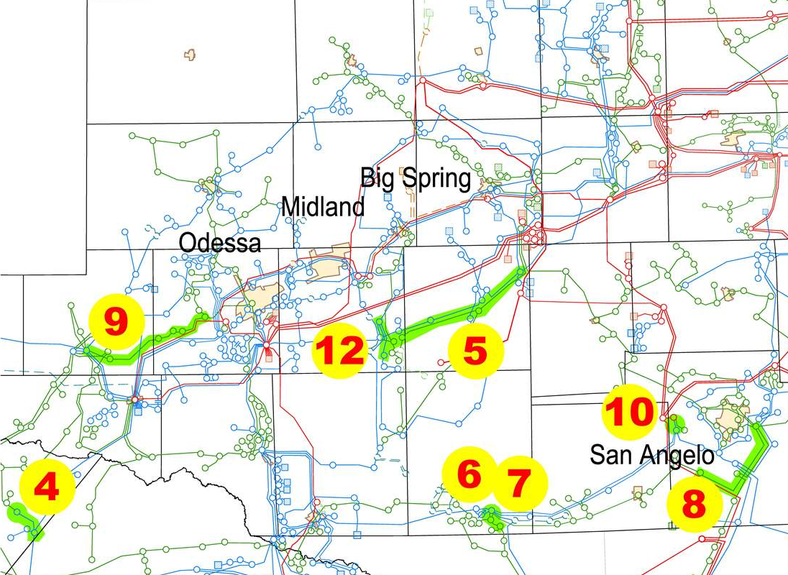
2015 Reliability Issues Needing Constraint Management Plans (CMP)

Slide 18
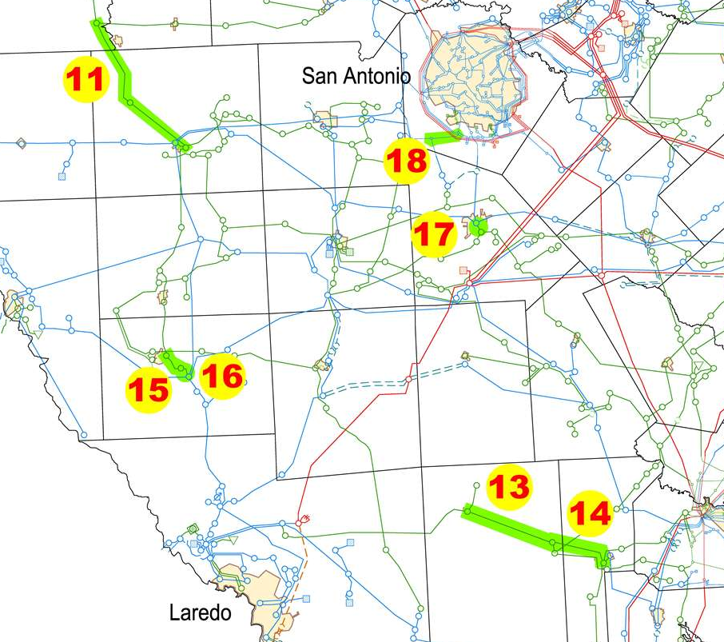
2015 Reliability Issues Needing Constraint Management Plans (CMP)

Slide 19
Comparison of Number of Unresolved Issues

Slide 20
Remaining Congestion
Map Index | Projected Constraining Element | 2017 Congestion | 2020 Congestion
1 | Baytown Energy Center 345/138 kV transformer
2 | Dupont Switch – Dupont PP-1 (Ingleside) 138 kV line
3 | Escondido – Eagle Hydro 138 kV line
4 | Glen Rose – Meridian 69 kV line
5 | Goldthwaite – San Saba Switch 69 kV line
6 | Hamilton Road – Maverick 138 kV line
7 | Jack Creek – Twin Oak Switch
8 | Jewett – Singleton 345 kV line
9 | Kiamichi Energy Facility – Kiowa Switch 345 kV line
10 | Loop 337 – GPI Switch 138 kV line
11 | Morris Dido – Eagle Mountain 138 kV line
12 | Nevada – Royse Switch 138 kV line
13 | Randolph – Weiderstein 138 kV line
14 | Singleton – Zenith 345 kV line
15 | Spur – Aspermont 138 kV line
16 | Wolfgang – Rotan 69 kV line
17 | Panhandle Export Limit
Congestion Color Key
 | None
 | Low
 | Medium
 | High
Notes:
Some congestion seen in 2017 is not seen in 2020 due to reliability projects being built in the interim timeframe relieving the congestion (e.g. Singleton – Zenith due to HIP).

Slide 21
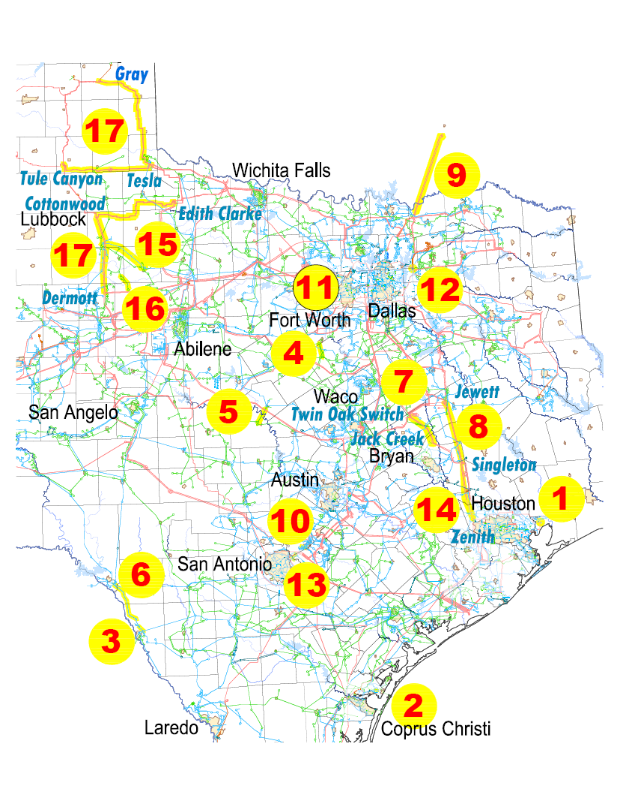
Remaining Congestion

Slide 22
Panhandle Study
ERCOT completed a Panhandle study in April, 2014
Study was initiated for a number of reasons:
  2012 Long-Term System Assessment
    Significant expansion of wind resources in the Panhandle under a range of future outcomes.
    If the northwestern-most portion of the Panhandle CREZ system becomes over-subscribed, voltage stability limits will constrain wind power delivery to the rest of the ERCOT System
  Generation projects will exceed the CREZ design capacity for the Panhandle area (based on the CREZ Reactive Study “Initial Build” recommendations)
  No near-term Panhandle transmission projects being developed post CREZ 2013

Slide 23
Panhandle Study
Identified the challenges and needs to integrate large wind generation capacity in the Panhandle region
The results provide a roadmap to both ERCOT and TSPs that includes the upgrade needs and the associated triggers in terms of wind generation capacity in the Panhandle

Slide 24
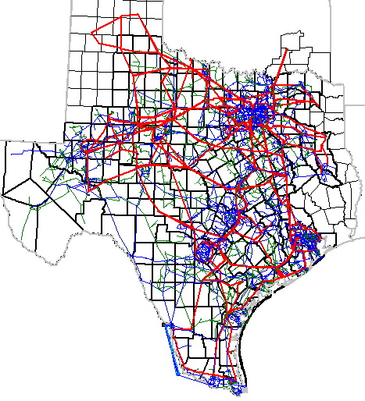
Panhandle Region

Slide 25
Panhandle Study Results
Stability challenges and system strength are identified as the significant constraints for Panhandle export
The Panhandle is a weak grid
  Not what most operators are used to seeing

Slide 26
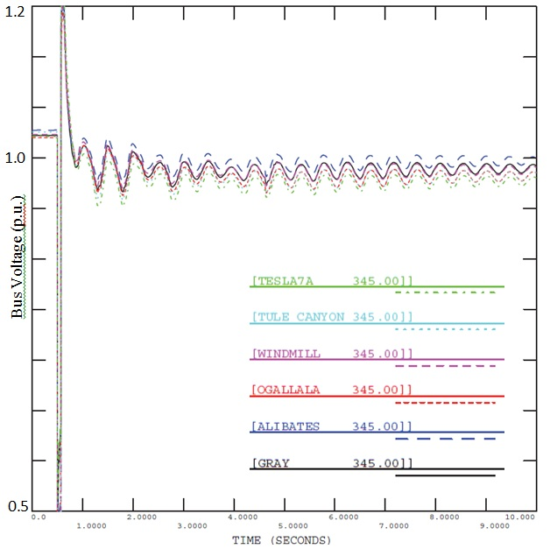
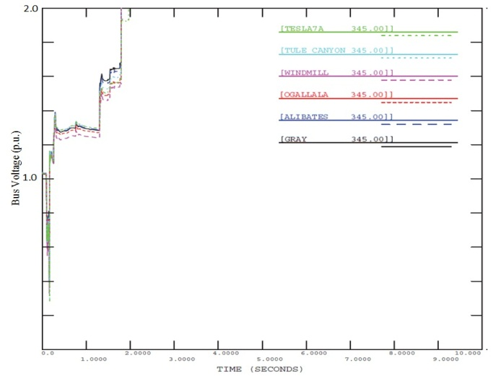
Stability Studies
Planning study results: multiple thousands MW wind generation connect to the Panhandle
Oscillatory Response
Voltage Collapse

Slide 27
Ongoing Evaluation of the Panhandle
~3500 MW of wind capacity meeting planning requirements is enough to model the Panhandle export stability limit for transmission studies
  1000 MW already in-service
  More than 3500 MW slated to be in-service by 2016
At that level of wind capacity, the Panhandle export stability limit is likely to be binding
Wind plants may need to be curtailed to avoid violating the Panhandle export stability limit

Slide 28
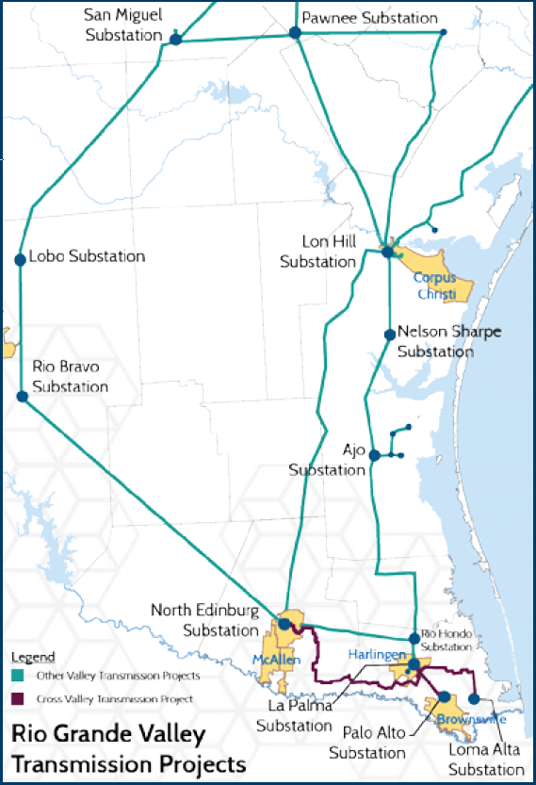
Lower Rio Grande Valley
Limited generation and transmission infrastructure
High risk of rotating outages
Can be at risk even when the rest of the ERCOT grid remains in normal operations
Projects to improve reliability are underway

Slide 29
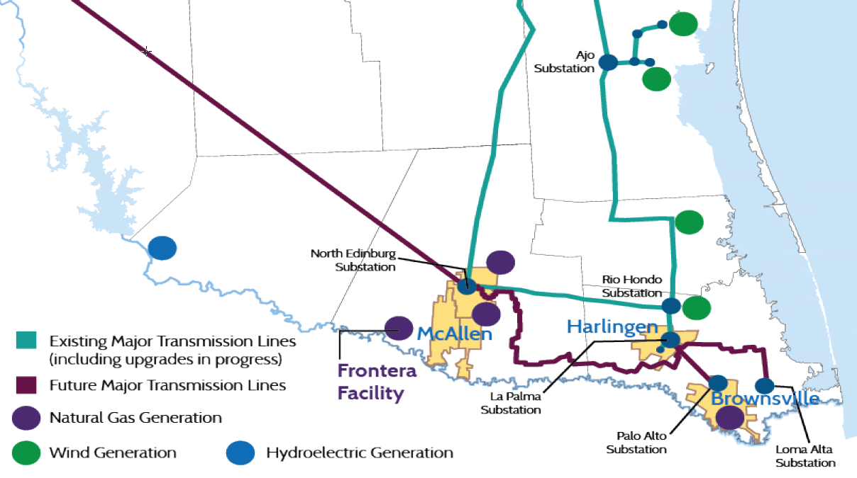
Availability of the Frontera Facility
170 MW of capacity will not be available to ERCOT starting January 1, 2015
The entire Frontera Facility will not be available to ERCOT after the Lobo – North Edinburg and North Edinburg – Loma Alta lines are energized in 2016

Slide 30
Effects of Frontera’s Availability on the Valley
TOs will need to maintain a high voltage profile (~1.03 pu) in the Valley region during high-demand periods
Stability issues will require transfers into the Valley to be limited at lower demand levels than in the past
Planned outages for major 345-kV lines and generation in the Valley will be further limited
Additional system upgrades will likely be required to reliably serve Valley load after 2016 if the Frontera Facility is not available after summer 2016
Notes:
Valley load is quite remote. Are additional 345-kV lines the best system upgrade options? Planning studies will need to consider higher voltages and / or HVDC.

Slide 31
LNG Additions

Slide 32
Long-Term System Assessment (LTSA) - Objectives
Focused on the 10-15 year time-horizon
Different potential future scenarios are studied
Projects are evaluated across these scenarios to determine what system upgrades may be needed under different future conditions

Slide 33
2014 LTSA - Takeaways
There is the potential for a lot of solar generation to be built in the Panhandle and in West Texas
  Would affect the Panhandle export stability limit similarly to wind generation
  May require significant transmission investment to move power from sites favorable to solar to load centers
  System ramping requirements would need to be monitored closely in the morning and in the evening
  May cause there to be two system peaks – one around 5pm (peak load) and one around 8pm (peak load without solar generation)
Six major potential reliability projects were identified across scenarios
Notes:
There is a large rate of change issue regarding solar build-out. We may have to deal with issues sooner than people think.

Slide 34
2014 LTSA - Takeaways
Notes:
Three stories: 1-4 are about growing load and lack of generation being built close to the load; 5 is about large solar build; 6 is about effects of LNG.

Slide 35
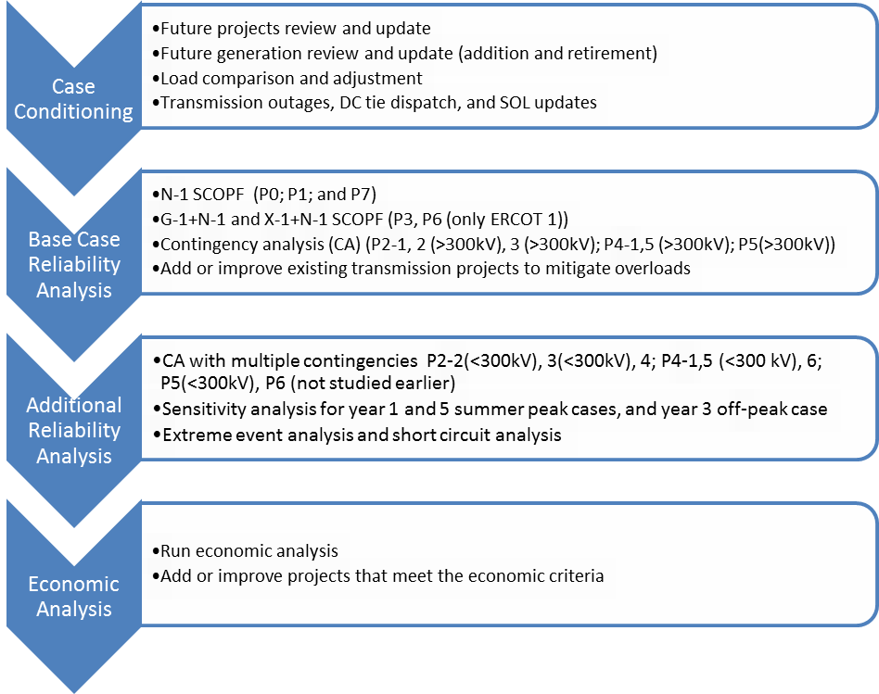
New Planning Criteria
Notes:
Compare to slide 12.

Slide 36
Questions
?
?

Slide 37
1) What is the study time horizon for the Capacity Demand Reserves (CDR) report and the Seasonal Assessment of Resource Adequacy (SARA)?
  10 years and the upcoming season (Spring)
  5 years and the upcoming season (Spring)
  10 years and 2 upcoming seasons (Spring, Summer)
  5 years and 2 upcoming seasons (Spring, Summer)
  None of the above.

Slide 38
2) Which of the following is not an input to the Capacity Demand Reserves (CDR) report?
  Load forecast for summer and winter peak seasons
  Seasonal resource capacity ratings
  Delivered natural gas prices
  Capacity contribution of wind and solar resources
  Projected in-service dates of planned resources

Slide 39
3) Which ERCOT Resource Adequacy study takes into account estimated resource outages during the forecasted peak load hour for the upcoming season(s)?
  Capacity Demand Reserves (CDR) report
  Loss of Load Probability (LOLP) study
  Seasonal Assessment of Resource Adequacy (SARA)
  A and B
  None of the above

Slide 40
4) What region(s) within ERCOT have the most remaining reliability issues requiring CMP for 2015?
  Houston area
  West Texas
  South Texas
  B and C
  All of the above

Slide 41
5) Which of the following pieces of evidence indicate that the Panhandle export stability limit may be a significant reliability constraint?
  It is highly congested in both 2017 and 2020 economic simulations conducted for the 2014 RTP
  The Panhandle study indicates possible stability issues for the number of wind IAs currently in the queue
  Significant solar build-out in the Panhandle for several LTSA scenarios, affecting the limit similarly to wind
  All of the above
  None of the above

