Slide 1

Synchrophasors
Advanced Network Applications
ERCOT Operations Training Seminar
2015

Slide 2
Objectives
Upon completing this course, you will be able to:
Identify the technology used for Synchrophasors and how Synchrophasor Data is different from traditional SCADA
Recognize the benefits of Synchrophasor Technology in managing the power grid
Identify how Synchrophasor Data is used to detect oscillations in the system
Identify how Synchrophasor Data is used in Event Analysis
Identify generator model validation methodology using Synchrophasor Data

Slide 3
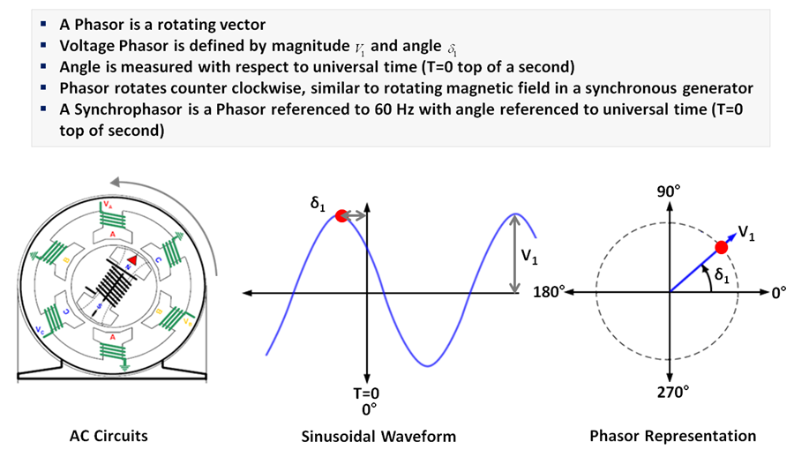
What is a Voltage Phasor ?
*Source: Electric Power Group
http://www.animations.physics.unsw.edu.au/jw/phasor-addition.html#sub5

Slide 4
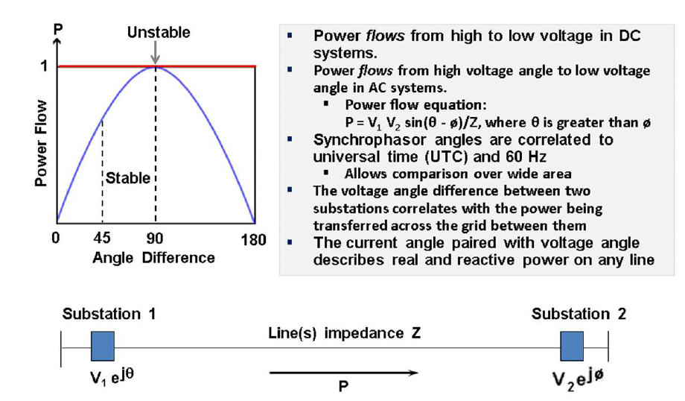
Power Flow Function of Phase Angle Difference
*Source: Electric Power Group

Slide 5
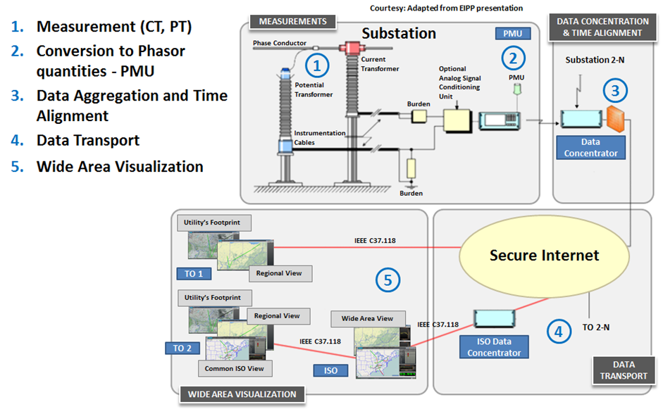
Phasor Technology Infrastructure
*Source: Electric Power Group

Slide 6

Phasor Vs. SCADA Measurements
ATTRIBUTE | SCADA | SYNCHROPHASORS
Resolution | 1 sample every 2-4 seconds | 10-60 samples per second
Measured Quantities | Magnitude Only | Magnitude & Phase Angle
Time Synchronization | No | Yes
Focus | Local utility monitoring & control | Wide area monitoring & control
*Source: Electric Power Group

Slide 7
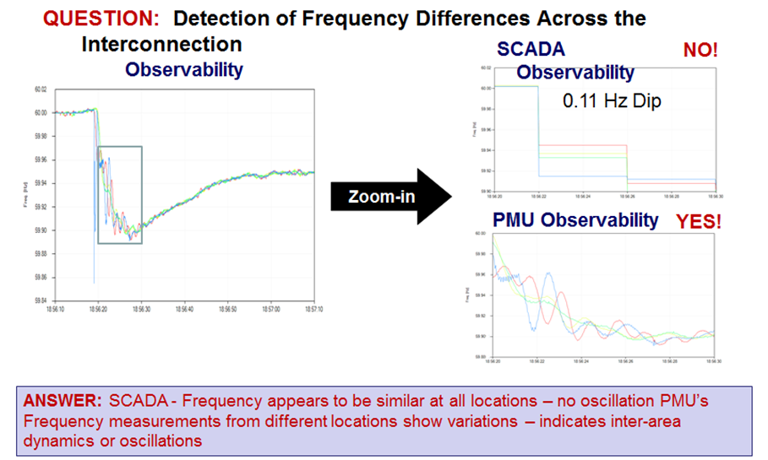
Observability - SCADA vs. PMUs
*Source: Electric Power Group

Slide 8
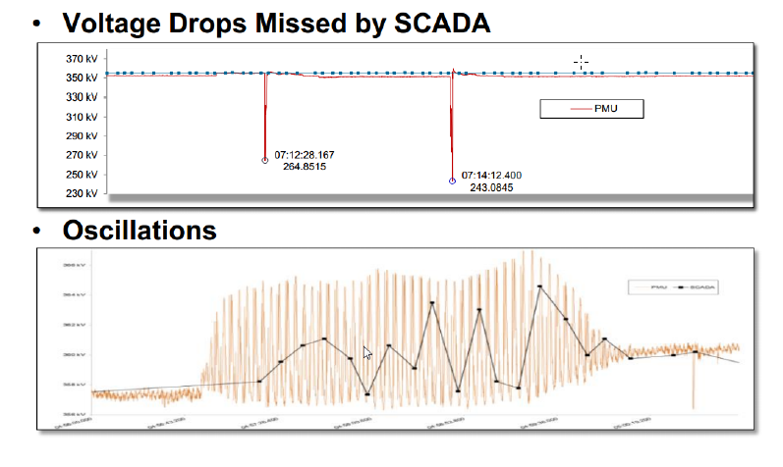
Observability - SCADA vs. PMUs

Slide 9
Objectives
Upon completing this course, you will be able to:
Identify the technology used for Synchrophasors and how Synchrophasor Data is different from traditional SCADA
Recognize the benefits of Synchrophasor Technology in managing the power grid
Identify how Synchrophasor Data is used to detect oscillations in the system
Identify how Synchrophasor Data is used in Event Analysis
Identify generator model validation methodology using Synchrophasor Data

Slide 10
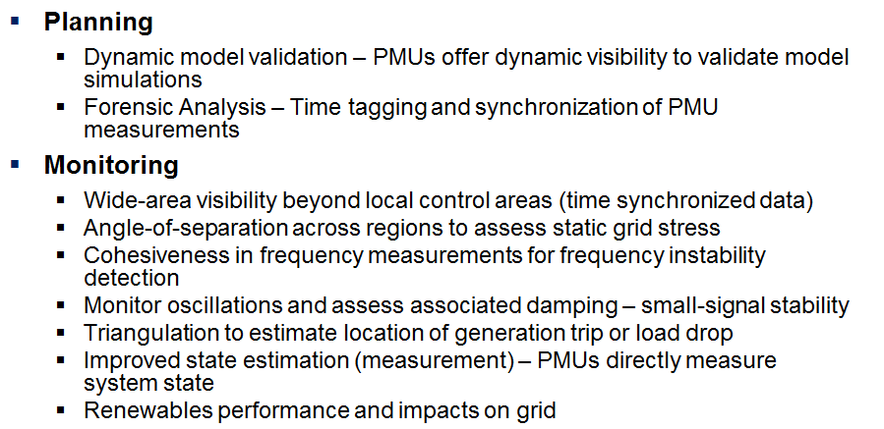
Phasor Technology Uses
*Source: Electric Power Group

Slide 11
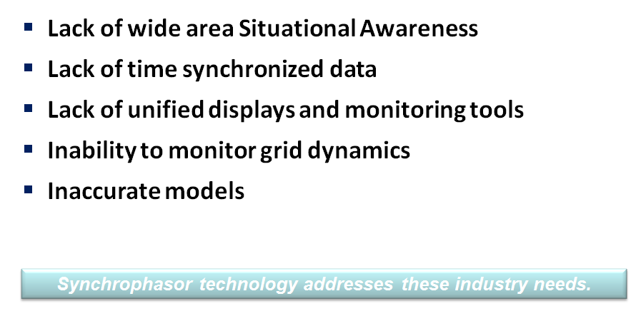
Major Blackout Events – Lessons Learned
*Source: Electric Power Group

Slide 12
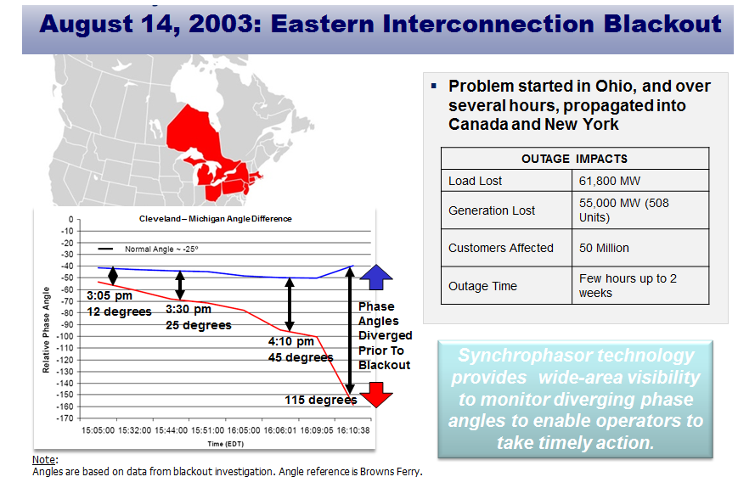
Major Blackout Events – Lessons Learned
*Source: Electric Power Group

Slide 13
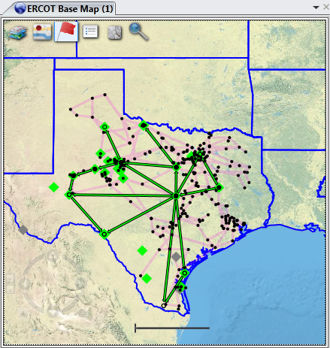
How Synchrophasors Could Have Helped
Synchrophasors allow system operators to monitor angle differences on defined interfaces
Alarms may be set to alert operators of growing angle differences and grid stress
Operators may take action by re-dispatching generation or shedding load to reduce angle difference

Slide 14

The ERCOT Synchrophasor (PMU) Project

Slide 15
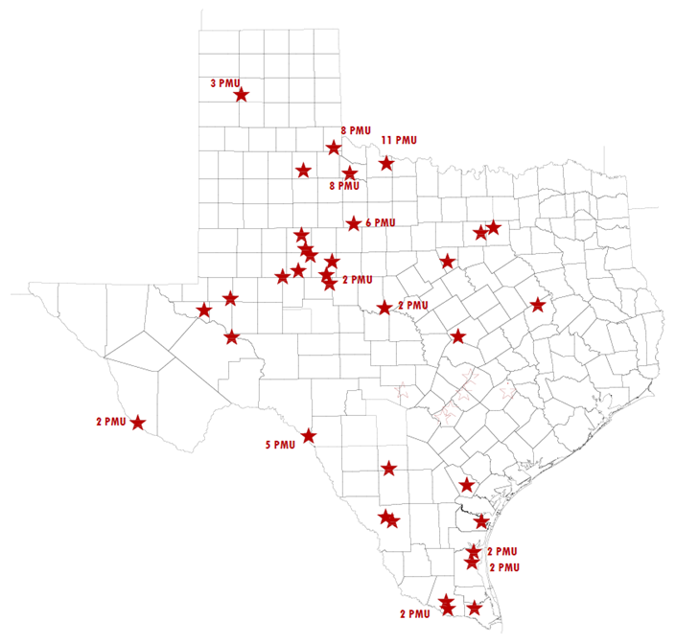
Number of PMUs in CCET Project (as of Nov 2014)
Total 76 PMUs @ 35 Locations
AEP: 54
ONCOR: 17
Sharyland: 5

Slide 16
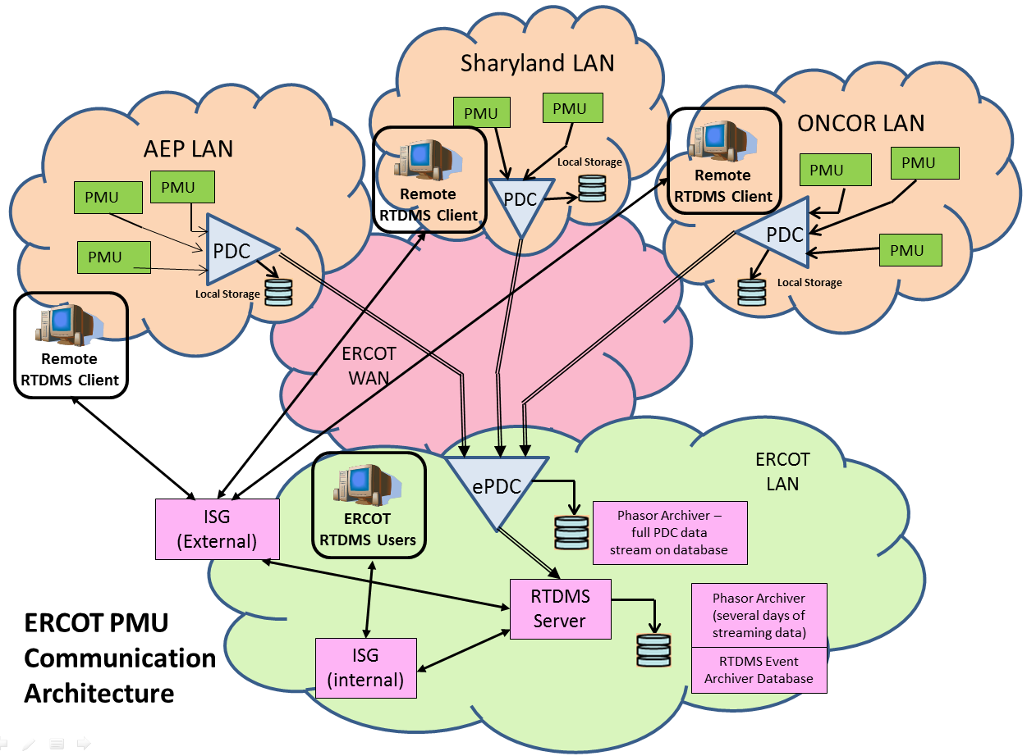
The Synchrophasor Data Communication Network

Slide 17

ERCOT ROS Synchrophasor Task Force
PMTF Deliverables
Synchrophasor Technology Assessment
Addresses the major questions posed to the PMTF by ROS
Includes an overall summary of key recommendations
Synchrophasor Communication Handbook
Provides guidance for connecting new PMUs to ERCOT’s network
Draft Nodal Operating Guide Section 6 language
Recommends language to formalize the placement and usage of PMUs within ERCOT
Status of NOGRR

Slide 18
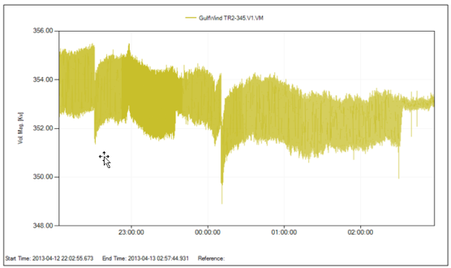
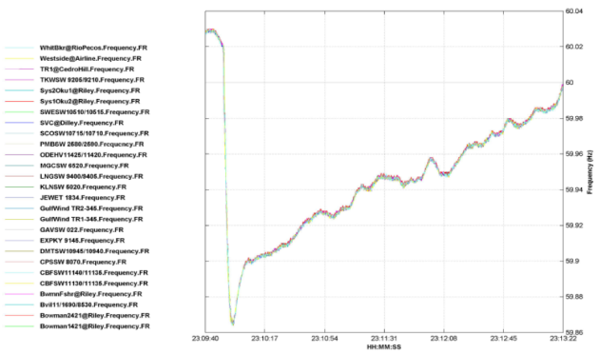
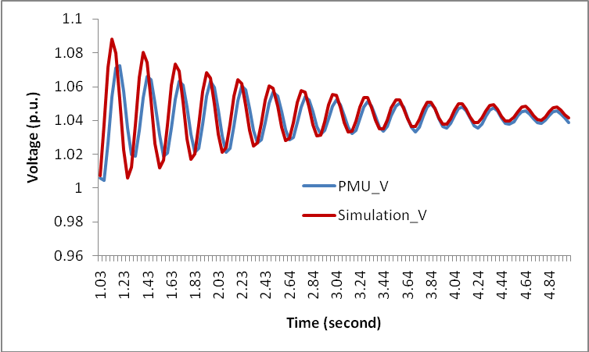
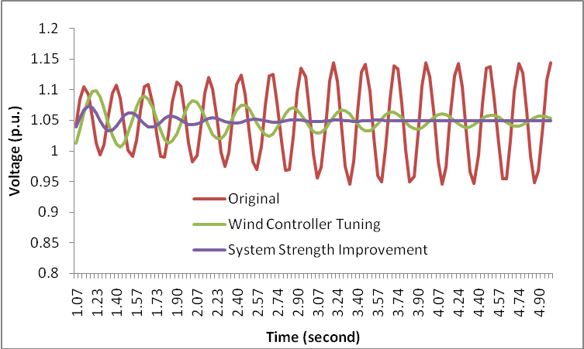
How Synchrophasor Data Is Being Used
System Oscillations
Event Analysis
Generator Model Validation/Tuning

Slide 19
Objectives
Upon completing this course, you will be able to:
Identify the technology used for Synchrophasors and how Synchrophasor Data is different from traditional SCADA
Recognize the benefits of Synchrophasor Technology in managing the power grid
Identify how Synchrophasor Data is used to detect oscillations in the system
Identify how Synchrophasor Data is used in Event Analysis
Identify generator model validation methodology using Synchrophasor Data

Slide 20
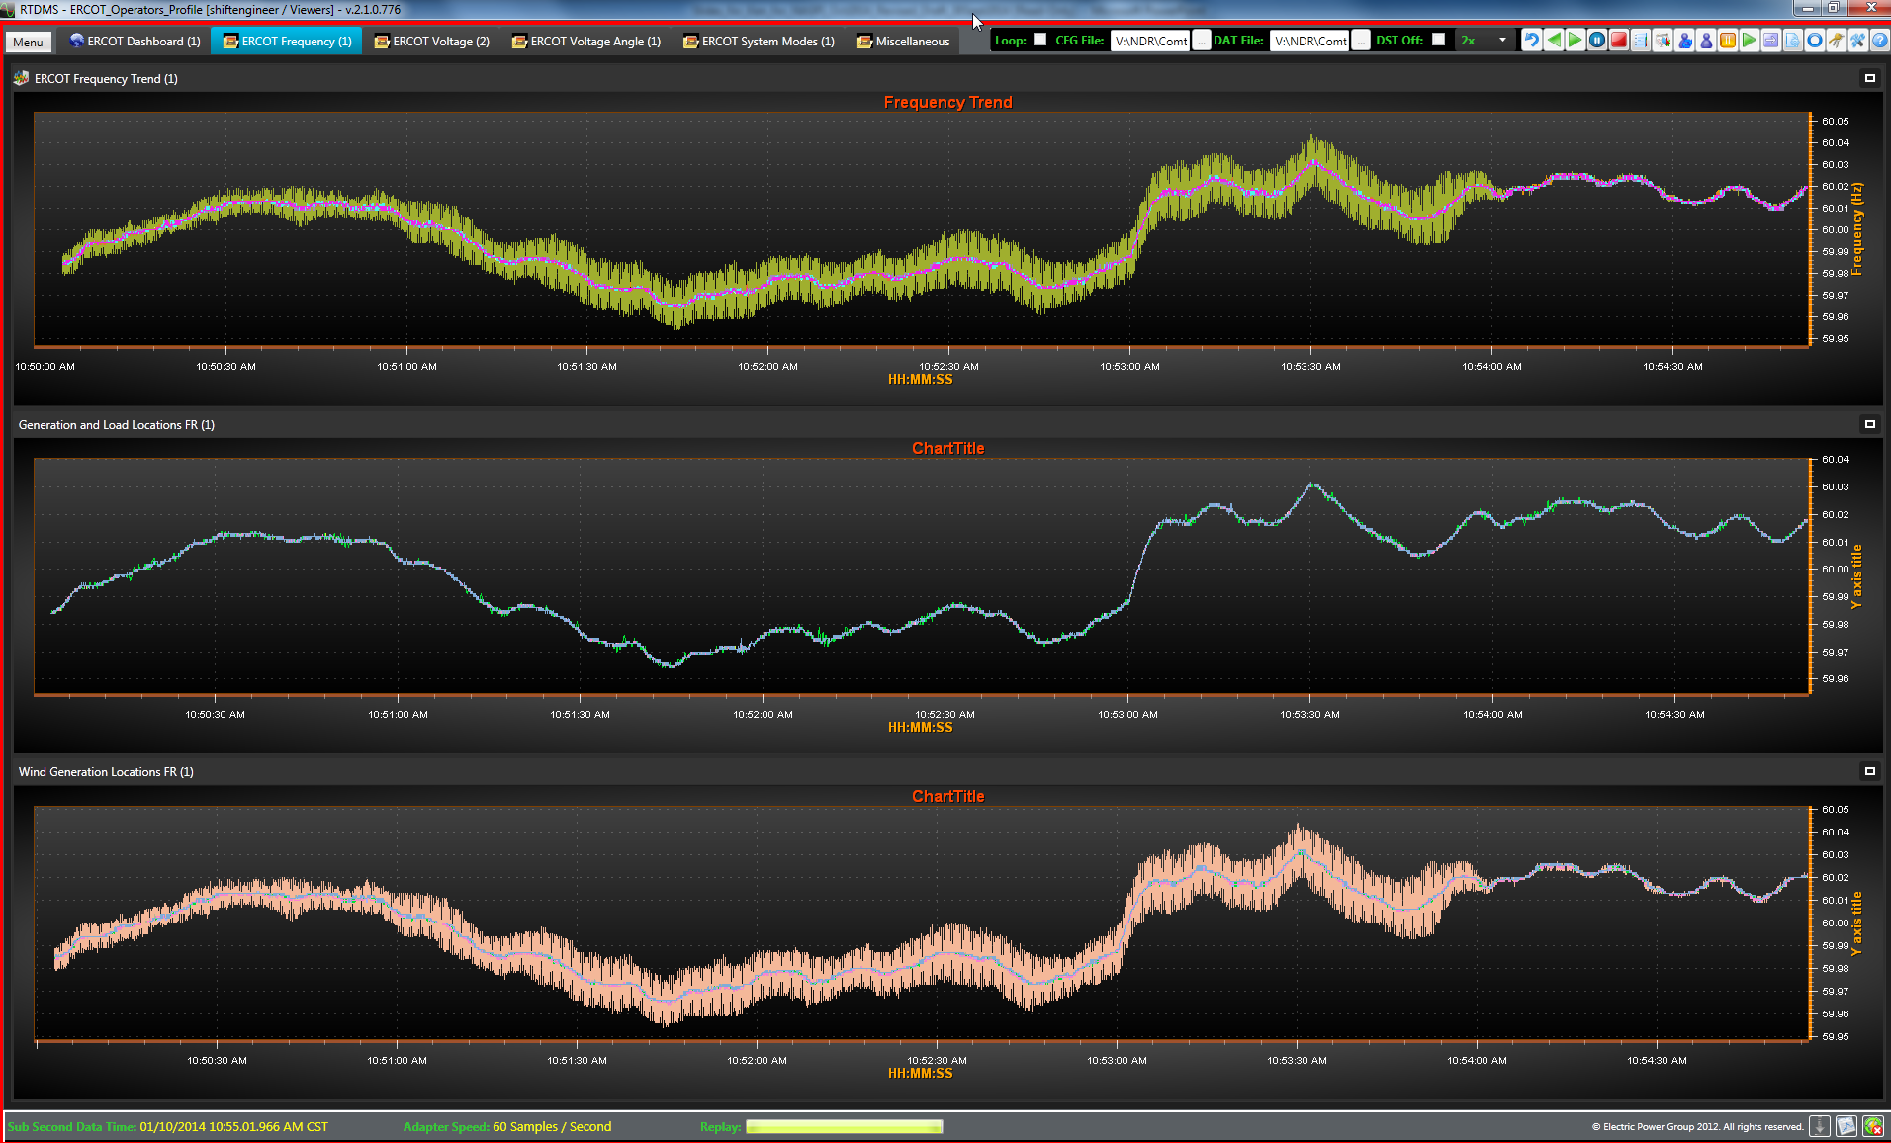
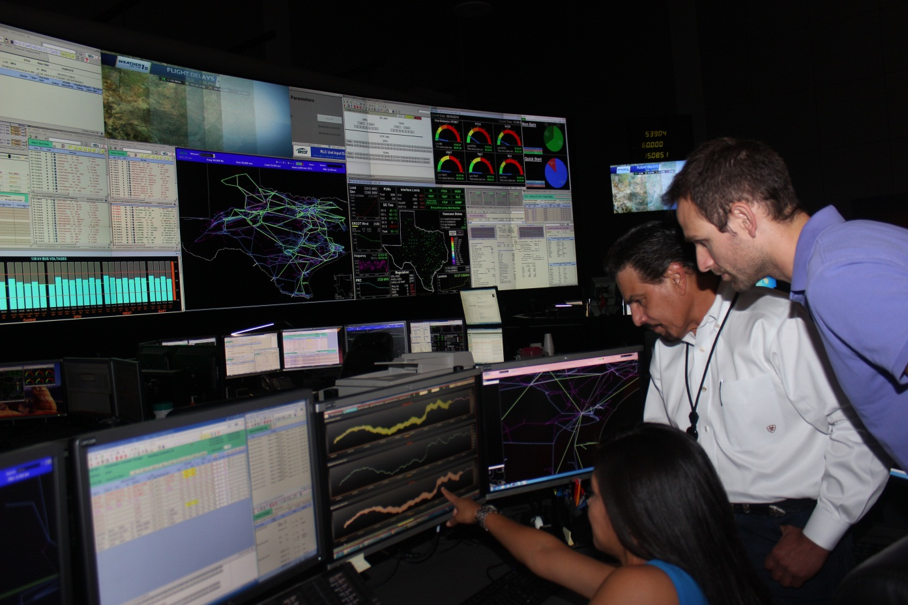
Oscillation Detection & Damping

Slide 21
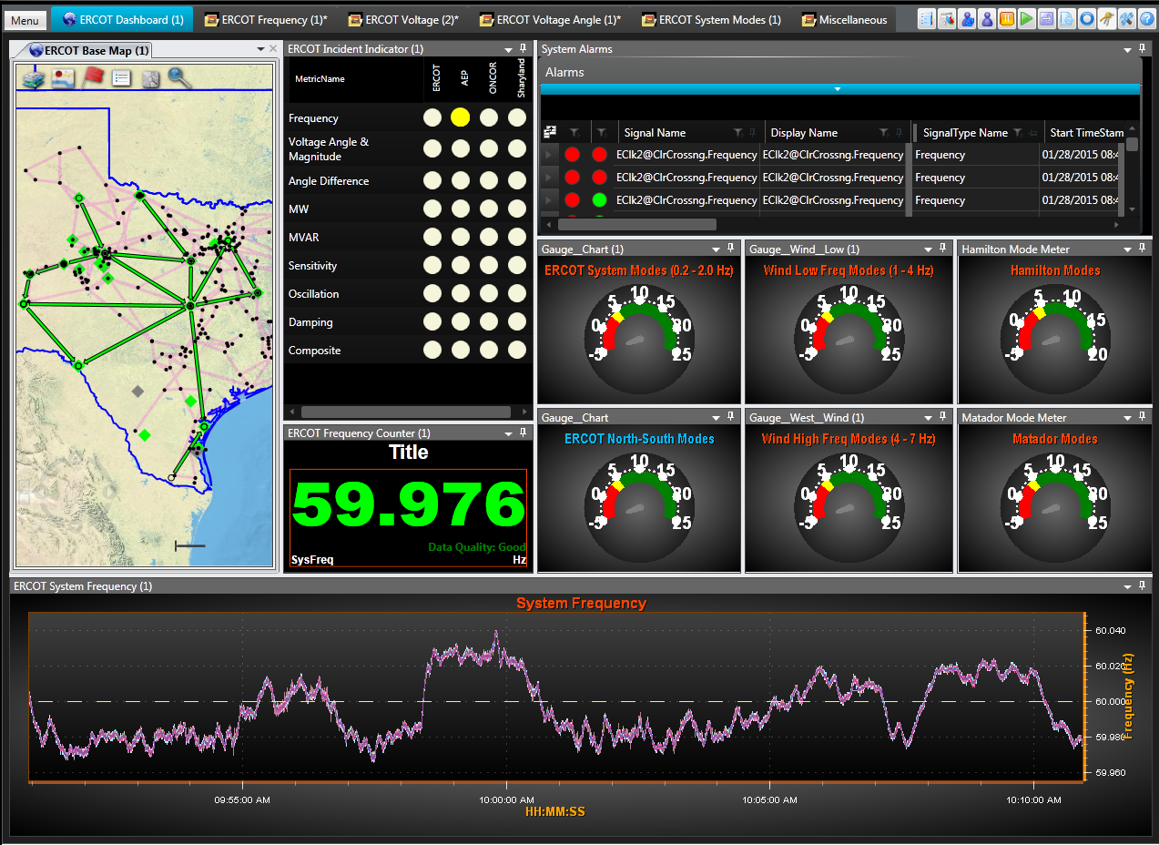
RTDMS Dashboard

Slide 22
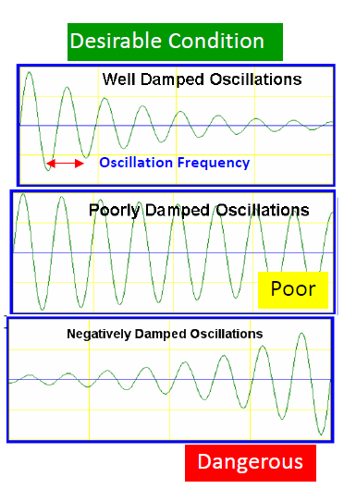
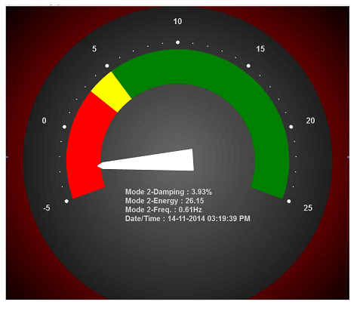
Characterizing Oscillations - Frequency and Damping
Well Damped: 5%
or Higher Damping
Poorly Damped:
3% - 5% Damping
Growing Oscillations:
Less than 3% or Negative Damping
*Source: Electric Power Group

Slide 23
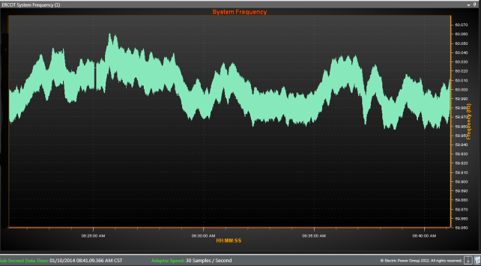
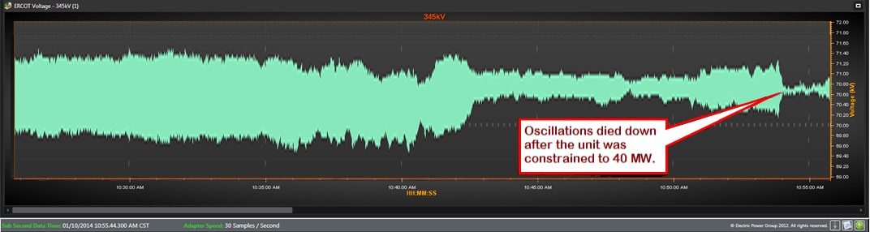
Example of Oscillation Event
RTDMS system was used to detect oscillations and
take corrective measures to mitigate them
ERCOT operations contacted the plant operator at the
Wind Farm to determine the cause of the oscillations
It was discovered that some updates were made to the
settings for the system controller which matched the
time of initial observation of the oscillations
After ERCOT informed the Wind Farm Operations about the oscillations, they pulled back the updates which stopped the oscillations. After that, no oscillations were observed even when the plant was generating above 50 MWs

Slide 24
RTDMS Oscillation Demo

Slide 25
Objectives
Upon completing this course, you will be able to:
Identify the technology used for Synchrophasors and how Synchrophasor Data is different from traditional SCADA
Recognize the benefits of Synchrophasor Technology in managing the power grid
Identify how Synchrophasor Data is used to detect oscillations in the system
Identify how Synchrophasor Data is used in Event Analysis
Identify generator model validation methodology using Synchrophasor Data

Slide 26
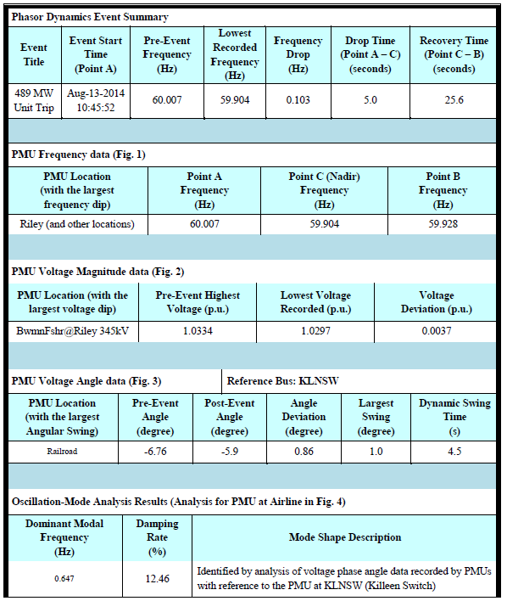
Event Analysis Reports
Can be used to support (future) PRC-002-2 Disturbance monitoring and reporting requirements
Four metrics analyzed for each event with frequency dropping to 59.9 Hz and below
System frequency and frequency excursion
Location with largest frequency deviation
System Voltage
Location with the largest voltage swing
Relative Angle (measured with respect to a reference PMU)
Location with the largest relative angle swing
Modes of small-signal oscillation
Prony/HTLS Algorithm
The Phasor Grid Dynamics Analyzer (PGDA) application provided by the Electric Power Group (EPG) is used for this analysis.

Slide 27
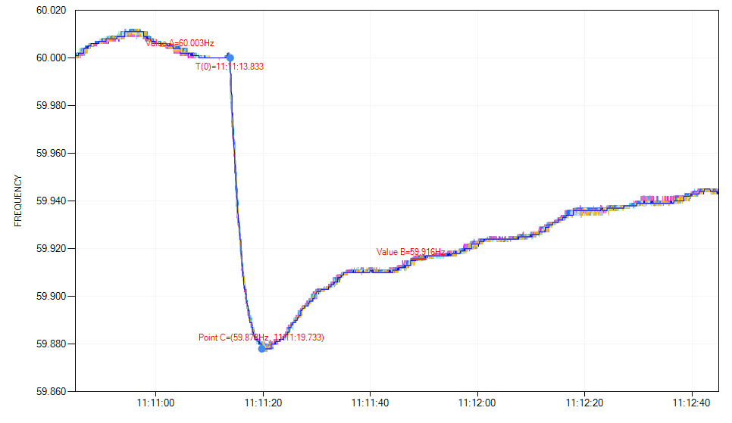
EPG’s Phasor Grid Dynamics Analyzer
Fig. 1 System Frequency Captured by the PMU’s

Slide 28
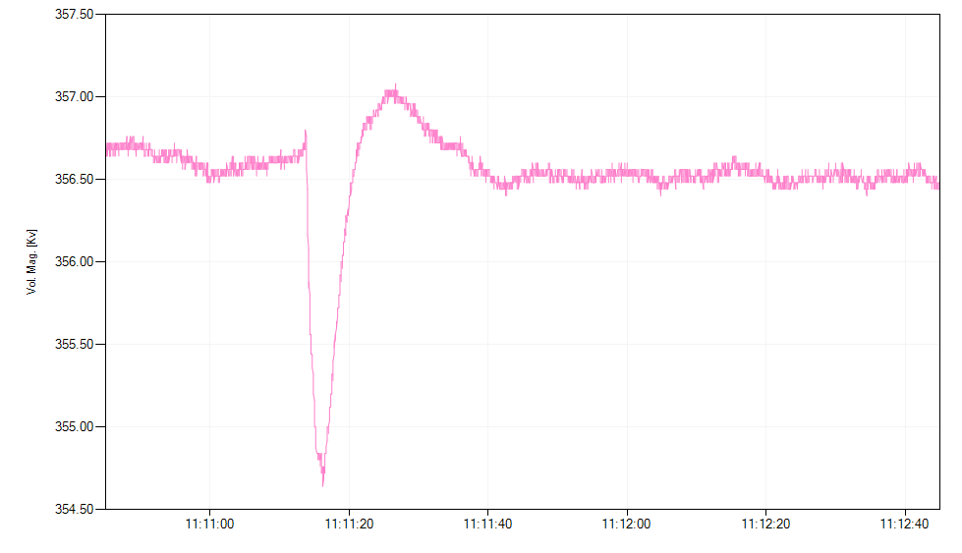
EPG’s Phasor Grid Dynamics Analyzer
Fig. 2 Voltage magnitude measured by the PMU with largest voltage swing

Slide 29
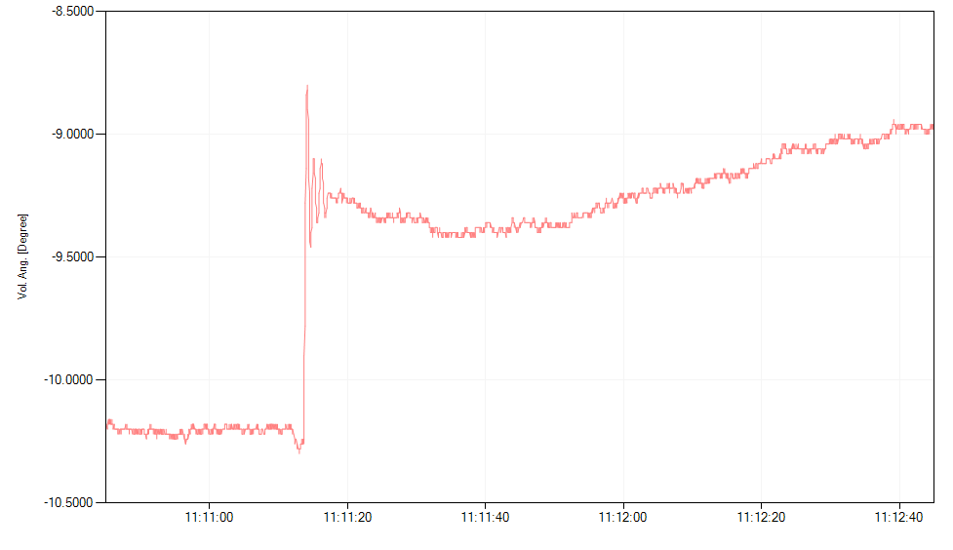
EPG’s Phasor Grid Dynamics Analyzer
Fig. 3 Relative Voltage angle measured by the PMU with largest angular swing

Slide 30
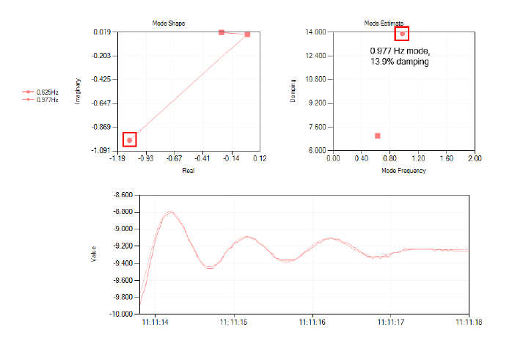
EPG’s Phasor Grid Dynamics Analyzer
0.67 Hz mode
8.21% damping
Dominant Mode
Dominant mode
Fig. 4 Ring-down analysis

Slide 31
Objectives
Upon completing this course, you will be able to:
Identify the technology used for Synchrophasors and how Synchrophasor Data is different from traditional SCADA
Recognize the benefits of Synchrophasor Technology in managing the power grid
Identify how Synchrophasor Data is used to detect oscillations in the system
Identify how Synchrophasor Data is used in Event Analysis
Identify generator model validation methodology using Synchrophasor Data

Slide 32
Generator Model Validation
PMU’s can be used to satisfy model validation requirements set in NERC standards MOD-026-1 and MOD-027-1
PMU’s provide high accuracy measurements for comparison against simulation, which may be accomplished with unit online
Automation of the process using software tools greatly eases the workload associated with matching simulation models with measured response.
Result is a good dynamic model for a Generator/Excitation System that matches the actual equipment in the field and is validated through online testing

Slide 33
Generator Model Validation
Post Event Analysis
Re-create the oscillations as captured by the PMU using simulation tools such as MATLAB and Powertech Tools
Identify the cause and solutions to mitigate the oscillations
Benchmarking of the tuned model using PMU data

Slide 34
Generator Model Validation
Proposed tuning based on simulation studies

Slide 35
Summary
What is Synchrophasor Technology
Phasors and PMUs
Difference between Synchrophasors and SCADA
Benefits of Synchrophasors
Wide-Area Visualization
Higher resolution than SCADA for better observability
Provides ability to assess grid stress due to angle differences
Allows for better dynamic modeling
Current Synchrophasor Deployment in ERCOT
76 PMU’s installed in 35 locations
Status of PMTF and NOGRR
Current Use Cases
Oscillation Detection & Damping
Event Analysis and Reporting
Generator Model Validation

Slide 36

Questions?

Slide 37
Q&A
Question 1:
Which of the following statements regarding Synchrophasors and SCADA is correct:
Synchrophasor Technology is a replacement for SCADA
SCADA and Synchrophasors both have time synchronization with GPS
SCADA has slow scan rates when compared to Synchrophasors
SCADA and Synchrophasors are both capable of measuring voltage and current phase angles

Slide 38
Q&A
Question 2:
Synchrophasor Technology is useful for the following:
Wide area visualization
Monitoring oscillations
c) Assess grid stress
d) All of the above

Slide 39
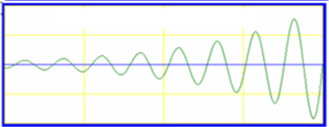
Q&A
Question 3:
The following waveform indicates :
a) Well Damped Oscillations
b) Poorly Damped Oscillations
c) Growing Oscillations
d) None of the above
Magnitude
Time

Slide 40
Q&A
Question 4:
For Post-Event Analysis, Synchrophasor Data can be used to:
Locate the area with the largest frequency deviation
Locate the areas with the largest voltage magnitude and angle swing
Determine dominant modes of oscillations associated with the event
All of the above

Slide 41
Q&A
Question 5:
Synchrophasor Technology is useful for the following:
a) Generator Model Validation
b) To increase the generator output
c) To improve generator efficiency
To get maximum revenue from the generator

