Slide 1
Lessons Learned from Hurricane Sandy
2015 Operator Training Seminar

Slide 2
Objectives
Compare Superstorm Sandy (October 2012) to Texas Gulf Coast past major tropical storms and hurricanes.
Explain Superstorm Sandy’s impact on the following:
Transmission
Distribution
Generation
Communications
Control systems
Describe and discuss applicability of four general preparatory actions recommended in NERC’s report for the ERCOT region.
Discuss three causes of high transmission voltage during the storm and evaluate how six actions taken to manage it may be used in the ERCOT region.
List operational impacts to generators during and after the storm.
List five potential “Lessons Learned” for generation stations.

Slide 3
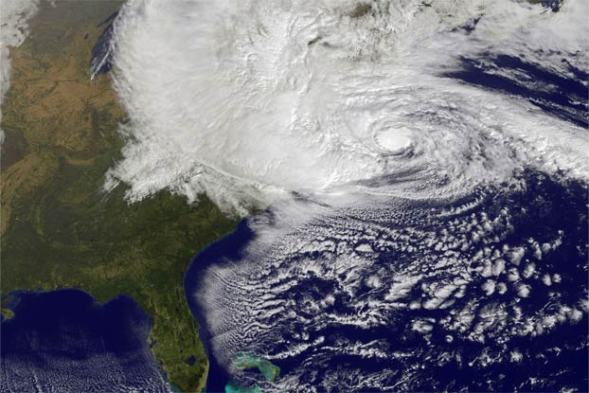
Hurricane Sandy – An Anomaly
Sandy’s central barometric pressure measure was 940 mb, which is typical of a Category 4 hurricane (and a record for a hurricane north of Cape Hatteras, NC).
Hurricane Sandy
October 29, 2012
Briefly Category 2 hurricane but made landfall just south of Atlantic City, NJ as a post-tropical cyclone (no longer a hurricane, but with Category 1 hurricane force winds).
Not a major threat, based on the Saffir-Simpson hurricane wind scale.
Notes:
Review some of Sandy Facts

Slide 4
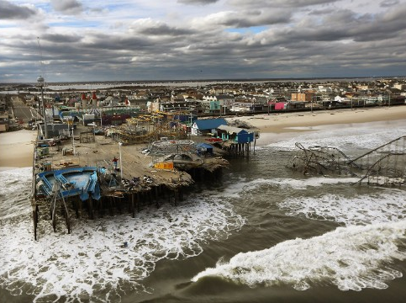
Hurricane Sandy Facts
Hurricane Sandy defied its relative weak classification
Second-costliest storm in U.S. history at $71.4 billion in damage
Largest Atlantic hurricane, by diameter, at 945 miles
8-10-foot storm surge, New York and New Jersey (plus additional 3-5 feet due to high tide)
51 square miles (17% of NYC) inundated with water
A large weak storm carries more energy than a small intense storm
Notes:
Costliest U.S. Atlantic Hurricanes – From NOAA/NHC Report (2010) Sandy was after the report was written
Rank Hurricane Season Damage
1 Katrina 2005 $108 billion
2 Sandy 2012 $65 billion
3 Ike 2008 $29.5 billion
4 Andrew 1992 $26.5 billion
5 Wilma 2005 $21 billion

Slide 5
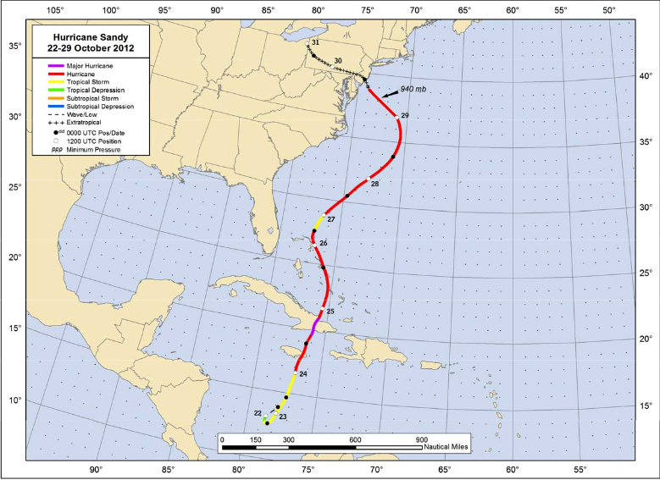
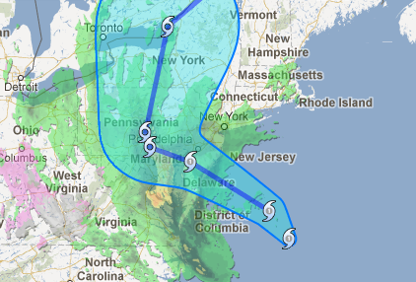
Hurricane Sandy Storm Surge
Integrated Kinetic Energy (IKE) measures hurricane intensity than the Saffir-Simpson scale (Cat 1-5).
IKE is a measure of wind speed integrated over the area of the tropical cyclone and is a good indicator of storm surge.
Hurricane Sandy recorded the 2nd highest ever IKE.
Storm surge is a greater threat to life and property than wind; more Americans have died due to storm surge than any other hurricane-related threat.

Slide 6
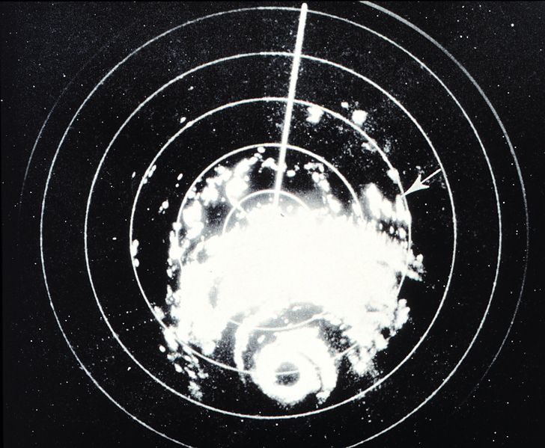
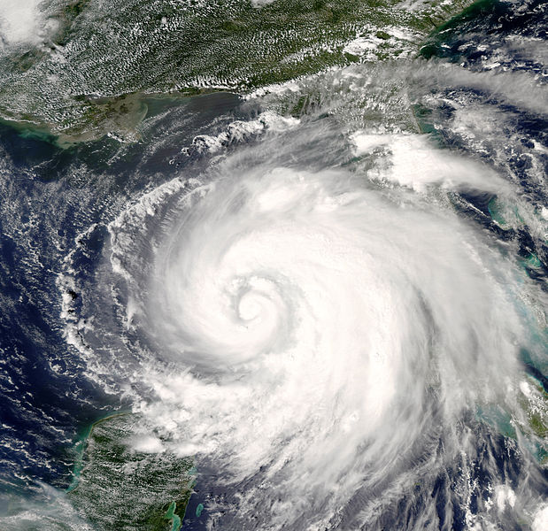
Hurricane Similarities
Hurricane Carla (1961) and Hurricane Ike (2008) draw similarities to Sandy

Slide 7
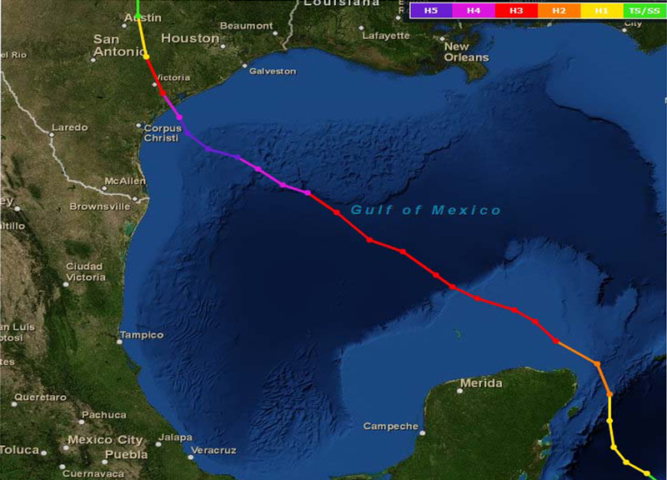
Hurricane Carla Facts
Carla - largest hurricane ever recorded in Atlantic basin at the time it occurred.
Estimated diameter over 500 miles.
Entire Texas coastline recorded hurricane force gusts.
Storm surge over 10 feet along a 180 miles of Texas Gulf Coast.
15-18’ - Houston to Galveston
22’ - Port Lavaca
Inflation-adjusted dollar cost, $2.36 billion in damages.
Most metrics show Carla as most powerful hurricane to ever strike Texas, though modern metrics have not been applied pre-1980.
Hurricane Carla
September 11, 1961

Slide 8
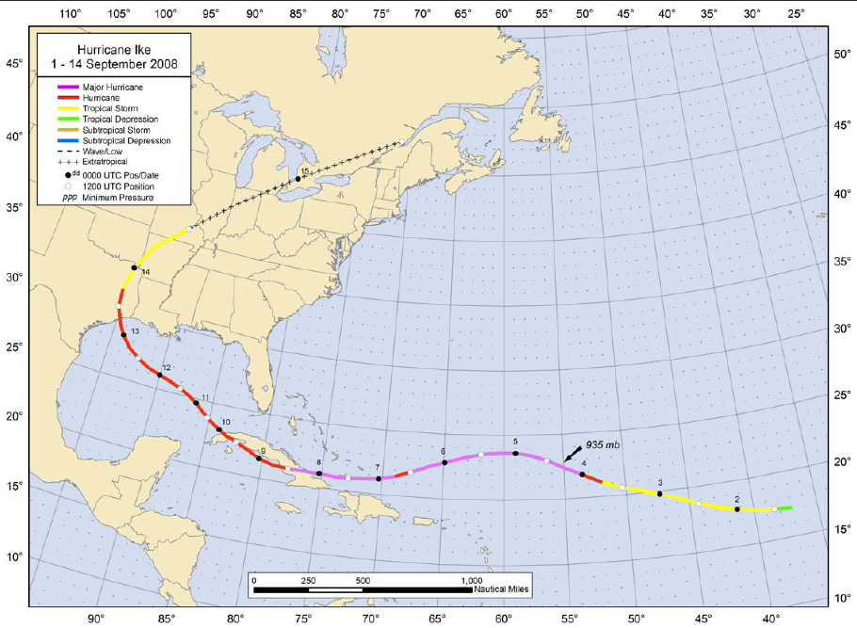
Hurricane Ike Facts
Hurricane Ike defied its relatively weak Saffir-Simpson rank (Cat 2).
Third-costliest in U.S. history at $29.5 billion.
Caused 10-13’ storm surges along Galveston Island and 13-17’ surges along Bolivar Peninsula.
Central Barometric Pressure of 951 mb more like Category 3 storm.
Over 600 miles in diameter (average is about 250 miles).
Hurricane Ike
September 13, 2008

Slide 9
Weather Alerts Review
Advisory
For “less serious” conditions than warnings
May cause significant inconvenience, and if caution is not exercised, could lead to situations that may threaten life or property
Warning
Weather conditions pose a threat to life or property
Watch
Hazardous weather is possible
Timing of Warnings
Each ISO posts updates and calls from four to twelve hours

Slide 10
Conclusions
Hurricanes should not be measured only by Saffir-Simpson (Cat 1-5) scale
Size of storm combined with entire wind shield (winds of tropical storm force or greater) is critical to know
Storm surge can affect hundreds of coastline miles far from hurricane’s center. A surge of 23’ can inundate:
The Gulf Coast is highly prone to significant storm surge
Measures wind speed near eye
Water along Gulf Coast is much shallower than that along Atlantic
More easily displaced in storm surge (allowing for greater inundation)
67% of interstates
57% of arterials
50% of rail miles
29 airports
Virtually all ports in Gulf Coast area

Slide 11
Future Projections
2013 and 2014 Atlantic hurricane seasons quietest since 1993 and 1994
Indications of long-term (20+ year) period with most seasons featuring normal or below numbers of tropical cyclones in the Atlantic basin
Even in a relatively quiet season, a catastrophic hurricane is possible
Hurricane Carla occurred in an average season
South Florida’s Hurricane Andrew occurred during a quiet season

Slide 12
Event Background
Pre-existing System Conditions
Considered normal for the season – late fall
Affected Areas
Eastern Seaboard & Mid-Atlantic
New England and beyond: New York, New Jersey, Connecticut, New Hampshire, Pennsylvania, Maryland, Virginia, West Virginia, Ohio, and Kentucky
Time Frame for Outage and Restorations
7 to 31 days
6.5 million customers affected

Slide 13
Event Weather Alerts
Weather System and Notification
Timing of Warning Systems and Actions Taken
Benefits of On-site Meteorologists
Understand the weather data and inform the Chief Operator Current conditions
Storm Weather Updates During Events
Conference calls
Information Broadcast
Emailed and paged alerts
Alerts sometimes supplemented by videos or graphic clips that provided more details
Storm Weather Updates Following Event

Slide 14
Preparation
Entities across the impacted area made special preparations:
Existing storm prep plans activated
Helicopters staged inland for aerial patrols
Sandbags and barriers deployed to substations
Debris in substations inspected and removed
Loose equipment in substations secured
Substations manned with qualified personnel
Plans to de-energize barrier island to minimize damage
Critical mobile equipment moved to the mainland
Service vendors contacted
All available transmission and generation outages returned to service

Slide 15
Preparation (cont.)
Special Preparations for Areas Expecting Snow & Ice
Entities impacted brought on additional labor, material, and equipment
Communications with Neighbors
Regional and inter-Regional calls
Additional Staffing
RC, TO and TOPs
Extra Operators will be needed for shift rotations
Extra crews will be needed to handle the extreme damage
Manning Substations
Sandbagging Facilities in Storm Surge Zone
Pre-positioning Transmission System Equipment
Pre-positioning Storm Restoration Crews from “Outside Area”

Slide 16
Damage to Transmission Facilities
Affected Lines
Affected Transformers
765 kV (1)
500 kV (10)
345 kV (31)
230 kV (33)
138 kV (127)
115 kV (16)
Total: 218
Total: 28
345/138 & 345/115 kV transformers (17)
230/115 kV transformers (4)
138 kV phase angle regulators (7)
Affected Substations
Total: 18
230 kV (8)
138 kV (10)

Slide 17
Affected Generation Facilities
Nuclear - 3 Facilities: Limerick, Nine Mile, and Indian Point
Damage
Identified Nuclear Safety Issues
Fossil
Flooded Stations – 16,738 MW tripped off-line
Units taken off-line in preparation of Storm – 546 MW
Wind - None Reported Damaged but 323 MW tripped due to high winds
Hydro - 36 MW (reported by RF & PJM)

Slide 18
Generation Operation Concerns During Storm
Increased potential for Loss of Off-Site Power (LooP) to nuclear facilities
Loss of normal condenser cooling and loss of availability of service water due to high water
Precipitator fly ash buildup and higher gas flow pressure due to operating without auxiliary feeds
Curtailments due to wet coal, normal with any significant precipitation.
Potential lack of fuel due to damage to the fuel provider’s facilities

Slide 19
Customer Impact
Amount of Load Lost
ISO-NE reported 1,366 MW
NYISO reported 5,200 MW
PJM reported 11,680 MW
Total Amount Load Reported to NERC: 18,246 MW
Duration of Load Lost
95% of customers returned to service between Nov 1 – Nov 9, 2012
7 – 31 days (fully restored)
Havoc on the distribution system

Slide 20
CON-ED Havoc on the distribution system

Slide 21
Operations - Conservative Operations and Operational Challenges
Conservative Operations Mode or Emergency Procedures Implemented During Storm
Challenges Associated with High-Voltage Issues
Open-ended high voltage transmission facilities
Significant loss distribution load
Lightly loaded extremely high-voltage facilities, such as 500 kV lines
Challenges in Maintaining Load/Generation Balance During Storm
Besides loss of load and generation, 2 DCS events on October 29th

Slide 22
Actions Taken to maintain High Voltages
De-energized equipment
Removed lines from service
Removed capacitor banks from service
Operated reactors
Brought on pumped storage units in pump configuration
Had generators lower their VAR output

Slide 23
Post-Storm Operations
Long-term effects that could impact serving firm load 2012-2013 Winter
No long term effects to transmission
However, one Generation station may be forced to early retirement due to flooding
The Danskammer plant flooded
Units 1 & 4 flooded
Units 5 & 6 were not flooded but transformer was flooded
As of 1/3/2013 Dynegy Danskammer LLC announced the intent to retire the generation units
In November 2013, Helios Power purchased the plant and asked to delay the filing retirement notice until they completed assessment

Slide 24
Restoration Challenges
Loss of power to control facility
Impede accessibility to substations
Securing food, lodging and fuel for work crews
Equipment damage from salt water and flooding.
Reported from an entity: After the flooding of stations, a proactive approach to washing and cleaning equipment affected by salt water was undertaken, and items such as metal-clad switchgear and breakers were sent to repair companies for cleaning, testing and part replacement. Where equipment could not be cleaned, repaired, or replaced, mobile units were implemented or system configurations were modified to support consumer load.

Slide 25
Lessons Learned Overall
Pre-stage equipment when possible.
De-energize facilities in “flood-prone” areas.
Consider water-tight doors in flood-prone areas.
Use text messages when cell phone coverage is sporadic.
Install additional sectionalizing switches to better isolate flood-prone areas.
Use water dams instead of sandbags to prevent flooding.
Replace non-submersible underground equipment with submersible underground equipment.
Create long-term plans for operating flood-prone substations.

Slide 26
Questions?
Notes:
High Voltage Transmission Line in West Virginia

Slide 27
Question #1
What was common between the 3 Hurricanes we talked about?
Jimmy Buffett wrote songs about all three
They all hit their coastlines at “Cat 5”
They all hit their coastlines at “Cat 2”
They all hit Florida before coming to Texas

Slide 28
Question #2
What was the total number of BES Transmission Lines that were affected by Superstorm Sandy?
218 Lines
35 Lines
127 Lines
None were affected

Slide 29
Question #3
How many MW of Distribution were temporary lost due to Sandy in the three areas that it effected?
100,000 MW
70,000 MW
A Gazillion MW
18,246 MW

Slide 30
Question #4
Which of the following was not part of recommended preparations before a hurricane is going to hit the coast in Texas?
Have a hurricane party and listen to Jimmy Buffett – it’s 5 o’clock somewhere!
Add more staff to your control centers
Prepare and sandbag facilities in Storm Surge Zones
Pre-positioning Transmission System Equipment

Slide 31
Question #5
What was not one of the actions taken to manage the high voltage during Sandy?
De-energize equipment
Remove lines and capacitors from service
Order generators to raise their VAR output
Order generators to lower their VAR output

