Slide 1
ERCOT Wind Forecast and Impact of Cold Weather Events
Sandip Sharma
ERCOT Operations

Slide 2
Objectives
Understand the regions within ERCOT for wind.
Understand the key weather systems that can impact wind output and forecast.
Understanding Icing events and corrective actions to improve forecast due to icing-related shut downs.
Identify the system that ERCOT uses for large wind ramp events.

Slide 3
Table of Contents
Overview
Variation and Uncertainty of Wind Generation
Wind Forecast @ ERCOT
Wind Forecast and Extreme Weather (Icing Event)
Wind Forecast and Real-time Operation
ERCOT Large Ramp Alert System: ERLAS
Overview of Solar Forecast in ERCOT
Acronyms for this presentation:
WGR: Wind-powered Generation Resource
STWPF: Short-term Wind Power Forecast
COP: Current Operating Plan
RUC: Reliability Unit Commitment
SCED : Security Constraint Economic Dispatch
ELRAS: ERCOT Large Ramp Alert System

Slide 4
Overview

Slide 5
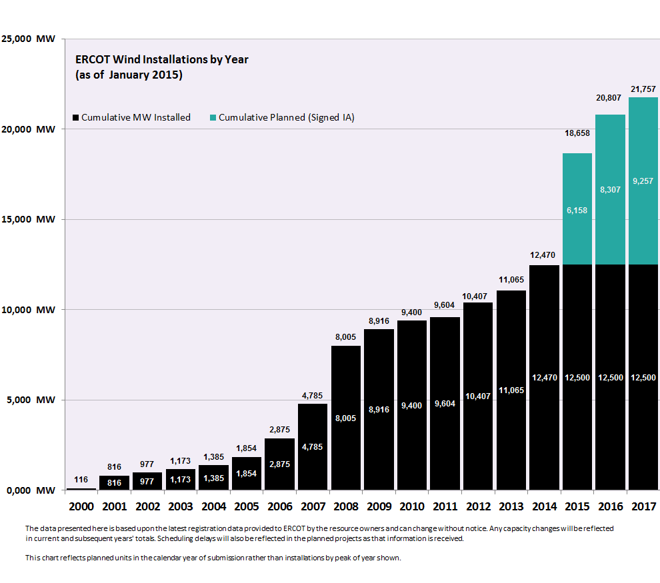
Installed Wind Generation in ERCOT

Slide 6
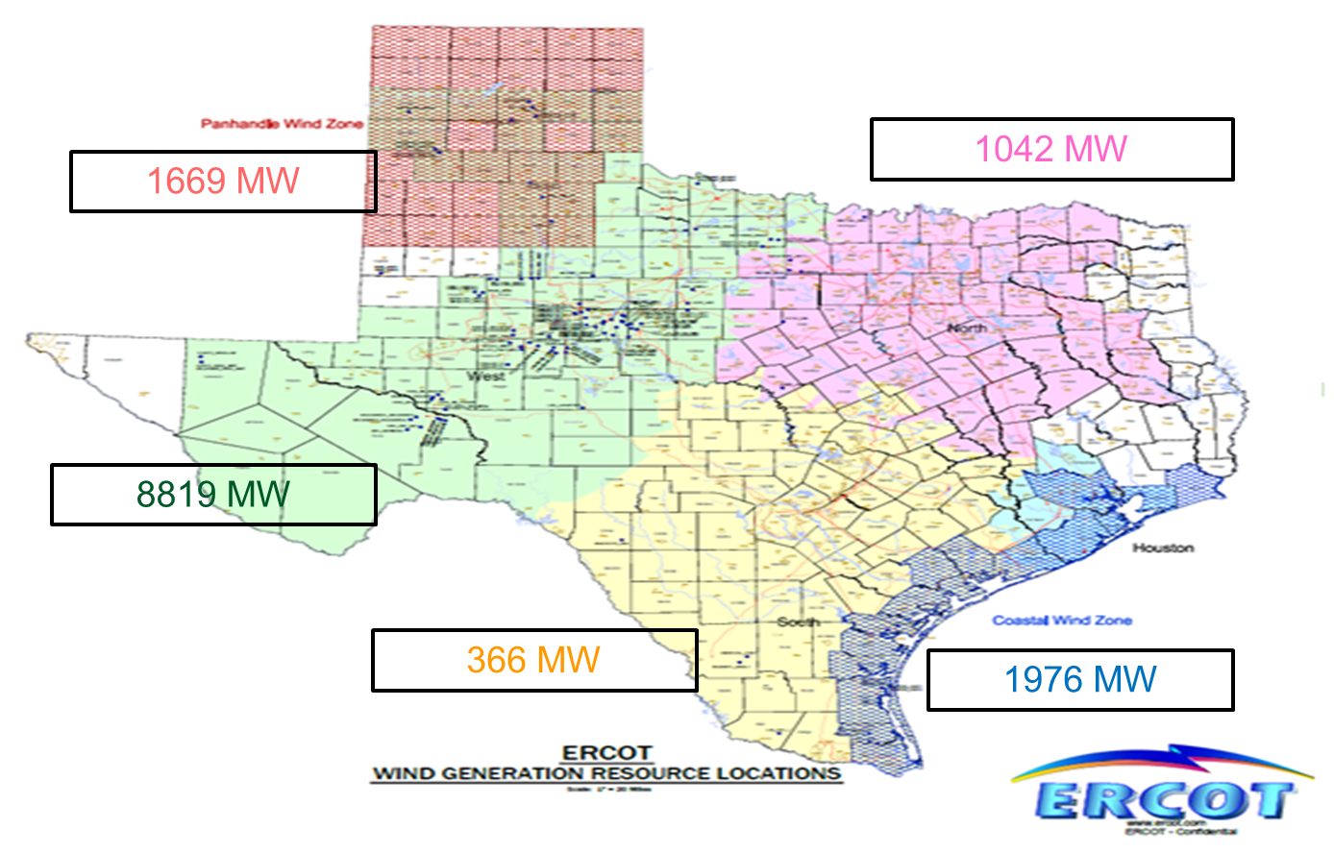
Wind Regions within ERCOT

Slide 7
Extreme Weather: Underlying Weather Phenomena
Several weather phenomena are identified as the causes for significant changes wind profile
Frontal system, trough, or dry line. These fronts can extend for over 600 miles, and the frontal line can advance with speeds in excess of 34 mph. These fronts typically cause a rapid increase of wind speed, followed by a slower decay of wind speed.
Thunderstorms and convection-induced outflow. These storms are generally more local in extent, and can move with considerable speed. They can form rapidly and are sometimes difficult to predict.
Low-level jets are a common weather feature in Texas, and can form due to radiational cooling at sunset, or due to a cold front.
Weakening pressure gradients cause rapid decrease of wind speed over a potentially large area.
Strengthening pressure gradient, developing high winds that can potentially cause widespread wind turbine cutouts.
Notes:
Talk with Chris Coleman to see if he has an example of these types of events.

Slide 8
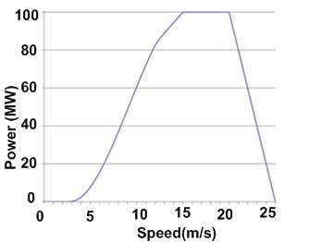
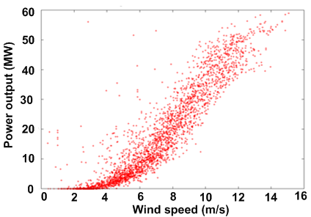
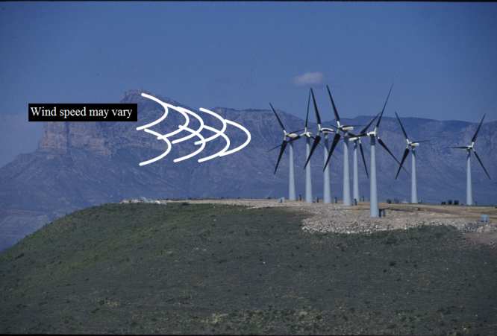
Challenges in Wind Forecast
Relatively concentrated geographic region for wind installation (lack of spatial diversity)
Texas weather can change rapidly
Severe changes in wind generation output caused by different types of extreme weather (large wind ramps)
Frontal system, trough, or dry line/Thunderstorms/Low-level jets/Weakening pressure gradients/Strengthening pressure gradients
There is an approximation of hypothetical wind speed-power curve to the real one
Hypothetical
Power Curve
Actual Wind Farm
Power
The steep part of the power curve from 4-12 m/s is where power increases strongly with speed.

Slide 9
Variation and Uncertainty of Wind Generation

Slide 10
Wind Generation Record
 | WIND (MW) | LOAD(MW) | Penetration
12/14/2014 02:50 | 10240 | 25814 | 39.67%
02/19/2015 22:25 | 11,154 | 32614 | 34.20%
Notes:
2/19/2015 22:52
Coastal [MW]
Non-Coastal [MW]
Total [MW]
Wind Generation
1,282
9,872
11,154
Active Wind HSL Capacity(*)
2,140
11,230
13,800

Slide 11
Monthly Averages of Wind Output

Slide 12
Wind Gen by Region against ERCOT Load 08/20-08/27
Notes:
Majority of Wind comes from in-land. Coastal wind has higher correlation with Peak load.

Slide 13
Wind forecast on Dec. 30, 2014
Notes:
This is just to demonstrate the uncertainty in the day ahead

Slide 14
Wind Forecast @ ERCOT

Slide 15
Importance of Wind Forecast
“the seamless integration of wind plant output forecasting – into both power market operations and utility control room operations – is a critical next step in accommodating large penetrations of wind energy in power systems”
DOE, 20% Wind Energy by 2030 (Washington, DC: DOE, 2008), http://www.20percentwind.org/20p.aspx?page=Report.

Slide 16
4.2.2 Wind-Powered Generation Resource Production Potential
ERCOT shall produce and update hourly a Short-Term Wind Power Forecast (STWPF) that provides a rolling 48-hour hourly forecast of wind production potential for each Wind-powered Generation Resource (WGR). ERCOT shall produce and update an hourly Total ERCOT Wind Power Forecast (TEWPF) providing a probability distribution of the hourly production potential from all wind-power in ERCOT for each of the next 48 hours. Each Generation Entity that owns a WGR shall install and telemeter to ERCOT the site-specific meteorological information that ERCOT determines is necessary to produce the STWPF and TEWPF forecasts. ERCOT shall establish procedures specifying the accuracy requirements of WGR meteorological information telemetry.
Please note : For a WGR going through commissioning process, ERCOT will start providing STWPF to the QSE once WGR receives approval to Generate into the ERCOT Grid (Part II of the Commissioning check list)

Slide 17
3.9.1 Current Operating Plan (COP) Criteria
(7) For the first 48 hours of the COP, a QSE representing a Wind-powered Generation Resource (WGR) must enter an HSL value that is less than or equal to the amount for that Resource from the most recent Short-Term Wind Power Forecast (STWPF) provided by ERCOT.

Slide 18
WPF Process Inputs
Source | Data
Registration system | Resource Parameters Resource Name Location of wind farm (latitude and longitude or equivalent for the center point of wind farm) Location of the meteorological tower (latitude and longitude or equivalent) Type (manufacturer/model) and number of turbines Turbine hub height(s) above ground level with associated number of turbines Manufacturer’s power curve (capability curve) Resource Commercial Operation Date
Energy Management System (EMS) | Most recent Resource (wind farm) status with date/time Most recent MW output of wind farm with date/time Most recent wind speed and direction at hub height from one meteorological tower with date/time Temperature and barometric pressure at 2 m above ground level on the meteorological tower
Telemetry value | SCADA telemetry values are sent every 5 minutes from EMS to the wind power forecast service provider (all of these are Unit specific information with their Qualified Scheduling Entities (QSE) mapping) 1. MW Average 2. Wind Speed 3. Wind Direction 4. Temperature 5. Barometric Pressure 6. HSL Average 7. Num of Turbines ON 8. Num of Turbines Off 9. Num of Turbines Unknown 10. Curtailment Flag

Slide 19
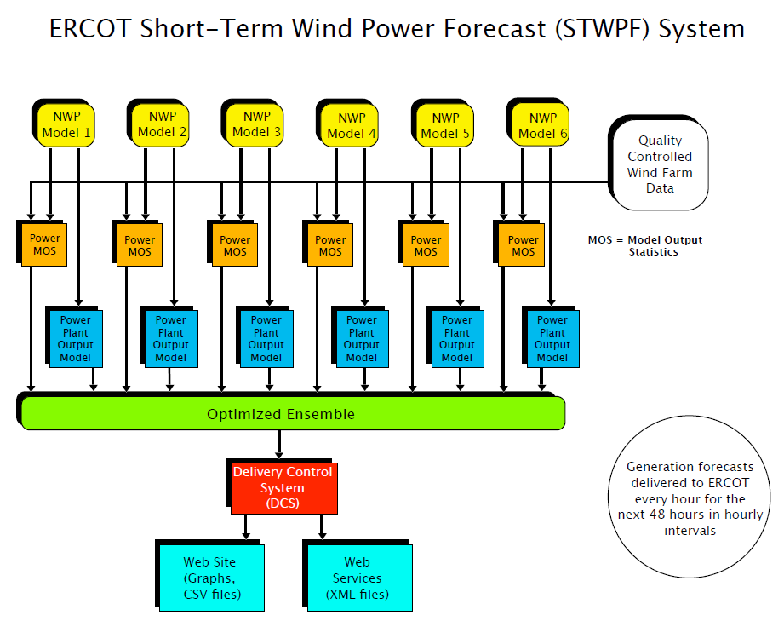
ERCOT Short-term Wind Power Forecast
Notes:
The short-term wind power forecast system is updated hourly for the next 48 hours.

Slide 20
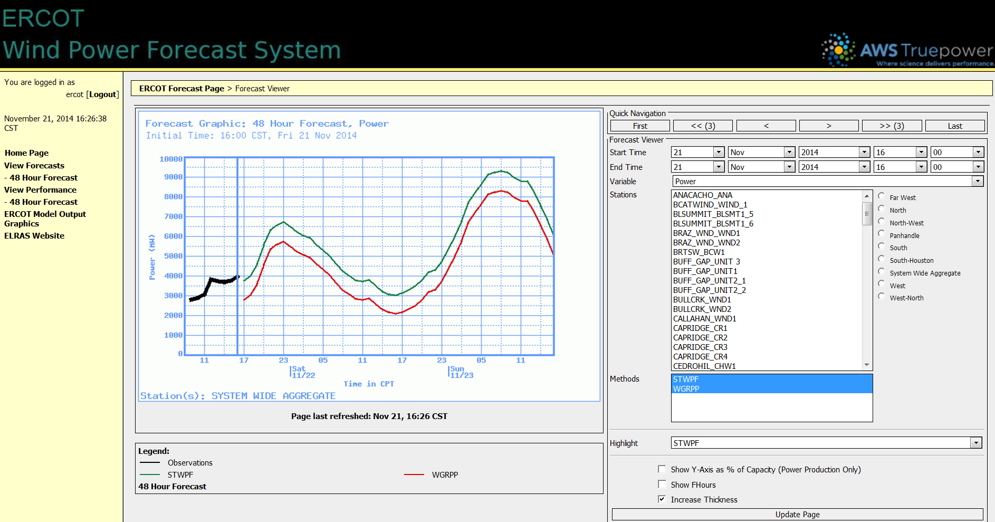
ERCOT Wind Power Forecast System

Slide 21
Forecast vs. Observed Time Series – November 2012 (Low MAE month despite high wind variability)
Notes:
Here is an example of observed time series for the wind forecast performed in Nov. 2012. The black line is the total actual wind generation, the red line is the 3hour-ahead forecast, and the yellow line is the day-ahead wind forecast delivered before 1430 of the prior day.

Slide 22
Performance of Wind Forecast
Annual MAPE for day-ahead wind forecast 2014 is 8.3%

Slide 23
Wind Forecast and Extreme Weather (Icing Event)

Slide 24
Wind forecast on Feb 10, 2014

Slide 25
Wind Forecast on Feb. 11, 2014

Slide 26
Issues created by Icing
Icing created a mismatch between the forecast and actual production.
This created an error in the forecast which then was provided to WGRs.
This error was used in the COP for RUC.
Could lead to ERCOT counting on more wind than WGRs are able to generate.

Slide 27
Correction for Icing
Key to addressing Icing is to update the telemetry for number of turbines on and off.
If the outage will last greater than 2 hours then enter into the outage scheduler.
3.1.4.5 Notice of Forced Outage or Unavoidable Extension of Planned or Maintenance Outage Due to Unforeseen Events
(2) Any Forced Outage that occurs in Real-Time must be entered into the Outage Scheduler if it is to remain an Outage for longer than two hours.

Slide 28
Wind Forecast and Grid Operation

Slide 29
Wind Forecast Used for Scheduling
WGRs must keep the COP (current operating plan) up to date to reflect latest wind forecast and changes in capacity or resource status; and DAM (day-ahead market) and RUC (reliability unit commitment) use the COP for the WGR in their scheduling.
RUC engine uses Wind Forecast submitted as COP for reliability commitment

Slide 30
Wind in Real Time
In real-time, telemetered High Sustainable Limit (HSL) and telemetered ramp-rates are used to dispatch wind resources
SCED issues WGR specific curtailment instruction for maintain transmission reliability
In Real-Time, WGRs are required to
telemeter HSL equal to current net output of the facility
Each WGR that is part of a Standard Generation Interconnection Agreement (SGIA) signed on or after January 1, 2009 shall limit its ramp rate to 20% per minute of its nameplate rating (MWs) as registered with ERCOT when responding to or released from an ERCOT deployment.

Slide 31
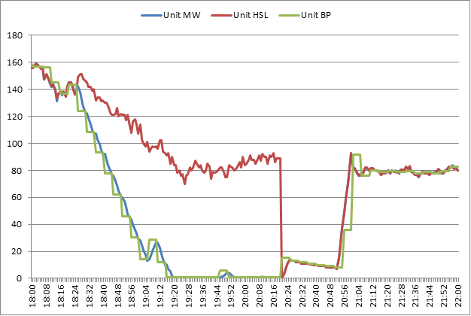
Real-Time Wind Curtailment

Slide 32
ERCOT Large Ramp Alert System: ERLAS

Slide 33
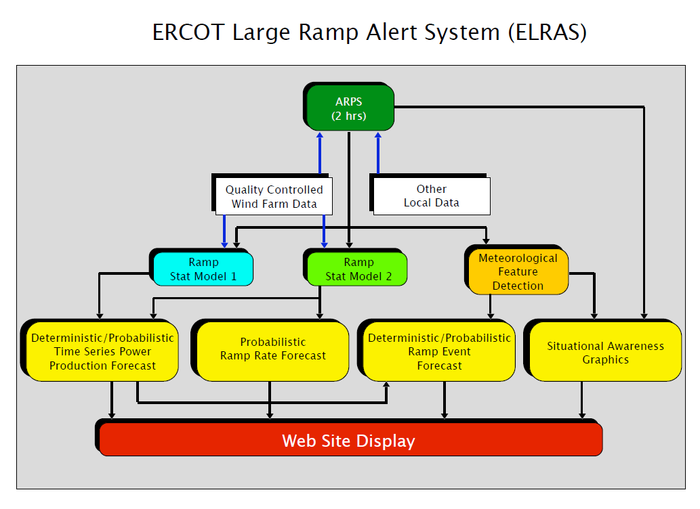
ERCOT Large Ramp Alert System

Slide 34
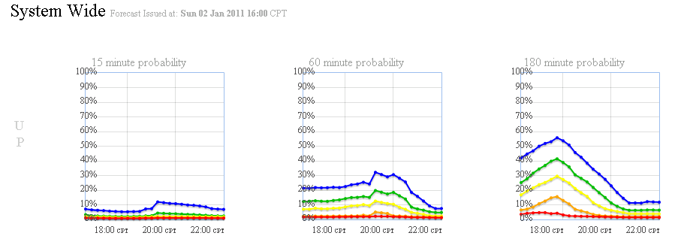
ERCOT Large Ramp Alert System
The main focus of ELRAS is to provide the probabilities of Wind Power ramp events of various MW changes over various time frames
The far right graph shows that there is a 30% chance of the wind output changing by 2000 MW or more between 18:00 and 21:00
Information is provided for both the system and region levels
UP

Slide 35
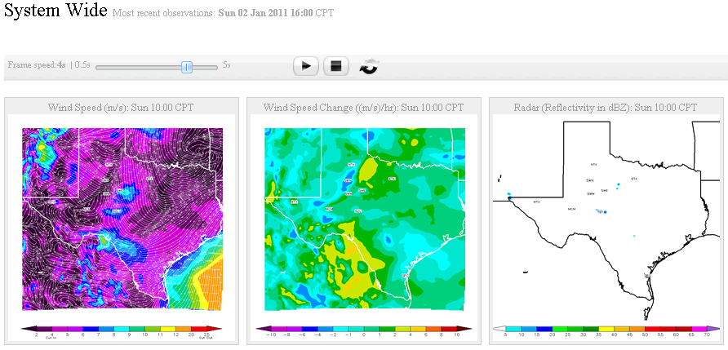
ELRAS and Operations
The Operator is also able to begin using the ERCOT Large Ramp Alert System (ELRAS)
ELRAS provides probabilistic forecast information for the next 6 hours
For further details see Section 3.2 “Monitor Large Ramp Events” of Real Time Desk Procedure. (http://www.ercot.com/content/mktrules/guides/procedures/Real%20Time%20Operating%20Procedure%20V1Rev35.doc )

Slide 36
Overview of Solar Generation and Forecast in ERCOT

Slide 37
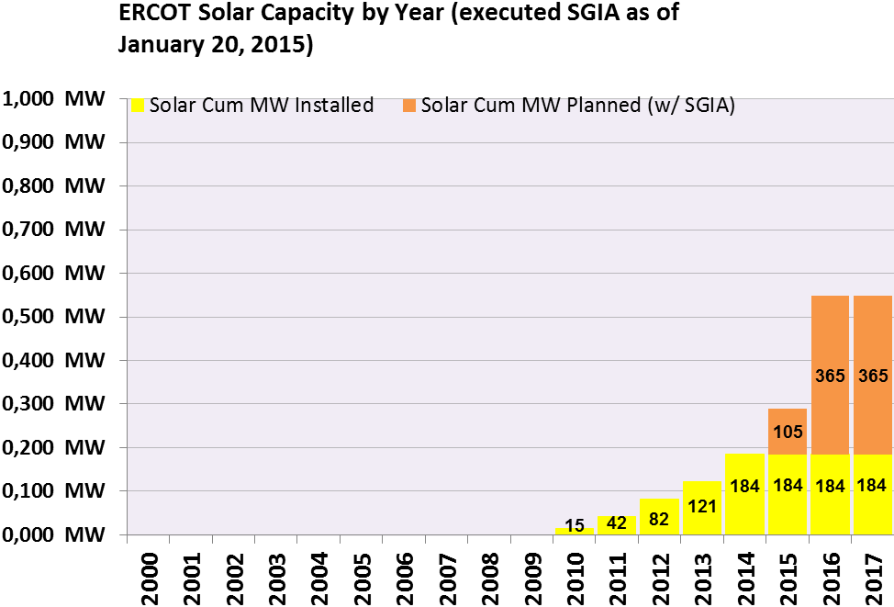
Projected Installed Capacity of PV in ERCOT

Slide 38
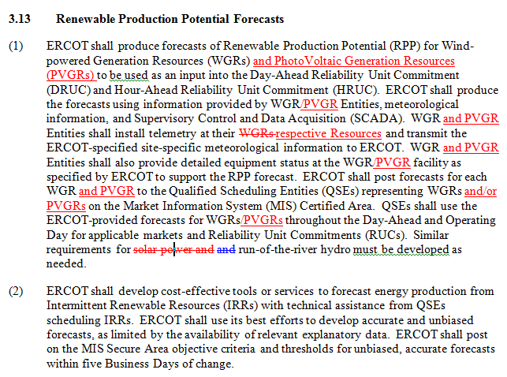
NPRR 615 PVGR Forecasting
PVGRPP PhotoVoltaic Generation Resource Production Potential
STPPF Short-Term PhotoVoltaic Power Forecast
PVGR PhotoVoltaic Generation Resource
Approved by Board of Directors on Aug. 12, 2014

Slide 39
Factors that Affect Solar Power
Global Solar Irradiance (~90%),
Temperature (~10%),
Wind (<1%)
Type of Plant
Determines exact impact of all three factors
Categories of plants:
PV,
Concentrating PV,
Solar thermal (also concentrating)
PV is sensitive to Global Irradiance
Concentrating types (thermal and PV) are sensitive to Direct Normal Irradiance
Also significant sensitivity variations within basic categories

Slide 40
Timelines of PV Forecasting RFP
7/23/2014 Optional Notice of Intend to Propose Due
09/30/2014 Vendor Presentations
06/15/2015 Anticipated End of Evaluation period
05/01/2015 Anticipated Start of phase 2
07/15/2015 Anticipated Contract Award
7/16/2014
RFP release
08/18/2014 Vendor Proposals Due
03/01/2015 Start of Phase 1
06/01/2015 Anticipated Completion of Phase 2
08/15/2015 Anticipated Contract Start Date
Proposed/ Current timeline. May be modified based on expected ability of respondents and ERCOT to complete necessary RFP evaluations.

Slide 41
Questions?

Slide 42
Test Question 1
Which Region has the largest installed capacity of the Wind Generation?
North
Panhandle
West
South

Slide 43
Test Question 2
What corrective actions should be taken when WGRs experience Icing issues?
Update the Number of turbines out telemetry
Update the COP and Outage Scheduler
Update the Outage Scheduler
All of the above.

Slide 44
Test Question 3
If Short-Term Wind Power Forecast (STWPF) for a wind farm is 100 MW, which COP value is acceptable?
a) 90 MW
110 MW
120 MW
All of the above.

Slide 45
Test Question 4
What is the maximum ramp-rate per minute for Wind and Solar Resources?
10%
20%
No limits, its based on Wind Speed or Solar Irradiance
2%

Slide 46
Test Question 5
Under what scenario, can the telemeter HSL of the WGRs be higher than the WGRs telemetered output?
Always
When Curtailed
During startup and shutdown
All of the above

