Slide 1
Recent ERCOT Events
Lessons Learned
Stephen Solis
2015 OTS

Slide 2
Objectives
At the completion of this course of instruction you will:
Identify the beneficial actions that a Transmission Operator (TO) takes during an EEA (1/06/14 event).
Identify the beneficial actions that a TO takes during a localized Transmission Emergency (10/08/14 event).
Identify the communication protocol to be utilized during these situations.

Slide 3
January 6, 2014 EEA event
At 6:52, ERCOT declared Level 1 of its Energy Emergency Alert (EEA) and declared EEA Level 2 at 7:01, primarily due to the loss of a number of generating units
Non-Spin Reserve Service (NSRS), Load Resources (LR) and Emergency Response Service (ERS) were deployed, but firm load shed was not required
ERCOT moved from EEA2 to EEA1 at 7:51 and resumed normal operations at 9:12
Generation outages & derates peaked at 9355 MW just before 07:00, with 3541 MW due to weather
Hourly peak demand was 55,487 MW for HE08 and instantaneous peak demand was 56,478 MW at 07:08:24

Slide 4
Timeline – January 6, 2014 EEA
ERCOT issued EEA Level 1 for PRC below 2300 MW
07:51 AM
ERCOT recalled EEA Level 2. EEA Level 1 remains in effect
07:56 AM
ERCOT recalled 30 minute ERS
07:58 AM
ERCOT recalled 10 minute ERS.
EEA Level 1 cancelled. Watch remains in effect.
ERCOT issued EEA Level 2 for PRC below 1750 MW
Watch terminated as PRC was above 3000 MW
Watch issued due to PRC below 2500 MW
06:42 AM
06:52 AM
07:01 AM
09:12 AM
09:55 AM
06:37 AM
06:42 AM
06:52 AM
06:57 AM
07:02 AM
ERCOT deployed 30 minute ERS for 111.68 MW
07:05 AM
ERCOT deployed 10 minute ERS for 508.72 MW
07:13 AM
ERCOT recalled all RRS from Generators due to frequency above 59.91 Hz
08:10 :36 AM
ERCOT recalled all Non-Spin
08:10:48 AM
ERCOT deployed RRS to Generators for frequency below 59.91 Hz
08:17 AM
ERCOT recalled all RRS from Generators due to frequency above 59.91 Hz
ERCOT deployed Non-Spin for 187 MW
ERCOT deployed Group 1 RRS for 546.36 MW
07:43 AM
ERCOT recalled all Group 2 RRS
07:50 AM
ERCOT recalled all Group 1 RRS
ERCOT deployed RRS to Generators for frequency below 59.91 Hz
ERCOT deployed Group 2 RRS for 536.24 MW

Slide 5
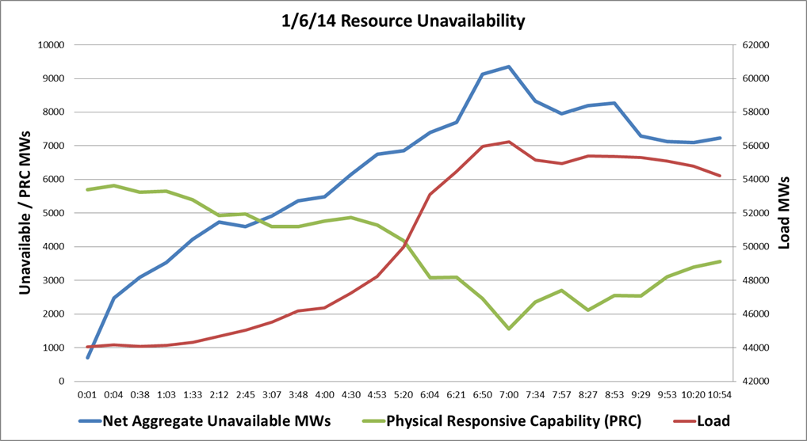
Generation Outages
Note: This does not include outages which occurred before midnight on January 6
EEA1 Active
EEA2 Active
Notes:
While not expressed in the graph below, ERCOT also had 2468 MW of capacity on planned outage and 2938 MW of capacity on forced outage leading into the operating day. This would indicate a cumulative peak impact of 14,761 MW of generation that was unavailable during the EEA.
ERCOT deployed 1082 MW of Load Resources between 06:52 and 07:50
ERCOT deployed 112 MW of ERS 30 minute service between 07:02 and 07:56
ERCOT deployed 508 MW of ERS 10 minute service between 07:05 and 07:58

Slide 6
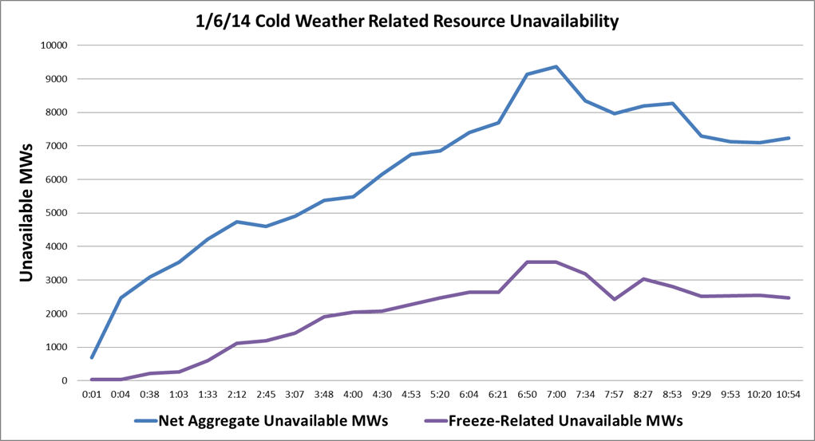
Cold Weather Related Outages
2/2/11 - Approximately 2/3 of unavailable MW was related to cold weather.
1/6/14 - Approximately 1/3 of unavailable MW was related to cold weather.
Notes:
2/2/11 – Approximately 2/3 of unavailable MW was related to cold weather.
1/6/14 -- Approximately 1/3 of unavailable MW was related to cold weather.
Better awareness/weatherization
Large unit trips included in the freeze-related.

Slide 7
How cold was it?

Slide 8
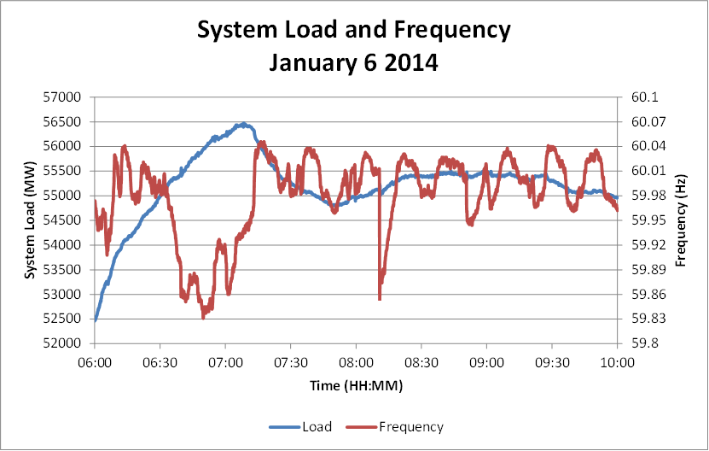
Frequency Disturbances
Large unit trip
6:30 to 7:00 loss of generation plus load ramp

Slide 9
Lessons Learned
ERCOT should continue its winterization site visits
ERCOT should continue to give advanced notice to market participants when cold weather approaches
ERCOT should review the use of PRC as currently defined as the trigger for reserve monitoring and declaration of emergency operations.
No 3 part communications issues were observed

Slide 10
TO beneficial actions in advance of cold weather
Restoring any available transmission outages
  Especially beneficial if icing anticipated
  May allow additional generation output
Reviewing emergency procedures
Reviewing communication protocols
  Clear and concise communications
  3 part communications

Slide 11
TO beneficial actions during an EEA
General
  Communicating to TSPs that a TO represents
  3 part communications
  Reactive Support
EEA1
  Coordinating DC Tie schedules
  Deploying Load Management programs
EEA2
  Distribution Voltage Reduction
  Media Appeals for conservation
EEA3
  Firm load shed

Slide 12
Timeline – October 8, 2014 Transmission Emergency

Slide 13
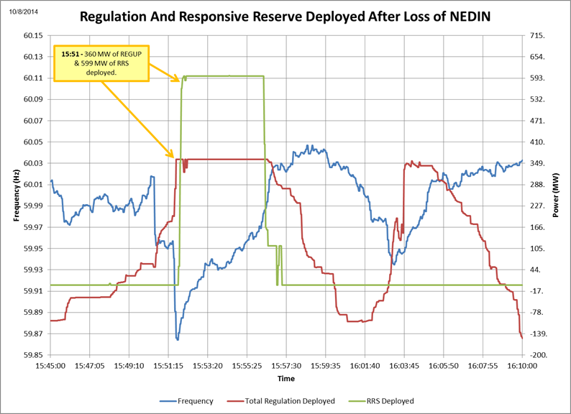
Frequency Response - unit trip
Notes:
After the loss of the entire NEDIN Combined Cycle train (651 MW) at 15:50, frequency dropped to 59.864 Hz. Immediately after, 360 MWs of Regulation-Up (REGUP) and 599 MWs of Responsive Reserve Service (RRS) were deployed to recover frequency. During this event 625 MW/0.1 Hz of generation response was observed within 16 seconds after the second trip, which is much better than expected response of 420 MW/0.1 Hz.

Slide 14
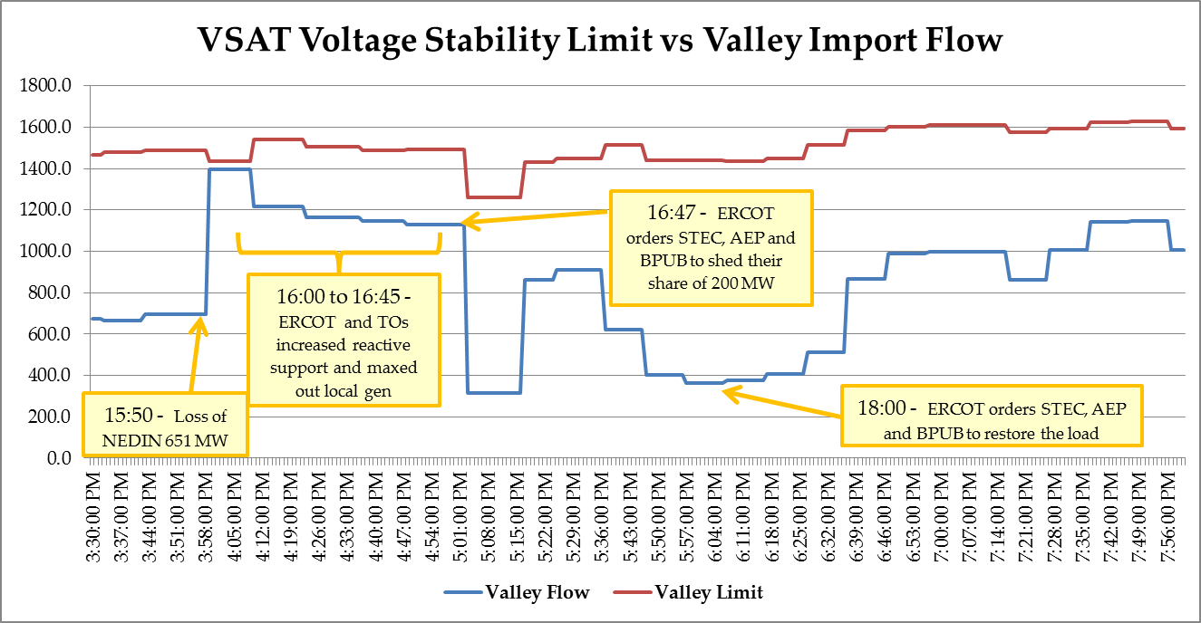
Valley Import Limit

Slide 15
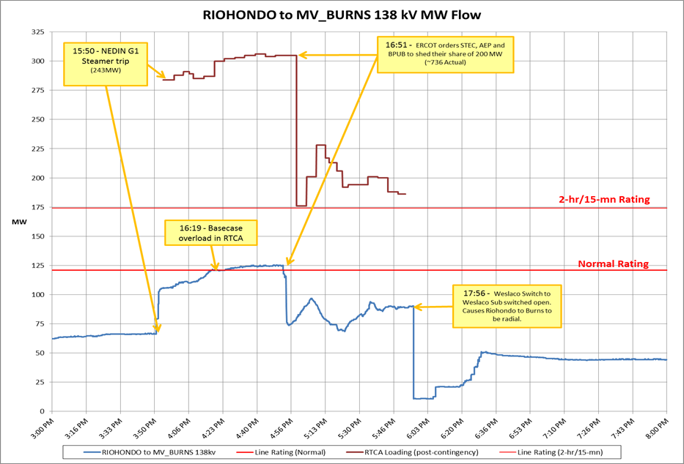
Overloaded Lines

Slide 16
Overview

Slide 17
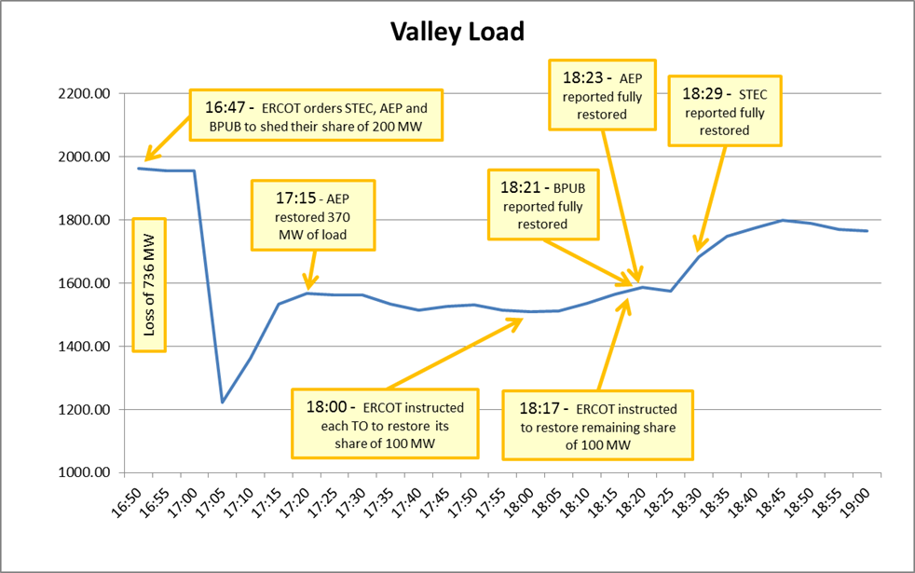
Load Shed

Slide 18
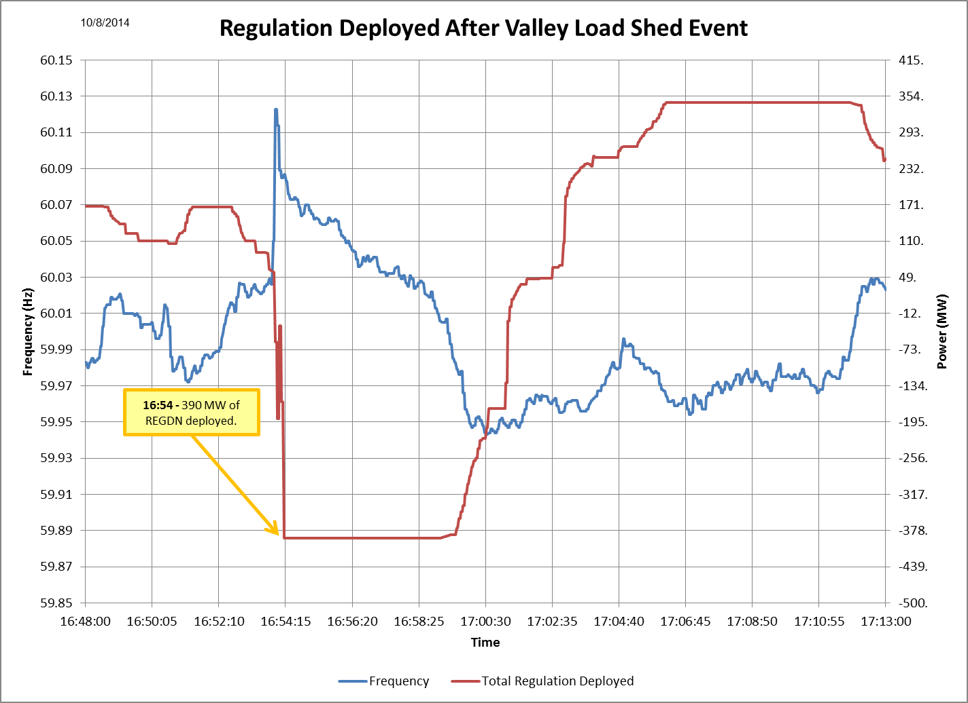
Frequency Response – Load Shed
Notes:
high frequency was due to error on the side of TSPs controls

Slide 19
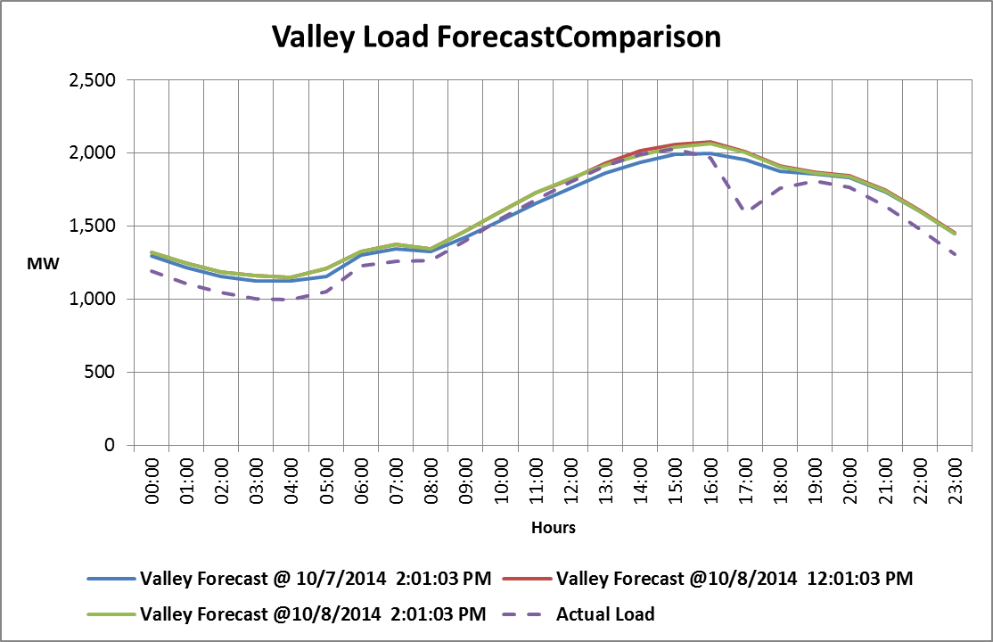
Load Forecast
Notes:
The valley load in the in the figure above is calculated as 43% of Southern Weather Zone. This is consistent with valley load assumptions in other studies. Load forecast error was not a contributing factor.

Slide 20
Lessons Learned
Review all combined-cycle contingency definitions
Create load shed displays based off individual TO load
Develop tool to more easily simulate UVLS actions for steady state analysis.
Utilize this event as an emergency operations training scenario. Specifically review methods to implement more target load shed when necessary.
Add checkboxes to Constraint Management Plans

Slide 21
TO beneficial actions during a local Transmission Emergency
Restoring Outages
Coordinating Constraint Management Plans
Re-rating transmission facilities during Emergency
Verifying any automatic relay setpoints
Communicating to TSPs that a TO represents
3 part communications

Slide 22
TO beneficial actions during a local Transmission Emergency (cont)
Reactive Support
Coordinating DC Tie schedules(if applicable)
Deploying Load Management programs(if applicable)
Distribution Voltage Reduction
Media Appeals for conservation
Firm load shed

Slide 23
3 Part Communications
New Standard COM-002-4 coming by 2016
Directives must be communicated in a clear, concise, and definitive manner.
3 Part Communication involves both the issuer and the receiver of a directive to be successful.
ERCOT and ERCOT TOs issue directives

Slide 24
3 Part Communications during an Emergency
3 Part Communications even more critical
Miscommunications can result in more severe consequences
Compliance sanctions more severe
Reinforce before or during an Emergency
Clarify Facility names if necessary
Be patient and mute phones during Hotline
Work together and call back if needed

Slide 25
Summary
Two different types of emergencies with similar TO beneficial actions.
3 part communications critical during emergencies
Efforts to prepare for cold weather yields positive results
Event Analysis yields positive observations and Lessons Learned

Slide 26
Questions
?
?

Slide 27
Questions
Which of the following actions may be taken by the Transmission
Operator during an EEA event?
  Deploy Load Management Programs
  Implement Voltage Reduction measures
  Shed Firm Load
  All of the above

Slide 28
Questions
2. Which of the following actions should NOT be taken by the Transmission Operator during an EEA event?
  Deploy Load Management Programs
  Disarm Under Frequency Load Relays
  Coordinate DC Tie Schedules if a DC Tie Operator
  Use 3 part communication

Slide 29
Questions
3. Which of the following actions may be taken by the Transmission
Operator during a localized Transmission Emergency?
  Notify the President of the US.
  Take as many transmission lines out of service as possible
  Issue Media Appeals for energy conservation
  Disarm all SPS’s to minimize unauthorized outages

Slide 30
Questions
4. Which of the following actions should NOT be taken by the Transmission
Operator during a localized Transmission Emergency?
  Restore transmission outages
  Take as many transmission lines out of service as possible
  Coordinate Constraint Management Plans
  Provide Reactive Support as needed

Slide 31
Questions
5. Which of the following communication protocols shall be used during all
Emergency situations?
  Use only last names of employees to eliminate any confusion
  Proper use of 3-Part Communication on all phone calls, radios, etc.
  Ensure correct spelling of employee names while talking to the media
  Disregard all communication protocols until the Emergency has passed

