Slide 1
New Generation technologies and ERCOT
John Adams
Principal Engineer
1

Slide 2
What we will talk about
New Technologies
  Photovoltaic
    Utility
    Rooftop
    Price Trends
  Battery Storage ($600/KWH?, 300/KWH?; 150/KWH?)
  Small Diesel interconnected at Distribution
  Larger Wind Turbines
  Pumped Storage
  CAES
Barriers to Acceptance
Technical Challenges
ERCOT Emerging Technologies process
New Transmission/Distribution Technologies
Notes:
Smart Grid – Distribution Automation; Real Time Distribution monitoring; Storage as a transmission technology, Real time dynamic line rating; AC line flow control by: modifying impedances (smart line; switched caps); phase shifting (transformers, electronics); SVC’s; Series capacitors.;

Slide 3
Photovoltaic

Slide 4
Photovoltaic

Slide 5
Photovoltaic

Slide 6
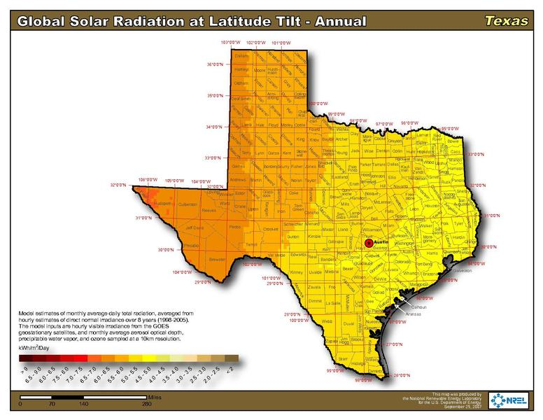
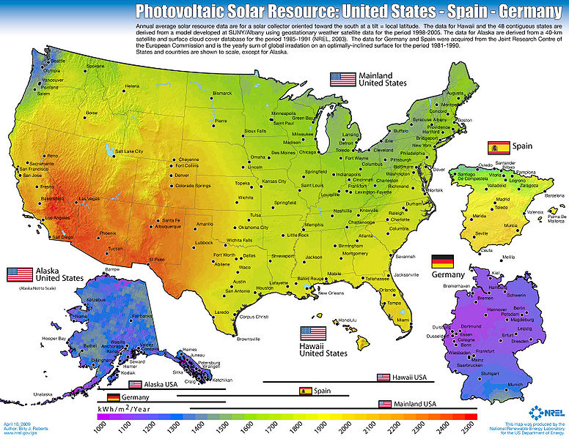
Solar Radiation in Texas – from National Renewable Lab

Slide 7
EIA projections of average LCOE for different technologies

Slide 8
EIA projections of average LACE for different technologies

Slide 9
So what technology makes sense???

Slide 10
Cost and Risk of new generation – the California view
Source: California Natural Resources Agency Practicing Risk-Aware Electricity Regulation, 2012 http://www.ceres.org/resources/reports/practicing-risk-aware-electricity-regulation

Slide 11
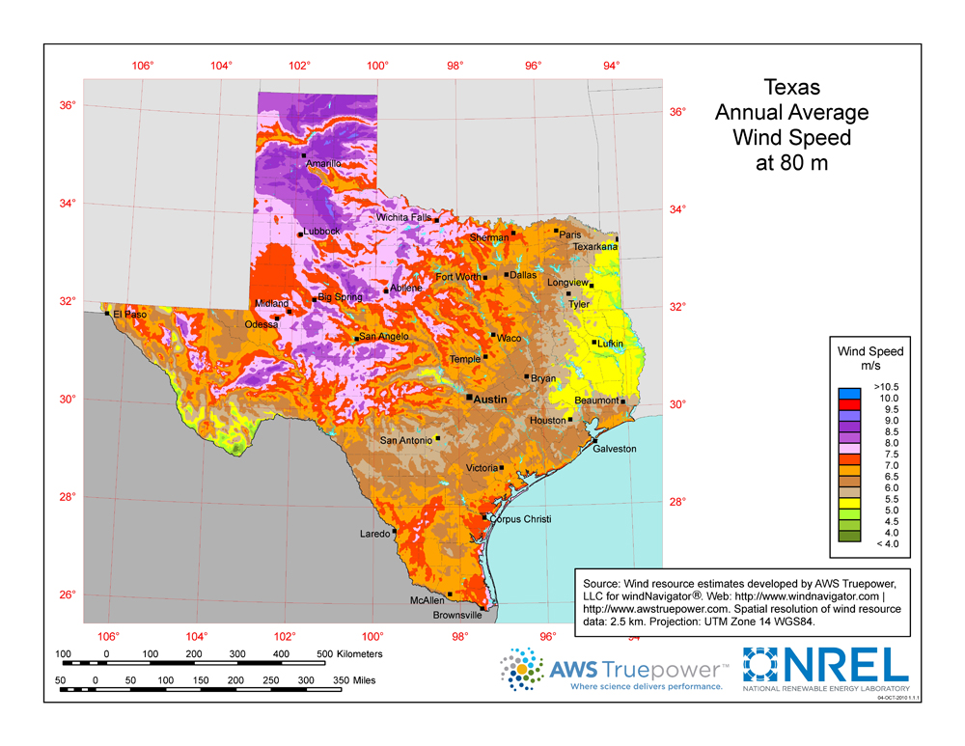
Wind Speeds at 80 Meters

Slide 12
Wholesale Price of wind energy Nationwide

Slide 13
Wind power development in the United States

Slide 14
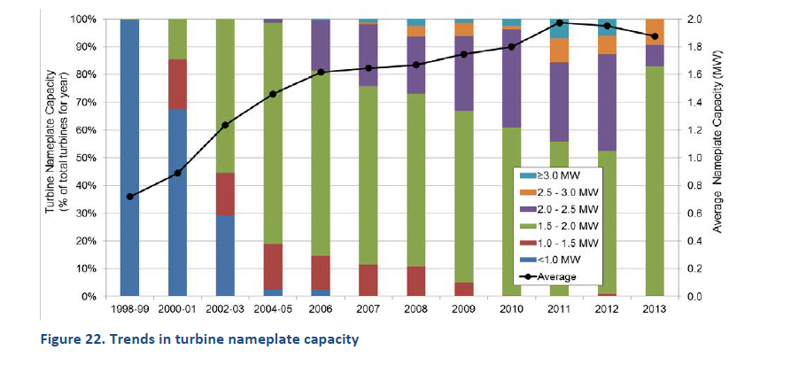
Trends in United States Wind Turbine size
The average nameplate capacity of a small sample of newly installed wind turbines in the United States in 2013 was 1.87 MW, up 162% since 1998-1999.
Typical modern wind turbines have diameters of 40 to 90 meters (130 to 300 ft.) and are rated between 500 kW and 2 MW. As of 2014 the most powerful turbine, the Vestas V-164, is rated at 8 MW and has a rotor diameter of 164m ²
In 2013, GE captured a large portion of the US market with its 1.5 MW turbine; but overall 2013 was a bad year for wind turbines

Slide 15
Wind Power Capacity under Construction - USA

Slide 16
Utility Storage
Battery Technologies:
Lead-Acid Technology
Lead-Carbon Technology – ARPA (EastPenn)
Flow- Zn-Halogen (Primus Power)
Flow – ZnBR – SMUD
Flow – Vanadium Redox (Ashlawn)
Flow – FE-CR (Enervault)

Slide 17
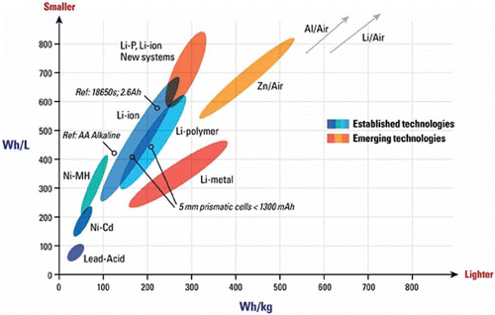
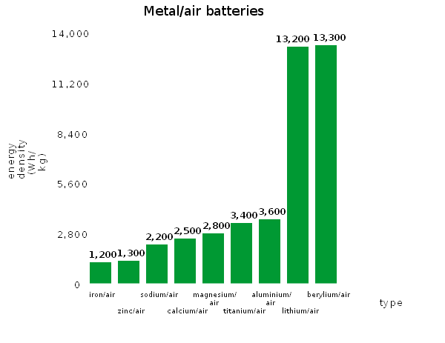
What are differences between battery types?
● Vd Redox

Slide 18
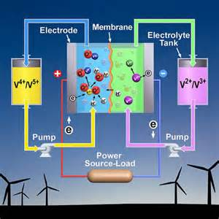
What's a Flow Battery? (Vanadium Redox)

Slide 19
Brattle Report & Oncor
Our analysis shows that deploying electricity storage on distribution systems across Texas could provide substantial net benefits to the state. We estimate that up to 5,000 MW (15,000 MWh, assuming a three-to-one ratio of storage to discharge capability) of grid-integrated, distributed electricity storage would be cost effective from an ERCOT system-wide societal perspective based on a forecast of installed cost of storage of approximately $350/kWh.
The $350/kWh installed cost projection is based on Oncor’s discussions with vendors, consistent with industry sources. For example, Morgan Stanley predicts that battery-only costs may reach $125–$150/kWh in the near future, down from the $500/kWh currently. See Byrd, et al. (2014), p. 40. If battery costs are capable of reaching the low costs projected by Tesla Motors Inc., this would imply a battery-only cost of only $110/kWh.

Slide 20
Logic of Brattle report to Oncor – Merchant battery plants cannot monetize value in ERCOT

Slide 21
Logic of Brattle report to Oncor – Transmission value + merchant value justifies battery investments
Source: Brattle Group Report to Oncor The Value of Distributed Electricity
Storage in Texas, November 2014

Slide 22
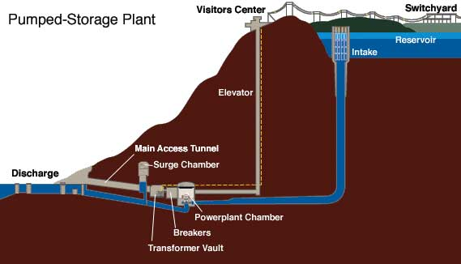
Pumped Storage
Notes:
Typical efficiency 70-80% Maximum claimed 87%

Slide 23
CAES
Notes:
Practical Round trip efficiency expected to be around 70%

Slide 24
Small Distributed Electric Resources
Small Natural Gas fired Reciprocating Engines
  Natural gas generator sets (gensets) are distributed power generation units that use reciprocating internal combustion engines to produce useable energy from gaseous fuels. Distributed generation has the advantage of going online more quickly than traditional large centralized power stations, reducing demand pressure on the electrical grid, and reducing inefficiencies that are common in centralized power generation, transmission, and distribution. Natural gas-fueled gensets are poised for rapid growth, particularly in markets where inexpensive natural gas is widely available.
  Advantages of small resources are:
    Quick installation
    Minimal interconnection requirements (<10 MW)
    Paid zonal price
    Price responsive; not normally in market
Notes:
ERCOT currently has about 897 MW of distributed generation operating (November 2014)
One provider is generating ~158 MW on a purely commercial (price chasing) basis; even though they only get compensated at zone price.

Slide 25
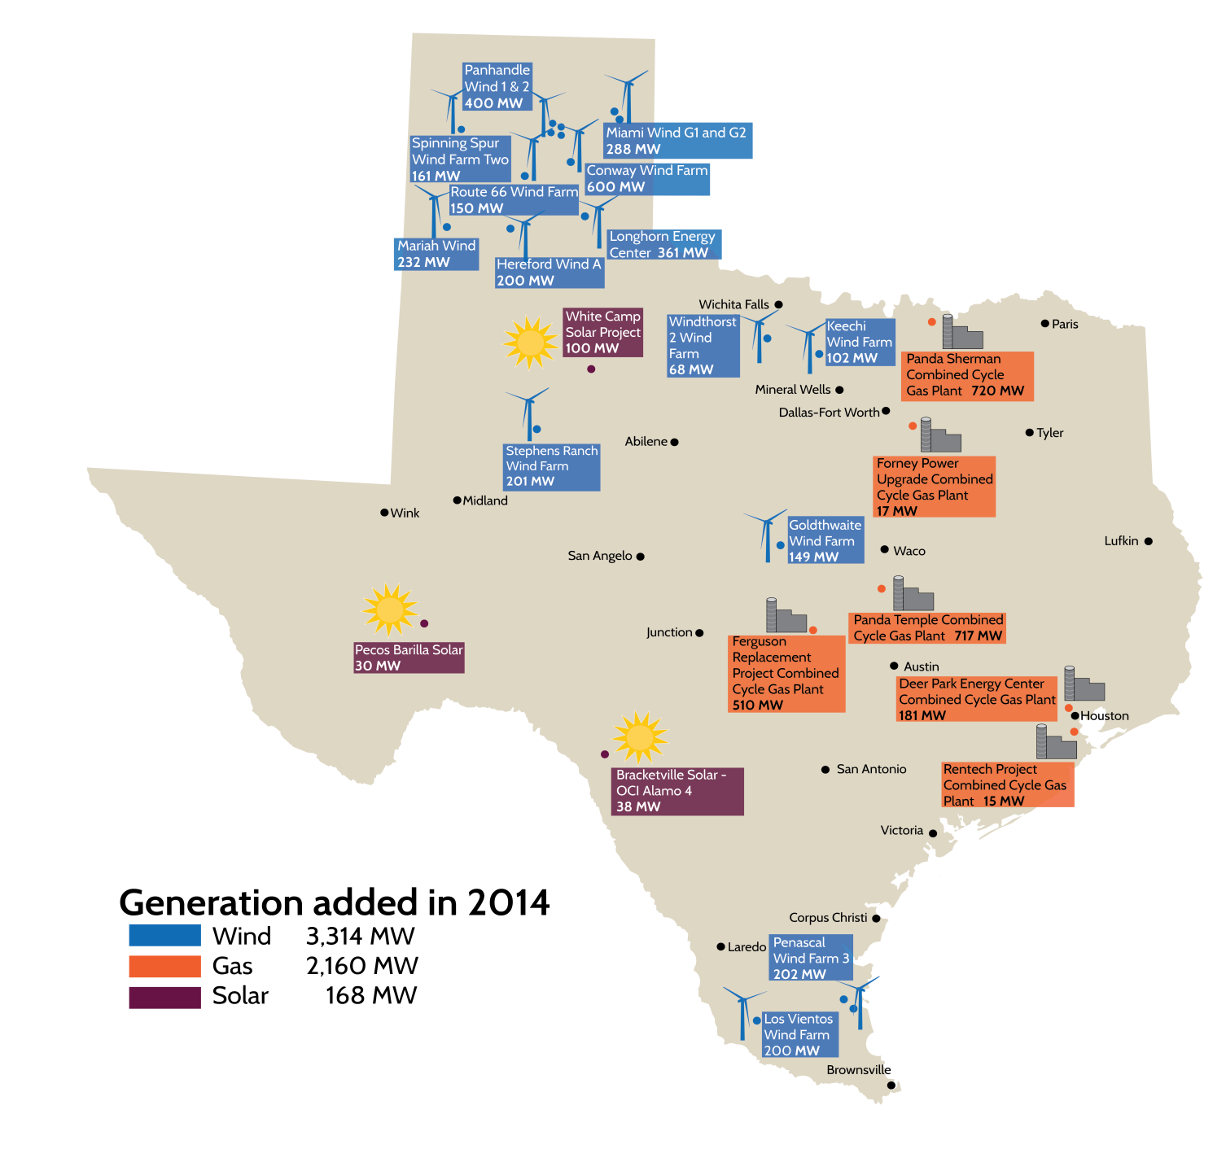
ERCOT Generation Additions 2014

Slide 26
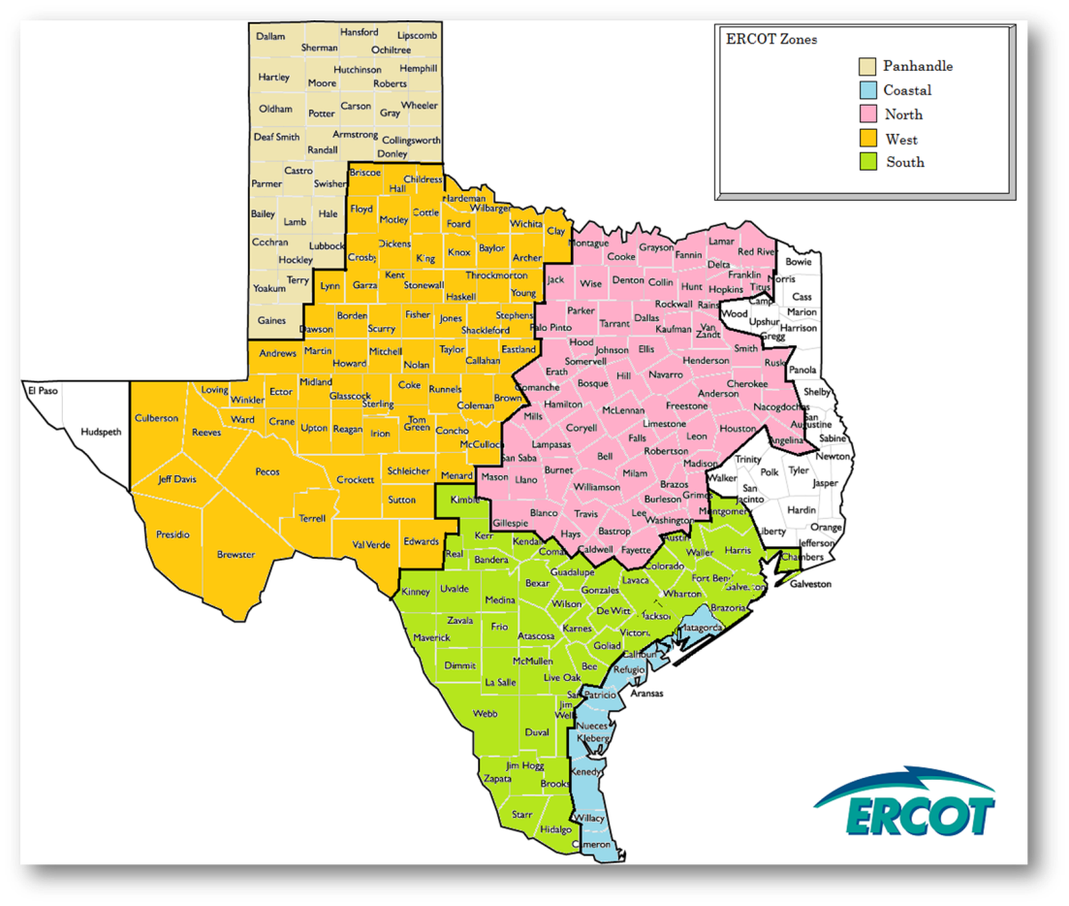
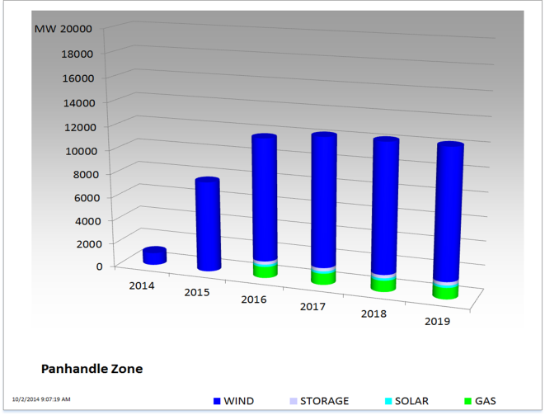
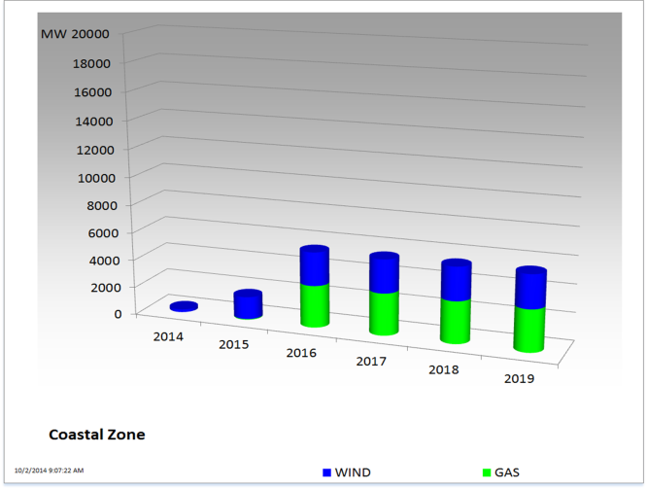
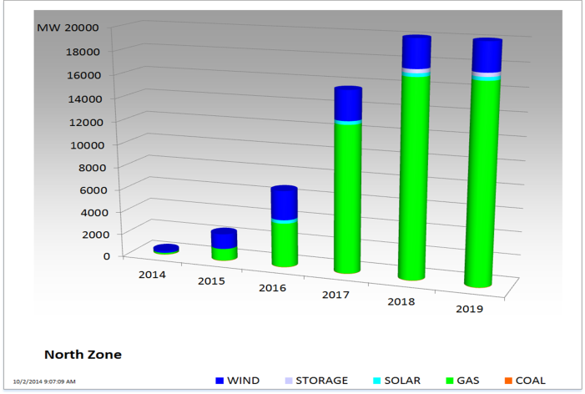
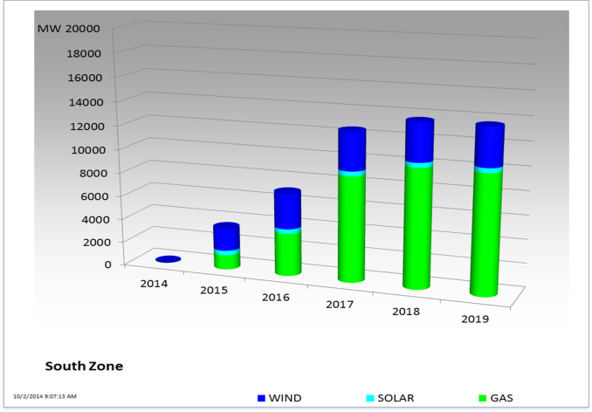
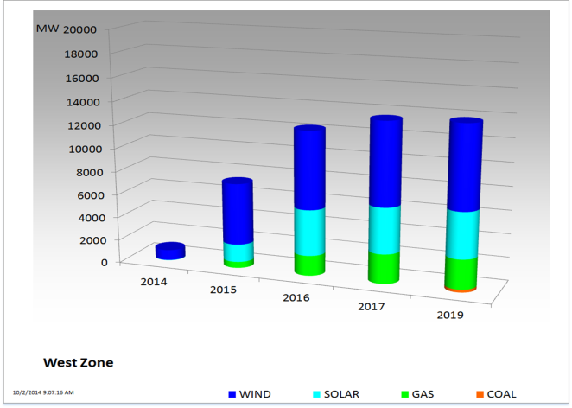
Effect of CREZ on Interconnection requests

Slide 27
From the ERCOT Standard Generation Interconnection Agreement (SGIA)
The TSP shall apply to have the full costs of the TIF included in TCOS…
ERCOT will include a proposed Generation Resource in the base cases … once the Interconnecting Entity (IE) notifies ERCOT that it has received a Texas Commission on Environmental Quality (TCEQ)-approved air permit …and demonstrates that it has obtained water rights sufficient for plant operation…, and ERCOT receives one of the following:
(a) A signed Standard Generation Interconnection Agreement …and a written notice from the TSP that the IE has provided:
  (i) A notice to proceed with the construction of the interconnection; and
  (ii) The financial security required to fund the interconnection facilities; or …

Slide 28
Regional Transmission planning normally lags generation interconnection requests
From the ERCOT Planning Guides
Each Transmission Service Provider (TSP) will perform steady-state, short circuit, and dynamic analyses appropriate to ensure the reliability of its portion of the ERCOT System and implement appropriate solutions to meet the reliability performance criteria in this Section 4.1.
The base cases created by the Steady-State Working Group (SSWG) and System Protection Working Group (SPWG) are available for use by Market Participants.
Normally the transmission planning process is a lagging process. Only after planning cases are completed with generation included, can the need for new transmission out of a region be recognized…

Slide 29
Current Barriers to New generation technologies in ERCOT
Low electricity prices
Large Utility Photovoltaic
  Interconnection Requirements & Studies
  Concern about potentially changing ERCOT/NERC requirements (Frequency Response, Voltage response, ride through, FAST)
  Potential problems with high ramps induced by sunrise/sunset driving prices & leading to price uncertainty over term of investment.
Large Utility Battery Storage
  High cost (but falling Now 500-600/kwh)
  Difficulty in monetizing the congestion reduction, energy, and ancillary service values
  Risk of improving technologies undercutting your investment
  ERCOT/PUCT protocols/rules unclear about handling of storage (generation, load?) LMP price or zonal price?

Slide 30
Current Barriers to New generation technologies in ERCOT
Low electricity prices
Small Rooftop PV
  High installation costs
  In areas, low support from local utility
  Uncertainty/inconsistency across State about requirements
  Low/uncertain return on investment
  Risk – roof leaks, no service after sale, changing utility requirements, Unknown O&M costs, Lack of strong suppliers,etc.
Small local Battery Storage
  Few suppliers
  High costs
  Uncertainty about avoidance of T&D charges
  Unknown O&M costs/providers, potential toxic chemicals
  Lack of financial strength in supplier/installers
  High risk
  Inability to capture LMP price/value

Slide 31
Selected European Country Requirements
LV Connection
Country | Europe (≤16 A) | Germany | Italy | Austria | France | Spain | Europe (≤16 A) | Europe (>16 A)
Function | 2007 | 2011 | 2012 | 2013 | 2013 | 11/14 | 2013 | 2014
P at low f | No | Yes (all) | Yes (all) | Yes | No | No | Yes | Yes
P(f) | No | Yes (all) | Yes (all) | Yes | Yes* | No | Yes | Yes
Q/cosφ | No | >3.68kVA | >3 kVA | >3.68kVA | No | No | Yes | Yes
Q(U) | No | No | >6 kVA | optional | No | No | Yes | Yes
Remote P | No | >100kW | >3 kVA | >100kW | No | No | No | Yes
Rem. trip | No | No | Yes | No | No | No | No | Yes
LVRT | No | No | >6 kVA | No | No | No | No | Yes
HVRT | No | N/A | No | No | No | No | No | Yes
Reference | EN 50438 2007 | VDE AR N 4105: 2011 | CEI 0-21:2012 | TOR D4:2013 | * ERDF-NOI-RES_13E Version 5 - 30/06/2013 | RD 1699/2011 206007-1 IN:2013 | EN 50438 2013 | FprTS 50549-1:2014 DRAFT!

Slide 32
Summary of Key Trends and Progress
In the US, since 1978, utilities are required to purchase power from qualified DG. Standards evolved for safety, grid connection and screening. Now we are changing for new DG technologies and increased deployments.
For Interconnection of DG – IEEE Standard 1547
  Since 2003, for inverter and rotating machines
  In 2014 changes allow grid support (“smart inverters”)
  Mandatory support (MV grid codes) is in discussion.
For Screening of DG – FERC Requirement SGIP
  Since 2005, applied to open access tariffs for ≤ 20MW
  In 2013, changes raised DG level from 15% to 100% of minimum load, fast screening for ≤2 MW and no screen for ≤10kW DG with certified inverter.
Source: EPRI “Interconnection Standards in North America” presented 6th International Conference on Integration of Renewable and Distributed Energy Resources November 21, 2014 Kyoto, Japan

Slide 33
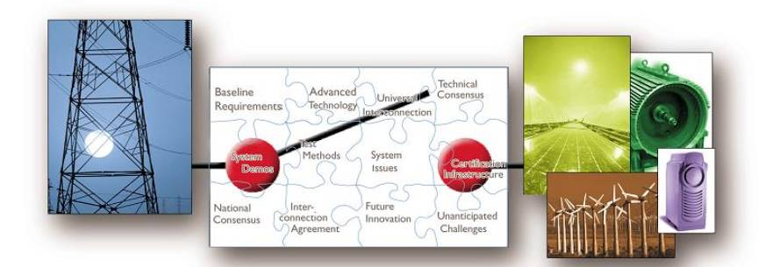
Standards need to address different viewpoints:
End Users, Wires Companies (DSO/TSO), Grid Operators (ISO)
End User, “Interconnection” – interface issues specific to a single DG at a PCC. Original IEEE 1547, UL 1749, and local codes.
Wires DSO/TSO, “Integration”– questions about multiple DGs, distribution feeder penetration levels, hosting capacity, voltage support.
Grid Operation “ISOs” – aggregate affects, reserves, capacity, energy and load balance, planning, markets and dispatch, also contingency recovery.
Source: EPRI “Interconnection Standards in North America” presented 6th International Conference on Integration of Renewable and Distributed Energy Resources November 21, 2014 Kyoto, Japan

Slide 34
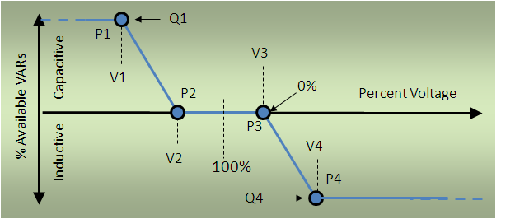
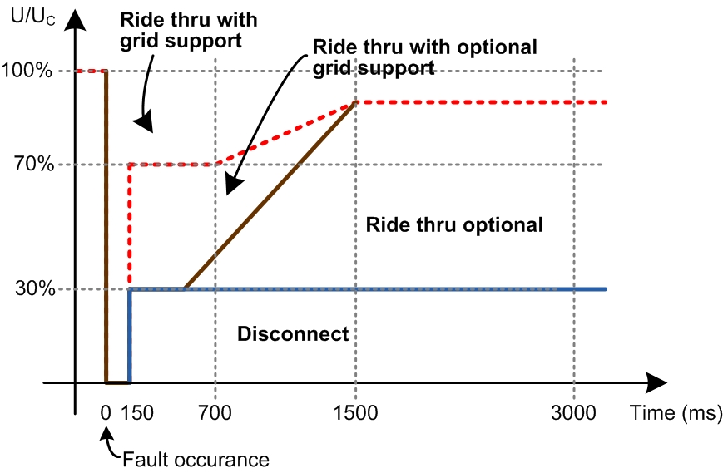
Grid Support functions of DG – If not provided could inhibit widespread penetration
Voltage regulation and
reactive support
    Volt-VAR control
    Power factor setting
    Dynamic reactive current
Active power and ramp
rate limiting
Volt-watt control
Frequency-watt control
Dynamic response, voltage
and frequency ride-through
Example Volt-VAR Behavior (EPRI, 1023059)
LVRT in German MV Grid Code
Source: EPRI “Interconnection Standards in North America” presented 6th International Conference on Integration of Renewable and Distributed Energy Resources November 21, 2014 Kyoto, Japan
Notes:
If these functionalities are not provided by DG they could inhibit widespread penetration of the new technologies!

Slide 35
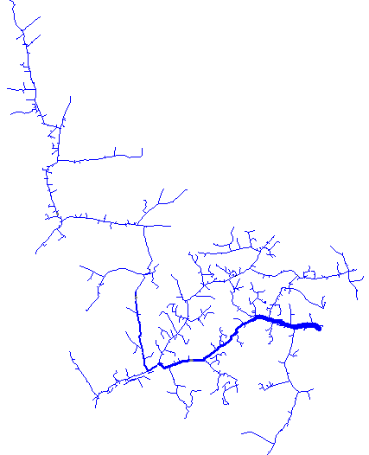
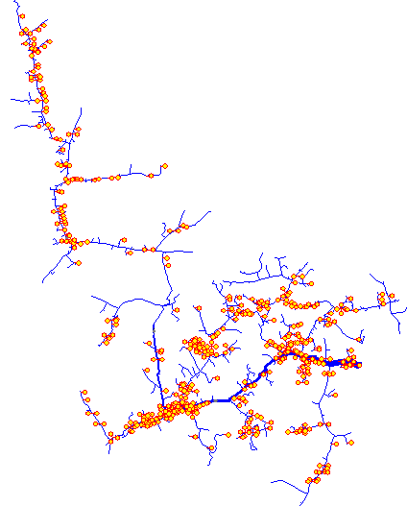
Daily energy and voltage regulation at end user – EPRI Analysis
Volt-Var Control
Solar Rooftop PV
Customer Load
Q1
Customer PV
Capacitive
System Voltage
Solar Rooftop PV
With volt/var control
VARs Generated
Q2
Q3
Inductive
V4
V1
V2
V3
Q4
20% PV
20% PV with
volt/var control
Baseline – No PV
24 Hour Simulation
Source: EPRI “Interconnection Standards in North America” presented 6th International Conference on Integration of Renewable and Distributed Energy Resources November 21, 2014 Kyoto, Japan
Notes:
EPRI studies show that PV with volt/var control can stabilize feeder voltage; but without volt/var control the impact will be “spikey”

Slide 36
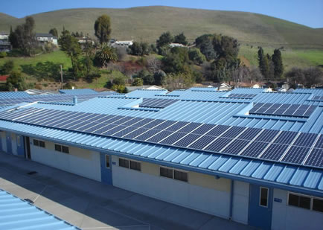
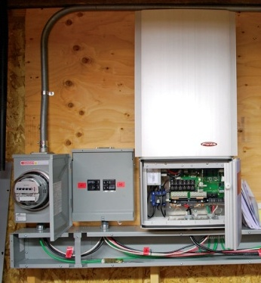
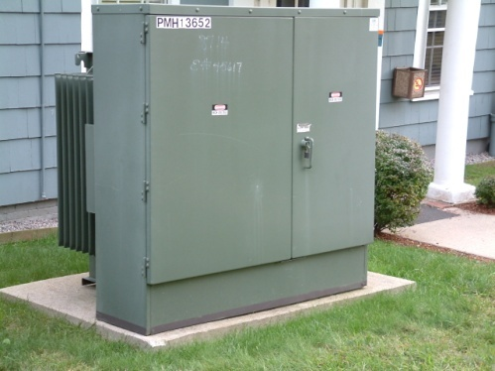
For example a PV system with Smart Inverter
DC Power
AC Power
Traditional Inverter Functionality
Smart Inverter Functionality
Matching PV output with grid voltage and frequency
Providing safety by providing unintentional islanding protection
Disconnect from grid based on over/under voltage/frequency
Voltage Support
Frequency Support
Fault Ride Through (FRT)
Communication with grid
Source: EPRI “Interconnection Standards in North America” presented 6th International Conference on Integration of Renewable and Distributed Energy Resources November 21, 2014 Kyoto, Japan

Slide 37
BUT: Solar/Storage Very Strong Growth Outlook, even as
Subsidies Likely to Fall Later in the Decade
1. Looking forward to 2020, with lower solar PV capital costs, solar would be competitive in many US states even without subsidies.
2. The long-term addressable solar market in the US is larger than appreciated. With only 10% federal Investment Tax Credit (ITC) and solar customers paying 50% of a typical fixed grid charge, we see a US commercial and residential solar market of ~265 GW.
3. The household market for solar panels is dependent on two key factors: net metering rules and the 30% solar Investment Tax Credit (ITC). Currently, distributed generation customers can eliminate all or most of their power bill in 43 states by using distributed generation, including the part associated with utilities’ investments in providing a reliable grid; this net metering approach will in our view likely change over time.
4. Projected decrease in costs of batteries and distributed generation could significantly disrupt the relationship between utilities and their customers in
states with high utility rates and favorable sun conditions. Over time, many US customers could partially or completely eliminate their usage of the power grid. We see the greatest potential for such disruption in the West, Southwest, and mid-Atlantic. However, utilities in some regions could adapt to distributed generation to
minimize the impact on shareholders.

Slide 38
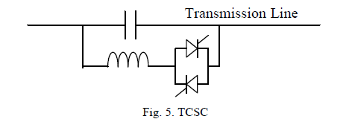
New Transmission/Distribution Technologies on edge of acceptance
Adjustable Impedance of transmission lines – Already in existence in ERCOT with switched inductors on transmission lines. Companies such as “smartwire” are trying to commercialize this technology with remotely controlled inductors bolted onto lines which may be switched on and off.
Switched Series Capacitors
Phase shifting transformers
Distribution automation – remote control and monitoring of distribution circuits
Transmission/Distribution Technologies probably cost prohibitive
Universal Power Controller
SEN transformer
Thyristor Controlled series capacitor

Slide 39
ERCOT Innovation which supports new resources
Open transmission Access
Correct Scarcity Pricing (ORDC) – Adjustment of energy pricing to reflect risk of shortage
Efficient dispatch of system through Energy only design, efficient hedging, LMP & Dynamic line ratings & Automated Special Protection Schemes
Transparent forecasting of system conditions including Wind Forecast & Wind Ramp forecast & associated processes
  Brattle studies forecasting market i.e. reserve margin
Primary frequency response requirement for wind
Loads in SCED
Emerging Technologies Working group process to address new technologies concerns
Notes:
Other items
Procedures to deal with changing wind conditions
Automated special Protection Schemes
Weekly model development and implementation
Congestion Revenue Rights – hedging and price protection
Series Compensated transmission
Sub-synchronous resonance analysis as part of interconnection process
VSS

Slide 40
New Innovation under development supporting renewables
Solar power forecast
Revision of Ancillary Service products Synchrophasors & synchrophasor training (simulator under development)
Multi-interval SCED and real-time co-optimization

Slide 41
Questions?

Slide 42
Questions
Which of the following is a new generation technology set to enter the ERCOT market?
  Photovoltaic
  Battery Storage
  Larger Wind Turbines
  All of the above

Slide 43
Questions
Which of the following is a barrier to one or more of the new generation technologies that are set to enter the ERCOT market?
  High return on investment
  Low Installation Cost
  Low Electricity Prices
  All of the above

Slide 44
Questions
Which economic factor could speed the acceptance of the new generation technologies?
  The abundant supply of cheap nuclear power
  Higher solar PV capital cost
  Eliminating the Solar Investment Tax Credit
  The projected decrease in costs of batteries

Slide 45
Questions
Which technological difficult could prevent the widespread penetration of the new generation technologies?
  Frequency-watt control
  Voltage regulation and reactive support
  Eliminating the Solar Investment Tax Credit
  All of the above

Slide 46
Questions
Which of the following is a new transmission or distribution technology on the edge of acceptance in the ERCOT market?
  Adjustable Impedance of transmission lines
  Switched Series Capacitors
  Phase shifting transformers
  All of the above

