Slide 1
Operating Reserve Demand Curve
John Dumas
Director of Wholesale Market Operations
ERCOT

Slide 2
Objectives
Identify the System Wide Offer Cap price that became effective on June 1, 2014.
Identify the NPRR that implemented the Operating Reserve Demand Curve (ORDC)
Identify what the Value of Lost Load is in ERCOT.
Identify the On-Line Adder for On-Peak of August 2014

Slide 3
ERCOT Market
High Level Market Design
Energy Only
Voluntary Day-Ahead Market
Co-optimizes energy and reserves hourly for next day
Real-Time Market
5-minute nodal pricing
15-minute settlement
Semiannual and Monthly Congestion Revenue Rights (CRR) Auctions

Slide 4
Summary of Nodal Policy Changes
Established Offer Floors for Non-Spinning Reserve, Responsive Reserve & Regulation Up Reserve
NPRR 426, 427, & 428 (effective January 2012)
System Wide Offer Cap raised to
$4,500/MWh effective Aug 1, 2012
$5,000/MWh effective June 1, 2013
$7,000/MWh effective June 1, 2014
$9,000/MWh effective June 1, 2015
NPRR 568 & 598
Implemented an Operating Reserve Demand Curve (ORDC) with the Value of Lost Load equal to $9,000/MWh effective June 1, 2014
Removed Offer Floors for Responsive Reserve & Regulation Up Reserve and updated the one for Non-Spinning Reserve to $75/MWh

Slide 5
Exercise
The marginal cost of energy in ERCOT is currently $0.05/kwh
ERCOT will run out of reserves in 30 minutes due to expected demand increase
We need to curtail 75% of the homes in order to cover peak
What are you willing to pay in order to not be interrupted?
Current ERCOT Generation

Slide 6
The Operating Reserve Demand Curve (ORDC)
VOLL
VOLL = Value of Lost Load

Slide 7
ORDC and Resource Adequacy
Can a generator make money selling energy at cost without appropriate scarcity pricing mechanism?
ORDC provides revenue to generators above their fuel costs
ORDC appropriately prices system conditions
Provides incentive to generate during scarcity
Provides incentive to reduce consumption during scarcity
Expected Reserve margins per the Brattle study
10.2% economic optimum
11.5% in equilibrium of current energy market design (minimizes customer cost)
14.1% required to meet 1-in-10 reliability standard

Slide 8
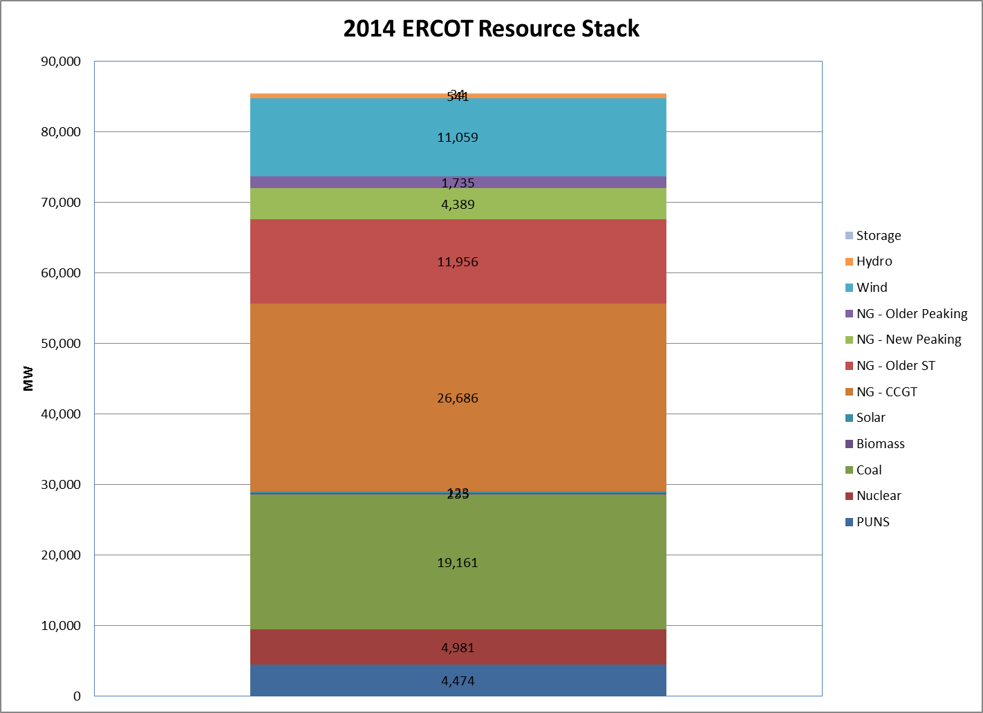
Fleet Flexibility in ERCOT (2014)
Plenty of Wind, but also…
44,800 MW of Natural Gas
Generation

Slide 9
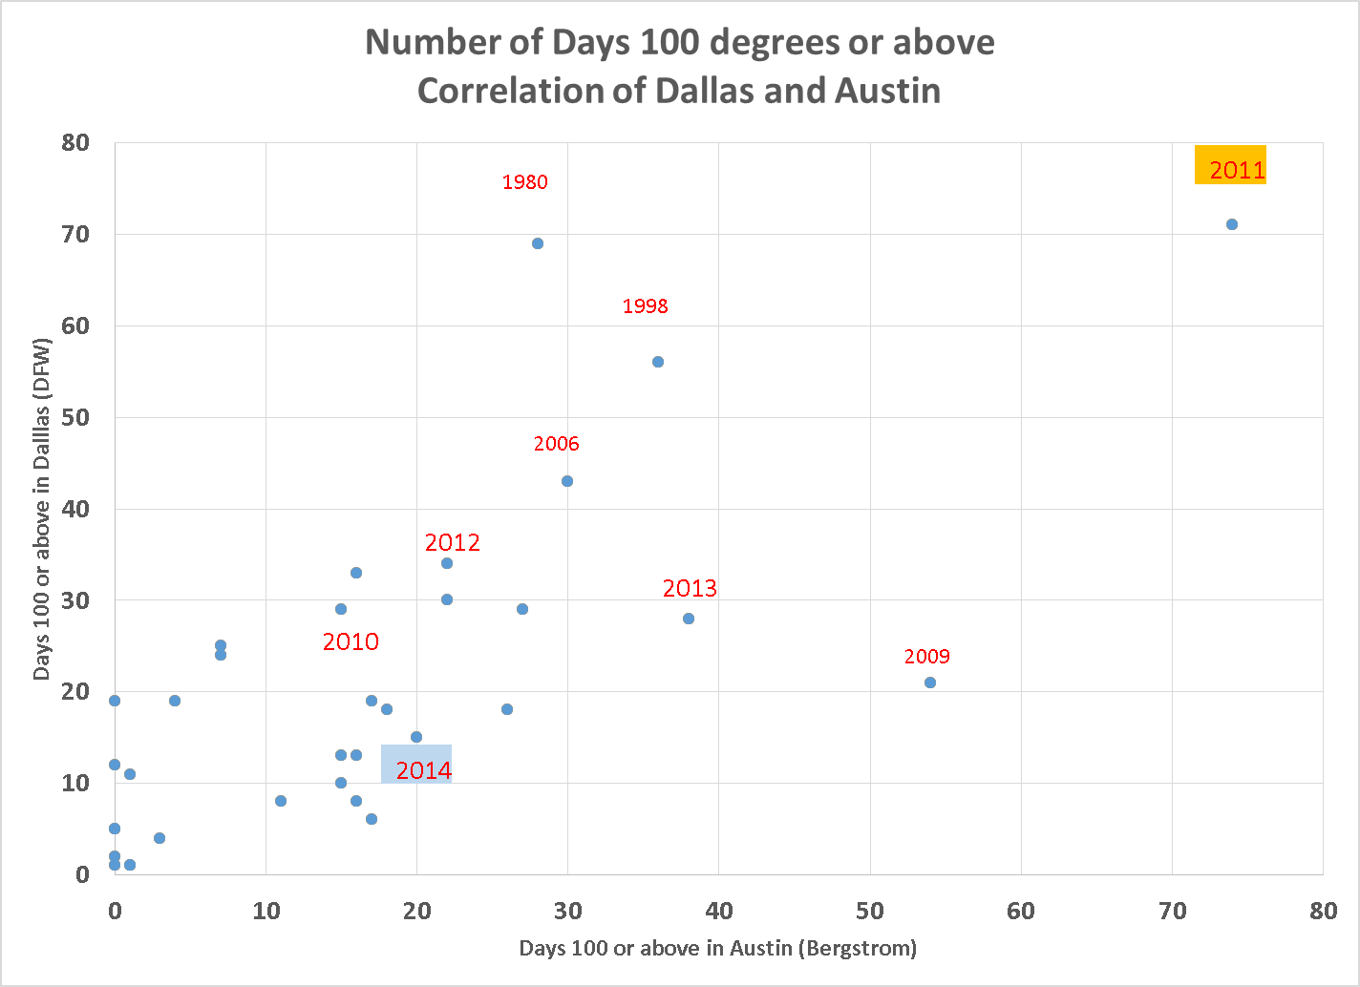
Weather

Slide 10
Operating Reserve Demand Curve (ORDC) – How did it perform this summer?
Average Monthly On-Peak Prices | System Lambda ($/MWh) | On-Line Reserve Price Adder ($/MWh) | Off-Line Reserve Price Adder ($/MWh)
June-2014 | 40.54 | 0.043 | 0.010
July-2014 | 38.45 | 0.157 | 0.038
August-2014 | 41.37 | 1.093 | 0.586
Average Monthly Off-Peak Prices | System Lambda ($/MWh) | On-Line Reserve Price Adder ($/MWh) | Off-Line Reserve Price Adder ($/MWh)
June-2014 | 31.93 | 0.003 | 0.000
July-2014 | 29.55 | 0.038 | 0.008
August-2014 | 30.73 | 0.265 | 0.105
Notes:
maximum RTORPA of $304.34/MWh happened at 14:30 of 8/4/2014.
Aug avg 0.64
292k -11k = ~281k payment

Slide 11
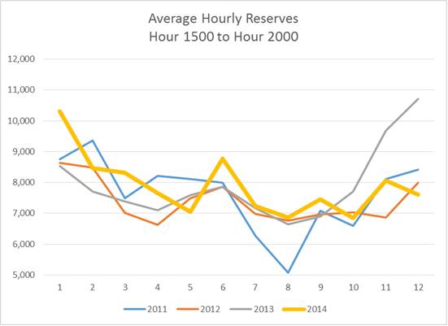
Average Hourly Reserves

Slide 12
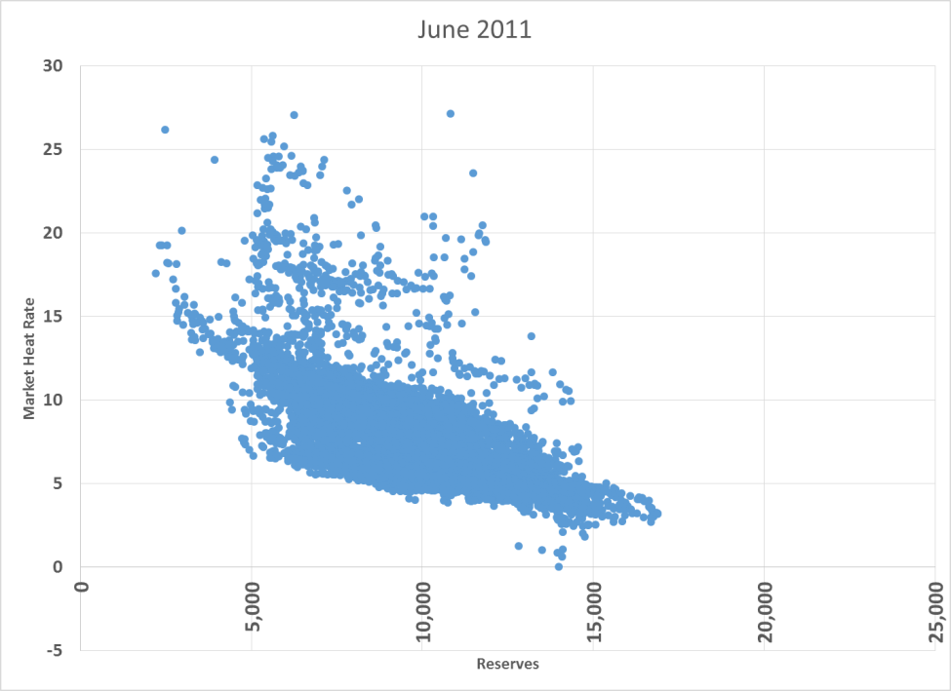
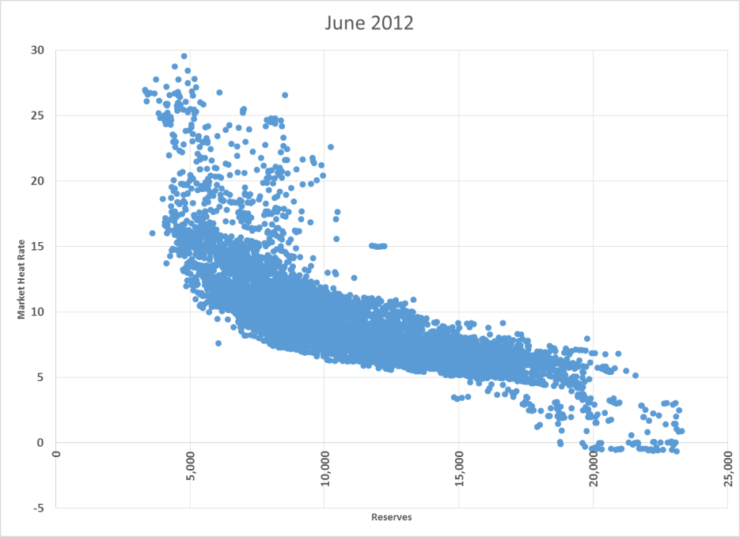
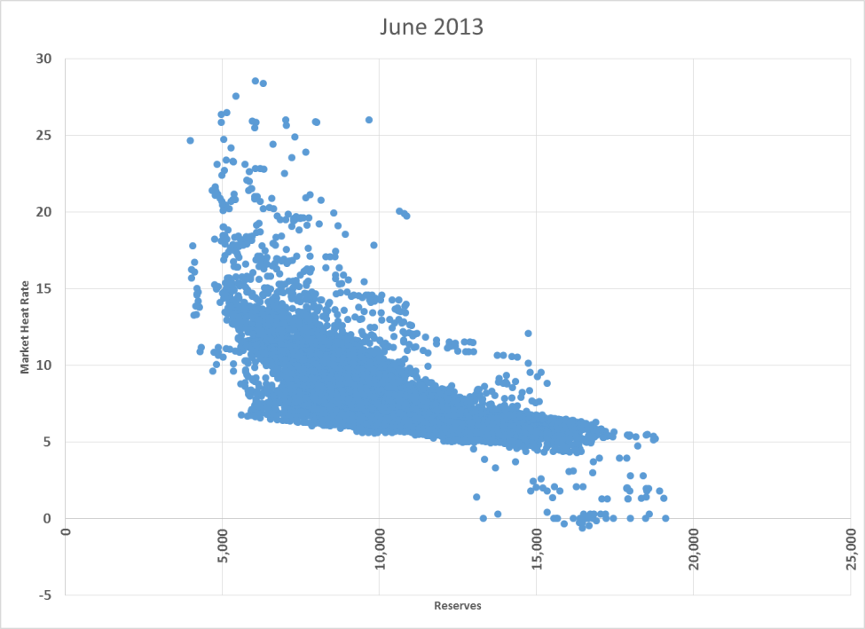
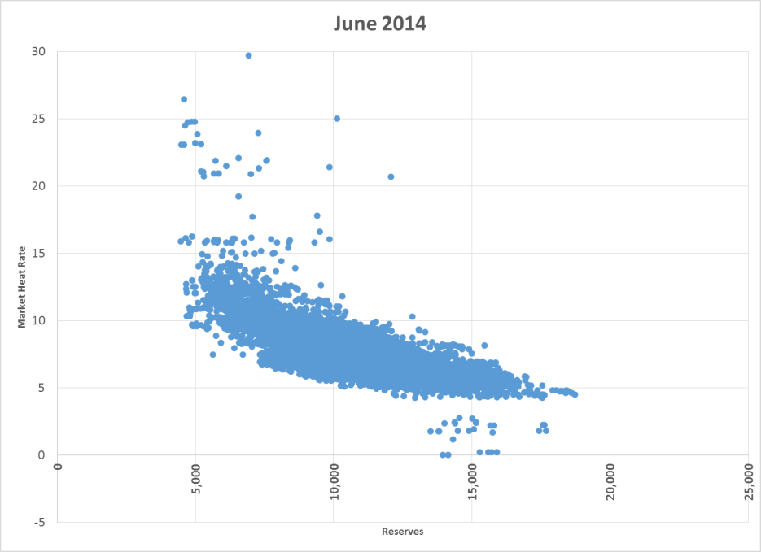
Market Heat Rate and Reserves – June 2011 to 2014

Slide 13
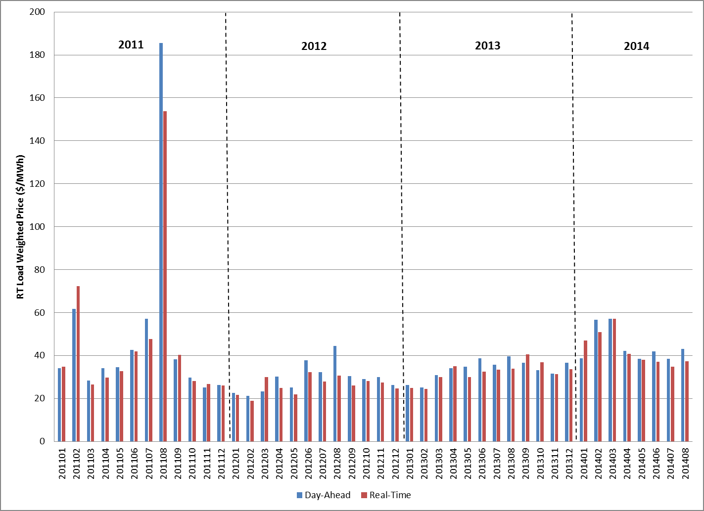
Monthly Average Hub Price

Slide 14
Summary
System Wide Offer Cap price is changing from $7,000/MWh to $9,000/MWh on June 1, 2015.
A new scarcity pricing mechanism using Operating Reserve Demand Curve (ORDC) based on Value of Lost Load of $9,000/MWh was implemented this summer which created pricing consistent with the system conditions this summer and fall.

Slide 15
Questions
Which of the following is the System Wide Offer Cap price that became effective on June 1, 2014?
$4,500
$5,000
$7,000
$9,000

Slide 16
Questions
Which NPRR implemented the Operating Reserve Demand Curve (ORDC)?
NPRR 428
NPRR 568
NPRR 598
Both b & c

Slide 17
Questions
3. A generator can make money while selling energy at cost without appropriate scarcity pricing mechanism.
True
False

Slide 18
Questions
The average On-Line Adder ($/MWh) for On-Peak of August 2014 was roughly?
0
1
10
100

