Slide 1
Operational Communications and Coordination:
Real World Experiences
2015 ERCOT
Operator Training Seminar

Slide 2
Objectives
Describe how ineffective communications effect the power system
Describe the steps in effective 3-part communications
Assess effective communication techniques
Utilize and discuss examples of communications from recent events
Recognize how variables in a mitigation plan are addressed in an example of a declared emergency and the importance of critique and feedback on the plan and its execution.
Assess how declaration of an emergency condition may impact normal operations processes in progress

Slide 3
Why Do We Need Effective Communication?
Many of the tasks performed by System Operators involve communication with others.
  Poor communications jeopardize safety, reliability, and/or the economy of the power system.
  Many problems are the result of inadequate or ineffective communications.

Slide 4
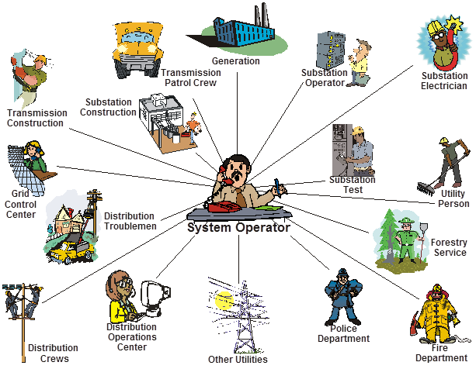
The System Operator World

Slide 5
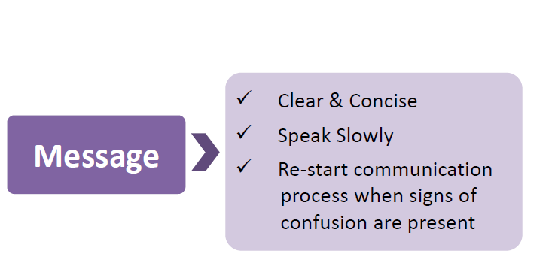
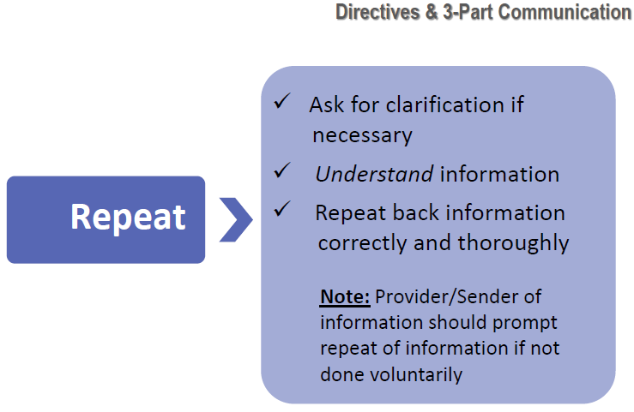
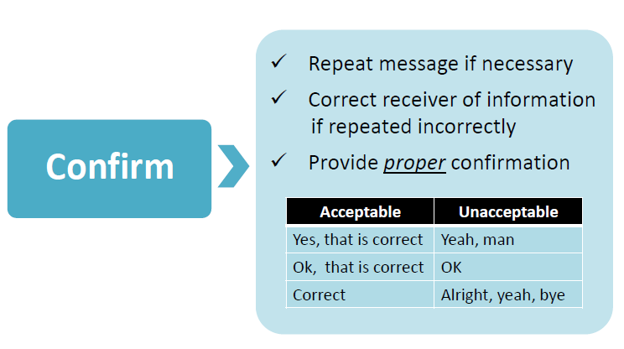
Directives and Three-Part Communication
Recipient
System Operator
System Operator

Slide 6
Techniques for Effective Communication
Plan the message and communication
Focus on critical content to be communicated
Be precise and to the point
Be confident and speak with authority
Speak in a tone of voice that reinforces content of message
Do not interrupt message
Eliminate distractions during message exchange
Avoid words with more than one meaning or are open to interpretation
Avoid long words and rambling phrases
Avoid slang
Avoid low volume or poor enunciation
Always repeat name of equipment or action if there is any doubt
Use approved format, terminology and nomenclature
If you don’t understand, ask for clarification

Slide 7
Actual Event Discussion
Play back of actual recorded conversations during events
  Company names, Operator names, and substation/generator names have been changed to protect the innocent (and not so innocent)
For each call, consider the following questions:
  Was proper 3-part communication used?
  Was the request or instruction clear?
  What was done well?
  How could the communication be improved?

Slide 8

Example: Hotline Call with Repeat Back
Roles
  Resource entity
  Local transmission operator
  QSE
  ERCOT
Clarity about emergency conditions
  Instruction characteristics
  Helping out with communications from both sides
  Discussion
  Was proper 3-part communication used?
  Was the request or instruction clear?
  What was done well?
  How could the communication be improved?
Audio #1
Notes:
Hotline Call Script
RC Operator: This call requires everyone to remain on the line until it is complete. ABC Transmission, I will be asking you for the repeat back. This is RC Operator Smith, at 06:30, the RC is declaring EEA 3. The RC is directing all Transmission Operators to shed their share of 500 MW. Transmission Operators are to report to the RC when this is complete. ABC Transmission, please repeat this back to me.
Operator #1: I didn’t get it all (static). Can you repeat it back?
RC Operator: That’s fine. At 06:30, the RC is declaring EEA 3. The RC is directing all Transmission Operators to shed their share of 500 MW. Transmission Operators are to report to the RC when this is complete.
Operator #1: I understand at 06:30 (static), the RC is (static) EEA3. (Static) all Transmission (static) MW. Transmission Operators are (static).
RC Operator: That is correct.

Slide 9
Example: Load loss due to outage coordination error
Audio #1
Audio #2 (~ 15 minutes later)
  Discussion
  Was proper 3-part communication used?
  Was the request or instruction clear?
  What was done well?
  How could the communication be improved?
Notes:
Outage Event Script:
Call #1
Operator #1: System Operations, this is Smith.
Operator #2: This is Jones with XYZ Transmission, we’re going to start switching at Substation #1 for the autotransformer that goes to line #2
Operator #1: OK
Operator #2: Thank you sir
Operator #1: Thank you
Call #2 (~ 15 minutes later)
Operator #2: Operations, this is Jones.
Operator #1: Yes sir Jones, the Operator Smith with ABC Transmission. Ya’ll just switched out that transformer at Substation #1, and by doing that ya’ll dumped all my load at Substations #2, #3, #4, and #5 area. We had to have a breaker open for a contingency and I don’t know how all this got through the outage scheduler, but, is there any way ya’ll can put that back in?
Operator #2: I will call them right now to tell them to put the transformer back in service.
Operator #1: All right, Thank you sir.
Operator #2: And your name once again?
Operator #1: Smith
Operator #2: All right, thank you.

Slide 10
Example: TO Communication with Generators
Roles
  Resource entity
  Local transmission operator
  QSE
  ERCOT
Clarity about intent
  Instruction characteristics
  Helping out with communications from both sides
Use of slang
  “Take your unit to the top”
  “Put your unit to bed”
Examples from events

Slide 11
Example: Generation voltage support
Audio #1
Audio #2 (Same plant and TO, ~ 2 minutes later)
Audio #3 (different plant and TO)
  Discussion
  Was proper 3-part communication used?
  Was the request or instruction clear?
  What was done well?
  How could the communication be improved?
Notes:
Call #1
Operator #1: Generation desk, this is Smith
Operator #2: Smith, you have the XYZ units?
Operator #1: Yes sir
Operator #2: I need you to run your units to the top
Operator #1: Can I get your name?
Operator #2: This is Jones at ABC Transmission
Operator #1: OK Jones, we will run our units to the top.
Operator #2: As soon as possible
Operator #1: All right
Operator #2: Thank you
Call #2 (~ 2 minutes later)
Operator #1: Generation desk, this is Smith
Operator #2: Smith, this is Jones again at ABC Transmission
Operator #1: Yes sir
Operator #2: On those XYZ units, if you could, go in the lag as far as you can, need as much voltage support as you can provide.
Operator #1: On all units?
Operator #2: Yep, everything you got.
Operator #1: OK
Operator #2: Thank you
Call #3 (different plant and TO)
Operator #1: This is Smith
Operator #2: Yes Jeff, this is Jones at XYZ Transmission, do you have the ABC generation units?
Operator #1: Yes that’s correct
Operator #2: We’ve got some voltage issues down there right now, could you call those generation units and get them to maximize their voltage output?
Operator #1: OK, hold on just a minute and let me get a pen and paper. (pause)
OK, what was your name, Jones?
Operator #2: Yes, Jones at XYZ Transmission
Operator #1: OK, you want us to maximize voltage outputs at our ABC units. Let’s see, right now we’re at 141
Operator #2: Yes, if they can get that up to 143 to 143.5 and maintain that please
Operator #1: OK, you want us at 143.5. OK, and this is due to an emergency, is that correct?
Operator #2: Yes, we had a contingency in the area and the voltage is at a critical level, so if they could maintain at 143.5
Operator #1: OK, I gonna repeat this back. At 1408, Jones called from XYZ transmission, requesting max voltage output on ABC generation units, looking for us to go to 143.5, this is per a voltage emergency contingency in the area.
Operator #2: That is correct
Operator #1: OK, we’ll get on it right away
Operator #2: Thank you

Slide 12
Example: Excellent Call Example
Audio #1
  Discussion
  Was proper 3-part communication used?
  Was the request or instruction clear?
  What was done well?
  How could the communication be improved?
  Conclusions
  Proper 3-part communication was used
  The instruction was clear and authoritative
  Instruction was clarified when necessary
Notes:
Excellent Call Example from Valley load shed event on 10/8/2014
Operator #1: ABC Transmission, this is Smith.
Operator #2: Smith, this is Jones at ERCOT.
Operator #1: Yes sir
Operator #2: Here at 1647, ERCOT is giving you a directive to shed your share of 200 MW in the Valley area (pause), shed your load west of Rio Hondo sub
Operator #1: OK, just to let you be aware of, off of those stations, without shedding our undervoltage load…
Operator #2: Yeah, keep those on
Operator #1: We can only shed 35 MW
Operator #2: Perfect, that would be fine, get the rest on the other side
Operator #1: Over on the Rio Hondo side
Operator #2: Yes
Operator #1: OK, I understand at 1647, Jones with ERCOT is issuing a directive for ABC Transmission to shed our share of 200 MW in the Valley
Operator #2: That’s correct
Operator #1: OK, we’ll get it done
Operator #2: Thanks

Slide 13
Multiple Mitigation Plans in One Area
Example – from Valley load shed event
  Two existing Mitigation Plans for Valley area
  One TOAP for ongoing outage in eastern Valley area
  All called for load shed under certain contingencies
Clarity about plan documents
  Identification
  Modifications
  Various versions and dates
  Communicate specifically on which plan is being executed
Importance of critique and feedback on the plan and its execution

Slide 14
Emergency Condition Impact on Normal Operations
How does an emergency declaration affect normal operations in progress?
Assess how declaration of an emergency condition may impact normal operations processes in progress
Example: Emissions limitations in an Emergency
  Generation in areas with emissions limitations must balance TCEQ and ERCOT needs
  QSEs and ERCOT are in the middle
  TCEQ makes the call based on ERCOT’s initiative

Slide 15
TCEQ Air Emissions Enforcement Discretion Steps during an ERCOT EEA
ERCOT makes Hotline call to declare EEA
Qualified Scheduling Entity (QSE) or Resource contacts TCEQ about emissions exceedances during the emergency
EXCERPT FROM ERCOT MARKET NOTICE M-C041114-01, April 2014:
…If/when increased generation is requested during EEA events, the agency [Texas Commission on Environmental Quality, TCEQ] will exercise enforcement discretion for exceedances of emission and operational limits of power generating plants for Generators who exceed air permit limits in order to maximize generation for the duration of the EEA event.
Any Generator who will exceed its air permit limits during the EEA event should provide a notice of this action to Kelly Cook (kelly.cook@tceq.texas.gov), Director of Critical Infrastructure Division (preferably by email). Unless ERCOT or TCEQ provides Notice otherwise, the period of enforcement discretion will end when ERCOT declares that it is no longer in EEA status.
Notes:
If ERCOT is in an EEA status, and ERCOT receives communications from QSEs regarding emissions limitations preventing them from meeting ERCOT dispatch instructions, then the following occurs:
ERCOT contacts TCEQ [Homeland Security Coordinator or Director of Critical Infrastructure] to notify them that ERCOT is in an Emergency and is requesting air permitting requirements enforcement discretion.
Upon receiving TCEQ’s [Office of Compliance Enforcement] response to ERCOT’s generic request to consider enforcement discretion on air emissions, ERCOT will then make Hotline call to QSEs letting them know that TCEQ is accepting enforcement discretion requests from QSEs.
ERCOT will also state [on Hotline call] that QSEs must individually contact TCEQ (http://www.tceq.texas.gov/assets/public/response/power-emergency/enforcement-discretion.pdf) by phone or email to request the discretion for their particular unit(s).
TCEQ will consider and reply to QSEs on questions/discretion requests.
Unless ERCOT or TCEQ provides Notice otherwise, the period of enforcement discretion will end when ERCOT declares that it is no longer in EEA status.
QSE contacts ERCOT about emissions limitations
ERCOT contacts TCEQ* (Homeland Security Coordinator or Director of Critical Infrastructure)
ERCOT receives TCEQ’s response
ERCOT makes Hotline call to QSE
ERCOT advises QSE to individually contact TCEQ to request discretion
TCEQ responds to QSE
ERCOT declares end to EEA status
The period of enforcement discretion ends

Slide 16
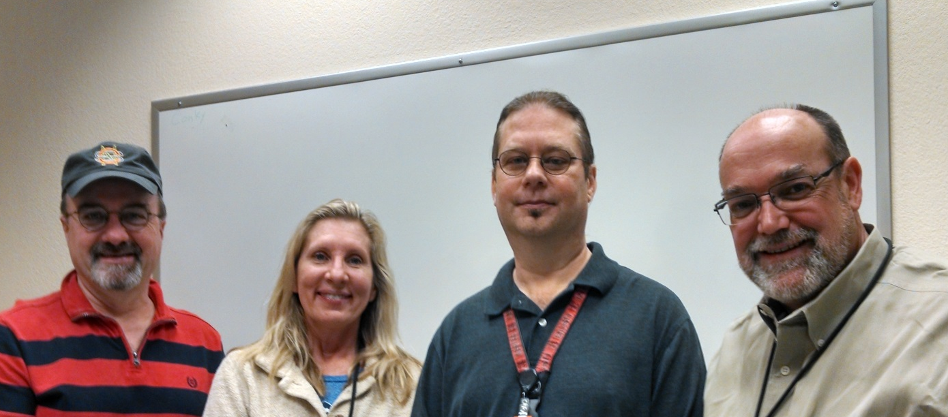
Questions?
Special Thanks to our Guest Voices: (L-R) John Jameson, Joan Wise, James Stone and Kelly Blackmer

Slide 17
Exam
Please turn your iClicker on and answer each of the following questions.

Slide 18
Question #1
Poor communications can ____________.
Jeopardize safety
Increase system reliability
Improve operator morale
Reduce cost
All of the above

Slide 19
Question #2
Effective three-part communication involves which of the following?
Use of well-known slang terms
Speaking quickly to get the information out
Re-starting the process if there is confusion
Repeating back only the main points
All of the above

Slide 20
Question #3
Techniques for effective communication include which of the following?
Interrupting to ask questions
Multi-tasking during the communication
Using well-known slang terms
Focusing on the critical content
All of the above

Slide 21
Question #4
Who is responsible for notifying the Texas Commission for Environmental Quality on emissions exceedances for a specific generation facility during an ERCOT-declared EEA?
ERCOT
Qualified Scheduling Entity or Resource Entity
Environmental Protection Agency
North American Electric Reliability Corporation
None of the above

