Slide 1
Energy & Market Management System
(EMMS)
Support Model & Processes
Steve White
Manager, EMMS Production Support

Slide 2
Upon completing this course of instruction, you will
Recognize the EMMS Support Model and Control Room Operations Support.
Understand QSE/TSP Telemetry Data Flow to EMMS Applications and EMMS Applications Data Flow to QSE.
Recognize Telemetry issues impact on EMMS Applications.
Identify the EMMS Network Model Update Process and look at TSP/QSE Model Load delay impacts on Grid Reliability.
Understand the EMMS Site Failover Process and Impacts to Grid Reliability/ERCOT Market.
Objectives

Slide 3
EMMS Support Model
&
EMMS Monitoring

Slide 4
Defined Roles
Application changes -Requirements/Design Review
Perform Detailed Applications Testing
Applications Production/Control Room Support
Application Engineers
Review/Support Infrastructure
Software builds
Systems Support
Systems Monitoring
Control Room Support
Systems Analyst
EMMS Production Support
Infrastructure – Current/Future
Systems
Databases
Applications
Systems Monitoring
Application Architect

Slide 5
EMMS Support Model
What we do to support Control Room Operations?
24 X 7 Control Room Support on EMS and MMS Applications
Weekly Network Model Load (DBLOAD) /DPC Implementation
Site Failover / Disaster Recovery
EMMS Support Model
For
Control Room Operations
Control Room EMMS workstations Support
Operator Training Simulator and Macomber Map Support
QSE Resources AS Qualification Testing Support to Control Room

Slide 6
EMMS Support Model
How is EMMS Production Group alerted to EMS & MMS Application Issues/Incidents related to Control Room?
Control Room Operators Contacts EMMS Prod On-Call
EMMS Monitoring
EMMS Monitoring
Enables EMMS Production to provide faster resolution to Production issues.
EMMS Production alerted to possible production issues and resolves them before Control Room Operators experience the issue.
Goal is to identify an Issue before it becomes an Incident.

Slide 7
EMMS Monitoring
Monitoring
Server
Unreachable
Memory/CPU
Disk Space
Back-up Status
Database
Memory/CPU
Table Locks
Long Execution Queries
Archive Logs
Replication Lags
Application
Execution Delay
Log Errors
Data Flow Delay
Input Data Quality
Results Validation

Slide 8
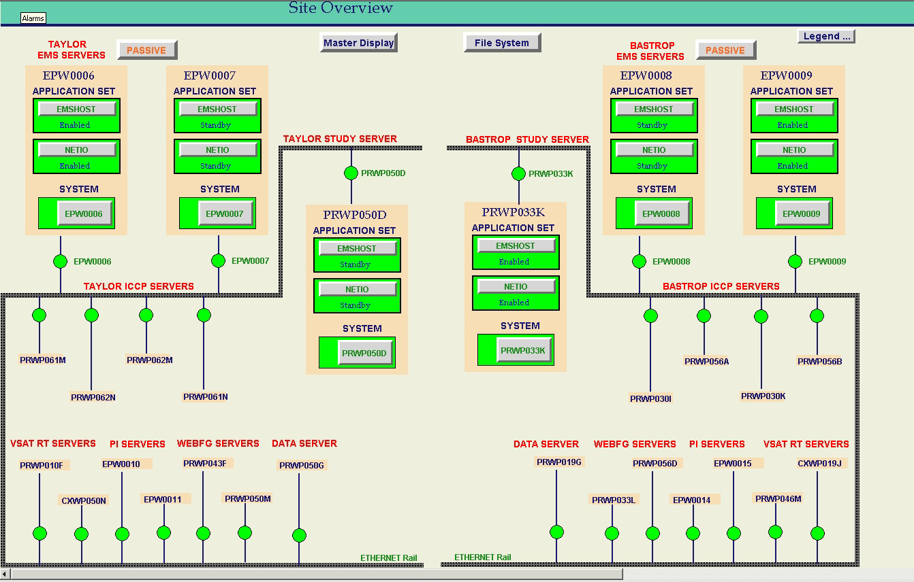
EMMS Monitoring - EMS System Site Overview
Help desk contacts EMMS Production On-Call if any one of the component turns Red

Slide 9
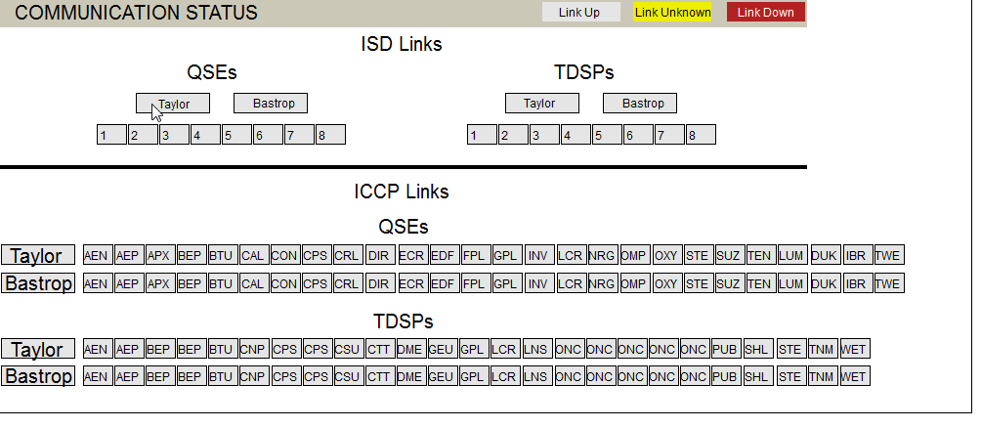
EMMS Monitoring - ICCP Communication Status
Control Room Operator or Help desk contacts EMMS Production On-Call if any one of the TSP/QSE links are down.

Slide 10
QSE/TSP Telemetry Data Flow to
EMMS Applications
&
EMMS Applications Data Flow to QSE

Slide 11
EMS Applications – Used by Control Room Operators
Inter-Control Center Communication Control Protocol (ICCP):
Application used to send and receive Telemetry data to Market Participants from and to EMS System.
Supervisory Control and Data Acquisition (SCADA):
Scans the telemetry Analog and Status points from ICCP every 2 seconds
Performs the data quality and reasonability checks.
Provides telemetry data to EMS Applications.
Load Frequency Control (LFC):
Executes every 4 seconds,
Controls Grid Frequency Control
Deploys Regulation, Responsive Reserves
Performs Ancillary Service Capacity Monitor Calculations (Physical Responsive Reserve, RRS Capacity etc.) every 10 seconds.
Resource Limit Calculator (RLC):
Executes every 4 seconds
Calculates Generation To Be Dispatched (GTBD) based on Generating Units Telemetered Current Generation, next 5 minute Load change and Regulation deployed value.
Calculates Resource High/Low Ancillary Service Limits (HASL/LASL), High/Low Dispatch Limits (HDL/LDL), SCED Up/Down Ramp Rates based on the Telemetered High/Low Sustainable Limits (HSL/LSL), Telemetered Ancillary Service Responsibilities and Schedules.
Limits are used in Real-Time Security Constraint Economic Dispatch (SCED) Application.

Slide 12
EMS Applications – Used by Control Room Operators
State Estimator (RTNET):
Executes every 5 minutes determines the real-time network electrical state based on real-time network model, Telemetered SCADA Analog, Status Points data, operator entries.
Detects errors in measurements and models, to the extent possible, maintains statistics, this information is available for system operators and network analysis applications (real-time contingency analysis, dynamic studies, study network analysis etc.).
Real-time Contingency Analysis (RTCA):
Executes every 5 minutes following the State Estimator completion.
Performs power flow analysis on the real-time network model for base case as well as defined N-1 Contingencies and detects the voltage violation, MVA overloads.
RTCA presents the base case/contingency violations information to Control Room Operators.
RTCA also calculates the Units and Loads shift factors for each violation during each run.
Transmission Constraint Manager (TCM):
TCM Application provides a user interface to the Control Room and displays Transmission Lines/Transfers/ZBR/Interfaces real-time base case/Contingency violations (constraints) and corresponding violations shift factors.
Control Room Operators activate the constraints to Real-Time Security Constraint Economic Dispatch (SCED) Application to resolve violations based on the overload percentage and constraints shift factors data.
TCM application executes after RTCA has completed with a Valid Solution and captures all the required violations data and corresponding violation shift factors from RTCA.

Slide 13
EMS Applications – Used by Control Room Operators
Load Forecast (LF):
LF performs Short Term Load Forecast (STLF), Mid Term Load Forecast (MTLF).
STLF executes every 5 minutes and provides next 12 5-minute intervals load forecast, it is used in the Market System Look-Ahead Security Constraint Economic SCED (LA-SCED) application.
MTLF runs every top of the hour and provides the future 7 days hourly forecast, It is used in Market System Hourly Reliability/Daily/Weekly Unit Commitment (HRUC/DRUC/WRUC) applications.
Dynamic Ratings Application (DYNRTG):
It runs every 5 minutes and calculates the Dynamically rated Lines ratings in real-time based on the Telemetered MVA, AMPS,TEMPERATURE and Weather Forecast and updates in SCADA for Real-Time Network Applications use (RTNET/RTCA).
DYNRTG also calculates the next 7 seven days the Dynamically Rated Line ratings based on the next 7 days weather forecast.
Forced Outage Detection (FOD):
FOD Application executes every 10 seconds and reads the real-time topology changes to determine the documented and undocumented outages.
Control Room Operators monitor the unit/load trips using the FOD application displays.

Slide 14
Market Management System (MMS) Applications – Used by Control Room Operators
Security Constraint Economic Dispatch (SCED):
Executes every 5 minutes.
SCED dispatches Generation Resources economically and maintains the system-wide power balance and reliability.
SCED also determines ORDC reserves and ORDC Price Adders.
During Real-Time operations, SCED dispatches Resources to match the system total generation requirement provided by the EMS while observing Resource and Transmission Constraints.
SCED produces the Base Point & LMP for Resources, these data sets are transferred to Market Participants through ICCP.
Reliability Unit Commitment (RUC):
Reliability Unit Commitment (RUC) determines the commitment of the Generation Resources to match the forecasted system demand, and is subject to Transmission and Resource constraints.
RUC commits additional Generation capacity on top of Resources already committed in previous RUCs, Resources that are self-committed in the Current Operating Plans (COPs), and Resource capacity already committed to provide Ancillary Service.
ERCOT performs three RUC Process:
Hourly RUC (HRUC)
Day-Ahead RUC (DRUC)
Weekly RUC (WRUC) - It is used for Study Purpose.

Slide 15
Market Management System (MMS) Applications – Used by Control Room Operators
AS Manager:
Control Room Operators uses AS Manager application to deploy Non-Spin to Generating Units and Load Resources , Responsive Reserve to Non-Controllable Load Resources as well as Emergency Responsive Service (ERS) to ERS Loads.
Non-Spin and Responsive Reserve deployments are transferred to Market Participants via XML deployment messages.
EMS LFC Applications retrieves the Non-Spin and RRS deployments Flag from AS Manager for Ancillary Service monitoring.
Non-spin Deployment flag is sent to QSE’s through ICCP telemetry and QSE’s update the Generating units Telemetered Non-Spin Schedule values.
RRS Deployment flag is sent to QSE’s through ICCP telemetry and QSE’s update the Load Resources Telemetered RRS Schedule values.
Supplemental Ancillary Service Market (SASM):
Control Room Operator executes a SASM during the Adjustment Period to procure additional Regulation Down, Regulation Up, Responsive Reserve, and Non-Spin capacities as required.
Control Room Operator will use SASM to procure Ancillary Services in the Adjustment Period to maintain AS capacity sufficiency for:
Replacement of Ancillary Services capacity that is undeliverable due to transmission constraints.
Replacement of Ancillary Services capacity due to failure to provide.

Slide 16
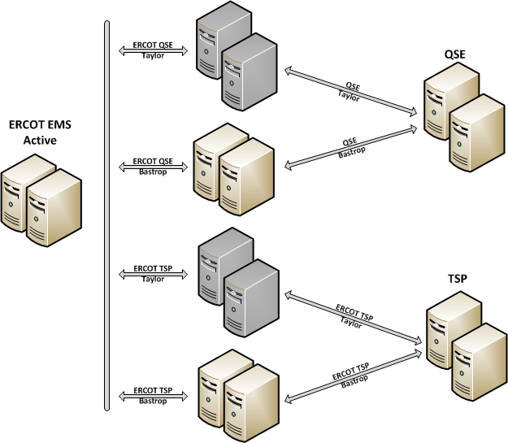
QSE/ TSP ICCP Telemetry Communication to ERCOT

Slide 17
QSE/TSP Telemetry Data Flow to EMS & MMS Applications
EMS Applications
Load Forecasting Application
EMS->MMS Interface
MMS Applications
Security Constrained Economic Dispatch (SCED)
Resource Limit Calculator
QSE/TSP ICCP
(Telemetry)
Load Frequency Control
Ancillary Service (AS) Manager
ICCP
SCADA
State Estimator
Reliability Unit Commitment (WRUC, DRUC, HRUC)
Real-Time Contingency Analysis
Supplemental Ancillary Services Market (SASM)
Transmission Constraint Manager (TCM)
Look Ahead SCED (LASCED)
Dynamic Ratings
Day Ahead Market (DAM)
Forced Outage Detection

Slide 18
QSE/TSP Telemetry Data Flow to MMS Applications
QSE/TSP Telemetry Data to MMS Applications:
EMS Applications validates the QSE/TSP Telemetry Data and transfer to MMS Applications.
EMS Applications performs the calculations based on QSE/TSP Telemetry Data and transfer the calculated data to MMS Applications.
SCED & Look-Ahead SCED:
Receives Generating Units and Controllable Load Resources following telemetered data sets from EMS.
Current Generating /Consuming MW
Resource Status
High Sustained Limit (HSL)
Low Sustained Limit (LSL)
Ancillary Service Responsibilities/Schedules
Receives HDL/LDL, HASL/LASL data from the EMS Resource Limit Calculator Application.
Receives transmission constraints and shift factors data set from the EMS Transmission Constraint Manager Application.
Ancillary Service (AS) Manager:
Receives Generating Unit and Load Resource telemetered data (HSL/LSL, Ancillary Service Responsibilities/Schedules, Resource Status etc.) from Resource Limit Calculator Application.

Slide 19
QSE/TSP Telemetry Data Flow to MMS Applications
Reliability Unit Commitment (RUC):
Receives Load Forecast from EMS Load Forecasting Application
EMS Load Forecast Application uses Generating Units and Tie Lines Telemetered MW in forecasting calculations.
Receives Generating Units Online/Offline Hours from EMS Forced Outage Detection Application
EMS Forced Outage Detection Application determines the Generating Units Online/Offline Hours based on the Generating Units Telemetered Resource Status and MW.
HRUC receives First Hour Breaker Status from EMS.
SASM/DAM:
Receives Generating Units Online/Offline Hours from EMS Forced Outage Detection Application
EMS Forced Outage Detection Application determines the Generating Units Online/Offline Hours based on the Generating Units Telemetered Resource Status and MW.

Slide 20
EMMS Applications Data Flow to QSE
MMS Applications
EMS Applications
Security Constrained Economic Dispatch (SCED)
SCED Base Points and LMPs
Resource Limit Calculator (RLC)
SCADA
ICCP
QSE ICCP
(Telemetry)
RRS and Non-Spin Deployment Flag
Load Frequency Control
(LFC) –Regulation/RRS Deployments to QSE
Ancillary Service (AS) Manager
Non-Spin and RRS Deployment Instructions
Reliability Unit Commitment (DRUC, HRUC)
ERCOT TIBCO Web Service
RUC Commitment Instructions
QSE
Market Interface (Web Service)
Supplemental Ancillary Services Market (SASM)
SASM AS Awards Instructions
QSE – Manual Down Load of ERCOT Instructions
Electronic Dispatch Instructions
(VDI)
ERCOT Market User Interface (MMS UI)

Slide 21
QSE/TSP Telemetry Issues -
Impact on EMMS Applications

Slide 22
QSE Telemetry Issues Impact on EMMS Applications
QSE
Generating Units/Load Resources Telemetry Points
(Good Quality but Invalid Values)
Resource Status (RST)
MW/NPF,
HSL/LSL
Regulation Up/Down, RRS, Non-Spin Ancillary Service Responsibilities/Schedules
Regulation Up/Down Participation Factors
Impacts
Incorrect Resource Online and Offline Hours Calculations.
Invalid RUC Resource Commitments
Units and Load Resource may not be available for Non-Spin/RRS Deployments.
Impacts
Incorrect RLC Dispatch Limits/GTBD Calculations
May lead to SCED Dispatch/Prices issues.
LFC Ancillary Service Monitoring provides incorrect Physical Responsive Capacity, RRS Capacity to Control Room.
LFC Regulation/Responsive Reserve Deployments may not be same as QSE Awarded AS Quantity.
Incorrect LFC Emergency Base Point Deployment.
Invalid Units Non-Spin and Load Resource Deployments.
6. Control Room may not be able to maintain Grid Frequency effectively.
Impacts
LFC - Incorrect Resource Level Regulation Up/Down Deployed calculations.
Incorrect Resources expected Generation Deviations are presented to Control Room.

Slide 23
TSP Telemetry Issues Impact on EMMS Applications
TSP
Transmission Equipment's Telemetry Points
(Good Quality but Invalid Values)
TIE Lines MW
Amps, Temperature,
MVA Rating
CB/DSC Status
Bus Voltage, Line/Transformer Flow, Transformer Taps, Load MW/MVAR,AVR Status
Impacts
Short Term Load Forecast (STLF) generates bad quality forecast
Impacts Mid Term Load Forecast (MTLF) Quality
Incorrect LFC Load Area Calculations.
Impacts State Estimator Solution Quality.
Impacts
Real-time Dynamic Ratings may be inaccurate.
False Transmissions Lines Violations may show up in State Estimator/Real-Time Contingency Analysis
Impacts
State Estimator/Real-Time Contingency Analysis may not solve or solution quality will be impacted.
Transmission violations Shift Factor values may be incorrect.
May lead to SCED congestion management Issues.
Can make HRUC Commitments wrong.
Impacts
State Estimator/Real-Time Contingency Analysis may not solve or solution quality will be impacted.
Impacts Voltage and Stability Limit Calculations.

Slide 24
QSE/TSP Telemetry Issues Impact on EMMS Applications
QSE/TSP Telemetry Issues impacts directly or indirectly all EMS and MMS Applications.
Load Frequency Control (LFC)
Resource Limit Calculator (RLC)
State Estimator
Real-Time Contingency Analysis
Forced Outage Detection
Dynamic Ratings
Load Forecast
Security Constraint Economic Dispatch (SCED)
Ancillary Service Deployments
Reliability Unit Commitment (HRUC/DRUC)
SASM/DAM
All EMS applications have validation checks for Suspect/Garbage Quality Telemetry.
EMS Applications applies Reasonability Limits if Telemetry Quality is Good but Value is Invalid for Only certain Telemetry Points (Unit MW, HSL/LSL etc.).
It is Highly Critical to maintain the Good Quality Telemetry all the time to maintain the Grid Reliability and avoid impact to Market.

Slide 25
Network Model Update Process
(DBLOAD)

Slide 26
EMMS Model Load Process - DBLOAD
Update EMS, MMS, Outage Scheduler(OS) and PI systems to allow applications to run using a model that is closest to what is out on the Grid.
Network Model includes Network Topology, Resource/QSE, Resource to QSE Relationship changes etc.
EMMS Production creates a Model changes report and the Control Room reviews the model changes.
EMMS Production loads the Network Model into Production EMS/MMS/OS/PI systems at Mid Night on scheduled DBLOAD date.
Network Model Load is performed every week (called Weekly DBLOAD).

Slide 27
TSP
QSE
EMMS Model Load Process
NOMCR
PROCESS
CIM/XML Model
NETWORK MODELING SYSTEM
EMMS Production – Model Load Process
Model Load into
ICCP/EMS/MMS/OS/PI Systems in Model Verification Environment
Model Testing
Of
ICCP/EMS/MMS/OS/PI Applications in
Model Verification Environment
Model Load
into
Production ICCP/EMS/MMS/OS/PI Systems, Applications Verification

Slide 28
QSE Model Load Delays - Impacts to ERCOT Grid Reliability
When are QSE Model Loads expected to happen?
At the same time as the ERCOT Model Load, specifically when Resource to QSE Relationship changes to the Model.
At the same time or prior to the ERCOT Model Load when there are New Resource/QSE Additions in the Model.
What happens if QSE Model Load does NOT execute at the same time as the ERCOT Model load if Model has Resource to QSE Relationship changes?
New QSE will not receive the ERCOT SCED Dispatch Instructions/Regulation Deployments.
Impacts Grid Frequency Control

Slide 29
QSE Model Load Delays - Impacts to ERCOT Grid Reliability
What happens if QSE Model Load does not happen at the same time as ERCOT Model load if Model has new Resource(s)/QSE(s)?
QSE will not receive the resource base point instructions from ERCOT, so resource will not follow ERCOT base point instructions.
Resource may be subjected to Base Point Deviation charges.
Impacts Grid Frequency Control
What happens if QSE Model is Loaded at same time as ERCOT Model load but Telemetry is NOT established for the new Resource(s)?
ERCOT Applications sees Garbage/Suspect Quality telemetry for all analog points (MW, HSL/LSL, Resource Status, Ancillary Service etc.) that may lead to improper SCED dispatch instructions to the resource(s).
Resource may be subjected to Base Point Deviation charges.
Impacts Grid Frequency Control
Can also impact SCED Real-Time Price

Slide 30
TSP Model Load Delays - Impacts to ERCOT Grid Reliability
When are TSP Model Loads expected to happen?
At the same time or prior to ERCOT Model Load specifically when there are significant topology changes (Example: Station Reconfigurations, New Stations etc.)
What happens if TSP Model is Loaded at same time as ERCOT Model load but Telemetry is NOT established for the new network changes?
ERCOT Applications see Garbage/Suspect Quality telemetry.
State Estimator/Real-Time Contingency may not solve.
ERCOT control room will not have visibility into transmission overloads and may not be able to manage transmission congestion effectively.

Slide 31
EMMS
Site Failover

Slide 32
ERCOT’s Data Center Configuration
Taylor
INTERNET
Bastrop
Internet
Firewall
Internet
Firewall
MP WAN Firewall
MP WAN Firewall
MP
WAN
NETWORK & TELECOM
CORE
SWITCH
CORE
SWITCH
DEV
Firewall
TEST
Firewall
PROD
Firewall
EMMS
Firewall
PROD
Firewall
EMMS
Firewall
DEV TEST
PROD EMMS
PROD EMMS
SERVERS
STORAGE
TCC1
TCC3
BCC1

Slide 33
EMMS Site Failover
EMMS Site Failover - Transition EMMS Core systems from one Data Center to another
ERCOT perform EMMS Site Failovers
To practice Disaster Recovery Planning
To perform Patching and Maintenance work on passive site.
EMMS Site Failovers Frequency:
Planned Site Failovers – Quarterly (Planned Site Failovers are NOT scheduled peak Summer Months)
Unplanned Site Failovers - can occur at any time depending on System, Hardware or Data Center issues.
EMS/MMS Systems/Applications down time during Site Failover Transition:
EMS System/Applications - < 2 minutes
MMS System/Applications - 6 to 8 minutes

Slide 34
Site Failover – Impacts to Grid Reliability/ERCOT Market
1 - 2 SCED intervals may not execute during Site Failover Transition.
Emergency Base Points will be activated if SCED does not run for 2 consecutive 5 minute intervals (i.e. when time difference between Last Successful SCED run and Current Time >= 605 Seconds)
Control Room Operator may deploy Emergency Base Points to maintain Grid frequency.
At this time Resources will follow the emergency base point instructions from ERCOT in place of the SCED Dispatch Instructions.
Emergency Base Points will be deactivated once SCED application is running in New Active Site and Control Room operator verifies SCED solution.
ERCOT may perform SCED price correction depending on Emergency Base Point Deployments if required.

Slide 35
EMMS Site Failover– Emergency Base Points
Time difference between Last Successful SCED run and Current Time >= 605 Seconds
Emergency Base Points Flag will be activated automatically
Grid Frequency Deviation within Tolerance?
Yes
Operator deactivates Emergency Base Points Flag when SCED Solution is available in
New Active Site
No
Control Room Operator Deploys Emergency Base Points
Resources follow Emergency Base Points Instructions from ERCOT

Slide 36
Questions?

Slide 37
Questions
Exam
Please turn your iClicker on and answer each of the following questions.

Slide 38
Questions
1. Which one of the following is EMMS Support area for Control Room Operations?
24x7 EMS & MMS Applications Support
Network Model Load
QSE AS Qualification Testing Support
All of the above

Slide 39
Questions
2. Who will receive Resource SCED Base Points from ERCOT EMS ICCP System?
All QSE’s
All TSP’s
QSE who owns the Resource
None

Slide 40
Questions
3. Which one of the following EMMS Applications are impacted by Real Time Telemetry issues?
LFC
SCED
State Estimator
All of the above

Slide 41
Questions
4. How Often ERCOT performs Network Model Updates?
Quarterly
Monthly
Weekly
Annually

Slide 42
Questions
5. How many consecutive 5 minute SCED intervals failures activates Emergency Base Points flag automatically?
3
2
4
1

Slide 43
Questions
6. When QSE/TSP Network Model Load is expected to happen?
After ERCOT Model Load
At same time as ERCOT Model Load
At any time
Never

