Slide 1
ERCOT Demand Response
Spring 2015 ERCOT Operator Seminar

Slide 2
Objectives
Describe the various Demand Response Opportunities available in the ERCOT Region
Understand the amount of Demand Response available to ERCOT for dispatch during emergency conditions
Describe what Weather Sensitive ERS is and why it is important to ERCOT
Understand 4CP load Reduction

Slide 3



Demand Response in ERCOT
Load Resources
  Non-Controllable (NCLR)
  Controllable (CLR)
    Loads In SCED
Emergency Response Service
  10-Minute ERS
  30-Minute ERS
  Weather-Sensitive ERS
TDSP Load Management Programs
Retail Demand Response Products offered through Reps, Munis, and Coops
4CP (Transmission Costs)

Slide 4
DR available for ERCOT dispatch (summer peaks 2014)
Service | MWs | Notes
Load Resources providing Responsive Reserves | ≤1400 | AKA “LaaRs” -- procured on an hourly basis in the Day-Ahead Market for next Operating Day Deployed via 10-minute instruction or instantaneously based on grid frequency Since 4/2012 capped at half of total hourly RRS procurement (2800 MW) Starting June 1 quantities determined in 4 hour blocks, LRs may still provide up to 50% of the requirement
Emergency Response Service (ERS) | ~635¹ | DR and DG assets with 10- or 30-minute ramp periods Also open to weather-sensitive loads such as residential AC aggregations Procured three times per year (4-month strips), with 4 Time Periods within each contract term
TDSP Load Management Programs | ~240 | C&I Loads procured for summer peak hours only Dispatched concurrently with ERS through agreements between ERCOT and TDSPs
2,200+ MW of dispatchable DR: ~ 3.3% of ERCOT summer peak
¹ ERS procurement for Feb-May15 increased to 947 MW

Slide 5
Product types & REP-reported enrollment - Background
ERCOT has been working with LSEs (REPs and NOIEs) to begin tracking growth of retail product offerings for dynamic pricing and other retail demand response incentives
REPs have now provided lists of ESI IDs enrolled in various product types on two snapshot dates:
  June 15, 2013
  Sept. 30, 2014
    After 2013 experience and dialogue with market participants, we concluded end-of-summer snapshot had more value than early summer snapshot

Slide 6
Product types & REP-reported enrollment
Notes:
  170-fold increase in residential Peak Rebate
  115% increase in residential Time of Use
  123% increase in C&I Real-time Pricing
  72% decline in C&I Block & Index Pricing

Slide 7
Response to wholesale price spikes (>$3,000)
Based on 2013 Enrollment Data
Product type | Estimated MW response
Real-time Price + Block & Index | 232¹
NOIE Load Control | 200
Peak rebate | 0.5
Price Response Total | 432.5
(1) Includes an estimate for industrials within NOIE service areas.
NOTES:
Only one settlement interval cleared at $3000 or above in summer 2013; therefore, 2013 results should not be considered a definitive quantification of retail price response capability in ERCOT.

Slide 8
Response during actual and potential 4CP intervals
ERCOT Staff analyses
Customer type | Estimated MW response | ESIIDs responding
IDR transmission connected | 300 - 420 | 70 of 375
IDR distribution connected NWS | 300 | 1,250 of 9,500
IDR distribution connected WS | 30 | 450 of 2,000
NOIE | 200 | ?
4CP Total | 830 - 950 | 1,770 of 11,875
Response in competitive areas is based on August and September 2014 … June and July had uncharacteristically low response.

Slide 9
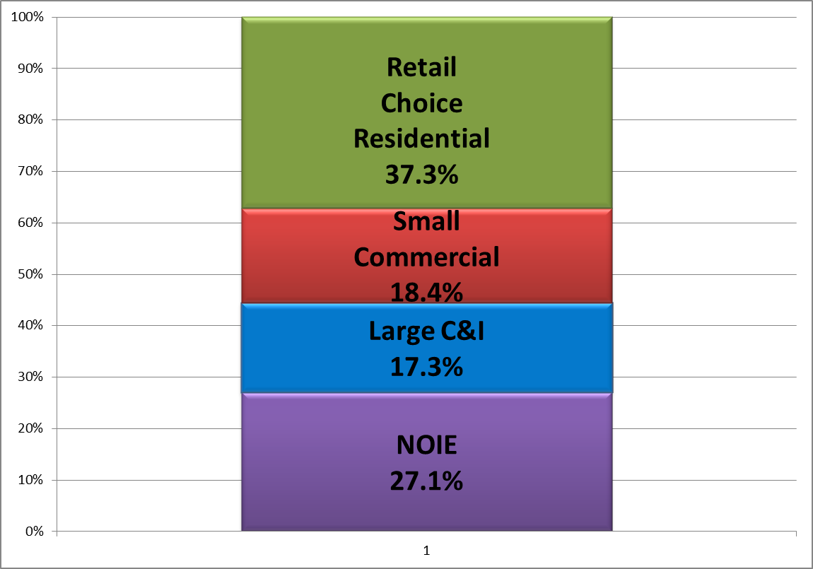
What is 4CP?
The Four Coincident Peaks in ERCOT are the highest-Load 15-minute settlement intervals in each of the four summer months (June, July, August, September)
These intervals are the basis of various Transmission and Distribution (T&D) charges for much of the ERCOT Load
  Non-Opt In Entities (Muni’s and Co-ops), at the
  boundary meter level
  Retail Choice customers with peak
  demand ≥700 kW (Interval Data
  Recorder meter required)
Retail choice load
Combined, over 44% of total ERCOT Load is subject to 4CP charges
Chart represents percentages of Load at IE 1700 on Aug. 3, 2011, ERCOT’s all-time system peak
“Large C&I” = IDR Required

Slide 10

4CP Tariffs: Hypothetical case study
Let’s assume an industrial customer:
  Has 10 MWs of Load and is capable of interrupting all of it
  Is connected at transmission voltage
  Is in Oncor service territory, where the tariff* is $2.840117 per 4CP kW
  Correctly anticipates and reduces Load to zero for all four 4CP intervals in 2013
Our customer’s transmission charge line item would be $0.00 per month for each month of 2014
If he had been consuming his usual 10 MWs during those 4 intervals, his charge would be:
  $2.84 x 1000 (kW to MW) x 10 (MW) = $28,400 per month
  x 12 (months) = $340,800 in savings for the year
* Based on 2013 tariffs

Slide 11
Weather Sensitive ERS

Slide 12
Weather impacts on load by customer type
Wed., Aug. 3, 2011
5:00 PM
ERCOT Load: 68,416 MW
Temperature in Dallas: 109°
Wednesday
March 9, 2011
5:15 PM
ERCOT Load: 31,262 MW
Temperature in Dallas: 64°
Residential
51.2%
(~35,000 MW)
Customer class breakdown is for competitive choice areas; percentages are extrapolated for munis and co-ops to achieve region-wide estimate
Large C&I are IDR Meter Required (>700kW)
ERCOT Load quantities are 15 minute integrated peak
Residential 27.4%
(~8,500 MW)
Small Commercial
25.2%
Small Commercial 28.9%
Large C&I
23.7%
Large C&I
43.7%

Slide 13
Residential DR: Weather-Sensitive ERS
Weather Sensitive ERS participated as a pilot project during Summer of 2013 (2.6 MWs)
NPRR571- ERS Weather Sensitive Loads Requirements approved by the Board in December 2013 enabled on June 1, 2014

Slide 14
Residential DR: Weather-Sensitive ERS
3 QSEs awarded in June-September 2014 Contract Term
  3 Residential Aggregations
  30-minute ERS
21.6 MW awarded across peak hours (1 PM – 8 PM)
Initial participation 54,241 ESI IDs offered
Monthly updates allowed; final participation in September was 67,121 ESI IDs

Slide 15
Weather Sensitive ERS Performance
VDI Start: 15:24:15 Average MW Reduction: 21.2 MW
VDI Stop: 17:02:00 Average PM Dry Bulb: 92.8⁰

Slide 16
Weather Sensitive ERS Performance
VDI Start: 15:26:43 Average MW Reduction: 21.8 MW
VDI Stop: 17:48:22 Average PM Dry Bulb: 99.3⁰

Slide 17
Loads In SCED

Slide 18
Loads in SCED (ver. 1.0)
Eligibility to participate: LSE QSEs representing Load Resources capable of following 5-minute SCED base point instructions
  Existing or new single-site Controllable Load Resources (CLRs)
  Aggregate Load Resources (ALRs) composed of multiple sites within single ERCOT Load Zone
QSEs with LRs in SCED will submit Bids to buy (not Offers to sell)
Bids will reflect LR’s willingness to consume “up to” a specified five-minute Load Zone LMP
Bid will modify the SCED demand curve and have ability to set price

Slide 19
Loads in SCED (ver. 1.0)
LR benefits and opportunity:
  Avoided cost of consumption above specified price
  Price certainty due to ERCOT dispatch
  Eligibility to provide Non-spin and/or ORDC payments
Market impacts:
  LR Bids may set price in the RTM
  No make-whole payments
  No load ratio share uplifts to market for DR value
Protocols governing Loads In SCED (ver. 1.0) and Aggregated Load Resources enabled on 6/1/14
  25-30 MW of ALRs currently in qualification process, consisting of aggregated residential Load
    AC, water heaters, pool pumps under direct load control

Slide 20
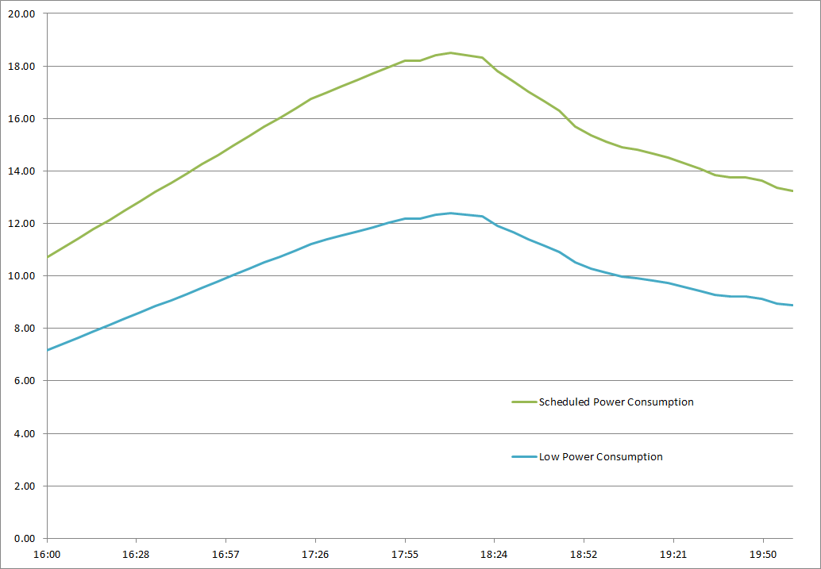
RTM Energy Dispatch from SCED for CLRs

Slide 21
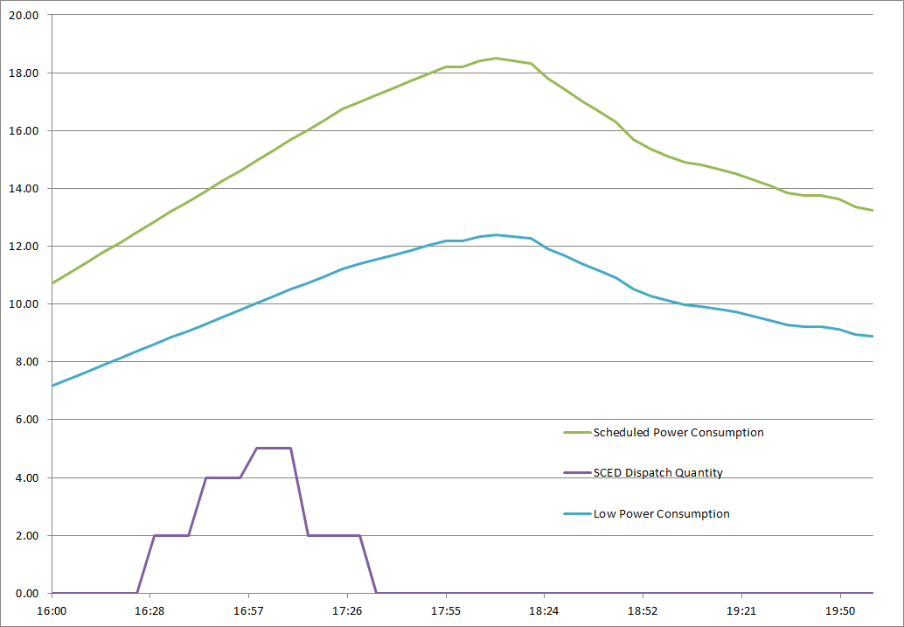
RTM Energy Dispatch from SCED for CLRs

Slide 22
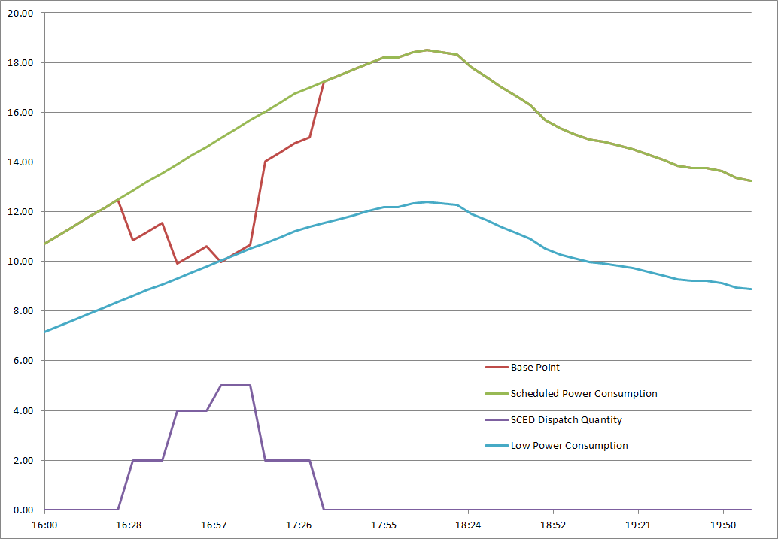
RTM Energy Dispatch from SCED for CLRs

Slide 23
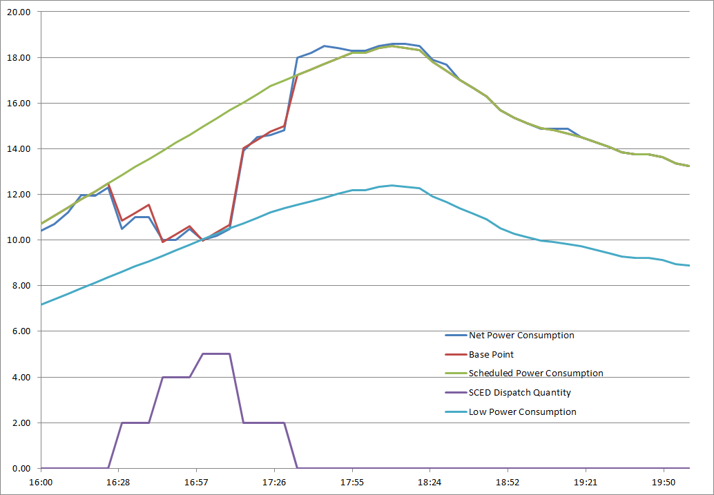
RTM Energy Dispatch from SCED for CLRs

Slide 24
DR Historical Performance

Slide 25
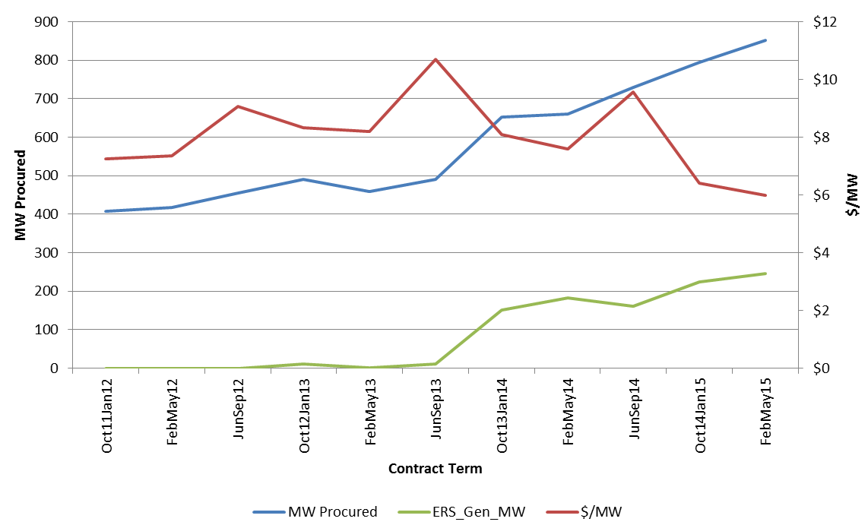
Emergency Response Service (ERS) Trends

Slide 26
ERS-30 Performance (Jan, 6, 2014 Event)
Performance is based on a prorated obligation for the 1st partial interval
only (11.57 minutes) therefore prorated obligation for 1st partial interval was 86.11 MWs
Fleet response = 94.831 MWs

Slide 27
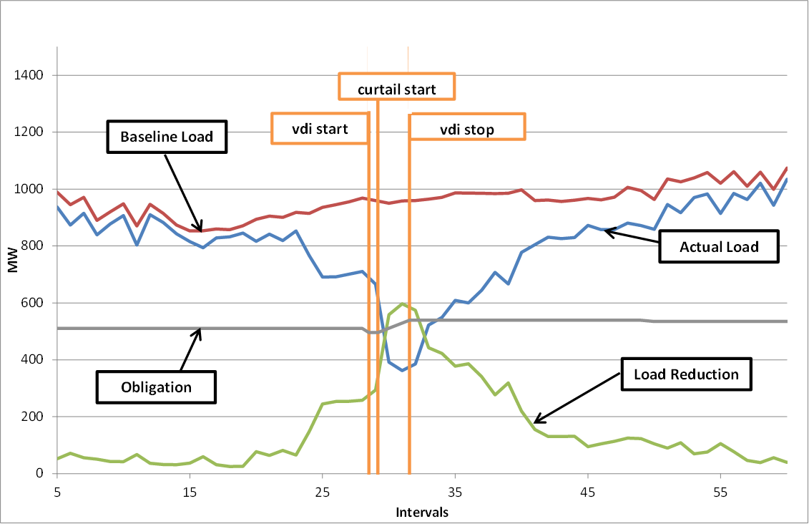
ERS-10 Performance (Jan 6, 2014 Event)
Fleet wide obligation less scheduled unavailability = 495.72 MWs
Fleet Response = 594.86 MWs

Slide 28
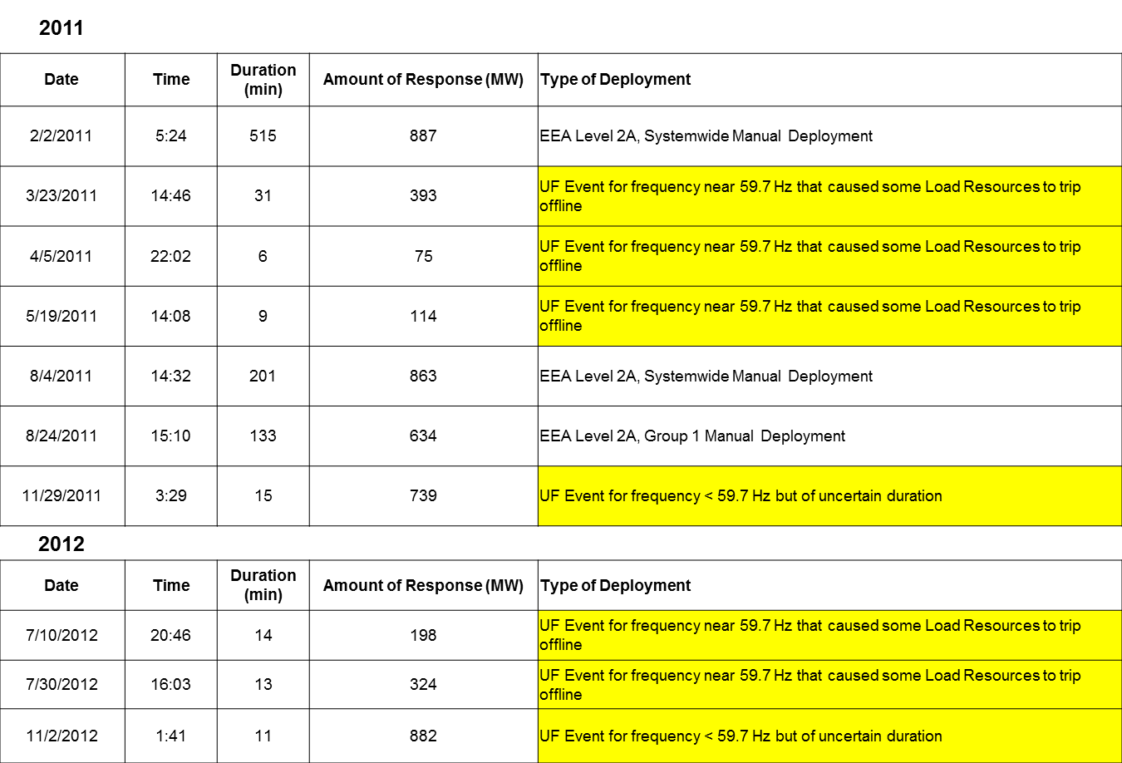
Load Resource RRS Deployments 2011 to Current

Slide 29
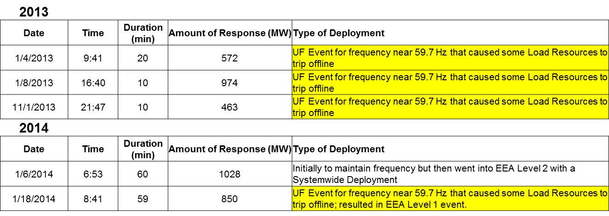
Load Resource RRS Deployments 2011 to Current

Slide 30
January 6, 2014 LR Deployment

Slide 31
January 18, 2014 Under-Frequency Deployment of Load Resources

Slide 32
Questions
Which of the following are considered Demand Response products offered by Retail Electric Providers in the ERCOT Region
  Peak Rebate
  Time-of-Use
  Real Time Pricing (RTP) and Block and Index (BI)
  All of the above

Slide 33
Questions
During the Summer of 2014 approximately how much DR capacity was available to be dispatched by ERCOT?
  230 MWs
  2200+ MWs
  635 MWs
  1400 MWs

Slide 34
Questions
Which of the following is the correct contract period in which Weather Sensitive ERS is available for dispatch?
  February-May
  June-September
  October-January
  All the Above

Slide 35
Questions
4CP Load Reduction is primarily used for:
  Reduce Corporate Taxes
  Congestion Management
  Reduction of various Transmission and Distribution (T&D) charges
  None of the above

