Slide 1
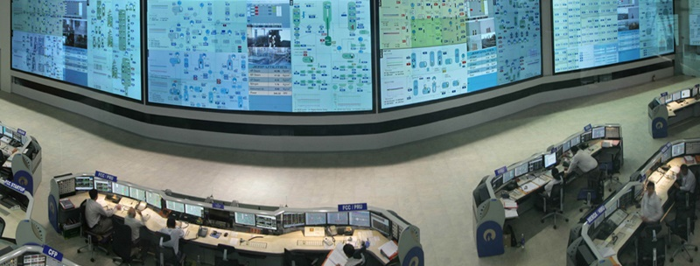
Design Your Screens for Situation Awareness
Mike Legatt, Ph.D.
Principal Human Factors Engineer
Electric Reliability Council of Texas, Inc.
Michael.Legatt@ercot.com
Source: Design Directions

Slide 2
Introduction
This presentation is cover how humans perceive visual information and control visual attention, so that you can optimize your displays and control room environment to maximize situation awareness.

Slide 3
Objectives
You will:
Comprehend and report key components of how people process visual information
Comprehend and report the role of working memory on human performance
Comprehend and report the levels and characteristics of situation awareness
Evaluate the layout of operator workstations, maximizing information processing
Formulate UI design improvements to reduce working memory loading

Slide 4
Definitions
Color Discriminability/Deficiency/Blindness
Signal Detection Theory (SDT)
Situation Awareness
Visual pathways
Magnocellular
Parvocellular
Koniocellular
Non-linear contrast gain
Working memory

Slide 5
Question 1
Which text can you read most quickly, due to the nonlinear contrast gain control system and pathway speed?
Gray text against a white background
Black text against a white background
Yellow text against a blue background
Green text against a red background

Slide 6
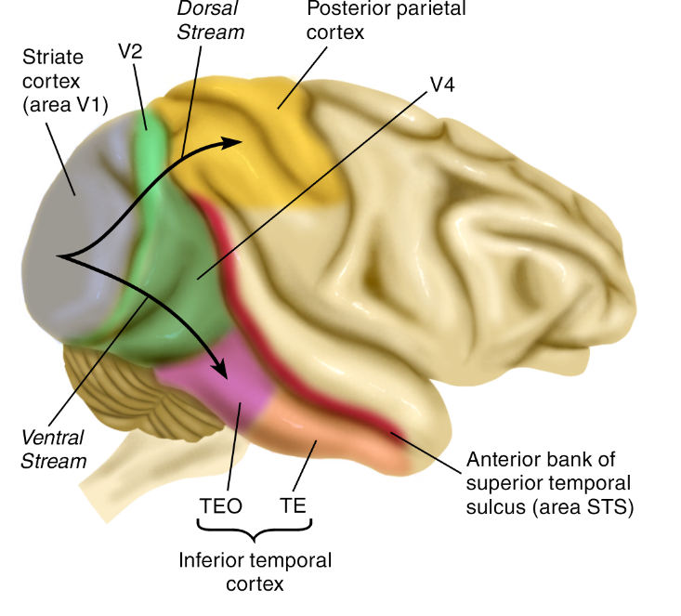
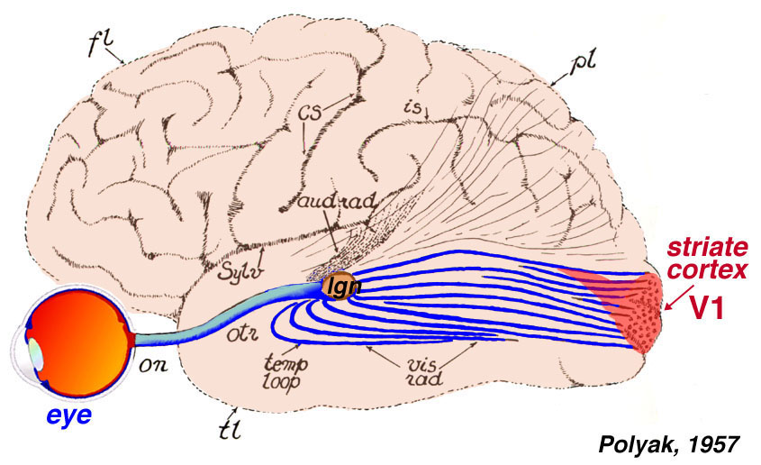
Starting Small…
Eye to LGN to several areas of brain:
“What” system
“Where / how” system
Both involved in visual attention

Slide 7
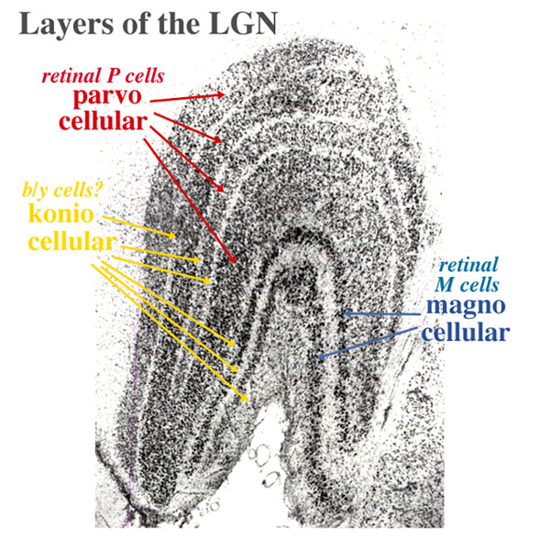
Starting Small…
Magnocellular (large cells):
Edges, motion, low contrast
“Low resolution”
Black/Gray/White
Fast processing
Strongly linked to attention
Nonlinear contrast gain control system – speeds up visual processing to high contrast
Source: Legatt, 2005

Slide 8
Starting Small…
Parvocellular (small cells):
Red/green color, form, high contrast, slower processing
“High resolution”
80% of LGN area
Koniocellular (“sand” cells)
Yellow/blue color, slowest processing
Recently discovered, hidden between layers
Source: Legatt, 2005

Slide 9
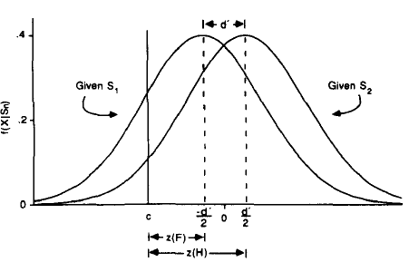
Signal Detection Theory
Green & Swets (1966)
Ability to correctly identify stimuli on a radar screen
How accurately can you detect stimuli?
Hit / False Alarm Proportion
Accuracy (% correct)
Sensitivity (accuracy)
Response criterion (bias in ambiguous situations)
 | Target | Noise
Response | Hit | False Alarm
No Response | Miss | Correct Rejection
Source: Legatt, 2005

Slide 10
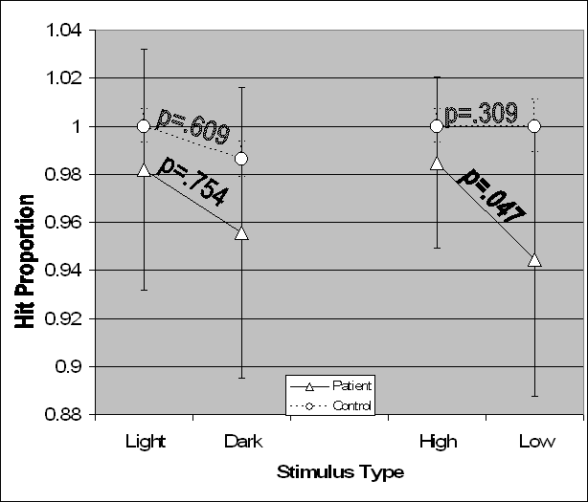
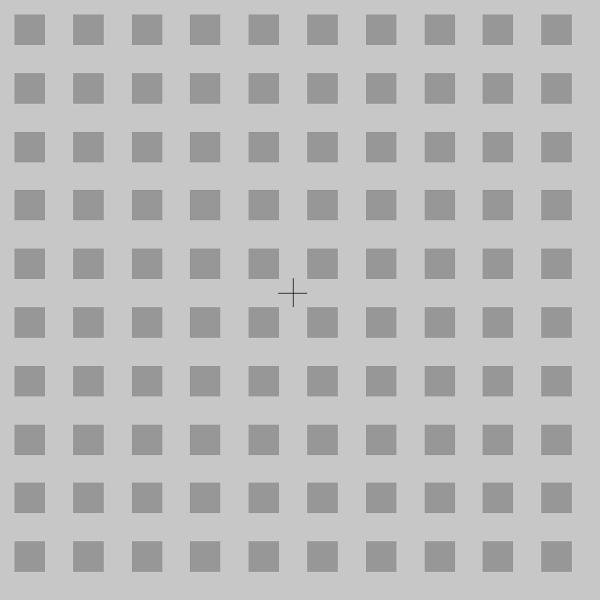
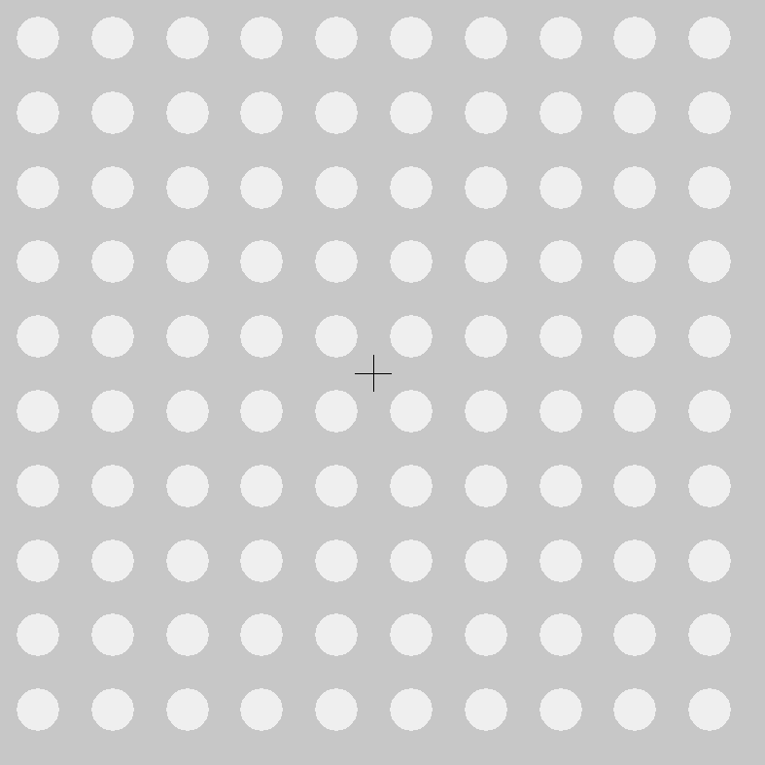
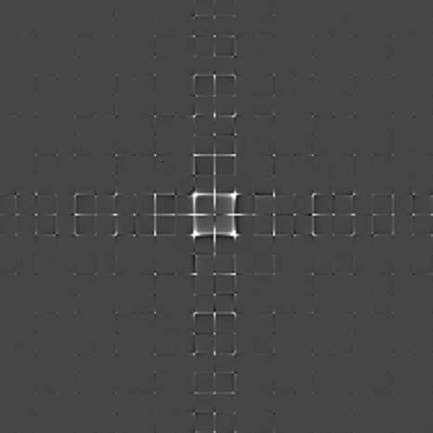
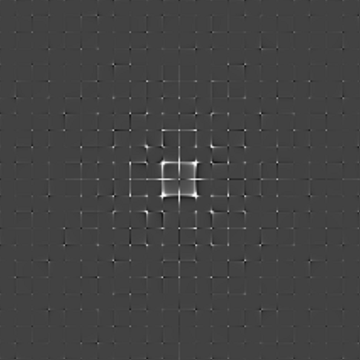
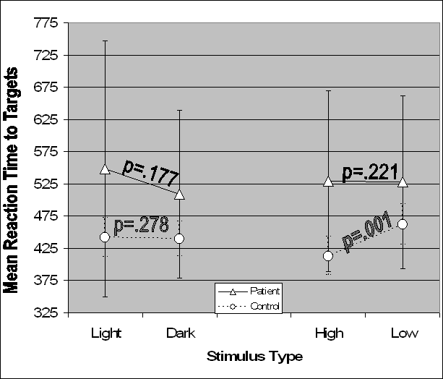
Measuring Visual Attention: VC-CPT
Source: Legatt, 2005

Slide 11
Question 1
Which text can you read most quickly, due to the nonlinear contrast gain control system and pathway speed?
Gray text against a white background
Black text against a white background
Yellow text against a blue background
Green text against a red background

Slide 12

Situation Awareness

Slide 13
Question 2
Which of the following indicates the highest level of situation awareness when looking at a screen?
Being able to locate important information
Understanding the status of the equipment
Being able to predict the status of the equipment one minute from now
Seeing a flashing alarm when there’s a problem

Slide 14
Situation Awareness
“The perception of elements in the environment within a volume of time and space, the comprehension of their meaning, and the projection of their status into the near future” (Endsley, 1995).
Level 1: Perception (What?)
Level 2: Comprehension (So what?)
Level 3: Projection (Now what?)
Both individual and team SA
Source: Endsley, 2011

Slide 15
Question 2
Which of the following indicates the highest level of situation awareness when looking at a screen?
Being able to locate important information
Understanding the status of the equipment
Being able to predict the status of the equipment one minute from now
Seeing a flashing alarm when there’s a problem

Slide 16
Question 3
Which designing your workstation, how should your content be laid out, if you’re facing forward?
 | User Interfaces (Left to Right) | Desk Materials
A) | Within 60° | To sides
B) | Within 30° | Forward
C) | Within 15° | Forward
D) | Within 15° | To sides

Slide 17
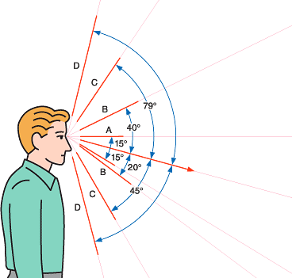
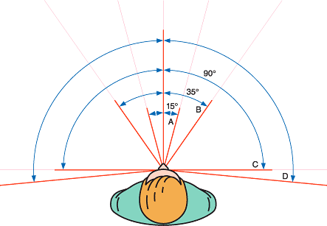
Field of Vision
Resolution on retina highest at center, lower towards periphery.
Farther out, you can only detect motion & vague shapes.
Motion in the periphery can be distracting
Try to keep content within
FOV A(-15 to +15).
Source: Lean Valley

Slide 18
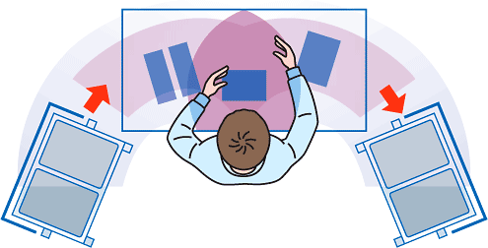
Area of Reach
Lay out your workspace, and user interfaces so the most commonly-used interfaces and materials are in front of you, and less frequently used materials/interfaces are on the periphery.
Source: UN Enable

Slide 19
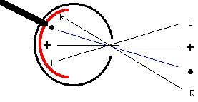
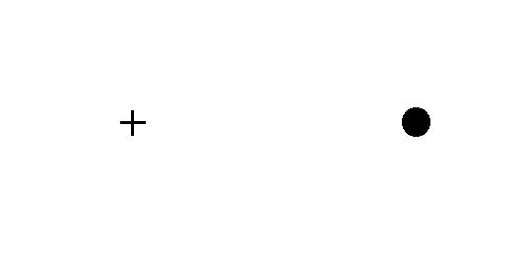
Blind Spot
Close one eye and stare at the cross (if right eye open) or dot (if left eye open). Move your head back or forward
Source: Serendip Studio

Slide 20
Question 3
Which designing your workstation, how should your content be laid out, if you’re facing forward?
 | User Interfaces (Left to Right) | Desk Materials
A) | Within 60° | To sides
B) | Within 30° | Forward
C) | Within 30° | To Sides
D) | Within 15° | To sides

Slide 21
Question 4
What is absolutely necessary for good information organization and consolidation in a UI?
Operator trust in the system
Showing only warning/error information
Avoiding colors at all costs
Preventing redundant data across screens

Slide 22
Ambient Lighting
High contrast differences between environment and your screen/UI can cause stress. For example,
Full brightness in the middle of the night
Low brightness screen in direct sunlight
Transitioning between the screen and other factors of the environment can be frustrating.
Source: Lean Valley

Slide 23
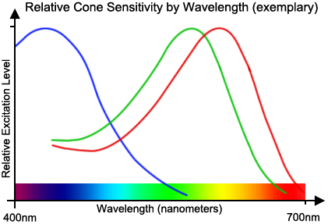
Colors
Color is a fascinating subject
Cultural values associated with colors
Evolutionary issues
Favorite color blue (60% of men, 35% of women)
Processing speed increases when large red objects seen
In the eye, three types of cones process color
Source: Color Blindness Simulator

Slide 24
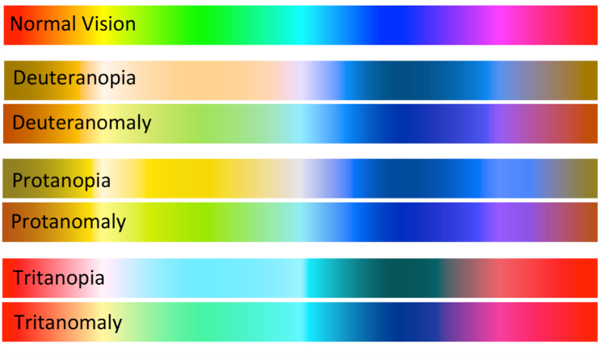
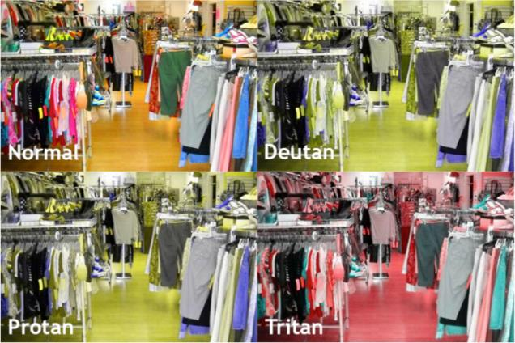
Issues with color
Color discriminability decreases both with age and nicotine use
Color deficiency / blindness
Source: Chroma: A wearable augmented reality…

Slide 25
Targeting our visual system
Based on knowledge on the visual system:
If colors are being used, critical information should have strong red/green components (but check users for color blindness)
Motion captures attention – only use when you want to capture attention
Critical information should not have low contrast differentials
Source: UN Enable

Slide 26
Information Organization
Try to group UIs based on task, frequency of use, and/or how critical its information
Try to minimize redundant data across multiple screens
If possible, integrate information from multiple sources to support operations
If possible, stay involved in development/vendor efforts; make sure the screens you receive work for you.

Slide 27
Information Organization
When possible, show as little “all good” information – especially in complex systems
Provide straightforward paths to navigating to detail and searching
Whenever possible, test screens in simulations under a variety of conditions before deploying.

Slide 28
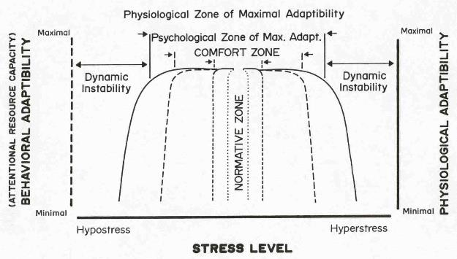
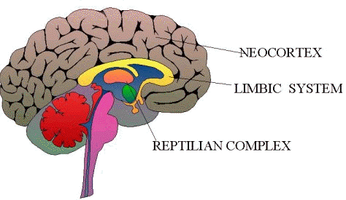
Processing under stress
It’s most difficult to process information under extreme stress
Working memory decreases under stress
7±2 items => 3-5 long term damage
Source: Hancock & Warm (1989)

Slide 29
Trust is key!
A low trust in system is a major source of stress and forces changes in processing

Slide 30
Question 4
What is absolutely necessary for good information organization and consolidation in a UI?
Operator trust in the system
Showing only warning/error information
Avoiding colors at all costs
Preventing redundant data across screens

Slide 31
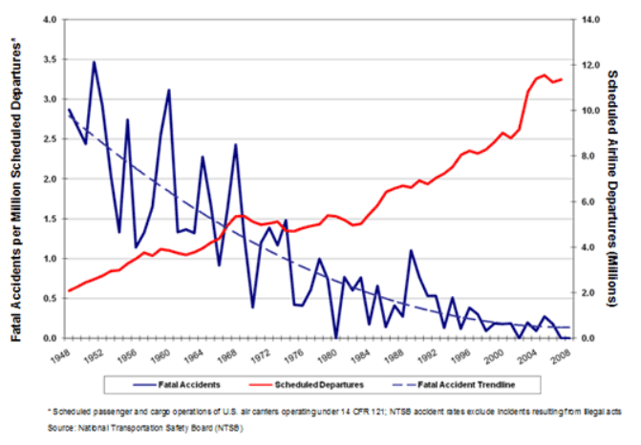
User-Centered Design
Organize around:
User procedures and abilities
The way we process information and make decisions
Users understanding the state of the system (e.g., avoid early auto-pilot failures)
Source: Bernardo Malfitano

Slide 32
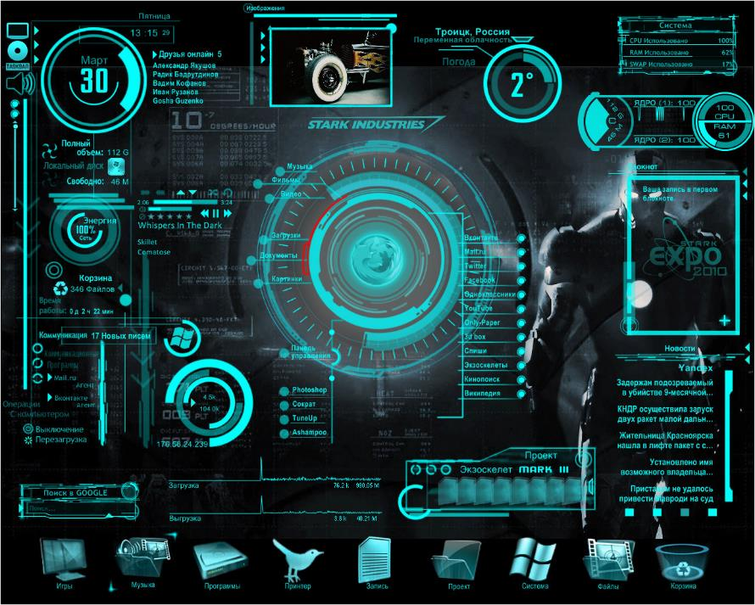
Focus on the message
“This system is powerful”
Source: StackExchange

Slide 33
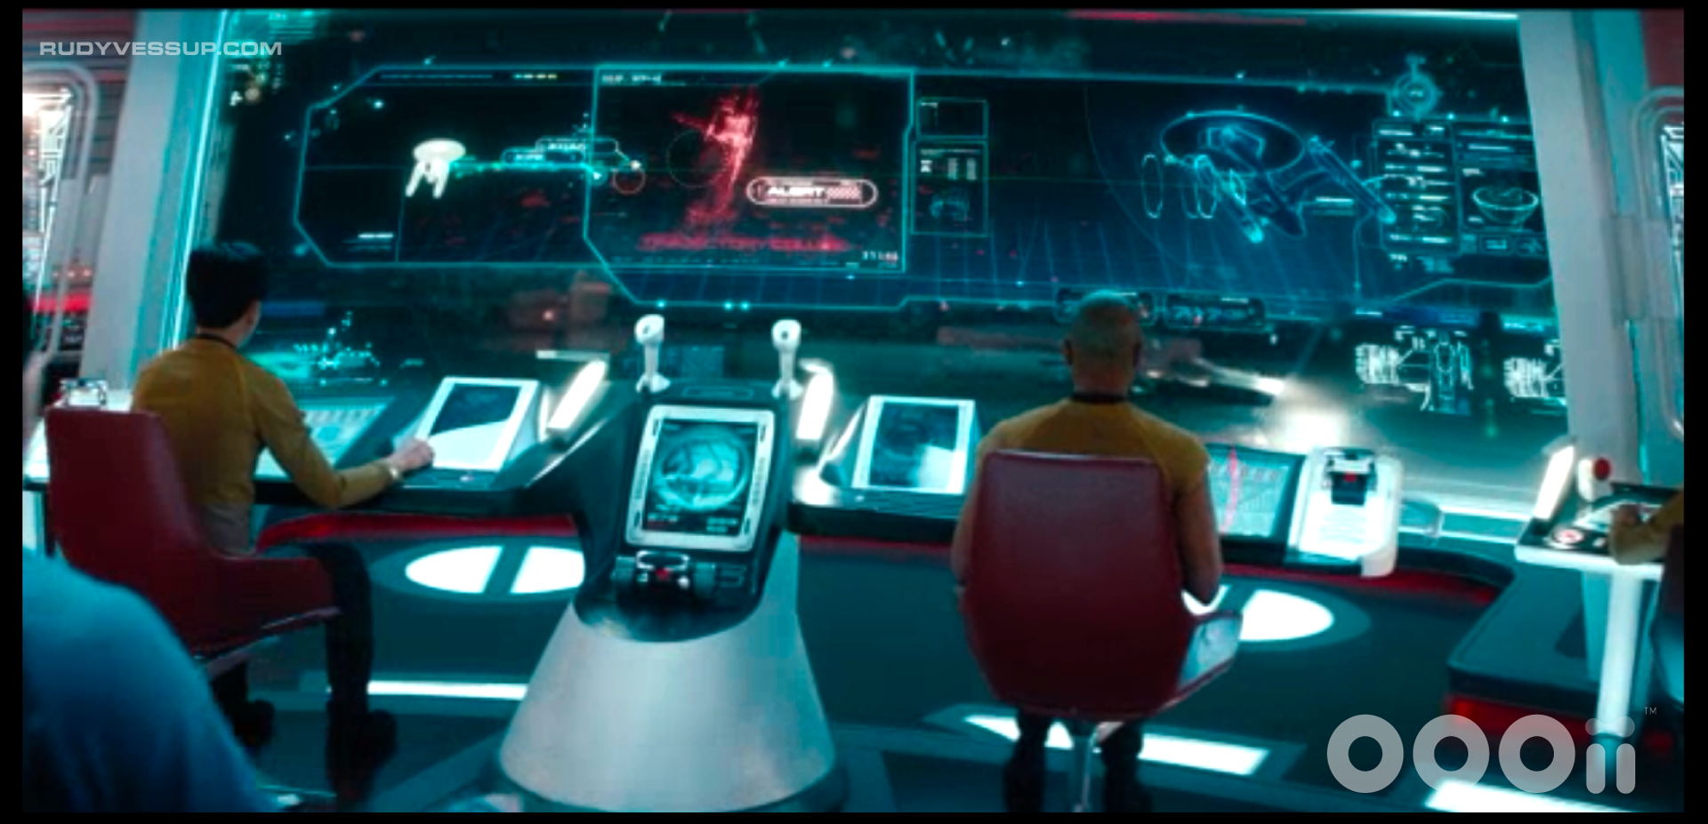
Focus on the message
“This system is powerful”
Source: Rudy Vessup

Slide 34
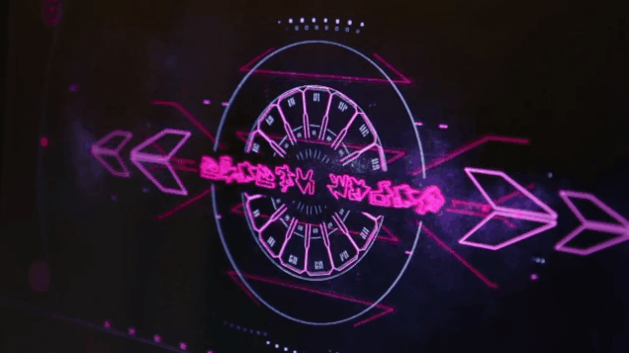
Focus on the message
“This system is powerful”
Source: Gizmodo

Slide 35
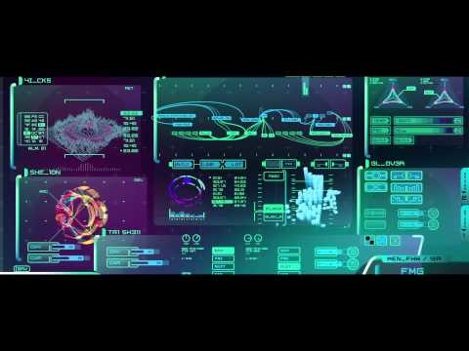
Focus on the message
“This system is powerful”
Source: YouTube

Slide 36
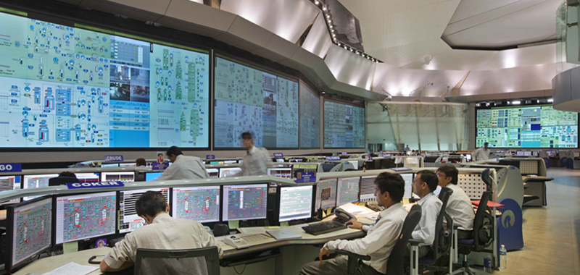
Focus on the message
“This system is powerful”
Source: Design Directions

Slide 37
Focus on the message
“This system is powerful”
vs.
“This system is optimized so you can quickly understand what is going on”
Source: UN Enable

Slide 38
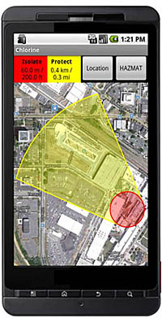
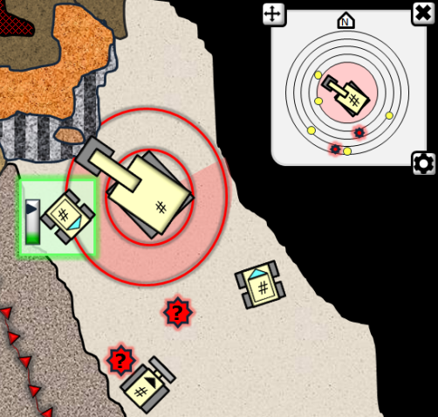
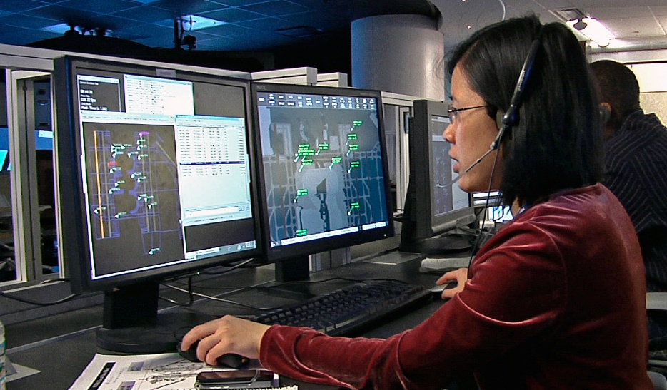
Focus on the message
“This system is trying to optimize SA”
Sources: SA Tech, DHS,

Slide 39
Question 5
Which of these statements is always true?
“Powerful system” user interfaces should never be used
Operator error risk can be mitigated, even with increased data complexity
User interface design can completely compensate for operator fatigue
An operator in a dark, quiet room will perform best

Slide 40
Focus on the message
Why “this system is powerful?”
Dignitaries and others visiting control rooms
“cool” / “wow” factor
Why “Optimizing SA?”
Important, mission critical systems
Data that may be changing rapidly, and is of importance
Trust in core systems – show primarily the exceptions, not all information
Both messages have their place!
Source: UN Enable

Slide 41
Avoid Pitfalls
Attentional narrowing – attention grabbed, drawing focus away from critical information
Data overload – More/faster information presented than a human can process
Misplaced salience – Avoid the wrong things standing and catching your attention
Source: Endsley, 2011

Slide 42
Avoid Pitfalls
Complexity Creep – Additions to a UI or procedure may affect far more than one screen
Alarm screens
“Alarm storms” – critical information scrolling off the screen due to other important alarms
“Dust storms” – critical information scrolling off the screen due to unimportant alarms
Source: Endsley, 2011

Slide 43
Avoid Pitfalls
Human factors still matter
User Interfaces can’t compensate fully for fatigue, stress, etc.
People’s personality types influence how they perform in different environments
Low operator confidence in systems
Uncertainty in data not represented to users
Source: Endsley, 2011

Slide 44
Question 5
Which of these statements is always true?
“Powerful system” user interfaces should never be used
Operator error risk can be mitigated, even with increased data complexity
User interface design can completely compensate for operator fatigue
An operator in a dark, quiet room will perform best

Slide 45
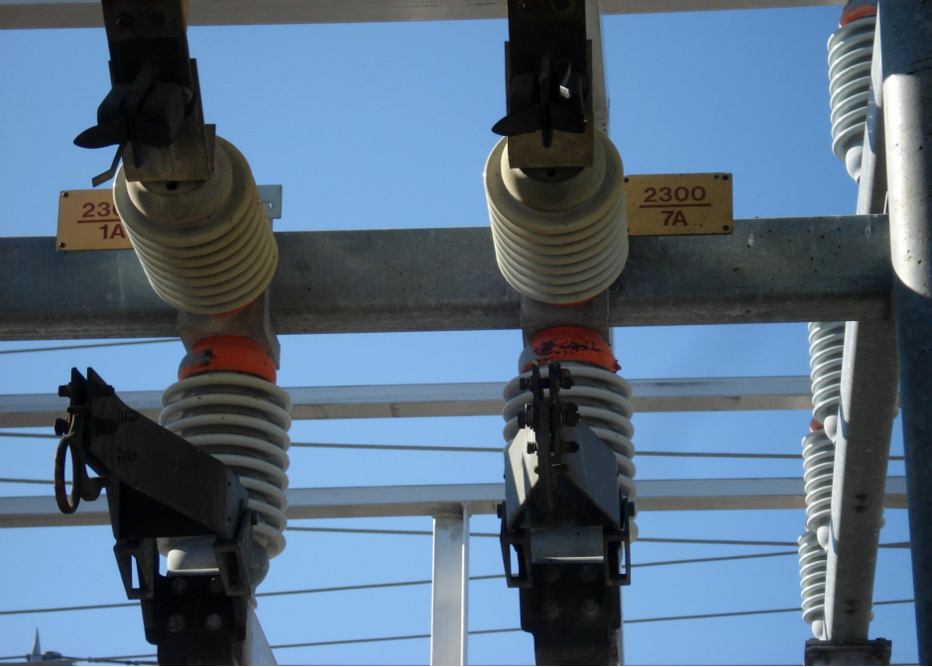
Watch for Data Context & Misinterpretation Risk
Source: J. Merlo

Slide 46
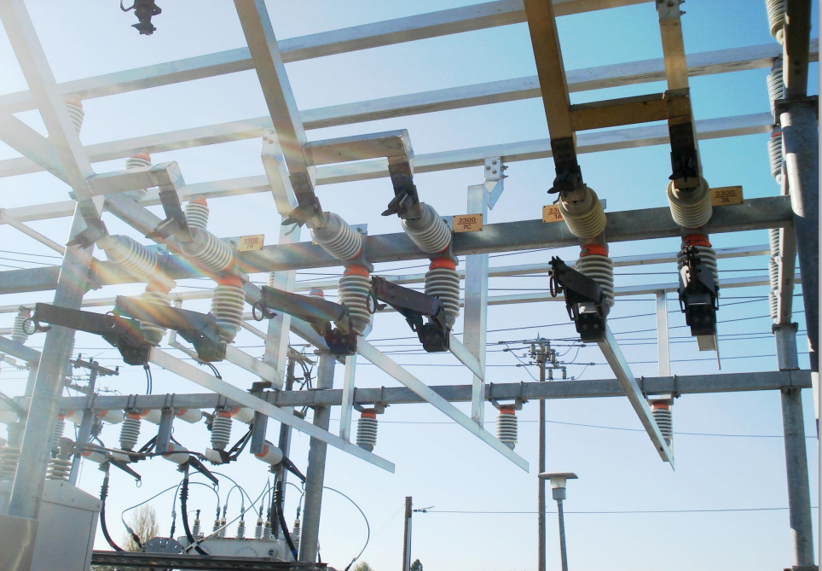
Watch for Data Context & Misinterpretation Risk
Source: J. Merlo

Slide 47
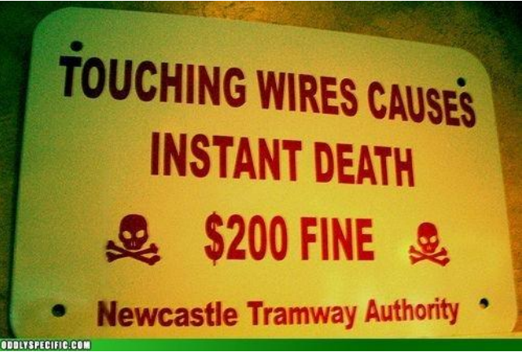
Focus On What’s Important
Source: J. Merlo

Slide 48
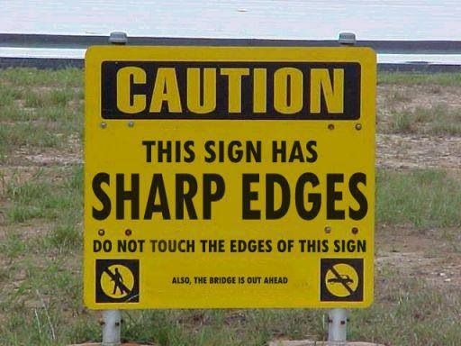
Focus On What’s Important
Source: J. Merlo

Slide 49
Blind Spot
Close one eye and stare at the cross (if right eye open) or dot (if left eye open). Move your head back or forward
Source: Serendip Studio

Slide 50
Questions
?
?

Slide 51
Question 1
Which text can you read most quickly, due to the nonlinear contrast gain control system and pathway speed?
Gray text against a white background
Black text against a white background
Yellow text against a blue background
Green text against a red background

Slide 52
Question 2
Which of the following indicates the highest level of situation awareness when looking at a screen?
Being able to locate important information
Understanding the status of the equipment
Being able to predict the status of the equipment one minute from now
Seeing a flashing alarm when there’s a problem

Slide 53
Question 3
Which designing your workstation, how should your content be laid out, if you’re facing forward?
 | User Interfaces (Left to Right) | Desk Materials
A) | Within 60° | To sides
B) | Within 30° | Forward
C) | Within 30° | To Sides
D) | Within 15° | To sides

Slide 54
Question 4
What is absolutely necessary for good information organization and consolidation in a UI?
Operator trust in the system
Showing only warning/error information
Avoiding colors at all costs
Preventing redundant data across screens

Slide 55
Question 5
Which of these statements is always true?
“Powerful system” user interfaces should never be used
Operator error risk can be mitigated, even with increased data complexity
User interface design can completely compensate for operator fatigue
An operator in a dark, quiet room will perform best

