Slide 1
Real-Time Transmission Congestion Management & Market Effects
Chad Thompson, Manager, Operations Support, ERCOT
Jeff Gilbertson, Sr Market Operations Analyst, ERCOT

Slide 2
Objectives
Identify what defines a constraint in the ERCOT system.
Identify which ERCOT application dispatches generation to resolve constraint overloads.
Identify the types of Constraint Management Plans as detailed in the ERCOT Nodal Protocols.

Slide 3
Objectives
Identify the time-frame in which all Congestion Management Plans are intended to resolve loading below Emergency Ratings.
Identify where Congestion Management Plans are posted to the Market
Identify the ERCOT application whose goal is to minimize generation costs while also respecting transmission constraints.

Slide 4
Objectives
Identify when the transmission network is “invisible” to Security Constrained Economic Dispatch (SCED).
Identify the condition when a constraint Shadow Price is zero dollars ($0)

Slide 5
Congestion Management:
Real-Time
Chad Thompson

Slide 6
Congestion Basics
Equipment Ratings
Normal/Continuous
Emergency/2-Hour
Loadshed/15-Minute
Dynamic Line Ratings
Temperature-adjusted based on ambient temperature
TSPs submit a static ratings table that is tied to the ERCOT weather forecast
TSPs also have the option to submit a rating via ICCP telemetry – MVA, Amps, Temperature
All Autotransformers and Transmission lines have 3 ratings in the model; some may be the same

Slide 7
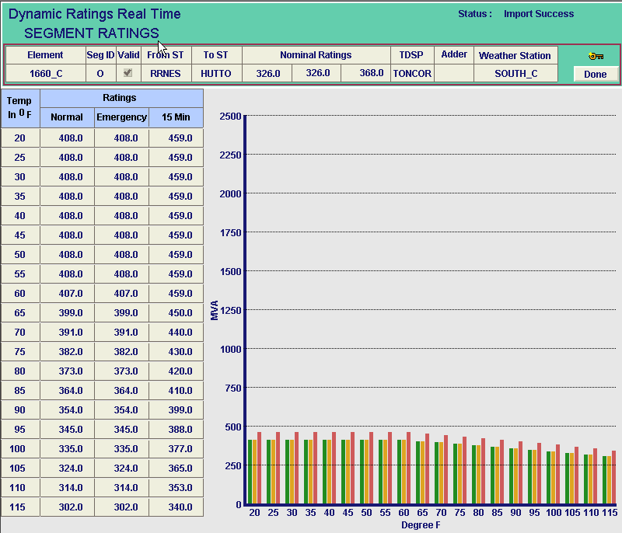
Congestion Basics

Slide 8
Congestion Basics
ERCOT Operates to “N-1” Contingency Criteria
Contingencies include the loss of Autotransformers, Transmission Lines and Generation Units
N-1 congestion *generally* based on the Emergency Rating
Base Case congestion based on the Normal Rating
What is a constraint?
An N-1 contingency and overloaded transmission element pair
A base case, or real-time transmission element overload

Slide 9
Constraint Management
How are constraints identified?
ERCOT executes its State Estimator and performs a Real-Time Contingency Analysis (RTCA) every 5 minutes
RTCA produces a list of constraints which is updated every time it executes
How are constraints used?
ERCOT executes a Security Constrained Economic Dispatch (SCED) market every 5 minutes
SCED dispatches generation to resolve constraint overloads
Only those constraints passed from RTCA into SCED are considered in congestion management

Slide 10
Constraint Management
“Only those constraints passed from RTCA into SCED are considered in congestion management”
Does this mean that not all constraints are activated?
What are the criteria for activating constraints?
Correct modeling, telemetry, & solution
Not redundant
Not Private Use Network Equipment
2 % or greater Generator Shift Factor*
Constraint Management Plans (CMP)

Slide 11
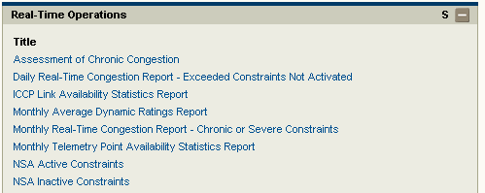
Constraint Management
How can I find out why a constraint was not activated?
MIS Secure Area under Grid → Transmission → Real-Time Operations

Slide 12
Constraint Management
What’s a Constraint Management Plan?
A transmission switching action that is developed to ensure overall grid reliability in the event a given contingency occurs
CMPs are intended to supplement SCED, while maximizing transmission capacity when possible

Slide 13
Constraint Management
What’s a Constraint Management Plan?
Currently 4 types of CMPs as detailed in Section 2.1 Definitions of the ERCOT Nodal Protocols
Mitigation Plan
Pre-Contingency Action Plan (PCAP)
Remedial Action Plan (RAP)
Temporary Outage Action Plan (TOAP)
All CMPs are intended to resolve loading to below Emergency Ratings, with restoration of normal operating conditions within two hours

Slide 14
Constraint Management
Mitigation Plan
Post-contingency actions
May include load shed
Constraints managed to their Emergency Ratings
Not Modeled in ERCOT Systems
Pre-Contingency Action Plan (PCAP)
Pre-contingency actions
Do not include load shed
Constraints managed to their Emergency Ratings
Not Modeled in ERCOT Systems

Slide 15
Constraint Management
Remedial Action Plan (RAP)
Post-contingency actions
Do not include load shed
Constraints managed to their 15-Minute Ratings
Modeled in ERCOT Systems
Temporary Outage Action Plan (TOAP)
Post-contingency actions
May include load shed
Constraints managed to their Emergency Ratings
Not Modeled in ERCOT Systems
“Mitigation Plan for the duration of an outage”

Slide 16
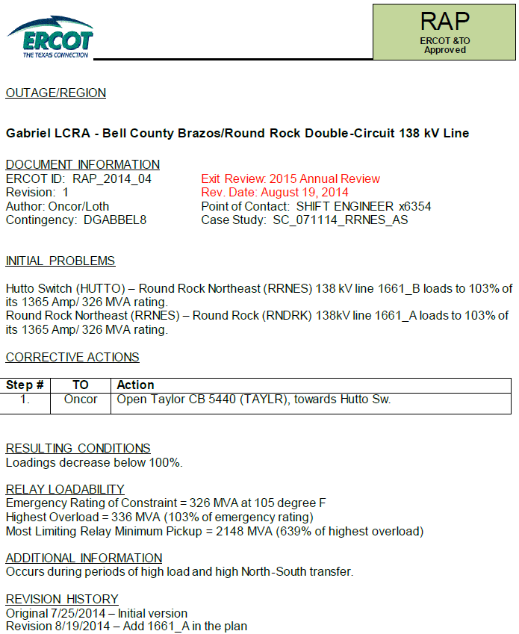
Constraint Management
Contingency Details
Administrative Details
Overloaded Elements
Corrective Actions
Additional Details

Slide 17
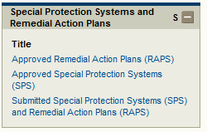
Constraint Management
Where are CMPs Posted?
MIS Secure Area under Grid → Long-Term Planning → Special Protection Systems and Remedial Action Plans

Slide 18
Congestion Management:
Market Effects
Jeff Gilbertson

Slide 19
Topics Covered
Security Constrained Economic Dispatch (SCED) inputs and outputs
Constraint Scenarios
Data relationships

Slide 20
SCED Inputs and Outputs
Security Constrained Economic Dispatch (SCED)
Goal: Minimize generation cost while also respecting transmission constraints (“security constrained”)
Inputs
Generation to be Dispatched (GTBD)
Generator offer curves
Generator limits (Low/High Dispatch Limits)
Generator current power output
Active transmission constraints (cont’d)

Slide 21
SCED Inputs and Outputs
Active transmission constraints
Contingency and monitored element pair names
Monitored element (“constraint”) post-contingency flow
Constraint limit
Maximum shadow price
Resource shift factors
This is all SCED knows about the ERCOT transmission network!

Slide 22
SCED Inputs and Outputs
Transmission Constraint Shadow Price (SCED output)
Change in cost of system dispatch for a 1 MW change in monitored element limit
Maximum Shadow Price (SCED input)
Prevents wide price spread when constraint is not resolvable or very difficult to resolve
BASE CASE | $5,000 |  | 138 kV | $3,500
345 kV | $4,500 |  | 69 kV | $2,800

Slide 23
SCED Inputs and Outputs
Resource Shift Factor
Change of flow on monitored element due to 1MW change of output of Resource
Value range: -1 to 1
Positive shift factor : flow on monitored element increases as generation increases
Negative shift factor: flow on monitored element decreases as generation increases

Slide 24
SCED Inputs and Outputs
Resource Shift Factor
Magnitude of shift factor indicative of number of paths Resource output has to flow
Greater magnitude shift factors:
Resource located on a radial path from monitored element; and/or
Resource located close to monitored element

Slide 25
SCED Inputs and Outputs
Outputs
Resource Base points (sent only to Resource)
Locational Marginal Prices (LMPs) – cost to serve additional 1MW of load at a location
Consistent with base points
LMP higher than offer curve price, base point instructs resource to increase output
LMP lower than offer curve price, base point instructs resource to decrease output
Constraint solution flow

Slide 26
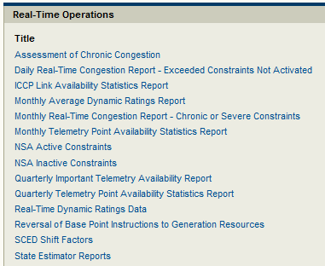
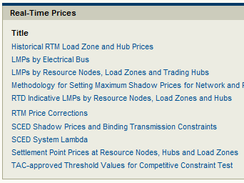
SCED Inputs and Outputs
Where is SCED constraint data posted?
MIS Secure Area under Markets → Real-Time Market

Slide 27
Constraint Scenarios
No active constraints
Transmission network “invisible” to SCED
Dispatch is like using an “offer stack”
Resources dispatched to meet GTBD
Less expensive resources fully dispatched to High Dispatch Limit (HDL)
More expensive resources dispatched to Low Dispatch Limit (LDL)
Resources in between LDL and HDL are “marginal” and set one system-wide Locational Marginal Price (LMP)
No congestion costs

Slide 28
Constraint Scenarios
Active constraint(s) that are not binding in SCED
By dispatching inexpensive resources first, the resulting post-contingency flow on constraints is less than limit
No congestion costs; one system-wide LMP
Again, dispatch is like using an “offer stack”

Slide 29
Constraint Scenarios
Active constraint(s) that are binding in SCED
Dispatch based on economics alone would result in post-contingency flow above transmission limit
More expensive resources must be dispatched higher and less expensive resources dispatched lower in order to respect the limit
Flow change on constraint is (solution resource output – initial resource output) * shift factor for each resource
Power balance must be maintained, so resource level adjustments must balance each other out

Slide 30
Constraint Scenarios
Active constraint(s) that are binding in SCED
Binding constraints have a non-zero “shadow price”
The shadow price is the price sensitivity of the transmission constraint
If transmission limit was 1MW lower, what would that mean in terms of cost?
Since we are already starting at the most economic solution at the limit, the less expensive resources would need to produce less and more expensive resources would need to produce more
Results in different LMPs throughout the system

Slide 31
Constraint Scenarios
Active constraint(s) that are violated in SCED
Transmission limit is NOT respected
Occurs because:
there are no resources that can be dispatched to resolve the constraint
the cost to resolve the constraint is very high
Remember, flow is post-contingency flow. Actual monitored element flow is not allowed to go above limit.

Slide 32
Constraint Scenarios
Conditions for transmission congestion
At least one transmission constraint is active
SCED dispatch results in post-contingency flow on the monitored element at or above the constraint limit

Slide 33
Data Relationships
Relationship between constraint flow and constraint shadow price
Scenario | Flow | Shadow Price
Not binding | < limit | $0
Binding | = limit | > $0 and < Max SP
Irresolvable/ violated | > limit | Max Shadow Price

Slide 34
Data Relationships
Relationship between shadow price, shift factors, and LMP
LMP = System Lambda - (shift factor * shadow price) - (shift factor * shadow price)…
(shift factor * shadow price) subtracted for each constraint

Slide 35
Data Relationships
Example:
System Lambda is $50
Resource A has a shift factor of 0.2 to constraint A
Constraint A shadow price is $100
LMP = System Lambda – (shift factor * shadow price)
LMP = $50 – (0.2 * $100) = $50-$20 = $30

Slide 36
Questions?

Slide 37
Questions
A constraint in the ERCOT system is defined as
An N-1 contingency and overloaded transmission element pair
A base case, or real-time transmission element overload
All of the above

Slide 38
Questions
Which ERCOT application dispatches generation to resolve constraint overloads?
SCED
RTCA
VSAT
VSS

Slide 39
Questions
Which of the following Constraint Management Plans are detailed in the ERCOT Nodal Protocols:
Mitigation Plan (MP)
Pre-Contingency Action Plan (PCAP)
Remedial Action Plan (RAP)
All of the above

Slide 40
Questions
Within what time-frame which all Congestion Management Plans are intended to resolve loading below Emergency Ratings?
2-hours
4-hours
24-hours
Doesn’t matter as long as resolved

Slide 41
Questions
Where are Congestion Management Plans posted to the Market?
MIS Restricted
MIS Public
MIS General
MIS Secure

Slide 42
Questions
Which ERCOT application’s goal is to minimize generation costs while also respecting transmission constraints?
GTBD
RTCA
SCED
SASM

Slide 43
Questions
Under what condition is the transmission network “invisible” to Security Constrained Economic Dispatch (SCED)?
No Active Constraints
Active Constraints
Binding Constraints
Non-Binding Constraints

Slide 44
Questions
Under what condition would a Shadow Price of zero dollars ($0) be calculated?
Constraint flow is < limit
Constraint flow is = limit
Constraint flow is > limit
None of the above

