Slide 1
Voltage Support Service (VSS) for CREZ Region and baseline Power angle ranges post CREZ
Bill Blevins
Manager Operations Planning

Slide 2
Objectives
Identify the purpose for VSS.
Identify what system ERCOT uses to operate VSS.
Identify control/equipment that is used to manage voltage within VSS.
Identify locations VSS is used for.
Identify voltage limits that VSS will correct.
Identify where VSS is available for TOs.

Slide 3
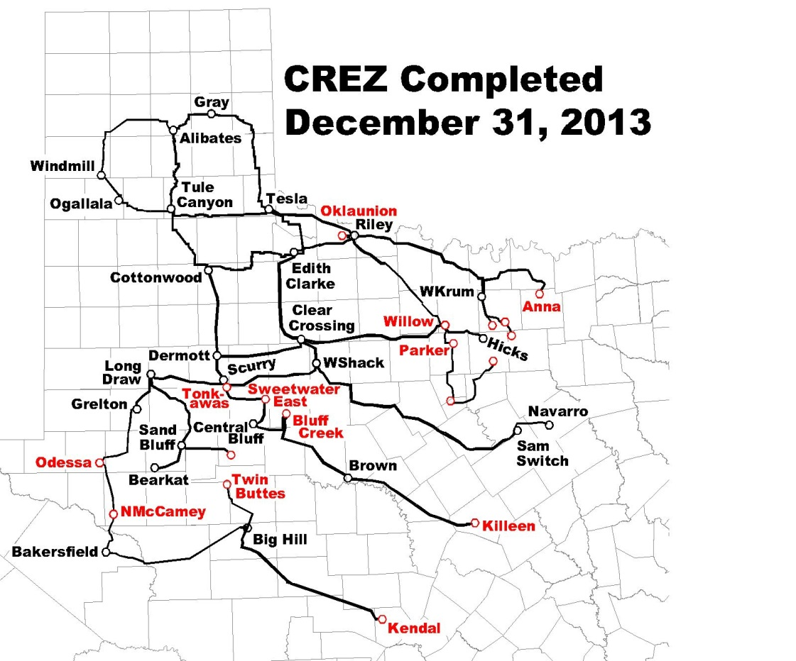
MAP of CREZ region
Notes:
The system is changing with the implementation of CREZ and system upgrades.

Slide 4
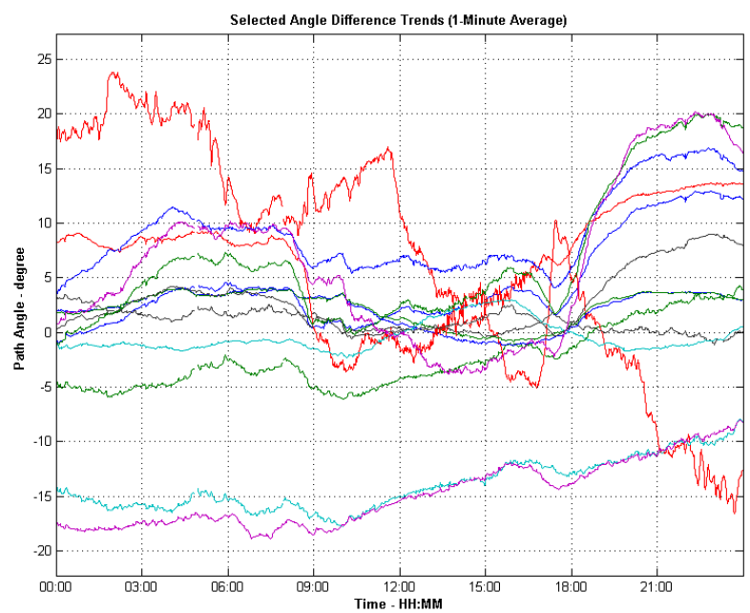
Phasor measurement Unit Voltage Angle trend over 24 Hours

Slide 5
CREZ project energization
Notes:
Twenty eight new Competitive Renewable Energy Zone (CREZ) 345 kV lines were added to the Electric Reliability Council of Texas (ERCOT) system in 2013, which change the results obtained with the 2012 data and the first six-months of 2013 data, particularly in angle differences between locations. Nineteen of these lines were added in the second half of 2013.

Slide 6
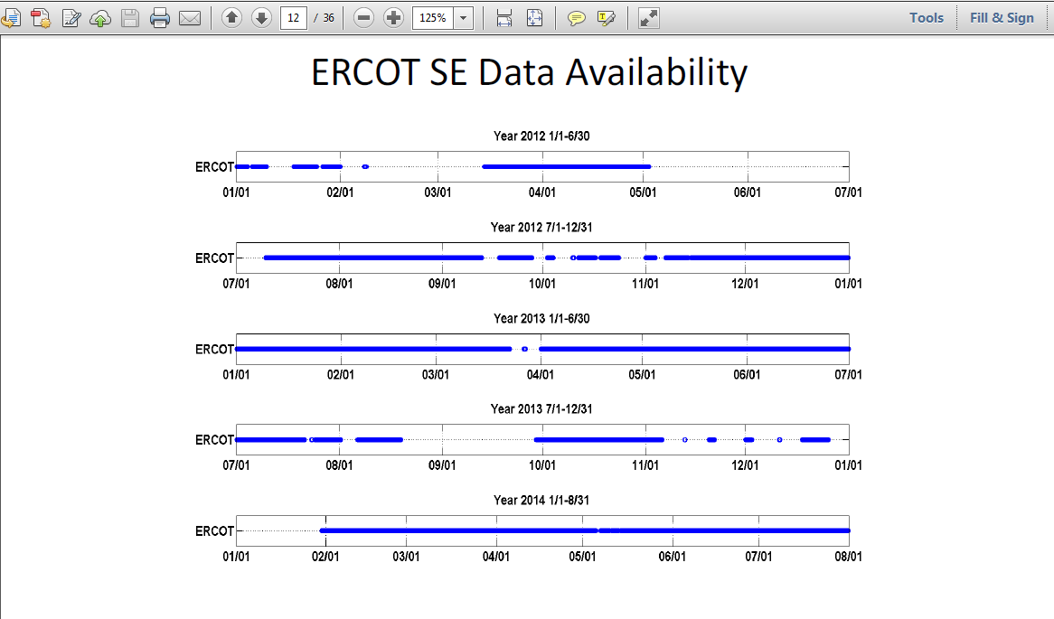
SE data used for the study
Notes:
The Center for Commercialization of Electric Technologies (CCET) was awarded contract DE-OE0000194 by the Department of Energy to perform the Discovery Across Texas demonstration project. Electric Power Group, LLC (EPG) received a subaward from CCET to provide professional services to perform, among other things, a substation cluster analysis, comparison of phasor data versus state estimator data, and voltage and angle difference baselining.
ERCOT provided EPG phasor data for the February to July 2014 period with a resolution of 30-samples per second (SPS). Through an automated process, EPG downloaded, cleaned, and filtered data dropout to make it suitable for analysis. Further manual cleaning was necessary to weed out remaining outliers.
16000 cases from SE in 2012, about 50000 cases in 2013 and 25,419 SE cases in first 6 months of 2014.

Slide 7
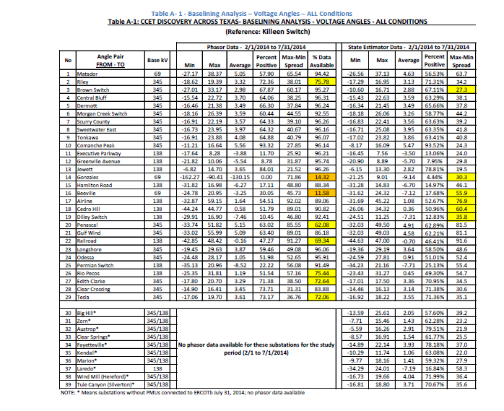
Example comparison of PMU to SE data
Notes:
Good comparison between PMU data and SE. Means both are very accurate in measuring the state of the system.

Slide 8
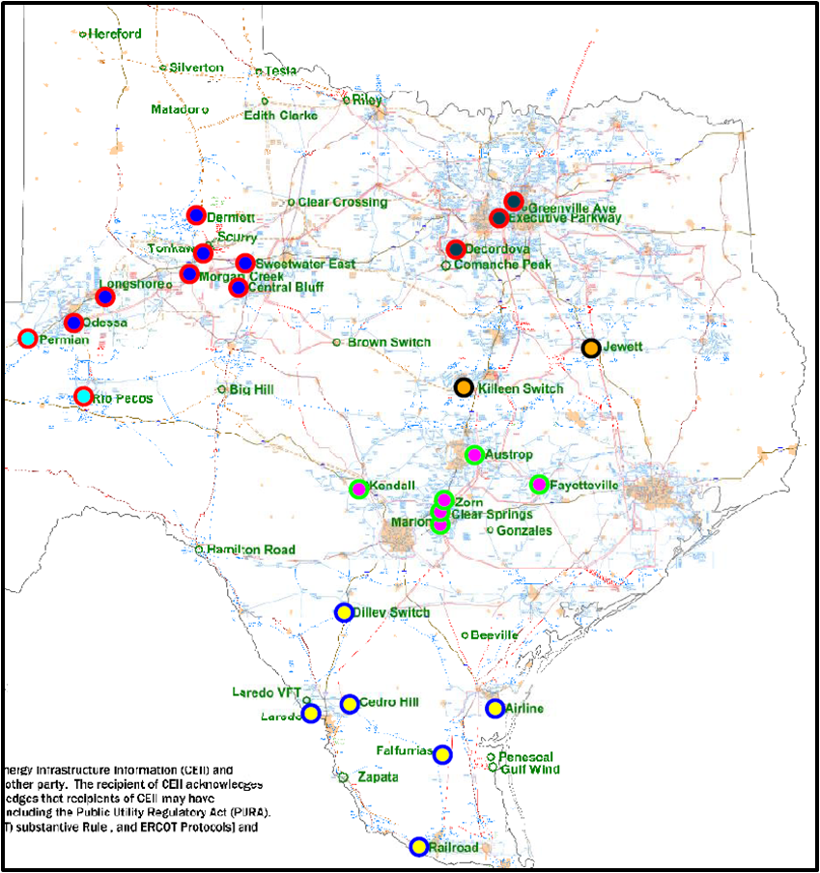
capturing the change in the system due to CREZ buildout
Largest SE angle into the Valley was -40
54% of the time power flows this direction
Notes:
Looking at just one area the Angle can tell you the direction of flow over the entire study period between 2012 to the middle of June 2014. The angle pair is reference between Killeen and Railroad as an example of how the pairs work. The colored circles represent clusters of PMUs that the angels change with respect to the reference well. For example Killeen and Jewett appear to change their angle with the same direction together. Therefore they are clustered together.

Slide 9
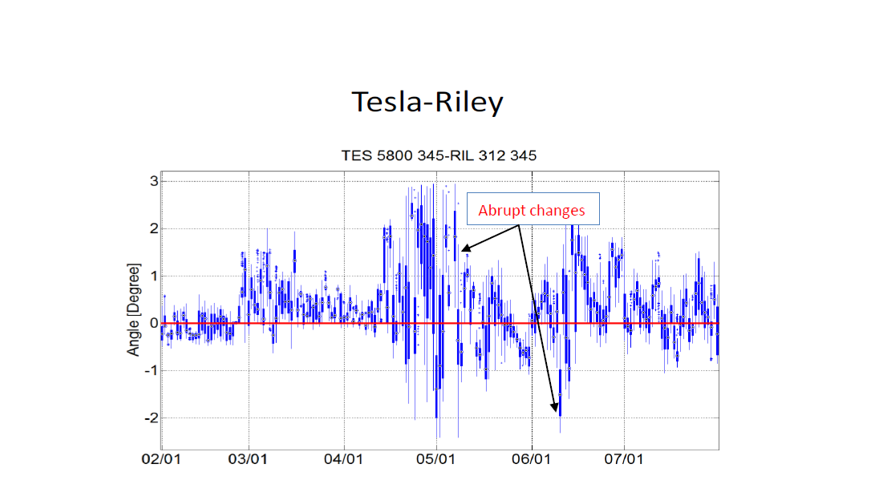
Example of plot showing
Notes:
Box-whisker and time duration curves were developed for each of the pairs analyzed. Angle differences that may be the results of contingencies were excluded by reviewing points of inflection; that is, points that significantly deviated from the normal operation trend observed in the box-whisker plots.
Box whisker plots are based on state estimator data and phasor data.

Slide 10
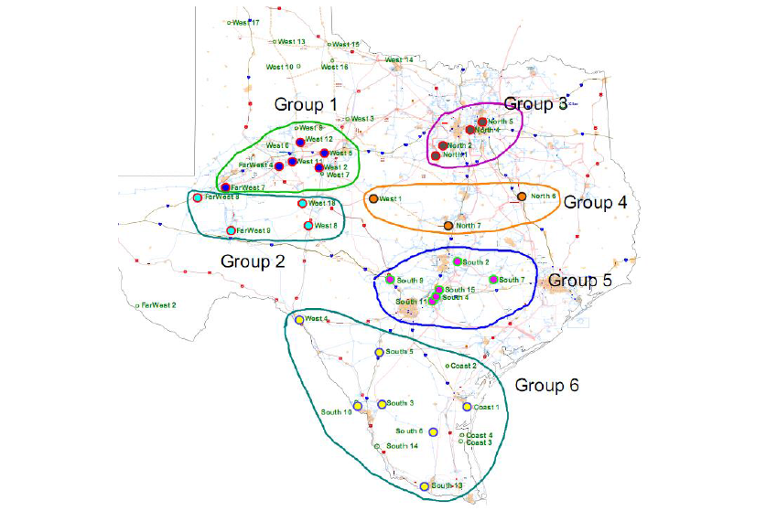
2013 Cluster results

Slide 11
PAIRS FOR REAL TIME MONITORING with updated clusters
Notes:
This chart shows the PMU locations and the region they are in. So you can see the locations that were selected for clusters.

Slide 12
Report findings
Angles and angle spreads from State Estimator data track well with those obtained with phasor data except for Gonzales and Beeville. Phasor data for these two substations is incomplete or unreliable.
Voltage angle fluctuations have been reduced and now they vary over a smaller range. There are only five substations with Max-Min angle spread of more than 60 degrees. The largest angle variations occurred among the substations in the southern part of the state: Railroad with 85.5 degrees (-40.3 to 45.2 degrees), Gulf Wind with 76.8 degrees ( -29.1 to 47.7 degrees), Penascal with 76.6 degrees (-29.1 to 47.5 degrees) and Airline with 71.2 degrees (-29.9 to 41.2 degrees).
Only two substations had a Max-Min angle spread of less than 20 degrees: Jewett (18.5 degrees) and Kendall (19.3 degrees). All other substations have Max-Min spreads in the 21 to 61 degrees range.
With the addition of the CREZ lines the voltage angles in the Central and Western part of the state (Odessa, Morgan Creek, Tonkawa, Permian Switch, Rio Pecos, Longshore, Central Bluff, Dermott and Sweetwater East) varied within a range significantly smaller than in 2013.
The four largest normal condition angles in degrees observed were at Gulf Wind (47.73), Penascal (47.74), Railroad (45.16) and Airline (41.21).
The smallest normal condition angles in degrees occurred at Railroad (-40.30) and Laredo (-33.46).
Notes:
Railroad and Laredo are areas where there appears to be more imports. Higher imports and more of the time.

Slide 13
How did the system change
Table 5 - BASELINING ANALYSIS UPDATE #3 - VOLTAGE ANGLE COMPARISON (February to July months) - 2012, 2013 and 2014
# | Angle Pair | 2012 Median | 2013 Median | 2014 Median | 2014-2013 Difference
1 | Matador-Killeen Switch | 13.12 | 9.42 | 3.29 | -6.13
2 | Riley-Killeen Switch | 7.84 | 8.99 | 3.36 | -5.63
3 | Edith Clark-Killeen Sw | N/A | N/A | 3.51 | N/A
4 | Cottonwood-Killeen Sw | N/A | 10.38 | 3.31 | -7.07
5 | Dermott-Killeen Switch | 9.90 | 8.46 | 3.03 | -5.43
6 | Sweetwater East-Killeen Sw | 9.45 | 8.34 | 3.04 | -5.30
7 | Odessa-Killeen Switch | 7.61 | 6.84 | 0.27 | -6.57
8 | Odessa-Kendall | 4.18 | 7.98 | -0.08 | -8.06
9 | Morgan Creek-Killeen Sw | 9.68 | 8.20 | 2.33 | -5.87
10 | Greenville Ave-Killeen Sw | -1.38 | -4.56 | -5.96 | -1.40
11 | Jewett-Killeen Switch | 5.31 | 3.71 | 2.84 | -0.87
12 | Airline-Killeen Switch | 11.21 | -0.36 | 0.90 | 1.26
13 | Railroad-Marion | 0.62 | -3.08 | -2.55 | 0.53
14 | Hamilton Road-Marion | -9.84 | -5.08 | -7.95 | -2.87
15 | Rio Pecos-Marion | 3.53 | 5.00 | -1.32 | -6.32
16 | Marion-Killeen Sw | 3.83 | -1.04 | 0.93 | 1.97
Notes:
Positive means the power flows into that area have increased over the period 2012 to June 2014. Also could mean the export has decreased from one area.
The voltage angles for substations in the West Texas and Panhandle areas have tightened (smaller angles referenced to Killeen Switch) significantly due to the addition during the second half of 2013 and January of 2014 of 22 new CREZ lines between these substations and the central area of Texas.
A re-distribution of power has occurred among the several transmission lines in the Valley area of Texas.
These voltage angle monthly medians are likely to change less in the future unless a significant amount of wind power is added in the western area and the Panhandle areas of Texas displacing generation in other areas such as the Valley area.
The new CREZ lines added in March 2014 are not expected to result in any major changes in voltage angle monthly medians.

Slide 14
Voltage Control Challenges in CREZ
Maintain voltages within operational limits
  Weak grid in the panhandle with no large synchronous generators to provide stability
  Long, highly compensated 345KV transmission lines to load centers in the north
  Extreme variability of wind power outputs and transfers
  Coordination between different Transmission Service Providers and the ERCOT Control room
  Minimize continuous variation and switching of control equipment
Notes:
Purposes for VSS

Slide 15
VOLTAGE SUPPORT SERVICES (VSS)
VSS is a tool built into the Alstom EMS Application
VSS application is designed to resolve voltage violations by solving an optimization problem
Uses following controls
  Shunt Capacitors/reactors
  Generators
  Transformers
Solves for both base case and post-contingency conditions.
Runs every five minutes along with State Estimator and Contingency Analysis
VSS application will be used to manage voltage violations in CREZ
Notes:
Tools that are used

Slide 16
VSS Results For TSPs
VSS results will be made available to all the TSPs using the SOTE application
TSPs will see the same displays available to ERCOT operators in the control room thus helping in communications between ERCOT and TSPs
Dashboard and Overview displays provided to improve CREZ TSPs’ situational awareness and system overview
Tabular displays to provide detailed information about the neighboring TSPs’ reactive device statuses and outputs, voltages and suggested control actions

Slide 17

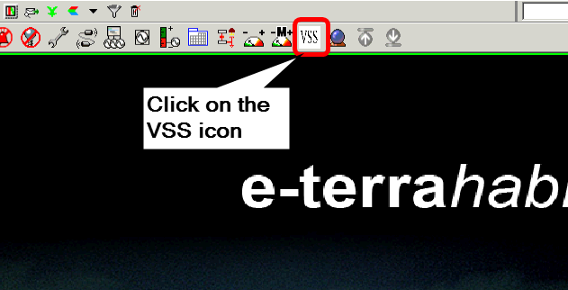
Access System Operations Test Environment (SOTE) and VSS Applications
Login to System Operations Test Environment (SOTE)
  Login into ERCOT Citrix using https://gateway.ercot.com/
  Click on the SOTEEMS icon to open the SOTE system
Once the SOTE application is open, click on the “VSS” icon in the toolbar on top of the window.

Slide 18
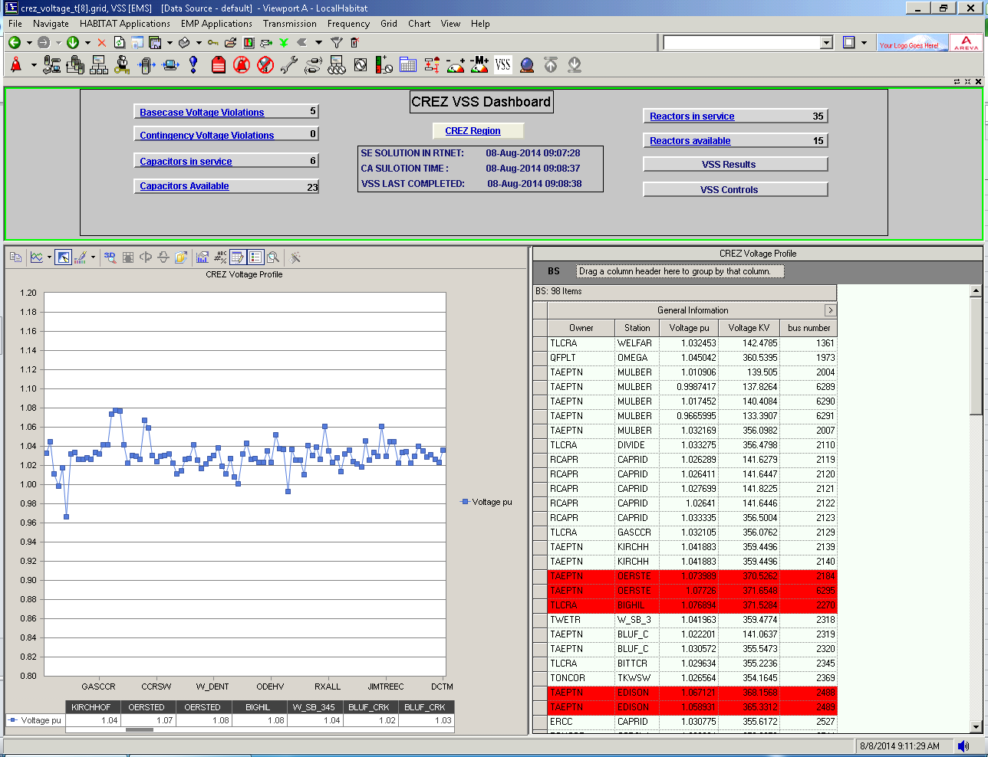
CREZ Dashboard Display

Slide 19
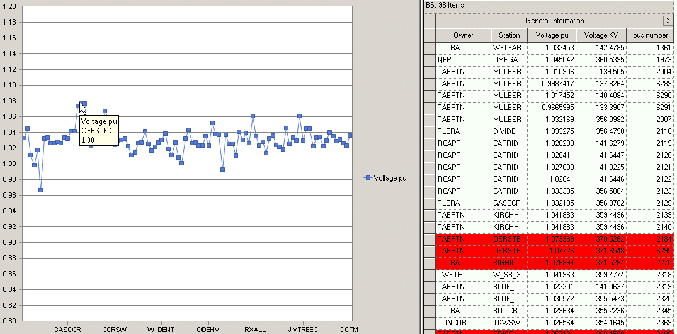
CREZ Dashboard Display (Continued)
Graph – Shows the PU voltages for all buses in the CREZ stations
  Hover mouse on the dots to display the Station name and Bus PU voltage
Tabular display – Shows Owner, Station, Voltage PU, Voltage KV etc..
  Highlights voltages above and below the limits

Slide 20

Application runtimes
SE, CA and VSS timestamps show the last successful runtime for these applications
Helps in identifying upstream application issues during failures

Slide 21
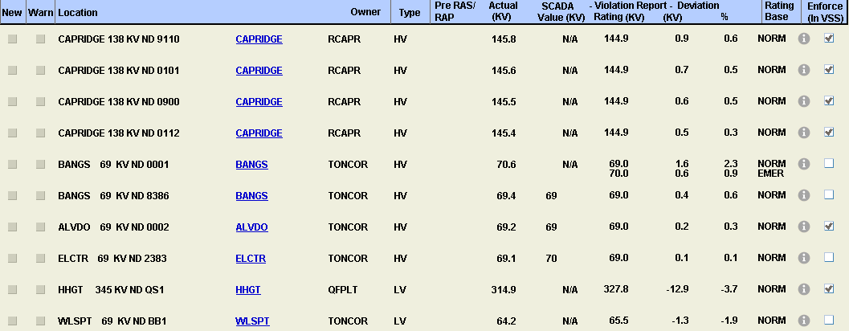
Activate violations to VSS - Basecase
Click on the “Basecase Voltage Violations” button to view the violations activated to VSS for resolution
ERCOT Operator has the option to activate / deactivate violations to the VSS application

Slide 22

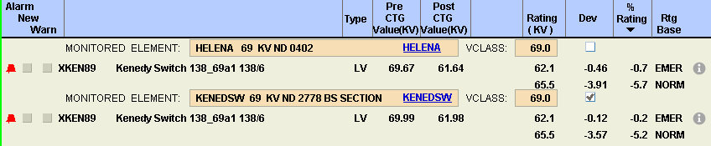
Activate violations to VSS – Contingency Analysis
Click on the “Contingency Voltage Violations” button to view the Contingency violations activated to VSS for resolution
ERCOT Operator has the option to activate / deactivate violations to the VSS application

Slide 23

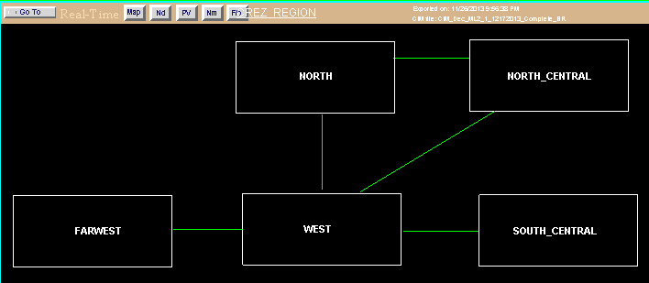
CREZ Overview Displays
Click “CREZ Region” button
  Shows 5 regions that the CREZ stations have been divided into

Slide 24
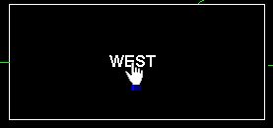
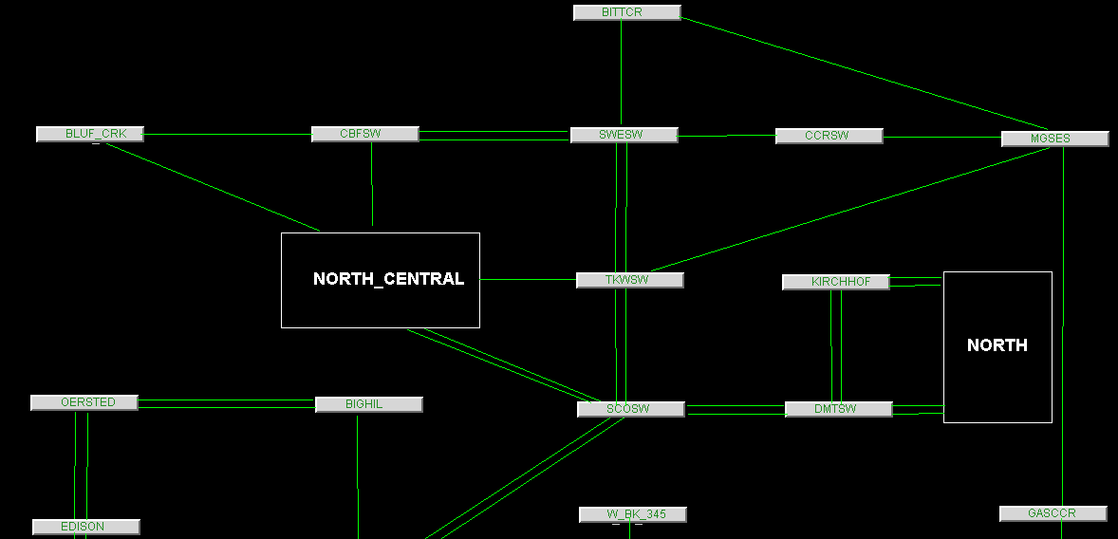
CREZ Overview Displays (Continued)
Click on any of the regions – Example “WEST”
  Shows the stations in the zone and the connectivity between the stations

Slide 25

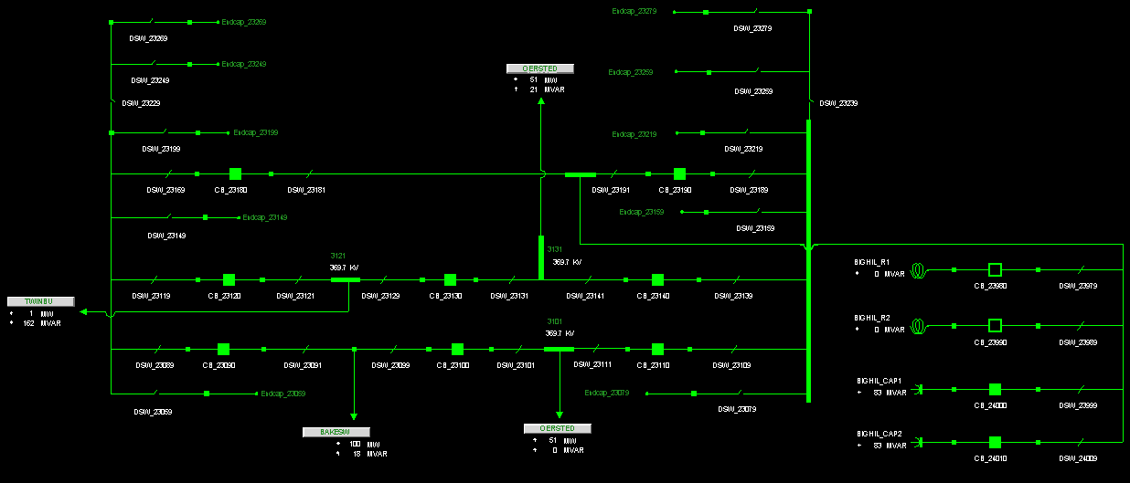
CREZ Overview Displays (Continued)
Click on any of the stations – Example “BITTER”
  Shows the station online for the selected station
  Same displays used by the ERCOT control room

Slide 26

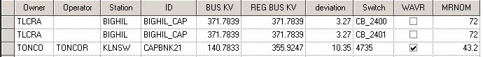

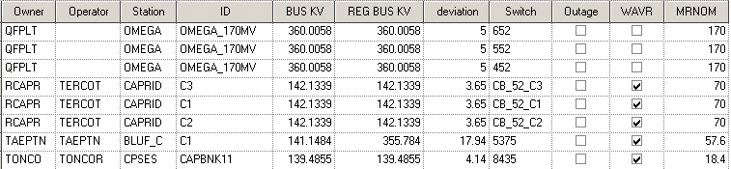
CREZ Capacitor / Reactor status – Example Capacitors
Click on “Capacitors in service” button
  Shows the CREZ region Capacitors that are switched in
Click on “Capacitors Available” button
  Shows the CREZ region Capacitors that are switched off but available to turn on

Slide 27

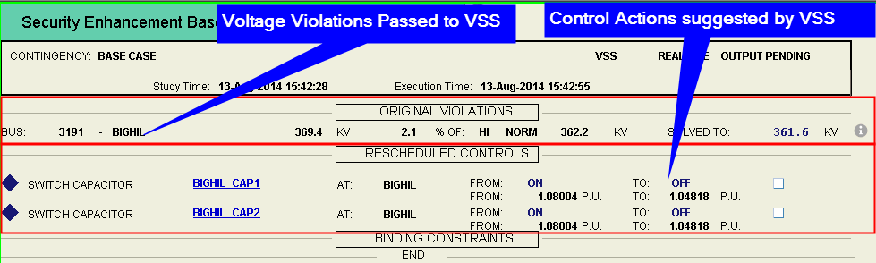
VSS Results
Click on “VSS Results” button
  Shows the violations activated to VSS by the ERCOT Operator
  Shows the Control Actions suggested by VSS

Slide 28

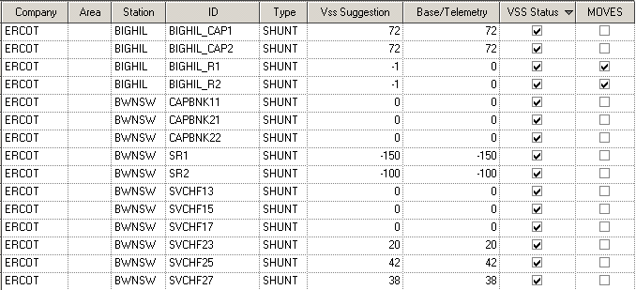
VSS Controls
Click on “VSS Controls” button
  Shows all reactive devices that can provide voltage control in the CREZ region

Slide 29
Initial List of Stations Identified As CREZ Related
Station | KV |  | Station | KV |  | Station | KV
AJ_SWOPE | 345 |  | EMSES | 345/138 |  | RILEY | 345
ALIBATES | 345 |  | FSHSW | 345/138 |  | RIOP | 138/69
ALLNC | 345 |  | GASCCR | 345 |  | RXALL | 138
BAKESW | 345 |  | GAUSS | 345/138 |  | SARC | 345/138
BELCNTY | 138/69 |  | GRSES | 345/138 |  | SWESW | 345
BGLK | 138/69 |  | GRVSW | 345 |  | TKWSW | 345
BIGHIL | 345 |  | HNDSW | 345 |  | TULECNYN | 345
BITTCR | 345 |  | JIMTREEC | 345 |  | VERN | 138/69
BLUF_CRK | 345/138 |  | KIRCHHOF | 345 |  | VERS | 138/69
BTHOT | 138 |  | KLNSW | 345/138 |  | W_BK_345 | 345
BURSW | 345 |  | LKWSW | 138/69 |  | W_CW_345 | 345
CAPRIDG4 | 345 |  | LNGSW | 345 |  | W_DENT | 345/138
CAPRIDGE | 345/138 |  | MCAM | 138/69 |  | W_FD_345 | 345
CCRSW | 345 |  | MOSSW | 345/138 |  | W_GT_345 | 345
CLEARCRO | 345/138 |  | MULBERRY | 345/138 |  | W_LD_345 | 345
CMNSW | 345/138 |  | NORTMC | 345/138 |  | W_SB_345 | 345
CPSES | 345/138 |  | ODEHV | 345/138 |  | WELFAR | 138
CTT_CROS | 345 |  | OECCS | 345 |  | WFSSW | 138
CTT_GRAY | 345 |  | OERSTED | 345 |  | WINDMILL | 345
DCTM | 345 |  | OGALLALA | 345 |  | WLVSW | 345/138
DIVIDE | 345 |  | OMEGA | 345 |  | WSHACK | 345
EDISON | 345 |  | PLVSW | 138/69 |  | WTCCS | 345
EDITHCLA | 345 |  | QALSW | 345 |  | ROMNEY | 345

Slide 30
Test questions
What is the purpose of VSS?
a) VSS application is designed to resolve voltage
violations by solving an optimization problem
b) Reactive testing
c) Day Ahead Market

Slide 31
Test questions
2. What ERCOT system is VSS provided from?
a)VSS is a tool built into the Alstom EMS
Application.
b)ABB Market system
c)Siemens Network Model
d)Outage scheduler

Slide 32
Test questions
3. What control/equipment that is used to manage voltage within VSS.
a)Shunt Capacitors/reactors, Generators, Transformers
b)Generators
c)Transformers
d)Line switching
e)Distribution

Slide 33
Test questions
4. What locations VSS is used for?
a)CREZ
b)Coastal
c)Local TO area

Slide 34
Test questions
5. What voltage limits that VSS will correct?
a)Solves for both base case and post-contingency
conditions.
b)RAPs
c)Mitigation Plans

Slide 35
Test questions
6. Where VSS is available for TOs?
a)VSS results will be made available to all the TSPs
using the SOTE application
b)MIS
c)ERCOT.com

