Slide 1

Critical Infrastructure Protection Updates (CIP Compliance)
Christine Hasha
Matt Mereness
April 2015

Slide 2
Objectives
At the end of this presentation you will be able to:
Explain why the electricity industry is under federal regulation for physical and cyber protection
Describe some of the physical and cyber risks to the electric grid
Identify why the regulations are continuing to change

Slide 3
Agenda
CIP Background and Policy
Physical Security
Cyber Security
Wrap-Up

Slide 4
CIP Background & Policy

Slide 5
What is Critical Infrastructure?
“Critical infrastructure is the backbone of our nation's economy, security and health. We know it as the power we use in our homes, the water we drink, the transportation that moves us, and the communication systems we rely on to stay in touch with friends and family.”
“Critical infrastructure are the assets, systems, and networks, whether physical or virtual, so vital to the United States that their incapacitation or destruction would have a debilitating effect on security, national economic security, national public health or safety, or any combination thereof.”
- Department of Homeland Security

Slide 6


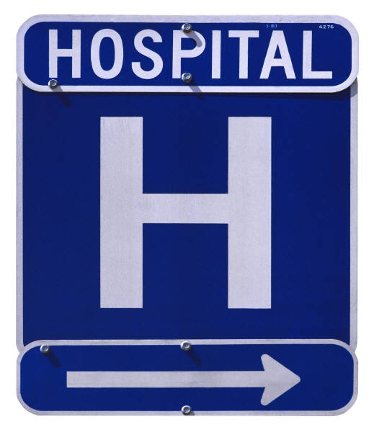
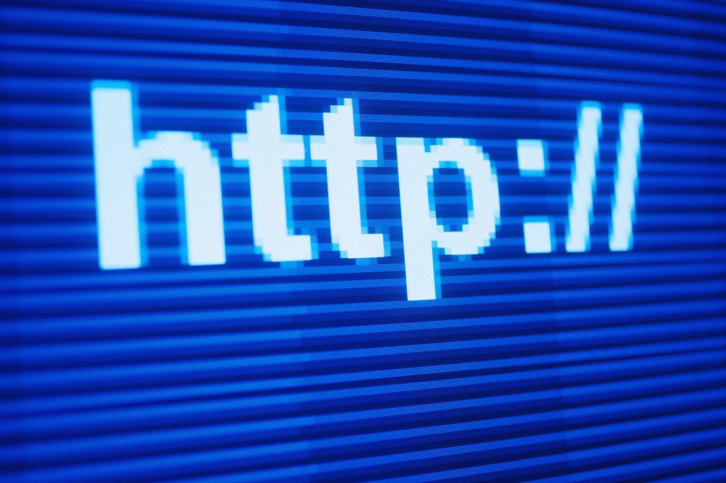

Critical Infrastructure Sectors
Chemical
Communications
Commercial
Critical Manufacturing
Dams
Defense Industrial Base
Emergency Services
Energy (power, oil, natural gas)
Financial Services
Food & Agriculture
Government Facilities
Healthcare & Public Health
Information Technology
Nuclear Reactors, Materials & Waste
Transportation Systems
Water & Wastewater Systems
Notes:
These are the 16sectors defined as critical infrastructure by the National Infrastructure Protection Plan. Each of these sectors is monitored daily by the Department of Homeland Security. There is a daily Infrastructure Report that summarizes information concerning significant critical infrastructure issues. You can get this by subscribing at the DHS website.

Slide 7
The Concern
Automated and interlinked computers and communications
More efficient economy and perhaps stronger economy
More vulnerable
The infrastructure is now a target
Vulnerable to threats from potential terrorism
Traditional
Nontraditional
Notes:
In the past, the systems and networks of the infrastructure elements were physically and logically independent and separate. With advances in technology, the systems within each sector became automated, and interlinked through computers and communications facilities.
While this increased reliance on interlinked capabilities helps make the economy and nation more efficient and perhaps stronger, it also makes the country more vulnerable to disruption and attack. Now, the elements of the infrastructure themselves are also considered possible targets of terrorism. The elements of the infrastructure are also increasingly vulnerable to a dangerous mix of traditional and nontraditional types of threats.

Slide 8

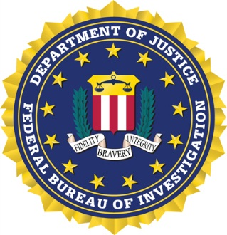






Agencies Protecting Critical Infrastructure
Federal
Department of Homeland Security (DHS)
Federal Bureau of Investigation (FBI)
Department of Energy (DoE)
Federal Energy Regulatory Commission (FERC)
North American Electric Reliability Corporation (NERC)
Electricity Sector Information Sharing and Analysis Center (ES-ISAC)
State
Public Utility Commission of Texas (PUCT)
Department of Public Safety (DPS)
ERCOT
Notes:
There are many agencies and groups that work together to address critical infrastructure protection from the state and federal levels.
DoE: Provides us with direction in the protection of energy critical infrastructure. We provide reports of incidents within the region
DHS & FBI: Provides us with information on threats and vulnerabilities. A number of ERCOT staff and other utility company staff have SECRET clearances to get the most detailed threat, vulnerability, and exploit information.
PUCT: Oversees initiatives to improve reliability and security in Texas. Reviews cyber security threats state-wide. In the event of a disaster, ERCOT provides critical grid information and restoration to promote public safety.
DPS: Reviews cyber security threats state-wide through the Fusion Center.
Electricity Sector Information Sharing and Analysis Center: Receives incident data from private and public entities. Coordinates with other sectors. Disseminates threat alerts, warnings, advisories, notices, and vulnerability assessments to the electric sector.
ERCOT: In the event of a disaster, ERCOT provides critical grid information and restoration to promote public safety. Annually, ERCOT performs blackstart training for the electric utility industry in Texas. We simulate a blackout and conduct an exercise to restore power to the communities. This is observed by some of the agencies listed. How many of you heard about GridEx? GridEx is conducted every two years. It is an international grid security exercise that simulates cyber and physical attacks to the power system. It is used for participants to validate their plans and readiness to address a real attack.

Slide 9
Critical Infrastructure Protection Regulation
The government policy requires industry in each critical sector to:
Assess its vulnerabilities to attacks
Physical
Cyber
Plan to eliminate significant vulnerabilities
Develop systems to identify and prevent attempted attacks
Alert, contain, and rebuff attacks
Rebuild in the aftermath
Prevent/Contain/Recover
Physical Attacks
Prevent/Contain/Recover
Cyber Attacks

Slide 10
CIP Standards Emerge
13 of the 46 Blackout Report Recommendations relate to cyber security (in response to 2003 Northeast Blackout).
Development of cyber security policies and procedures
Strict control of physical and electronic access
Assessment of cyber security risks and vulnerability
Capability to detect wireless and remote wireline intrusion and surveillance
Guidance on employee background checks
Procedures to prevent or mitigate inappropriate disclosure of information
Improvement and maintenance of cyber forensic and diagnostic capabilities
Notes:
13 of the 46 2003 Blackout Report Recommendations relate to these areas of cyber security.
Development of cyber security policies and procedures to determine how an organization will protect their computer assets
Strict control of physical and electronic access to their critical systems
Assessment of cyber security risks and vulnerability
Capability to detect wireless and remote wireline intrusion and surveillance
Guidance on employee background checks
Procedures to prevent or mitigate inappropriate disclosure of information
Improvement and maintenance of cyber forensic and diagnostic capabilities

Slide 11
Physical Security

Slide 12
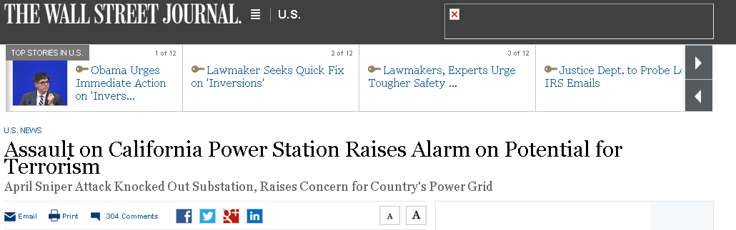
CIP-014-1 Physical Security
“The attack was "the most significant incident of domestic terrorism involving the grid that has ever occurred" in the U.S.”
-- Jon Wellinghoff, former Chairman of FERC

Slide 13
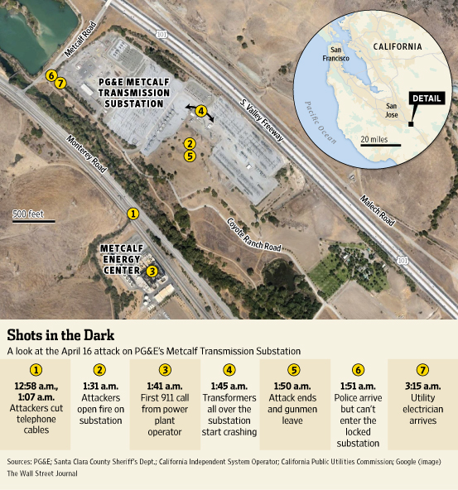
California Metcalf Attack – April 16, 2013

Slide 14
CIP-014-1 Physical Security
The attack began when someone slipped into an underground vault and cut telephone cables.
Within half an hour, sniper(s) opened fire on the substation. Shooting lasted for 19 minutes, knocking out 17 transformers.
A minute before a police car arrived, the shooter(s) disappeared into the night.
To avoid an area-wide blackout, electric-grid officials rerouted power around the site and asked power plants in Silicon Valley to produce more electricity.
It took utility workers 27 days to make repairs.
Nobody has been arrested or charged in the attack.

Slide 15
CIP-014-1 Physical Security
FERC Directive Mar 7, 2014
Approved by Industry Final Ballot May 5, 2014
Adopted by NERC Board of Trustees May 13, 2014
Approved by FERC Nov 20, 2014
Effective Oct 1, 2015

Slide 16
CIP-014-1 Physical Security
FERC directed creation of the Standard
Gave a 90-day time limit to complete
Applies to Transmission Owners of Substations with BES elements 200 kV and above and those Control Centers that they operate
Requires risk assessment, physical security plan, third-party verification of these
Notes:
Purposefully not prescriptive

Slide 17
Cyber Security

Slide 18
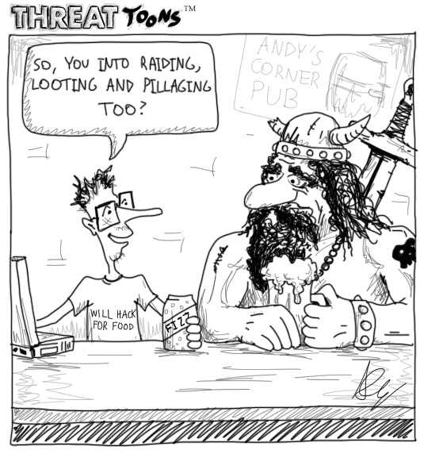
21st Century Cyber Attacker

Slide 19
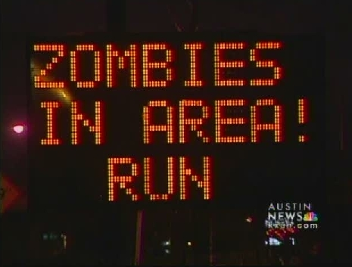
2009- Hacked road signs in Texas
Notes:
This occurred in Austin in January 2009. Again, someone forgot to change the default administrator password. This was reported on KXAN, FOX, and in Wired.

Slide 20
Current Cyber Threats
Heartbleed
Shellshock
CryptoLocker Ransomware
Advanced Persistent Threat
BlackEnergy Crimeware

Slide 21
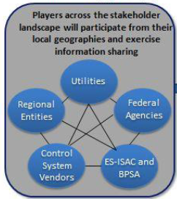
2013 GridEx II
Conducted by NERC every 2 years
Last conducted November 2013
Over 234 organizations with more than 2,000 individuals
Key bulk power system functions
Department of Homeland Security (DHS)
Federal Bureau of Investigation (FBI)
Department of Energy (DOE)
The exercise simulated:
Cyber attacks on corporate and control networks
Concurrent simulated physical attack degrading reliability and threatened public health and safety

Slide 22
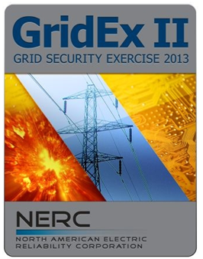
2013 GridEx II
GridEx II’s Objectives
Exercise the readiness of the industry to respond to a security incident
Review existing command, control, and communication plans and tools for NERC and its stakeholders
Identify potential improvements in physical security and cybersecurity plans, programs, and responder skills
Lessons Learned & Recommendations
Enhance information sharing and coordination
Challenges of simultaneous attacks
Continue improvement of incident response
Continue improvement of situational awareness
Continue to improve the Grid Exercise Program

Slide 23
CIP Standards Emerge and Evolve
2003 – NERC Urgent Action 1200
2008 – CIP Version 1
2009 – CIP Version 2
2010 – CIP Version 3
2016 – CIP Version 5 (High & Medium Impact)
2017– CIP Version 5 (Low Impact)
Cyber standards change rapidly, driven by:
Actual events
Technology changes
Directives from national level security
Lessons learned in what-if scenarios
Notes:
In August 2003, NERC approved the Urgent Action 1200 standard, which was the first comprehensive cyber security standard for the electric industry. This was voluntary and applied to control areas, transmission owners and operators, and generation owners and operators that perform defined functions.
CIP Version 1 had a 3 year phased implementation period. The earliest enforcement was 6/30/2008.

Slide 24
Current changes coming in CIP Versions 5
The NERC CIP Standards Version 5 is the first major change in requirements and approach in a decade, representing significant progress in mitigating cyber risks to the bulk power system.
CIP v6 is on horizon already (based on FERC Order 791)
Identify, Assess, Correct (IAC)
Low Impact Assets
Communication Networks
Transient Devices

Slide 25
Wrap-Up

Slide 26
Wrap-Up
Why we do this:
Electricity sector is part of national critical infrastructure
National interest and standards for securing critical infrastructure
Securing the infrastructure includes plans to not only prevent problems, but also to detect, contain, and recover
Cyber protection requirements are changing rapidly with technologies
How we go about it:
Physical protection is changing with new CIP-014-1
CIP begins moving from Version 3 to Version 5 on April 1, 2016

Slide 27
Questions?

Slide 28
Questions?
Which industries are identified as Critical Infrastructure Sectors?
Energy (power, oil, natural gas)
Communications
Information Technology
All of the above

Slide 29
Questions?
Which of the following agencies are responsible for protecting Critical Infrastructures within ERCOT.
DOE
PUCT
DPS
All of the above

Slide 30
Questions?
What Electric Industry exercise is conducted by NERC every two years?
Winter Storm Drill
GridEx
Blackstart
Wildfire Response

Slide 31
Questions?
What criteria drives changes in the NERC cyber security standards?
Actual events
Technology changes
Directives from national level security
All of the above

