Slide 1

CEO Perspectives
Trip Doggett
President & CEO
ERCOT
2015 ERCOT Operations Training Seminar
March & April 2015

Slide 2
Opening Remarks

Slide 3

2014 in Review
Improved systems and tools (76 NPRRs of which 21 required system changes) that support competitive wholesale and retail energy markets and reliable grid operations
Completed implementation of the Operating Reserves Demand Curve, enhancing the effectiveness of scarcity pricing for energy
Took important steps to address transmission needs to maintain electric reliability in the Houston area and identified other future challenges
Implemented a new, more effective load forecasting methodology, using premise counts as the basis
Achieved a 2 day reduction in the settlement cycle

Slide 4
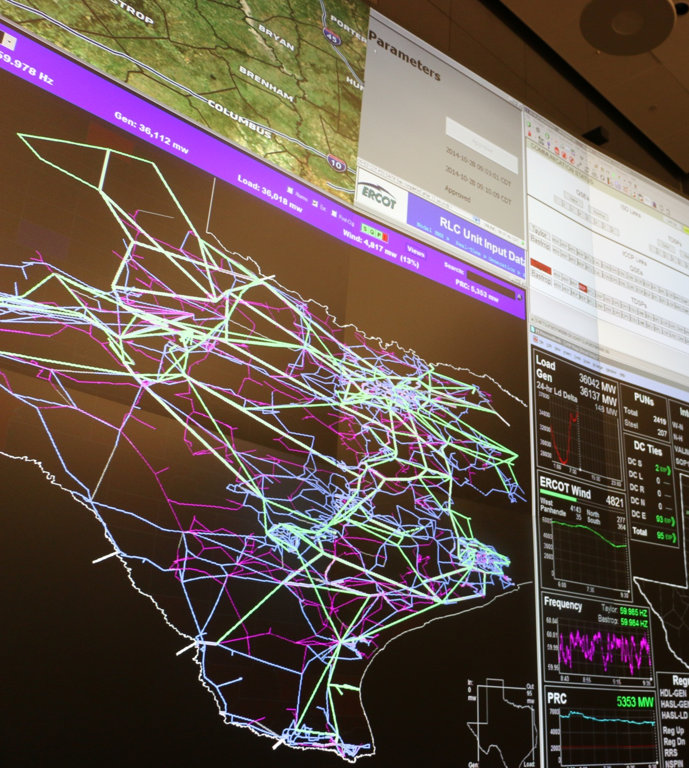
2014 in Review: Managing today, preparing for tomorrow
Identified and defined, with stakeholders, the Ancillary Services needed to support reliability of the future electric grid
Completed upgrades to the Taylor Control Center to continue improving operations
Developed capability for demand response providers to participate in Real-Time Energy Market
Evaluated and reported on the potential impacts of new and pending environmental regulations on future grid reliability
Responded effectively to emergency conditions, maintaining a reliable grid during extreme winter weather and localized challenges

Slide 5

2014 in Review: Using resources wisely
Achieved at least $4.9 million in cost savings through vendor collaborations and other strategic activities
Developed and executed departmental business plans that support ERCOT strategic initiatives
Improved framework and processes for Enterprise Risk Management activities
Supported the community in numerous ways, providing donations and services to organizations serving children, the elderly, veterans and schools

Slide 6
Current Records – April 1, 2015
Peak Demand Record: 68,305 megawatts (MW)
68,305 MW, August 3, 2011
Weekend Record
65,159 MW, Sunday, August 28, 2011
Winter Peak Record: 57,265 MW
57,265 MW, February 10, 2011
Wind Generation Records (instantaneous)
11,154 MW, February 19, 2015, 10:52 p.m.
  Non-Coastal Wind Output = 9,872 MW
  Coastal Wind Output = 1,282 MW
  Supplying 34.2% of the load
  Active Wind Capacity = 13,370 MW
40.58 % Wind Penetration, March 29, 2015, 2:12 a.m.
  Total Wind Output = 10,308 MW
  Total Load = 25,400 MW
Summer 2014 Demand
  59,786 MW, June 30
  63,532 MW, July 21
  66,454 MW, August 25
  64,440 MW, September 10
  No new records

Slide 7
Load

Slide 8
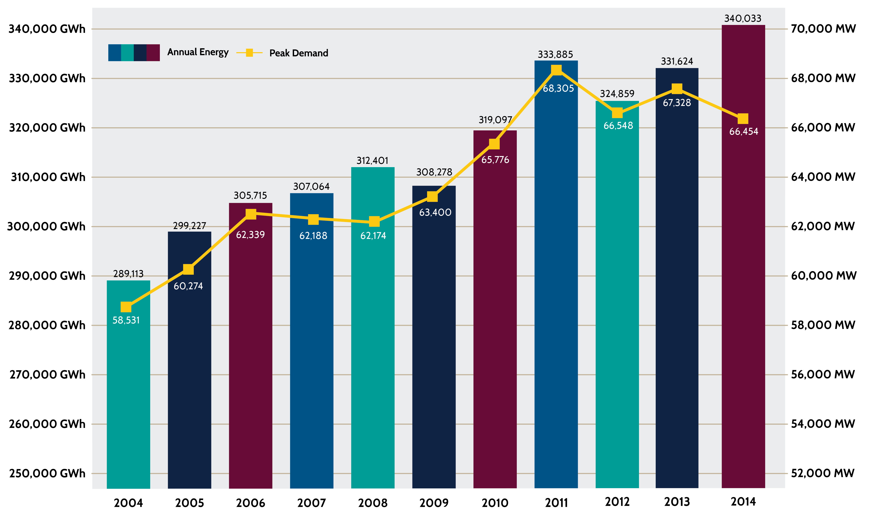
Annual Energy and Peak Demand (2004-2014)

Slide 9
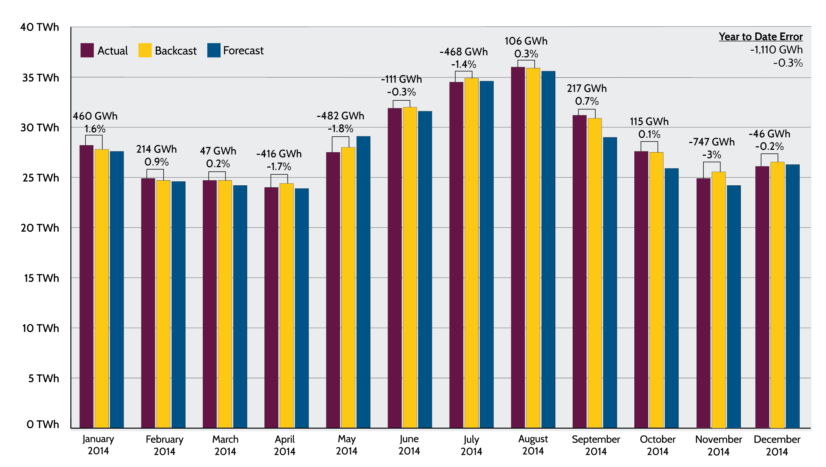
2014 Load Forecast Performance Summary
Notes:
To be updated on Jan 2nd after Calvin provides data for 2014.

Slide 10
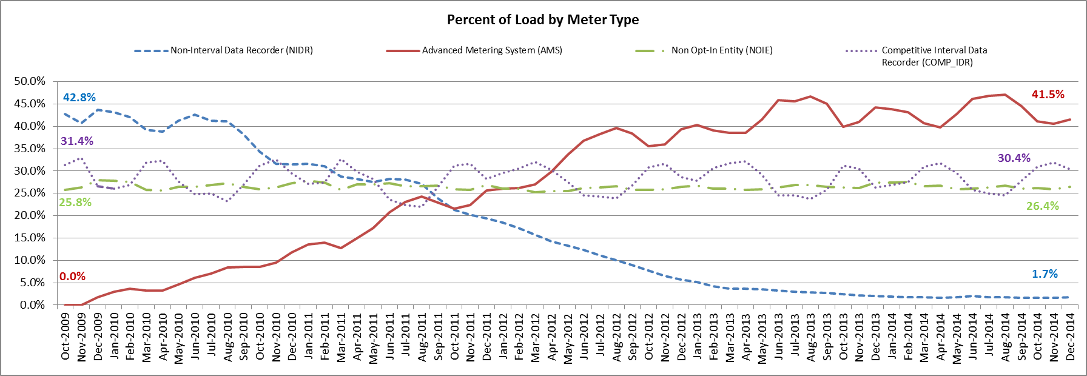
15-Minute Load Data
The abundance and timeliness of 15-minute load data contributes to settlement stability and opens the door for other advancements
Notes:
15-min load data stats:
Over 6.7M ESIIDs are settled using Advanced Meter data
AMS deployment is near complete, < 5% remain to be provisioned
Sharyland will file AMS deployment plan with the commission in 2015, therefore AMS numbers will increase
Over 98% of the load in ERCOT is settled with 15-min interval data (AMS, Competitive IDR, and NOIE IDR).
Over 67% of the 15-minute interval data is quickly available for use on RTM Initial Settlement (~5 days later)
ESI ID Counts by Meter Type:
- AMS: > 6.7M ESI IDs
- Competitive IDR: ~ 12K ESI IDs
- NOIE IDR ESI IDs: ~ 1300 ESI Ds
- NIDR: ~ 295K ESI IDs
- TOTAL: ~ 7M ESI IDs
“Settlement Stability”:
Reduced need for ERCOT to profile and estimate load for 15-minute intervals → increases accuracy
Increased “actual” data on Initial Settlement → less settlement volatility throughout the settlement cycle
Both of these contribute towards to reduced UFE. UFE levels steadily decreased, while 15-min data availability steadily increased
“Other advancements”:
Wholesale demand response
Retail products and services

Slide 11
Resources

Slide 12
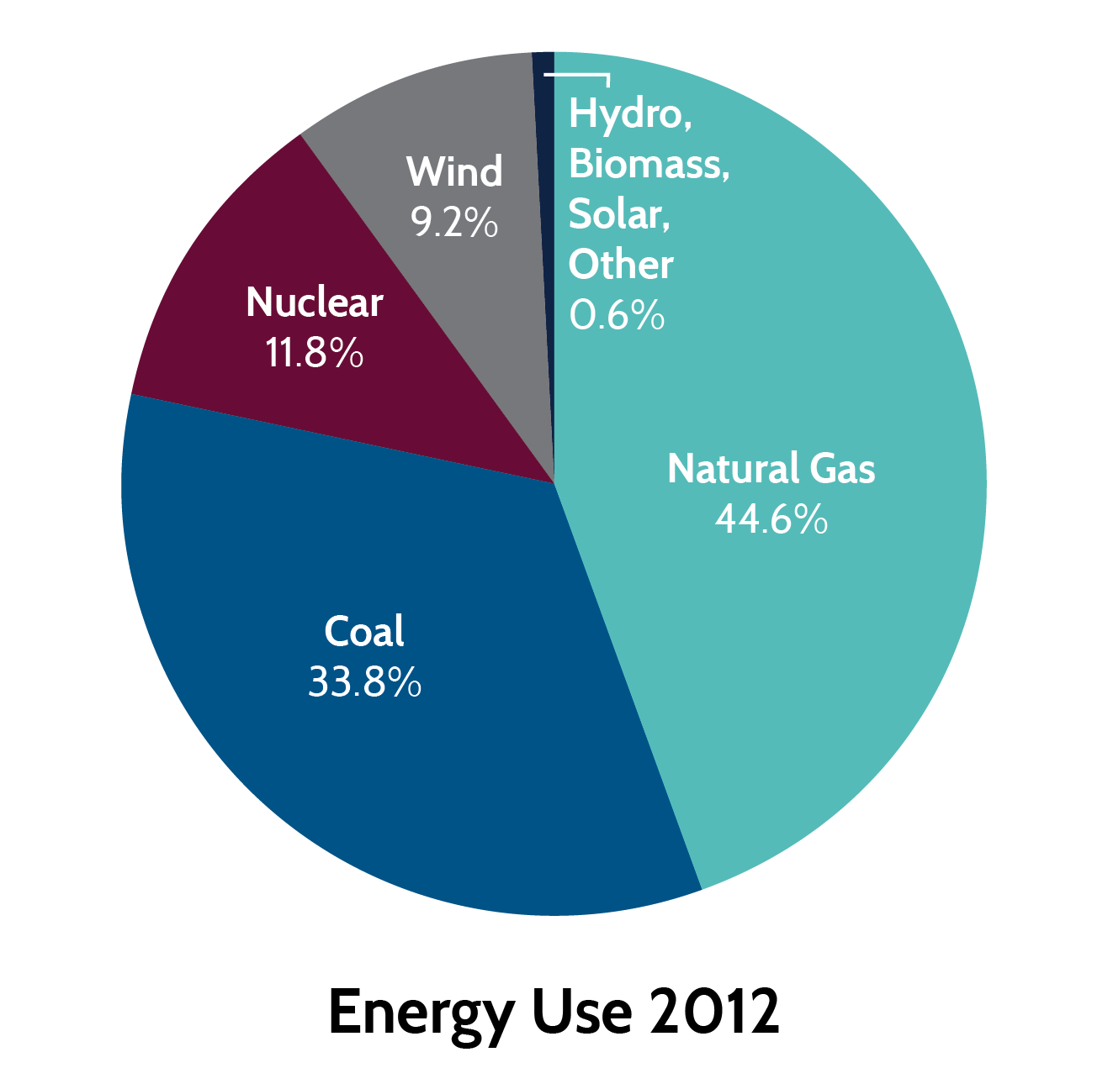
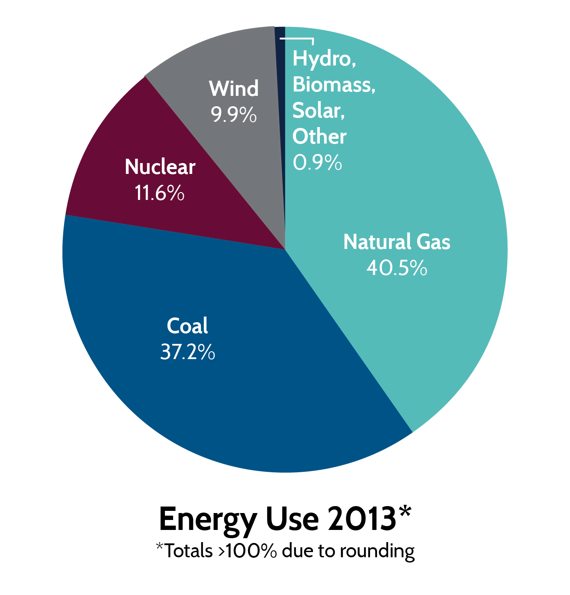
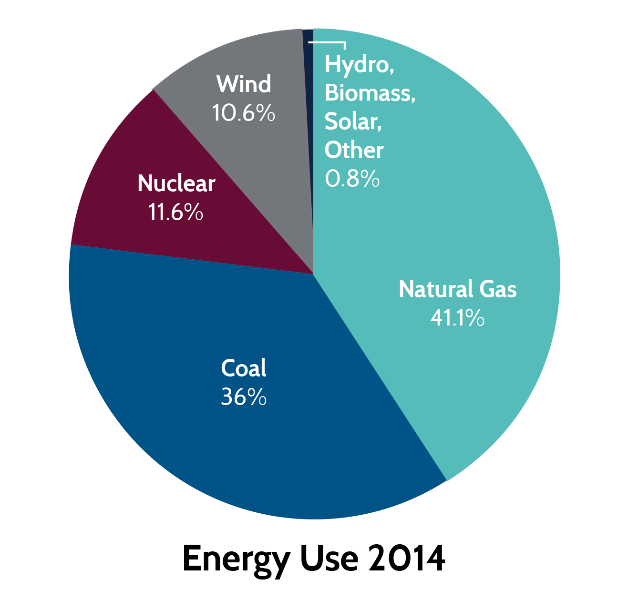
Energy Use Comparison
Total energy consumed:
324,859,701 MWh
Total energy consumed:
331,624,102 MWh
Total energy consumed:
340,033,353 MWh

Slide 13
Capacity, Demand & Reserves (CDR)

Slide 14
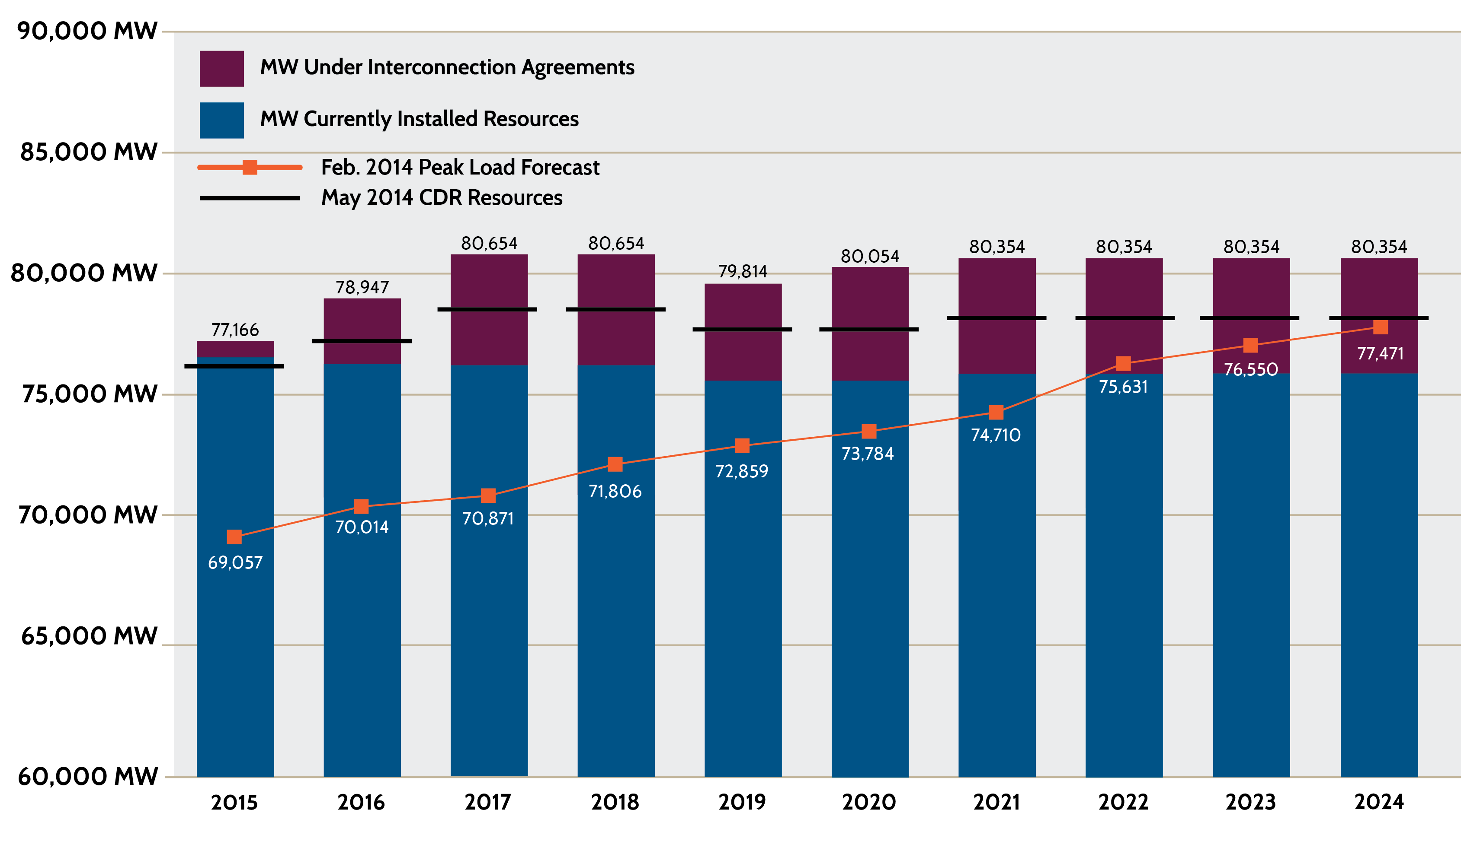
December 2014 CDR compared to May 2014

Slide 15
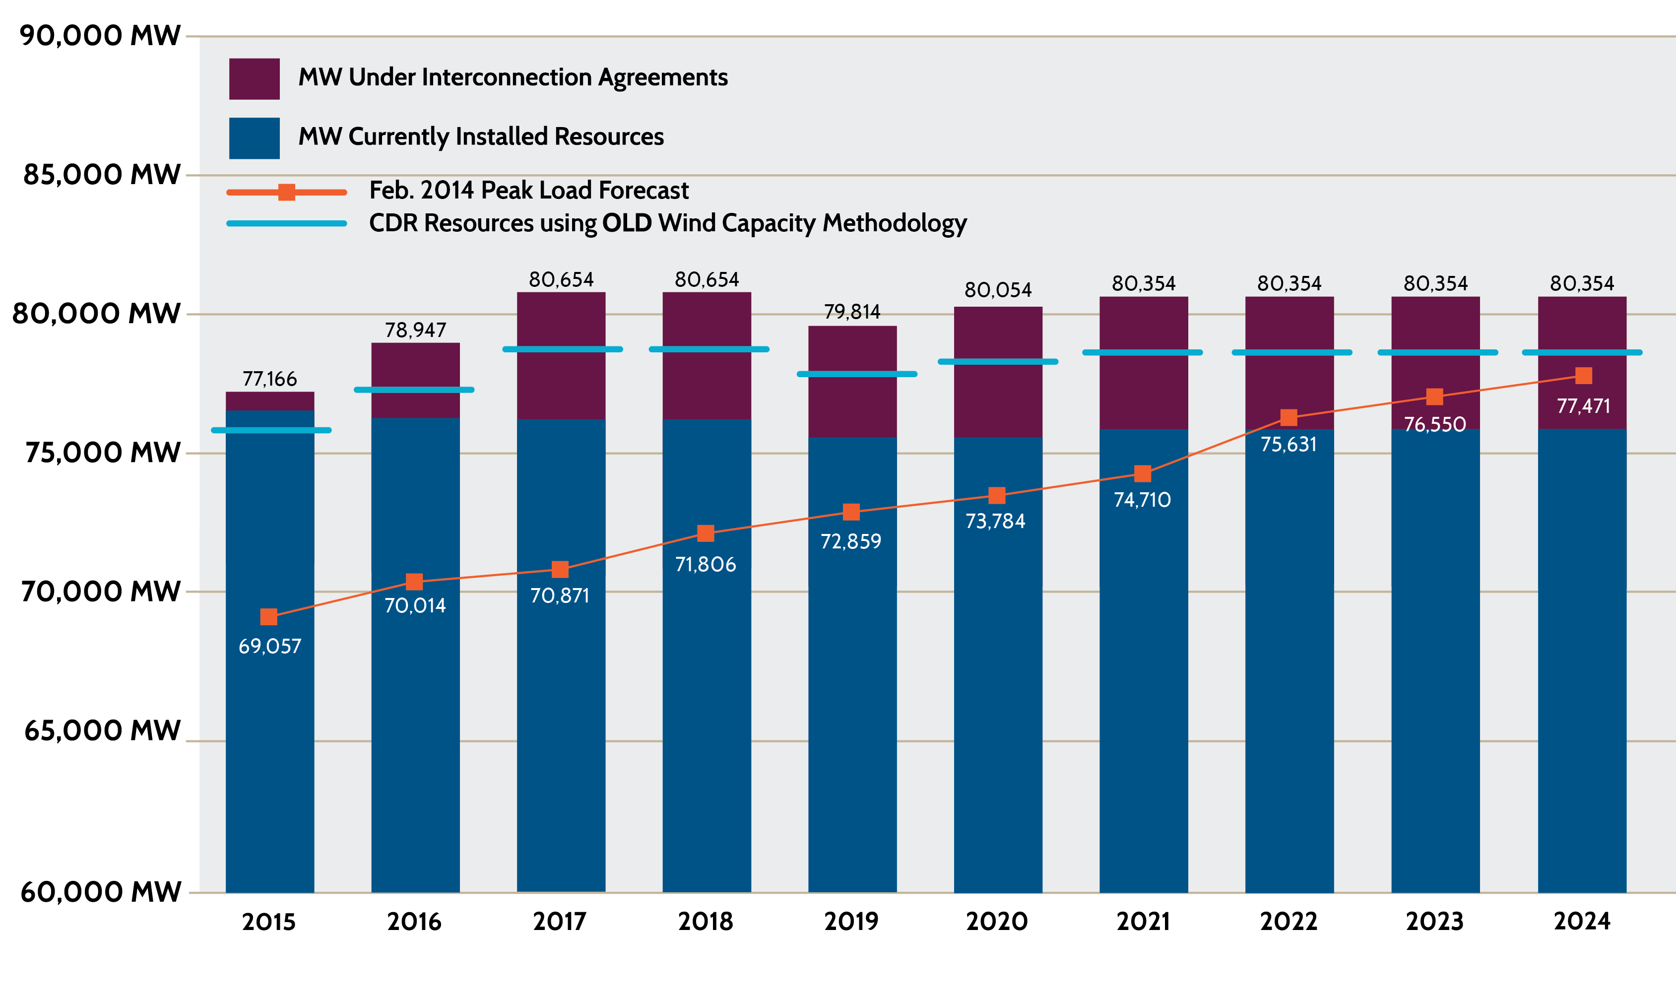
Effect of Wind Capacity Methodology Changes
Notes:
Resources using old Wind Capacity Methodology
2015 75,847
2016 77,307
2017 78,886
2018 78,886
2019 78,046
2020 78,286
2021 78,586
2022 78,586
2023 78,586
2024 78,586

Slide 16

Effect of Load Forecast Methodology Change
Notes:
2013 Load Forecast
2015 72071
2016 74191
2017 75409
2018 76186
2019 76882
2020 77608
2021 78380
2022 79055
2023 79651
2024 80194

Slide 17
Wind Generation Capacity – March 2015
Texas is #1 in the U.S. in wind capacity.
Our capacity is more than twice the amount of #2 (California)
If Texas were a separate country, we’d be #6 in the world in wind generation capacity (as of end of 2014).

Slide 18
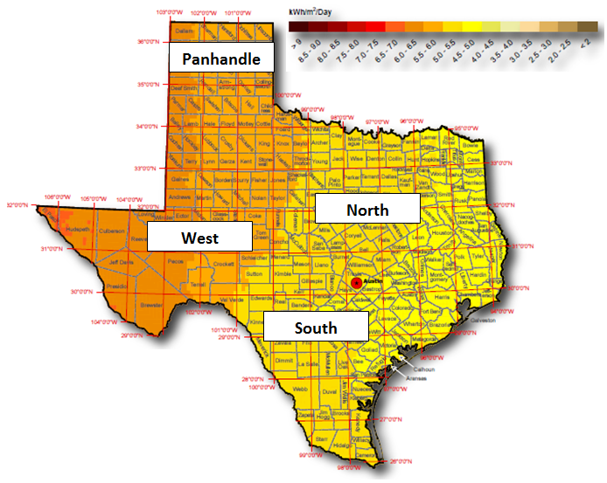
Installed and Planned Solar Capacity by Area – December 2014

Slide 19
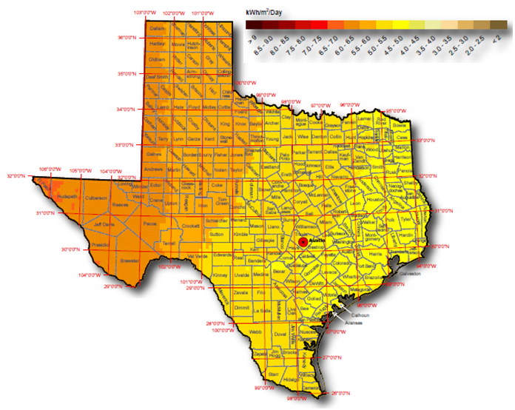
Cumulative Installed and Planned Solar Capacity – December 2014

Slide 20
Potential Impacts of Environmental Regulations
ERCOT reviewed potential impacts of new and pending environmental regulations on grid reliability.
Included CSAPR, MATS, Regional Haze, Clean Water Act Section 316(b), Ash Disposal Regulations & Clean Power Plan
Studies indicate:
Half of coal-fired generation capacity (about 9,000 MW) is likely to retire by 2022.
Retirement of units serving urban areas may result in localized reliability issues.
Growth in renewable resources may require development of new or additional generation and transmission facilities and technologies to manage operational issues (e.g., ramping, inertia, etc.).
Costs of compliance could drive up consumer energy costs as much as 20%.
  Does not include costs of transmission upgrades or other investments to support grid reliability
ERCOT and other grid operators support incorporation of “safety valve” provisions to allow sufficient flexibility to maintain system reliability.

Slide 21
Successes & Initiatives

Slide 22
Black Start – Electric/Gas Coordination
Black Start Gas Coordination Group (BSGCG)
  The four major intrastate gas pipelines provided the BSGCG with a list of priority loads that would need off-site power during a black start event in order to maintain gas flows to Black Start Resources
  Transmission Operators incorporated these loads in their Black Start Plans as priority loads
  2015 Black Start Plans include all of the gas pipeline priority loads
Electric Gas Coordination in Real-Time
  Enhanced communication with gas pipelines through Confidentiality Agreements in place that allow ERCOT to have better situational awareness in terms of gas pipeline restrictions.
Notes:
BSGCG – The Black Start Gas Coordination Group is comprised of ERCOT Transmission Operators and gas pipeline and storage operators. Coordination on both sides has been very good. Gas pipelines are understanding the difficulties of getting off-site power to their stations and are looking at back-up generation options. Many of the gas pipeline compressor stations have dual drive compressors. Approximately 15 loads within the ERCOT footprint require off-site power. There has been quite a bit of coordination between TOs to energize some of these loads located in the Eagle Ford Shale.
Real-Time – Two NDAs in place at this time (Atmos Pipeline and Enterprise Products). A third is under legal review with the gas pipeline (Energy Transfer). All of the pipelines are willing to work with ERCOT in terms of communicating operational issues occurring on the pipelines. ERCOT received notification of gas restrictions in the DFW area almost 24 hours earlier (than for previous cold snaps) during the cold snap in November 2014 with the enhanced communication with Atmos. We are receiving notification at the same time generators are advised.

Slide 23
Sub-Synchronous Oscillations
The use of series capacitors on long 345 kV transmission lines in ERCOT has led to concerns that sub-synchronous oscillations (SSO) could damage existing and new generation units
Series capacitors are located on two circuits into the Lower Rio Grande Valley and on new CREZ circuits in West Texas
Units are at greater risk when they are electrically close (i.e., lower impedance and closer to a radial connection) to series compensated lines
ERCOT is working with the PUC and Stakeholders to assist in developing policies that ensure adequate protection of generating units from SSO

Slide 24
2015 Key Initiatives
Implement NPRR 626 – (Reliability Deployment Price Adder; formerly “ORDC Price Reversal Mitigation Enhancements”)
Implement NPRR 588 (Clarifications for PV Generation Resources)
Complete Cost Benefit Analysis on Ancillary Services Redesign (NPRR667)
Continue work on Synchronous Inertial Response (SIR) and explore developing a market for SIR
Continue to explore and evaluate Real-Time Co-optimization and Multi-Interval Security Constrained Economic Dispatch (SCED) [Concept Paper submitted to TAC in September 2014]
Develop a “Roadmap” to accommodate more Distributed Energy Resources (batteries, rooftop PV, small distributed generation and load resources)
Evaluate findings of the Voltage Reduction Task Force and develop action plans

Slide 25
Distributed Energy Resources
Distributed Energy Resources (DERs) include solar photovoltaic (PV) installations, small wind turbines, batteries, small generators, and advanced demand response.
Identify potential future impacts of DERs on ERCOT’s functions – including but not limited to load forecasting, network modeling, real-time grid operations, metering and settlement.
Identify and, when possible, eliminate barriers to DER participation in ERCOT markets, including developing ways for appropriate wholesale market price signals to be delivered to DERs
Notes:
Slide #5

Slide 26
Transmission Projects

Slide 27
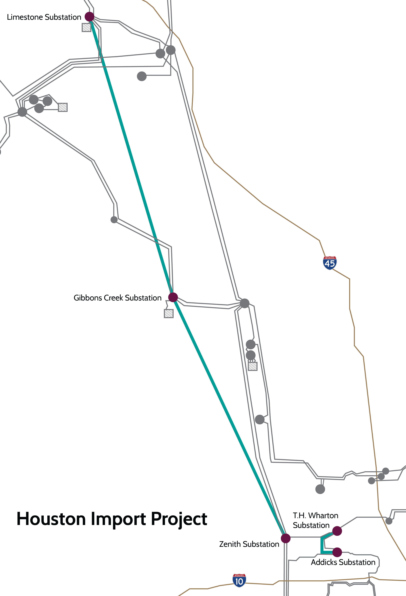
Houston Import Project
On April 8, 2014, the ERCOT Board of Directors endorsed the Houston Import Project:
New Limestone-Gibbons Creek-Zenith 345 kV double-circuit line deemed critical
Includes improvements to substations and other existing facilities
Scheduled for completion by summer 2018

Slide 28
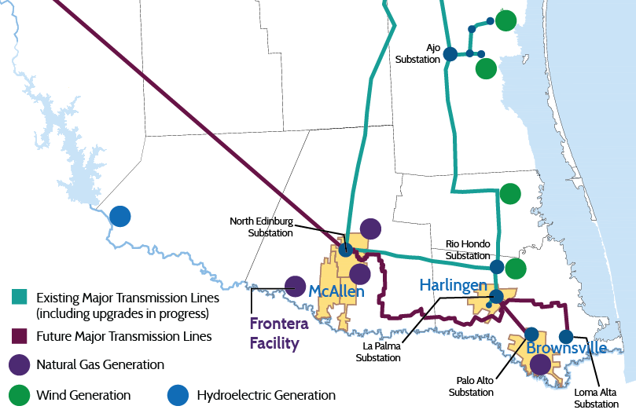
Lower Rio Grande Valley Projects
Valley Import Project
Includes new Lobo – North Edinburg 345 kV line and upgrade of existing Valley import 345 kV lines
Scheduled for summer 2016 in-service
Cross Valley Project
Includes North Edinburg – Loma Alta 345 kV line
Scheduled for summer 2016 in-service

Slide 29
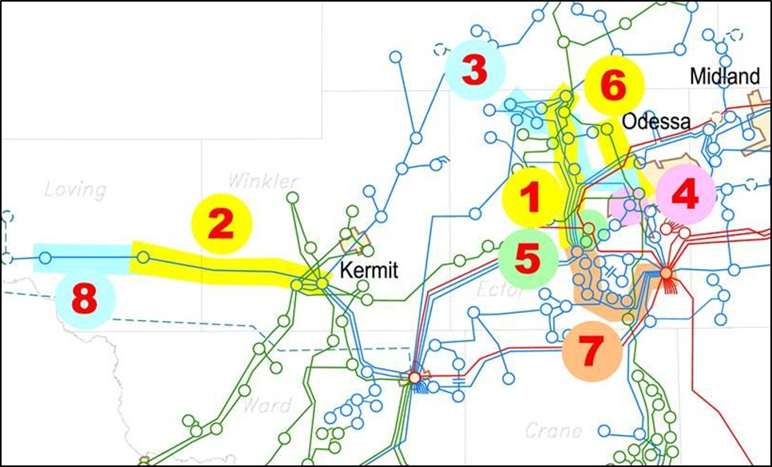
Recent Permian Basin Transmission Projects
      Moss – Holt Switch 138 kV line upgrade – January 2014
      Wink – Loving 138 kV line upgrade – January 2014
      Odessa North – Goldsmith Junction 138 kV line upgrade – May 2014
      Odessa North 138 kV switching station construction – May 2014
      Moss 345 kV switching station circuit breaker installation – May 2014
      Odessa North – Cowden 69 kV line upgrade – May 2014
      Moss – Odessa EHV 138 kV line upgrade – May 2014
      Loving – Elmar 138 kV line upgrade – June 2014

Slide 30
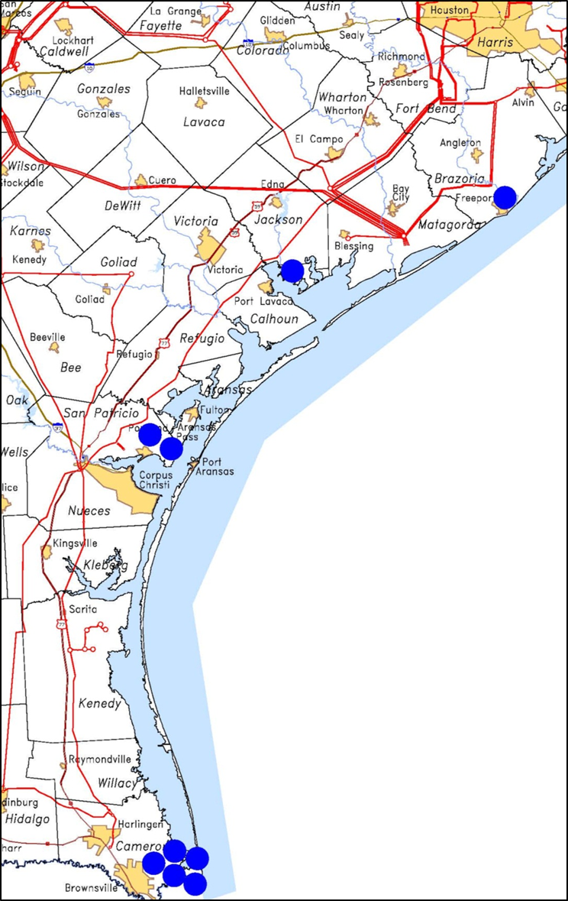
Liquefied Natural Gas (LNG) Facilities
Nine proposed LNG facilities in ERCOT
Production of LNG is an energy intensive process; However, many LNG projects use gas driven compressors which have much lower electric load consumption than electric driven compressors
Freeport LNG, which will utilize electric driven compressors, is the furthest along in the permitting process and is expected to add approximately 700 MW of net load to the ERCOT System starting in 2017
ERCOT reviewed and endorsed the Jones Creek project which includes $78 million in transmission upgrades in the Freeport area

Slide 31
Drought

Slide 32
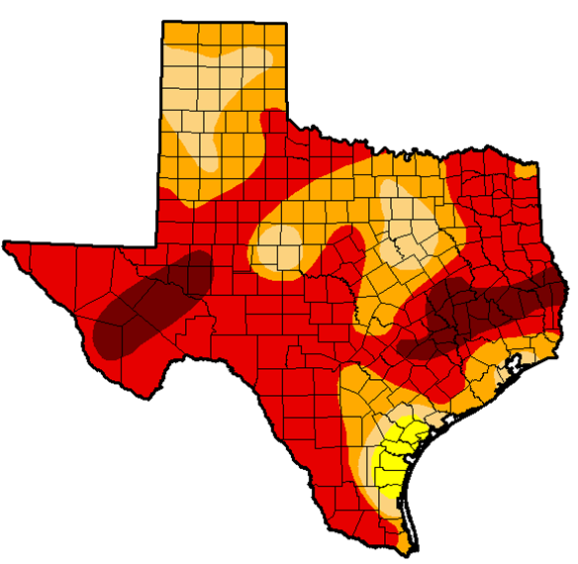
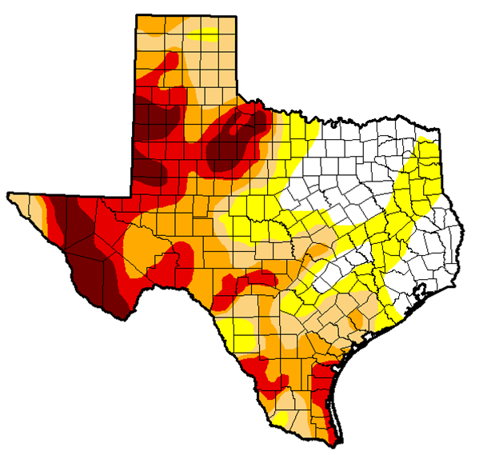
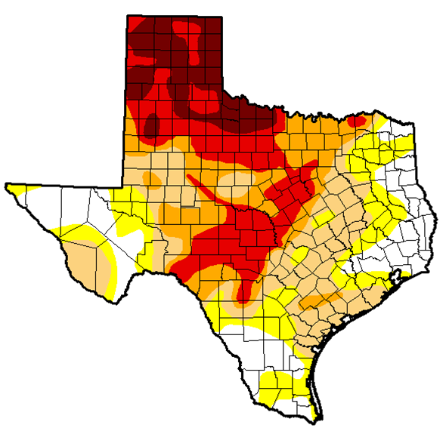
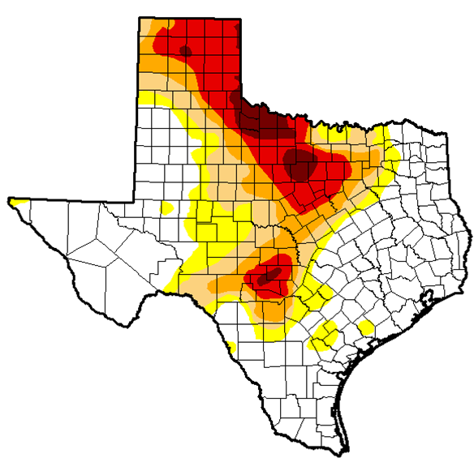
Historical versus Current Drought Conditions
Apr 2011
Apr 2012
98% of the state
in moderate or worse drought
64% of the state
in moderate or worse drought
Apr 2014
Apr 2015
66% of the state
in moderate or worse drought
35% of the state
in moderate or worse drought
Maps from National Drought Mitigation Center

Slide 33
Security

Slide 34

ERCOT Cyber & Physical Security Program
ERCOT has a dedicated and integrated cyber/physical security organization and established strategy
ERCOT uses layered cyber and physical security architectures known as a defense-in-depth strategy along with careful monitoring
ERCOT is committed to external collaboration with relevant government agencies, law enforcement, industry and national labs to enhance its and the industry’s security posture

Slide 35



















External Collaboration
Federal/National:
State:
Industry:
National Labs:
Critical Infrastructure
Protection Working Group
(CIPWG)
Utility Owners/Operators
Notes:
Federal agencies: DHS, US-CERT, ICS-CERT, DOE and FBI
National agencies: FERC, NERC, ESISAC and NESCO
State agencies: PUCT, DPS, State of Texas DIR
Industry members: ISO/RTO Council, NATF, Regional Critical Infrastructure Protection Working Group (CIPWG)
National Labs: INL, PNNL, SNL, Argonne
CIPWG highlights:
Provides information sharing and collaboration on NERC CIP compliance, cyber security and physical security
35 Texas utility owner and operator entities participating
186 industry members including PUCT, DPS, DHS

Slide 36
Social Media Update

Slide 37
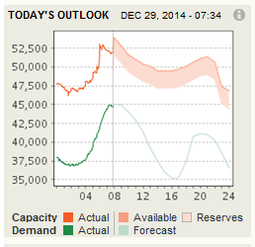
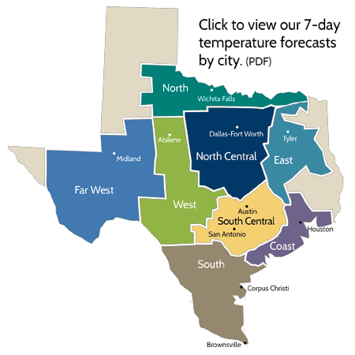



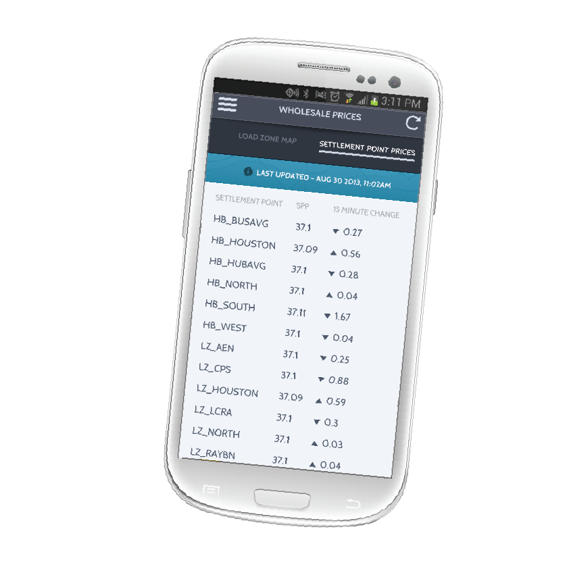
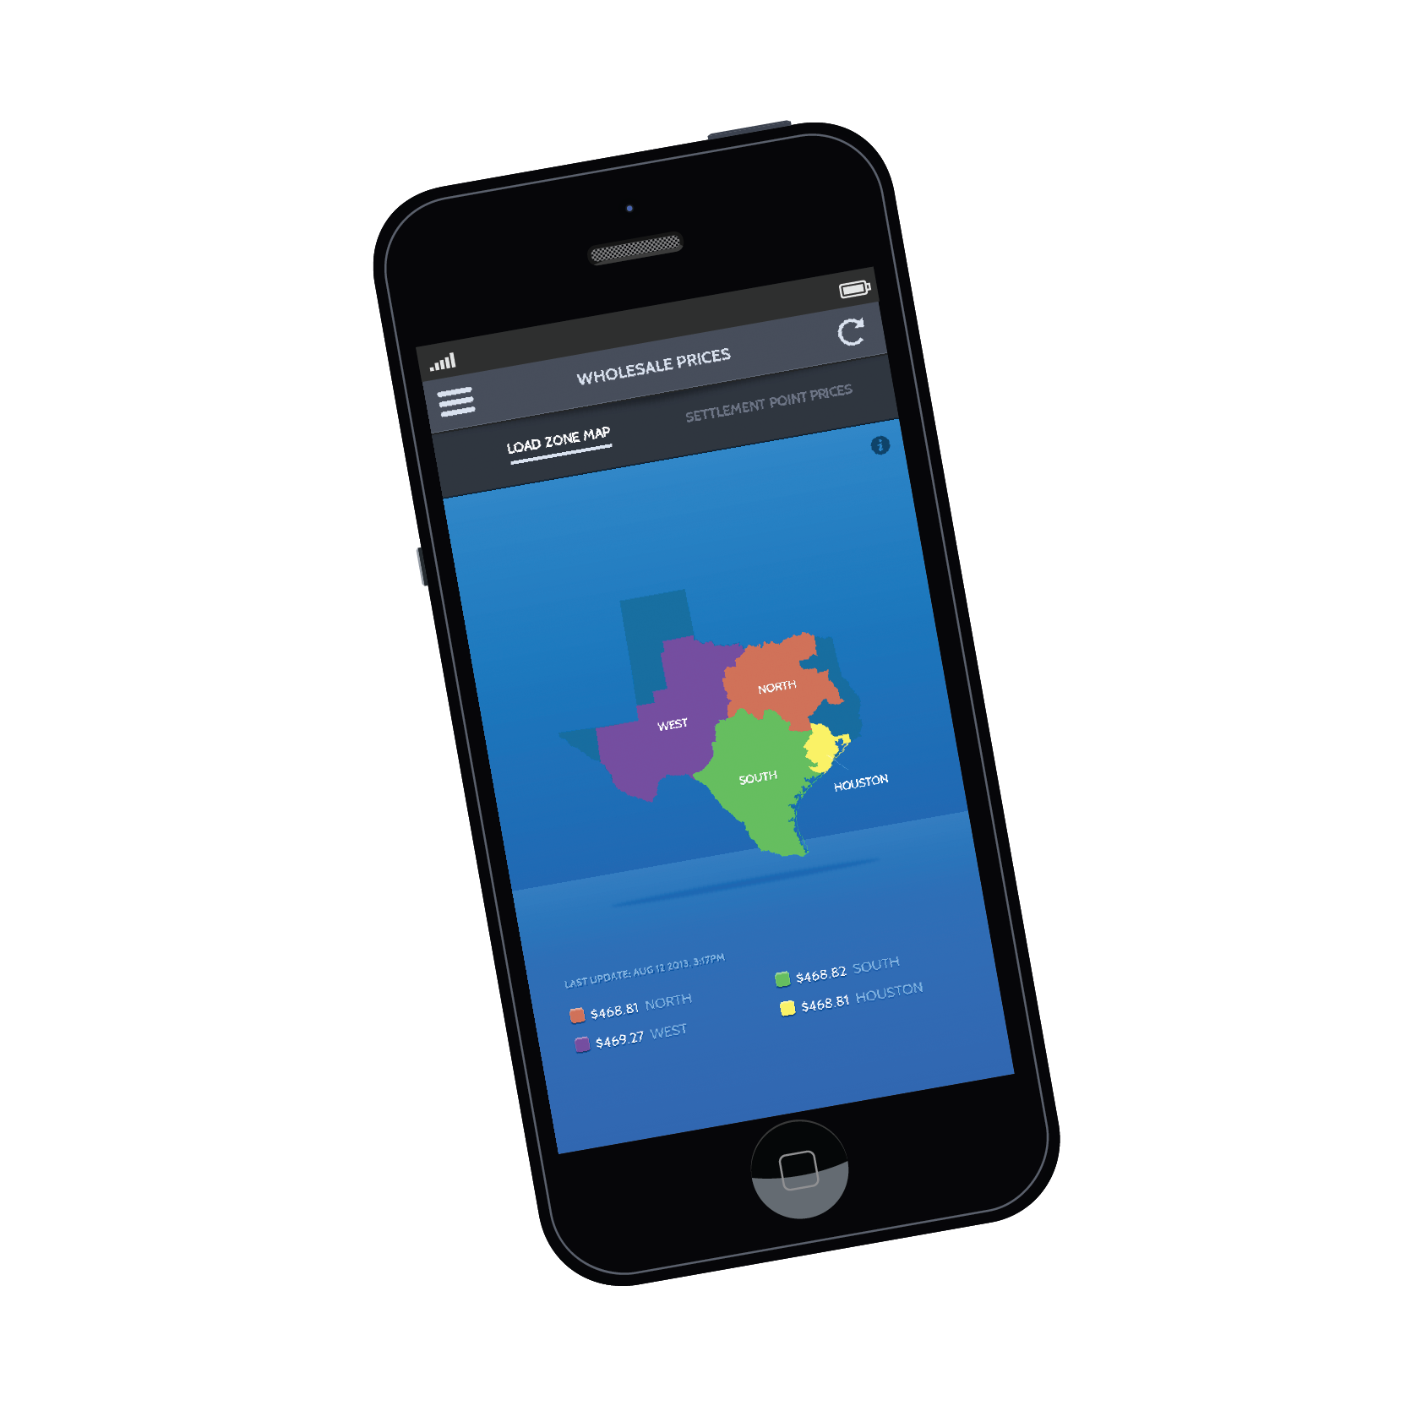
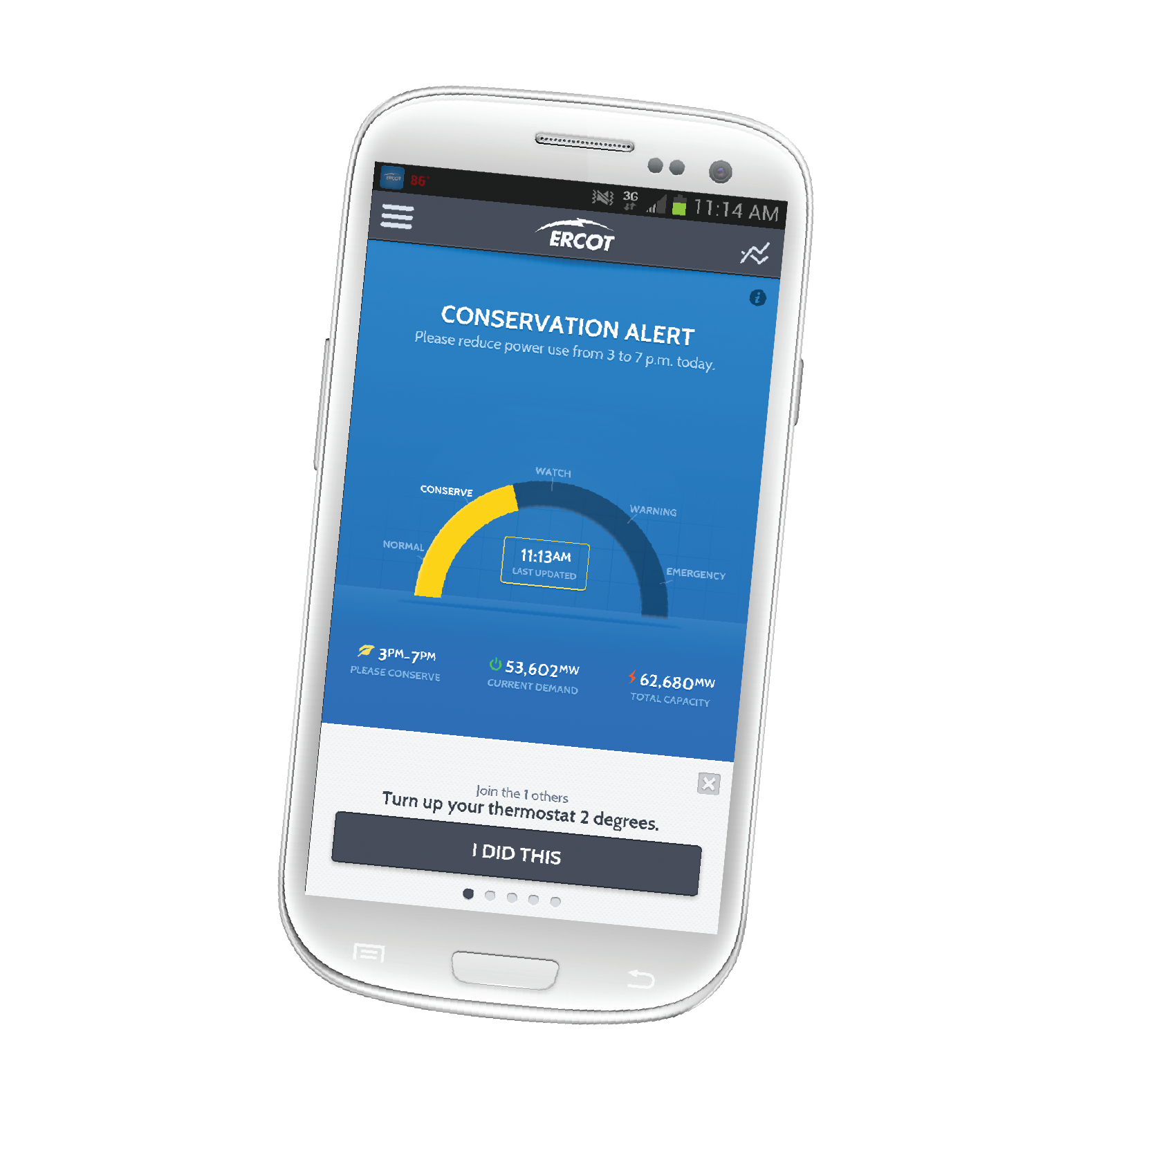
Improving communications with consumers
ERCOT website – added features
Today’s Outlook: Real-Time demand and capacity
Weather page: Daily, seasonal
Social media – join us!
Twitter: 6,400+ followers
Facebook: 1,500+ friends
LinkedIn: 3,500+ followers
ERCOT Energy Saver mobile app – upgraded
System conditions – Real-Time demand and capacity
Wholesale pricing information – Hubs and Load Zones
Information-sharing options
Notes:
Communication will remain important to help consumers understand when conservation needed most and how best to get there.
Also working to improve awareness of operating reserves – new Today’s Outlook on home page shows generation capacity
Added weather page for Chris’ forecasts, adding a page this week for longer-term outlooks, working on new conservation page
Organizational change this spring moved ercot.com to Corporate Communications.
Overall website overhaul still in progress – team moved to Corporate Communications. Goal is rollout by summer 2014
Amy Apodaca working to keep content on existing site fresh
Aubrey Hale working on strategy for site redesign

Slide 38

Looking back on 2014
During 2014, ERCOT experienced several new monthly records, especially during cold-weather periods. The system managed these challenges well, thanks in great part to the work by all of you — transmission and distribution operators, QSE and plant operators, and our own internal team of committed and skilled operators. Our challenges ahead include the potential impacts of new regulations, more localized concerns while grid improvements continue, and integrating increasing amounts of intermittent renewables. We expect that our shared commitment and excellent teamwork will enable us all to keep the grid reliable and the power flowing throughout the ERCOT region. I sincerely thank you all for your continued hard work and dedication. It truly matters and makes a difference.

