Slide 1

Distribution Service Provider Black start training 2015

Slide 2
Objectives
Identify the reasons for including Distribution Service Providers (DSP) in Black Start Training.
Identify the different types of load and how loads are used in the Black Start restoration.
Identify the problems associated with “Cold Load Pickup” and the results when these concerns are not addressed.
Identify who the DSP’s will communicate with and what communications will be required during Black Start restoration.

Slide 3
Including Distribution Service Providers ….. Why?
Standard EOP-005-2
System Restoration from Black Start Resources
Purpose: Ensure plans, Facilities, and personnel are prepared to enable System restoration from Black Start Resources to assure reliability is maintained during restoration and priority is placed on restoring the Interconnection.
Applicability:
  Transmission Operators.
  Generator Operators.
  Transmission Owners identified in the Transmission Operators restoration plan.
  Distribution Providers identified in the Transmission Operators restoration plan.

Slide 4

Including Distribution Service Providers ….. Why?
ERCOT Black Start Plan
6.5. Building Stable Islands
During the restoration process it is critical that each Transmission Operator build stable Islands in order to prevent collapse.
Stable Islands: Islands that have stable frequency, Resources loaded to at least 50% of the maximum output and stable voltage across the Island.
During the restoration, load will be used to stabilize Island Generation, Frequency and Voltage.

Slide 5

Where do we get stabilizing Load?
Power Plant Auxiliary Loads

Slide 6
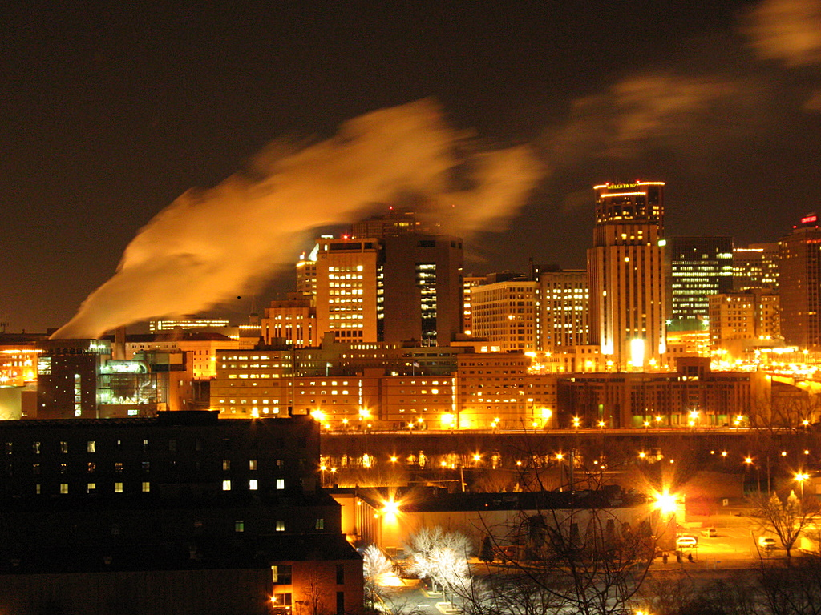
Where do we get stabilizing Load?
Industrial / Commercial Customers Loads

Slide 7

Where do we get stabilizing Load?
Residential Customer Loads

Slide 8
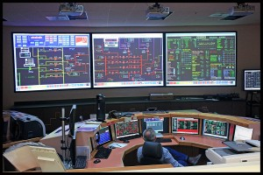
DSP’s ………. Keepers of the Load
These Operators control both Transmission and Distribution Loads from the same location.
When these Operators need to add or drop load during the restoration it is done in house.

Slide 9
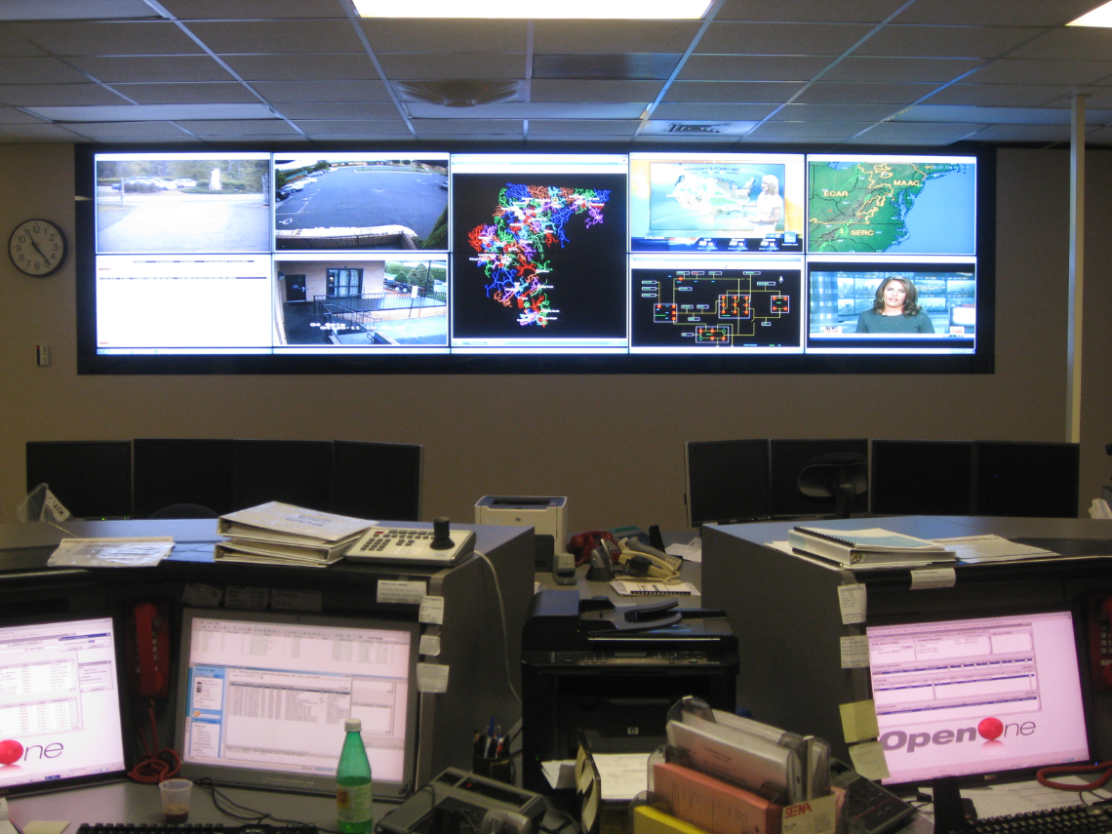
TDSP’s ………. Keepers of the Load
Distribution Loads are controlled by the same company from a different office or location.
When these Transmission Operators need to add or drop load during the restoration it is usually accomplished with a phone call.

Slide 10
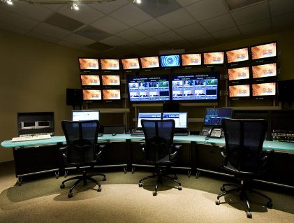
DSP’s ………. Keepers of the Load
Distribution Loads are controlled by other companies Co-ops and municipalities at different locations.
When these Transmission Operators need to add or drop load during the restoration it is usually accomplished with a phone call, Fax, or sending a representative.

Slide 11
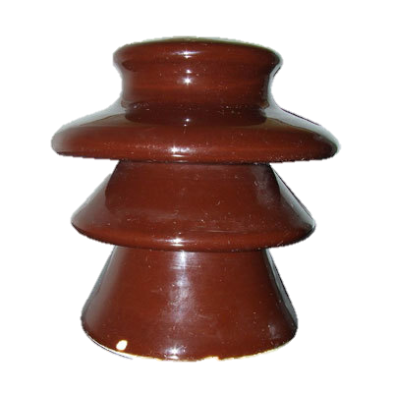
Picking up Load
Load Types
Inductive Loads
Resistive Loads

Slide 12
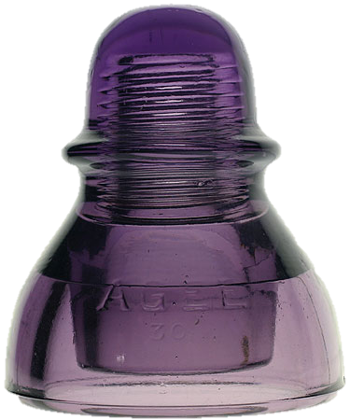
Picking up Load
Inductive Loads
An Inductive Load is a load that pulls a large amount of current (an inrush current) when first energized.
Motors and Transformers

Slide 13

Picking up Load
Resistive Loads
When a resistive load is energized the current rises instantly to its steady-state value without first rising to a higher value.
incandescent lighting electrical heaters

Slide 14
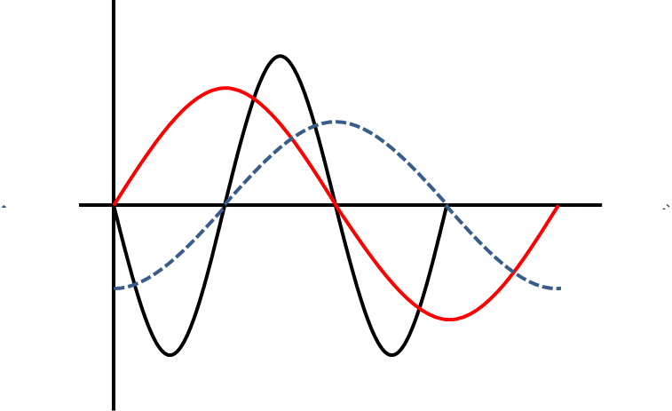
Adding Load
X
The Facts
  Most Black Start Islands are capacitive by nature due to the use of lightly loaded transmission lines.
  The net result of adding load to a Black Start Island is a reduction in voltage on that Island.
Power
Voltage
Current

Slide 15
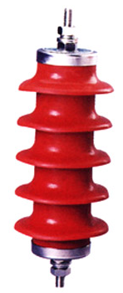
Adding Load
When adding load to a Black Start Island things for the DSP to consider include:
Location
Type
  Residential, Commercial or Industrial
  Interruptible or Under frequency
Monitored and Adjusted

Slide 16


Cold Hard Facts about “Cold Load Pickup”
Cold load pickup is the phenomenon that takes place when a load is reenergized following an extended outage. Cold load pickup is a composite of two conditions: inrush and loss of load diversity.
Inrush could be up to 10 times the normal value.
Drops off to 2 times normal value in about 3 seconds.
“Taper off” to normal value in about 30 minutes.

Slide 17
Cold Hard Facts about “Cold Load Pickup”
When energizing load that has been off for an extended time DSP Operators should factor in “Cold Load Pickup”.
“Inrush”
  Calculate.
“Taper off”
  Monitor and Adjust.

Slide 18
Cold Hard Facts about “Cold Load Pickup”
Failure to consider “Cold Load Pickup” will impact your Island.
“Inrush” / Calculate.
  Low frequency / Low Voltage.
“Taper off” / Monitor and Adjust.
  High frequency / High Voltage.

Slide 19
Talk the Talk
TO
  Load / Restoration
    Where
    When
    How much
    What Type
  Load / Switching
    Where
    When
    How much
    What Type
DSP
Operator
DSP
Switchman

Slide 20
Talk the Talk
TO
TO
DSP
Operator
DSP
Manager
DSP
Operator
DSP
Switchman
Customer
Nuisance
Customer
Nuisance
DSP
Switchman
DSP
Switchman
DSP
Switchman
Customer
Nuisance
Customer
Nuisance

Slide 21
Review
  Identify the reasons for including Distribution Service Providers (DSP) in Black Start Training.
    NERC Standard EOP-005-2
      Ensure plans, Facilities, and personnel are prepared to enable System restoration from Black Start Resources……etc.
      Applicability: Distribution Providers identified in the Transmission Operators restoration plan.
    ERCOT Black Start Plan 6.5. Building Stable Islands
      During the restoration, load will be used to stabilize Island Generation, Frequency and Voltage.
      DSP’s ………. Keepers of the Load

Slide 22
Review
Identify the different types of load and how loads are used in the Black Start restoration.
    Inductive Loads
      Motors and Transformers
      High Inrush current when first energized
    Resistive Loads
      Incandescent lighting and electrical heaters
      The current rises instantly to its steady-state value
    Stabilize the Islands
      During the restoration, load will be used to stabilize Island Generation, Frequency and Voltage.

Slide 23
Review
Identify the problems associated with “Cold Load Pickup” and the results when these concerns are not addressed.
    Inrush could be up to 10 times the normal value.
      Calculate
      Low frequency / Low Voltage
    “Taper off” to normal value in about 30 minutes.
      Monitor and Adjust
      High frequency / High Voltage

Slide 24
Review
Identify who the DSP’s will communicate with and what communications will be required during Black Start restoration.
    Transmission Operator
      Load / Restoration
    Switchmen
      Load / Switching

Slide 25
Final Thoughts?
Discussion?
Questions?

Slide 26
Questions
1. The Purpose of NERC Standard EOP-005-2 is to ensure plans, Facilities, and personnel are prepared to enable System restoration and is applicable to which of the following?
  Distribution Providers identified in the Transmission Operators restoration plan
  Distribution Providers in systems larger than 100MW
  Distribution Providers selected by ERCOT that meet all CIP Standards
  Distribution Providers that are not associated with Transmission companies

Slide 27
Questions
2. According to ERCOT Black Start Plan 6.5. Building Stable Islands, during the restoration load will be used for which of the following purposes?
  To stabilize Island Generation, Frequency and Voltage
  To keep all Islands equal in size for ease in combining multiple Islands
  To keep Islands from growing too large for ease in combining multiple Islands
  To offset the problems caused generation swings while in Isochronous mode

Slide 28
Questions
3. The two types of load that DSPs will energize during the restoration that have the effect of lowering voltage on the Island are:
  Inductive and Resistive
  Linear and Non-linear
  Additive and Subtractive
  Positive and Non-positive

Slide 29
Questions
4. Identify the problems associated with “Cold Load Pickup” caused by inrush current:
  Low frequency / Low Voltage
  High frequency / High Voltage
  Inrush current causes turbine blades to flex
  Inrush current causes phantom voltages in “no-load” tap changers

Slide 30
Questions
5. During the Black Start, communications between the DSP and TO will mainly focus on which of the following?
  Load / Restoration
  Generator voltage set-points
  Island Synch points
  Resource auxiliary loads

