Slide 1
Project Update and Summary of Project Priority List (PPL) Activity
April 16, 2015

Slide 2
2015 Project Update – Agenda
  Project Portfolio Update p. 3-5
    Recent/Upcoming Project Highlights
    Revision to 2015 Market System Enhancements Scope
      Potential Vote
    2015 Release Targets
    2015 Project Spending Update
  Appendix
    Project Portfolio Gantt Chart p. 7-14
Location of Project Priority List (PPL): http://www.ercot.com/services/projects/index

Slide 3
Recent / Upcoming Project Highlights
2015 March Release Complete
  SCR778 – Credit Exposure Calculations for NOIE Options Linked to RTM PTP Obligations
  MMS/OS Tech Refresh
    Impacts to MMS, CDR, CMM, CRR, CSI, MIS and S&B
2015 March Release Still In Flight
  SCR779 – Increase to the CRR Auction Transaction Limit
    Deferred due to issues during testing
    It is likely that the release will not be in production in time for the sequence 1 auction at the end of April. However, we are still hopeful to have it in place for the sequence 2 auction in mid-May.
Note: Projected Go-Live dates are subject to change.
Please watch for market notices as the effective dates approach.

Slide 4
Scope Change to 2015 Market System Enhancements
On 4/6/2014, WMS voted to recommend the removal of NPRR568 Phase 2 and NPRR644 from the September delivery and placed in the “TBD” bucket until further notice
WMS referred to the Demand Side Working Group (DSWG) for feedback
2015 Market System Enhancements | Timing
Phase 1 NPRR626 – Reliability Deployment Price Adder NPRR665 – As-Built Clarification of Reliability Deployment Price Adder NPRR645 – Real-Time On-Line Capacity Revisions NPRR598 – Clarify Inputs to PRC and ORDC OBD – Methodology for Setting Max Shadow Prices Phase 2 NPRR595 – RRS Load Resource Treatment In ORDC NPRR568 Phase 2 – Real-Time Reserve Price Adder Based on ORDC NPRR644 – Operating Reserve Demand Curve Phase 2 Revisions | Ph1 – 6/27-6/28 Ph2 – 9/21-9/25

Slide 5
2015 Release Targets – Board-Approved NPRRs / SCRs / xGRRs
February 2/2 – 2/12 | March 3/23 – 3/27 | June 6/13 – 6/28 |  | August 8/10 – 8/14 | September 9/21 – 9/25 | December 12/7 – 12/11
NPRR500 SCR772 | SCR778 SCR779 | NPRR543 NPRR559 NPRR589(b) NPRR597 | NPRR598 NPRR601 NPRR626 NPRR639 NPRR645 NPRR665 SCR774(b) SCR775 SCR779 OBD (Shadow Price Caps) | NPRR573 NPRR595 SCR771 | NPRR568 NPRR588 NPRR615 NPRR644 | NPRR419 NPRR495 NPRR556 RRGRR003
2 | 1 | 14 |  | 3 | 2 | 4
E
E
E
E
E
E
E
E
E
E
E
E
E
E
I
E
I
P
P
NS
NS
NS
NS
2015 TBD Items (and month they became “TBD”)
Aug 2014 | Oct 2014 | Dec 2014 | Jan 2015 | Feb 2015 | Mar 2015 | Apr 2015
NOGRR084 | NPRR327 H | NPRR272, SCR777 H | NPRR210, NPRR664 | NPRR493 | NPRR256 | NPRR568-ph2, NPRR644
Go-live dates can differ from Protocol effective dates – Please refer to market notices for more details
Red Text: New additions and target release changes
NPRR589(b) – S&B portion
SCR774(b) – Addition of Comments field
Strike-Through Text: Previous target release changes
Release targets are subject to change
(a), (b), etc. indicates multiple phases
Project Status Codes: NS = Not Started, I = Initiation, P = Planning, E = Execution, H = On Hold

Slide 6
2015 Project Spending Update
2015 project budget = $21.65M
Reason: Minor Capital, Program Control and Common Infrastructure projects were re-allocated to areas who use those funds

Slide 7
Business Integration Update – Appendix
  Appendix
    3/31/2015 Project Gantt
      In-flight items sorted by Project End Date
      “On Hold” projects listed separately
      “Not Started” items sorted by Project Start Date

Slide 8
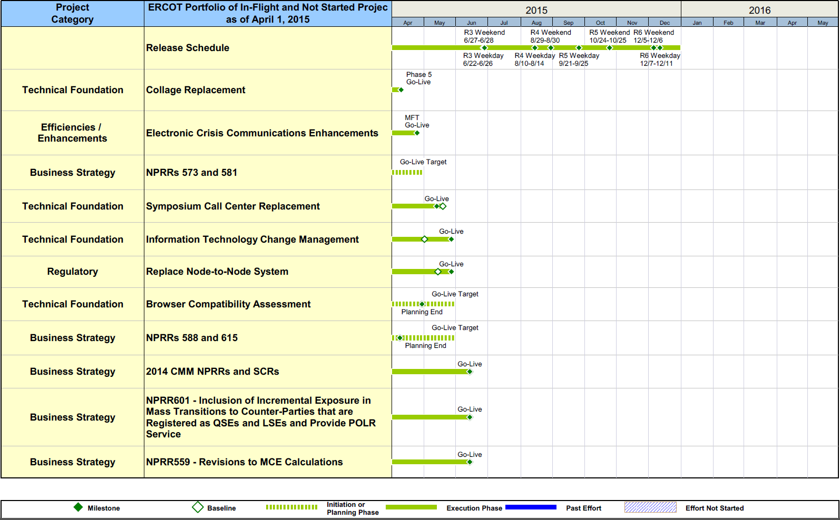
Project Portfolio Status – as of 3/31/2015

Slide 9
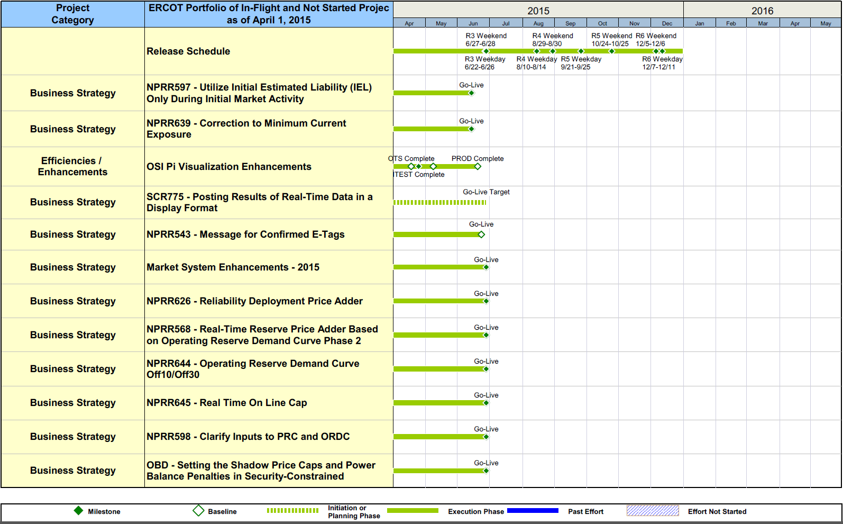
Project Portfolio Status – as of 3/31/2015

Slide 10
Project Portfolio Status – as of 3/31/2015

Slide 11
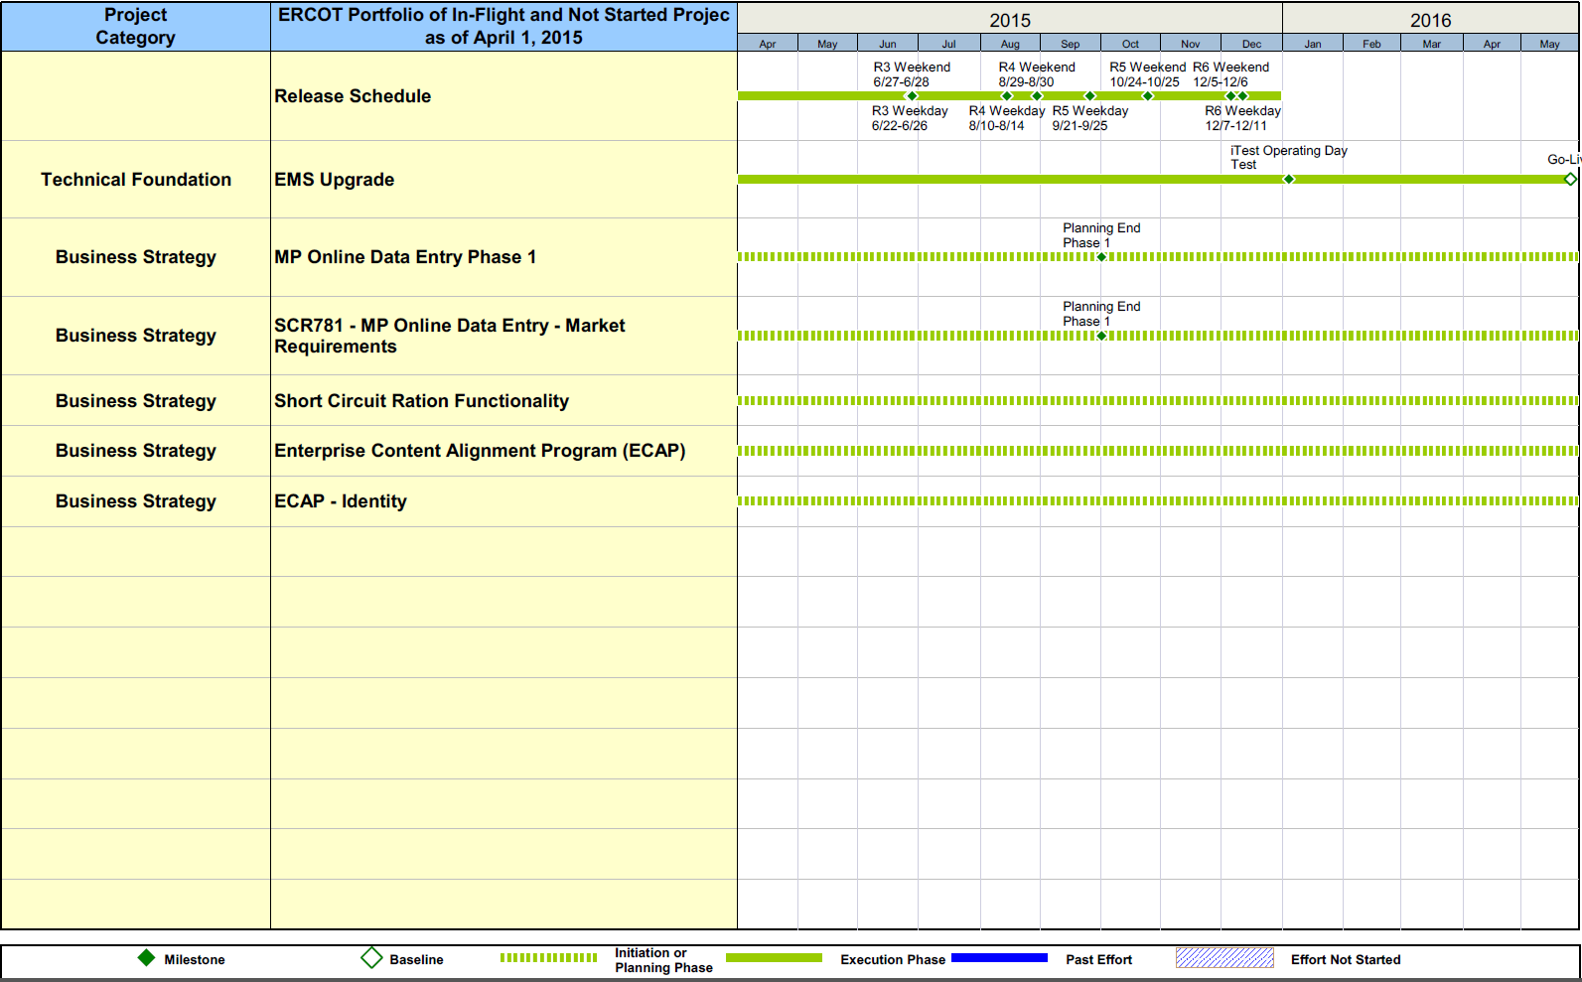
Project Portfolio Status – as of 3/31/2015

Slide 12
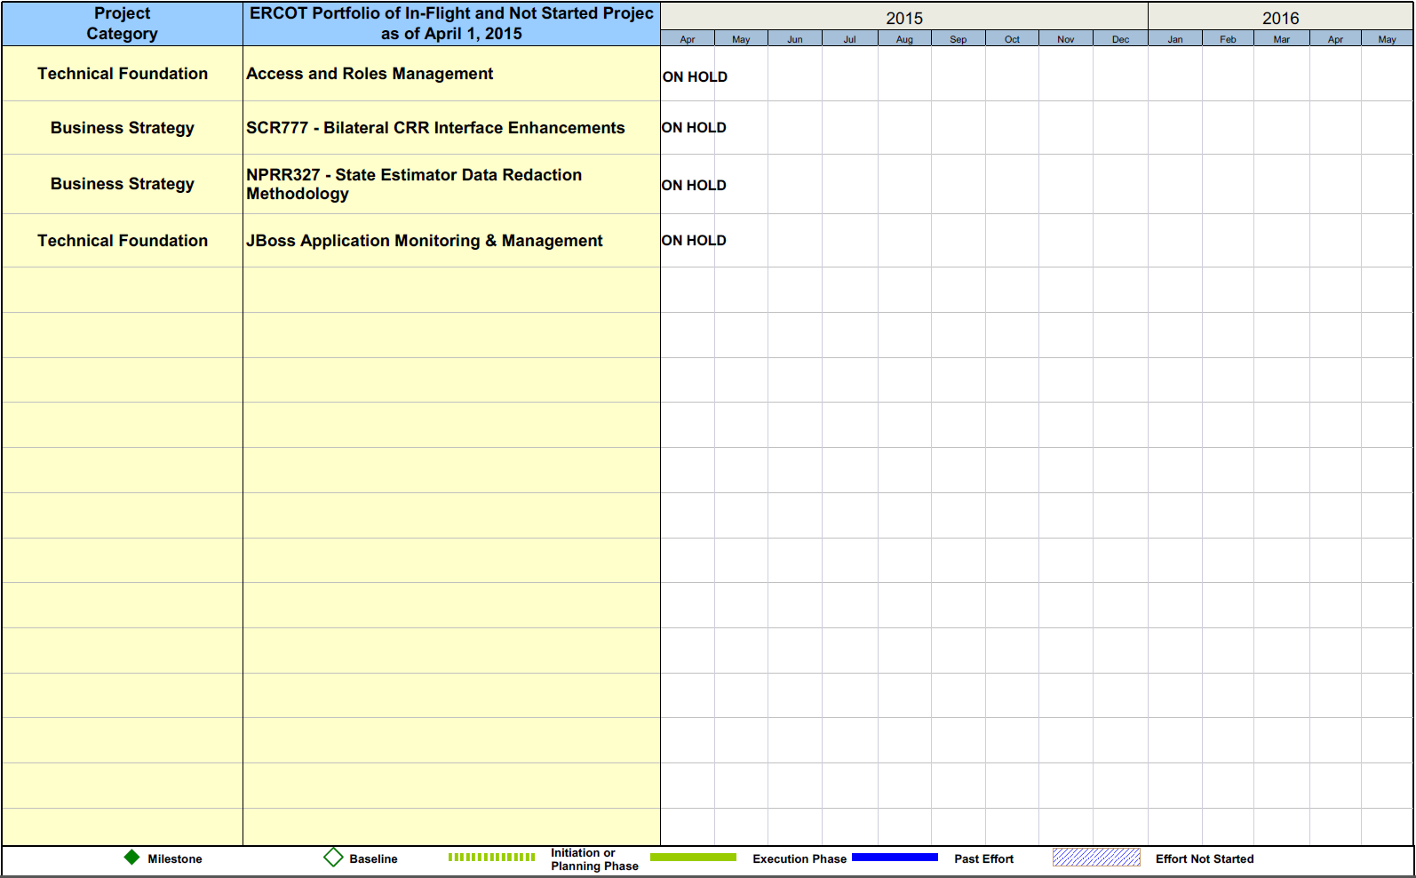
Project Portfolio Status – as of 3/31/2015

Slide 13
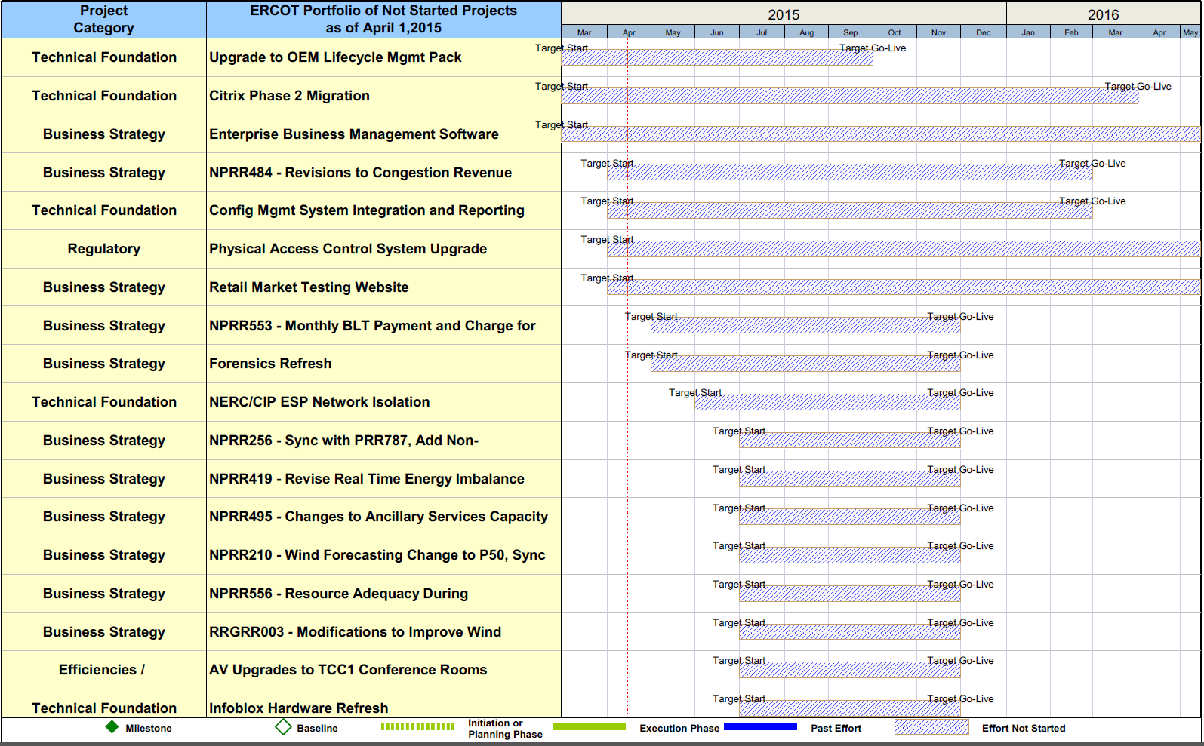
Project Portfolio Status – as of 3/31/2015

Slide 14
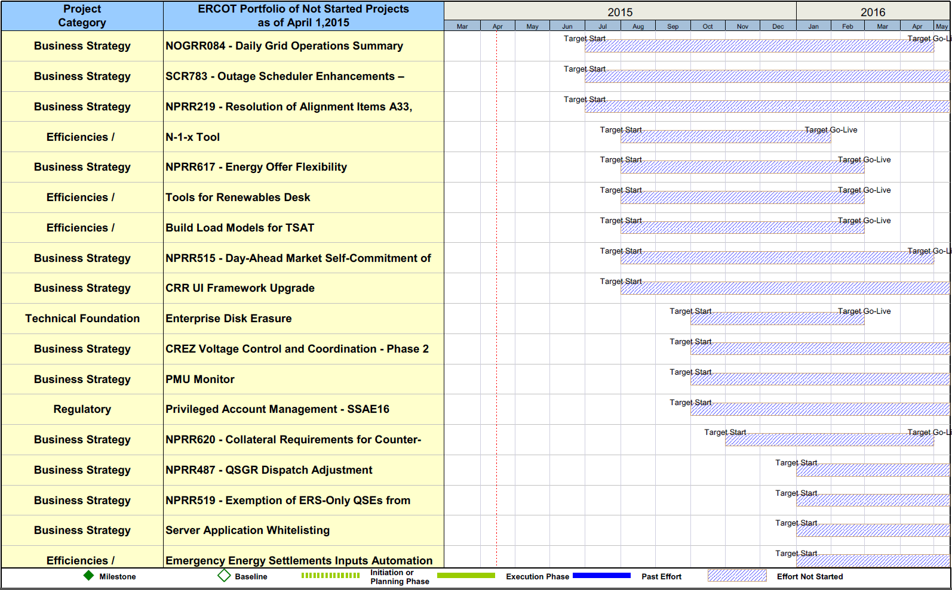
Project Portfolio Status – as of 3/31/2015

Slide 15
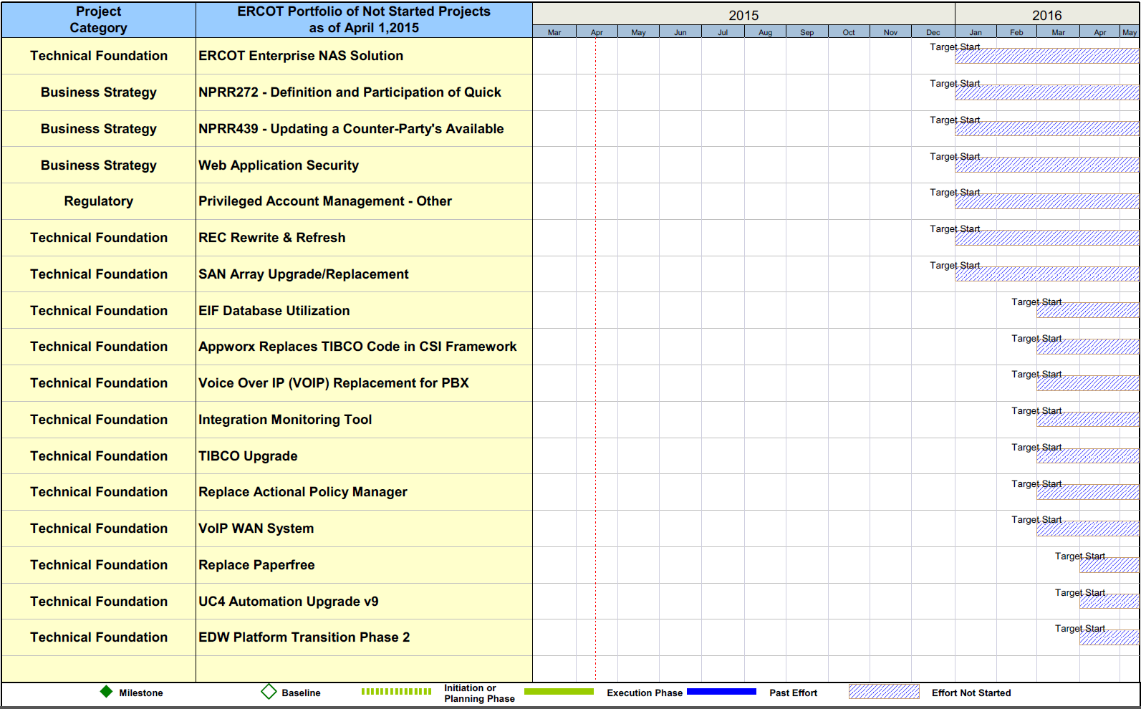
Project Portfolio Status – as of 3/31/2015

