Slide 1
Information Technology Report
Dave Pagliai
Manager, IT Support Services

Slide 2
Incident Report Highlights
Service Availability – February, March
  Retail Market IT systems met all SLA targets
Incidents & Maintenance – February
  02/08/15 – Retail Market planned maintenance outage
  02/04,11,14/15 – Premature transitioning of MarkeTrak issues
  02/17/15 – Duplicate Retail transactions, Find ESIID intermittent timeouts
Incidents & Maintenance – March
  03/01/15 – Retail Release (Database Upgrade)
  03/05/15 – System communication issue impacting the following services:
    Retail transaction processing
    Find ESIID, Find Transaction
    MarkeTrak
    MPIM
  03/11/15 – Find ESIID, Find Transaction slow performance
Supplemental AMS Interval Data Report Issue
  No impacts to report in February or March
  A long term solution has been developed and is scheduled for R3 release

Slide 3
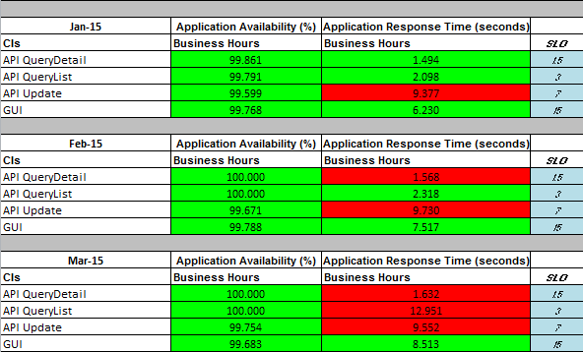
MarkeTrak Performance

