Slide 1
SMT Update To AMWG
April 21, 2015

Slide 2
Q&A Monthly SMT Reports to AMWG Data Through March 2015

Slide 3
Review CRs Needing Further Discussion, Clarification or Re-Estimation

Slide 4
Rough Order Of Magnitude (ROM) Effort Classification
Change Type | ROM
MINOR | 0 – 20 K
SMALL | 20 – 40 K
MEDUIM | 40 – 60 K
HIGH | 60 – 120 K
VERY HIGH | Over 120 K
These are rough order of magnitudes and do not include project ramp-up and testing effort (SIT & UAT) and only assumes unit testing. Actual estimates could vary significantly depending on requirements.
Ramp-up and testing would be 20 to 40% of the overall effort (needs minimum by in)

Slide 5
AMWG CR 2015-21 Improve REP of Record (ROR) search criteria, used during the customer registration process
5
5

Slide 6
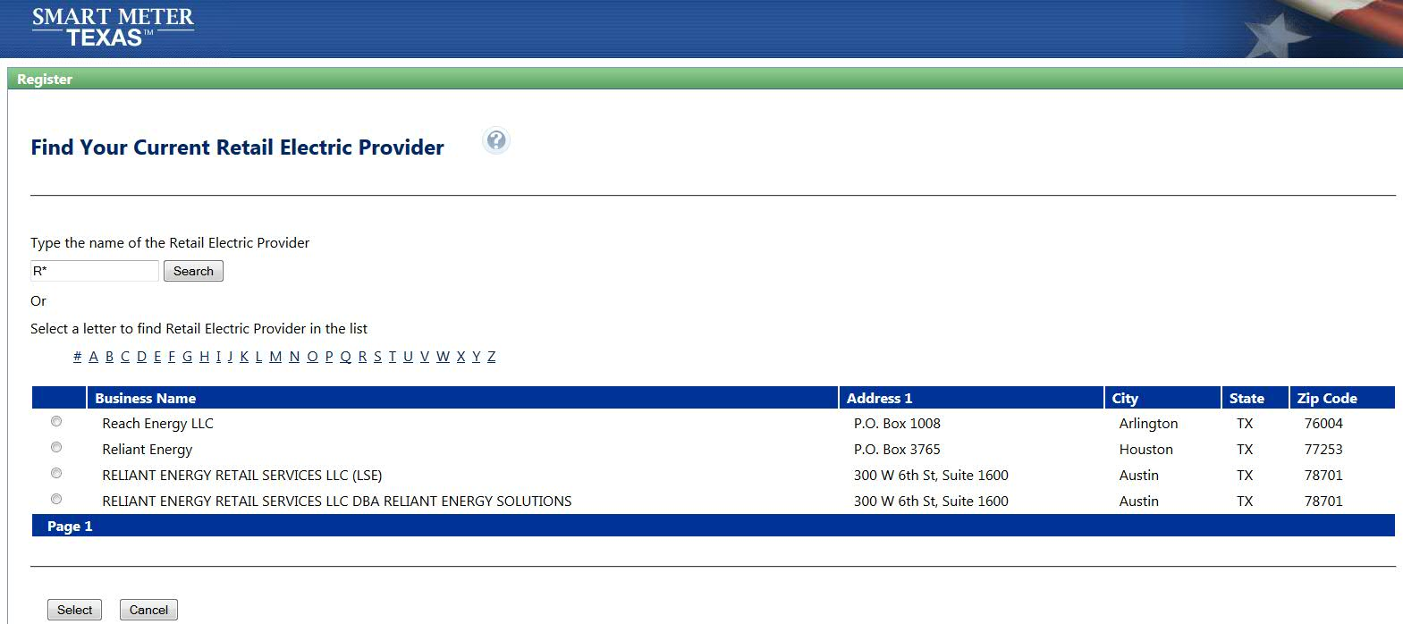
AMWG CR 2015-21 Improve REP of Record (ROR) search criteria, used during the customer registration process
Existing Production Behavior
REP of Record (ROR) search criteria, used during the customer registration process requires * (asterisk) for a wild character search.
REP Name Search using * (asterisk)
results in list of REPs starts with the typed letters

Slide 7
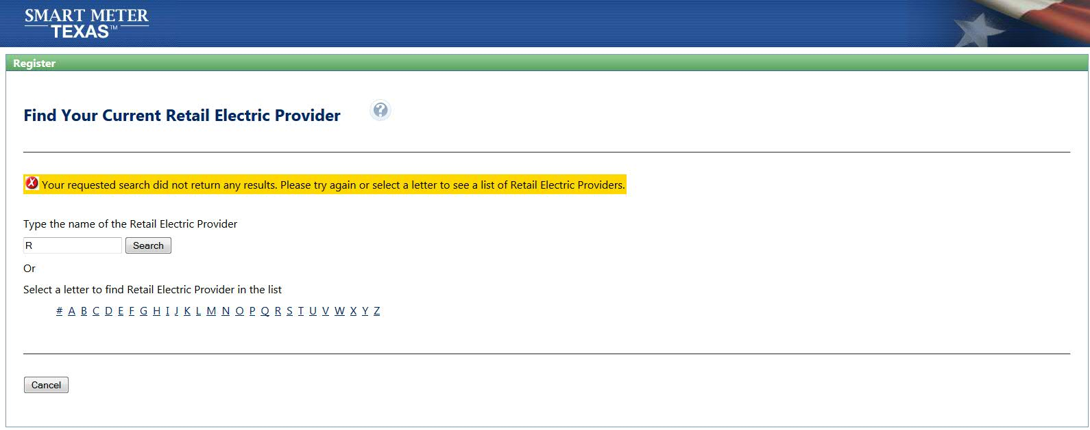
AMWG CR 2015-21 Improve REP of Record (ROR) search criteria, used during the customer registration process
Existing Production Behavior (cont)
REP of Record (ROR) search criteria, used during the customer registration process requires * (asterisk) for a wild character search.
REP Name Search using only single character without wild character
Results in no REPs

Slide 8
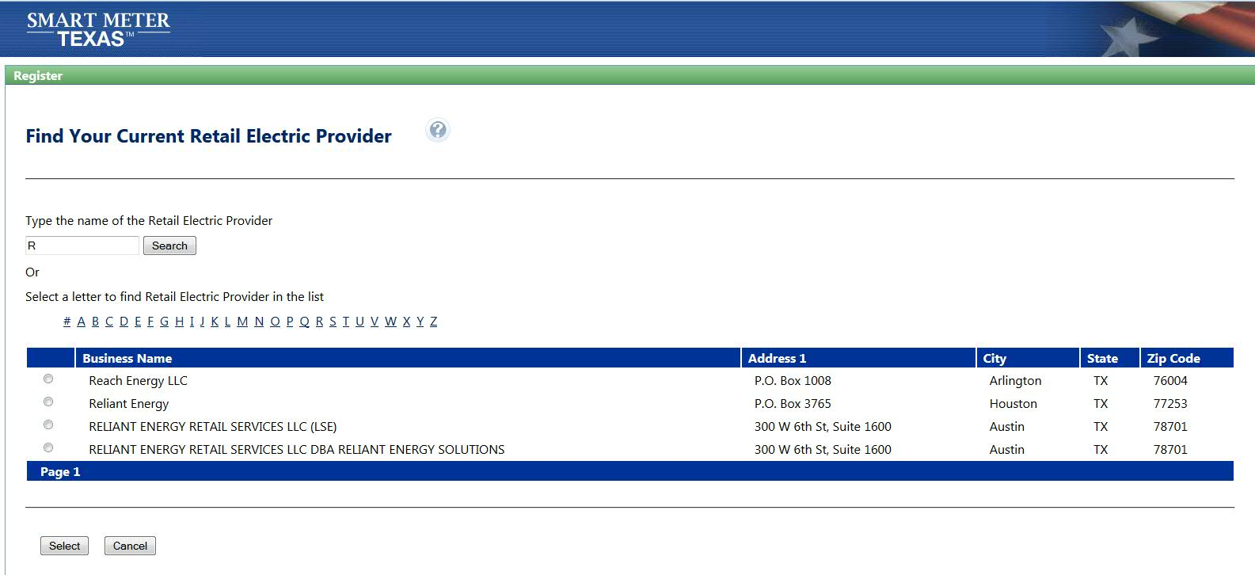
AMWG CR 2015-21 Improve REP of Record (ROR) search criteria, used during the customer registration process
Business Requirement
REP of Record (ROR) should be able to search based on single character or few initial characters, during the customer registration process.
REP Name Search using single character (example – R) results in list of REPs starts with that letter.
Note: Some of the problems reported by users are because they are using the name shown on their bill which could be a different brand or Doing Business As (DBA) entity name. The criteria needs to be further improved to include all relevant names in the selection list.

Slide 9
AMWG CR 2015-29 3rd Party Access functionality. Allow 3rd parties the ability to utilize an API for on-demand data requests/extracts.
9
9

Slide 10
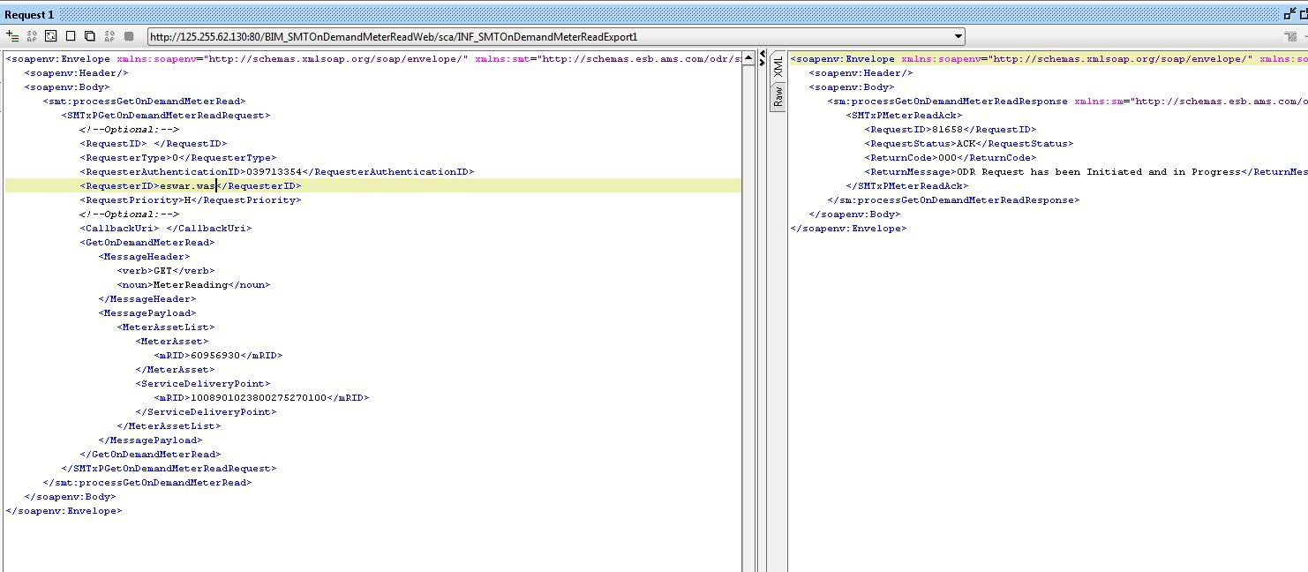
AMWG CR 2015-29 3rd Party Access functionality. Allow 3rd parties the ability to utilize an API for on-demand data requests/extracts.
Business Requirement
Allow 3rd parties the ability to utilize an API for on-demand data requests/extracts.
3rd Party ODR request will work like HAN provision and de-provision.
Flow of the Request will be
3rd Party SMT TDSP
SMT 3rd Party

Slide 11
AMWG CR 2014-018 Add Generation Data to SMT Portal View
11
11

Slide 12
AMWG CR 2014-018 – Add Generation Data to the SMT Portal View
Option 1
Toggle between Consumption and Generation Usage Data
If Consumption Usage Data is selected, the Usage Graph and Usage Table will display Consumption usage data
If Generation Usage Data is selected, the Usage Graph and Usage Table will display Generation usage data
Option 2
Add Generation Data to Usage Graph and Usage Table
Usage Graph will display both Consumption and Generation usage data at the same time. Different colors will be used to differentiate between the two usage data types
Usage Table will have two additional columns – Usage (kWh) for Generation and Actual / Estimate for Generation

Slide 13
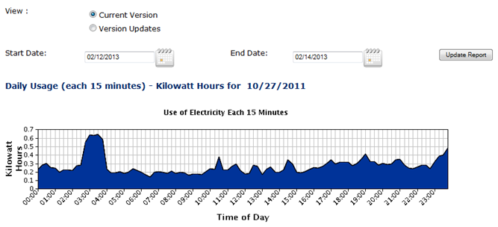
AMWG CR 2014-018 – Add Generation Data to the SMT Portal View
Welcome, Chris
Log Out
Business Requirement
Add Generation Data to the SMT Portal View
Home
My Account
Usage
Notices
Help
Customer Meters (ROR)
Usage / Customer Meters Search (3rd Party) / Customer Meters – Usage Report
Customer Meters – Usage Report
Customer Meters (3rd Party)
Report Request Status (ROR)
Report Request Status (3rd Party)
Address: 123 Demo Drive, ESI ID: 88888880000000001
Anytown, TX. Meter Multiplier: 1
Option 1:
Toggle between
Consumption and Generation
Usage Data
NEW radio button selection to toggle between Consumption and Generation Usage data
View Consumption / Generation Usage:
Consumption
Generation
By default, the 15-Minute Daily Usage graph will display the Consumption data.
Users will be provided an option to toggle between Consumption and Generation Usage data

Slide 14
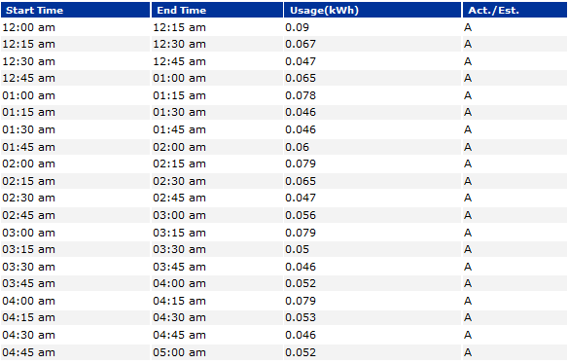
AMWG CR 2014-018 – Add Generation Data to the SMT Portal View
Option 1
Radio Button logic
The radio button allows users to toggle between Consumption and Generation Usage Data.
If “Consumption” is selected in the radio button, the Usage Graph and the Usable Table will display the Consumption Usage Data.
If “Generation” is selected in the radio button, the Usage Graph and the Usabe Table will display the Generation Usage Data.
Print
Export Report in CSV
< Previous Day
Next Day >

Slide 15
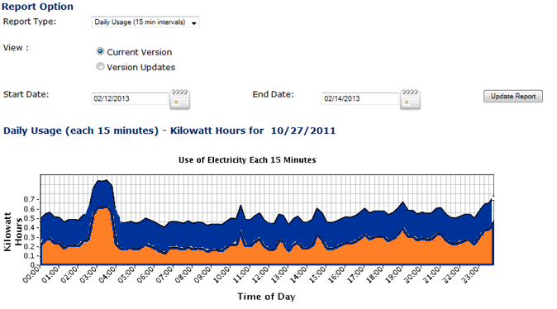
AMWG CR 2014-018 – Add Generation Data to the SMT Portal View
Welcome, Chris
Log Out
Business Requirement
Add Generation Data to the SMT Portal View
Home
My Account
Usage
Notices
Help
Customer Meters (ROR)
Usage / Customer Meters Search (3rd Party) / Customer Meters – Usage Report
Customer Meters – Usage Report
Customer Meters (3rd Party)
Report Request Status (ROR)
Option 2:
Usage Graph and Usage Table
Includes both Consumption and
Generation usage data
Report Request Status (3rd Party)
Address: 123 Demo Drive, ESI ID: 88888880000000001
Anytown, TX. Meter Multiplier: 1
By default, the 15-Minute Daily Usage graph will display both Consumption and Generation Usage data.
Consumption Usage Data is represented by blue graph
Generation Usage Data is represented by orange graph

Slide 16
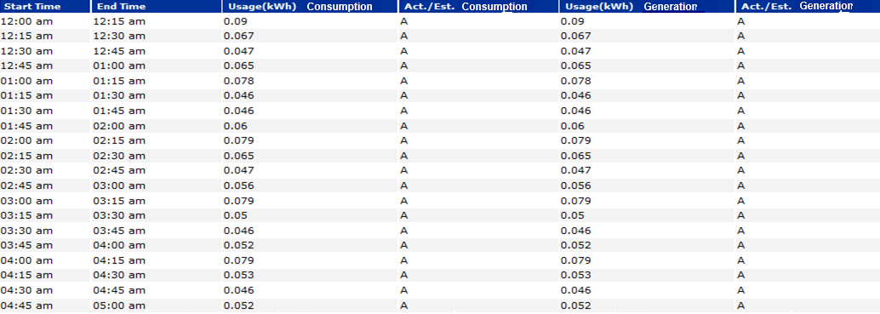
AMWG CR 2014-018 – Add Generation Data to the SMT Portal View
Option 2
Two additional columns – Usage (kWh) for Generation and Act / Est for Generation will be added in the Usage Table
Print
Export Report in CSV
< Previous Day
Next Day >
Two new columns for Generation Usage Data

Slide 17
AMWG CR 2014-018 – Add Generation Data to the SMT Portal View
Functional Rules – Ad hoc Usage Report
The addition of Generation usage data is applicable to ALL entity types – TDSP, REP, Third Party, Business and Residential Customers.
The changes impact UI only
Option 1 - The default Usage Data display is Consumption for the Usage Graph and the Usage Table (Usage kWh and Actual / Estimated columns)
Option 1 - If Generation Usage radio button is selected, the Usage Graph and the Usage Table (Usage kWh and Actual/Estimated columns) will be displayed for Generation usage data.

Slide 18
AMWG CR 2014-018 – Add Generation Data to the SMT Portal View
Business Scenarios / Issues
If ESIID does not have generation data, how should it be displayed in the Usage Graph?
If ESIID does not have generation data, how should it be displayed in the Usage Table?
Analyze whether Zero or N/A should be used to display no generation data.

Slide 19
AMWG CR 2015-24 3rd Party Access – Renew Energy Data Agreement after one year.
19
19

Slide 20
SMT Outage and Infrastructure Refresh Status

Slide 21
SMT Outage and Infrastructure Refresh Status
SMT has been restored utilizing the new infrastructure pointing to the legacy database
All functions are operational including ROR FTPS 15 minute interval data loads, Website, ODR, HAN, Ad Hoc Reporting, Enrollments, and role based features for Third Party / Customer / REP/TDSP
The data catch up from the outage is in process and close to completion
Detailed planning is in process to complete the move of the SMT solution onto the new database
It is estimated that the outage for the move to the new infrastructure database can be completed in less than 24 hours
A report will be developed to provide an analysis of metrics for affects of the outage on the Market
A thorough investigation and review of the outage is being conducted
A post mortem report will be developed for presentation to RMS in either May or June

Slide 22
Review Enhancement Requests
SMT Registration – Federation
3rd Party Agreement Details to FTPS (machine to machine)
Improved SMT Admin Functionality

Slide 23
Market Suggested SMT Enhancement 3rd Party Agreement Details FTP (Machine to Machine Consumption)
23
23

Slide 24
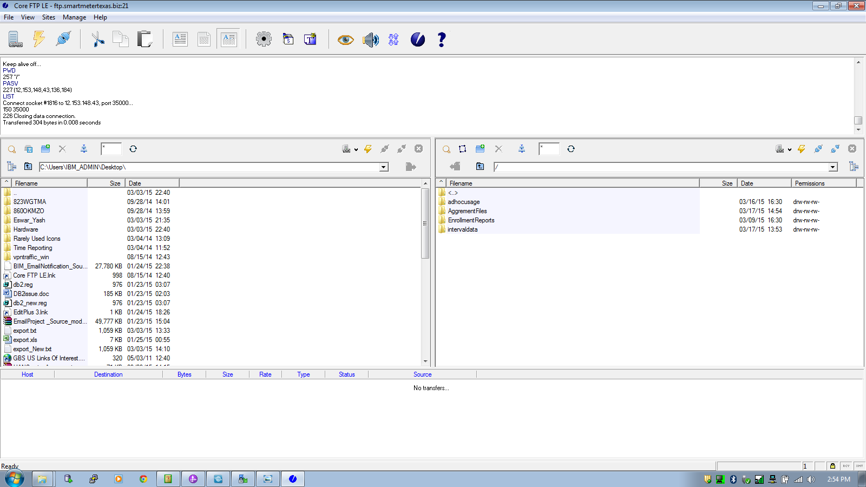
3rd Party Agreement Details FTP (Machine Consumption)
Business Requirement
3rd Party each Agreement action should be maintained in FTP location.
Proposed Solution: Separate folder/dir will be created for Agreement details purpose

Slide 25
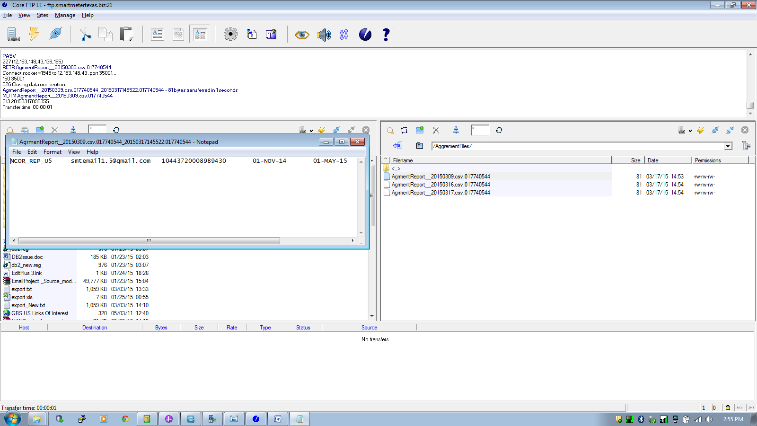
3rd Party Agreement Details FTP (Machine Consumption)
Business Requirement
(cont)
Proposed Solution: Fill will be created for each action of the 3rd party user.
File will contain –
User-ID
Email-ID
ESIID
Agreement Start-Date
Agreement End-Date
Usage Flag
HAN Flag
Agreement Status

Slide 26
Status Update of AMWG Change Requests

Slide 27
Status of AMWG Change Requests
Summary: 39 Total AMWG Change Requests Including 9 Delivered, 1 Ready for Delivery in the Next Release, 19 RMS Approved and 10 AMWG Drafts in Review 2/20/15
9 AMWG Change Requests Delivered 2014
SMT Reporting AMWG CR 2013 002, AMWG CR 2013 005, AMWG CR 2013 006, AMWG CR 2013 007, and AMWG CR 2013 009 – Delivered Q2 2014
ROR Historical Backfill and ROR New Customer Enrollment (Interim Solution) AMWG CR 2013 017 – Delivered Q2 2014
ROR Vendor on Behalf AMWG CR 2013 016 – Delivered Q3 2014
Usability Bypass redundant screen for Users with only one meter when accessing HAN device information AMWG CR 2013 012 – Delivered Q4 2014
Usability Timeout on SMT takes user to “incorrect login” screen AMWG CR 2013 013 – Delivered Q4 2014
1 AMWG Change Request Awaiting Next Release to Implement in 2015
AMWG CR 2013 014 Allow SMT user to toggle between 15-Minute Reads and Daily Reads without having to reset the date range

Slide 28
Status of AMWG Change Requests
6 AMWG Change Requests Completed JDOA Estimation, Approved by RMS and Awaiting Prioritization
AMWG CR 2013 001, AMWG CR 2013 003, AMWG CR 2013 004, AMWG CR 2013 008, AMWG CR 2013 011, and AMWG CR 2013 015
1 AMWG Change Request Completed JDOA Estimation Awaiting RMS Review in April
AMWG CR 2013 010
2 AMWG Change Request Disapproved by RMS
AMWG CR 2014 018 and AMWG CR 2015 035
11 AMWG Change Requests Completed JDOA Estimation Review by AMWG 3/25/15
AMWG CR 2015 019 through AMWG CR 2015 029
9 AMWG Change Requests Approved by AMWG 2/20/15 in Process of JDOA Estimation
AMWG CR 2015 030 through AMWG CR 2015 039 (Except 2015 035 Disapproved by RMS listed above)

Slide 29
Rough Order Of Magnitude (ROM) Estimate of Effort Classification
Change Type | ROM
MINOR | 0 – 20 K
SMALL | 20 – 40 K
MEDUIM | 40 – 60 K
HIGH | 60 – 120 K
VERY HIGH | Over 120 K
These are rough order of magnitudes and do not include project ramp-up and testing effort (SIT & UAT) and only assumes unit testing.
Actual estimates could vary significantly depending on requirements.
Ramp-up and testing would be 20 to 40% of the overall effort
Overall project cost will vary based on efficiency gains from packaging like functionality

Slide 30
AMWG Change Requests
AMWG Change Request | AMWG CR Document | Status | Estimated Delivery Date | Estimated Cost
AMWG CR 2013 001 – Report for AMWG Data Monitoring – Data Completeness Measurements |  | Estimate Complete & RMS Approved 3/3/15 | Awaiting Prioritization | 20 – 40K
AMWG CR 2013 002 – Reports for AMWG Data Monitoring – Data Timeliness Measurements |  | Implemented | Q2 2014 Delivered | Included in Maintenance Contract
AMWG CR 2013 003 – Reports for AMWG Data Monitoring – Measurement of Percentage of Actual Meter Reads |  | Estimate Complete & RMS Approved 3/3/15 | Awaiting Prioritization | 20 – 40K
AMWG CR 2013 004 – Reports for AMWG Data Monitoring – Measurement of Estimates |  | Estimate Complete & RMS Approved 3/3/15 | Awaiting Prioritization | 40 – 60K
AMWG CR 2013 005 – Reports for AMWG Data Monitoring – Number of SMT Help Desk Tickets Monthly by Ticket Type |  | Implemented | Q2 2014 Delivered | Included in Maintenance Contract
AMWG CR 2013 006 – Reports for AMWG Data Monitoring – Availability of SMT API |  | Implemented | Q2 2014 Delivered | Included in Maintenance Contract
AMWG CR 2013 007 – Reports for AMWG Data Monitoring – Availability of SMT FTPS |  | Implemented | Q2 2014 Delivered | Included in Maintenance Contract
AMWG CR 2013 008 – Reports for AMWG Data Monitoring – Average Time to Deliver HAN Messages |  | Estimate Complete & RMS Approved 3/3/15 | Awaiting Prioritization | 20 – 40K
AMWG CR 2013 009 – Reports for AMWG Data Monitoring – Number of Accounts by Type |  | Implemented | Q2 2014 Delivered | Included in Maintenance Contract
AMWG CR 2013 010 – Reports for AMWG Data Monitoring – Number of Reports Requested by GUI (Portal) and Number of FTPS Accesses |  | JDOA Estimate Complete | Awaiting RMS Approval in April | 40 – 60K

Slide 31
AMWG Change Requests (Cont.)
AMWG Change Request | AMWG CR Document | Status | Estimated Delivery Date | Estimated Cost
AMWG CR 2013 011 – Average Time from HAN Provision Request to Meter Ready Status |  | Estimate Complete & RMS Approved 3/3/15 | Awaiting Prioritization | 20 – 40K
AMWG CR 2013 012 – Bypass redundant screen for Users with only one meter when accessing HAN device information |  | Implemented | Q4 2014 Delivered | Included in Third-Party
AMWG CR 2013 013 – Timeout on SMT takes user to “incorrect login” screen |  | Implemented | Q4 2014 Delivered | Included in Third-Party
AMWG CR 2013 014 – Allow SMT user to toggle between 15-Minute Reads and Daily Reads without having to reset the date range |  | Implemented | 2015 Next Release | Included in Usability
AMWG CR 2013 015 – Expand Daily Usage Graph to show 35 days of daily usage on the SMT GUI |  | Estimate Complete & RMS Approved 3/3/15 | Awaiting Prioritization | 40 – 60K
AMWG CR 2013 016 – Capability for RORs to grant access to vendors on their behalf to the ROR’s customers via API (energy usage, HAN messaging , and HAN provisioning) and FTPS files |  | Complete | Q3 2014 Delivered | Included in Maintenance Contract
AMWG CR 2013 017 – REP API for Energy Usage on SMT (Backfill of Historical Usage Data for Existing Customers- “Interim”) | See Below CR 2013 017 Permanent | Implemented Interim | Q4 2013 Delivered | Included in SMT Work In Process
AMWG CR 2013 017 – REP API for Energy Usage on SMT (Subscription for New Customer Historical Usage – “Interim”) | See Below CR 2013 017 Permanent | Implemented Interim | Q2 2014 Delivered | Included in Maintenance Contract
AMWG CR 2013 017 – REP API for Energy Usage on SMT – Permanent Solution to Replace Interim Solution |  | JDOA Estimate To Begin After Q1 2015 | Awaiting JDOA Estimate | Will Be Estimated After New Infrastructure Implemented in Q1 2015
AMWG CR 2014 018 – Add Generation Data to the SMT Portal View |  | JDOA Estimate Completed | RMS Disapproved 3/3/15 | 40 – 60K

Slide 32
AMWG Change Requests (Cont.)
AMWG Change Request | AMWG CR Document | Status | Estimated Delivery Date | Estimated Cost
AMWG CR 2015 019 – Relocate Various SMT User Guides from the Authenticated Site to the Unauthenticated Site |  | JDOA Estimate Completed | Awaiting AMWG Review 3/25/15 | 20 – 40K
AMWG CR 2015 020 – Add Customer Type in the Customer Information Section in the View / Edit Agreement Page |  | JDOA Estimate Completed | Awaiting AMWG Review 3/25/15 | 40 - 60K
AMWG CR 2015 021 – Improve REP of Record Search Criteria During the Customer Registration Process |  | JDOA Estimate Completed | Awaiting AMWG Review 3/25/15 | 40 - 60K
AMWG CR 2015 022 – Keep Selected ROR Visible During Customer Registration |  | JDOA Estimate Completed | Awaiting AMWG Review 3/25/15 | 20 – 40K
AMWG CR 2015 023 – Allow Entry of Multiple ESIIDs During Customer Registration Process |  | JDOA Estimate Completed | Awaiting AMWG Review 3/25/15 | 60 – 120K
AMWG CR 2015 024 – Third Party Access Renew Energy Data Agreement After One Year |  | JDOA Estimate Completed | Awaiting AMWG Review 3/25/15 | 40 - 60K
AMWG CR 2015 025 – Third Party User Experience Add Identifying Data Fields in the Report Request Status Page |  | JDOA Estimate Completed | Awaiting AMWG Review 3/25/15 | 60 – 120K
AMWG CR 2015 026 – SMT Functionality Display Portal Message when Report Can Not be Displayed in the SMT Portal Page |  | JDOA Estimate Completed | Awaiting AMWG Review 3/25/15 | 0 – 20K
AMWG CR 2015 027 – SMT Functionality Allow Specific Date Entry on the Export Report Screen |  | JDOA Estimate Completed | Awaiting AMWG Review 3/25/15 | 20 – 40K
AMWG CR 2015 028 – SMT Functionality Allow ESIIDs to be Copied and Pasted into the ESIID Box on the Usage Page |  | JDOA Estimate Completed | Awaiting AMWG Review 3/25/15 | 0 – 20K
AMWG CR 2015 029 – This Party Allow Third Parties to Utilize an API for On Demand Data Requests |  | JDOA Estimate Completed | Awaiting AMWG Review 3/25/15 | 60 – 120K

Slide 33
AMWG Change Requests (Cont.)
AMWG Change Request | AMWG CR Document | Status | Estimated Delivery Date | Estimated Cost
AMWG CR 2015 030 – Support multiple RORs during CSV file meter upload |  | JDOA Estimate In Process
AMWG CR 2015 031 – Allow only current ROR for account registration validation and meter add validation |  | JDOA Estimate In Process
AMWG CR 2015 032 – Support SFTPS protocol for SMT integration |  | JDOA Estimate In Process
AMWG CR 2015 033 – Provide user id and password rules up front on UI registration page |  | JDOA Estimate In Process
AMWG CR 2015 034 – Display the day of the week in addition to the date on usage reports |  | JDOA Estimate In Process
AMWG CR 2015 035 - Provide a customer-selected option to receive a monthly usage report via email |  | JDOA Estimate on Hold | Disapproved by RMS 3/3/15
AMWG CR 2015 036 – Rename Overview tab to Home |  | JDOA Estimate In Process
AMWG CR 2015 037 – Remove SMT Demo from Private Site for REPs, TDSPs, and Third Parties |  | JDOA Estimate In Process
AMWG CR 2015 038 – Provide a “Hold” capability on Third Party accounts to reactivate usage until the Third Party has integrated with FTPS and API |  | JDOA Estimate In Process
AMWG CR 2015 039 – Provide more detail for Third Party Agreement Invitation Error Messages |  | JDOA Estimate In Process

Slide 34
Categorization of SMT RMS Approved AMWG CRs

