Slide 1

ISO Comparison – CAISO
Alex Lee (ERCOT)
David Douglass, Rodney Wheeler (CAISO)
ERCOT OCITF
4/15/2015

Slide 2

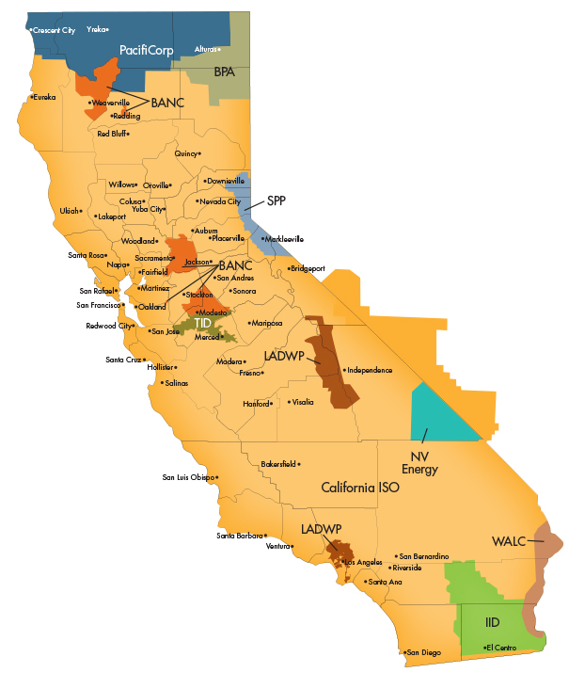
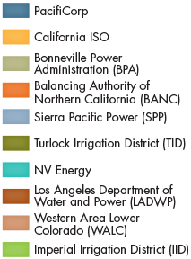
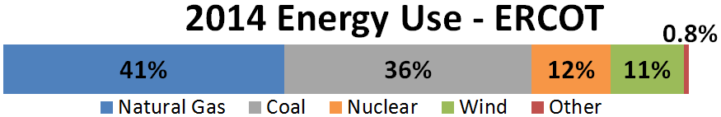
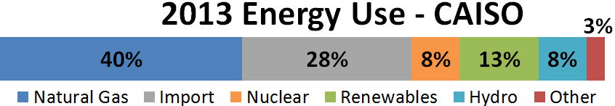
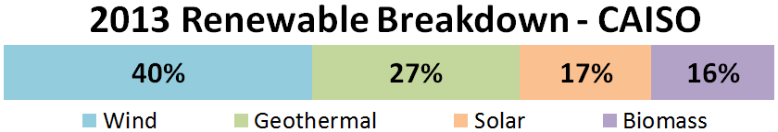
ERCOT vs CAISO High Level Overview
66.5 GW summer peak demand (2014)
68 GW all-time peak demand (2011)
550 generators
74 GW generating capacity
Annual Ave. Spot Price $34/MWh (2013), $41/MWh(2014)
43,000 miles of transmission lines
  69, 138, 345 kV
45 GW summer peak demand (2014)
50 GW all-time peak demand (2006)
760 generators
60 GW generating capacity
Annual Ave. Spot Price $46/MWh (2013)
26,000 miles of transmission lines
  60, 69, 70, 115, 230, 550 kV
TX

Slide 3
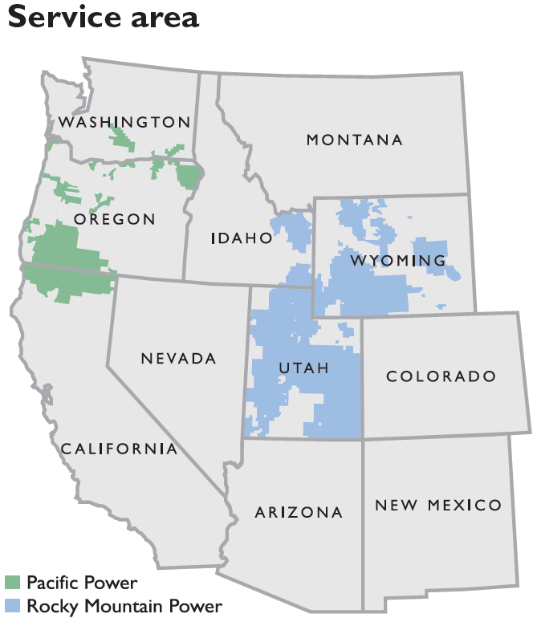
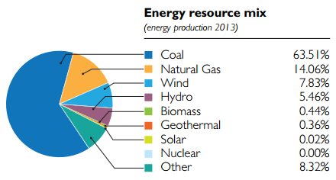
Energy Imbalance Market (EIM) – Nov 2014
PacifiCorp (Berkshire Hathaway Energy Company)
  75 Generators
  11 GW Capacity
  16,000 transmission lines
Oct 2015
Images Source: http://www.pacificorp.com/content/dam/pacificorp/doc/About_Us/Company_Overview/PC-FactSheet-Final_Web.pdf

Slide 4
Outage Coordination Process Timelines - Transmission
PLAN
START
ERCOT
90
45
9
4
3
90
45 (Mid Term)
9 (Mid Term)
4
3
Forced
Approval Deadline
75
30
4
3
2
CAISO
45
7
Long Range
Short Range
Forced
30 days after receipt
Approval Deadline
2
30
Significant Outage
Submit at least 30 days prior to the month the Outage is to begin.
200 kV+, part of defined flow limits, etc. lasting over 24 hours.
Note: All numbers are in days.

Slide 5
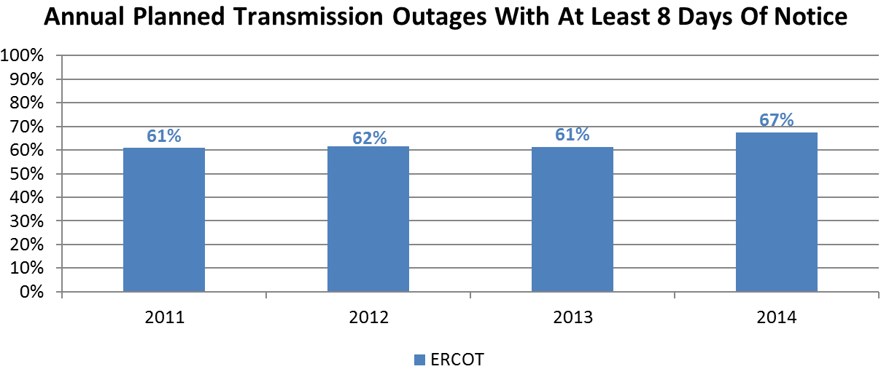
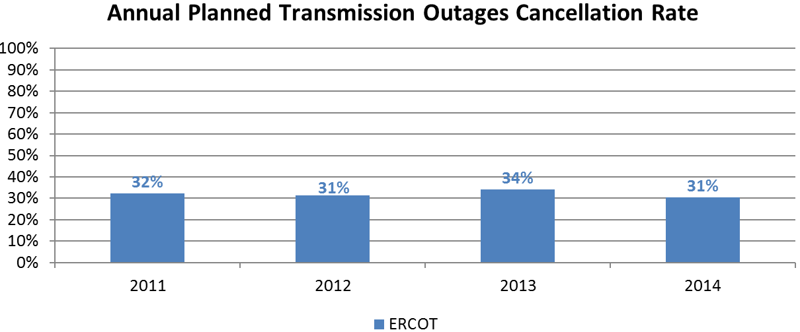
Transmission Outage Metrics/Statistics
Note: Includes Planned transmission outages submitted each year.
Excludes Simple and Opportunity transmission outages.
Excludes Forced-type transmission outages.
Excludes outages related to the New Equipment and Retirement.

Slide 6
Additional Transmission Outages in CAISO’s OMS
ISO | ERCOT | CAISO
Communications | RT | NoW
Relay Work | Email | NoW
Energized Work |  | NoW
RT = Handled in Real-Time.
Email = Handled through email. Not in Outage Scheduler.
NoW = Nature of Work attribute in Outage Scheduler.

Slide 7
Directive to Cancel Maintenance Outage (Tariff 9.3.7)
Prior to DAM Bids submission deadline, CAISO may direct the Operator to cancel an Approved Maintenance Outage to preserve or maintain system reliability.
CAISO will compensate for any direct and verifiable costs.
  Charged to the Scheduling Coordinators in proportion to their metered Demand during the Settlement Period(s) of the originally scheduled Outage.

Slide 8
Outage Coordination Process Timelines - Resource
PLAN
START
ERCOT
45
9
4
3
45
9
4
3
Forced
Automatically Accepted
5 business day after receipt; otherwise, automatically accepted
Approval Deadline
3
2
CAISO
45
7
Long Range
Short Range
Forced
30 days after receipt
Approval Deadline
2
Note: All numbers are in days.

Slide 9
Forced Outage Notification - Resource
Notify forced outage within 60 minutes of discovery.
  10 MW or 5% of Pmax whichever is greater.
  1 MW for IRs over 10 MW
  Lasts 15 minutes or longer
Availability Reporting Requirement (Tariff 37.4.1)
  First violation in calendar month = warning.
  $1,000, $2,000, $5,000 for subsequent violations for rolling 12-month.

Slide 10
Forced Outage Report for Resource (Tariff 9.3.10.6)
Recently Removed.
CAISO prepares reports on Forced Outages to determine potential gaming or other questionable behavior to the FERC.
  Influenced market prices (Exceptional Dispatches).
  Coincide with change in the Bids.
  Outage on the unit was recently rejected by CAISO.
  Timing or content of the notice is inconsistent with subsequent report or actual cause.
  Created or exacerbated congestion.

Slide 11
Additional Resource Outage In CAISO’s OMS
ISO | ERCOT | CAISO
AVR | RT | NoW
PSS | RT | NoW
Unit Test | RT | NoW
New Generator Test | RT | NoW
RT = Handled in Real-Time.
NoW = Nature of Work attribute in Outage Scheduler.
CAISO’s AVR and PSS outage submissions are for tracking purpose only. Outage Coordination does not implement analysis to approve or deny.
Knowing future planned unit testing schedules could slightly improve accuracy of the forward economic analysis.

Slide 12
Final Approval Attribute – Transmission & Resource
If the Final Approval is Required, Market Participant shall not commence the Outage without obtaining the final approval from the CAISO Control Center.
Final Approval Required (FAR)
  Transmission
    Market Impacts.
    500kV or higher.
    Nature of Work of Communications.
    Outages included in a group.
  Resource
    Market Impact.
    Blackstart.
    AVR or PSS.
    Curtailment over 50 MW.
    Outages included in a group.
Rolling 12-month Violations (Tariff 37.4.2):
  $5,000 for first violation.
  $10,000 per subsequent violation.
  Triple during a CAISO System Emergency.

Slide 13
Outage Coordination Analysis
Analysis | Powerflow & Contingency | Dynamic Studies | Economic Analysis
ERCOT | Yes | Need-based | High Impact Outages
CAISO | Engineer | Need-based | N/A
Power-flow and contingency analysis are performed daily prior to each outage’s approval deadline.
Dynamic studies are performed when outages affecting interfaces are requested.

Slide 14
CAISO Economic Outage Evaluation History
Chose Siemens as the vendor.
Currently, project is on hold.
No metric, criteria, or threshold has been decided yet.

Slide 15
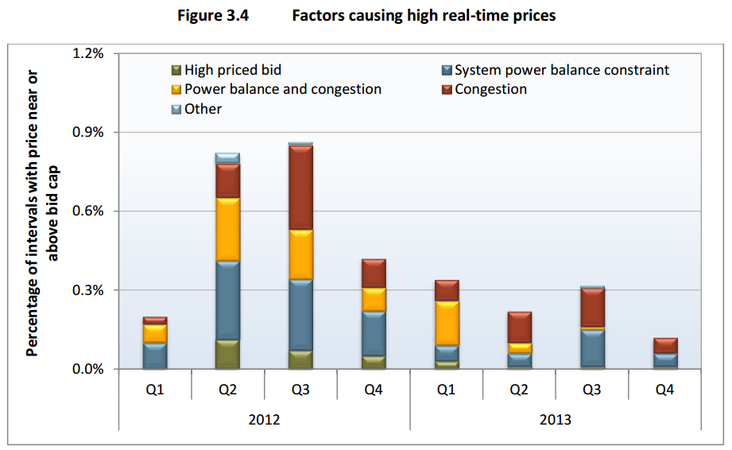
CAISO Price Spike Intervals (Above $700/MWh)
High priced bid: power balance constraint was not relaxed and congestion component was less than $200/MWh,
but a high priced bid was dispatched.
System power balance constraint: power balance constraint was relaxed and congestion component was less than $200/MWh.
Power balance and congestion: power balance constraint was relaxed and congestion component was greater than $200/MWh.
Congestion: power balance constraint was not relaxed and congestion component was greater than $200/MWh.
Other: Not due to above four categories.
Source: CAISO DMM, 2013 Annual Report on Market Issues & Performance

Slide 16
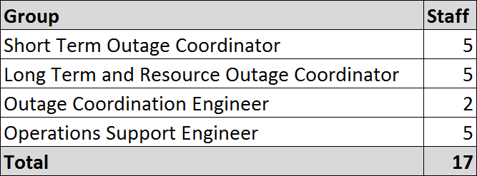
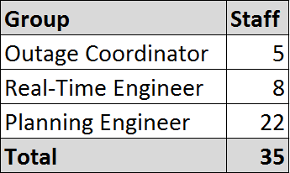
Staff Comparison
ERCOT
CAISO

