Slide 1
ERCOT Monthly Operational Overview (March 2015)
ERCOT Public
April 15, 2015

Slide 2
Grid Planning & Operations

Slide 3
Summary – March 2015
Operations
The peak demand of 53,084 MW on March 6th was less than the mid-term forecast peak of 54,721 MW of the same operating period. In addition, it was less than the March 2014 actual peak demand of 54,549 MW. The instantaneous peak load on March 6th was 54,161 MW.
Day-ahead load forecast error for March was 3.81%
ERCOT issued six notifications
One advisory due to cold weather (3/3)
One watch due to cold weather (3/4)
One advisory for a GMD Alert of K-7, later upgraded to K-8 (3/17)
One watch due to failure of SCED (3/30)
One watch due to failure of HRUC for HE 0700 (3/30)
One advisory due to postponing of the DAM Solution (3/30)
Planning Activities
251 active generation interconnection requests totaling over 58,300 MW, including 25,300 MW of wind generation as of March 31, 2015. Six additional requests yet 4,700 fewer MW from February 28, 2015.
12,569 MW wind capacity in commercial operations on March 31, 2015.
Notes:
Emergency Notices:
Mar 03 2015 10:36:17 CST - ERCOT issued an Advisory for Thursday and Friday due to the cold weather system with freezing rain, sleet and snow forecasted for the North and West zones with reduced availability of generation due to the number of generators having already begun their spring outages.
Mar 04 2015 09:57:23 CST - ERCOT issued a Watch for Thursday until Friday at noon due to the cold weather system with freezing rain, sleet and snow forecasted for the North and West zones with reduced availability of generation due to the number of generators having already begun their spring outages.
Mar 17 2015 09:22:52 CST - ERCOT has issued an Advisory for a GMD Alert of K-7 from 3-17-2015 07:00 to 12:00. It has now been upgraded to a K-8 until further notice.
Mar 30 2015 06:30:05 CST – Watch issued for SCED Failure due to ERCOT’s Market Management System (MMS) went down at 6:13 and SCED failed to run due to a hardware failure on a server that supports the MMS. Emergency Base Points (EMBP) were activated automatically at 6:20. ERCOT Operations continued to enter EMBP Offsets to maintain the morning load ramp. The MMS was restored at 6:39 with EMBPs being deactivated at 6:58. The MMS SCED execution returned to normal operations at 7:00. ERCOT’s EMS performed well during the period controlling system frequency.
Mar 30 2015 06:41:58 CST - Watch issued due to the failure of the HRUC process for HE0700, same reasons as above.
Mar 30 2015 13:27:37 CST - ERCOT has postponed the deadline for the posting of the DAM solution for Operating Day 03/31/2015 due to a software issue causing a late start.

Slide 4
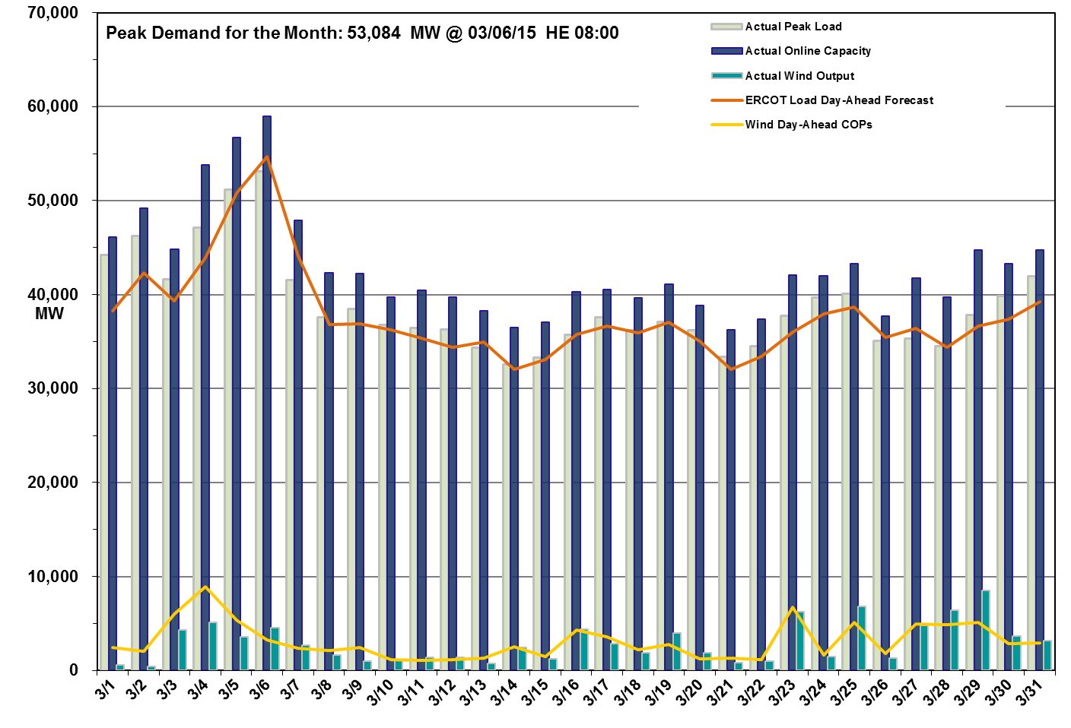
Daily Peak Demand: Hourly Average Actual vs. Forecast, Wind Day-Ahead COPs & On-line Capacity at Peak – March 2015

Slide 5
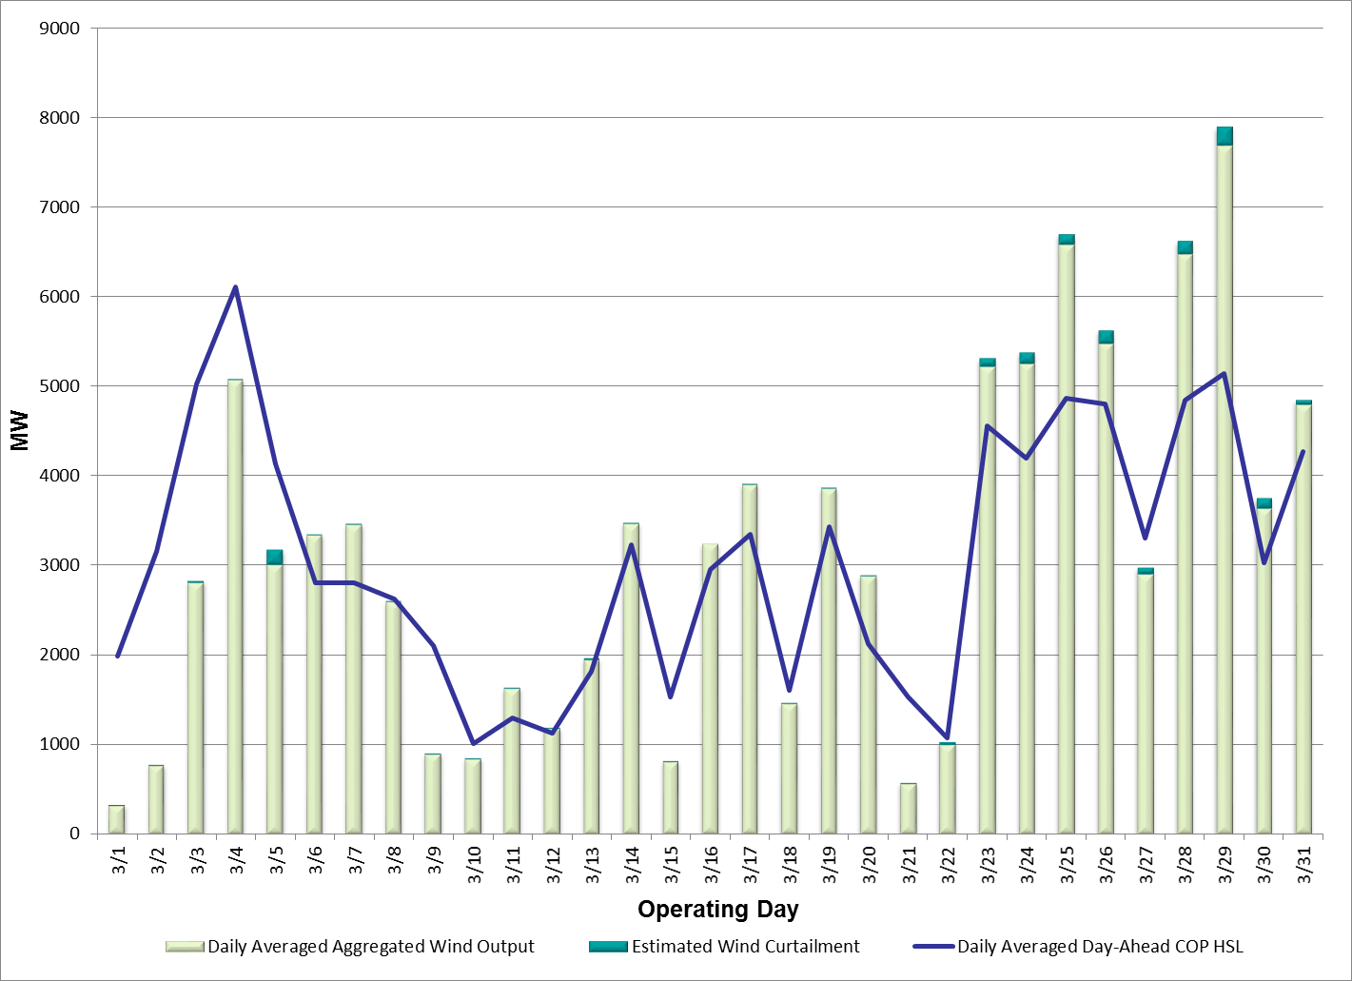
Actual Wind Output plus Curtailments vs. Wind Day-Ahead COPs for All Hours – March 2015
% of Hours when Estimated Uncurtailed Wind Output
>= COP HSLs (Target = 50%)
52%
Note: QSEs must use the AWST 50% probability of exceedance forecast as the HSL in their COPs

Slide 6
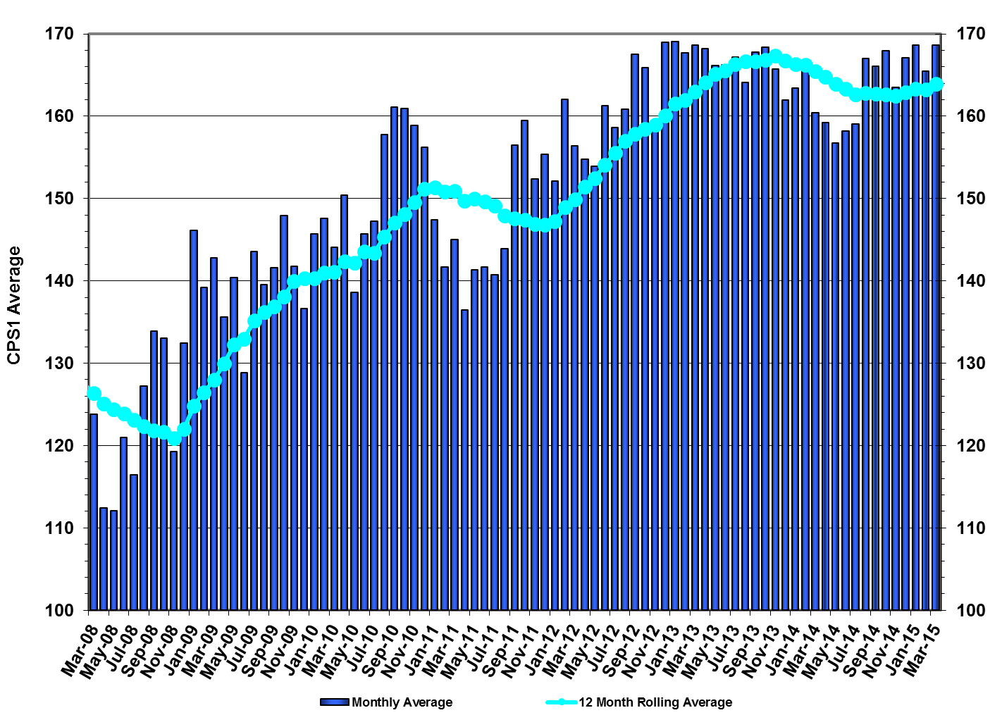
ERCOT’s CPS1 Monthly Performance – March 2015
CPS1 12 Month Rolling Average = 166.06%
Notes:
The ERCOT February 2015 CPS1 score was 167.20% and the 12 Month Rolling Average was 164.63%.

Slide 7
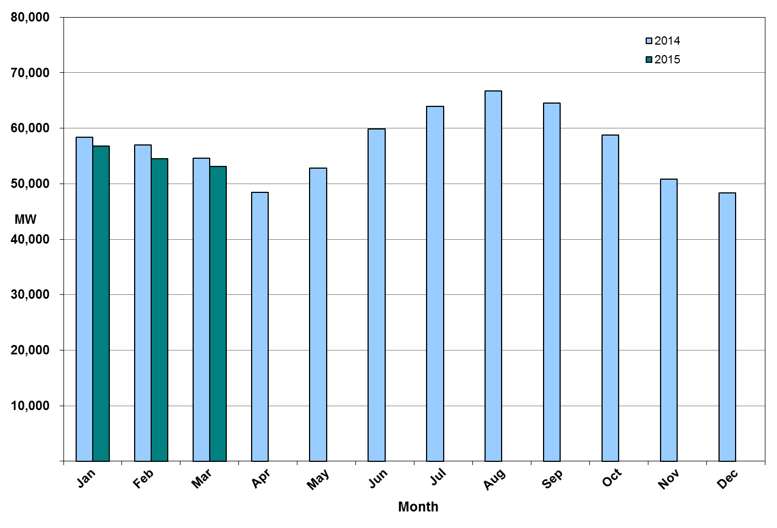
Monthly Peak Actual Demand – March 2015
Notes:
Monthly peak demand is based on Settlements EPS meter data.
February 15 Peak Interval occurred at HE 08:00 on 02/23/15: 54,714 MW
February 14 Peak Interval occurred at HE 08:00 on 2/6/14: 57,010 MW
ERCOT Summary page has February 2014 peak from 2014 Annual ERCOT Demand & Energy report.

Slide 8
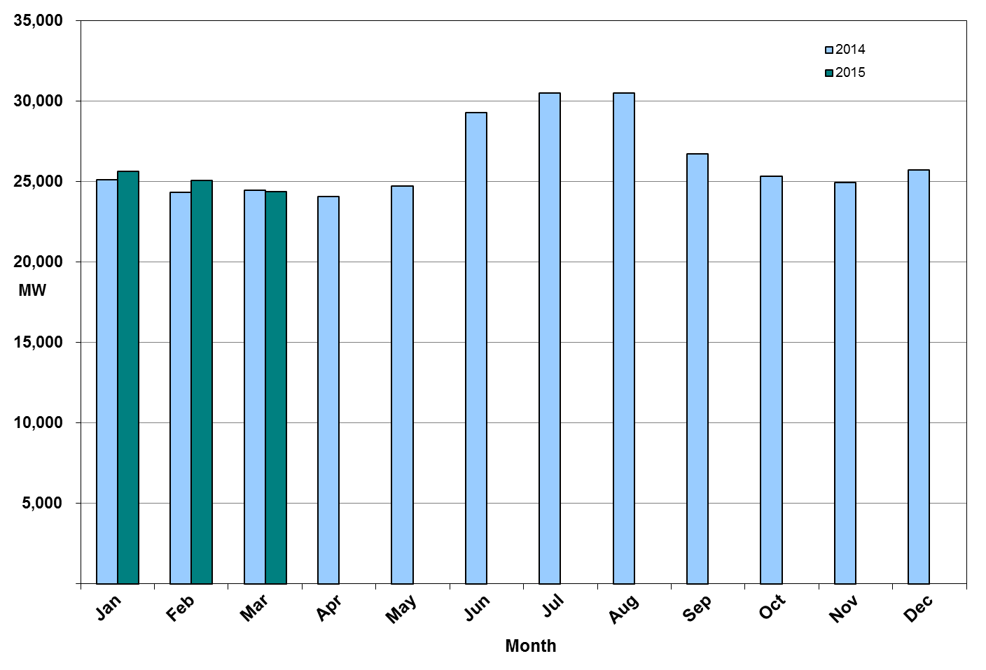
Monthly Minimum Actual Demand – March 2015
Notes:
Monthly minimum demand is based on Settlements EPS meter data.
March 15 Minimum Interval occurred at HE 05:00 on 03/29/15: 24,516 MW.
March 14 Minimum Interval occurred at HE 04:00 on 03/31/14: 24,466MW.

Slide 9
Day-Ahead Load Forecast Performance – March 2015
Mean Absolute Percent Error (MAPE) for ERCOT Mid-Term Load Forecast (MTLF) Run at 14:00 Day Ahead
 | 2012 MAPE | 2013 MAPE | 2014 MAPE | 2015 MAPE | March 2015 MAPE
Average Annual MAPE | 3.02 | 2.86 | 2.83 | 3.54 | 3.81
Lowest Monthly MAPE | 2.51 | 2.07 | 2.15 | 3.38 | Lowest Daily MAPE | 0.87 Mar – 18
Highest Monthly MAPE | 3.49 | 3.50 | 3.70 | 3.81 | Highest Daily MAPE | 12.73 Mar - 1
Notes:
Day-Ahead weather and model forecast accuracies vary from day to day which is why ERCOT uses multiple weather forecasts and load forecast models.
March 16 MAPE Error: The selected day-ahead forecast had a MAPE of 12.73%. This higher than normal MAPE was primarily caused by primarily due to temperature forecast error.

Slide 10
Reliability Unit Commitment (RUC) Capacity by Weather Zone March 2015
There were no HRUC or DRUC commitments for this month.
Notes:
Unit-Days: The overall number of RUC requests. If there were multiple units RUCed on a single day, each of those units is counted as a RUC request.
RUC Total Days: The number of calendar days units were RUCed.

Slide 11
Generic Transmission Constraints (GTCs) – March 2015
GTCs | Feb 14 Days GTCs | Dec 14 Days GTCs | Feb 15 Days GTCs | Mar 15 Days GTCs | Last 12 Months Total Days (Apr14 – Mar15)
North – Houston | 0 | 0 | 0 | 0 | 0
West – North | 0 | 0 | 0 | 0 | 1
Valley Import | 2 | 0 | 0 | 0 | 4
SOP110 | 0 | 0 | 0 | 0 | 10
AJO_ZO | - | - | - | 9 | 9
GTC: A transmission flow limit more constraining than a Transmission Element’s normal limit established to constrain flow between geographic areas of the ERCOT Transmission System that is used to enforce stability and voltage constraints that cannot be modeled directly in ERCOT’s transmission security analysis applications.
Note: This table lists how many times a constraint has been activated to avoid exceeding a GTC limit, it does not imply an exceedance of the GTC occurred.
Notes:
The West – North GTC/GTC was retired at the end of March.
The AJO_ZO GTC was effective as of Feb 27th. An OCN was issued on this date to notify the market of the new GTC. The AJO_ZO GTC was entered into the EMS as a manual constraint beginning February 27th up until it was submitted into the Network Operations Model on the March 11th database load. The name has since been changed to ZO_AJO.
Details of OCN:
Feb 27 2015 17:11:55 CST
An OCN has been issued due to ERCOT developing a new Generic Transmission Constraint due to a local voltage stability issue in South Texas near Ajo. Further details associated with this GTC are being posted to the MIS Secure Area at this time.

Slide 12
Advisories and Watches - March 2015
One advisory due to cold weather
Issued on 3/3
One watch due to cold weather
Issued on 3/4
One advisory due to a GMD Alert of K-7, later upgraded to K-8
Issued on 3/17
One watch due to failure of SCED
Issued on 3/30
One watch due to failure of the HRUC for hour ending 0700
Issued on 3/30
One advisory due to the postponing of the DAM Solution
Issued on 3/30
Notes:
Emergency Notices:
Mar 03 2015 10:36:17 CST - ERCOT issued an Advisory for Thursday and Friday due to the cold weather system with freezing rain, sleet and snow forecasted for the North and West zones with reduced availability of generation due to the number of generators having already begun their spring outages.
Mar 04 2015 09:57:23 CST - ERCOT issued a Watch for Thursday until Friday at noon due to the cold weather system with freezing rain, sleet and snow forecasted for the North and West zones with reduced availability of generation due to the number of generators having already begun their spring outages.
Mar 17 2015 09:22:52 CST - ERCOT has issued an Advisory for a GMD Alert of K-7 from 3-17-2015 07:00 to 12:00. It has now been upgraded to a K-8 until further notice.
Mar 30 2015 06:30:05 CST – Watch issued for SCED Failure due to ERCOT’s Market Management System (MMS) went down at 6:13 and SCED failed to run due to a hardware failure on a server that supports the MMS. Emergency Base Points (EMBP) were activated automatically at 6:20. ERCOT Operations continued to enter EMBP Offsets to maintain the morning load ramp. The MMS was restored at 6:39 with EMBPs being deactivated at 6:58. The MMS SCED execution returned to normal operations at 7:00. ERCOT’s EMS performed well during the period controlling system frequency.
Mar 30 2015 06:41:58 CST - Watch issued due to the failure of the HRUC process for HE0700, same reasons as above.
Mar 30 2015 13:27:37 CST - ERCOT has postponed the deadline for the posting of the DAM solution for Operating Day 03/31/2015 due to a software issue causing a late start.

Slide 13
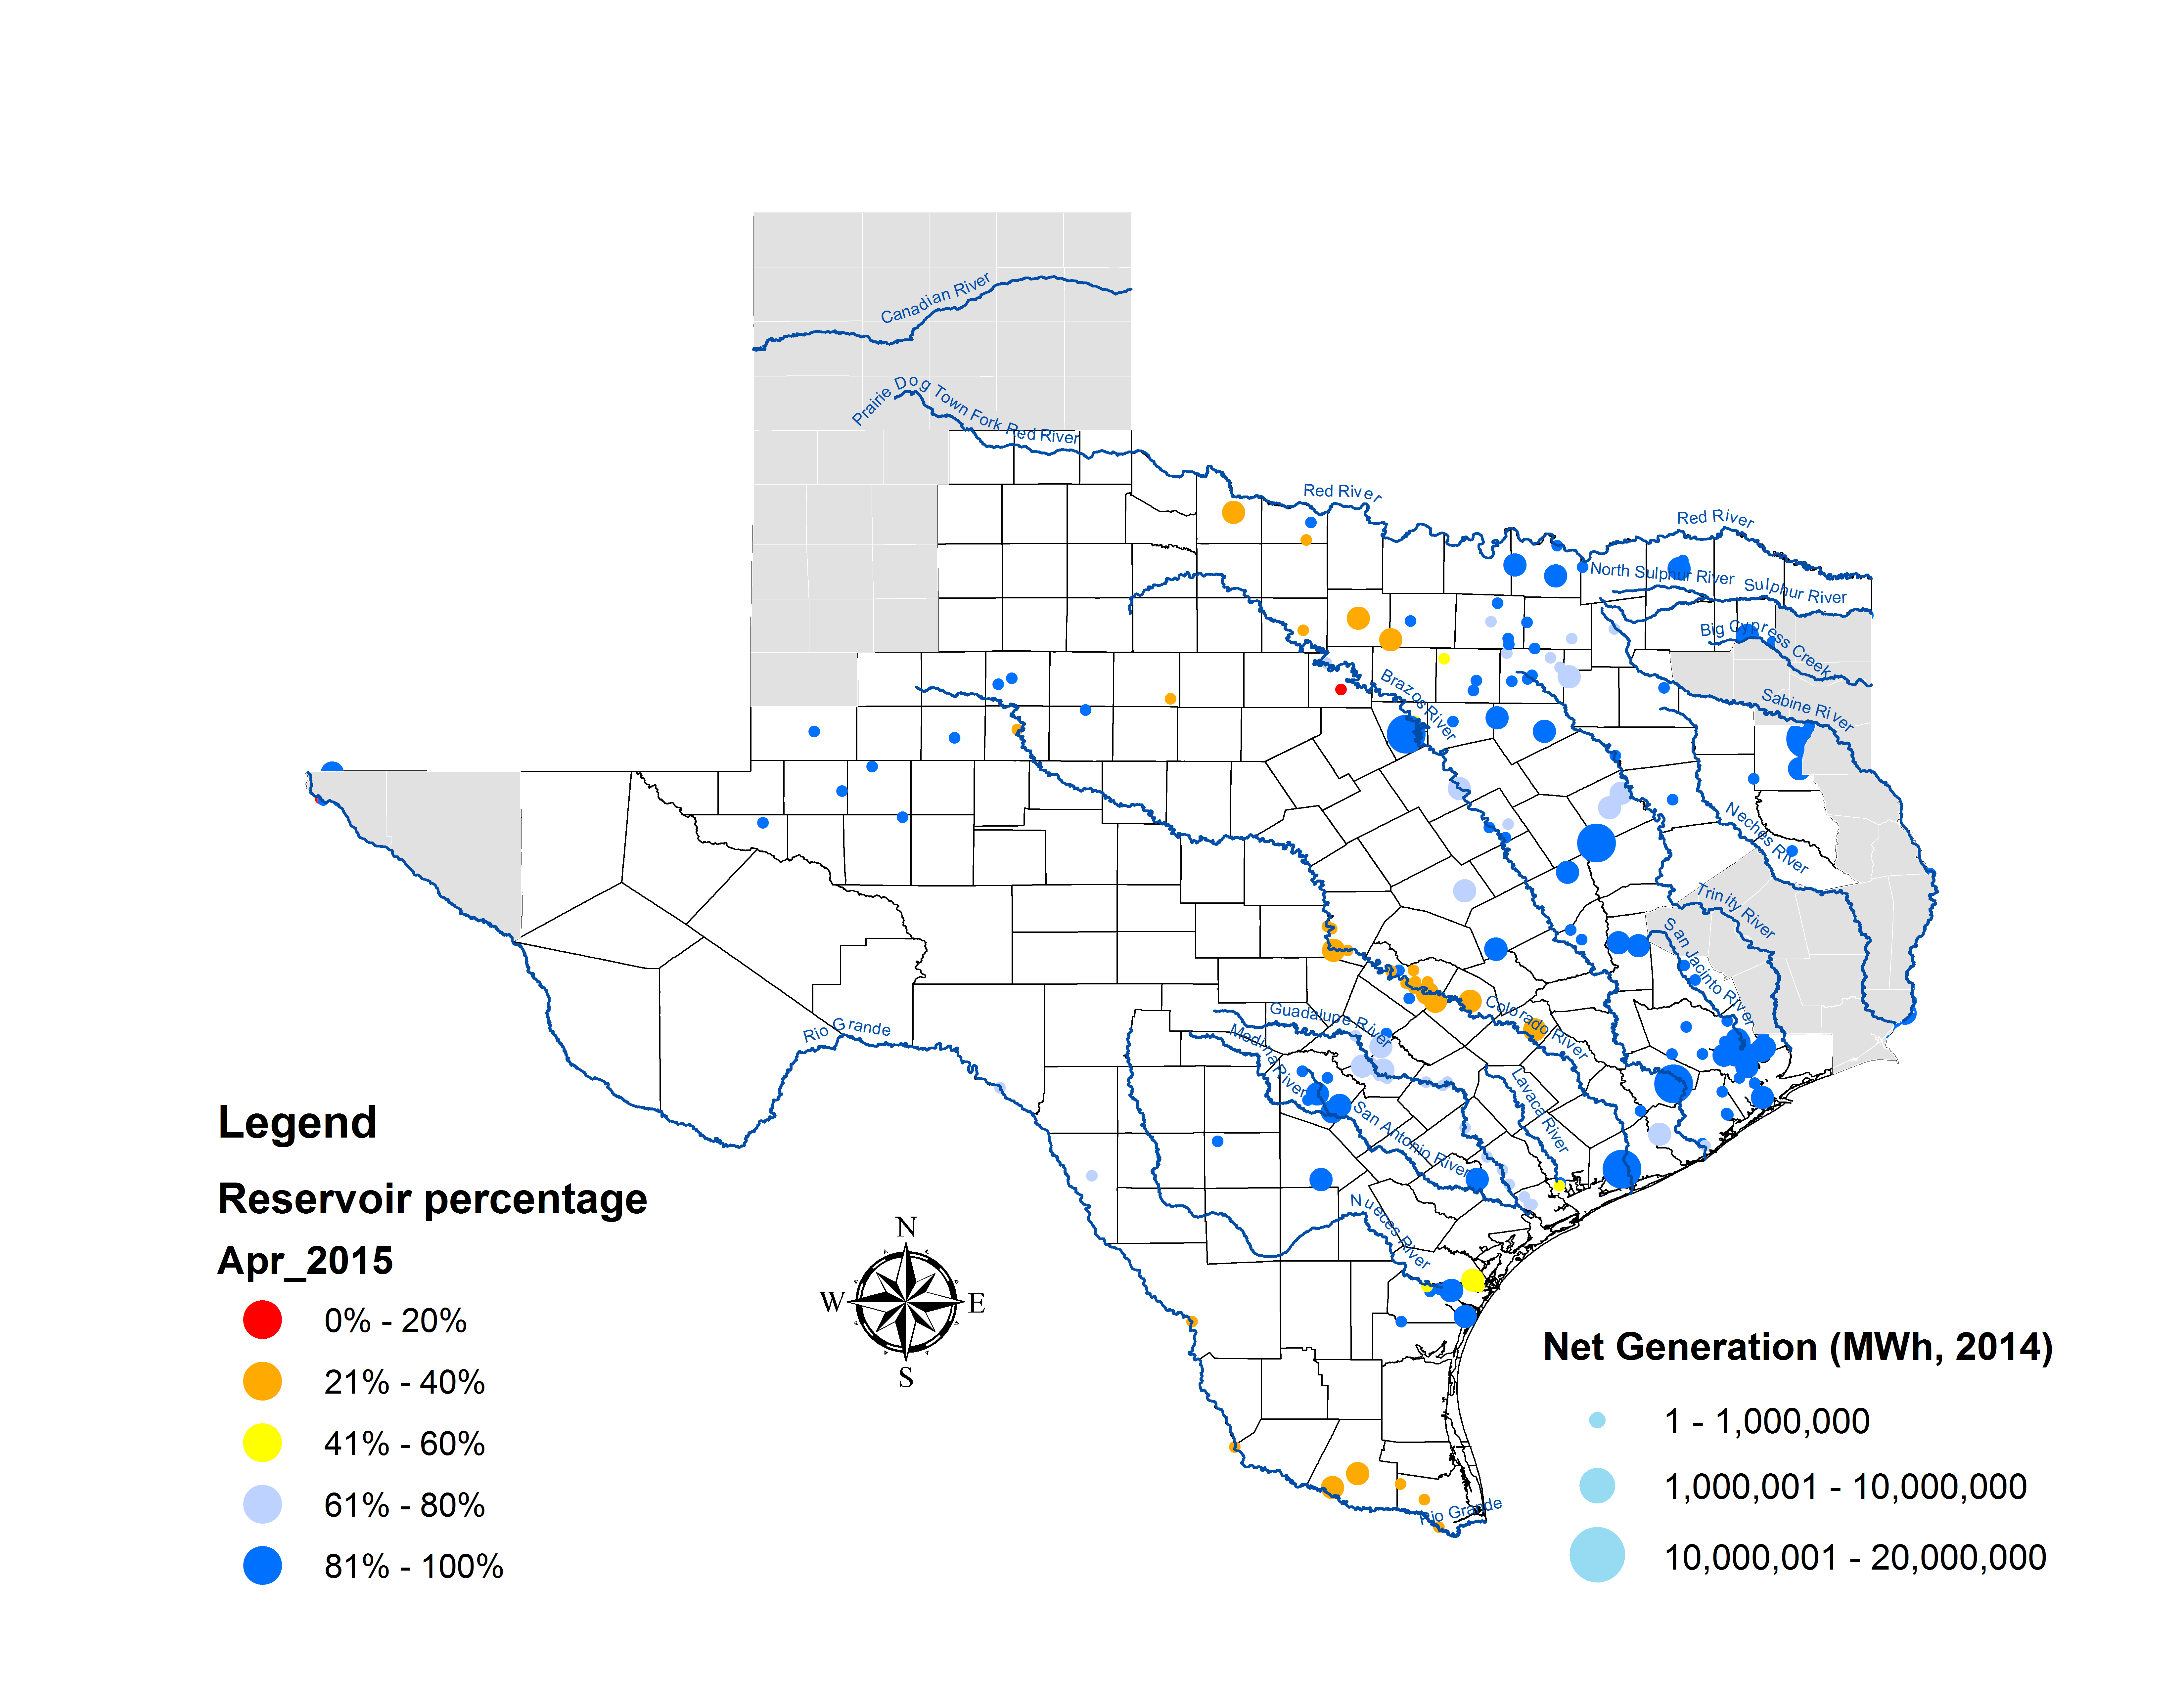
Lake Levels Update – April 1, 2015

Slide 14
Planning Summary – March 2015
ERCOT is currently tracking 251 active generation interconnection requests totaling over 58,300 MW. This includes over 25,300 MW of wind generation.
ERCOT is currently reviewing proposed transmission improvements with a total cost of $252 Million.
Transmission Projects endorsed in 2015 total $103.8 Million.
All projects (in engineering, routing, licensing, and construction) total approximately $6.15 Billion.
Transmission Projects energized in 2015 total about $32.8 Million.

Slide 15
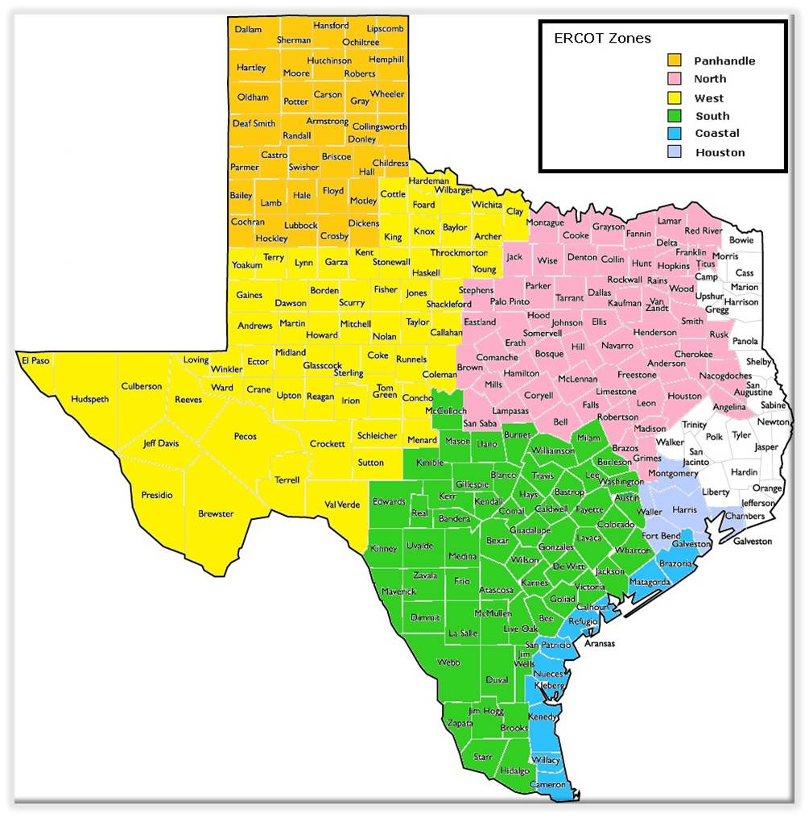
Cumulative Installed MW Capacity of Interconnection Requests by Zone – March 2015

Slide 16
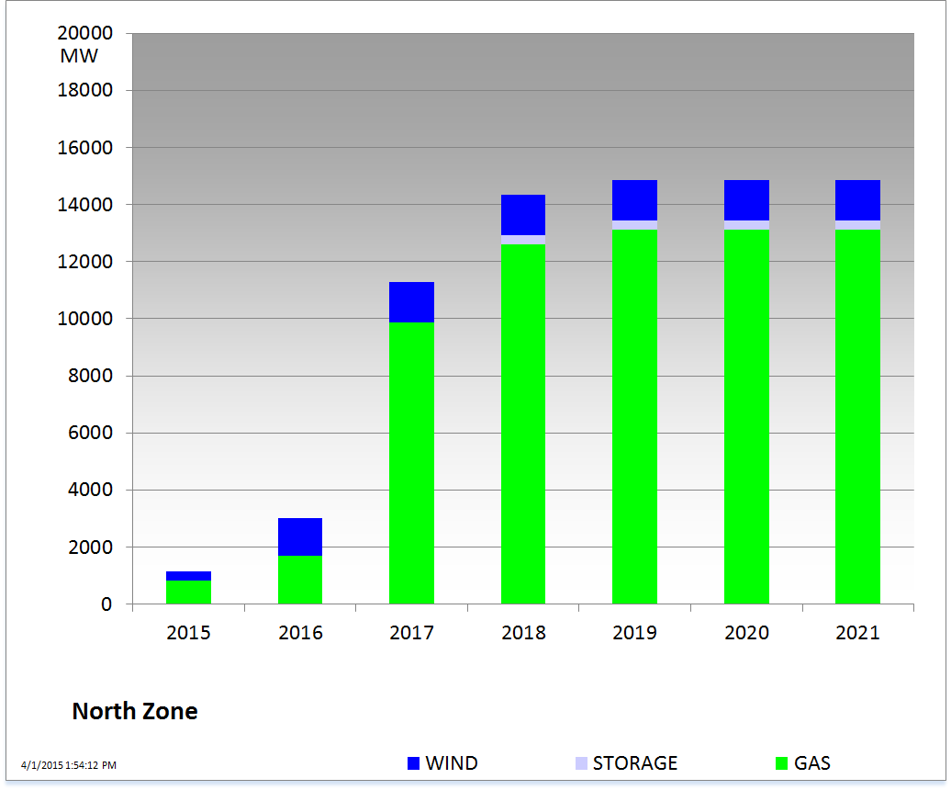
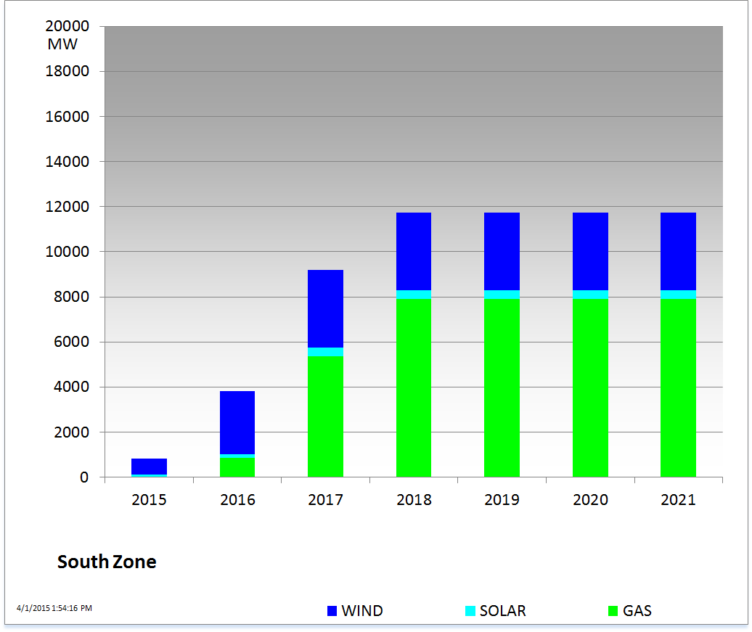
Cumulative Installed MW Capacity of Interconnection Requests by Zone – March 2015

Slide 17
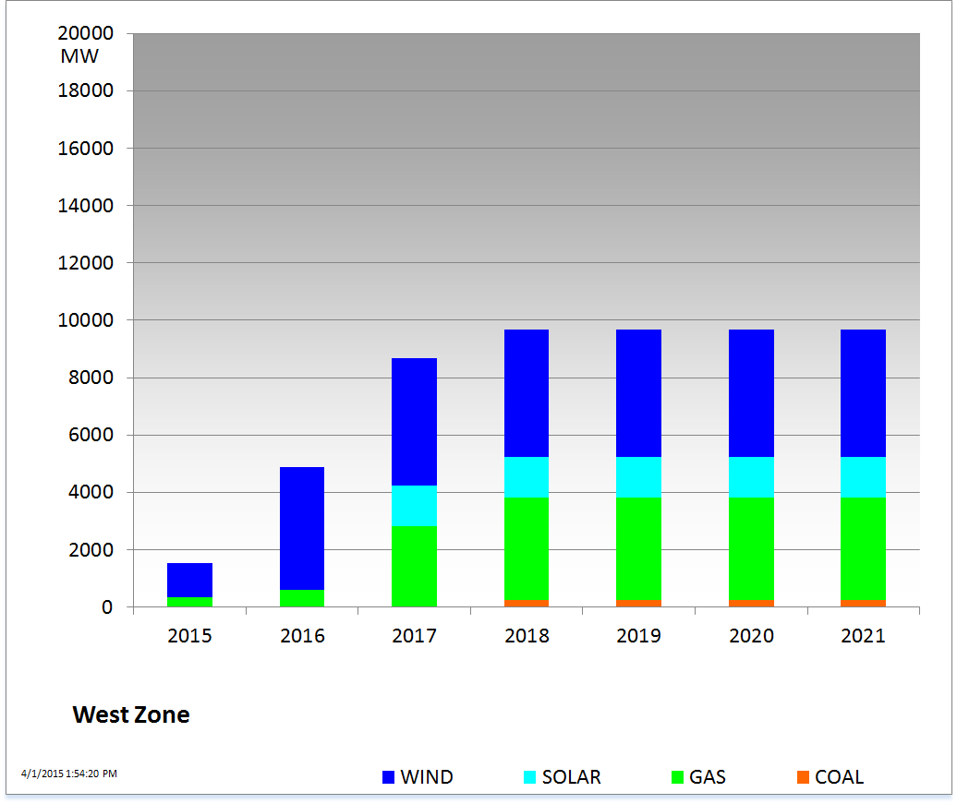
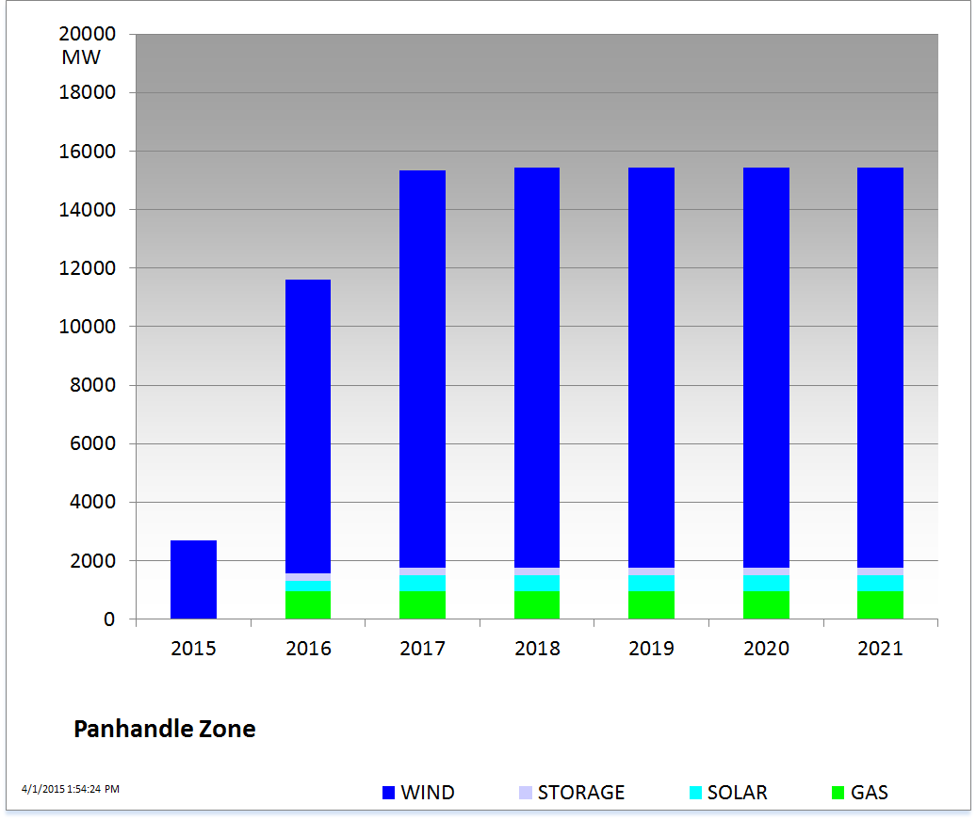
Cumulative Installed MW Capacity of Interconnection Requests by Zone – March 2015

Slide 18
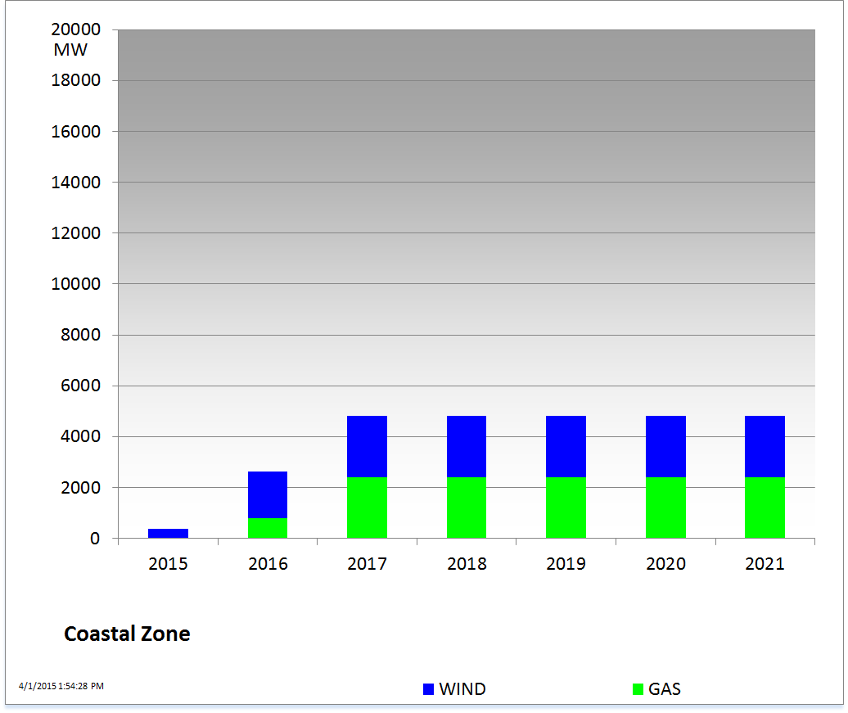
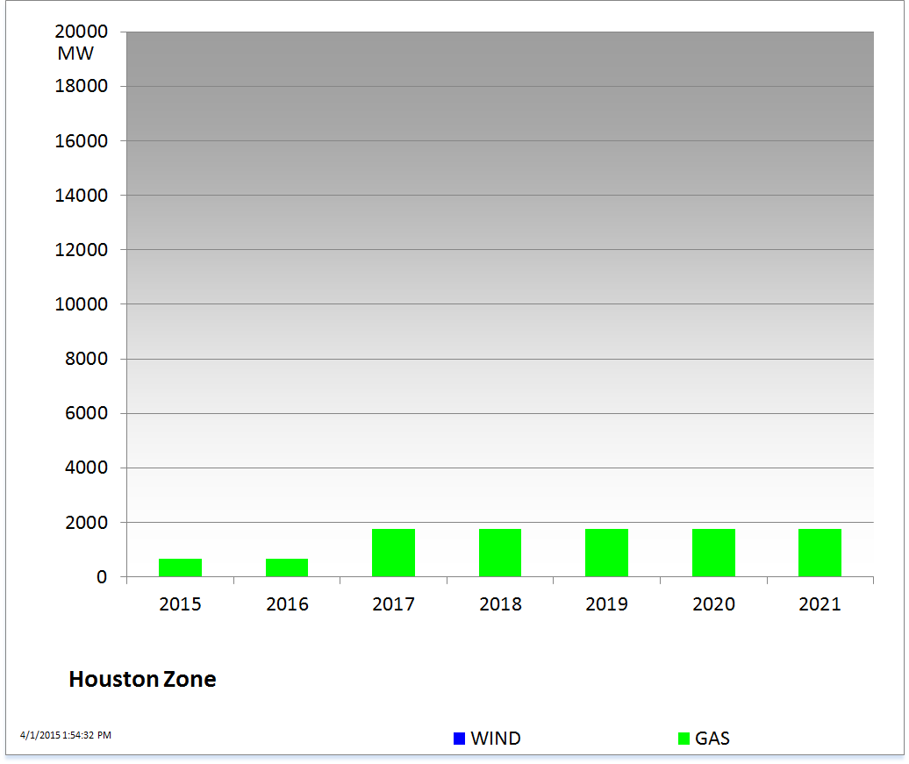
Cumulative Installed MW Capacity of Interconnection Requests by Zone – March 2015

Slide 19
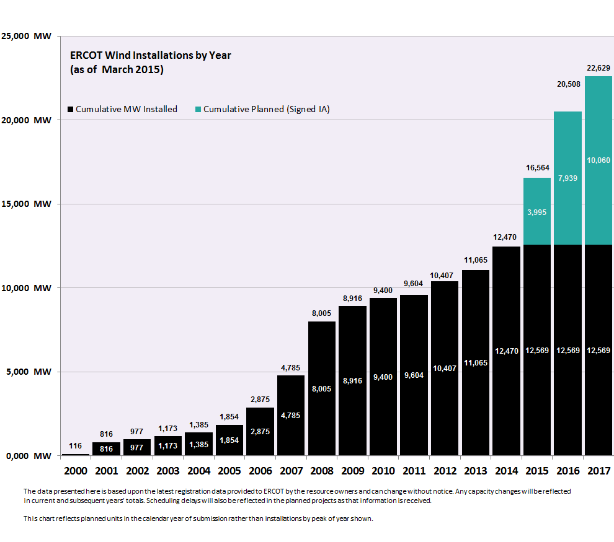
Wind Generation – March 2015

Slide 20
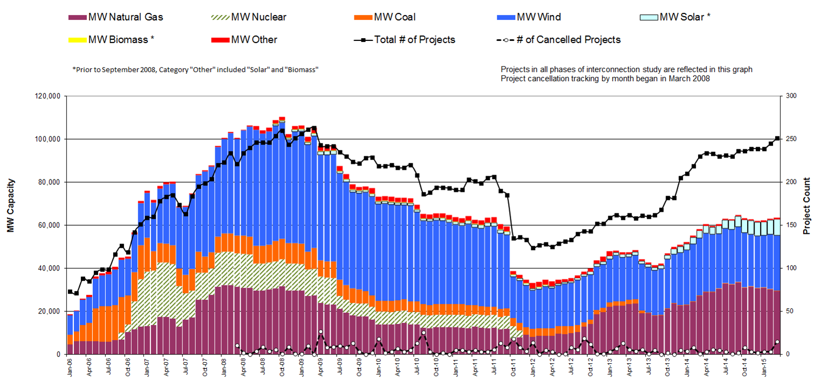
Generation Interconnection Activity by Fuel – March 2015

Slide 21
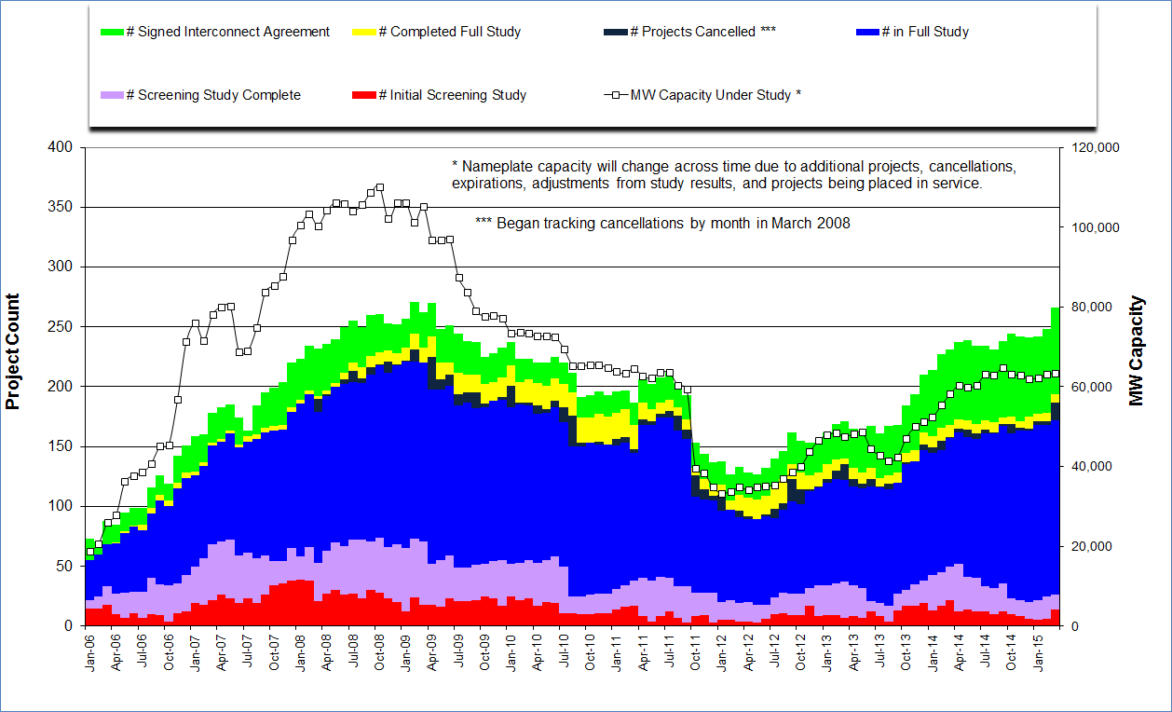
Generation Interconnection Activity by Project Phase – March 2015

Slide 22
Market Operations

Slide 23
Day-Ahead Schedule (Hourly Average) – March 2015

Slide 24
Day-Ahead Electricity And Ancillary Service Hourly Average Prices – March 2015

Slide 25
Day-Ahead Vs Real-Time Load Zone SPP (Hourly Average) – March 2015

Slide 26
Day-Ahead Vs Real-Time Hub Average SPP (Hourly Average) – March 2015

Slide 27
DRUC Monthly Summary (Hourly Average) – March 2015

Slide 28
HRUC Monthly Summary – March 2015

Slide 29
Non-Spinning Reserve Service Deployment – March 2015
Deployment Start Time | Deployment End Time | Deployment Duration (Hours) | Max Deployment (MW) | Reason
None

Slide 30
CRR Price Convergence – March 2015

Slide 31
ORDC Price Adder (Daily Average) – March 2015

Slide 32
ERS Procurement for February 2015 –May 2015
 | BH1 | BH2 | BH3 | NBH
ERS-10 MW Procured | 598.139 | 576.648 | 570.842 | 539.822
ERS-30 MW Procured | 349.356 | 347.416 | 310.620 | 275.695
Total MW Procured | 947.495 | 924.064 | 881.462 | 815.517
Clearing Price | $15.61 | $2.63 | $11.10 | $3.00
BH1 - Business Hours 1 HE 0900 through 1300, Monday thru Friday except ERCOT Holidays
BH2 - Business Hours 2 HE 1400 through 1600, Monday thru Friday except ERCOT Holidays
BH3 - Business Hours 3 HE 1700 through 2000, Monday thru Friday except ERCOT Holidays
NBH - Non-Business Hours All other hours

Slide 33
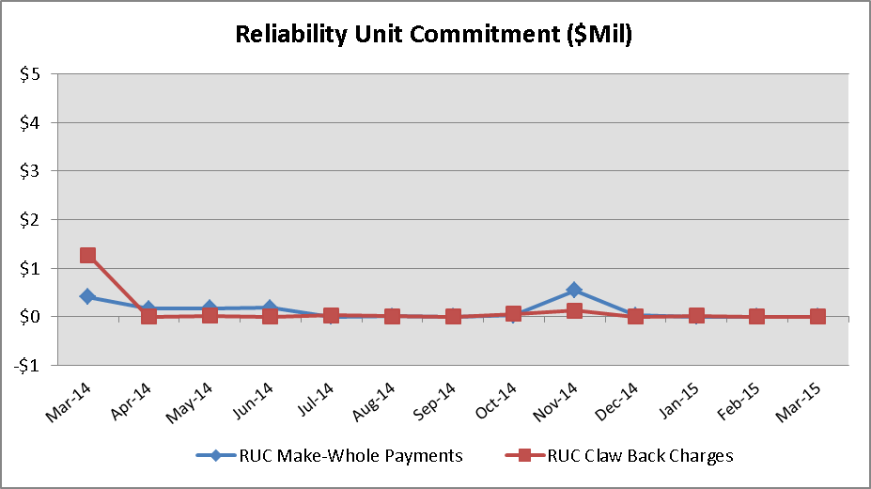
Reliability Services – March 2015
Reliability Unit Commitment (RUC) | $ in Millions
RUC Make-Whole Payments | $0.00
RUC Clawback Charges | $0.00
RUC Commitment Settlement | $0.00
RUC Capacity Short Charges | $0.00
RUC Make-Whole Uplift | $0.00
RUC Commitment Cost Allocation | $0.00
RUC Decommitment Payments | $0.00
RUC Make-Whole Payments remained at $0.00M in March. RUC Clawback Charges were $0.00M.
There was $0.00M allocated directly to load in March 2015, compared to:
$0.00M in February 2015
$1.27M credit in March 2014

Slide 34
Capacity Services – March 2015
Capacity Services | $ in Millions
Regulation Up Service | $4.75
Regulation Down Service | $1.82
Responsive Reserve Service | $20.19
Non-Spinning Reserve Service | $6.84
Black Start Service | $0.63
Voltage Services - Reactive Power | $0.00
Voltage Services - Lost Opportunity | $0.00
Total Charges | $34.23
Capacity Services costs increased from last month and decreased from March 2014.
March 2015 cost was $34.23M, compared to:
A charge of $19.82M in February 2015
A charge of $67.33M in March 2014

Slide 35
Energy Settlement – March 2015
Day-Ahead Market Energy Settlement | $ in Millions
Energy Purchases | $376.41
Point to Point Obligation Purchases | $17.60
RMR Day-Ahead Revenue | $0.00
Energy Sales | ($371.87)
Day-Ahead Congestion Rent | $22.14
Day-Ahead Market Make-Whole Payments | ($0.19)
Real-Time Market Energy Settlement | $ in Millions
Energy Imbalance at a Resource Node | ($390.21)
Energy Imbalance at a Load Zone | $596.19
Energy Imbalance at a Hub | ($184.88)
Real Time Congestion from Self Schedules | ($0.18)
Block Load Transfers and DC Ties | ($6.18)
Impact to Revenue Neutrality | $14.74
Emergency Energy Payments | ($0.08)
Base Point Deviation Charges | $0.21
Real-Time Metered Generation (MWh in millions) | 25.16
Both Day-Ahead Market and Real-Time Market energy settlement activity increased from last month and decreased from March 2014.

Slide 36
Congestion Revenue Rights (CRR) – March 2015
 | $ in Millions
Annual Auction | ($19.64)
Monthly Auction | ($5.73)
Total Auction Revenue | ($25.37)
Day-Ahead CRR Settlement | ($19.34)
Day-Ahead CRR Short-Charges | $0.32
Day-Ahead CRR Short-Charges Refunded | ($0.32)
Real-Time CRR Settlement | $0.00
Real-Time CRR Short-Charges | $0.00
Real-Time CRR Short-Charges Refunded | $0.00
Total CRR Funding | ($19.34)
Day-Ahead Point to Point Obligations Settlement | $17.60
Real-Time Point to Point Obligation Settlement | ($16.82)
Net Point to Point Obligation Settlement | $0.78
Congestion Revenue Rights settlement payments were fully funded and excess funds were deposited into the CRR Balancing Account Fund.
Point to Point Obligations settled with a net charge of $0.78M compared to a net payment of $2.10M last month.

Slide 37
CRR Balancing Account Fund – March 2015
CRR Balancing Account Fund | $ in Millions
Beginning Balance for the Month | $3.86
CRR Balancing Account Credit Total | $3.12
CRR PTP Option Award Charges | $0.06
Day-Ahead CRR Short-Charges Refunded | ($0.32)
Total Fund Amount | $6.72
ERCOT implemented the rolling CRR Balancing Account Fund beginning with Operating Month December 2014. The month of March 2015 closed with $2,853,013 in excess Day-Ahead congestion rent which was deposited into the Fund.
As of March 2015, the amount available in the CRR Balancing Account Fund is $6,717,548.

Slide 38
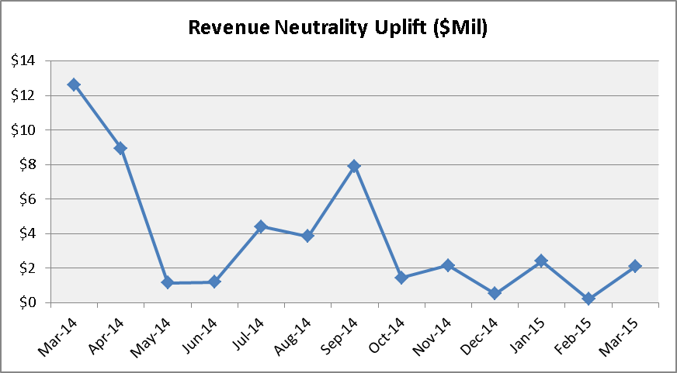
Revenue Neutrality – March 2015
Revenue Neutrality Settlement | $ in Millions
Real-Time Point to Point Obligation Settlement | ($16.82)
Real-Time Point to Point Options and Options with Refund Settlement | $0.00
Real-Time Energy Imbalance Settlement | $21.10
Real-Time Congestion from Self-Schedules Settlement | ($0.18)
DC Tie & Block Load Transfer Settlement | ($6.18)
Charge to Load | $2.08
Revenue Neutrality charges to load increased compared to last month and decreased compared to March 2014.
March 2015 was a charge of $2.08M, compared to:
$0.21M charge in February 2015
$12.61M charge in March 2014

Slide 39
Real Time Ancillary Service Imbalance (ORDC) – March 2015
Real Time Ancillary Service Imbalance | $ in Thousands
Real-Time AS Imbalance Payment Amount | ($297.99)
Load Allocated AS Imbalance Revenue Neutrality Amount | $297.97
Total Charges | $297.97
Real-Time Ancillary Service Imbalance Settlements increased from February 2015 to March 2015. Total payments for the month of March 2015 were $297,972 compared to a payment of $175,814 in February 2015.
8 of the 31 days in March had settlement dollars equal to $0 for the day.
All days were settled as a net credit to QSEs representing generation and as a charge to QSEs representing load.
The highest settlement occurred on March 1st. The total Real Time Ancillary Service Imbalance payments on that day were $84,723.

Slide 40
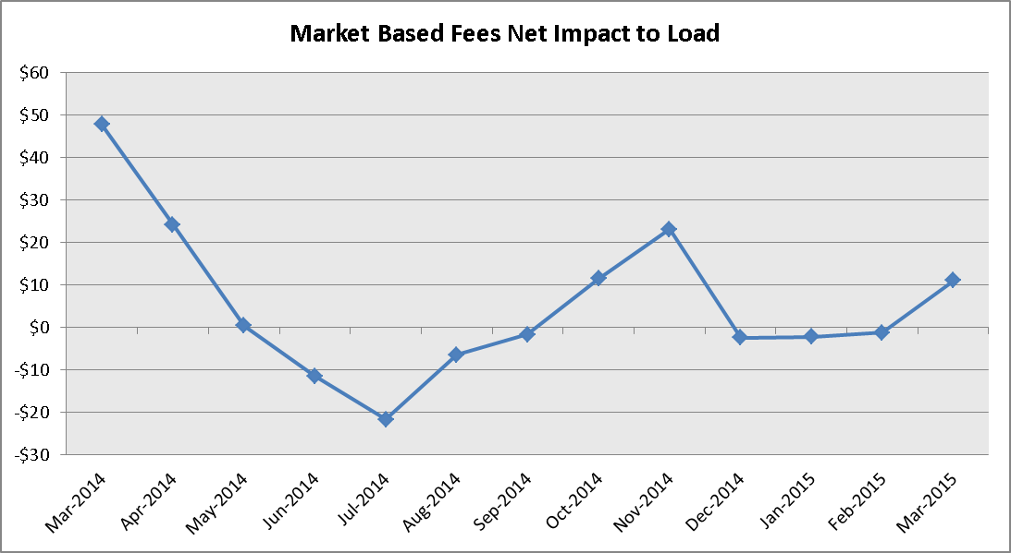
Net Allocation to Load – March 2015
Market-Based Allocation | $ in Millions
CRR Auction Revenue Disbursement Settlement | ($25.37)
Balancing Account Proceeds Settlement | $0.00
Net Reliability Unit Commitment Settlement | $0.00
Ancillary Services Settlement | $34.23
Reliability Must Run Settlement (incl. RMR for Capacity) | $0.00
Real-Time Revenue Neutrality Settlement | $2.08
Emergency Energy Settlement | $0.08
Base Point Deviation Settlement | ($0.21)
ORDC Settlement | $0.30
Total | $11.11
Fee Allocation
ERCOT Administrative Fee Settlement | $11.80
Net Allocated to Load | $22.91
The charge for the net allocation to Load increased from last month and decreased from March of 2014.
March 2015 was a charge of $22.91M, compared to:
A charge of $10.40M in February 2015
A charge of $59.27M in March 2014

Slide 41
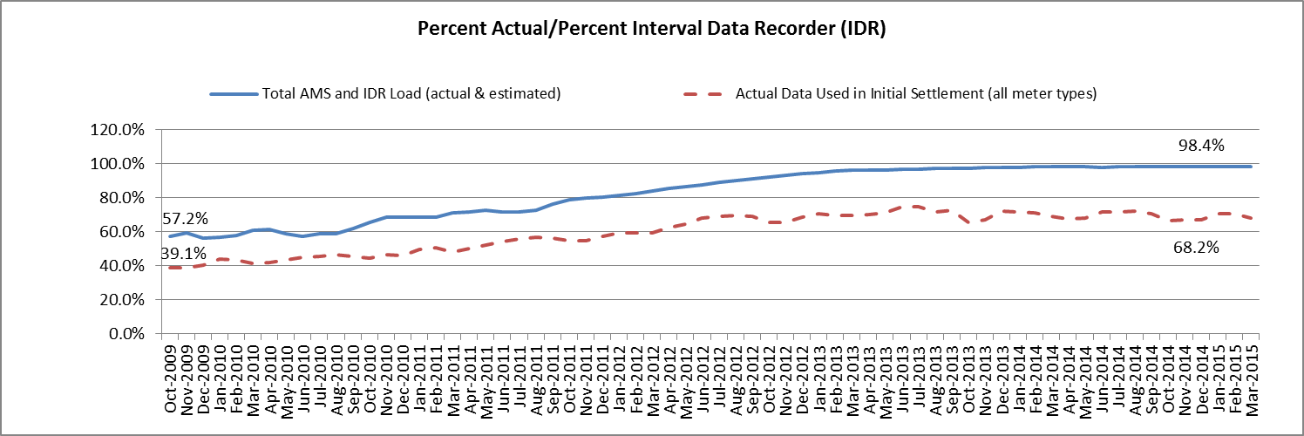
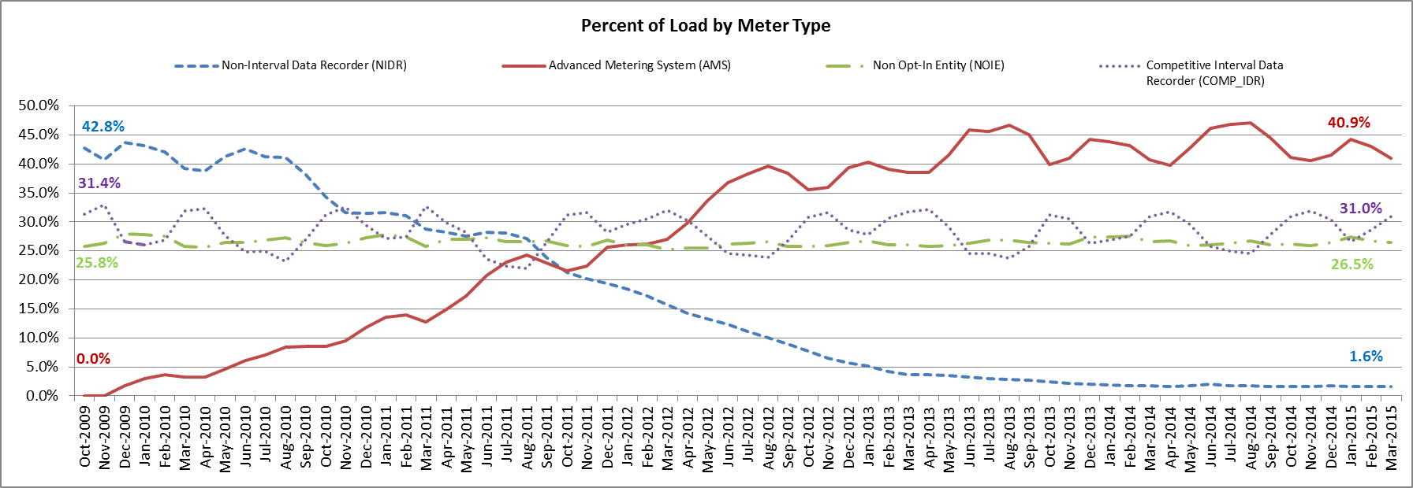
Advanced Meter Settlement Impacts – March 2015
March 2015: At month end, settling 6.7M ESIIDs using Advanced Meter data.
March 2015: 98.4% of the load in ERCOT is settled with 15-min interval data (AMS, Competitive IDR, and NOIE IDR).

Slide 42
ERCOT Wide Load Volumes by Meter Type – INITIAL Settlement – March 2015

Slide 43
Retail Transaction Volumes – Summary – March 2015
 | Year-To-Date |  | Transactions Received
Transaction Type | March 2015 | March 2014 | March 2015 | March 2014
Switches | 226,276 | 251,970 | 79,997 | 93,887
Acquisition | 0 | 0 | 0 | 0
Move - Ins | 611,740 | 629,943 | 215,950 | 214,724
Move - Outs | 301,956 | 310,967 | 108,859 | 107,266
Continuous Service Agreements (CSA) | 120,383 | 146,277 | 44,577 | 70,310
Mass Transitions | 0 | 0 | 0 | 0
Total | 1,260,355 | 1,339,157 | 449,383 | 486,187

Slide 44
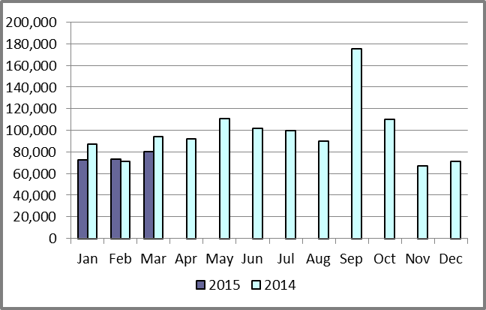
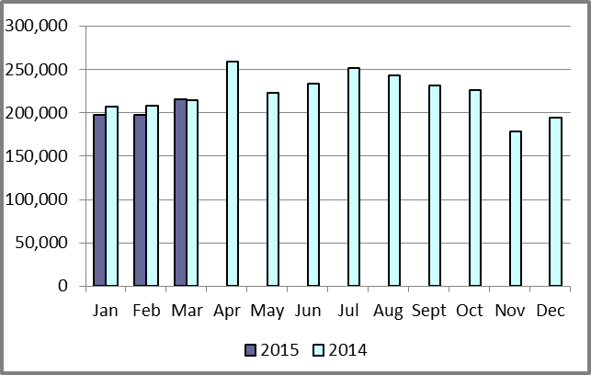
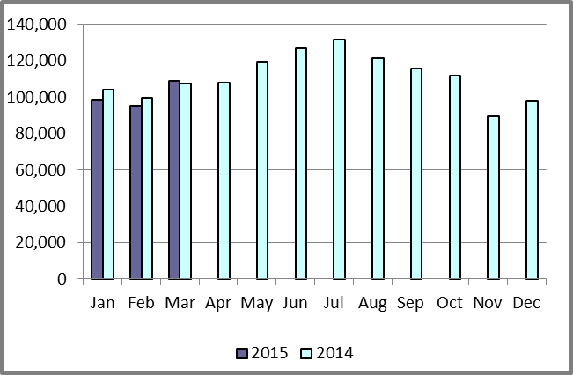
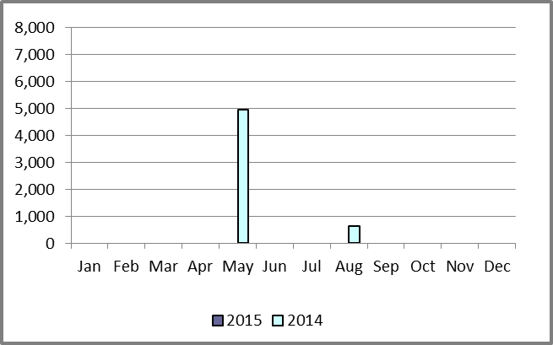
Retail Transaction Volumes – Summary – March 2015
Switches/Acquisitions
Move-Ins
Move-Outs
Mass Transition

Slide 45
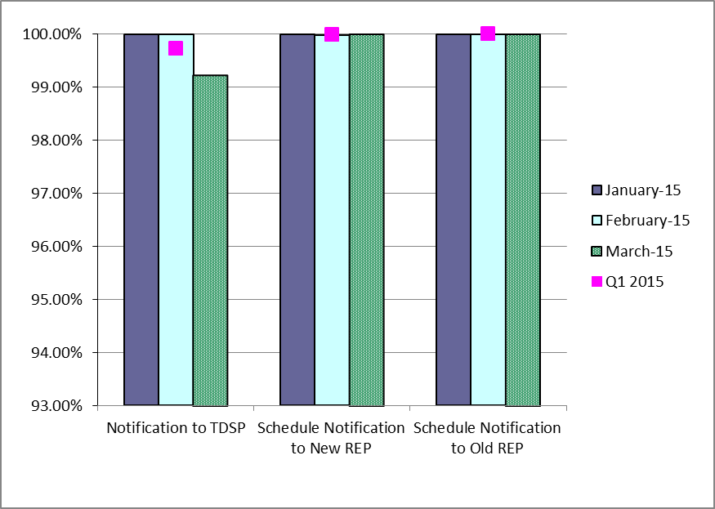
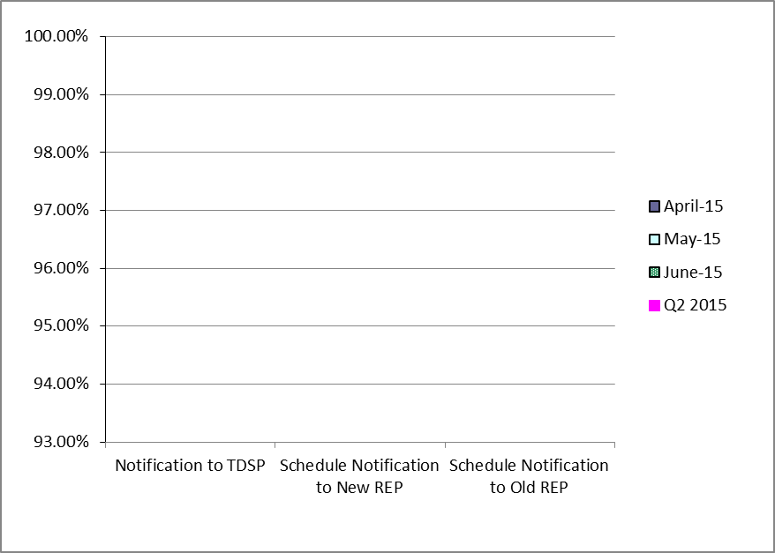
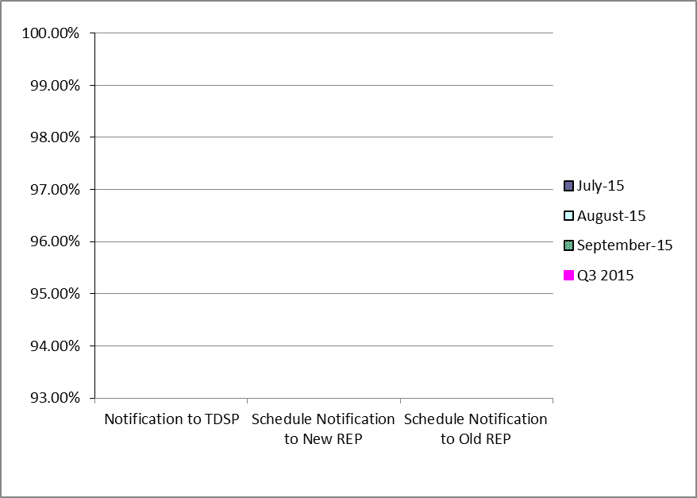
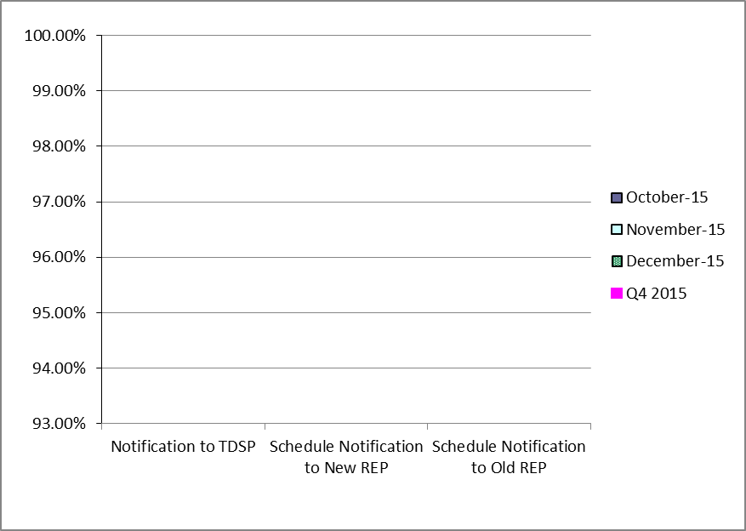
Retail Performance Measures – Switch – March 2015
1st Quarter
2nd Quarter
3rd Quarter
4th Quarter

Slide 46
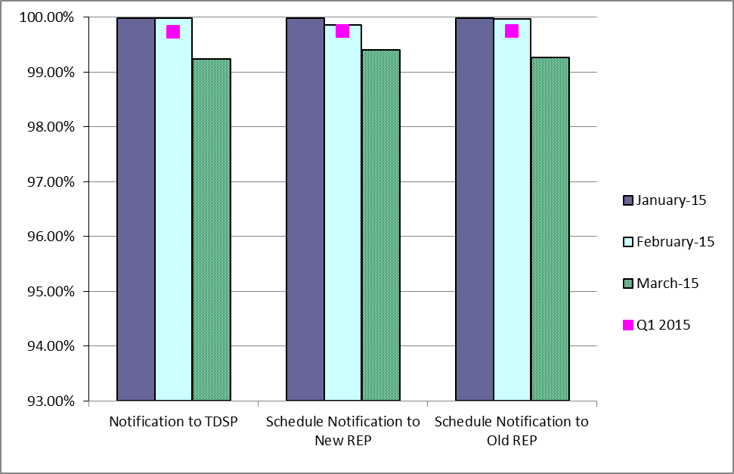
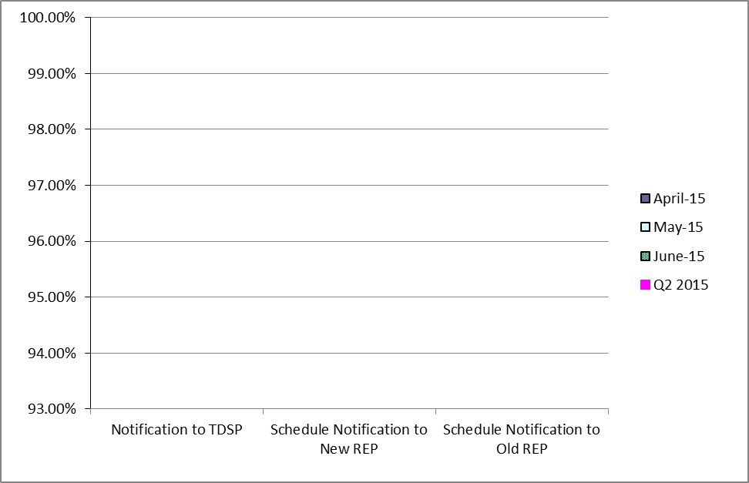
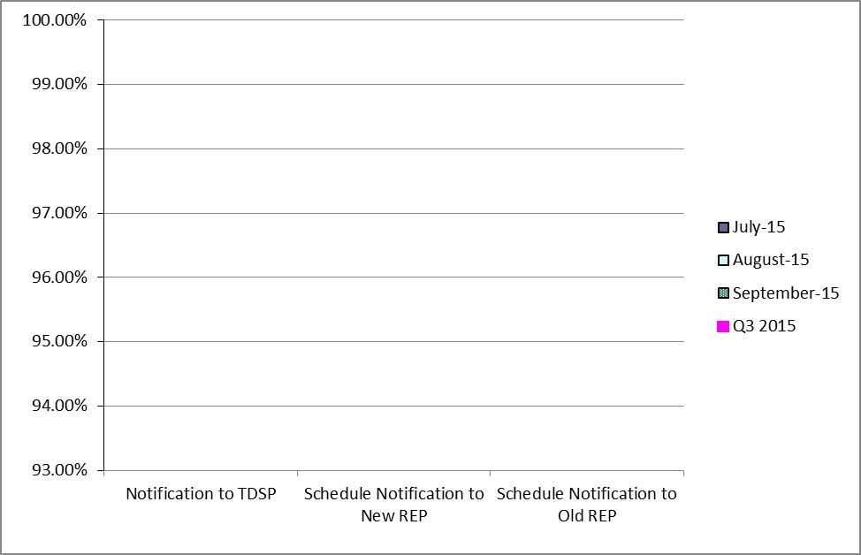
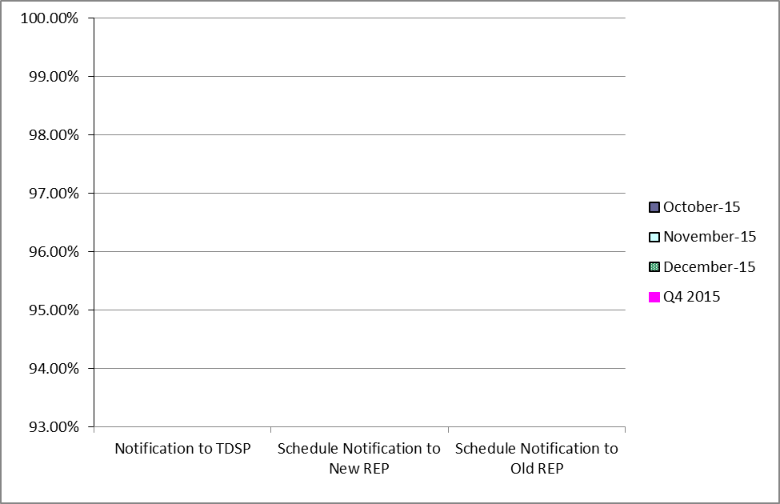
Retail Performance Measures (Same Day Move-In) – March 2015
1st Quarter
2nd Quarter
3rd Quarter
4th Quarter

Slide 47
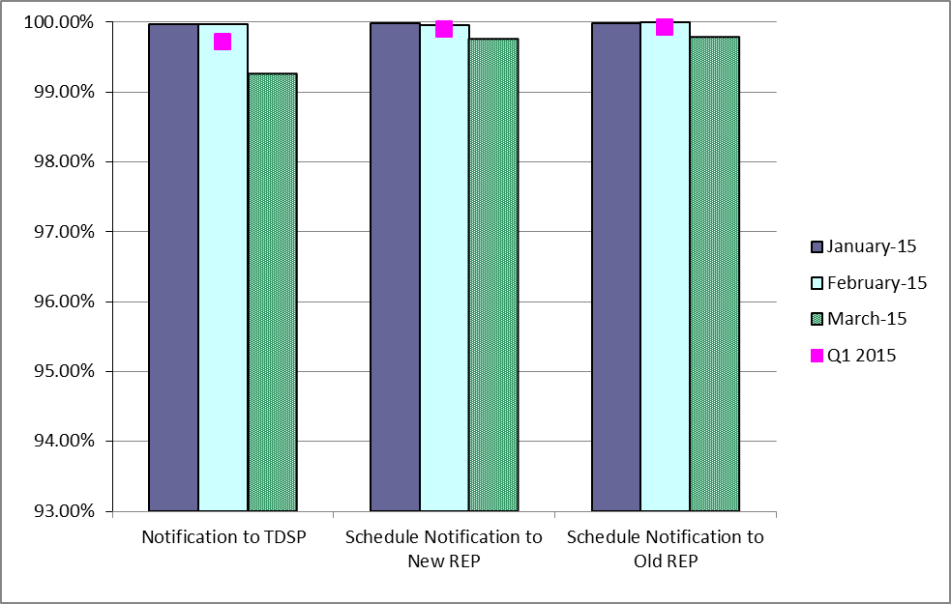
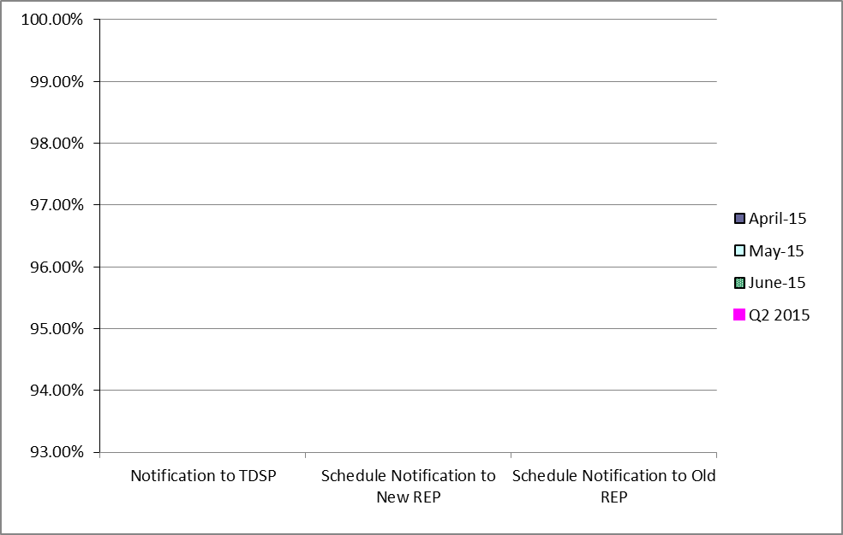
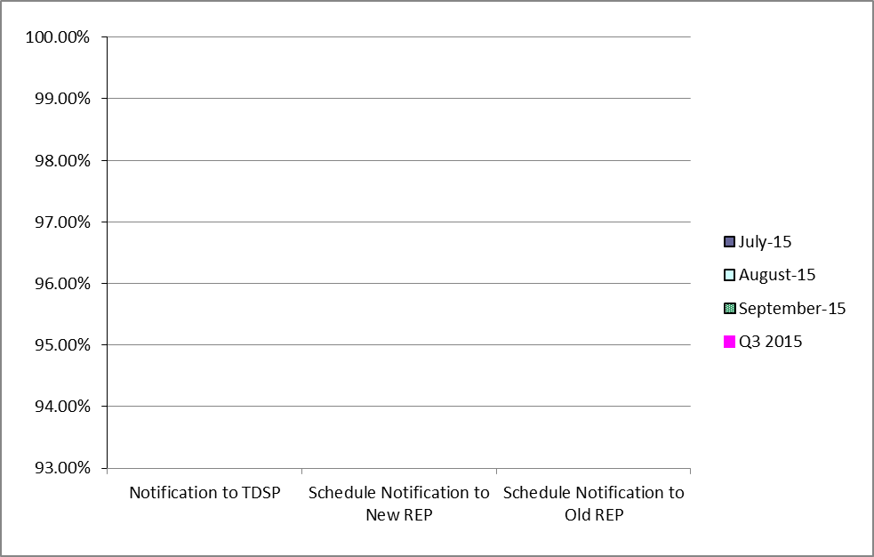
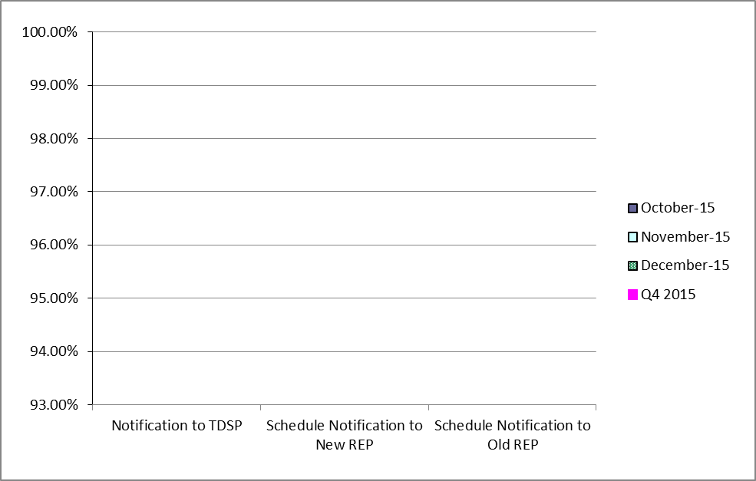
Retail Performance Measures (Standard Move-In) – March 2015
1st Quarter
2nd Quarter
3rd Quarter
4th Quarter

Slide 48
Projects Report

Slide 49
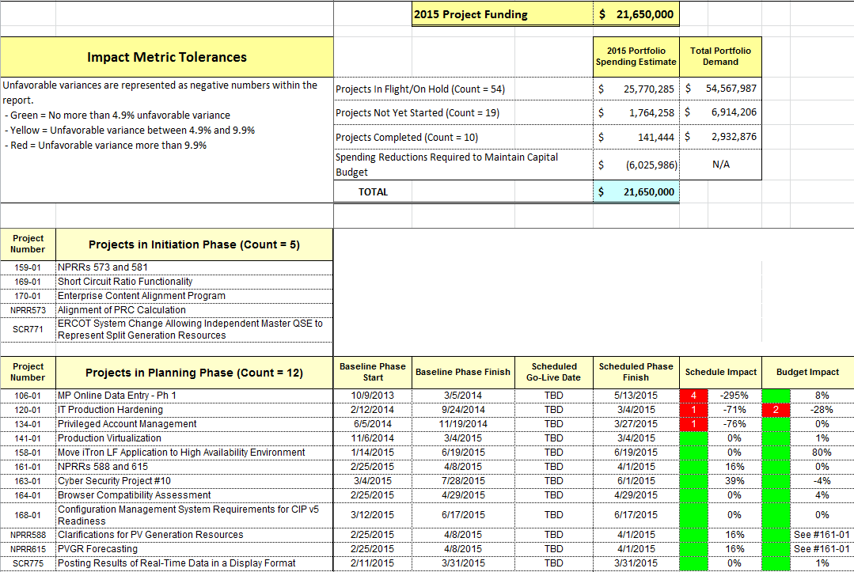
ERCOT Portfolio Stoplight Report – March 2015

Slide 50
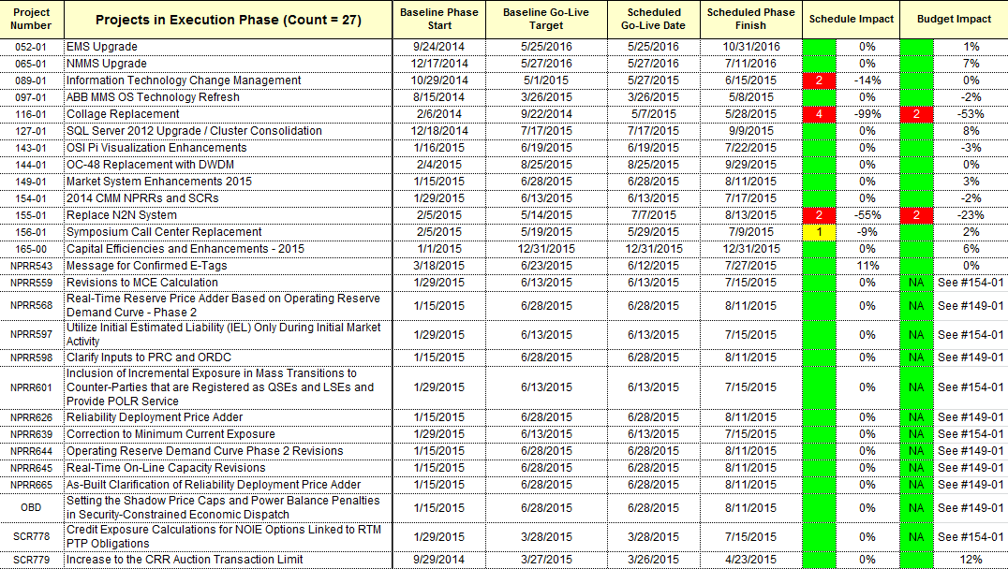
ERCOT Portfolio Stoplight Report – March 2015

Slide 51
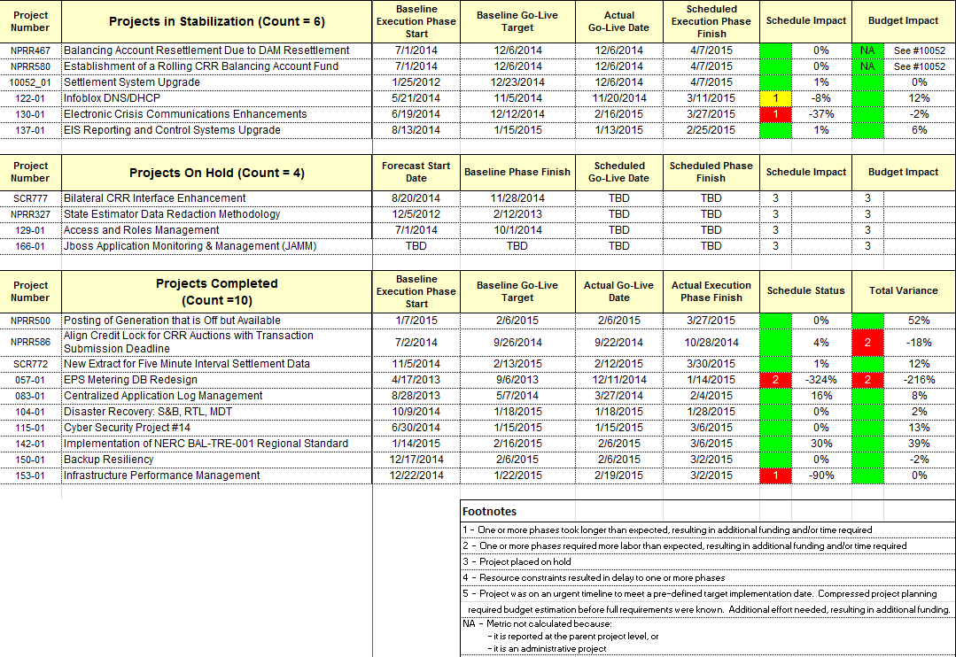
ERCOT Portfolio Stoplight Report – March 2015

Slide 52
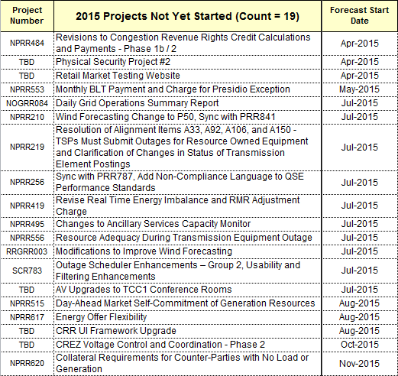
ERCOT Portfolio Stoplight Report – March 2015

