Slide 1
2015 RTP: Cascade Analysis
April 21, 2015

Slide 2
Outline
Cascade analysis in RTP
Scope and process
Next steps

Slide 3
Cascade analysis in RTP
Any contingency event defined in the Table 1 of the TPL standards where a non-consequential load shed is an acceptable corrective action plan will be screened further for potential cascade conditions
ERCOT is currently evaluating tools to perform the initial screen as well as detailed cascade analysis
This analysis will be conducted on the base case and sensitivity cases

Slide 4
Cascade analysis definition
NERC definition – “The uncontrolled successive loss of system elements triggered by an incident at any location. Cascading results in widespread electric service interruption that cannot be restrained from sequentially spreading beyond an area predetermined by studies.”
A contingency is studied in the following general steps
Following a contingency event, the study will trip elements if the post contingent voltages and branch flows exceed the relay trigger limits and re-solve power flow.
The study will continue to trip elements until the cascade analysis terminating condition is reached.

Slide 5
Cascade Analysis: Relay trigger limits
Criteria for Tripping equipment:
Transmission facilities (100 kV and above) overloaded beyond their relay loadability limits
Generator buses where voltage on the high side of the Generator Step Up (GSU) transformer are less than known or assumed minimum generator voltage limits
Generator buses where voltage on the high side of the GSU transformer exceed known or assumed maximum generator voltage limits
Buses with known UVLS protection schemes where voltages go below the under voltage triggering level
The thermal relay loadability limits will be based on 115% of Rate B or 150% of Rate A from the SSWG cases
The voltage limits for the above criteria will be obtained from ERCOTs databases used for dynamic studies
At the screening stage, the above criteria and process may be simplified further to speed up the study.
The study will determine the accumulated load loss as a result of a system cascade.

Slide 6
Cascade Analysis: Cascade analysis termination
The contingency event is identified to be a ‘potential’ cascade event if
The accumulated amount of load loss is greater than 6% of the total initial system load
The power flow does not converge - which may be a result of a potential voltage collapse condition, subject to additional confirmation
The number of cascade levels exceeds three.
A contingency causing potential cascade event will be studied in detail to determine if the event leads to an actual cascade condition. If a cascade condition is discovered a corrective action plan will be developed
ERCOT will coordinate the testing and corrective action plan development for potential cascade events with respective TP

Slide 7
Cascade Analysis: Detailed studies
Detailed studies to confirm cascade conditions will include (but may not be limited to)
For a power flow non-convergence, further evaluation will be done to identify non-numerical issues. A voltage stability assessment may be conducted to identify wide-spread voltage instability
Generator re-dispatch, tap setting changes and controlled load shed to reduce the overloads and voltages to within cascade trigger thresholds will be evaluated
A cascade condition will be confirmed if
A wide-spread voltage instability is identified after voltage stability assessment
Amount of the accumulated load loss as a result of the event is greater than 6% of the total initial system load

Slide 8
Next Steps
Seek comments and feedback from stakeholders regarding the methodology
Review tools needed to execute stated methodology
Finalize criteria to be applicable for 2015 RTP

Slide 9
Appendix

Slide 10
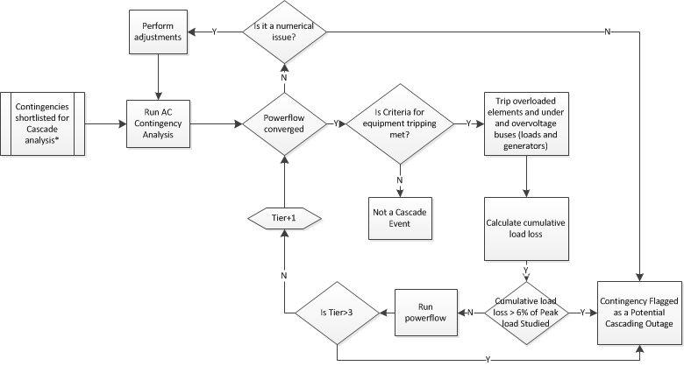
Screening for Potential Cascade Conditions

Slide 11
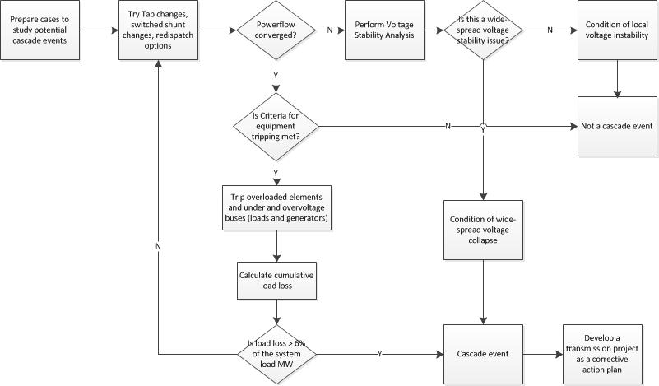
Detailed Cascade Analysis

