Slide 1

Settlement Stability
2015 Q1 Update to COPS
Mandy Bauld
ERCOT
COPS
04/15/2015

Slide 2
PR 8.2 (2) – Settlement stability
8.2 ERCOT Performance Monitoring
(c) Settlement stability:
(i) Track number of price changes “after-the-fact”;
(ii) Track number and types of disputes submitted to ERCOT;
(iii) Report on compliance with timeliness of response and disposition of disputes;
(iv) Other Settlement metrics; and
(v) Availability of Electric Service Identifier (ESI ID) consumption data in conformance with Settlement timeline;
(g) Uplift: ERCOT shall calculate and post the sum of all charges for all Qualified Scheduling Entities (QSEs) for each month and year-to-date due to each of the following:
(i) The RUC Capacity-Short Charge, as described in Section 5.7.4.1, RUC Capacity-Short Charge;
(ii) The RUC Decommitment Charge, as described in Section 5.7.6, RUC Decommitment Charge;
(iii) The Load-Allocated Reliability Must Run Amount per QSE, as described in Section 6.6.6.5, RMR Service Charge;
(iv) The Load-Allocated Voltage Support Service Amount per QSE, as described in Section 6.6.7.2, Voltage Support Charge;
(v) The Load-Allocated Black Start Service Amount per QSE, as described in Section 6.6.8.2, Black Start Capacity Charge;
(vi) The Load-Allocated Emergency Energy Amount per QSE, as described in Section 6.6.9.2, Charge for Emergency Power Increases;
(vii) The Load-Allocated Real-Time Revenue Neutrality Amount per QSE, as described in Section 6.6.10, Real- Time Revenue Neutrality Allocation; and
(viii) The total of the ERCOT System Administration Charge

Slide 3
8.2(c)(i) Track number of price changes “after-the-fact”
Reporting Period: 2015 Q1
Operating Day | # of Corrected Prices |  |  |  | # of Intervals Affected
 | DASPP | RTSPP | RTRMPR | ORDC Adders | DASPP | RTSPP | RTRMPR | ORDC Adders
03/25/2015 | 0 | 1196 | 985 | 2 | 0 | 2 | 2 | 2
03/30/2015 | 0 | 0 | 362 | 0 | 0 | 0 | 2 | 0
Notes:
Price corrections for OD 3/25/2015 were due to the Tech Refresh Project production cutover.
Price corrections for OD 3/30/2015 were due to an MMS application outage.

Slide 4
8.2(c)(ii) Track number and types of disputes submitted
YEAR | 2014
QUARTER | (All)
Row Labels | Denied | Granted | Total
Ancillary Services-RTM | 1 |  | 1
Congestion Revenue Rights-RTM |  | 1 | 1
Emergency Operations-RTM |  | 2 | 2
Energy-DAM | 3 |  | 3
Energy-RTM | 7 | 21 | 28
Gene. Res. Base Pt Deviation-RTM | 2 | 4 | 6
Reliability Unit Commitment-RTM | 3 | 2 | 5
Grand Total | 16 | 30 | 46

Slide 5
8.2(c)(ii) Track number and types of disputes submitted
YEAR | 2015
QUARTER | Q1
Row Labels | Denied | Granted | Granted w/Exc. | Grand Total
Congestion Revenue Rights-RTM | 1 |  |  | 1
Energy-DAM | 1 |  |  | 1
Energy-RTM | 2 | 6 |  | 8
Emergency Operations-RTM | 9 | 7 | 1 | 17
Grand Total | 13 | 13 | 1 | 27

Slide 6
8.2(c)(iii) Response compliance and disposition of disputes (timeliness)
YEAR | 2014
QUARTER | (All)
Row Labels | FINAL | TRUE-UP | Total
Ancillary Services-RTM | 100% |  | 100%
Congestion Revenue Rights-RTM | 100% |  | 100%
Emergency Operations-RTM |  | 100% | 100%
Energy-DAM | 100% |  | 100%
Energy-RTM | 100% | 100% | 100%
Gene. Res. Base Pt Deviation-RTM | 100% | 100% | 100%
Reliability Unit Commitment-RTM | 100% | 100% | 100%
Grand Total | 100% | 100% | 100%

Slide 7
8.2(c)(iii) Response compliance and disposition of disputes (timeliness)
YEAR | 2015
QUARTER | Q1
Row Labels | TRUE-UP | Grand Total
Congestion Revenue Rights-RTM | 100% | 100%
Energy-DAM | 100% | 100%
Energy-RTM | 100% | 100%
Emergency Operations-RTM | 100% | 100%
Grand Total | 100% | 100%

Slide 8
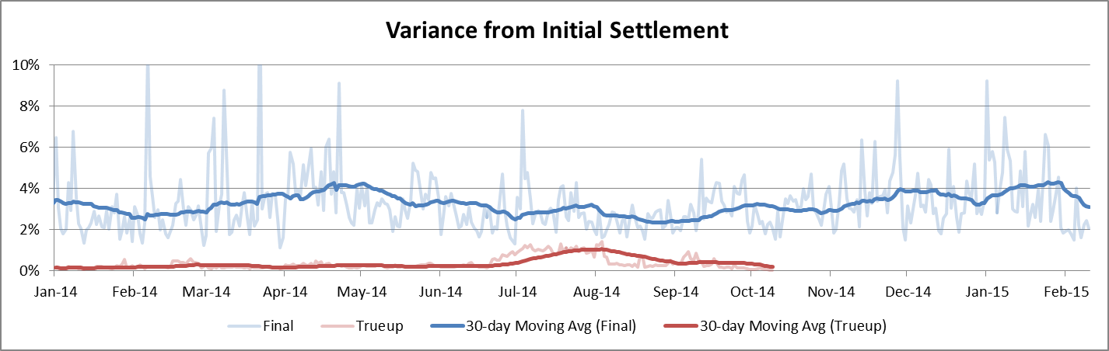
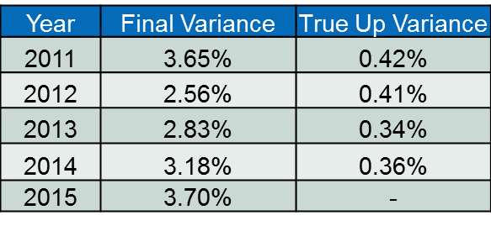
8.2(c)(iv) Other Settlement metrics
NOTE: ERS Final settlement data is not represented in graph.
Average per year

Slide 9
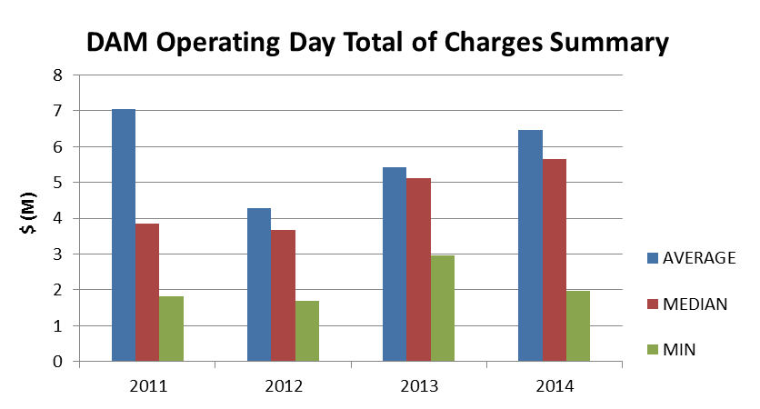
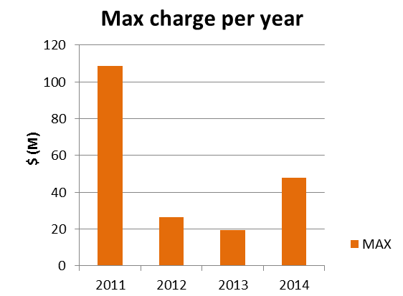
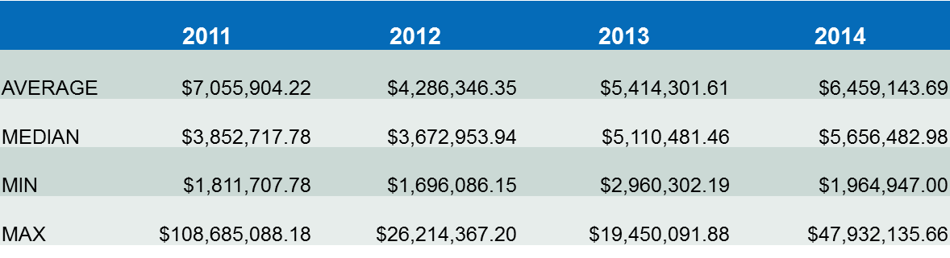
8.2(c)(iv) Other Settlement metrics
NOTE: “Total of Charges” represents the sum of statements that are a net charge to the Market Participant (i.e., the amount due to ERCOT)

Slide 10
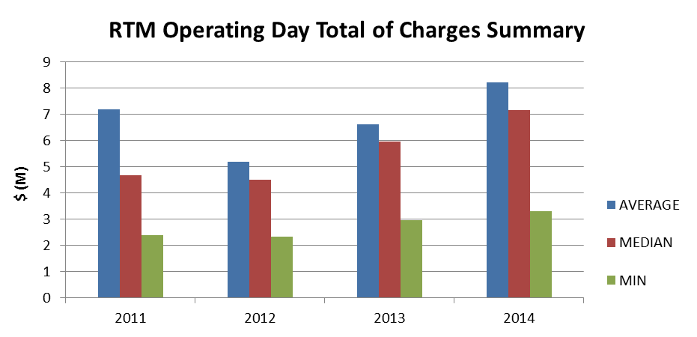
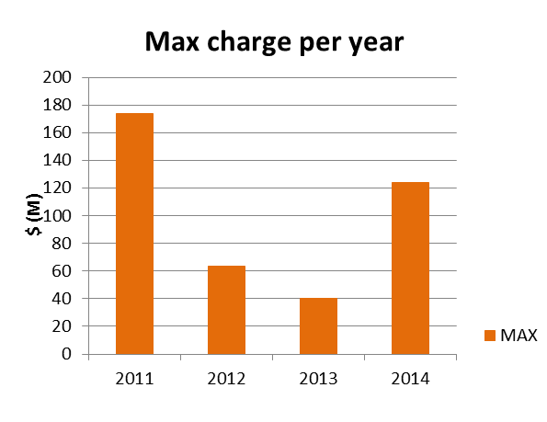
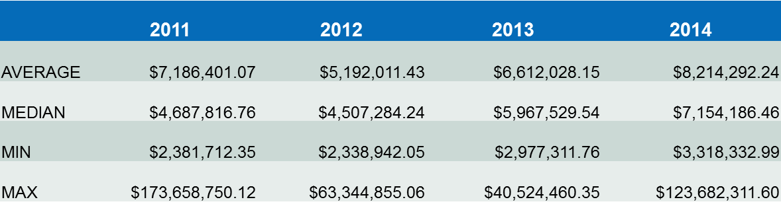
8.2(c)(iv) Other Settlement metrics
NOTE: “Total of Charges” represents the sum of statements that are a net charge to the Market Participant (i.e., the amount due to ERCOT)

Slide 11
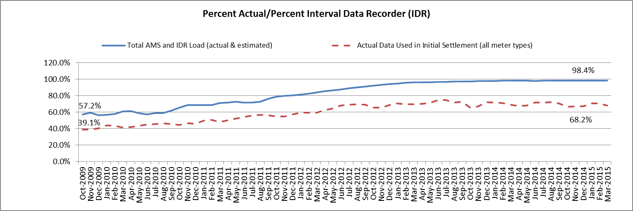
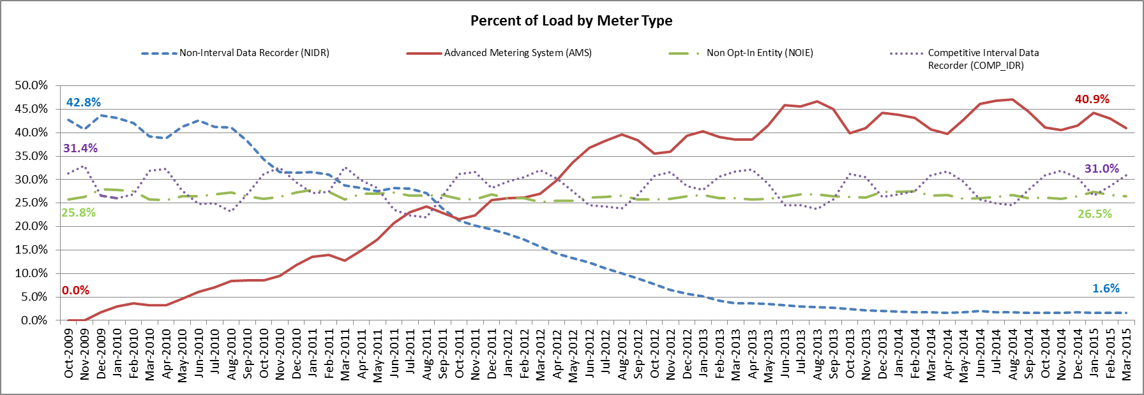
8.2(c)(v) Availability of ESIID consumption data
March 2015: At month end, settling 6.7M ESIIDs using Advanced Meter data.
March 2015: 98.4% of the load in ERCOT is settled with 15-min interval data (AMS, Competitive IDR, and NOIE IDR).
Notes:
SLIDE AVAILBLE IN THE ERCOT Monthly Operations Overview
Slide: Advanced Meter Settlement Impacts
Slide: ERCOT Wide Load Volumes by Meter Type at Initial Settlement
http://www.ercot.com/committees/board/index.html
Additional Information Available
Load Estimation Counts Report
Counts of ESIIDs and percentages of counts by MRE settled with actual meter data, estimated using historical meter data, and estimated using default load.
http://www.ercot.com/mktinfo/data_agg/index.html
AMS Volume & Count Report
Days lag between the Operating Day and the data loading date AMS reads.
http://www.ercot.com/committees/board/tac/rms/amwg/index.html
Reports posted under specific AMWG meeting pages on a periodic basis starting 03/2015

Slide 12
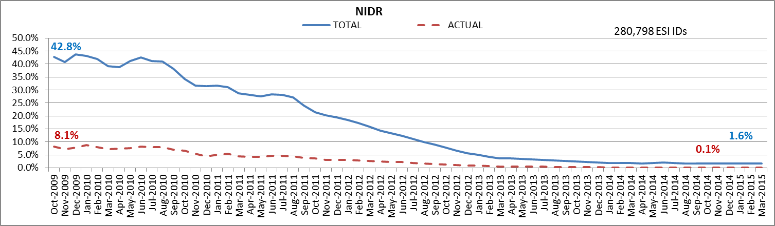
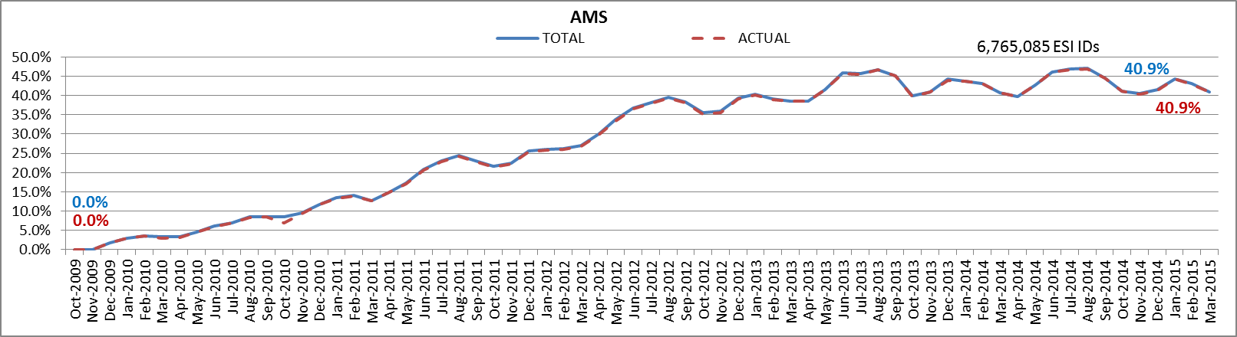
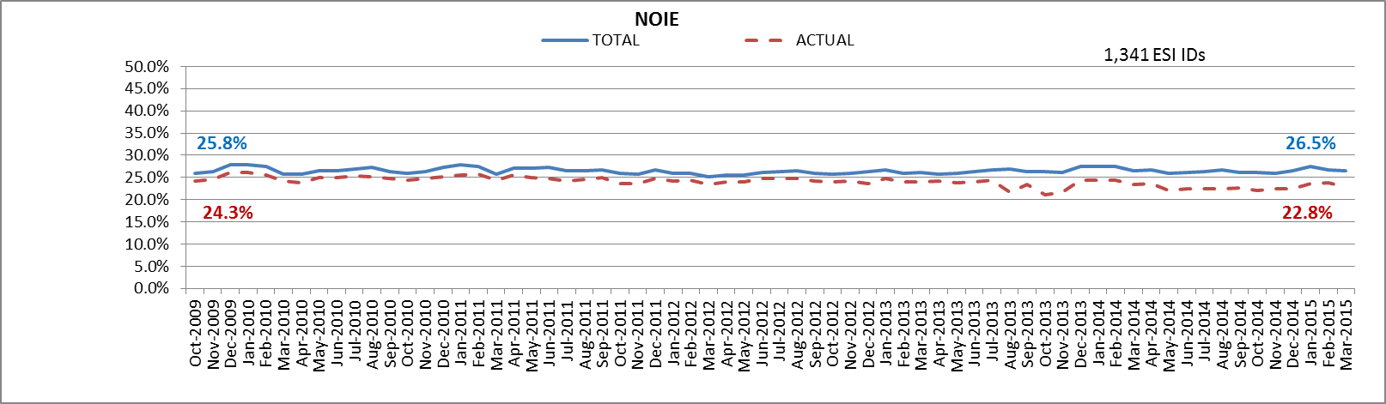
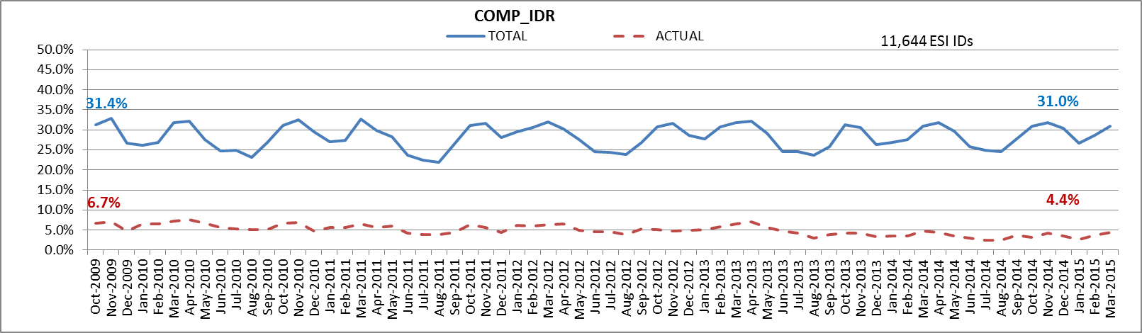
8.2(c)(v) Availability of ESIID consumption data
Notes:
SLIDE AVAILBLE IN THE ERCOT Monthly Operations Overview
Slide: Advanced Meter Settlement Impacts
Slide: ERCOT Wide Load Volumes by Meter Type at Initial Settlement
http://www.ercot.com/committees/board/index.html
Additional Information Available
Load Estimation Counts Report
Counts of ESIIDs and percentages of counts by MRE settled with actual meter data, estimated using historical meter data, and estimated using default load.
http://www.ercot.com/mktinfo/data_agg/index.html
AMS Volume & Count Report
Days lag between the Operating Day and the data loading date AMS reads.
http://www.ercot.com/committees/board/tac/rms/amwg/index.html
Reports posted under specific AMWG meeting pages on a periodic basis starting 03/2015

Slide 13
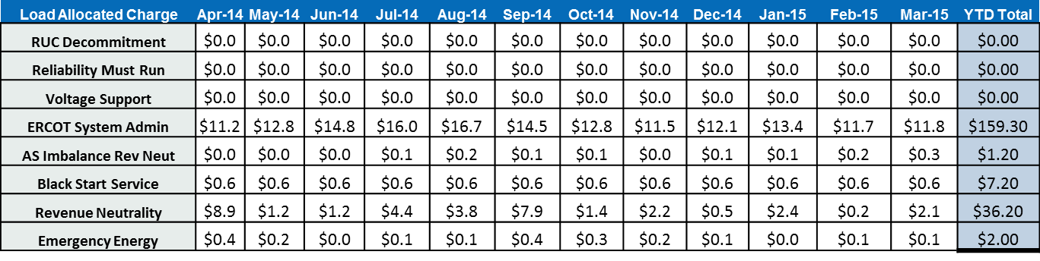
8.2(g) Uplift
($Millions)
$205.90

Slide 14
PR 8.2 (2) – Settlement stability – potential protocol improvements
8.2 ERCOT Performance Monitoring
(c) Settlement stability:
(i) Track number of price changes changes “after-the-fact” ;
(ii) Track number and types of disputes submitted to ERCOT;
(iii) Report on compliance with timeliness of response and disposition of disputes;
(iv) Other Settlement metrics; and
(v) Availability of Electric Service Identifier (ESI ID) consumption data in conformance with
Settlement timeline;
(g) Uplift: ERCOT shall calculate and post the sum of all charges for all Qualified Scheduling Entities (QSEs) for each month and year-to-date due to each of the following:
(i) The RUC Capacity-Short Charge, as described in Section 5.7.4.1, RUC Capacity-Short Charge;
(ii) The RUC Decommitment Charge, as described in Section 5.7.6, RUC Decommitment Charge;
(iii) The Load-Allocated Reliability Must Run Amount per QSE, as described in Section 6.6.6.5, RMR Service Charge;
(iv) The Load-Allocated Voltage Support Service Amount per QSE, as described in Section 6.6.7.2, Voltage Support Charge;
(v) The Load-Allocated Black Start Service Amount per QSE, as described in Section 6.6.8.2, Black Start Capacity Charge;
(vi) The Load-Allocated Emergency Energy Amount per QSE, as described in Section 6.6.9.2, Charge for Emergency Power Increases;
(vii) The Load-Allocated Real-Time Revenue Neutrality Amount per QSE, as described in Section 6.6.10, Real- Time Revenue Neutrality Allocation; and
(viii) The total of the ERCOT System Administration Charge;
(ix) The Load-Allocated Ancillary Service Imbalance Revenue Neutrality Amount, as described in Section 6.7.5, Real Time Ancillary Service Imbalance Revenue Neutrality Allocation; and
(x) The Load-Allocated Reliability Deployment Ancillary Service Imbalance Revenue Neutrality Amount, as described in Section 6.7.5, Real-Time Ancillary Service Imbalance Revenue Neutrality Allocation
Seeking input:
Should (c)(iv) remain general so that COPS has the flexibility to change the focus, as needed? (our recommendation)
What information should be provided in support of (c)(iv)?
Other changes?
Seeking input - Should (g) monitor
All costs/credits allocated to load, or
Only the unpreventable load ratio share based charge-types?

