Slide 1
Price Correction Process
Resmi Surendran
QMWG
04/10/2015

Slide 2
Real-Time Price Correction Protocol
Real-Time Price Correction Timeline
ERCOT could correct Real-Time Price until 1600 of the second Business Day after the Operating Day,
ERCOT BOD could approve Real-Time Price Correction if ERCOT has notified MPs within 30 days after the Operating Day.
SCED failure – When SCED fails to complete execution, hold the SCED LMP from last good SCED
Correct Prices
When SCED solution is invalid
Specific Prices are invalid in a otherwise valid solution
Correct RTRMPR when BPs received are inconsistent with SCED BPs

Slide 3
Scenarios Requiring Price Correction
Input data error
Stale/incorrect/incomplete inputs like offers, gen parameters, de-energized buses list, RLC data etc
Output data error
Stale/Incorrect/incomplete data transfer like Base Points not being telemetered to Market Participants, SCED solution not published to SPP calculation module etc
Software error
Memory leaks
Implementation defects in processes like mitigation, offer extension, SPP calculation etc
Infrastructure failure
Un-planned outages (Systems, Applications, Databases, ICCP telemetry)
Planned outages (Site failovers, Software releases)

Slide 4
Price Correction Methodology
SCED results are valid in general but few prices have issue
Use the SCED solution and correct the prices which have issues
Ex: Incorrect heuristic rule, Logical CC price calculation issue etc
SCED results are valid in general but SPP calculation has issue
Recalculate SPP using the valid SCED solution
SCED results are valid but not published and hence SPP is based on previous interval price
Recalculate SPP using the unpublished valid SCED LMP

Slide 5
Price Correction Methodology
SCED results are valid but EBP is set
15-minute RTRMPR (meter price) is a LMP, time and BP weighted and hence is recalculated using EBP weighting
15-minute RTSPP is just LMP and time weighted and hence not corrected if SCED LMPs are correct
SCED results are invalid due to incorrect input or SCED software error
Rerun the SCED using the correct input or with fixed SCED software and calculate the correct prices
SCED is not running – SCED failure
Use the last good SCED LMP until next good SCED LMP

Slide 6
Price Correction Statistics
Price correction events till date :
SCED – 62 (27 if we ignore 2011 & 2010)
DAM – 26 (5 if we ignore 2011 & 2010)
Corrected SPPs - 0.1% in SCED and 0.06% in DAM
Prices corrected up – 46.5% in SCED and 61% in DAM

Slide 7
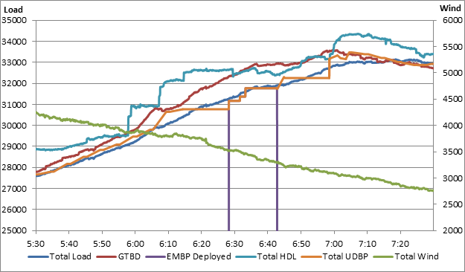
March 30th
Hardware failure on a server at 6:13 AM caused SCED to fail
SCED came back at 6:39 AM

Slide 8
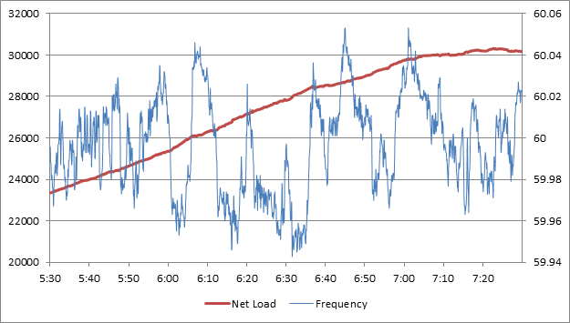
March 30th

Slide 9
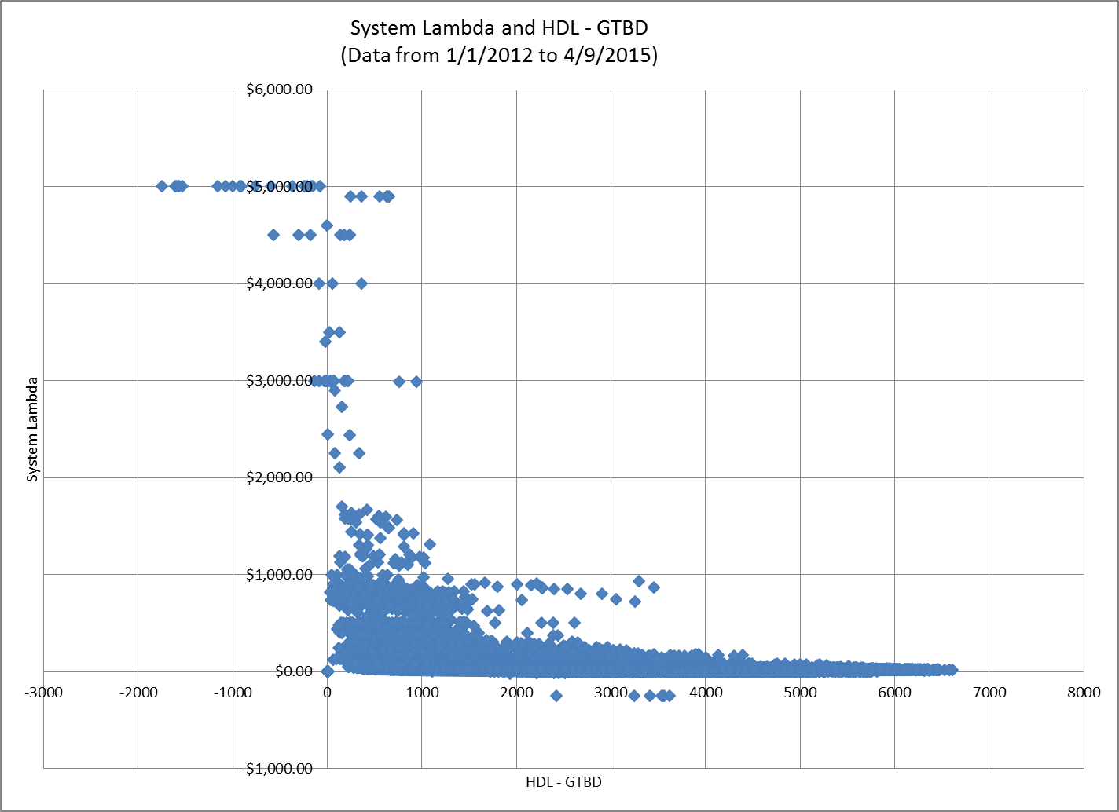
3/30/2015 6:42 am

Slide 10
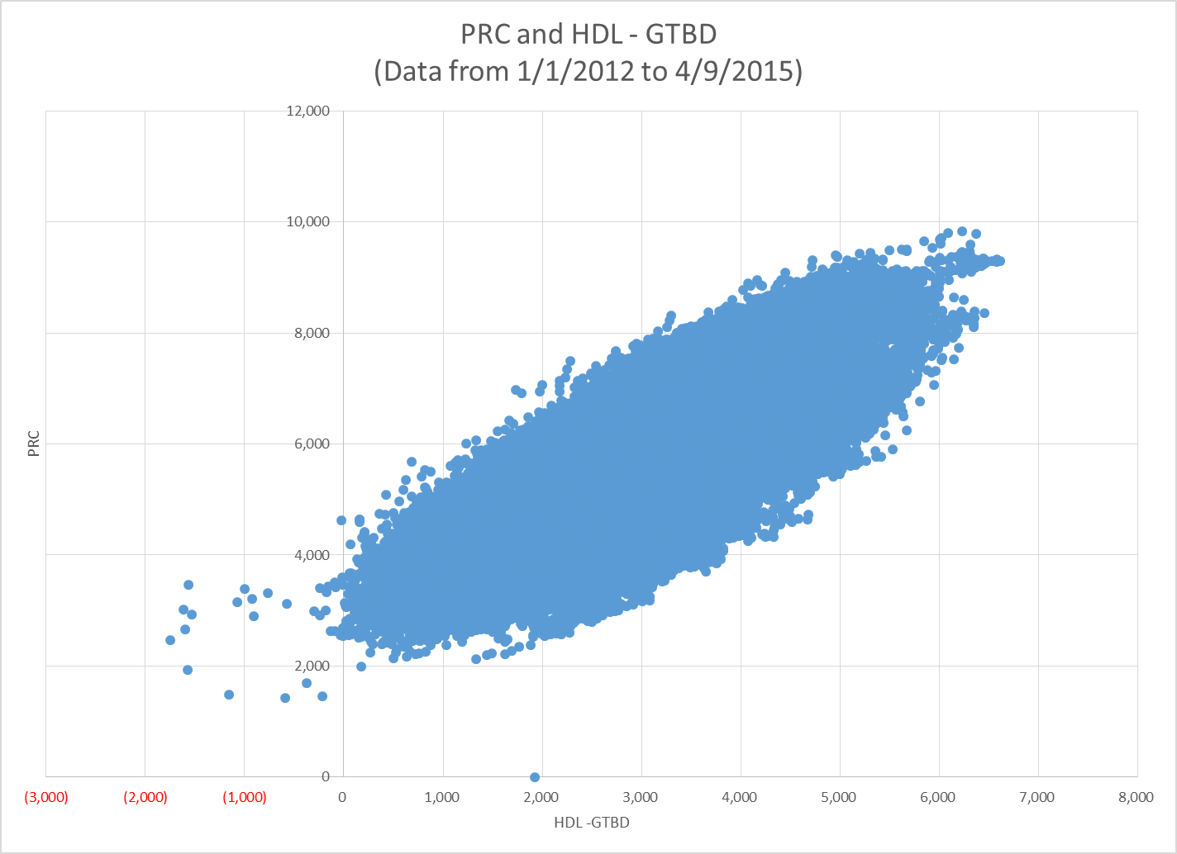
3/30/2015 6:42 am

