Slide 2
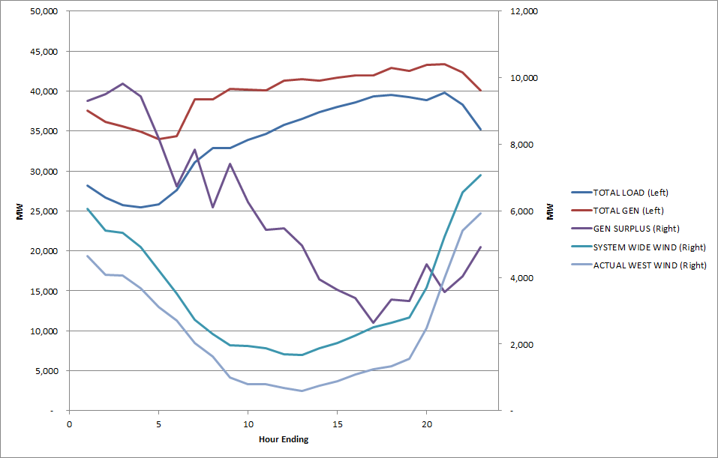
March 30th, 2015

Slide 3
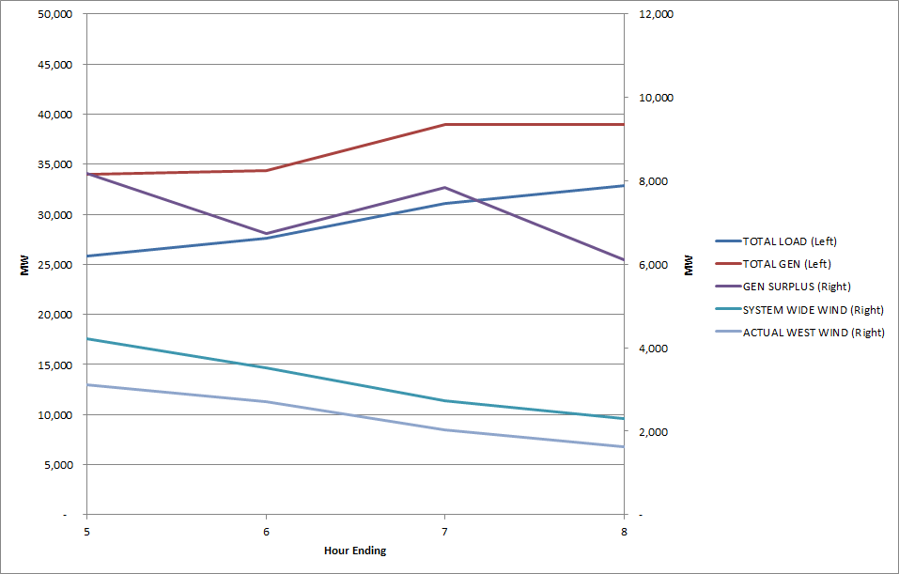
March 30th, 2015
Between HE6 and HE7:
Load increased 3,500MW
Gen increased 4,600MW
Gen Surplus increased 1,100MW
Wind decreased 771MW

Slide 4
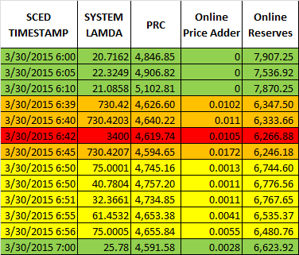

Slide 5
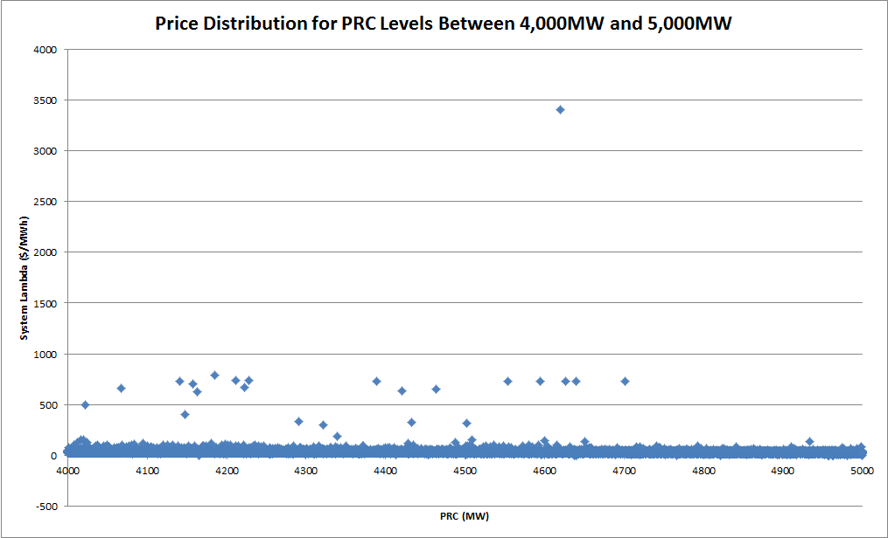

Slide 6
