Slide 1
Information Technology Report
Dave Pagliai
Manager, IT Support Services

Slide 2
Incident Report Highlights
Service Availability – February, March
Retail Market IT systems met all SLA targets
Incidents & Maintenance – February
02/08/15 – Retail Market planned maintenance outage
02/04,11,14/15 – Premature transitioning of MarkeTrak issues
02/17/15 – Duplicate Retail transactions, Find ESIID intermittent timeouts
Incidents & Maintenance – March
03/01/15 – Retail Release (Database Upgrade)
03/05/15 – System communication issue impacting the following services:
Retail transaction processing
Find ESIID, Find Transaction
MarkeTrak
MPIM
03/11/15 – Find ESIID, Find Transaction slow performance
Supplemental AMS Interval Data Report Issue
No impacts to report in February or March
A long term solution has been developed and is scheduled for R3 release

Slide 3
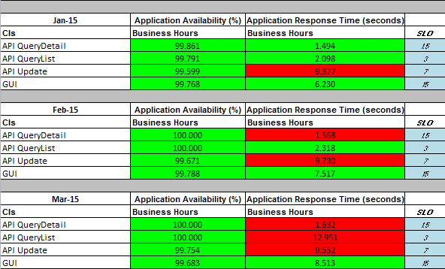
MarkeTrak Performance

