Slide 1
Technology Solutions for Wind Integration in ERCOT CCET Smart Grid Demonstration Project: Discovery Across Texas Battery Energy Storage System Milton Holloway, Ph.D. CCET President & COO ERCOT ETWG Meeting Austin, Texas April 9, 2015

Slide 2
Discovery Across Texas: Technology Solutions for Wind Integration in ERCOT
This material is based upon work supported by the Department of Energy under Award Number DE-OE0000194."
Disclaimer: "This report was prepared as an account of work sponsored by an agency of the United States Government. Neither the United States Government nor any agency thereof, nor any of their employees, makes any warranty, express or implied, or assumes any legal liability or responsibility for the accuracy, completeness, or usefulness of any information, apparatus, product, or process disclosed, or represents that its use would not infringe privately owned rights. Reference herein to any specific commercial product, process, or service by trade name, trademark, manufacturer, or otherwise does not necessarily constitute or imply its endorsement, recommendation, or favoring by the United States Government or any agency thereof. The views and opinions of authors expressed herein do not necessarily state or reflect those of the United States Government or any agency thereof.

Slide 3
CCET Membership (early 2014)
Governing Participants:
Affiliated Participants:
Advisor Directors:
University Collaborators:
Notes:
And our newest Affiliated Participants for 2013 - Intel/McAfee

Slide 4
Discovery Across Texas: Technology Solutions for Wind Integration in ERCOT ($27M Project) 2010-2014
Project Participants:
P³E
DOE administers the ARRA funded projects and helps guide the cooperative agreement

Slide 5
CCET Demonstration Project: Discovery Across Texas
CCET defined a demonstration project to help address the challenges of wind integration into the ERCOT grid with 18 GW of wind resources.
Key technology deployments to leverage:
A starter synchrophasor network
Expected AMS rollout of 6.5 million units
A smart grid future community with residential solar, smart appliances, home energy monitoring, and electric vehicles
Smart Meter Texas Portal (SMT)
Wind Farm at Reese Technology Center
Technology Solutions for Wind Integration in ERCOT
Award Number: DE-OE-0000194
Value: $27 million total; $13.5 million DOE
Original Award Date: 4 January 2010
Term: Five-years

Slide 6
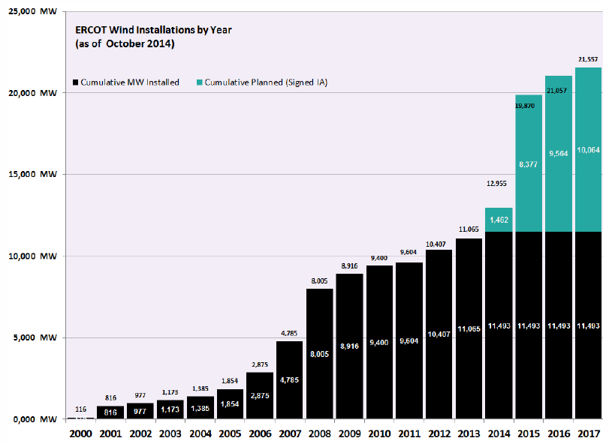
Context: Continuing Investment in Wind Generation
ERCOT Wind Capacity

Slide 7
Context: Continuing Investment in Wind Capacity
Completed ERCOT CREZ Build-Out

Slide 8
Discovery Across Texas Project: ERCOT & Part of SPP

Slide 9
CCET Demonstration Project: Discovery Across Texas
Seven Project Components:
Synchrophasor system with applications (ERCOT wide)
Security fabric demonstration for synchrophasor systems (demonstrated at Lubbock/TTU/RTC)
Utility-scale battery with wind farm (Lubbock/TTU/RTC)
Pricing trials at Pecan Street (Austin)
DLC demonstration with dual communication paths (Dallas and Houston)
Solar community monitoring (Houston & Austin)
PEV fleet Fast Response Regulation Service demonstration (Fort Worth)

Slide 10
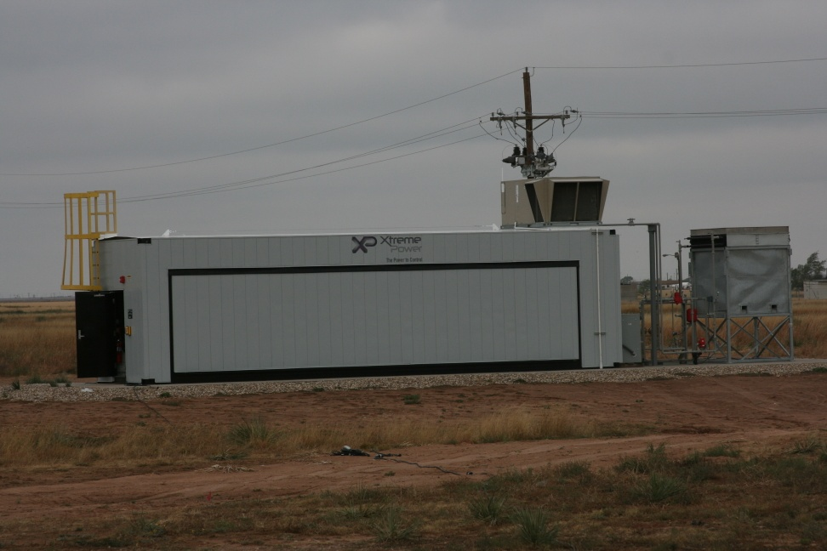
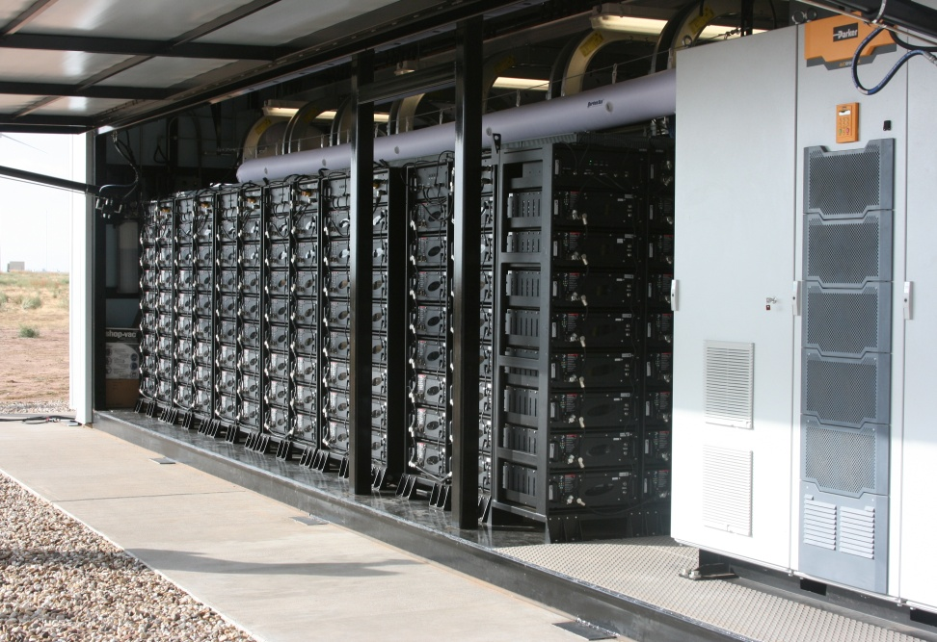
Utility Scale Battery System

Slide 11
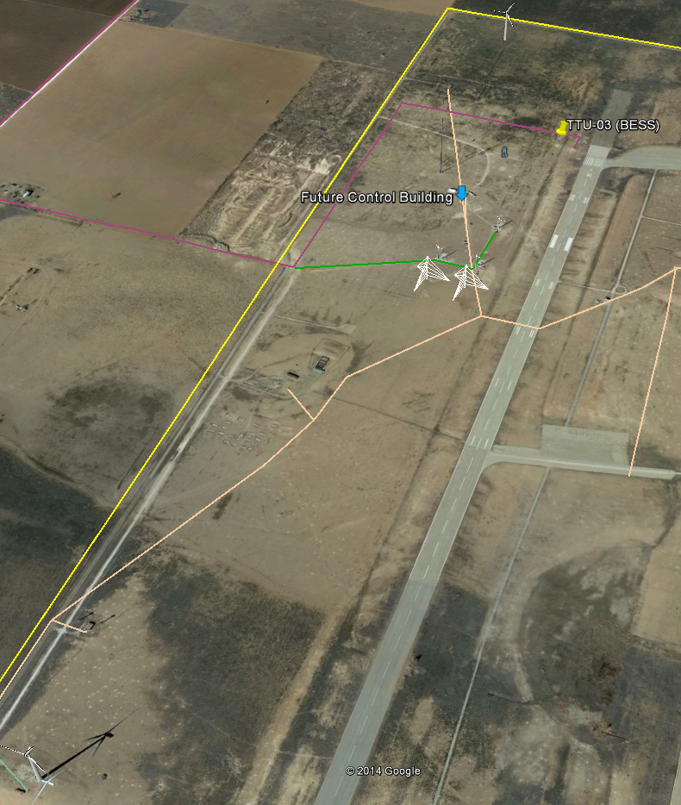
Battery on Location
Located at the Reese Technology Center 10 miles west of Lubbock

Slide 12
Introduction
Battery Specification
Testing
Real-Time Data
Economic Analysis
Summary

Slide 13
Overview of BESS Grid Tie
2.0 MW Wind Turbine
CCET 1 MW/MWh
Storage Battery
1.7 MW Wind Turbine
Distribution Substation
(SPEC, Approx. 3 MW)
Distribution Substation
(SPEC, Approx. 4 MW)
Interchange
(GSEC, Approx. 18 MW)

Slide 14
Battery Selection & Integration
RFP Specification Released Nov 2012
Contract Awarded - February 2013
Operational - October 2013 by SPEC with Support from XP/Younicos
Notes:
Xtreme Power (XP) partnered with Samsung to Respond to RFP

Slide 15
Battery Specifications
1 MWh Battery System (50ms Response)
Lithium Manganese Oxide
Cell Capacity – 60 Ah
Nominal Voltage – 3.7V (Min – 2.7V, Max – 4.1V)
Power – 222 Wh
8 Cells = Module (1.8 kWh)
2 Modules = Tray (3.6 kWh, 16 Cells)
16 Trays = Rack (56.8 kWh, 256 Cells)
20 Racks = BESS (1.136 MWh, 5120 Cells)
3-Phase Inverter (DC – AC)
24/7 Real-Time Monitoring

Slide 16
Performance in Actual Operation
Evaluation of Performance
Providing Data for TTU EE Department to Complete Simulation Models
Modeling Battery + Wind Turbines + Dist. System
Refine Model based on Test Results
Providing the data to support an economic analysis of the benefits and cost of the BESS

Slide 17
Tests Performed
Demand Response
Frequency Response
Ramping Battery – Load Leveling
Wind Speed Drop
Fast Responding Frequency Response (FRRS)
Combined these tests after they were completed independently

Slide 18
Testing Approach

Slide 19
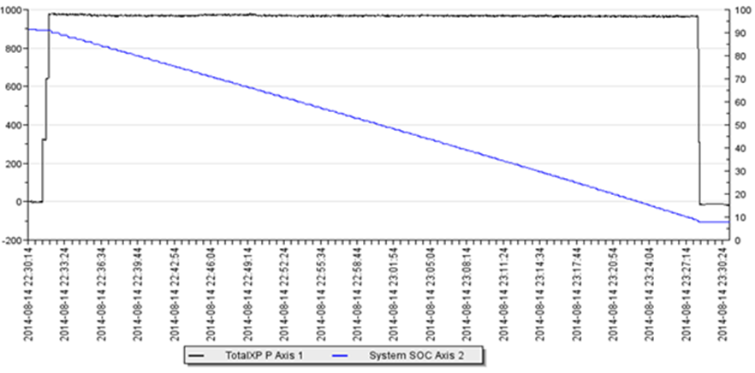
Demand Response
SPEC is Summer Peak Driven
100% Demand Rate Structure from GSEC
GSEC Area Peak - 266 MW Demand (2012)
Peak as Early as July 27th (This Year)
Peak as Late as August 12th (2009)
Notes:
Demand Reduction during August 2014. The figure shows the battery providing peak reduction/demand shaving. Younicos charged the battery to 90% SOC and discharged the battery at 1000 KW for 53 minutes or when the SOC reached 10%.

Slide 20
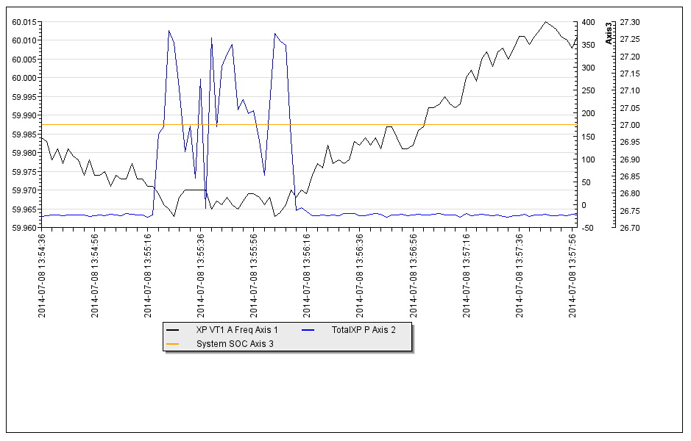
Frequency Response (under frequency event)
Dead Bands – 60.04 to 59.97
Response Slope – 0.01%
Max Output +/- 400 KW
Notes:
When the frequency went below 60 Hz, the battery automatically ramped up to supply the required power and met the demand. In the figure below, which demonstrates the responsiveness of the BESS, the black line is frequency (dead band is set to 59.70 Hz), the orange line is system state of charge, and the blue line is kilowatt (kW) output (with a maximum setting at 400 kW).

Slide 21
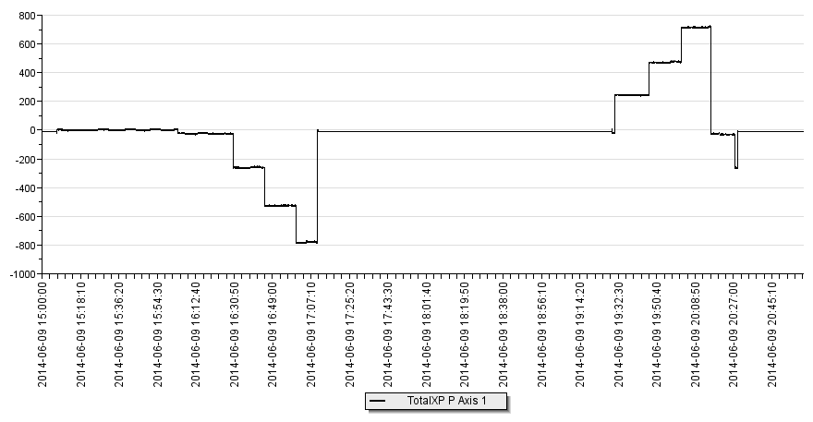
Ramp Support
Charge Batteries in 15-min Intervals
250KW, 500KW, 1000KW (SOC-50%)
Discharge in Same Manner

Slide 22
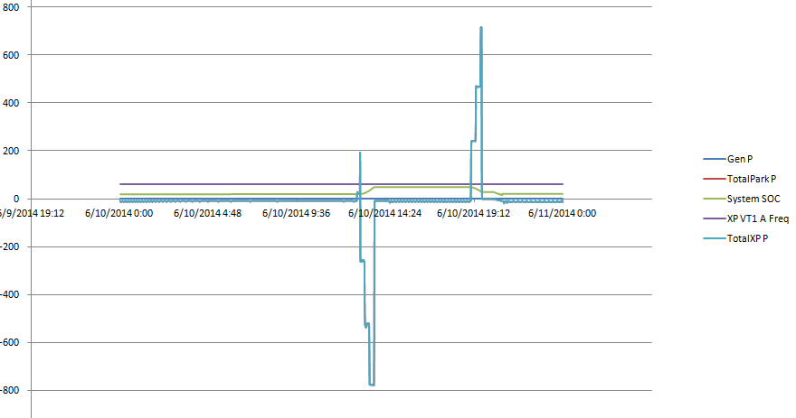
Ramp Support
Charge & Discharge in 15-min Intervals
250KW, 500KW, 1000KW (SOC-50%)
Notes:
The battery was ramped to an SOC of 50%. It was charged at a rate of 250 kW for 15 minutes, or until reaching 50% SOC. Then charge rate was increased to 500 kW for 15 minutes, or until reaching 50% SOC. Later it was the charged to 750 kW and 1000 kW for 15 minutes, or until 50% SOC.

Slide 23
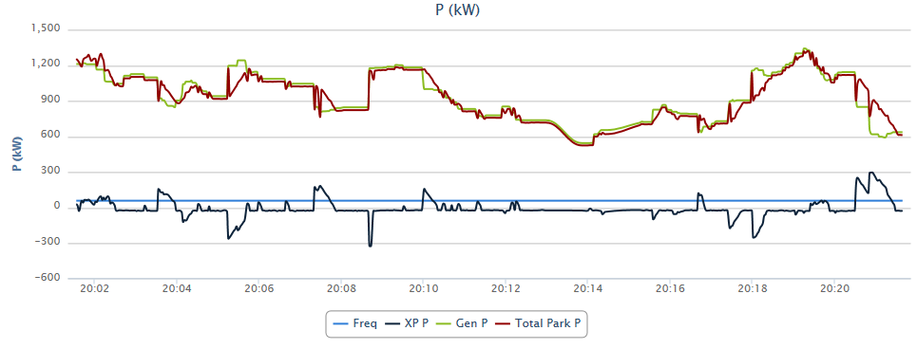
Wind Speed Drop
Counteract Rapid Changes in Wind Generation

Slide 24
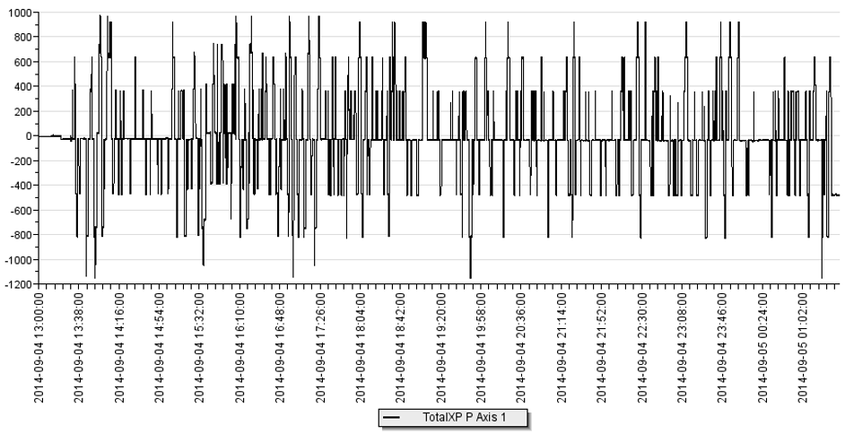
Fast Response Regulation Service (FRRS)
Simulated ERCOT Signal from the “No Trees Project”
Notes:
Younicos has updated the BESS Monitoring System to respond to an ERCOT FRRS simulated signal. They reviewed their “No Trees Project” and found a day that had good power fluctuations (charge & discharge). They scaled this back to fit the 1 MWH system we have to work with.
Younicos charged the battery this morning at 5:30 CST to approx. 50% SOC. At approx. 8:30 CST the battery system began responding to the simulated FRRS ERCOT signal. We will run this test through the remainder of the day.

Slide 25
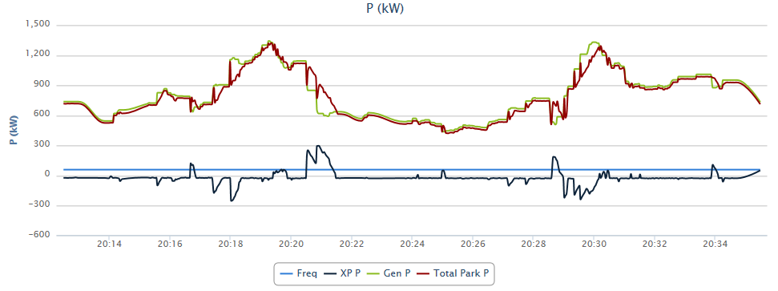
Combo Wind Speed & Frequency Response
Combination of Wind Speed & Frequency Response
Best for Automation

Slide 26
Economic Analysis
Several electric system functions
Positive B-C depends on capturing multiple benefit streams
Economic operation of BESS - optimal time to charge and discharge (a dynamic algorithm) considering
capital & O&M costs
depreciation rate = f{charge/discharge cycles, the cost of alternative power sources and hourly market (electricity) prices}
Regulatory policy that limits ownership and functional uses
Location on the grid
TTU EE Dept developed simulation models of BESS, wind turbines and load and we used a DOE (Navigant) provided Energy Storage Computational Tool for B/C analysis

Slide 27
TTU Economic Analysis Algorithm

Slide 28
Navigant Energy Storage Computational Tool (note: the inputs used are often not unique to this BESS but are ESCT default values)
ESCT identifies the economic, reliability and environmental benefits and capital and O&M costs
Calculates NPV of cost and benefit streams over life of the battery

Slide 29
ESCT Cases Studied with BESS on:
Distribution network owned by a utility in a deregulated market
Distribution network owned by a utility in a regulated market (without demand charge management)
Distribution network owned by a utility in a regulated market (with demand charge management)
Transmission network owned by a generator in a regulated market

Slide 30
Distribution network owned by a utility in a regulated market (with demand charge management)
PV Benefits
Reduced electric cost (consumer)--$2.3M
Reduced outages--$0.6M
Environmental (reduced CO2, SOx,NOx & PM)--$1.1M
PV costs
Capital--$2.4M
O&M--$0.5M
Decommissioning--$0.06M
PV Net Benefits--$0.5M

Slide 31
Owned by a Utility in a Deregulated Market (Reduced BESS Cost by 50%)
PV Benefits
Deferred distribution Investments--$0.03M
Reduced outages--$1.3M
Improved power quality--$0.02M
PV costs
Capital--$1.2M
O&M--$0.5M
Decommissioning--$0.06M
PV Net Benefits--$-0.4M

Slide 32
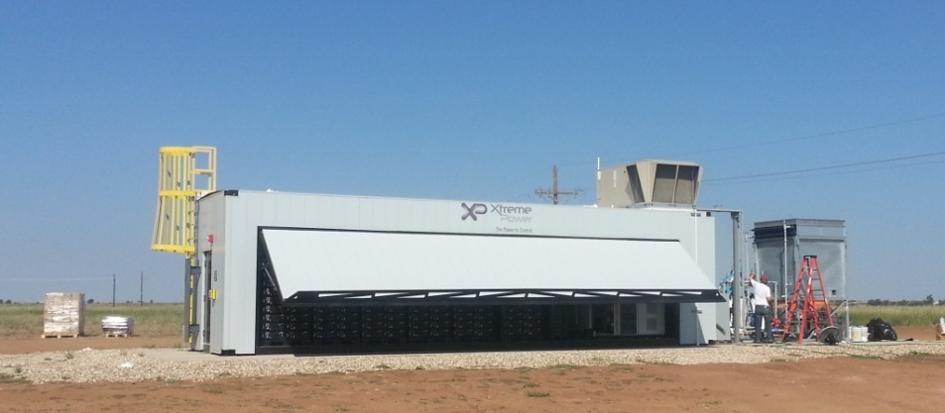
Summary
Positive Results with Completed Battery Testing & Some Guidance on the Economics of Ownership & Operations

Slide 33
Questions?
Milton Holloway, Ph.D.
(512) 472-3800
mholloway@electrictechnologycenter.com
http://www.electrictechnologycenter.com/

