Slide 1

NPRR638 Back-casting Updated Results
CWG/MCWG
Suresh Pabbisetty, ERP, CQF, CSQA.
ERCOT Public
April 22, 2015

Slide 2
Updated Prototype features
Updated NPRR638 prototype model includes:
  Application of look-backs to rolling averages over previous lrq and/or ldq days as in the NPRR.
  FIP Adjustment.
  Substitution of 0 for missing rolling average values.
  The prototype was executed for multiple Business Days as detailed below with ldq (Day Ahead look-back) at 1 and lrq (Real Time look- back) at 1, 3, 5, 7, and 10 days:
    01/28/2014 through 12/31/2014 for 1-year look-back with 2014 prices substituted for 2013.
    01/28/2014 through 02/28/2015 for 3-year look-back using prices from 2011 through 2015.
ERCOT Public

Slide 3
Updated Prototype assumptions & limitations
Assumptions and Limitations of Updated Prototype:
Prices do not include replacement of historic price caps with current price caps.
Prices prior to June 2014 do not include Operating Reserve Price Adders.
Very limited validation has been performed due to time and resource constraints. Results shall be viewed as indicative only.
The prototype is limited to calculation and comparison of RTLE+DALE values only.
Impact of NPRR638 on MCE and overall TPE is out of scope for this prototype. A significant proportion of Counter-Parties’ collateral requirements continue to be driven by MCE.
ERCOT Public

Slide 4
Updated Prototype known issues status
Known Issues of previous model:
In some cases RTLE calculation with higher look-back may result in relatively lower exposure than that of lower look-back.
This is caused by missing and sporadic activity by some Counter-Parties at some settlement points at various timeframes. An example is as follows;
Status of Known Issues:
The issue described above is fixed with the current model.
ERCOT Public

Slide 5
NPRR 638 FIP Ratio
ERCOT Public

Slide 6
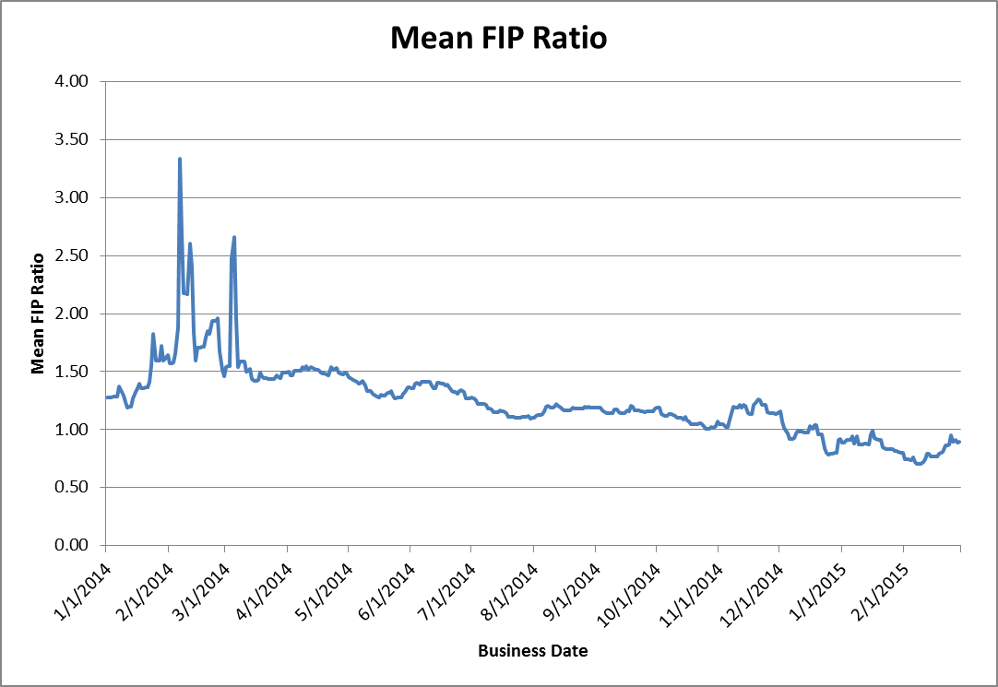
Results – FIP Ratio
Mean FIP Ratio = Average FIP Ratio for all Operating Days used in price estimates for a given Business Date based on NPRR 638.
ERCOT Public

Slide 7
NPRR 638 Backcast Results with 1 year look back using 2014 prices
ERCOT Public

Slide 8
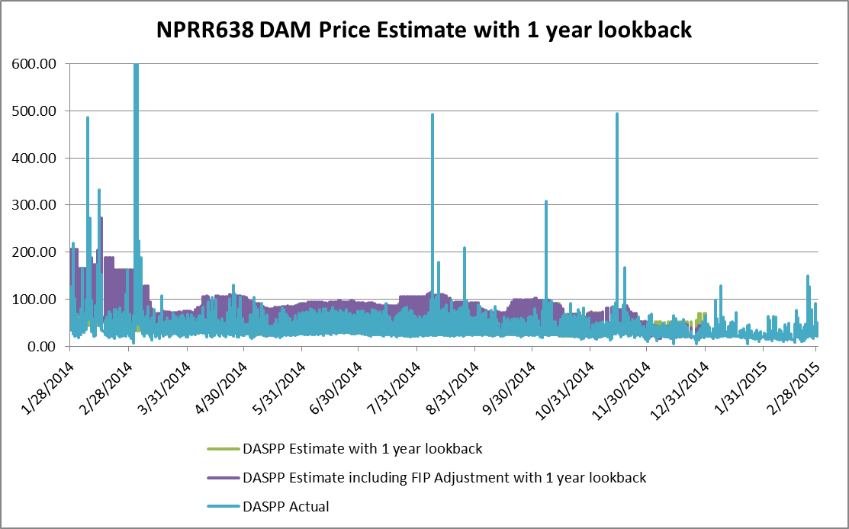
Results with 1 year look back - DASPP
DAM Settlement Point Prices (DASPP) comparison:
2014 prices are substituted for 2013
ERCOT Public

Slide 9
Results with 1 year look back - DASPP
DAM spread comparison:
2014 prices are substituted for 2013
ERCOT Public

Slide 10
Results with 1 year look back - DASPP
DAM Price Estimates Monthly Trends:
2014 prices are substituted for 2013
ERCOT Public

Slide 11
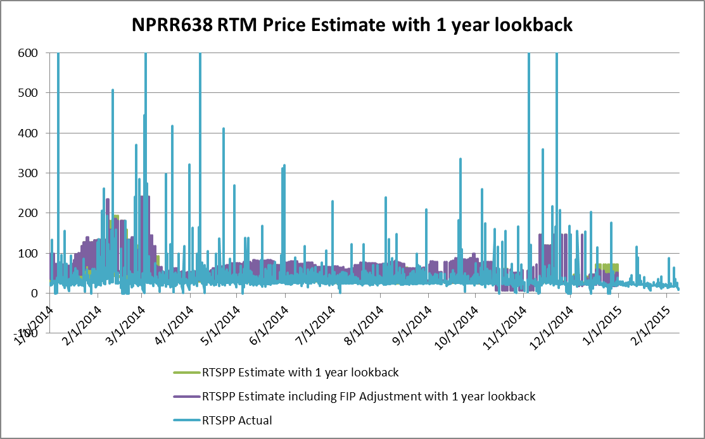
Results with 1 year look back - RTSPP
RTM Settlement Point Prices (RTSPP) comparison:
2014 prices are substituted for 2013
ERCOT Public

Slide 12
Results with 1 year look back - RTSPP
RTM spread comparison:
2014 prices are substituted for 2013
ERCOT Public

Slide 13
Results with 1 year look back - RTSPP
RTM Price Estimates Monthly Trends:
2014 prices are substituted for 2013
ERCOT Public

Slide 14
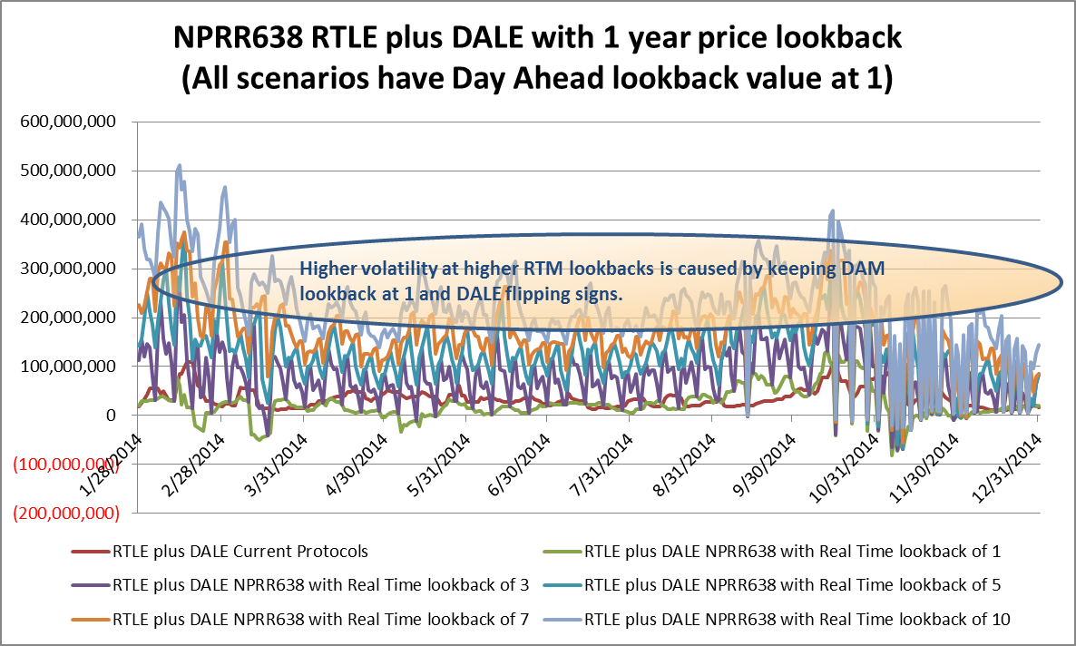
Results with 1 year look back – RTLE plus DALE
RTLE plus DALE comparison:
Spreadsheet with the following results is also published with meeting materials.
ERCOT Public

Slide 15
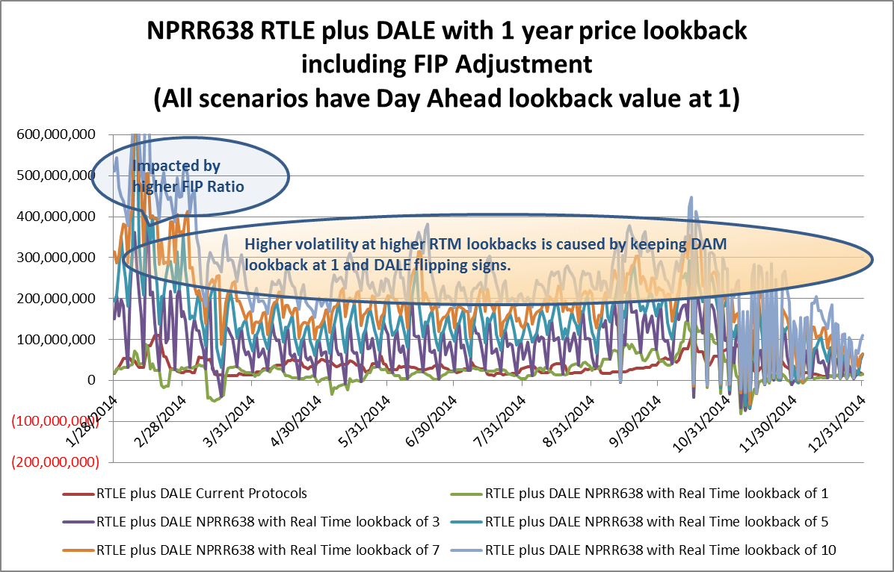
Results with 1 year look back – RTLE plus DALE with FIP
RTLE plus DALE with FIP comparison:
Spreadsheet with the following results is also published with meeting materials.
ERCOT Public

Slide 16
NPRR 638 Backcast Results with 3 year price lookback using 2011 - 2015 prices
ERCOT Public

Slide 17
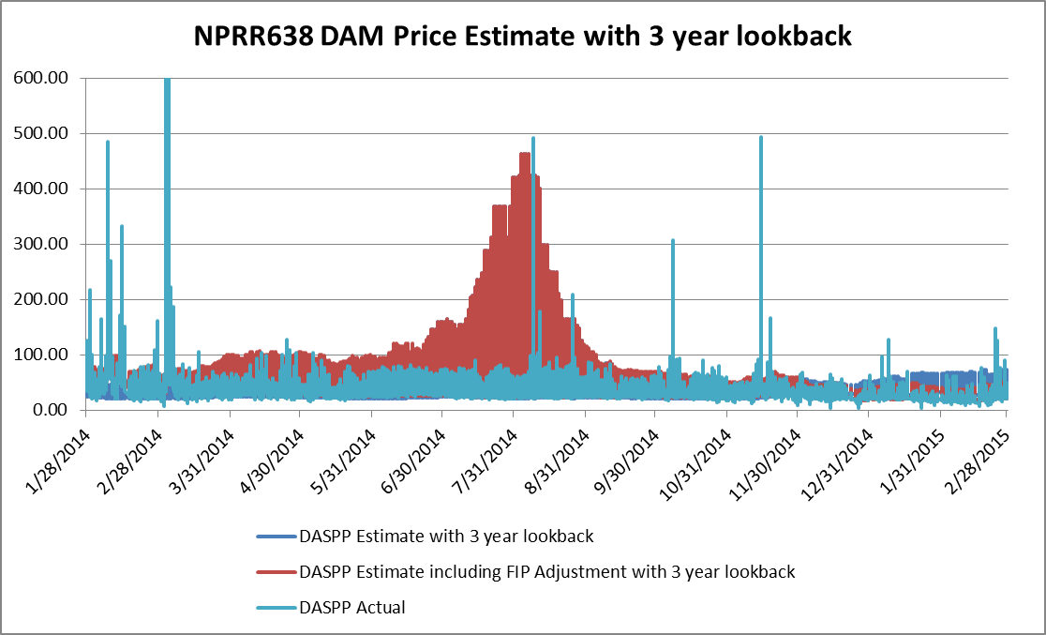
Results with 3 year look back - DASPP
DAM Settlement Point Prices (DASPP) comparison:
2011 – 2015 prices are used
ERCOT Public

Slide 18
Results with 3 year look back - DASPP
DAM spread comparison:
2011 – 2015 prices are used
ERCOT Public

Slide 19
Results with 3 year look back - DASPP
DAM Price Estimates Monthly Trends:
2011 – 2015 prices are used
ERCOT Public

Slide 20
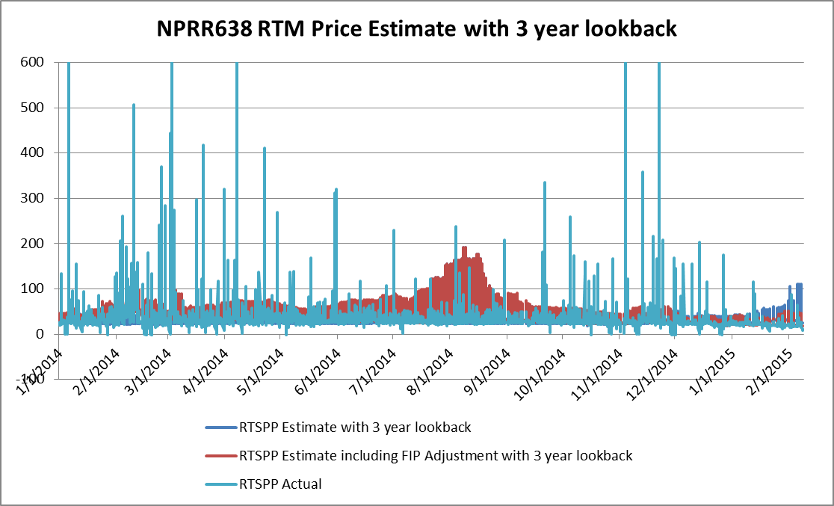
Results with 3 year look back - RTSPP
RTM Settlement Point Prices (RTSPP) comparison:
2011 – 2015 prices are used
ERCOT Public

Slide 21
Results with 3 year look back - RTSPP
RTM spread comparison:
2011 – 2015 prices are used
ERCOT Public

Slide 22
Results with 3 year look back - RTSPP
RTM Price Estimates Monthly Trends:
2011 – 2015 prices are used
ERCOT Public

Slide 23
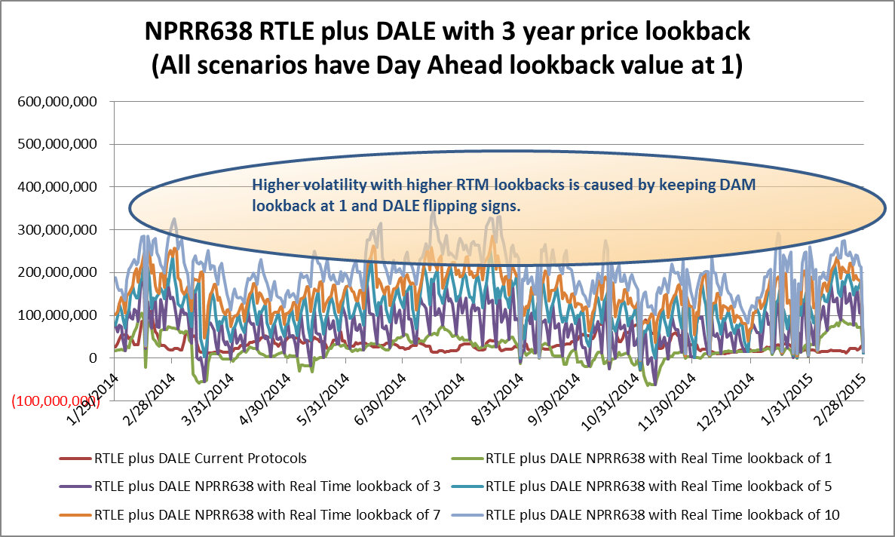
Results with 3 year look back – RTLE plus DALE
RTLE plus DALE comparison:
Spreadsheet with the following results is also published with meeting materials.
ERCOT Public

Slide 24
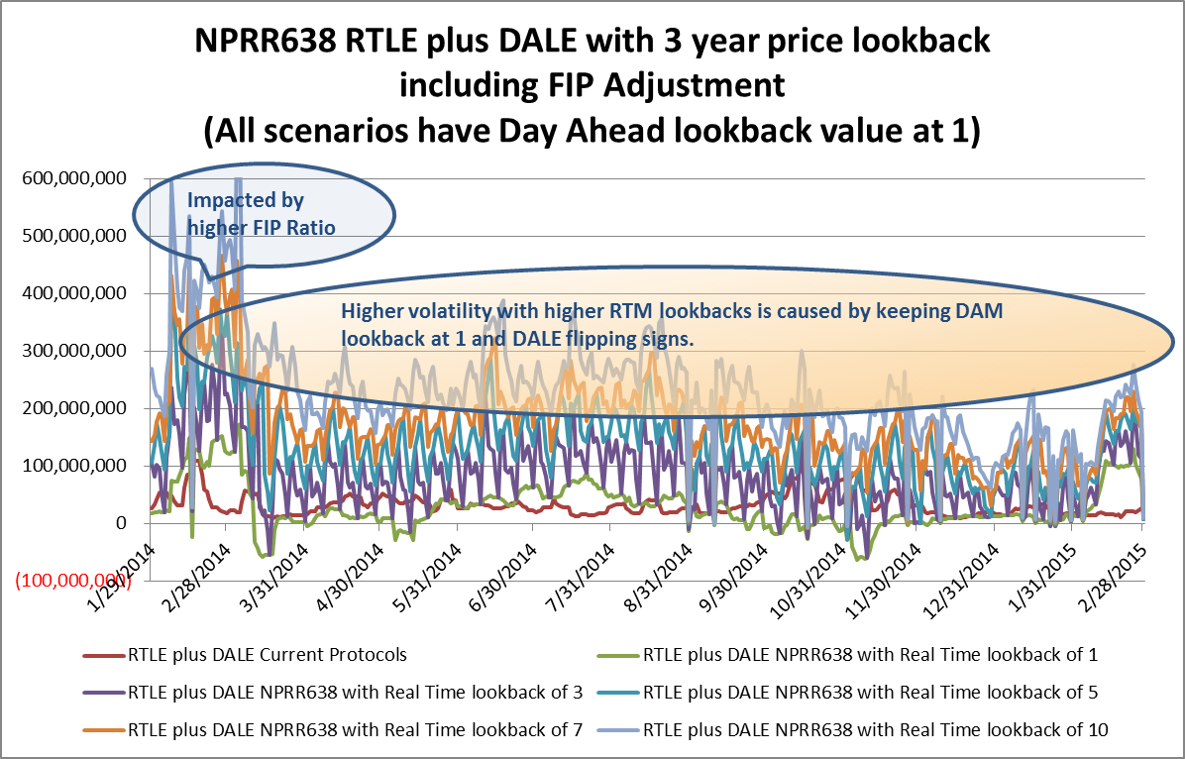
Results with 3 year look back – RTLE plus DALE with FIP
RTLE plus DALE with FIP comparison:
Spreadsheet with the following results is also published with meeting materials.
ERCOT Public

Slide 25
NPRR 638 Prototype Results Summary
ERCOT Public

Slide 26
NPRR 638 Prototype Results Summary
Price look-back
  Summer price spreads were low with 1 year look-back by substituting 2014 prices for 2013.
  Increase in summer price spreads is observed with 3 year look-back as the impact of 2011 prices prevail.
FIP Ratio
  Very high during Q1 of 2014, which resulted in relatively higher price estimates during that time frame.
  As we move toward Q1 2015 FIP Ratios were significantly lower, which resulted in relatively lower price estimates.
RTLE plus DALE
  Volatility is higher as RTM look back is increased from 1 through 10, this is caused by keeping DAM look back at 1 and DALE flips signs.
  Seasonal exposure level during summer with 1 year look back, was relatively low as a result of mild prices in 2014.
  Seasonal exposure level during summer with 3 year look back, was relatively high as a result of high prices from 2011.
ERCOT Public

Slide 27
Questions?
ERCOT Public

