Slide 1
SCR775 Wireframes
3/13/15

Slide 2
Launch
Link added under “Day-Ahead and Real-Time Displays”

Slide 3
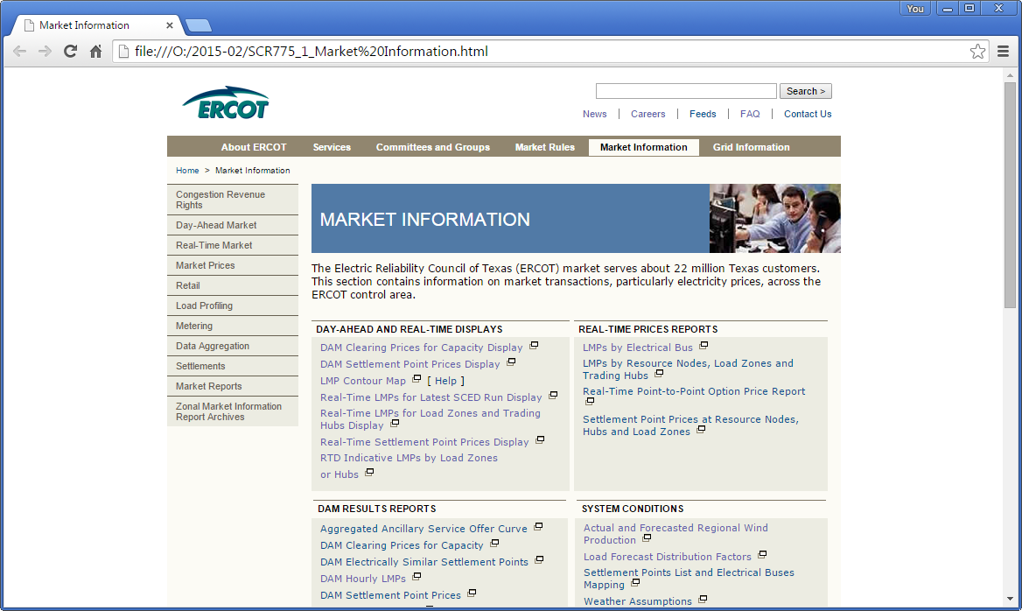

Slide 4
Display with SCED timestamp column
Alternative 1
This would be the standard/typical display
Updated Display title and column names
Reduced columns to 30-minutes

Slide 5
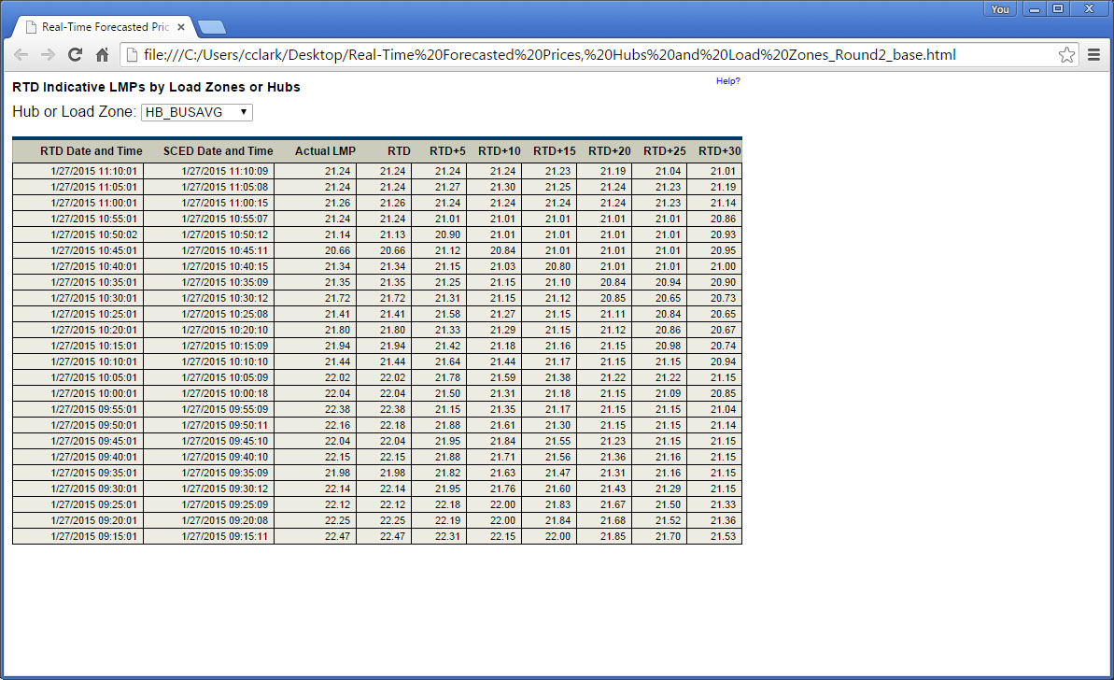
Standard Scenario: with SCED timestamp column

Slide 6
Display without SCED timestamp column
Alternative 2

Slide 7
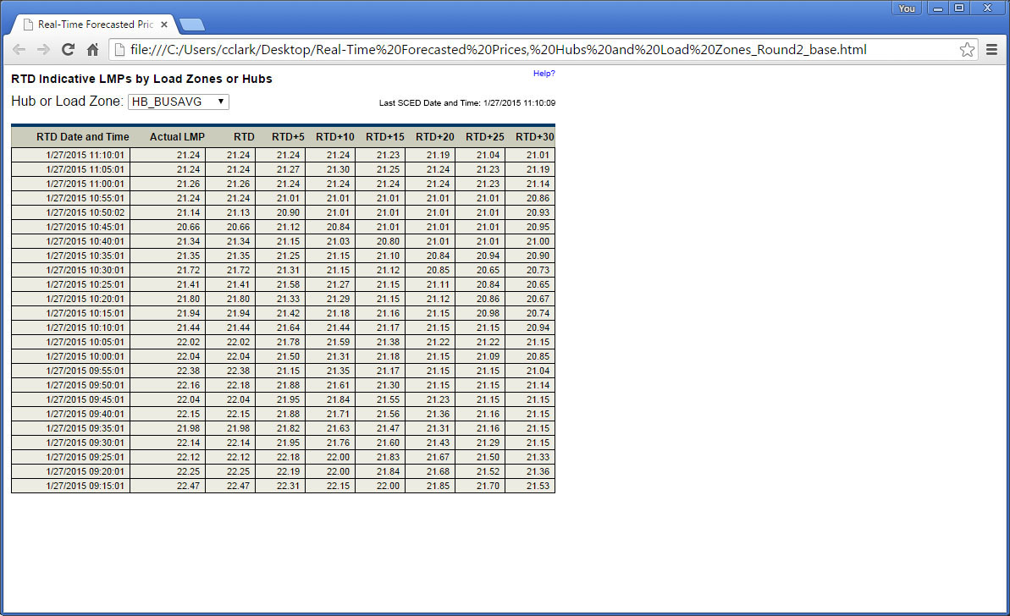
Standard Scenario: without SCED timestamp column

Slide 8
Display for 30-minutes of data
Alternative 2
Can be combined with Alternative 1 (removing the SCED timestamp column)

Slide 9
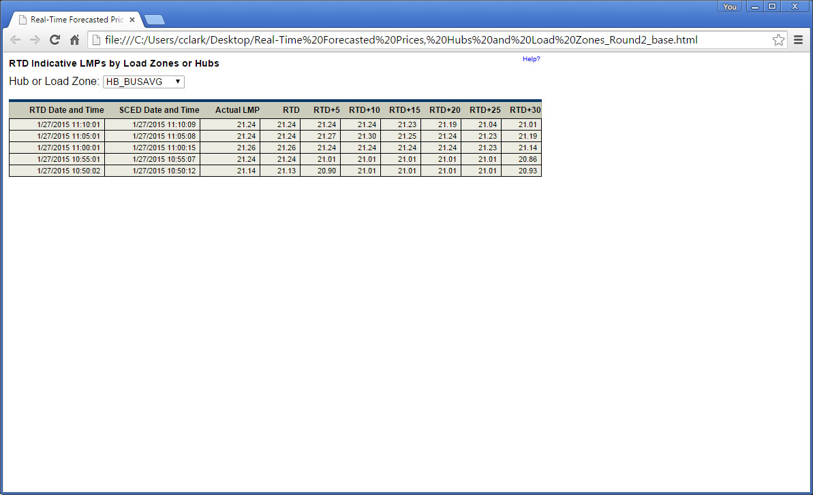
Standard Scenario: with 30 minutes of data

Slide 10
Scenario 1: Missed RTD
Display is triggered by RTD, so there will be no rows for time periods without an RTD run.

Slide 11
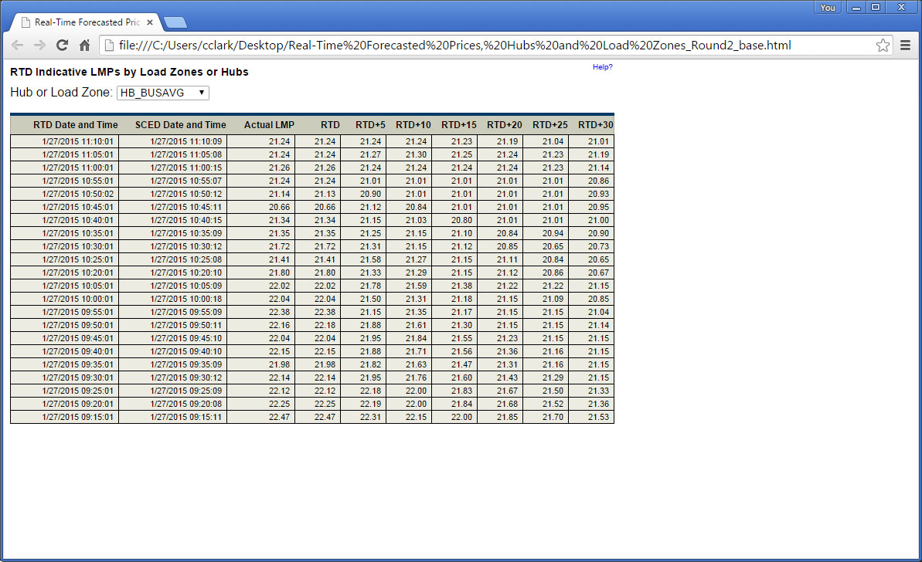
S1. Display with SCED timestamp row

Slide 12
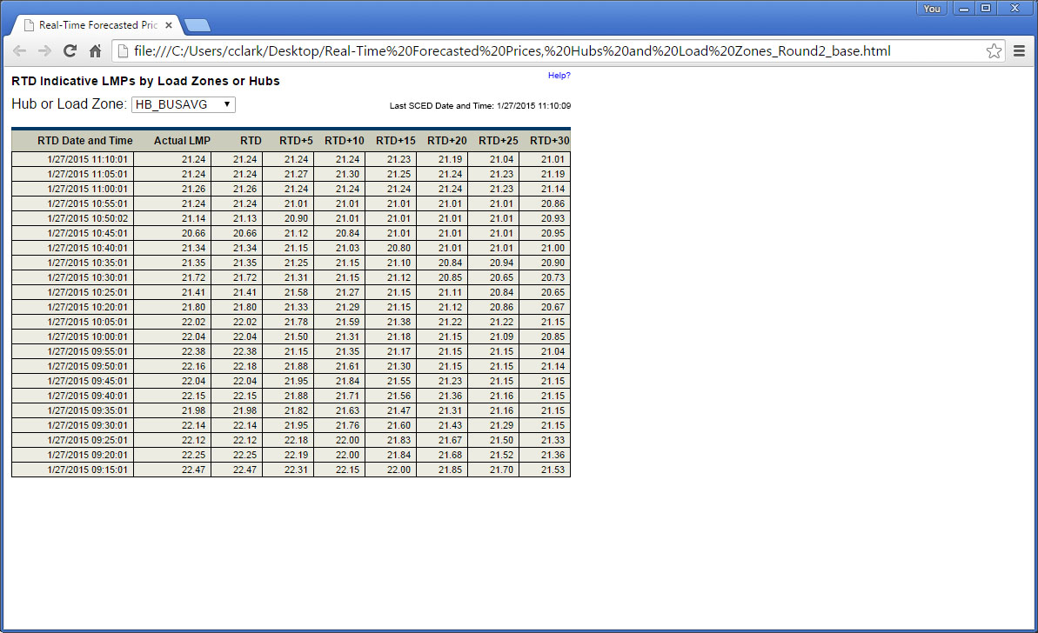
S1. Display without SCED timestamp row

Slide 13
Scenario 2: Missed SCED
Rows will be displayed for each RTD run. When there is no matching SCED, data from the latest SCED will be displayed.

Slide 14
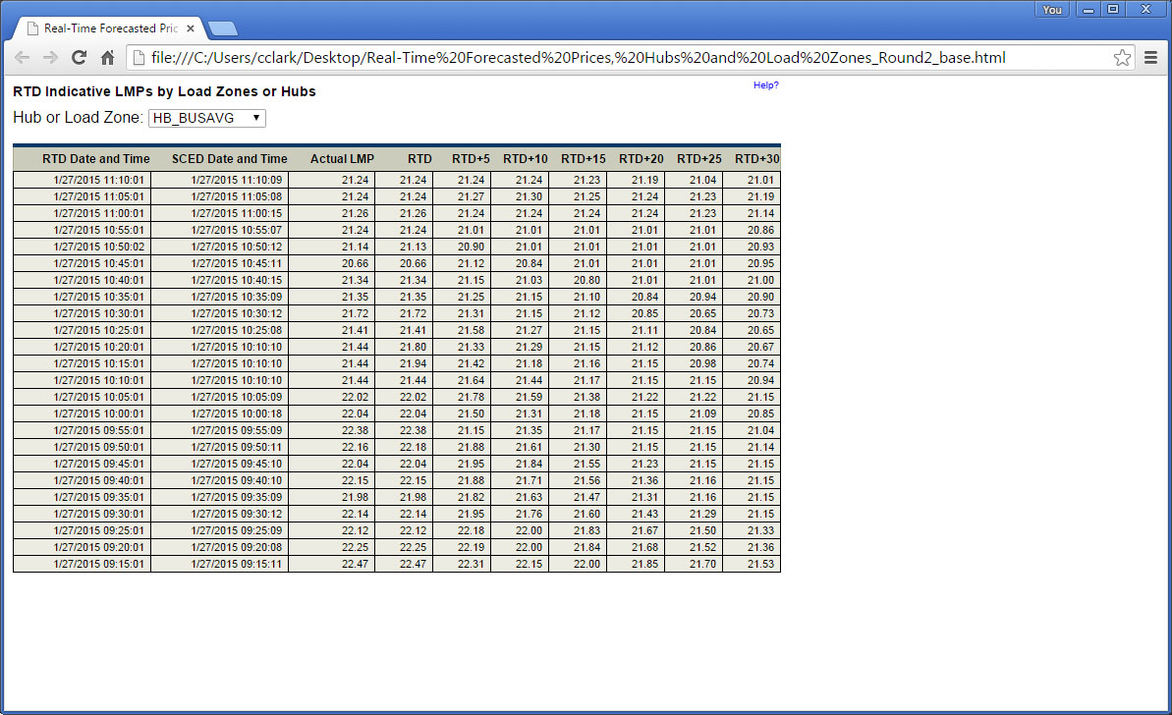
S2. Display with SCED timestamp row

Slide 15
S2. Display without SCED timestamp row

Slide 16
Scenario 3: RTD Manually Run
Rows will be displayed for each RTD run. When there is no matching SCED, data from the latest SCED will be displayed.

Slide 17
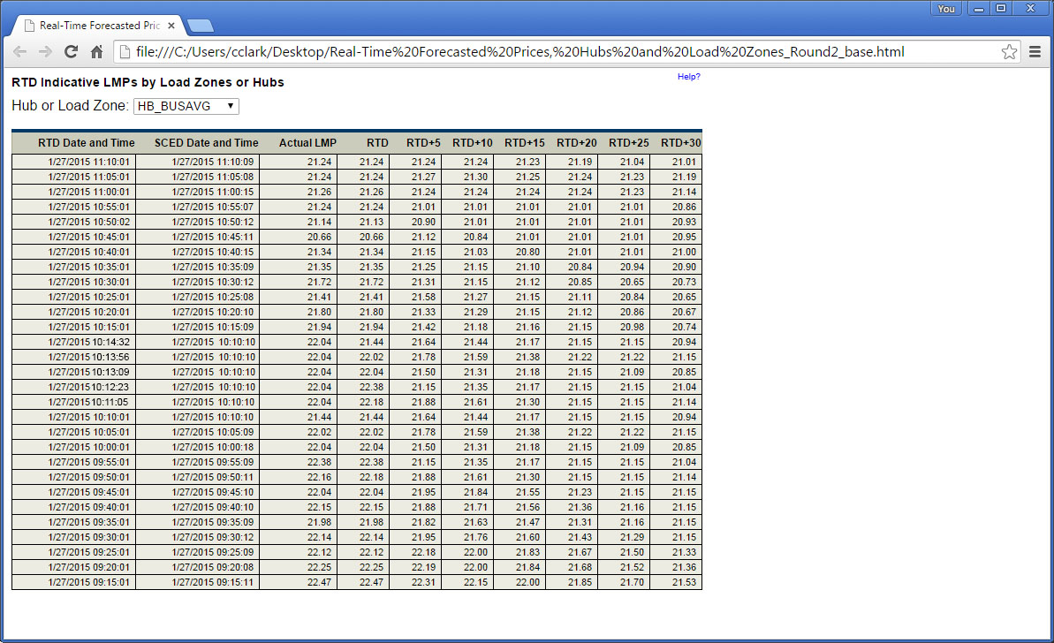
S3. Display with SCED timestamp row

Slide 18
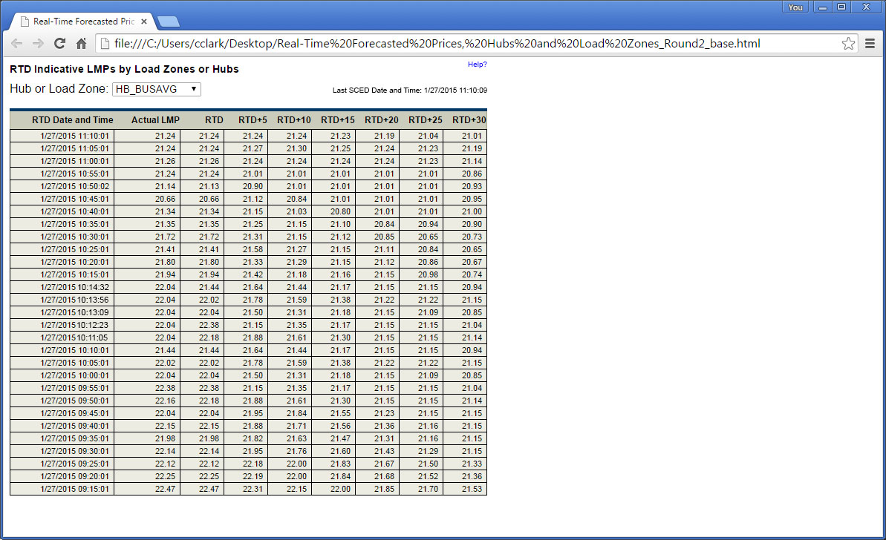
S3. Display without SCED timestamp row

