Slide 1
High Impact Outages
Outage Coordination Improvement Task Force
March 23, 2015

Slide 2
Overall Lifecycle of High Impact Outage Process
13,076 total outage “projects” in 2014.
Including unique outage groups and single equipment outages.
70 identified “High Impact Outages.”
High Cost Outages are subjectively determined by the amount of generation that has changed from an optimal dispatch to resolve reliability violations.
23 of those 70 “High Impact Outages” were cancelled.
15 of the 47 remaining “High Impact Outages” caused notable congestion.*
* congestion that was reported to ROS

Slide 3
ERCOT “screening” process
70
13,076
15
Outages can be pushed, shortened, cancelled, etc.
47
Including outages that were pushed, shortened, etc.
A “impactful outage” is any outage that has a significant impact on economic operations.
A “typical outage” is any outage that doesn’t have any significant impact on economic operations.
What are the characteristics of these “High Impact Outages”?
What about those that weren’t declared “High Impact Outages”?
How many?

Slide 4
Identifying High Impact Outage
High Cost Outages are subjectively determined by the amount of generation that has changed from an optimal dispatch to resolve reliability violations.
Outage Coordination “Market Impact” Questionnaire:
A statement of why the work is required.
Is there a switching solution to reduce market impact?
A statement of what has been done to reduce the length of Outage.
Are you working extended hours? If not, can you submit it daily?
Is this outage scheduled during a reduced load season? If not, please explain the reason.
Can the outage be scheduled during a resource outage that would reduce market impact?

Slide 5
Equipment Type Classification of High Impact Outages
Grouping the “High Impact Outages” by the primary equipment type and the voltage level.
Strongest contributors:
345/138 kV Autotransformers
345 and 138 kV Lines
High Impact Outage Types
 | Bus | Line | XFMR* | Total
69 | 1 | 2 | - | 3
138 | 9 | 21 | 1 | 31
345 | 10 | 20 | 6 | 36
Total | 20 | 43 | 7 | 70
* XFMR: 345 – 345/138 kV 138 – 138/69 kV

Slide 6
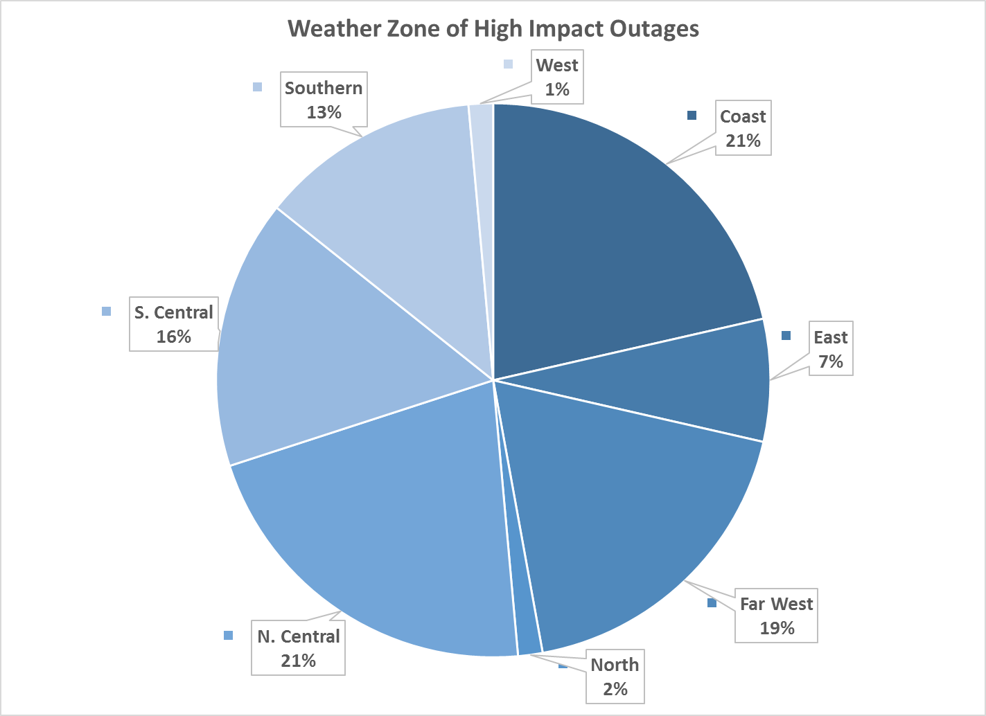
Location Classification of High Impact Outages
No clear geographical pattern in the “High Impact Outages”
No clear distinction
High amount of “High Impact Outages” in the Valley area.
High Impact Outage Types
 | Bus | Line | XFMR | Total
Coast | 4 | 9 | 2 | 15
East | 1 | 4 | - | 5
Far West | - | 12 | 1 | 13
North | - | 1 | - | 1
N. Central | 11 | 2 | 2 | 15
S. Central | 1 | 10 | - | 11
Southern | 3 | 5 | 1 | 9
West | - | - | 1 | 1
Total | 20 | 43 | 7 | 70

Slide 7
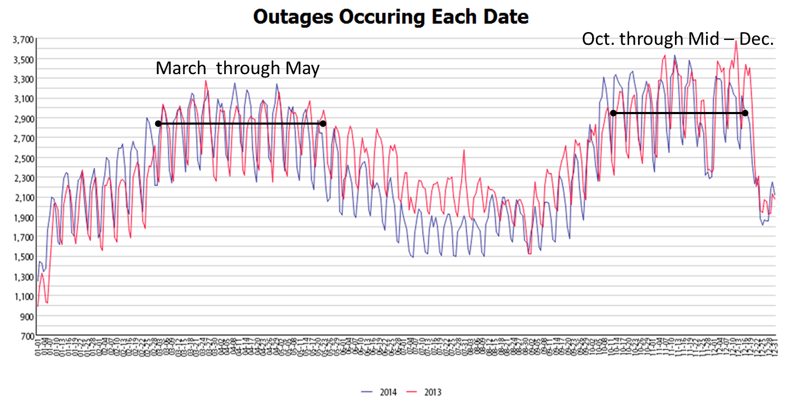
Monthly Classification of High Impact Outages
Outages occurring each date…
More outages during the “shoulder months.”
Correlation with system load.

Slide 8
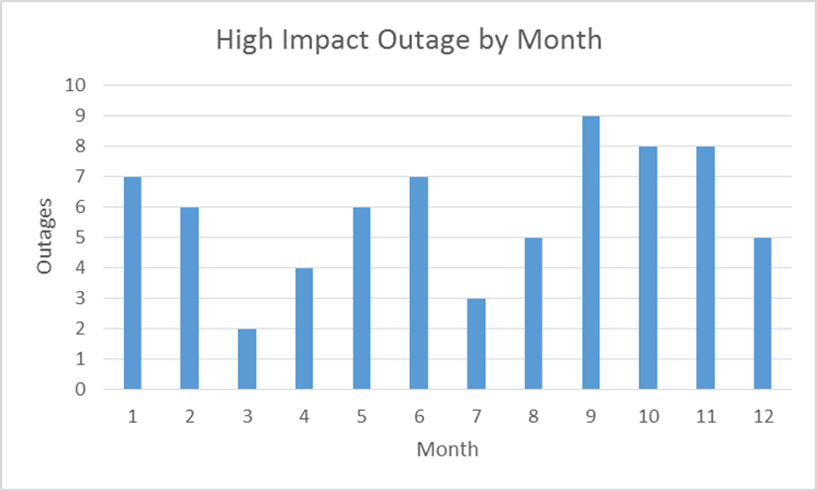
Monthly Classification of High Impact Outages
Grouping the High Impact Outages by the month of their occurrence.
No distinct correlation with “shoulder months.”
Sympathetic High Impact Outages

Slide 9
Submittal Timeline for High Impact Outages
32.8% were submitted with ≥90 days notice.
Outage Planned Start Time

Slide 10
Submittal Timeline for High Impact Outages
Of the 23 outages submitted with more than 90 days, 69.6% were specifically included in a CRR Auction model.

Slide 11
High Impact Outage Submittal & Update Statistics*
Outages that were identified as “High Impact Outages”
12.8% were lengthened.
25.7% were shortened.
7.1% were taken earlier than originally planned.
14.28% were pushed out later than originally planned.
23 of them were cancelled.
10 were rolled up into other outages or rescheduled.
* Assumed that these modifications are a result of the Market Impact notification and questionnaire

Slide 12
Typical Length of a High Impact Outage
During planning phase…
High Impact Outage takes roughly 10.7 days.
Of those that go into real-time…
High Impact Outage takes roughly 7.4 days.
15% took longer than their planned length (overage average of 2.7 days).
Average Planned Length of High Impact Outages (days)
 | Bus | Line | XFMR | Total
69 | 53.5 | 13.2 |  | 26.6
138 | 2.9 | 6.9 | 25.1 | 6.3
345 | 12.5 | 14.8 | 9.0 | 13.2
Total | 10.2 | 10.9 | 11.3 | 10.7
Average Actual Length of High Impact Outages (days)
 | Bus | Line | XFMR | Total
69 | 44.2 | 13.1 | - | 23.4
138 | 3.5 | 5.9 | 25.2 | 6.1
345 | 4.6 | 6.0 | 9.2 | 6.5
Total | 7.6 | 6.4 | 11.8 | 7.4

Slide 13
High Impact Outages Causing Real-Time Congestion
Of the 47 High Impact Outages that were actually taken, 15 of them were determined to have caused notable congestion that was reportable to ROS.
Contributed to an estimated total $50,000,000.00 of congestion rent.
Based on ROS report
How much could be saved through Economic Outage Coordination?
32.9%

Slide 14
High Impact Outages Causing Real-Time Congestion
Compare the High Impact Outages that actually caused congestion to those that were identified in the OC process.
Type, Time and Location
For High Impact Outages that caused congestion in real-time…
Grouped by equipment type and voltage level…
345 kV equipment contributed the most to actual congestion rent.
High Impact Outage Types
 | Bus | Line | XFMR* | Total
69 | 0 | 0 | - | 0
138 | 0 | 2 | 0 | 2
345 | 3 | 6 | 4 | 13
Total | 3 | 8 | 4 | 15

Slide 15
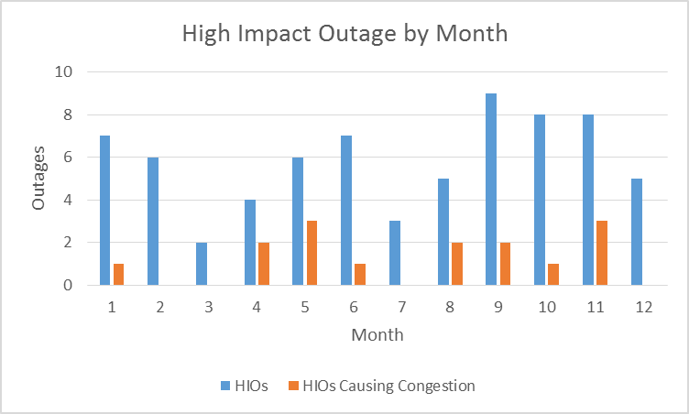
High Impact Outages Causing Real-Time Congestion
For High Impact Outages that caused congestion in real-time…
Geographically diverse.
Far West, N. Central & Southern most consistent with OC identified.
More identified HIOs actually caused congestion during the shoulder months.
High Impact Outage Causing Congestion Types
 | Bus | Line | XFMR | Total
Coast | 0 | 1 | 0 | 1
East | 0 | 0 | - | 0
Far West | - | 3 | 1 | 4
North | - | 0 | - | 0
N. Central | 2 | 0 | 2 | 4
S. Central | 0 | 2 | - | 2
Southern | 1 | 2 | 0 | 3
West | - | - | 1 | 1
Total | 3 | 8 | 4 | 15

Slide 16
Actual Planned Outages Causing Congestion
What about those outages that were not identified as High Impact Outages?

Slide 17
Outages Causing Real-Time Congestion
Using ROS reportable congestion…
Total of 96 reportable congestion events due to planned outages.
Planned outages of lines are the most contributing factor to real-time congestion.
A handful of Autotransformers
Congestion Causing Outages* Type
 | Bus | Line | XFMR | Total
69 | - | 5 | - | 5
138 | 4 | 46 | - | 50
345 | 1 | 35 | 5 | 41
Total | 5 | 86 | 5 | 96

Slide 18
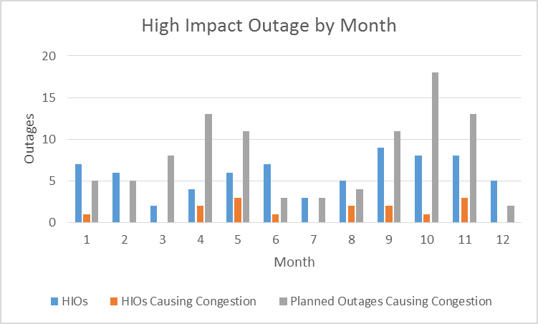
Outages Causing Real-Time Congestion
Planned outages cause more congestion during “shoulder months.”
More outages being taken.
Risk of “sympathetic” congestion due to numerous outages.

Slide 19
Conclusions
“Market Impact” screening process…
31.9% accuracy in identifying actual High Impact Outages
15.3% accuracy in identifying ALL actual High Impact Outages
Type of outage has a strong correlation with causing congestion.
345, 138 kV lines highest contributor, few 345/138 kV Auto’s
Geographical diverse.
No strong correlation with Weather Zones.
Planned outages cause more congestion during “shoulder months.”
More outages being taken
Risk of “sympathetic” congestion.
“Straw that broke the camel’s back.”

Slide 20
Questions?

Slide 21
List of High Impact Outages

Slide 22
List of High Impact Outages

