Slide 1
ISO Comparison – NEISO
Alex Lee (ERCOT)
Lee Blaede (NEISO)
ERCOT OCITF
3/23/2015

Slide 2
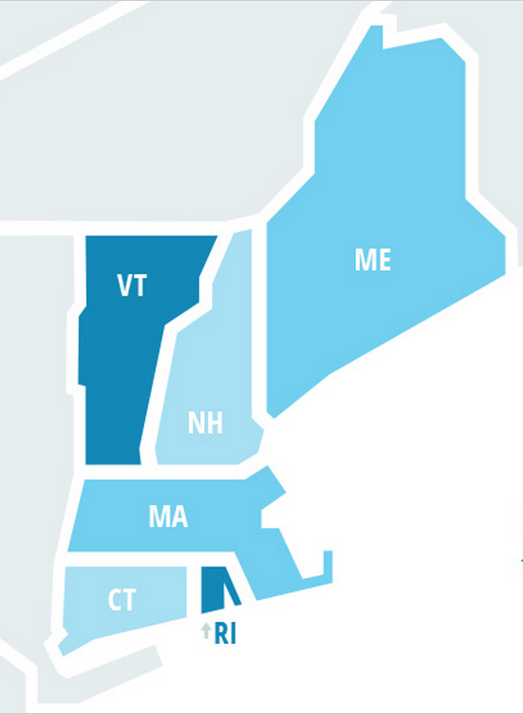
ERCOT vs NEISO High Level Overview
550 generators
68 GW summer peak demand
74 GW generating capacity
Annual Ave. Spot Price $42/MWh (2014)
6,500 bus
43,000 miles transmission lines (69kV+)
350 generators
28 GW summer peak demand
31 GW generating capacity
Annual Ave. Spot Price $82/MWh (2014)
900 bus
8,500 miles transmission lines (115kV+)
TX

Slide 3
Outage Coordination Process Timelines - Transmission
PLAN
START
ERCOT
90
45
9
4
3
90
45 (Mid Term)
9 (Mid Term)
4
3
Forced
Approval Deadline
75
30
4
3
2
NEISO
21
5
Long Term
Short Term
Unplanned
10 days after receipt
Approval Deadline
1
Note: All numbers are in days.

Slide 4
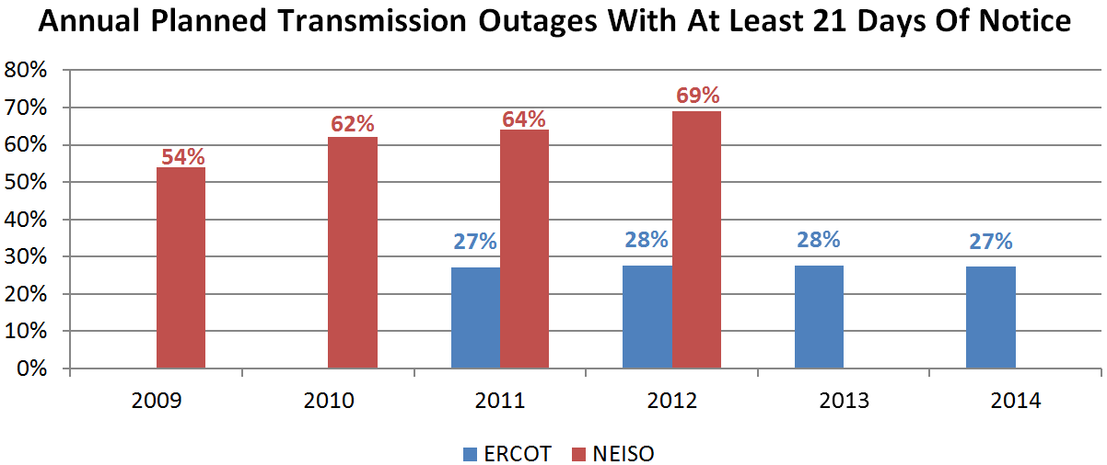
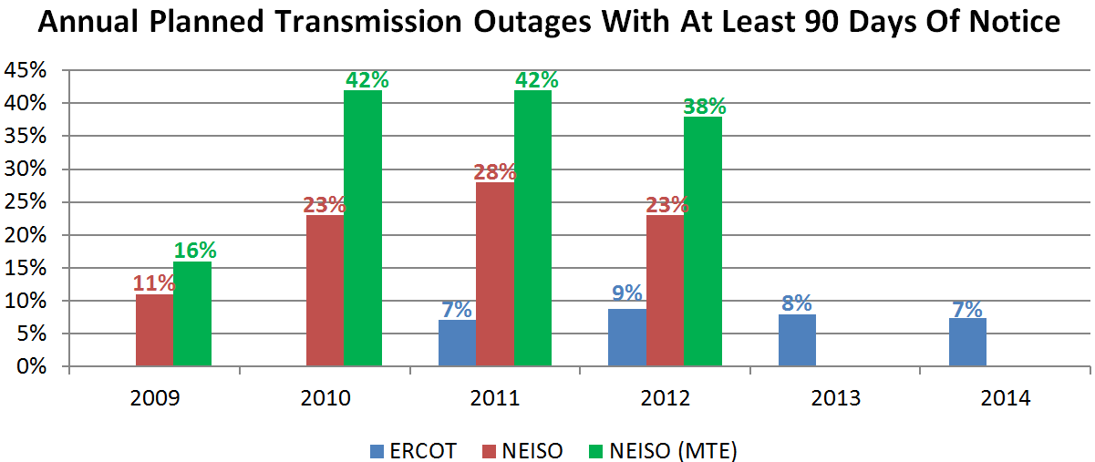
Planned Transmission Outage Submittal Pattern
 | 2012 Total Planned Transmission Outages
ERCOT | 74,785 equipment (7,903 groups and 4,462 ungrouped equipment)
NEISO | 3,495 groups
Note: Numbers includes only planned-type transmission outages which start each year.

Slide 5
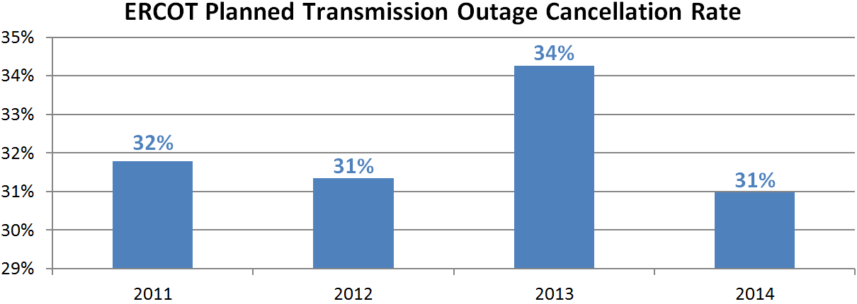
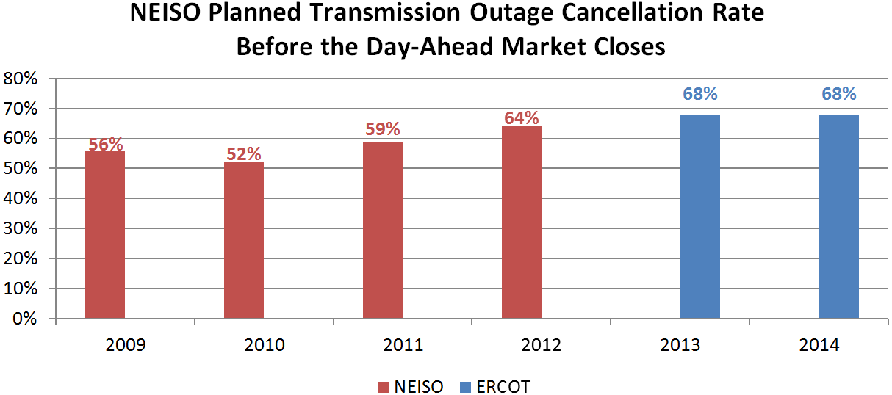
Planned Transmission Outage Cancellation Trend
Note: Numbers includes only planned-type transmission outages which start each year.

Slide 6
Outage Coordination Process Timelines - Resource
PLAN
START
ERCOT
45
9
4
3
45
9
4
3
Forced
Automatically Accepted
5 business day after receipt; otherwise, automatically accepted
Approval Deadline
NEISO
15
Planned
Unplanned
3 days after receipt
Requested at least 7 days in advance, process within 3 days.
Requested less than 7 days in advance, process within 1 day.
Approval Deadline
Note: All numbers are in days.

Slide 7
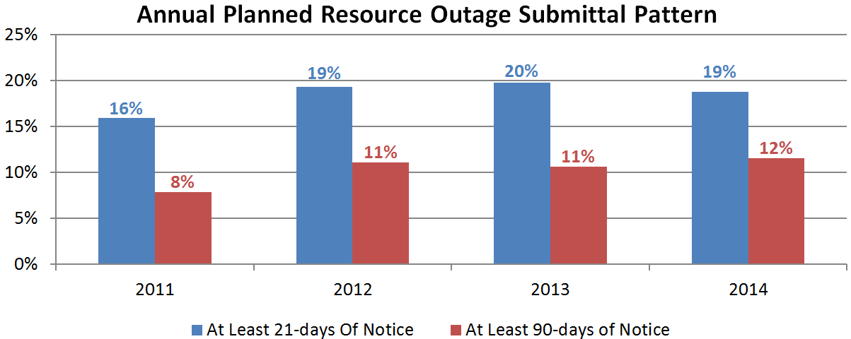
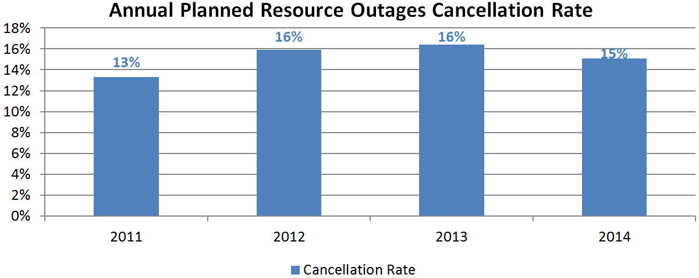
Planned Resource Outage
Note: Numbers includes only planned-type transmission outages which starts each year.

Slide 8
Additional Resource Outage Types
ISO | EROCT | NEISO
Failure to Start
AVR | RT | OS
PSS | RT | OS
Unit Test | RT | OS
RT = Handled in Real-Time.
OS = Requires Outage Submission.
NEISO’s AVR and PSS outage submissions are for tracking purpose only. Outage Coordination does not implement analysis to approve or deny.
Knowing future planned unit testing schedules could slightly improve accuracy of the forward economic analysis.

Slide 9
Outage Coordination Analysis
Analysis | Powerflow & Contingency | Dynamic Studies | Economic Analysis
ERCOT | Yes | Need-based | High Impact Outages
NEISO | Yes | Need-based | Need-based
Power-flow and contingency analysis are performed daily prior to each outage’s approval deadline.
Dynamic studies are performed when outages affecting interfaces are requested.
NEISO performs economic analysis when potentially costly outages are requested.

Slide 10
NEISO Economic Outage Evaluation History
2003
Observed high congestion over years and identified opportunities in rescheduling transmission outages to reduce congestion.
2005
Authorized to deny transmission outage which costs $200,000 or more per week.
Utilized existing Day Ahead market software.
Slow (45 minute), inflexible, and single-day only.
Manually enter real-time bids and offers
Easily takes full day to perform single analysis.
2008
Chose PowerGEM PROBE market simulator.
Fast (1 minute), flexible, and multiple-days.
Bid Production Cost Analysis.
2010/2011
Completed OCEAT (Outage Coordination Economic Analysis Tool) based on PROBE and started to fully utilize the tool.

Slide 11
NEISO: Bid Production Cost Analysis
Captures:
Reliability-committed generation incremental costs, startup costs, and no-load costs.
Expensive units dispatched out-of-merit due to transmission constraints caused by outages.
Generation cost-savings of units displaced by reliability commitments.
Potentially misses the high congestion rent with insignificant production cost difference.

Slide 12
NEISO: Economic Outage Evaluation Process Flow
PLAN START
90
5
Short-Term
Economic Analysis
Long-Term
Economic Analysis
At Risk for Economics in Short-Term Process
Approved or Denied
Interim Approved or Reposition
3-5 days before plan start
Identify and coordinate expensive or conflicting outages
Generally does not consider repositioning outages with long-term economic approval or taken in FTR auction
Provides relative certainty to proceed outage as scheduled.
Provides confidence in selecting the outage for monthly FTR and FCM reconfiguration auctions.

Slide 13
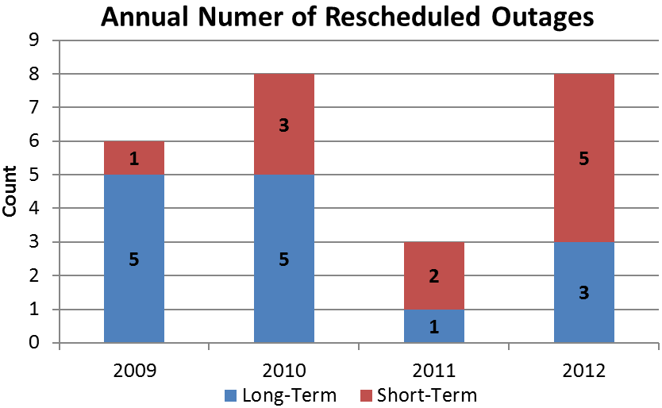
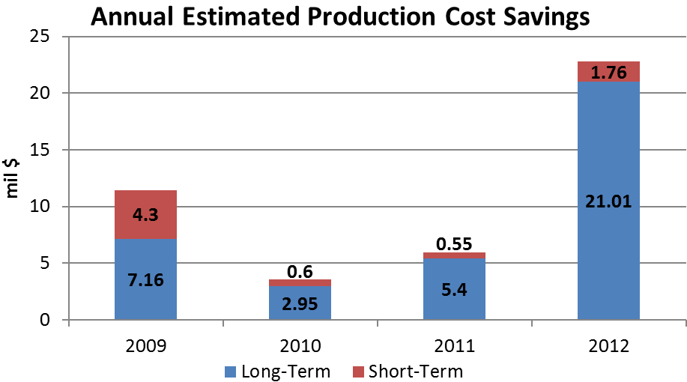
NEISO Economic Outage Evaluation

Slide 14
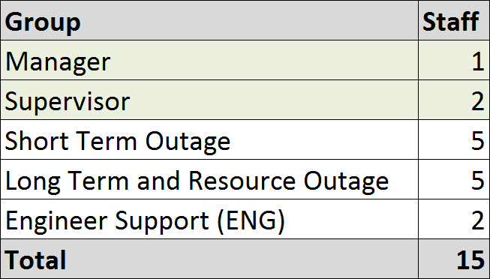
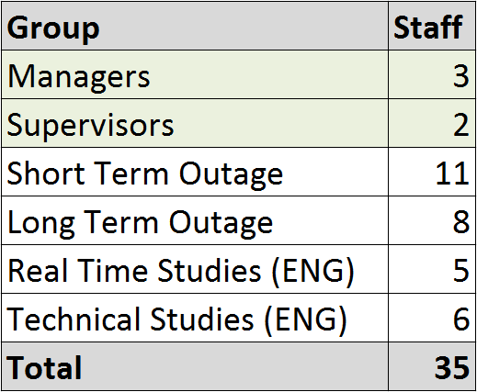
Staff Comparison
ERCOT Outage Coordination
NEISO

