Slide 1
LCRA TSC/ CPS Energy Transmission System Addition
Regional Planning Group Project
Jeff Billo
Sr. Manager, Transmission Planning
TAC
ERCOT Public
March 26, 2015

Slide 2
Project Background
San Antonio
Load is continuing to grow in the San Antonio area
J. T. Deely coal plant is scheduled to retire at the end of 2018
~850 MW within the CPS Energy area
Reliability criteria violations are expected on the transmission system serving the area by 2019
Project Submission
LCRA TSC and CPS Energy jointly submitted a project for Regional Planning Group review and comment in June 2014

Slide 3
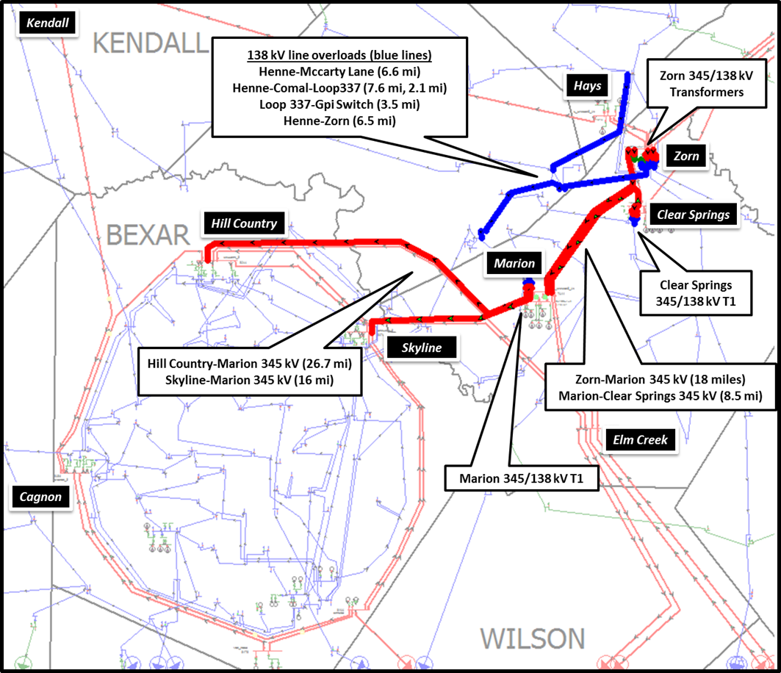
ERCOT Independent Review
Study Results
Study identified multiple overloads on the 345 kV and 138 kV system under contingency
ERCOT evaluated two options
J.T. Deely

Slide 4
ERCOT Recommendation
Recommendation
ERCOT will request Board of Directors endorsement of the following project (Option A):
Reconfigure the existing Hill Country-Elm Creek/Marion and Skyline- Marion/Elm Creek 345 kV double-circuit lines to form Hill Country-Marion double circuit and Skyline-Elm Creek double circuit. The Elm Creek-Skyline 345 kV double circuit and the Hill Country-Marion 345 kV double circuit are expected to have a minimum emergency rating of 1077 MVA and 1104 MVA, respectively
Construct a new Zorn-Marion 345 kV line (approximately 21 miles) with an emergency rating of at least 1959 MVA
Add a second 345/138 kV transformer at Clear Springs with an emergency rating of at least 525 MVA
Add a second 345/138 kV transformer at Marion with an emergency rating of at least 525 MVA
Upgrade the existing Cibolo-Schertz 138 kV line (approximately 3.6 miles) with an emergency rating of at least 477 MVA
The cost estimate is $86 million
ERCOT will ask the Board of Directors to designate the Zorn-Marion 345 kV line as critical to reliability pursuant to PUCT Substantive Rule 25.101(b)(3)(D)

Slide 5
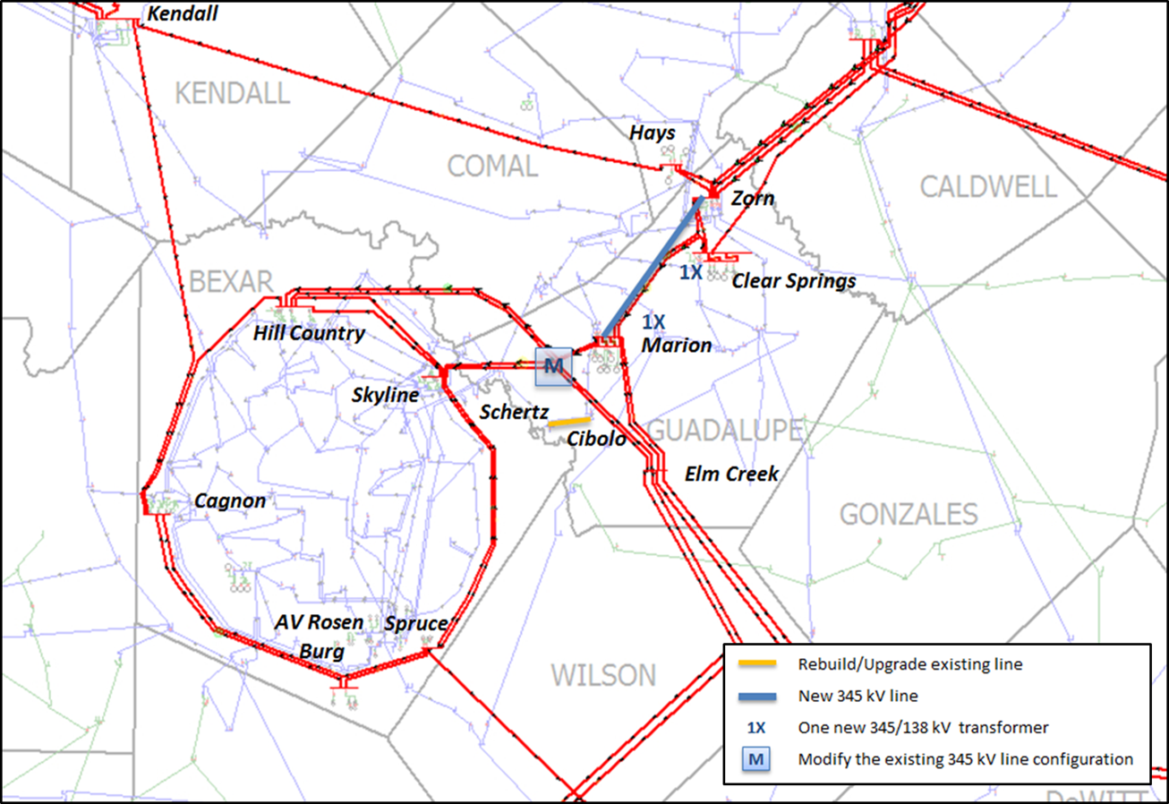
Map of Option A

