Slide 1
Texas Reliability Entity, Inc.
Protocol Compliance Department
Presentation to Operations Working Group
March 19, 2015

Slide 2
Protocol Compliance Department Staffing
Director, Paula Mueller
Senior Protocol Compliance Engineer, Jim Clawson
Senior Protocol Compliance Analyst, Greg Graham
Protocol Compliance Analyst, Doug Whitworth

Slide 3
Texas RE Protocol Compliance Department
Texas RE is the PUCT’s “Reliability Monitor” for the ERCOT Region.
Audits
Event Investigations
Investigations
Performance Monitoring Follow-Up
Texas RE initiated
Self-Reported Violations
PUCT Requests
NPRR Review
PUCT performs all enforcement activities.

Slide 4
Audits
2012 - 2013
Selected entities from NERC schedule based primarily on dates.
2014
Selected entities without regard for NERC schedule.
Used simple risk assessment method.
2015
Plan to perform greater number of more narrowly focused audits.
May combine self-certifications with follow-up spot checks.
Notes:
Talk about how we selected entities for audits
Add number of audits conducted in each year

Slide 5
Event Investigations
Need for this activity depends on whether there are events, so it is difficult to plan for or predict.
Coordinate initial data requests with NERC side.
Significant part of workload in 2011 and 2014.

Slide 6
Texas RE Initiated Investigations
Performance Monitoring Follow Up.
Protocols Section 8 requires ERCOT to report on certain metrics.
Reports are reviewed, information such as PI data and Operator Logs examined to confirm reported information.
Formal investigations initiated.
Study of known reliability issue may be undertaken to identify entities whose performance warrants investigation.
PUCT may request that we pursue particular topics/issues.

Slide 7
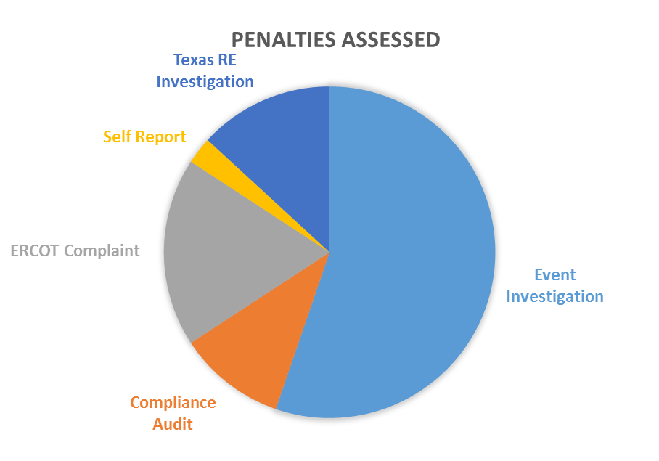
2011 – 2014: Origin for Cases Reported vs. Penalties Assessed

Slide 8
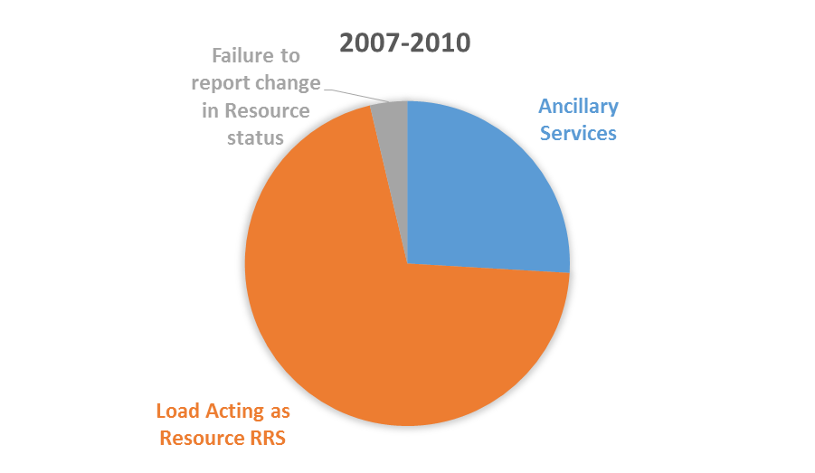
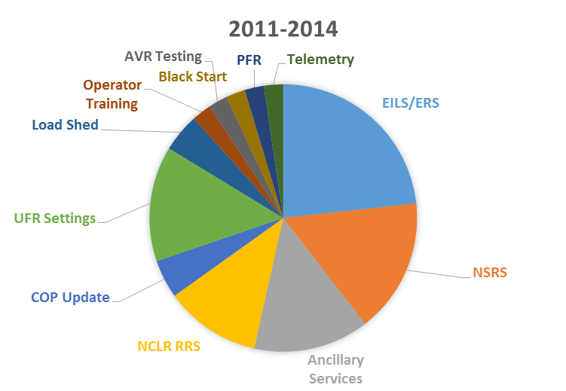
Compliance Issues for Penalty Assessments

Slide 9
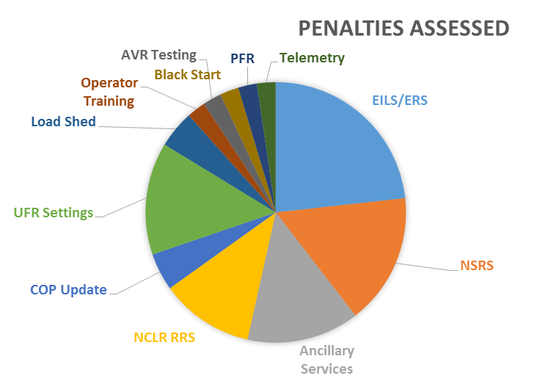
Compliance Issue: Cases Reported vs. Penalties Assessed 2011 – 2014 (number of cases)

Slide 10
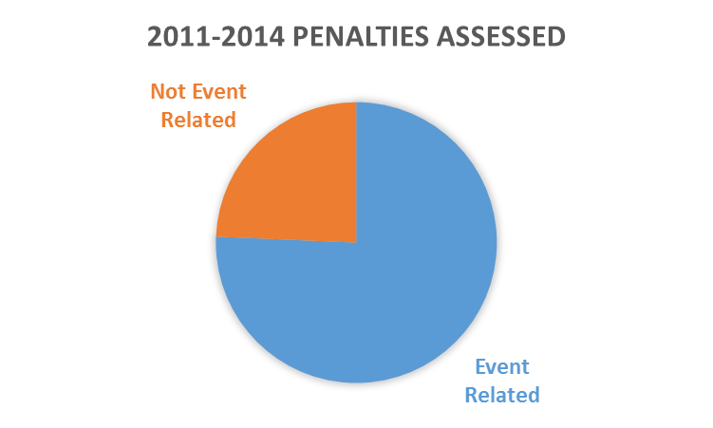
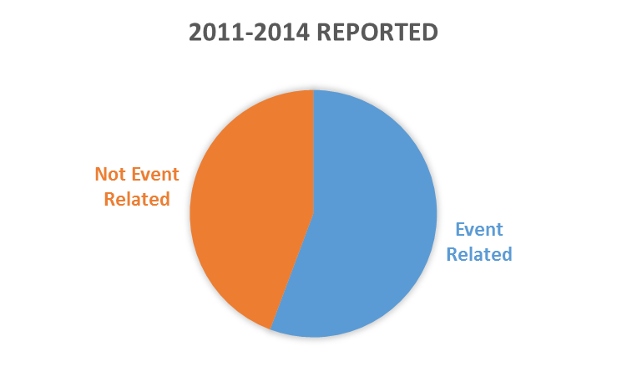
Penalties Assessed: Event Related vs. Not Event Related (number of cases)

Slide 11
Average Penalties Assessed
2007-2010
Compliance Issue | Average Penalty
Failure to report unplanned change in Resource status | $132,567
Failure to supply 95% of LaaR in 10 Min. | $90,416
Failure to provide Ancillary Services | $38,750
2011-2014
Compliance Issue | Average Penalty
Ancillary Services | $27,500
Operator Training | $27,000
Telemetry | $15,000
NCLR RRS | $27,500
Black Start | $35,000
Failure to shed load as directed | $68,500
NSRS | $149,000/ $29,000
EILS/ERS | $26,666
EILS/NCLR | $50,000
Primary Frequency Response | $70,000
COP Updates/UFR Settings | $21,800
COP Updates/NSRS | $57,000
AVR Testing/UFR Settings | $37,000

Slide 12
Find us on the Web
http://www.texasre.org/compliance/protocolcompliance/Pages/Default.aspx

Slide 13
Contact Us
http://www.texasre.org/about/contact/Pages/Default.aspx
paula.mueller@texasre.org; 512-583-4938
jim.clawson@texasre.org; 512-583-4917
greg.graham@texasre.org; 512-583-4946
doug.whitworth@texasre.org; 512-583-4918

