Slide 1
IMM Pricing Concerns with PFR and FFR
Proposed pricing structure provides incentive for FFR to offer at less than cost.
Dual clearing price pricing structure (“Alt 2”) establishes incentive for FFR to offer at cost, but requires loads providing FFR to estimate opportunity costs.
Dual clearing price with linked load bid/FFR offer option would establish an incentive for FFR to offer at cost, and not require load providing FFR to estimate opportunity costs

Slide 2
Current Pricing Proposal Creates Incentive to Offer Below Cost for FFRs
Requirements: PFR + 2 * FFR ≥ 3000MW
FFR ≤ 750MW
Assume all participants offer at cost
FFR Offer (MW) | FFR Offer ($/MWh) | Cleared MW
200 | 1 | 200
200 | 2 | 200
200 | 3 | 200
200 | 4 | 150
200 | 15 | 0
PFR Offer (MW) | PFR Offer ($/MWh) | Cleared MW
400 | 11 | 400
400 | 12 | 400
400 | 13 | 400
400 | 14 | 300
400 | 36 | 0
MCPC (per NPRR 667)
FFR = $28, PFR = $14

Slide 3
Current Pricing Proposal Creates Incentive to Offer Below Cost for FFRs
In the previous auction the highest priced FFR offer would have made a profit of $13/MWh if cleared, but it was not cleared. This provides an incentive to bid lower than cost (if there is a reasonable expectation that the MCPC will be higher than cost).

Slide 4
Current Pricing Proposal Creates Incentive to Offer Below Cost for FFRs
Requirements: PFR + 2 * FFR ≥ 3000MW
FFR ≤ 750MW
Assume all participants offer at rational offer
FFR Offer (MW) | FFR Offer ($/MWh) | Cleared MW
200 | 0 | 150
200 | 0 | 150
200 | 0 | 150
200 | 0 | 150
200 | 0 | 150
PFR Offer (MW) | PFR Offer ($/MWh) | Cleared MW
400 | 11 | 400
400 | 12 | 400
400 | 13 | 400
400 | 14 | 300
400 | 36 | 0
MCPC (per NPRR 667)
FFR = $28, PFR = $14

Slide 5
Current Pricing Proposal Creates Incentive to Offer Below Cost for FFRs
With rational/logical offering, the market loses the ability to choose the lowest cost offers and market efficiency suffers

Slide 6
Dual Clearing Price Pricing Proposal Creates Incentive to Offer at Cost for FFRs
Requirements: PFR + 2 * FFR ≥ 3000MW
FFR ≤ 750MW
Assume all participants offer at cost
FFR Offer (MW) | FFR Offer ($/MWh) | Cleared MW
200 | 1 | 200
200 | 2 | 200
200 | 3 | 200
200 | 4 | 150
200 | 15 | 0
PFR Offer (MW) | PFR Offer ($/MWh) | Cleared MW
400 | 11 | 400
400 | 12 | 400
400 | 13 | 400
400 | 14 | 300
400 | 36 | 0
MCPC (per Dual Clearing Price)
FFR = $4, PFR = $14

Slide 7
Dual Clearing Price Pricing Proposal Same as NPRR 667 if FFR not at Maximum
Requirements: PFR + 2 * FFR ≥ 3000MW
FFR ≤ 750MW
Assume all participants offer at cost
FFR Offer (MW) | FFR Offer ($/MWh) | Cleared MW
200 | 1 | 200
200 | 2 | 200
200 | 3 | 200
100 | 4 | 100
200 | 30 | 0
PFR Offer (MW) | PFR Offer ($/MWh) | Cleared MW
400 | 11 | 400
400 | 12 | 400
400 | 13 | 400
450 | 14 | 400
400 | 36 | 0
MCPC (per Dual Clearing Price)
FFR = $28, PFR = $14

Slide 8
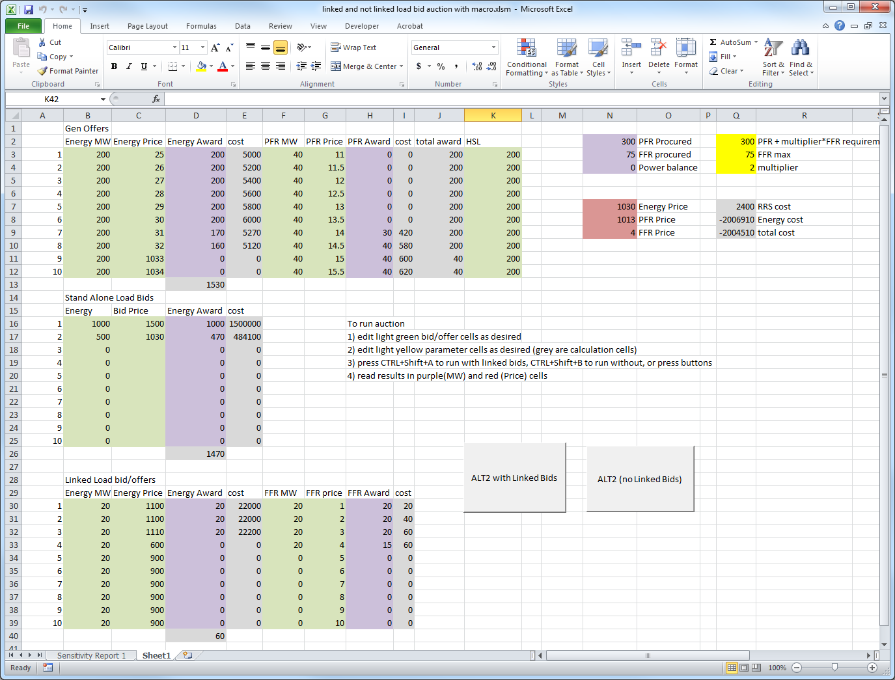
Dual Clearing Price Creates Need for Loads Providing FFR to Estimate their Opportunity Cost

Slide 9
Dual Clearing Price Creates Need for Loads Providing FFR to Estimate their Opportunity Cost

Slide 10
Dual Clearing Price Creates Need for Loads Providing FFR to Estimate their Opportunity Cost
In the previous auction the highest cost load providing FFR picked up a responsibility to run at 15MW and only got paid $4/MW, even though the price of energy was $1013/MW and their bid was $600/MW
Note that the generator providing PFR was not required to estimate their opportunity cost.

Slide 11
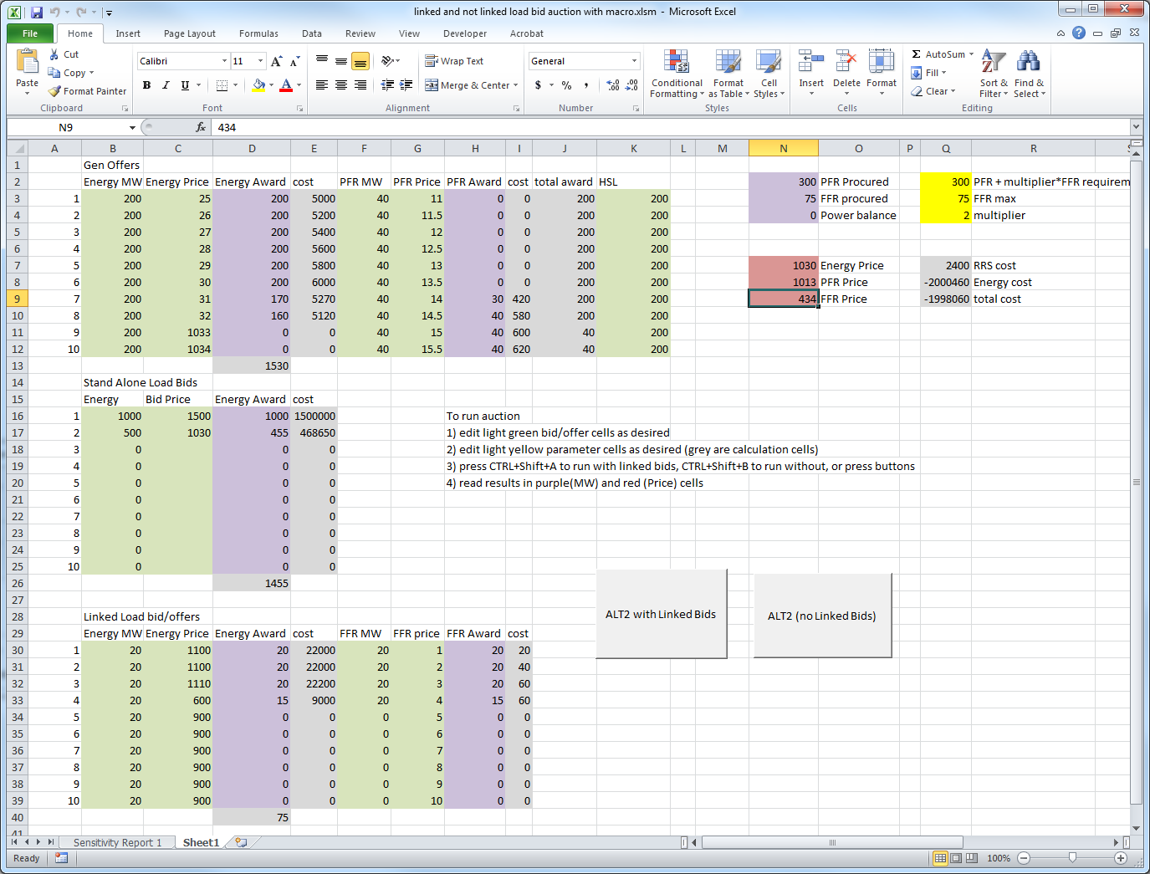
Dual Clearing Price with Linked Load Bid/Offers Removes Need for FFR Loads to Estimate their Opportunity Cost

Slide 12
Dual Clearing Price with Linked Load Bid/Offers Removes Need for FFR Loads to Estimate their Opportunity Cost

Slide 13
Dual Clearing Price Creates Need for Loads Providing FFR to Estimate their Opportunity Cost
In the auction with linked bids and offers the highest cost load providing FFR picked up a responsibility to run at 15MW and only got paid $434/MW. As the price of energy was $1030/MW, their energy bid was $600/MW and their FFR Offer was $4, they are indifferent.
  Note that for generators the opportunity cost is a tradeoff between making money on AS or Energy whereas for loads it is a tradeoff between losing money on energy and making money on AS.

Slide 14
Summary
Proposed NPRR pricing provides incentive for loads providing FFR to offer as price takers as long as the load feels the MCPC is above their costs.
Dual Clearing Price (“Alternative 2”) would provide incentive for loads providing FFRs to offer their costs.
However, Dual Clearing Price would require a rational load to estimate its energy opportunity cost and include it in its FFR offer, which generators are not required to do.
Enabling Linked FFR Offers/Load Bids would enable a rational load to not include any energy related opportunity costs into its FFR offer, like generators.

