Slide 1
Information Technology Report
Dave Pagliai
Manager, IT Support Services

Slide 2
Incident Report Highlights
Service Availability – February
Retail Market IT systems met all SLA targets
Incidents & Maintenance – February
02/08/15 – Retail Market planned maintenance outage
02/04,11,14/15 – Premature transitioning of MarkeTrak issues
02/17/15 – Duplicate Retail transactions
Incidents & Maintenance - March
03/01/15 – Retail Release
03/05/15 – System communication issue impacting the following services:
Retail transaction processing
Find ESIID, Find Transaction
MarkeTrak
MPIM
03/29/15 – Retail Release
Supplemental AMS Interval Data Report Issue
No impacts to report in January or February
A long term solution has been developed and will be included in an upcoming software release

Slide 3
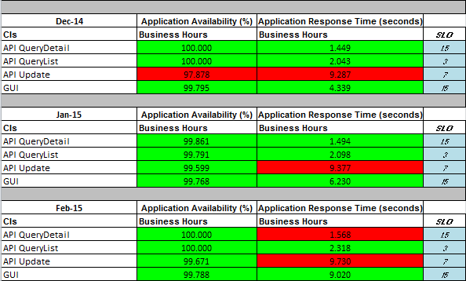
MarkeTrak Performance

