Slide 1
Project Update and Summary of Project Priority List (PPL) Activity
March 12, 2015

Slide 2
2015 Project Update – Agenda
  Project Portfolio Update p. 3-5
    Recent/Upcoming Project Highlights
    Revision to 2015 Market System Enhancements Scope
      Potential Vote
    2015 Release Targets
    2015 Project Spending Update
  Appendix
    Project Portfolio Gantt Chart p. 7-14
Location of Project Priority List (PPL): http://www.ercot.com/services/projects/index

Slide 3
Recent / Upcoming Project Highlights
2015 March Release In Flight
  SCR778 – Credit Exposure Calculations for NOIE Options Linked to RTM PTP Obligations
  SCR779 – Increase to the CRR Auction Transaction Limit
  MMS/OS Tech Refresh
    Impacts to MMS, CDR, CMM, CRR, CSI, MIS and S&B
Note: Projected Go-Live dates are subject to change.
Please watch for market notices as the effective dates approach.

Slide 4
Scope Change to 2015 Market System Enhancements
At the 3/4/2014 WMS meeting, ERCOT recommended the removal of NPRR568 Phase 2 from the June delivery
WMS concurred with ERCOT’s recommendation and asked that MPs consider whether they would support:
  The deferral of NPRR568 Phase 2 to the 2nd phase of the in-flight project; or,
  The removal of NPRR568 Phase 2 altogether (NPRR required to strike the gray box)
Follow-up discussion planned at April WMS meeting
2015 Market System Enhancements | Timing
Phase 1 NPRR626 – Reliability Deployment Price Adder NPRR665 – As-Built Clarification of Reliability Deployment Price Adder NPRR568 Phase 2 – Real-Time Reserve Price Adder Based on ORDC NPRR644 – Operating Reserve Demand Curve Phase 2 Revisions NPRR645 – Real-Time On-Line Capacity Revisions NPRR598 – Clarify Inputs to PRC and ORDC OBD – Methodology for Setting Max Shadow Prices Phase 2 NPRR595 – RRS Load Resource Treatment In ORDC NPRR568 Phase 2 – Real-Time Reserve Price Adder Based on ORDC NPRR644 – Operating Reserve Demand Curve Phase 2 Revisions | Ph1 – 6/27-6/28 Ph2 – 9/21-9/25

Slide 5
2015 Release Targets – Board-Approved NPRRs / SCRs / xGRRs
February 2/2 – 2/12 | March 3/23 – 3/27 | June 6/13 – 6/28 |  | August 8/10 – 8/14 | September 9/21 – 9/25 | December 12/7 – 12/11
NPRR500 SCR772 | SCR778 SCR779 | NPRR487 NPRR495 NPRR543 NPRR559 NPRR568 NPRR573 NPRR588 NPRR589(b) NPRR597 | NPRR598 NPRR601 NPRR615 NPRR626 NPRR639 NPRR645 NPRR665 SCR774(b) SCR775 OBD (Shadow Price Caps) | NPRR256 NPRR573 NPRR595 SCR771 | NPRR484(2) NPRR568 NPRR588 NPRR615 NPRR644 NPRR219 NPRR439 NPRR487 NPRR484(1b) NPRR484(2) | NPRR419 NPRR439 NPRR495 NPRR556 RRGRR003 NPRR519 NPRR617 NPRR620 SCR781 SCR783
2 | 2 | 13 |  | 3 | 4 | 4
E
E
P
E
NS
E
E
E
E
E
E
E
E
P
E
I
E
I
E
P
P
E
NS
NS
NS
NS
2016
2015 TBD Items (and month they became “TBD”)
July 2014 | Aug 2014 | Oct 2014 | Nov 2014 | Dec 2014 | Jan 2015 | Feb 2015 | Mar 2015
NPRR484(1b) | NOGRR084 | NPRR327 H | NPRR617, NPRR620 | NPRR519, NPRR272, SCR777 H | NPRR210, NPRR664 | NPRR219, NPRR493, SCR783 | NPRR256
Go-live dates can differ from Protocol effective dates – Please refer to market notices for more details
Red Text: New additions and target release changes
NPRR484(Ph1b) – Remaining Phase 1 items
NPRR484(Ph2) – S&B portion of NPRR
NPRR589(b) – S&B portion
SCR774(b) – Addition of Comments field
Strike-Through Text: Previous target release changes
Release targets are subject to change
(a), (b), etc. indicates multiple phases
Project Status Codes: NS = Not Started, I = Initiation, P = Planning, E = Execution, H = On Hold

Slide 6
2015 Project Spending Update
2015 project budget = $21.65M
Reason: Minor Capital, Program Control and Common Infrastructure projects were re-allocated to areas who use those funds

Slide 7
Business Integration Update – Appendix
  Appendix
    2/28/2015 Project Gantt
      In-flight items sorted by Project End Date
      “On Hold” projects listed separately
      “Not Started” items sorted by Project Start Date

Slide 8
Project Portfolio Status – as of 2/28/2015

Slide 9
Project Portfolio Status – as of 2/28/2015

Slide 10
Project Portfolio Status – as of 2/28/2015

Slide 11
Project Portfolio Status – as of 2/28/2015

Slide 12
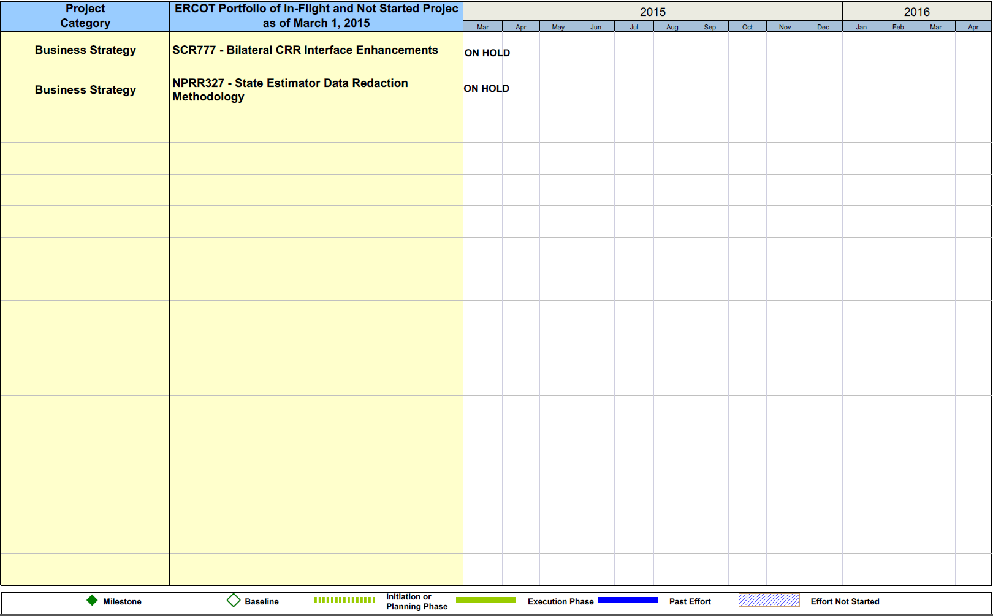
Project Portfolio Status – as of 2/28/2015

Slide 13
Project Portfolio Status – as of 2/28/2015

Slide 14
Project Portfolio Status – as of 2/28/2015

Slide 15
Project Portfolio Status – as of 2/28/2015

