Slide 1

Retail Smart Grid Trends
Paul Wattles
Senior Analyst, Market Design & Development
UT Energy Week: “How Smart Grids Enable Consumers”
Feb. 18, 2015

Slide 2
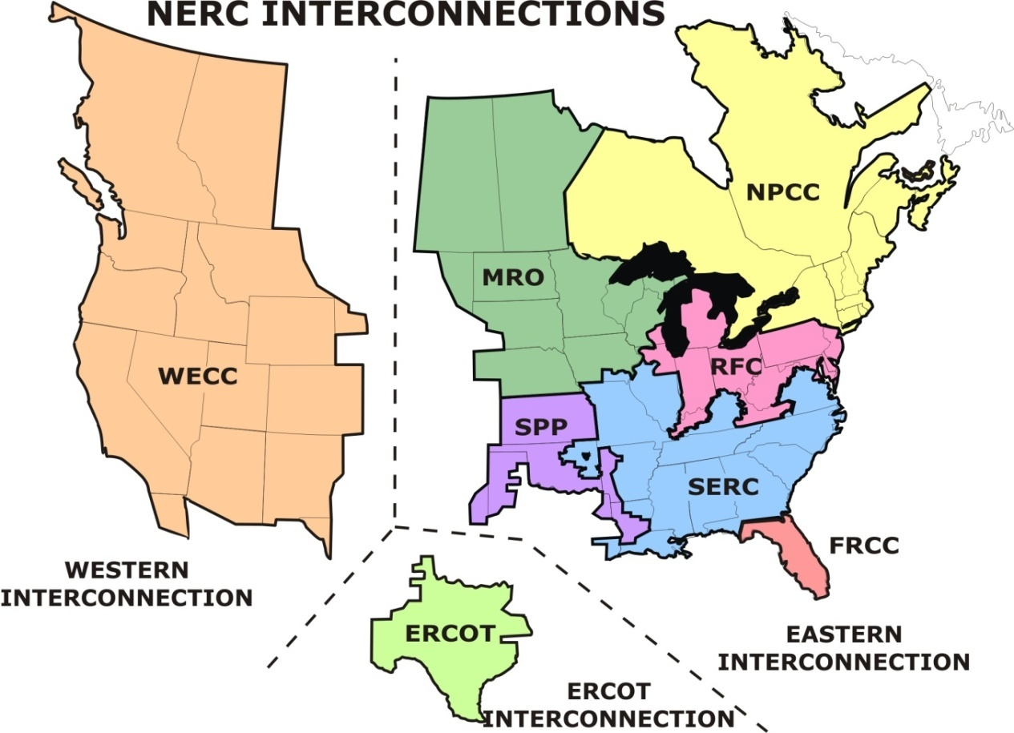
U.S.-Canadian Bulk Power Grids
The ERCOT Region is one of 3 grid interconnections in USA-Canada
The ERCOT grid:
  Covers 75% of Texas land
  Serves 90% of Texas load
  68,305 MW all-time peak (Aug. 3, 2011)
  >43,000 miles of transmission lines
  >550 generation units
  Physical assets are owned by transmission providers and generators, including municipal utilities and cooperatives
ERCOT connections to other grids are limited to direct current (DC) ties, which allow control over flow of electricity

Slide 3
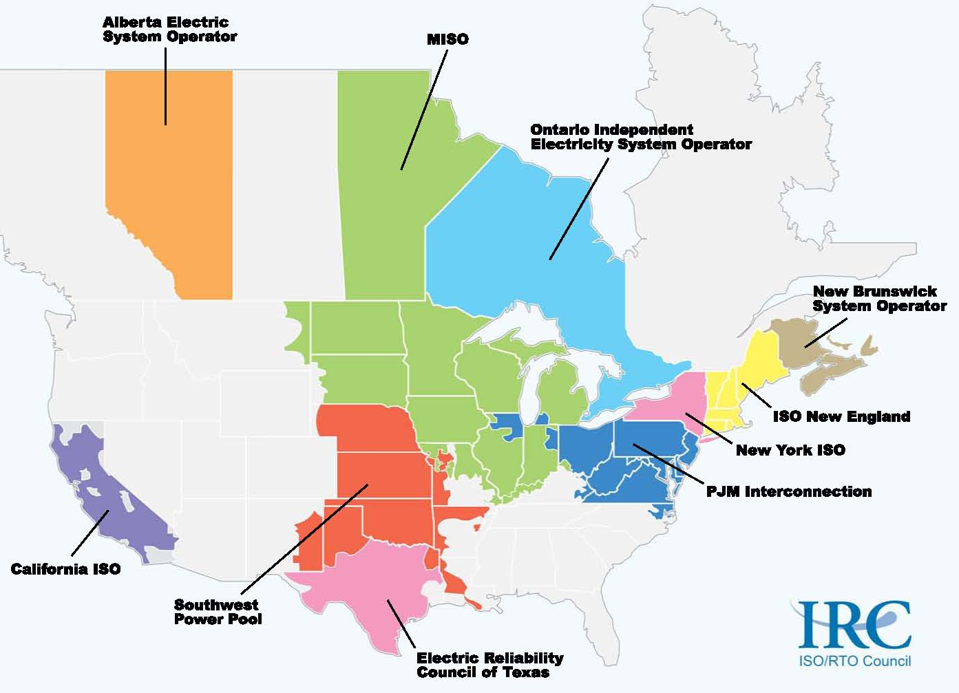
North American ISOs and RTOs
Independent System Operators and Regional Transmission Organizations
are the ‘air traffic controllers’ of the bulk electric power grids

Slide 4

Background: Advanced Metering
In 2005, Texas Legislature passed a law
(HB 2129) enabling accelerated cost
recovery for Transmission & Distribution
Utilities in retail choice areas for installing
Advanced Metering Infrastructure (AMI)
Subsequent PUC Rules required each meter to
measure load in 15-minute intervals, and for each Retail Electric Provider (REP) to be settled at wholesale on that 15-minute data
  This ensures that the benefits of any customer action to reduce Load during a high-price period will flow directly back to the REP in settlement
Other benefits include automatic meter reading and real-time outage detection
Retail choice areas ~74% of ERCOT Load

Slide 5

Background: Retail Products
Today, 4 investor-owned TDUs have implemented AMI
  6.7 million meters in service as of 12/14: nearly
  100% of retail choice customers
In 2013 ERCOT, working with REPs, began to track growth of smart grid retail product offerings enabled by AMI data:
  Dynamic pricing
  Other retail demand response or behavioral shift incentives
REPs have now provided headcounts of their customers enrolled in various product types on two snapshot dates: 6/15/13 and 9/30/14
  Additional ERCOT analysis, including responses to (rare) price events and shifts in behavior by Time of Use customers, coming later

Slide 6

Product type: Time of Use (TOU)
Pricing ($/kWh) that varies by day and/or
hour, but with fixed and known values
Examples: Free Nights, Free Weekends
  Numerous variations available from multiple REPs
Footnotes:
  222,000+ were new to TOU in 2014
  Fairly high attrition rate: -62,794 from the 2013 total
Residential TOU Enrollment
2013 | 2014
135,320 | 290,328

Slide 7

Product type: Peak Time Rebate (PTR)
Payment incentive for reducing load during events
identified by REP
  Prior notification by email, text, robo-call, etc.
Numerous variations available from multiple REPs
  Footnotes:
    Some REPs made PTRs available to all customers in their portfolio
    Some of these REPs reported their entire portfolio on PTR, regardless of whether they called an event
    Others reported numbers only for those that actually provided DR in a called event
  Inconsistencies difficult to resolve
    Data collection from REPs is voluntary (not required by market rules)
    Creating simple descriptions of all product types is proving elusive
Customer type | 2013 | 2014
Residential | 2,410 | 410,765
Commercial & Industrial | 58 | 3,007

Slide 8
Products: Real-Time Pricing (RTP) + Block & Index (B&I)
RTP: Pricing tied directly to Load Zone Settlement Point Prices in the ERCOT real-time market at all times
  Subject to change every 15 minutes
B&I: Fixed pricing most hours but exposure to RTPs in others
  Many variations on the B&I theme
Both are offered by numerous REPs, almost exclusively to C&I customers
  Footnotes:
    Indicates some migration from B&I to RTP
    Evidence elsewhere of migration from B&I to Peak Rebate plans
Commercial & Industrial Enrollment
 | 2013 | 2014
RTP | 4,358 | 9,700
B&I | 23,928 | 6,976

Slide 9
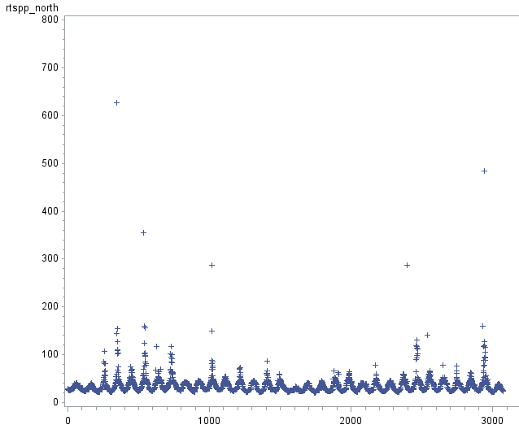
Aug. 2014 Wholesale Prices
Real Time Settlement Point Prices, ERCOT North Load Zone
This is typical of summer months from 2012-2014
$9,000 offer caps do not ensure high prices will be realized
Challenging to analyze price responsive load behavior
Two intervals above $450

Slide 10

Additional thoughts
Collecting data on retail price offerings is not a
pure science; many lines are blurred
  Some confusion on product definitions
  REP offerings not necessarily easy to match to the
  ERCOT categories
  REP databases may not be built to track product types through a customer’s history
This helps to explain some of the 2013-14 transitions, but makes year-to-year headcount tracking an inexact science
Caveats & disclaimers duly noted, I hope

Slide 11

Big Picture
Let’s not miss the forest while
looking at the trees
A decade after the Legislature enabled AMI, the retail smart grid is starting to take hold
More detail: http://www.ercot.com/calendar/2015/2/3/31977-DSWG
A significant chunk of the retail market now has some kind of incentive for DR, price response, or behavioral shift :
~ 12% of residential
> 8% of C&I
Overall, nearly 5-fold increase in customer counts from 2013-2014

Slide 12

Questions?

