Slide 1
Information Technology Report
Dave Pagliai
Manager, IT Support Services

Slide 2
Incident Report Highlights
Service Availability – January
Retail Market IT systems met all SLA targets
Incidents & Maintenance – January
01/18/15 – Retail Market planned maintenance outage (Site Failover)
Incidents & Maintenance – February
02/08/15 – Retail Market planned maintenance outage
02/04,11,14/15 – Premature transitioning of MarkeTrak issues
02/17/15 – Duplicate Retail transactions
March 2015
03/01/15 – Retail Release
Supplemental AMS Interval Data Report Issue
No impacts to report in January or February
A long term solution has been developed and will be included in an upcoming software release

Slide 3
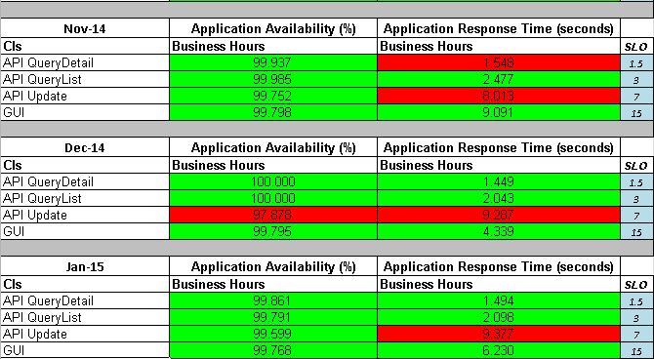
MarkeTrak Performance

Slide 4
Retail Processing Duplicate Transactions
On February 17, 2015, from 10:00 – 14:00, ERCOT experienced a Retail Processing system issue that resulted in duplicate transactions being forwarded to Market Participants
Find ESIID functionality was intermittent during this timeframe
ERCOT held Market calls on February 18 and 20 to discuss the issue and remediation
11,513 duplicate transactions and 1,136 duplicate server orders were created during this timeframe
Root Cause: While troubleshooting another issue, a second instance of a Retail processing application was started, resulting in the duplicate processing
ERCOT has taken steps to prevent the reoccurrence of this issue through process and application changes

Slide 5
Premature Transitioning of MarkeTrak Issues
ERCOT’s MarkeTrak application prematurely transitioned issues of all subtypes
This occurred on February 4 , 11, and 24, 2015
Investigation determined that a database parameter was getting changed by the MarkeTrak application
On February 12, ERCOT implemented monitoring for this condition (database parameter change), so early detection and correction could be achieved. This monitoring aided in timely identification of the issue when it reoccurred on February 24.
On February 24, ERCOT implemented a system change in an attempt to prevent the impact of the database parameter change, should it reoccur
A report was created and added to the MarkeTrak User Interface to help identify impacted issues (Premature Transition of MarkeTrak Issues).
Root cause investigation is still underway with the vendor to determine what conditions cause the database parameter to change, including attempting to duplicate those conditions in a test environment

