Slide 1
SCR775 Wireframes

Slide 2
Launch
Link added under “Day-Ahead and Real-Time Displays”

Slide 3
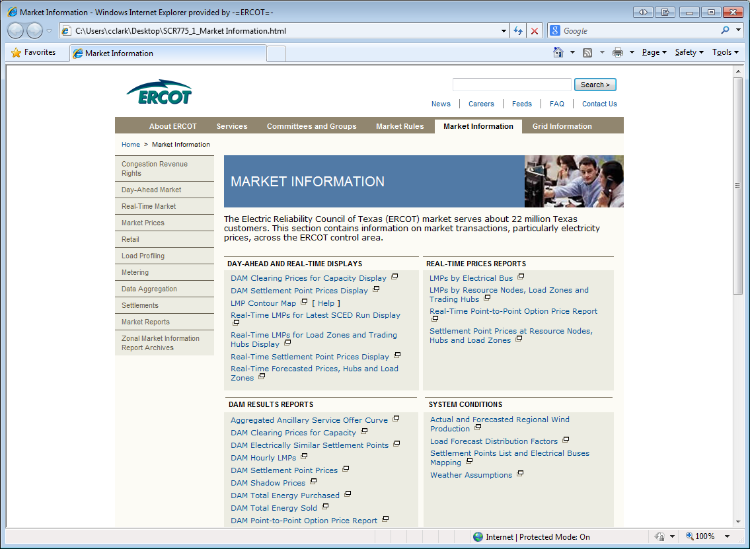

Slide 4
Display, Option 1
Launch in new tab
Table data is controlled by a drop-down menu containing each hub or load zone.
This behavior is the most similar to existing displays.

Slide 5
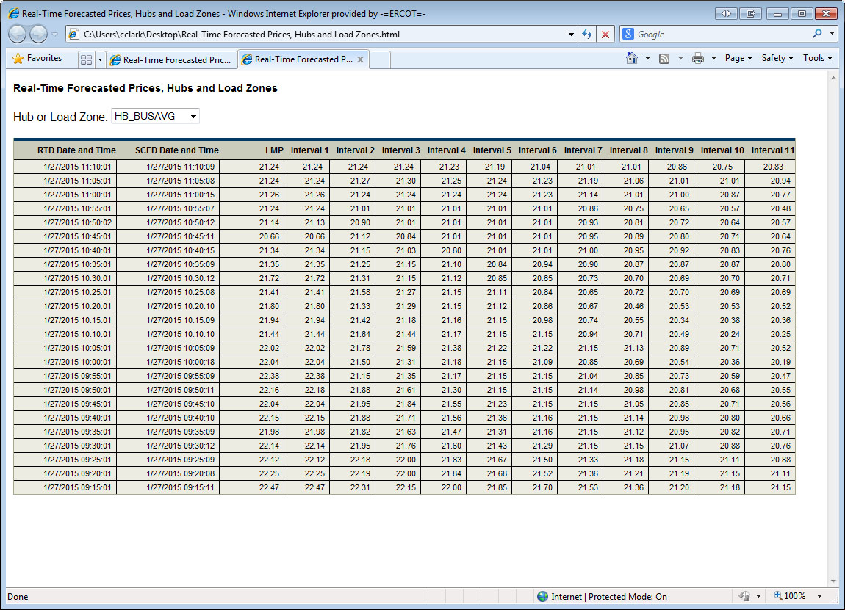

Slide 6
Display, Option 2
Launch a select screen in new tab
Launch screen contains a list of all hubs and load zones
Clicking a hub or load zone would open the appropriate data display in the same tab

Slide 7
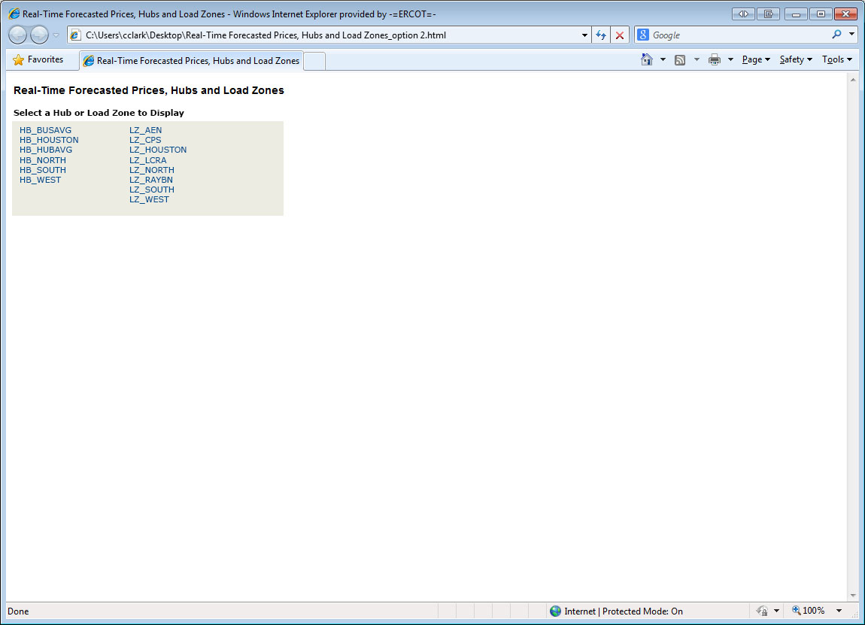

Slide 8
