Slide 1

CSWG Update
Blake Holt
ERCOT
CSWG
02/23/2015

Slide 2
CRR Balancing Account
 |  | $2,179,935.33 | CRRBACRTOT
 |  | $67,789.11 | CRRFEETOT
DACRRSAMTTOT | $500,375.28
 |  | $1,747,349.16 | CRRBAF _{JAN}

Slide 3
CRR Balancing Account

Slide 4
Approved Revision Requests “Not Started”
– Planned to Start in Future Months
Revision Request | Target Start Date | Release Target | Cost Estimate | Author
NPRR256 – Sync w/PRR787, Add Non-Compliance Language to QSE Perf. Standards | Mar 2015 | 2015-R4 | $120k-$135k | Luminant
NPRR589 (b)– Ancillary Service Offers in the Supplemental Ancillary Services Market | Mar 2015 | 2015-R3 | $20k-$35k | QMWG
NPRR484 (ph 1b) – Revisions to CRR Credit Calculations and Payments | Apr 2015 | 2015-R5 | $300k-$400k | Luminant
NPRR484 (ph 2) – Revisions to CRR Credit Calculations and Payments | Apr 2015 | 2015-R5 | $100k-$120k | Luminant
NPRR439 – Updating a Counter-Party's Available Credit Limit for Current Day DAM | Apr 2015 | 2015-R6 | $125k-$135k | ERCOT
NPRR553 – Monthly BLT Payment and Charge for Presidio Exception | May 2015 | 2015-R6 | $10k-$25k | CSWG

Slide 5
2015 Settlement System Updates
February 2/2 – 2/12 | April 4/23 –4/27 | June 6/13 – 6/28 | August 8/10 – 8/14 | Sept. / Oct. Dates TBD | December Dates TBD
 |  | NPRR589(b) NPRR568 (remaining gray-box) NPRR626 NPRR644 NPRR665 NPRR645 NPRR598 OBD (Shadow Price Caps) |  | NPRR615 NPRR588 NPRR484(2) | NPRR419 NPRR553
Currently done manually. Will be automated upon release
ORDC Phase 2 (and friends)

Slide 6
Summary of Changes
NPRR # | DESCRIPTION | CALCULATIONS AFFECTED
588/615 | PVGR Forecasting/ Clarifications for PVGR | RUC- SUPR, MEPR, HASLADJ, HASLSNAP AIEC- DAAIEC, RTAIEC CRR- MINRESPR, MAXRESPR
589 | AS offers in SASM | RUFQAMT, RDFQAMT, RRFQAMT, NSFQAMT
568/645/598/644/665/626 | ORDC Phase 2/ Reliability Deployment Adder | RTASIAMT, LAASIRNAMT, RTRDASIAMT,LARDASIRNAMT
484 | Revisions to CRR Credit Calcs and Pmts | CRR auction invoice changes
419 | Revise RTEI and RMR Adjustment Charge | RTEIAMT, RMRAAMT
553 | Monthly BLT Pmt and Charge for Presidio Exception | MBLTAMT, LAMBLTAMT

Slide 7
NPRR 645- AS Imbalance Settlement Changes
Current Logic | New Logic | Protocol Reference
Resource capacity excluded when in STARTUP mode. | Resource capacity considered when in STARTUP mode and carrying Non-Spin responsibility. | PR 6.7.4 (3)
Resource capacity excluded when telemetered generation less than telemetered LSL. | Resource capacity considered when telemetered generation less than telemetered LSL and carrying Non-Spin responsibility. | PR 6.7.4 (3)
Entire Resource capacity considered when UGEN. | UGEN quantity deducted from Resource capacity. | PR 6.7.4 (6)
Resource level adjustments for HSL and RTMG values aren’t present in extracts. | Resource level adjustments for HSL and RTMG values will be provided in extracts. | PR 6.7.4 (7)
Generation could exceed HSL in RTOLCAP calculation. | Generation will be capped at HSL in RTOLCAP calculation. | PR 6.7.4 (7)

Slide 8
NPRR 645- Allowing Capacity where TWTG < AVGTLSL
Variable | Unit | Definition | Original Source
TPVLSLFLAG | misc |  | RTM CODE- RTMOUTPUTINTERVAL
Telemetered Power (TWTG) Versus Telemetered Low Sustained Limit (AVGTLSL) Flag- Denotes Settlement intervals in which telemetered net real power (TWTG) from a Resource is greater than or equal to 95% (TPVLSL_FACTOR as of go-live date) of the Resource’s telemetered Low Sustained Limit (AVGTLSL).
If: TWTG < (TPVLSL_FACTOR * (AVGTLSL * ¼)) AND STATUSSTARTUP= 1 AND HNSADJ > 0
Then, Set: TPVLSLFLAG = 1
Else, If: TWTG >= (TPVLSL_FACTOR * (AVGTLSL * ¼))
Then, Set: TPVLSLFLAG = 1
Otherwise, Set: TPVLSLFLAG = 0

Slide 9
NPRR 645- Allowing Capacity in Startup Situations
Variable | Unit | Definition | Original Source
CAPEFLAG | misc | Capacity Exclusion Flag- Resource level cut that flags intervals that should be excluded from the calculation of Real Time Online Capacity for the QSE per PR 6.7.4 (3) (4) | RTM CODE- RTMOUTPUTINTERVAL
CAPEFLAG= 1 in intervals where:
STATUSSTARTUP = 1 AND HNSADJ <= 0 (hour)
STATUSSHUTDOWN= 1
STATUSONTEST= 1
TPVLSLFLAG= 0
RUC= 1 (hour)
For any interval where none of the above scenarios are true, set CAPEFLAG = 0

Slide 10
NPRR 645- Removal of UGEN Capacity
Variable | Unit | Definition | Original Source
UGENA | MWh |  | RTM CODE- RTMOUTPUTINTERVAL
Adjusted Under Generation Volumes per QSE per Settlement Point per Resource—The amount under-generated by the Generation Resource r represented by QSE q at Resource Node p for the 15-minute Settlement Interval adjusted pursuant to paragraph (6) above.
If: BPDAMT > 0 AND CAPEFLAG = 0
Then, set: UGENA = UGEN
Else, set: UGENA = 0

Slide 11
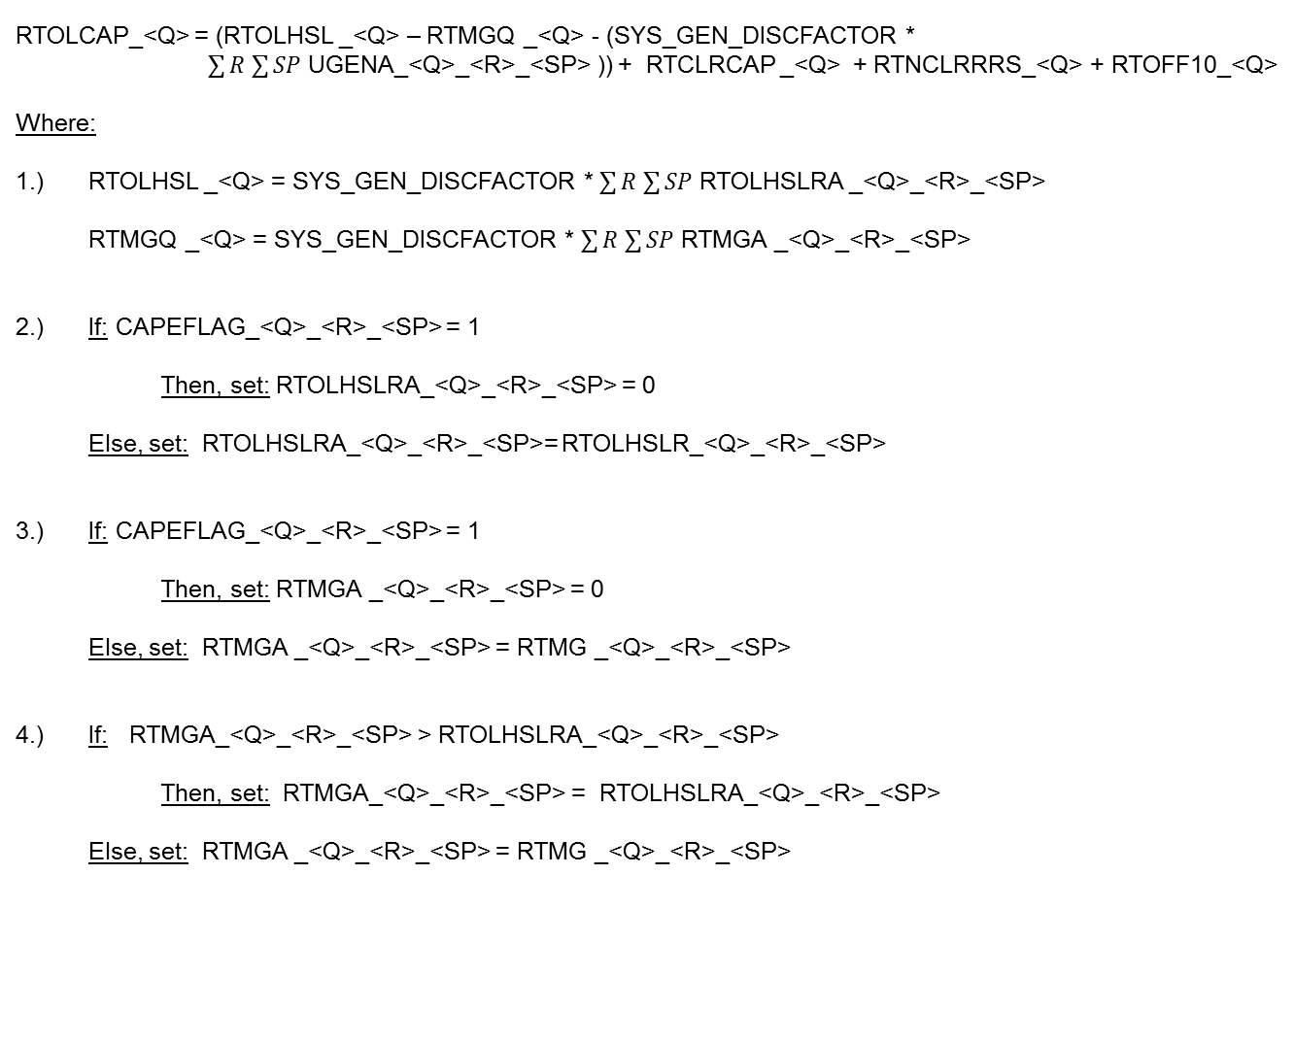
NPRR 645- Putting it all together
RTOLCAP_<Q> = (RTOLHSL _<Q> – RTMGQ _<Q> - (SYS_GEN_DISCFACTOR *
$\sum{R}$ $\sum{SP}$ UGENA_<Q>_<R>_<SP> )) + RTCLRCAP _<Q> + RTNCLRRRS_<Q> + RTOFF10_<Q>
Where:
1.) RTOLHSL _<Q> = SYS_GEN_DISCFACTOR * $\sum{R}$ $\sum{SP}$ RTOLHSLRA _<Q>_<R>_<SP>
RTMGQ _<Q> = SYS_GEN_DISCFACTOR * $\sum{R}$ $\sum{SP}$ RTMGA _<Q>_<R>_<SP>
2.) If: CAPEFLAG_<Q>_<R>_<SP> = 1
Then, set: RTOLHSLRA_<Q>_<R>_<SP> = 0
Else, set: RTOLHSLRA_<Q>_<R>_<SP>= RTOLHSLR_<Q>_<R>_<SP>
3.) If: CAPEFLAG_<Q>_<R>_<SP> = 1
Then, set: RTMGA _<Q>_<R>_<SP> = 0
Else, set: RTMGA _<Q>_<R>_<SP> = RTMG _<Q>_<R>_<SP>
4.) If: RTMGA_<Q>_<R>_<SP> > RTOLHSLRA_<Q>_<R>_<SP>
Then, set: RTMGA_<Q>_<R>_<SP> = RTOLHSLRA_<Q>_<R>_<SP>
Else, set: RTMGA _<Q>_<R>_<SP> = RTMG _<Q>_<R>_<SP>

Slide 12
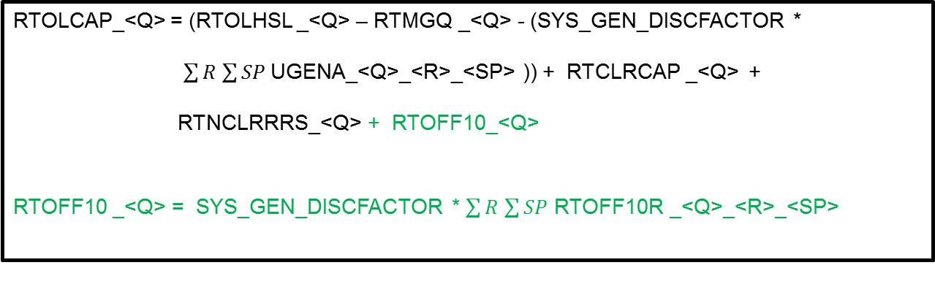
NPRR 568 Phase 2
Variable | Unit | Definition | Original Source
RTOFF10R | MWh | Real-Time Reserve Capacity Available in Ten Minutes for the Resource⎯The Real-Time telemetered OFF10 reserve capacity at the time of the SCED snapshot and validated pursuant to paragraph (11) of Section 6.5.5.2, time-weighted over the 15-minute Settlement Interval. | RTM CODE-MKTINPUTNTERVAL
RTOFF10 | MWh | Real-Time Reserve Capacity Available in Ten Minutes for the QSE⎯The Real-Time telemetered OFF10 reserve capacity at the time of the SCED snapshot and validated pursuant to paragraph (11) of Section 6.5.5.2, Operational Data Requirements, and discounted by the system-wide discount factor for the QSE q, time-weighted over the 15-minute Settlement Interval. | RTM CODE- RTMOUTPUTINTERVAL
RTOLCAP_<Q> = (RTOLHSL _<Q> – RTMGQ _<Q> - (SYS_GEN_DISCFACTOR *
$\sum{R}$ $\sum{SP}$UGENA_<Q>_<R>_<SP> )) + RTCLRCAP _<Q> +
RTNCLRRRS_<Q> + RTOFF10_<Q>
RTOFF10 _<Q> = SYS_GEN_DISCFACTOR * $\sum{R}$ $\sum{SP}$ RTOFF10R _<Q>_<R>_<SP>

Slide 13
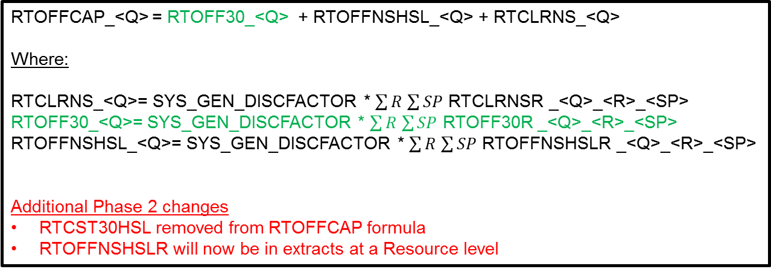
NPRR 568 Phase 2
Variable | Unit | Definition | Original Source
RTOFF30R | MWh | Real-Time Reserve Capacity Available in 30 Minutes for the Resource⎯The Real-Time telemetered OFF30 reserve capacity at the time of the SCED snapshot validated pursuant to paragraph (12) of Section 6.5.5.2, time-weighted over the 15-minute Settlement Interval. | RTM CODE-MKTINPUTNTERVAL
RTOFF30 | MWh | Real-Time Reserve Capacity Available in 30 Minutes for the QSE⎯The Real-Time telemetered OFF30 reserve capacity at the time of the SCED snapshot validated per Section 6.5.5.2 Operational Data Requirements paragraph (12) and discounted by the appropriate discount factor for the QSE q, time weighted over the 15-minute Settlement Interval. | RTM CODE- RTMOUTPUTINTERVAL
RTOFFCAP_<Q> = RTOFF30_<Q> + RTOFFNSHSL_<Q> + RTCLRNS_<Q>
Where:
RTCLRNS_<Q>= SYS_GEN_DISCFACTOR * $\sum{R}$ $\sum{SP}$ RTCLRNSR _<Q>_<R>_<SP>
RTOFF30_<Q>= SYS_GEN_DISCFACTOR * $\sum{R}$ $\sum{SP}$ RTOFF30R _<Q>_<R>_<SP>
RTOFFNSHSL_<Q>= SYS_GEN_DISCFACTOR * $\sum{R}$ $\sum{SP}$ RTOFFNSHSLR _<Q>_<R>_<SP>
Additional Phase 2 changes
RTCST30HSL removed from RTOFFCAP formula
RTOFFNSHSLR will now be in extracts at a Resource level

Slide 14
NPRR 626- Reliability Deployment Payment/Charge
Variable | Unit | Definition | Original Source
RTRDP | $/MWh | Real-Time On-Line Reliability Deployment Price ⎯The Real-Time price for the 15-minute Settlement Interval, reflecting the impact of reliability deployments on energy prices that is calculated from the Real-time On-Line Reliability Deployment Price Adder. | RTM MODE- MKTINPUTINTERVAL
RTRDASIAMT | $ | Real-Time Reliability Deployment Ancillary Service Imbalance Amount—The total payment or charge to QSE q for the Real-Time Ancillary Service imbalance associated with Reliability Deployments for each 15-minute Settlement Interval. | RTM CODE- RTMOUTPUTINTERVAL
RTRDRUCRSVAMT | $ | Real-Time Reliability Deployment RUC Ancillary Service Reserve Amount—The total payments to QSE q for the Real-Time RUC Ancillary Service Reserve payment associated with Reliability Deployments for each 15-minute Settlement Interval. | RTM CODE- RTMOUTPUTINTERVAL
RTRDASIAMT_<Q> = (-1) * ((RTASOLIMB_<Q> - RTOFF10 _<Q>) * RTRDP)
RTRDRUCRSVAMT_<Q> = (-1) * (RTRUCRESP_<Q> * RTRDP)

Slide 15
NPRR 626- Reliability Deployment Uplift
Variable | Unit | Definition | Original Source
LARDASIRNAMT | $ | Load-Allocated Reliability Deployment Ancillary Service Imbalance Revenue Neutrality Amount per QSE—The QSE q’s share of the total Real-Time Ancillary Service imbalance revenue neutrality amount associated with Reliability Deployments for the 15-minute Settlement Interval. | RTM CODE- RTMOUTPUTINTERVAL
LARDASIRNAMT_<Q> = (-1) * [(RTRDASIAMTTOT + RTRDRUCRSVAMTTOT) * LRS _<Q> ]

Slide 16
NPRR 665- Energy Offer Curves for RUC Resources
Proxy Curve Creation (no curve submitted by QSE):
If the RUC Committed Resource did not submit an Energy Offer Curve for the RUC committed interval the curve created in section 2.2.1 needs to be replaced with a simple two point curve, with quantities at HSL and LSL and a price at the RUC Price Floor (RUCPFLR).
Example:
If a curve does not exist in the ENERGYOFFERBLOCKS table for the Resource for the RUC Committed Interval then replace any EOCQTY, EOCPR for the Resource for the interval with the following curve.
EOCQTY_<Q>_<R>_<SP>_OP1 → LSL value for interval
EOCQTY_<Q>_<R>_<SP>_OP2 → HSL value for interval
EOCPR_<Q>_<R>_<SP>_OP1 → RUCPFLR
EOCPR_<Q>_<R>_<SP>_OP2 → RUCPFLR

Slide 17
NPRR 665- Energy Offer Curves for RUC Resources
If a curve exists in the ENERGYOFFERBLOCKS table for the Resource for the RUC Committed Interval:
Initial Curve
EOCQTY_<Q>_<R>_<SP>_OP1 → 100
EOCQTY_<Q>_<R>_<SP>_OP2 → 150
EOCQTY_<Q>_<R>_<SP>_OP3 → 151
EOCQTY_<Q>_<R>_<SP>_OP4 → 400
EOCQTY_<Q>_<R>_<SP>_OP5 → 0
EOCPR_<Q>_<R>_<SP>_OP1 → 99.00
EOCPR_<Q>_<R>_<SP>_OP2 → 199.50
EOCPR_<Q>_<R>_<SP>_OP3 → 6999.99
EOCPR_<Q>_<R>_<SP>_OP4 → 7000.00
EOCPR_<Q>_<R>_<SP>_OP5 → 0
Curve after Proxy Curve Transformation for RUC Committed Resources
EOCQTY_<Q>_<R>_<SP>_OP1 → 100
EOCQTY_<Q>_<R>_<SP>_OP2 → 150
EOCQTY_<Q>_<R>_<SP>_OP3 → 151
EOCQTY_<Q>_<R>_<SP>_OP4 → 400
EOCQTY_<Q>_<R>_<SP>_OP5 → 0
EOCPR_<Q>_<R>_<SP>_OP1 → 1500.00
EOCPR_<Q>_<R>_<SP>_OP2 → 1500.00
EOCPR_<Q>_<R>_<SP>_OP3 → 6999.99
EOCPR_<Q>_<R>_<SP>_OP4 → 7000.00
EOCPR_<Q>_<R>_<SP>_OP5 → 0

