Slide 1

OpenADR: The Standard for Automated Demand Response
Barry Haaser
Managing Director

Slide 2






OpenADR Progression
Official OpenADR specification (v1.0) by LBNL/CEC*
Research initiated by LBNL/ CEC
1. DR 2.0 Pilots and field trials
- Wholesale markets, ancillary services
- Dynamic pricing, renewable, EVs
- International demonstrations
2. All end-uses and sectors
OpenADR 1.0 Commercialization
(PG&E, SCE, and SDG&E)
Pilots and field trials
Developments, tests (Utilities)
2002 to 2006 2007 2008 2009 2010 2011 2012 2013 2014
EI 1.0 standards
- OpenADR profiles**
1. OpenADR Standards Development
- OASIS (EI TC), UCA, IEC
2. NIST Smart Grid, PAP 09
1. OpenADR 2.0 specifications
- International standards (IEC)
- OpenADR 2.0 products/deployments.
2. USGBC national pilots
3. Codes (CA T24)
Standards Interoperability Lifecycle Process: An iterative development process for a standard to be deployed In markets.***
Research and development
Pilots and field trials
Interoperability standards development
Deployment and market facilitation
1. Foster Adoption
2. Test/Certify (v2.0)
* OpenADR v1.0: http://openadr.lbl.gov/
** OASIS EI 1.0 standards: http://www.oasis-open.org/committees/download.php/45425/energyinterop-v1.0-cs01.zip
*** Publication: http://drrc.lbl.gov/sites/drrc.lbl.gov/files/LBNL-5273E.pdf

Slide 3
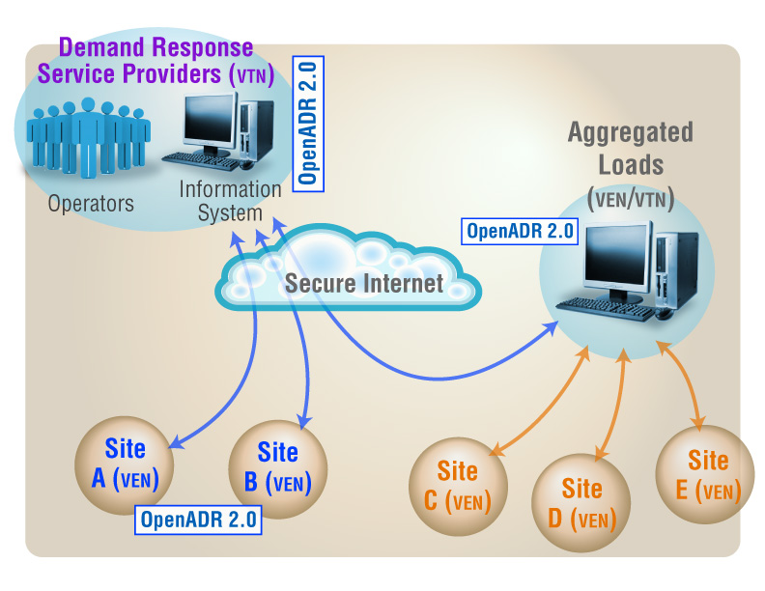
Understanding OpenADR
Open Automated Demand Response (OpenADR) provides a non-proprietary, open standardized DR interface that allows electricity providers to communicate DR signals directly to existing customers using a common language and existing communications such as the Internet.
Pricing
Data Models
Physical Communications
Control Strategies
Price Signal
$/kWh
Data Model
Comm
Internet
OpenADR
Auto-DR
Client Server
End-Use Controls
Building
Action
Source: LBNL

Slide 4
ADR Market Forecast
ADR Sites by Region World Markets: 2014-2023
(Source: Navigant Research)

Slide 5
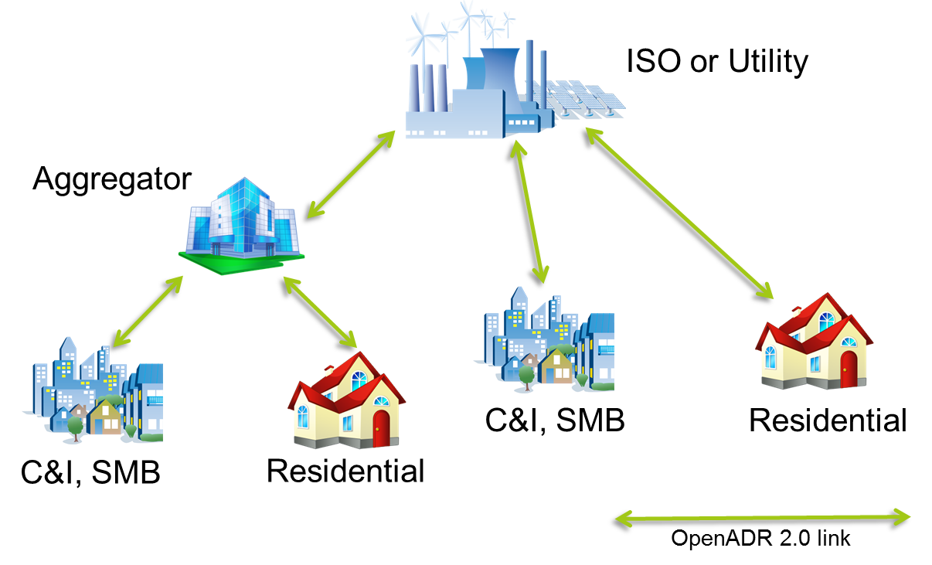
Introducing VENs and VTNs
OpenADR is a message exchange protocol with two primary actors:
  Virtual End Nodes (VEN)
    Receive events and respond
    to them
    Generate reports
    Control demand side
    resources
  Virtual Top Nodes (VTN)
    Transmit events other
    nodes
    Request Reports
VTN
VTN/VEN
VEN
VEN
VEN

Slide 6
OpenADR 2.0 Profiles
Energy Interoperation 1.0
B Profile
EiEvent
EiOpt
EiReport
EiRegistrerParty
A Profile
Simple EiEvent
“A” profile is targeted at limited resource devices and simple DR applications
“B” profile is targeted at robust devices and sophisticated DR applications
Excerpted from QualityLogic’s OpenADR Training Workshop © QualityLogic

Slide 7
Profile Architecture
Transport Protocols
  Simple HTTP: Using standard http command. Ideal for pull clients, possible for push but firewall issues need to be taken into account
  XMPP: Used in messengers and many other social communication tools. Excels for push applications and fast DR. Pull also possible
Simple HTTP or XMPP for VEN, both mandatory for VTN

Slide 8
Profile Architecture
Security
  Standard Security: TLS with server and client side certificates
  High Security: Standard Security + XML signatures to increase non-repudiation
Standard Security mandatory, High Security optional

Slide 9
Event Intervals
Intervals carry the actionable information in a DR Event. Example:
 | Signal Name Start Time: 10am | Interval 1 20 mins | Interval 2 30 mins | Interval 3 15 mins
Signal 1 | SIMPLE (Level) | 1 (moderate) | 3 (Special) | 2 (High)
Signal 2 | ELECTRICITY_PRICE (price) CurrencyPerKWh | 1.05 (USD) | 1.30 (USD) | 1.15 (USD)
Excerpted from QualityLogic’s OpenADR Training Workshop © QualityLogic

Slide 10
Event Resources
DRMS can target available resources.
Thermostat
Resource 1
Target a VEN
Target a Group
Target a device class
Target a service area
Target a Resource
VEN 1
Pool Pump
Resource 2
Pool Pump
Resource 3
VEN 2
Water Heater
Resource 4
Lighting
Resource 5
VEN 3
Water Heater
Resource 6
Excerpted from QualityLogic’s OpenADR Training Workshop © QualityLogic

Slide 11






Supports Multiple DR Applications
© greenlots
ISO/Utility/Operator
Residential
EV Chargers / Battery
Aggregator
C&I, SMB
Renewables
C&I, SMB
Residential
OpenADR 2.0 link

Slide 12
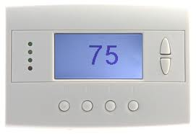



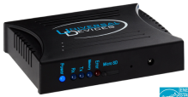





Cloud Interface
VTN
GUI in Cloud
VEN
Internet
OpenADR 2.0 a or b enabled
Retail or Operator provided or bring your own thermostat
Cloud interface
No resource constraints
Feedback supported
VEN

Slide 13
Direct Connect
VTN
GUI in Cloud or LAN
VEN
Internet
ZigBee
Wi-Fi
etc.
OpenADR 2.0a or b enabled
Retail or Operator provided
Easy config in cloud interface
Connection from cloud to device
up to vendor
No resource constraints
Feedback possible
VEN

Slide 14












Commercial & Industrial
VTN
Internet
BACnet
LonMark
OpenADR
ZigBee
Wi-Fi
etc.
VEN

Slide 15




Aggregators
VTN
VEN/VTN
Internet
Aggregator
Internet
VEN

Slide 16
OpenADR . . .
Standardizes customer DR interface
Delivers interoperability/interchangeability
Eliminates stranded assets
Backed by industry leaders
Over 65 certified products
  Demand Response Management Servers (DRMS)
  Building automation controllers
  Energy management interfaces
  Lighting controllers
  Thermostats
  Water heaters
  Gateways

Slide 17
What is the OpenADR Alliance?
Vision: Facilitate the global deployment of OpenADR to reduce the cost of supplying and consuming electricity, while improving energy reliability and reducing environmental impact.
California based nonprofit 501(c)(6) corporation
Member based organization comprised of over 130 industry stakeholders
Leverages Smart Grid related standards from OASIS, IEC, UCA and NAESB
Supports development, testing, and deployment of commercial OpenADR
Enables stakeholders to participate in automated DR, dynamic pricing, and electricity grid reliability
Notes:
M

Slide 18

























Key Players

Slide 19
OpenADR Resources

Slide 20
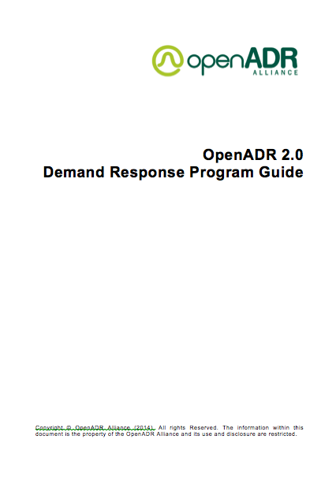
OpenADR Program Guide
Defines ADR program templates modeled after most popular DR programs
Defines deployment scenarios with actors and roles clearly defined
Defines best practices recommendations for OpenADR characteristics
Provides a decision tree to aide utilities in selecting templates and deployment scenarios
Draft available upon request

Slide 21
DR Program Templates
Critical Peak Pricing
Capacity Bidding Program
Residential Thermostat Program
Fast DR Dispatch (Ancillary Services)
Future Templates
  Real Time Pricing Program
  Direct Load Control Program

Slide 22
Certification & Testing
Alliance created
  Profile Specification
  PICS documents
  Test plan and testing
  Certification documents
  Certification test tool
Test tool built by QualityLogic
Third party testing performed by Intertek
Members can obtain test tool for pretesting and do final certification testing at the test lab

Slide 23
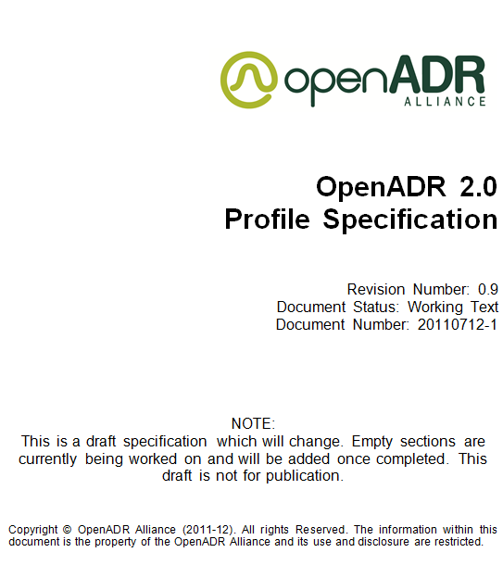
OpenADR 2.0 Documentation
OpenADR 2.0 Profile Specification
  Draft for Alliance members, final version public
  Overview section
  Definition of feature sets
  Conformance statements
  Transport Mechanism
  Security
  UMLs
  Mapping to other SG standards
Over 5000 Downloads
Available at www.openadr.org

Slide 24
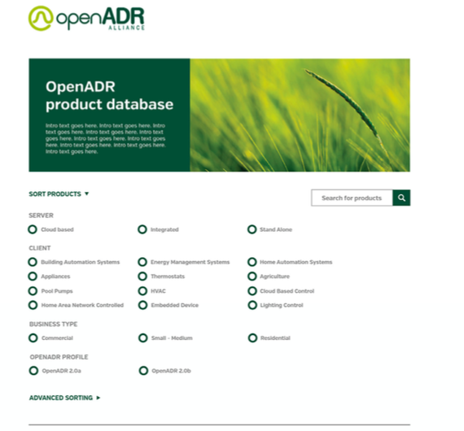
Product Database
Dynamic searchable database
66 certified VTNs and VENs
Simplifies product search process
Over 500 unique visitors search for certified products each month
www.openadr.org/certified-products

Slide 25
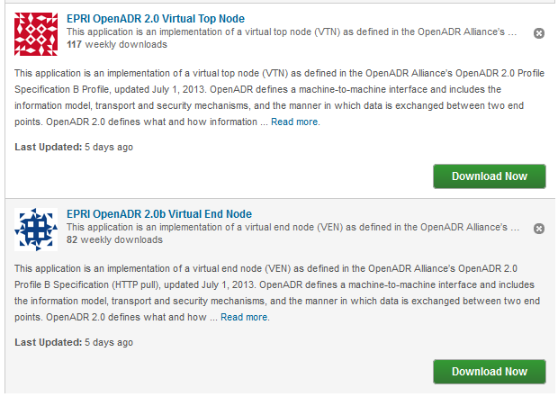
EPRI Open Source Code
VTN: http://sourceforge.net/projects/openadr2vtn/
VEN: http://sourceforge.net/projects/openadr2bven-pull/
Over 1500 Downloads

Slide 26
OpenADR Cloud Test Server
OpenADR Cloud Server for testing VENs
Subscription Service offered by QualityLogic
Ideal for small scale pilots
Verifies interoperability of VENs with a certified VTN
Good learning tool for understanding OpenADR
Available at www.qualitylogic.com

Slide 27
OpenADR International Standard
The OpenADR Alliance is active in several IEC working groups
  IEC PC118 published the OpenADR 2.0b Profile Specification as IEC/PAS 62746-10-1
  IEC/PAS 62746-10-1 proposed as IEC standard
  IEC PC118 and TC57 WG 21 are working on CIM integration
  IEC TC65 WG17 (Industrial Automation) is adopting on OpenADR functionality

Slide 28
OpenADR Implementers Workshop
1-2 day workshop
Periodic public workshops or private, on-site workshops
Led by Jim Zuber, QualityLogic’s Chief Test Architect and co-founder
  Authored the OpenADR Test Specification and PICS
  Designed the certification test harness,
  Major contributor to the Implementation Working Group

Slide 29
OpenADR Developers Workshop
1-2 day workshop
Periodic public workshops or private, on-site workshops
Led by Jim Zuber, QualityLogic’s Chief Test Architect and co-founder
  Authored the OpenADR Test Specification and PICS
  Designed the certification test harness,
  Major contributor to the profile specification itself

Slide 30
Rolf Bienert Barry Haaser
Technical Director Managing Director rolf@openadr.org barry@openadr.org
+1 925 336 0239 +1 408 310 9213
Thank You!
Q&A
www.openadr.org

