Slide 1
ISO/RTO Council
Wholesale Demand Response
Projects & OpenADR
David Forfia

Slide 2
Agenda
Project Support Organizations
Smart Grid Projects
Project Development Process
  How Organizations Contribute
  IEC Common Information Model
  NAESB Measurement & Verification Use Cases
  IRC Profile Development
Project Status

Slide 3
Project Support Organizations
Standards Development Organizations
  International Electrotechnical Commission (IEC) - www.iec.ch
  National Institute of Standards (NIST) - www.nist.gov
  North American Energy Standards Board (NAESB) - www.naesb.org
  Organization for the Advancement of Structured Information Standards (OASIS) - www.oasis-open.org
Trade & Technology Associations
  ISO/RTO Council (IRC) www.isorto.org
  Multispeak Intiative - http://www.multispeak.org/
  OpenADR Alliance - http://www.openadr.org/
  Smart Grid Interoperability Panel (SGIP) - http://collaborate.nist.gov/twiki-sggrid/bin/view/SmartGrid/WebHome

Slide 4
Smart Grid Projects
IRC sponsored Smart Grid Initiative in 2009
  Completed information model & use cases for ISO to Aggregator using Common Information Model (CIM)
  Submitted to NAESB
  Submitted to NIST Smart Grid Interoperability Panel (SGIP)
    Incorporated into Priority Action Plans 3 (Common Pricing Model)
    Incorporated into Priority Action Plan 9 (Standard Demand Response Signals)
    ERCOT & other ISOs were active participants in these Action Plans
  SGIP adopted into catalogue of standards in December 2011
A second IRC sponsored project jointly supported by the IT and Markets Committees
  Update 2009 IRC use cases and information model to the latest version of the CIM
  Create common message format using the CIM for Demand Response
  Map the OpenADR implementation profile to the ISO common CIM message
  Map the MultiSpeak implementation to the ISO common CIM message
  Publish the work in the US through the SGIP processes
  Publish the work internationally through the International Electrotechnical Commission (IEC) process

Slide 5
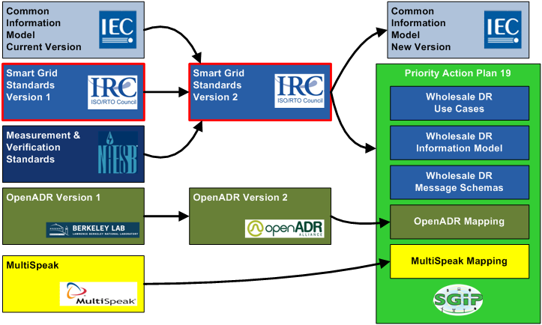
How Organizations Contribute

Slide 6
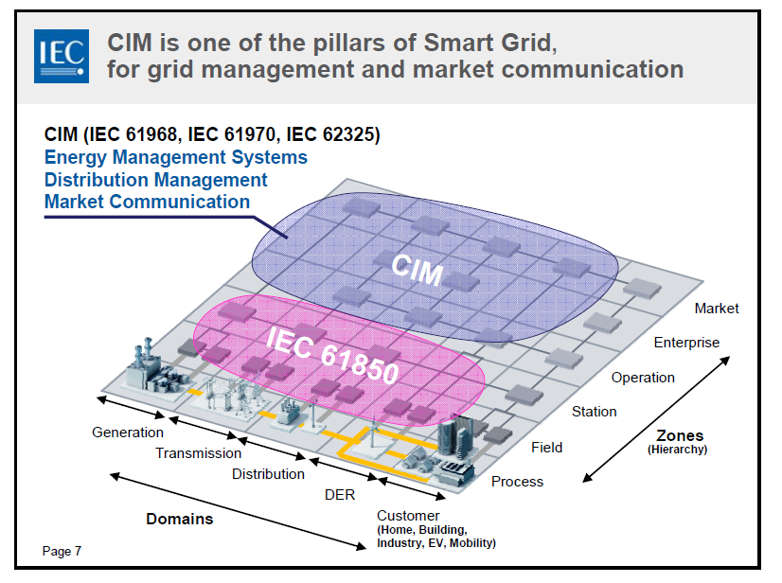
IEC Common Information Model

Slide 7
NAESB M&V Use Cases
Performance Evaluation Types
  Historical Baseline
  Meter Before / Meter After Comparison
  Maximum Base Load
  Metered Generator Output
Market Products
  Energy (Economic)
  Energy (Reliability)
  Capacity
  Reserve
  Regulation
Deployment Type
  Bulk
  Resource
  Self
Details about all of these concepts are defined in the NAESB Measurement & Verification Standards

Slide 8
Current Status of Objectives
  Complete - Update 2009 IRC use cases and information model to the latest version of the CIM
  Complete - Create common message format using the CIM for Demand Response
  Complete - Publish the work in the US through the NIST SGIP processes
  Complete - Map the OpenADR implementation profile to the ISO common CIM message
  Complete - Map the MultiSpeak implementation to the ISO common CIM message
  Complete – SGIP Priority Action Plan 19
  In Progress – Work moving through IEC TC57 WG16. Included with next CIM release.
  Next steps – Develop standard messages aligned with next CIM version
All materials are available at the SGIP site for PAP19
http://collaborate.nist.gov/twiki-sggrid/bin/view/SmartGrid/PAP19WholesaleDR

Slide 9
Questions
?

Slide 10
Standards Organizations
International Electrotechnical Commission (IEC) - The International Electrotechnical Commission is the world’s leading organization that prepares and publishes International Standards for all electrical, electronic and related technologies.
The IEC is one of three global sister organizations (IEC, ISO, ITU) that develop International Standards for the world.
National Institute of Standards (NIST) – Founded in 1901, NIST is a non-regulatory federal agency within the U.S. Department of Commerce. NIST's mission is to promote U.S. innovation and industrial competitiveness by advancing measurement science, standards, and technology in ways that enhance economic security and improve our quality of life.
North American Energy Standards Board (NAESB) - The North American Energy Standards Board (NAESB) serves as an industry forum for the development and promotion of standards which will lead to a seamless marketplace for wholesale and retail natural gas and electricity, as recognized by its customers, business community, participants, and regulatory entities.
Organization for the Advancement of Structured Information Standards (OASIS) - OASIS (Organization for the Advancement of Structured Information Standards) is a not-for-profit consortium that drives the development, convergence and adoption of open standards for the global information society.
OASIS promotes industry consensus and produces worldwide standards for security, Cloud computing, SOA, Web services, the Smart Grid, electronic publishing, emergency management, and other areas. OASIS open standards offer the potential to lower cost, stimulate innovation, grow global markets, and protect the right of free choice of technology.

Slide 11
Trade Associations
ISO/RTO Council (IRC) - The ISO/RTO Council (IRC) is comprised of 10 Independent System Operators (ISOs) and Regional Transmission Organizations (RTOs) in North America. These ISOs and RTOs serve two-thirds of electricity consumers in the United States and more than 50 percent of Canada's population.
MultiSpeak Intiative – The MultiSpeak Initiative is a collaboration of the National Rural Electric Cooperative Association (NRECA), leading software vendors supplying the utility market, and utilities. The Initiative has developed and continues to expand the MultiSpeak Specification for Interoperability a specification that defines standardized interfaces among enterprise software applications commonly used by electric utilities.
The MultiSpeak Specification is a key industry-wide standard for realizing the potential of enterprise application interoperability. The MultiSpeak Specification is the most widely applied de facto standard in North America pertaining to distribution utilities and all portions of vertically-integrated utilities except generation and power marketing. It is currently in use in daily operations of more than 600 electric cooperatives, investor-owned utilities, municipals, and public power districts in at least 15 different countries.
Open ADR Alliance - The OpenADR Alliance was formed to build on the foundation of technical activities to support the development, testing, and deployment of commercial OpenADR and facilitates its acceleration and widespread adoption. This approach needs to engage service providers (such as electric utilities and systems operators) within the domain of the Smart Grid that publish OpenADR signals, as well as the facilities or third-party entities that consume them to manage electric loads. The OpenADR Alliance will enable all stakeholders to participate in automated DR, dynamic pricing, and electricity grid reliability.
Smart Grid Interoperability Panel (SGIP) - The National Institute of Standards and Technology (NIST) initiated the SGIP to support NIST in fulfilling its responsibility, under the Energy Independence and Security Act of 2007, to coordinate standards development for the Smart Grid. Established in late 2009, the SGIP is a public/private partnership that defines requirements for essential communication protocols and other common specifications and coordinates development of these standards by collaborating organizations.

