Slide 1
MarkeTrak API Query Results
Dave Pagliai
Manager, IT Support Services

Slide 2
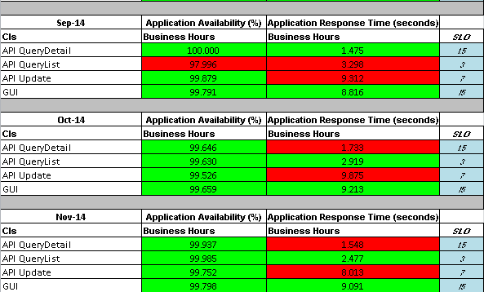
MarkeTrak Automated SLA Monitoring

Slide 3
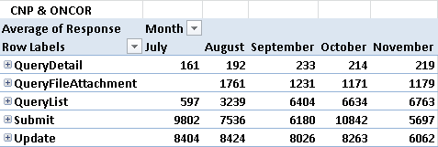
Actual API Query Average Response Times
Actual API Query Response Times
Centerpoint and ONCOR queries averaged by month
ERCOT test transaction values are not included

Slide 4
Actual API Query Average Response Times
This data was extracted from ERCOT’s integration application, so they represent a portion of the actual response times that CNP and ONCOR would see (and the SLOs we currently have in the SLA).
What is not reflected here is the time that the transactions take to traverse CNP and ONCOR’s IT infrastructure, the Internet, and ERCOT’s front end infrastructure (network, proxies, etc.).
The value of the data is that it represents a relative average response time, month to month, that can be compared to what CNP and ONCOR are experiencing.
If there are large discrepancies in average response times between months with what CNP and ONCOR are experiencing, that will most likely be attributed to elements outside of ERCOT’s control.

Slide 5
Actual API Query Average Response Times
Next Steps
ERCOT will gather December 2014 and January 2015 data
Compare ERCOT data with CNP and ONCOR data
Determine most appropriate way to report on this data in ERCOT’s monthly updates

