Slide 1

ERCOT Monthly Operational Overview (January 2015)
ERCOT Public
February 15, 2015

Slide 2
Grid Planning & Operations

Slide 3
Summary – January 2015
Operations
The peak demand of 56,764 MW on January 8th was slightly greater than the mid-term forecast peak of 56,215 MW of the same operating period. However, it was less than the January 2014 actual peak demand of 57,277 MW. The instantaneous peak load on January 8th was 57,470 MW.
Day-ahead load forecast error for January was 3.44%
ERCOT issued four notifications
  Two advisories due to cold weather (1/2 and 1/6)
  One advisory for a K Index 7 geomagnetic disturbance (1/7)
  One watch due to cold weather (1/7)
  One advisory due to postponing of the DAM solution (1/28)
Planning Activities
239 active generation interconnection requests totaling over 62,100 MW, including 24,100 MW of wind generation as of January 31, 2015. The same amount of requests and 100 more MW from December 31, 2014.
12,470 MW wind capacity in commercial operations on January 31, 2015.
Notes:
Emergency Notices:
1/2/15 - ERCOT has issued an advisory for the cold weather system that is forecasted to impact most of the region.
1/6/15 - ERCOT has issued an advisory for the extreme cold weather system forecasted to sweep through the state Wednesday leaving temperatures in the teens and 20’s for most of the region.
1/7/15 - ERCOT is issuing an Advisory for a K Index 7 geomagnetic disturbance storm alert that has been issued until 09:00 for January 7, 2015.
1/7/15 - ERCOT issued a watch for the extreme cold weather system impacting the region leaving temperatures in the teens and 20s for most of the region.
1/28/15 – HOT line call made and advisory issued due to delay of DAM, Brazos repeated back. DAM reported they did make the posting.

Slide 4
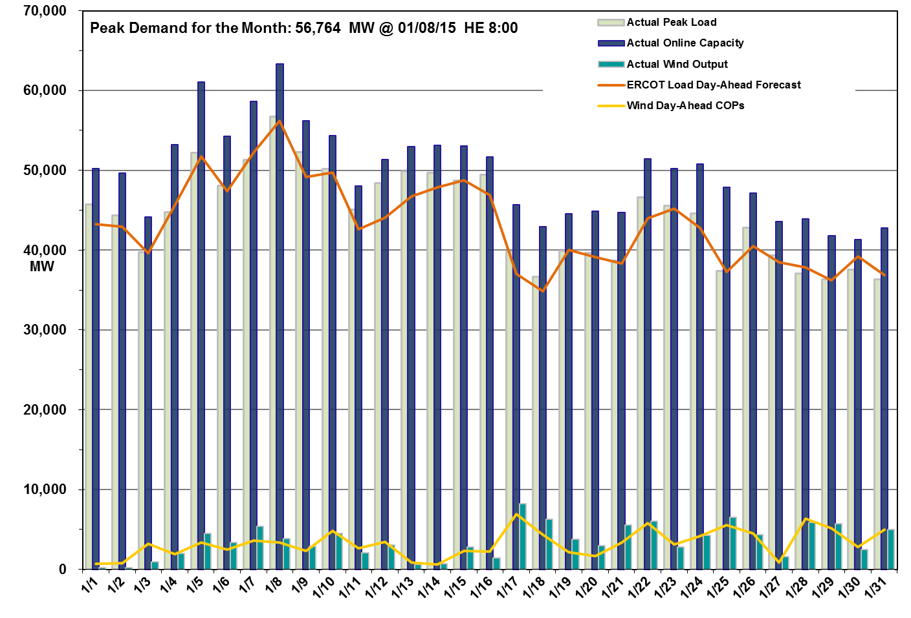
Daily Peak Demand: Hourly Average Actual vs. Forecast, Wind Day-Ahead COPs & On-line Capacity at Peak – January 2015

Slide 5
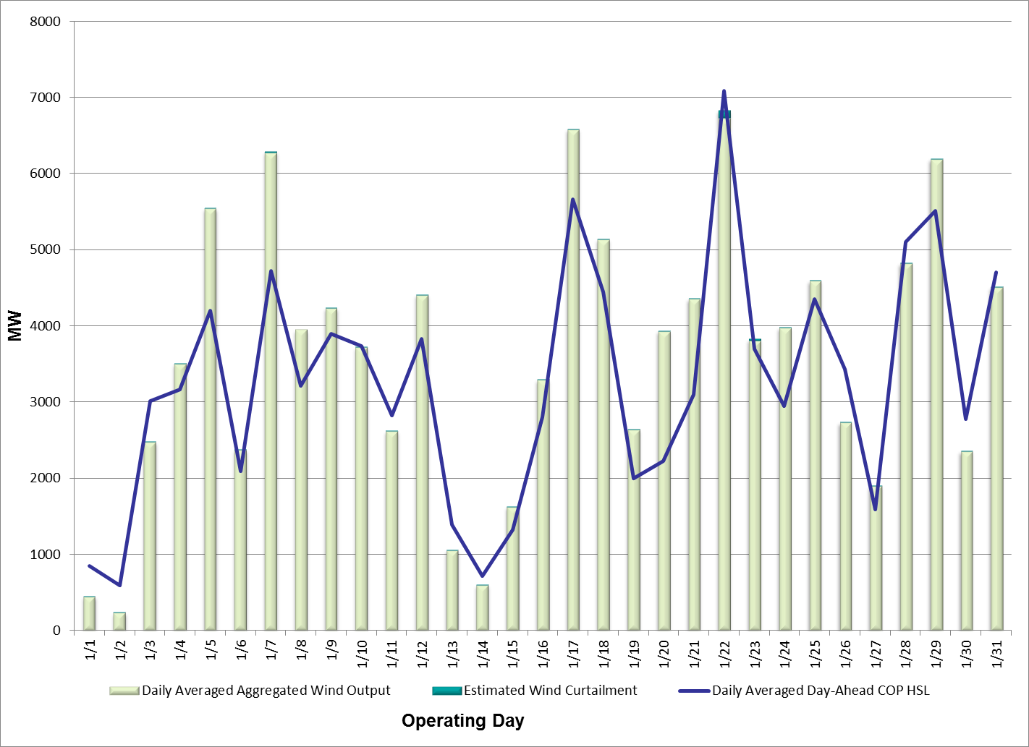
Actual Wind Output plus Curtailments vs. Wind Day-Ahead COPs for
All Hours – January 2015
% of Hours when Estimated Uncurtailed Wind Output
>= COP HSLs (Target = 50%)
57%
Note: QSEs must use the AWST 50% probability of exceedance forecast as the HSL in their COPs

Slide 6
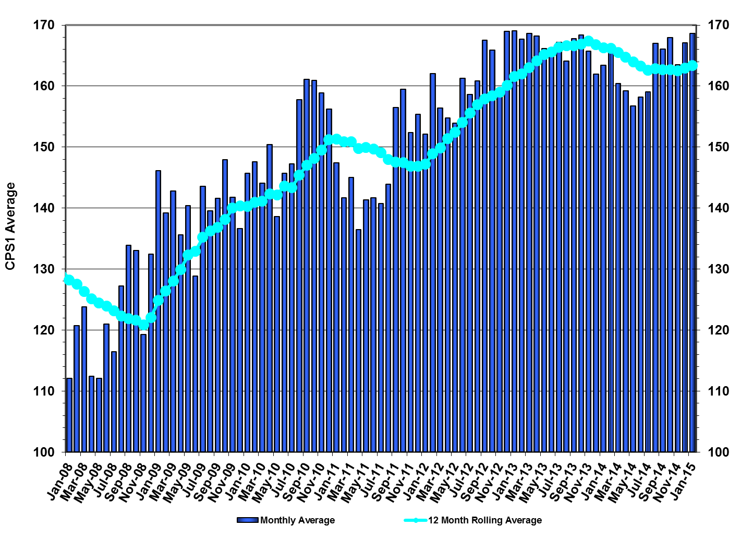
ERCOT’s CPS1 Monthly Performance – January 2015
CPS1 12 Month Rolling Average = 163.96%

Slide 7
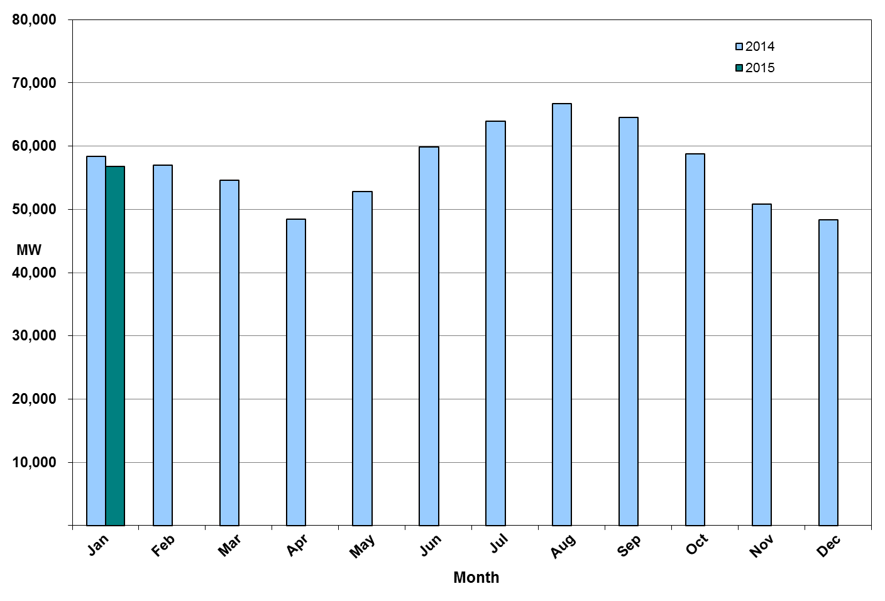
Monthly Peak Actual Demand – January 2015
Notes:
Monthly peak demand is based on Settlements EPS meter data.
January 15 Peak Interval occurred at HE 08:00 on 01/08/15: 56,831 MW
January 14 Peak Interval occurred at HE 08:00 on 01/07/14: 58,360 MW
ERCOT Summary page has January 2014 peak from 2014 Annual ERCOT Demand & Energy report.

Slide 8
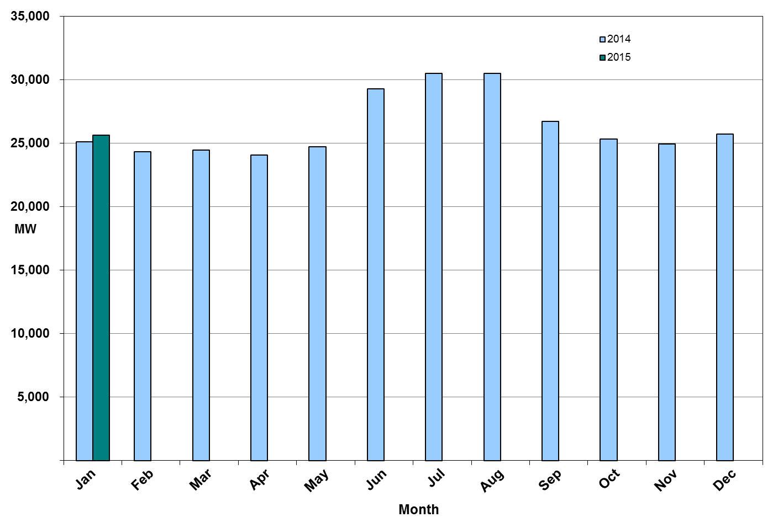
Monthly Minimum Actual Demand – January 2015

Slide 9
Day-Ahead Load Forecast Performance – January 2015
Mean Absolute Percent Error (MAPE) for ERCOT Mid-Term Load Forecast (MTLF) Run at 14:00 Day Ahead
 | 2011 MAPE | 2012 MAPE | 2013 MAPE | 2014 MAPE | January 2015 MAPE
Average Annual MAPE | 2.83 | 3.02 | 2.86 | 2.83 | 3.44
Lowest Monthly MAPE | 1.63 | 2.51 | 2.07 | 2.15 | Lowest Daily MAPE | 1.28 Jan – 25
Highest Monthly MAPE | 3.55 | 3.49 | 3.50 | 3.70 | Highest Daily MAPE | 6.83 Jan - 31

Slide 10
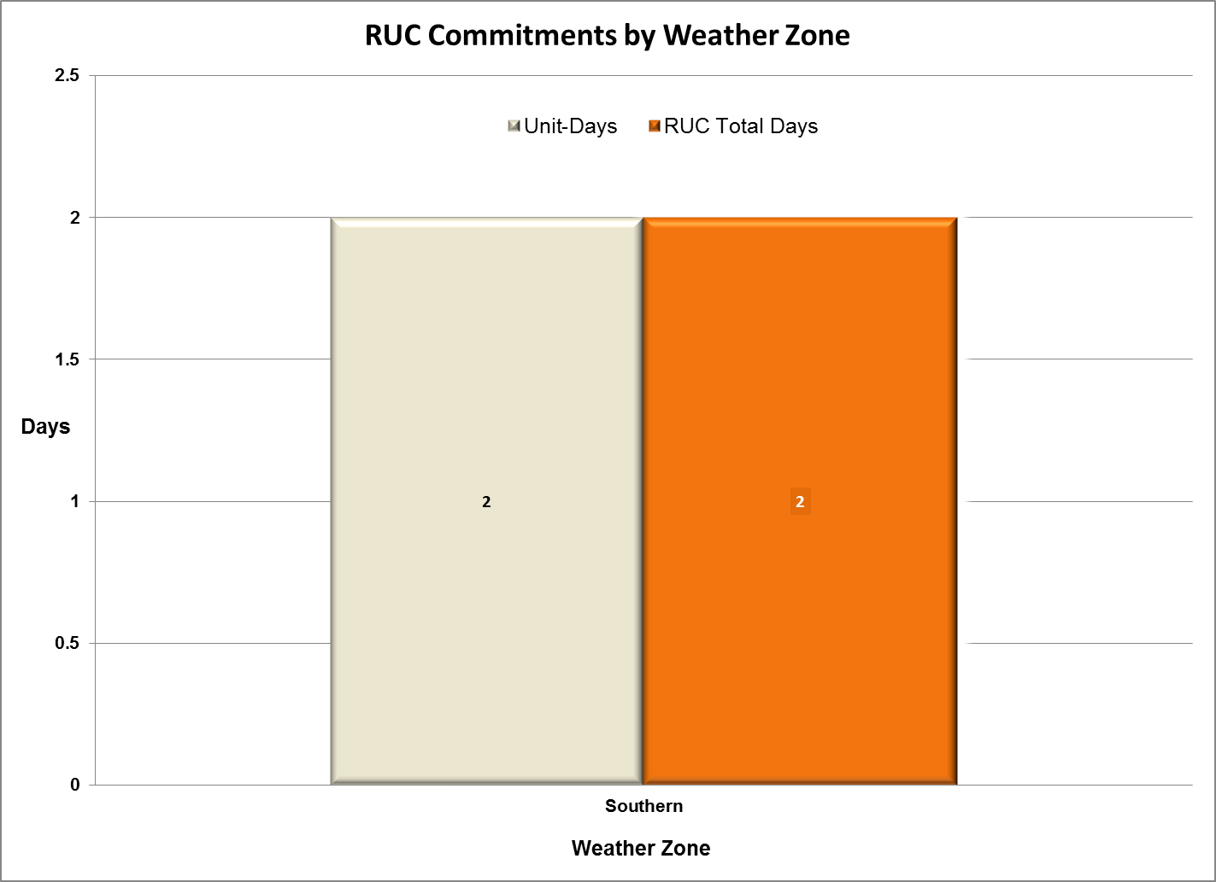
Reliability Unit Commitment (RUC) Capacity by Weather Zone – Jan 2015

Slide 11
Generic Transmission Limits (GTLs) – January 2015
GTLs | Jan 14 Days GTLs | Nov 14 Days GTLs | Dec 14 Days GTLs | Jan 15 Days GTLs | Last 12 Months Total Days (Dec13 – Nov14)
North – Houston | 0 | 0 | 0 | 0 | 0
West – North | 3 | 0 | 0 | 0 | 6
Valley Import | 0 | 0 | 0 | 2 | 10
SOP110 | 0 | 1 | 0 | 0 | 11
GTL: A transmission flow limit more constraining than a Transmission Element’s normal limit established to constrain flow between geographic areas of the ERCOT Transmission System that is used to enforce stability and voltage constraints that cannot be modeled directly in ERCOT’s transmission security analysis applications.
Note: This table lists how many times a constraint has been activated to avoid exceeding a GTL limit, it does not imply an exceedance of the GTL occurred.

Slide 12
Advisories and Watches - January 2015
Two advisories due to cold weather
  Issued on 1/2 and 1/6
One advisory for a K Index 7 geomagnetic disturbance
  Issued on 1/7
One watch due to cold weather
  Issued on 1/7
One advisory due to postponing of the DAM Solution
  Issued on 1/28
Notes:
Emergency Notices:
1/2/15 - ERCOT has issued an advisory for the cold weather system that is forecasted to impact most of the region.
1/6/15 - ERCOT has issued an advisory for the extreme cold weather system forecasted to sweep through the state Wednesday leaving temperatures in the teens and 20’s for most of the region.
1/7/15 - ERCOT is issuing an Advisory for a K Index 7 geomagnetic disturbance storm alert that has been issued until 09:00 for January 7, 2015.
1/7/15 - ERCOT issued a watch for the extreme cold weather system impacting the region leaving temperatures in the teens and 20s for most of the region.
1/28/15 – HOT line call made and advisory issued due to delay of DAM, Brazos repeated back. DAM reported they did make the posting.

Slide 13
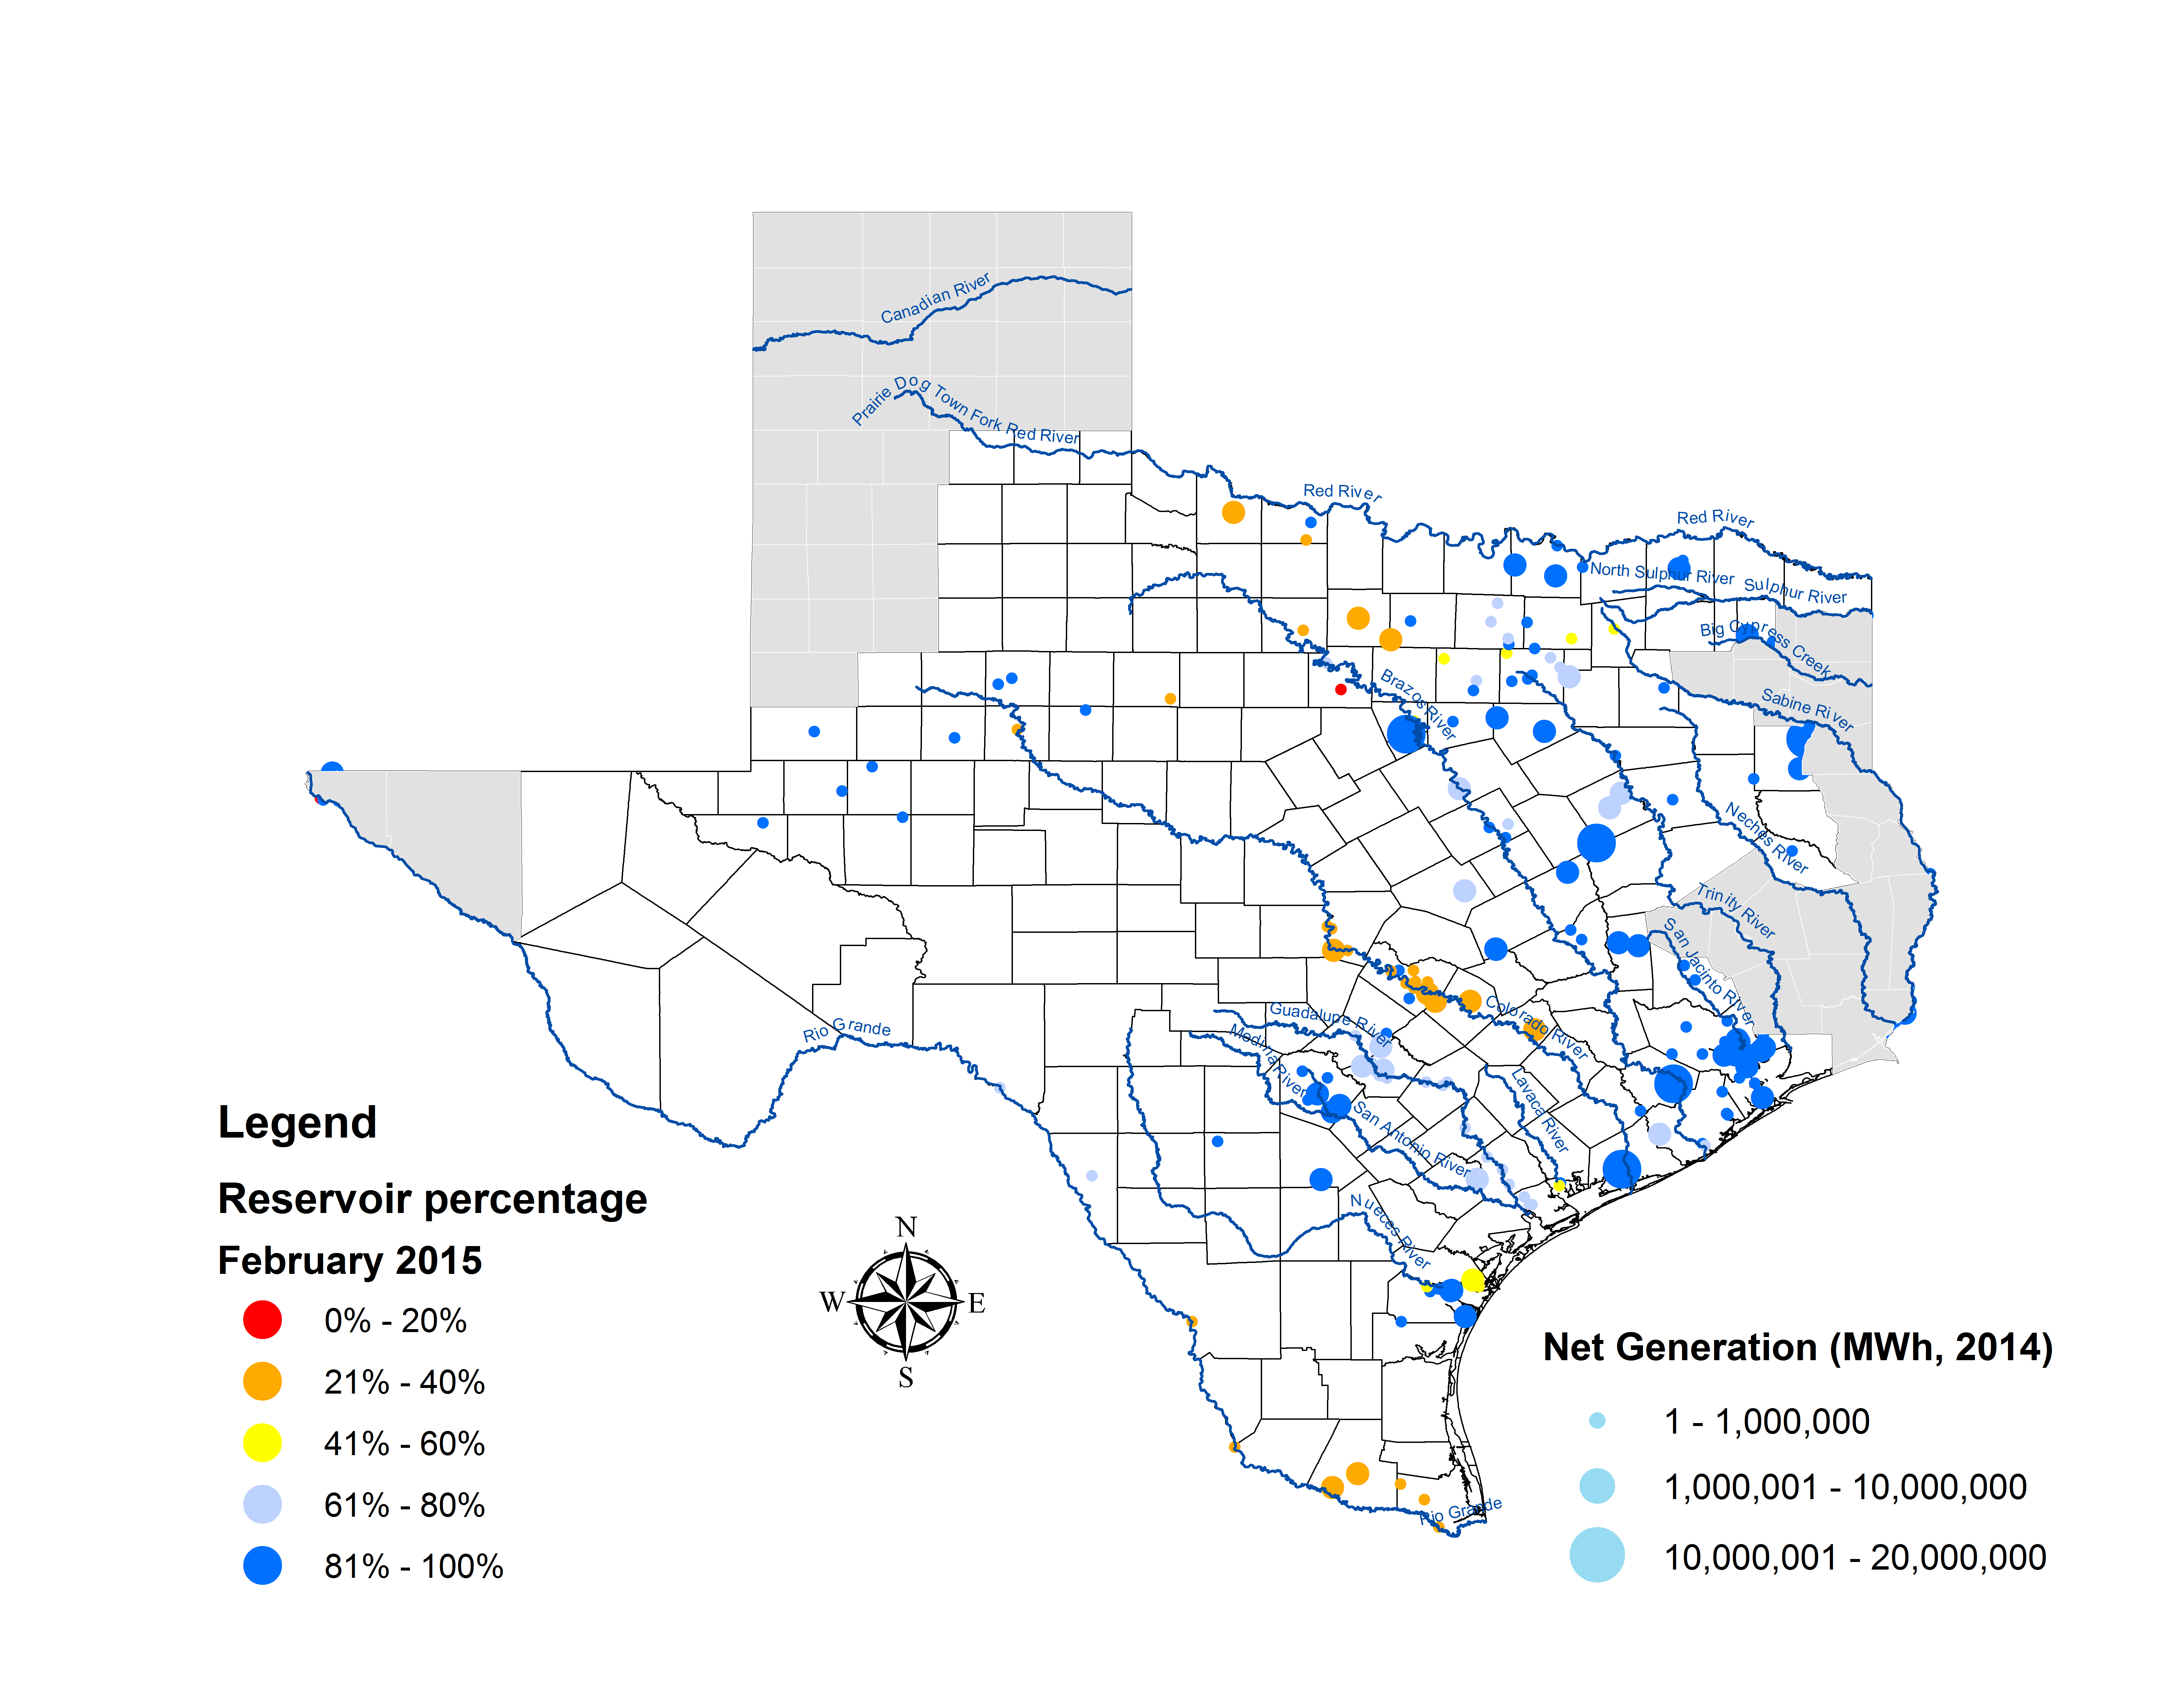
Lake Levels Update – February 1, 2015

Slide 14
Planning Summary – January 2015
ERCOT is currently tracking 239 active generation interconnection requests totaling over 62,100 MW. This includes over 24,100 MW of wind generation.
ERCOT is currently reviewing proposed transmission improvements with a total cost of $483.1 Million.
Transmission Projects endorsed in 2015 total $24 Million.
All projects (in engineering, routing, licensing, and construction) total approximately $5.54 Billion.
Transmission Projects energized in 2014 total about $693.7 Million.

Slide 15
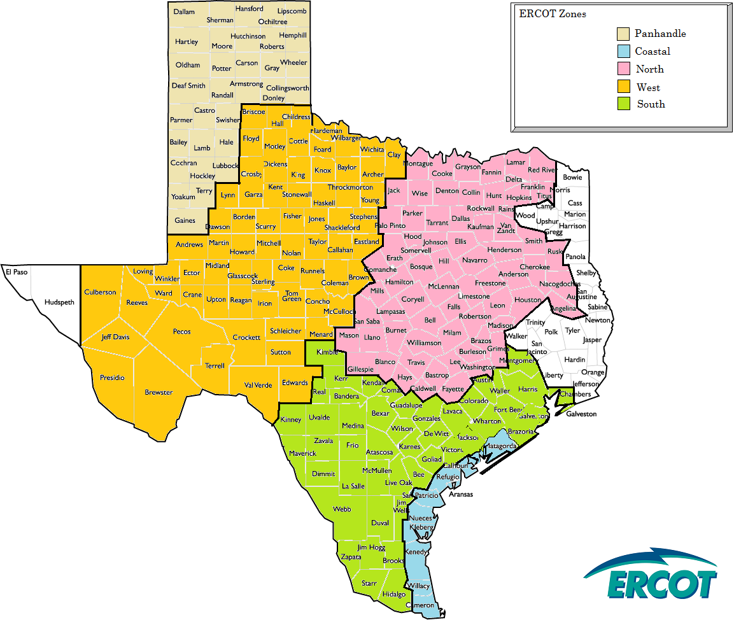
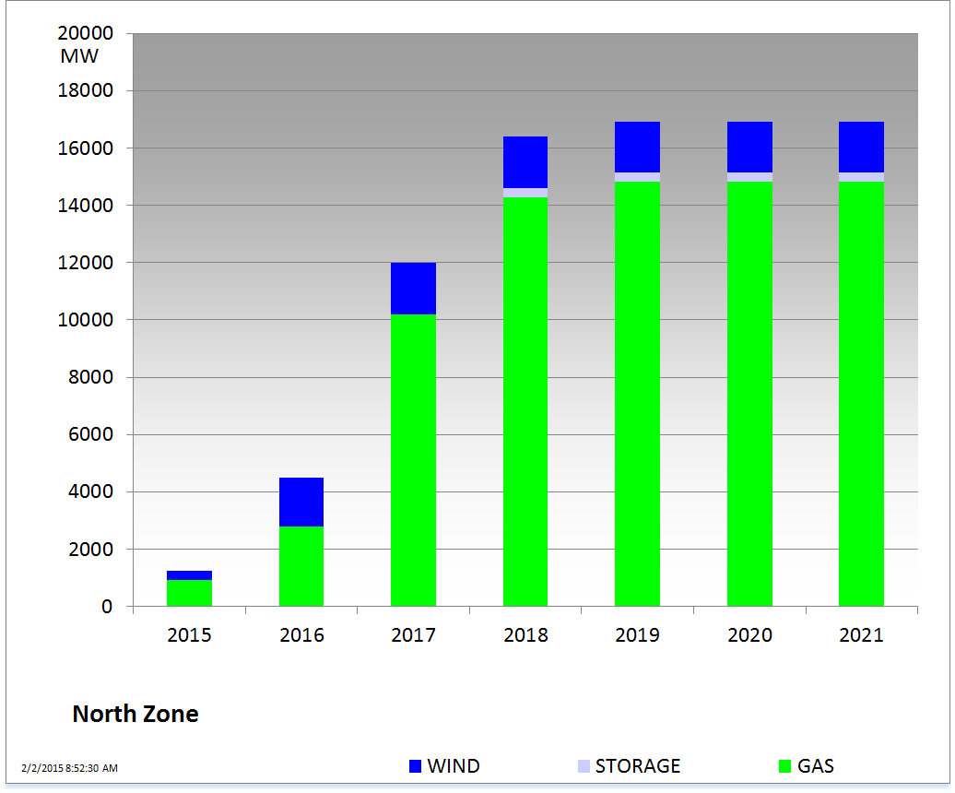
Cumulative Installed MW Capacity of Interconnection Requests by Zone – January 2015

Slide 16
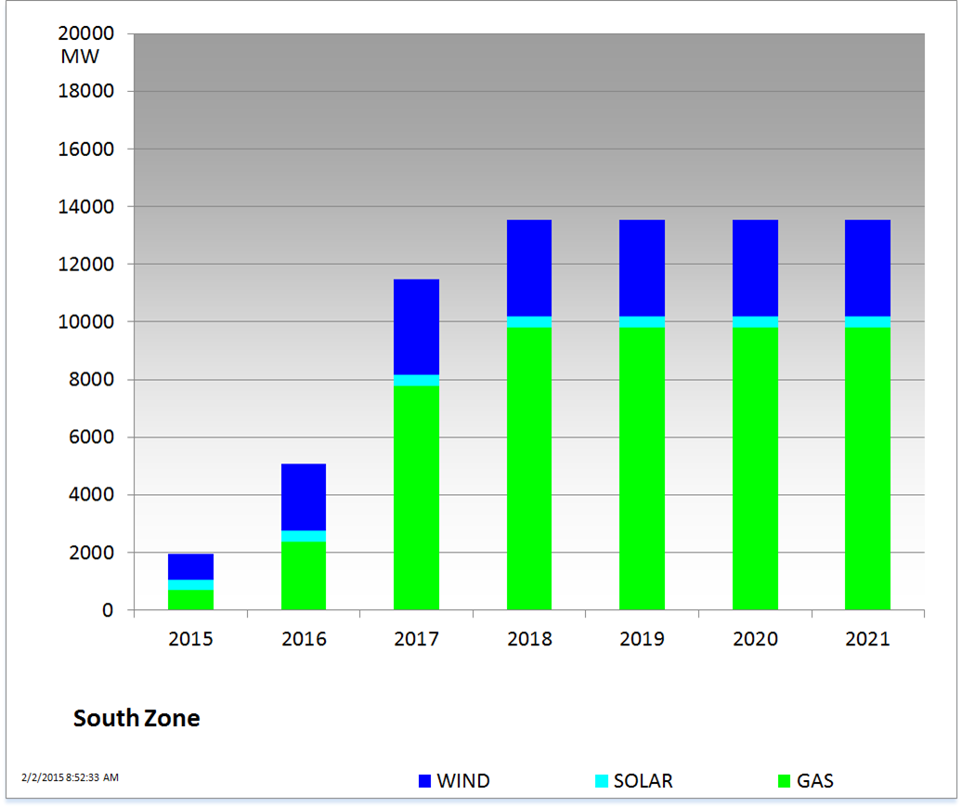
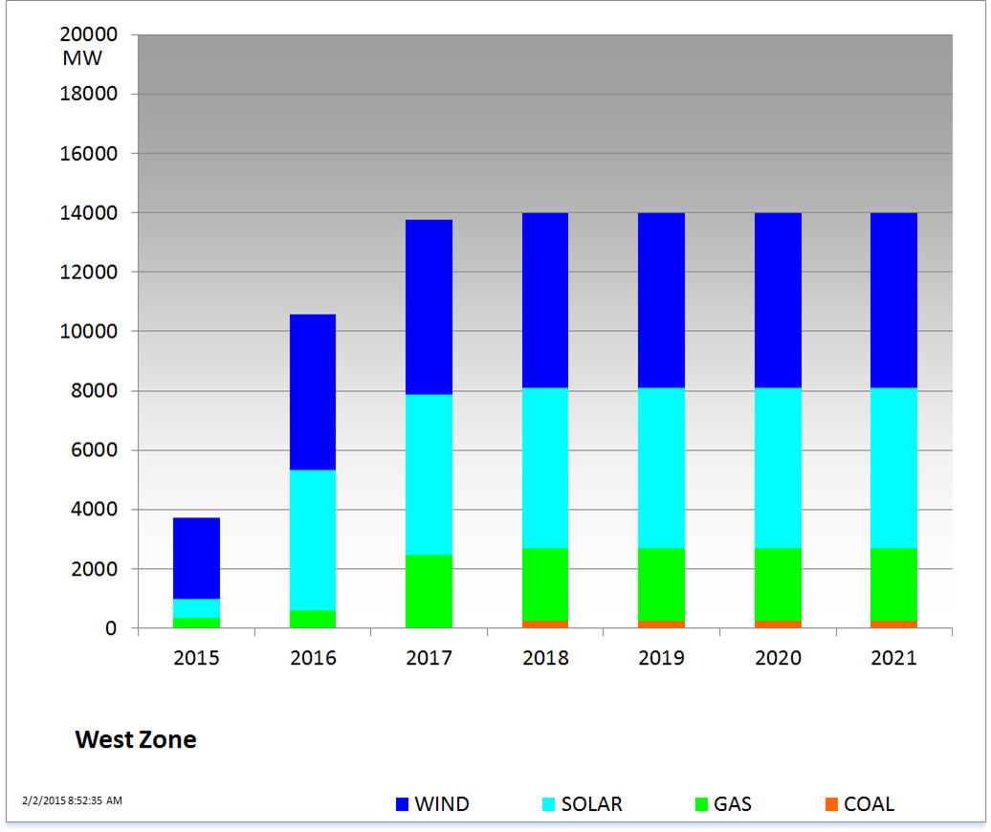
Cumulative Installed MW Capacity of Interconnection Requests by Zone – January 2015

Slide 17
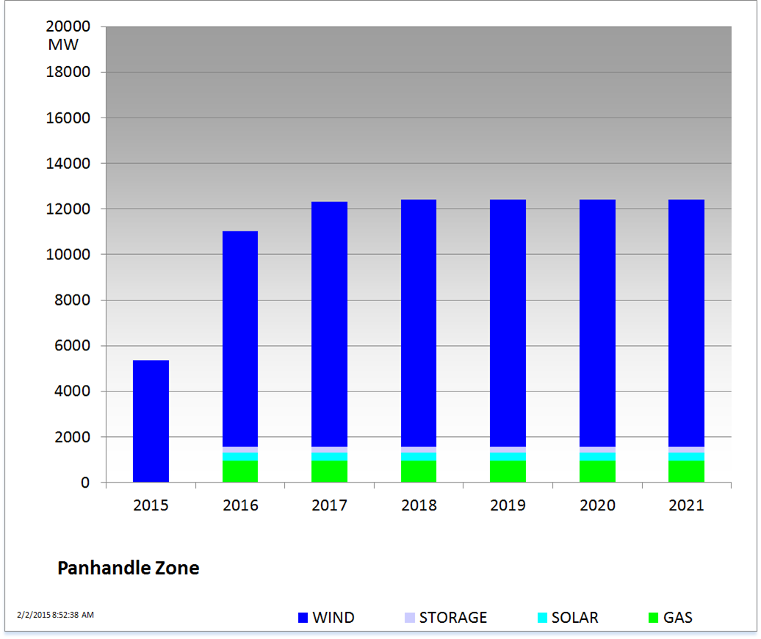
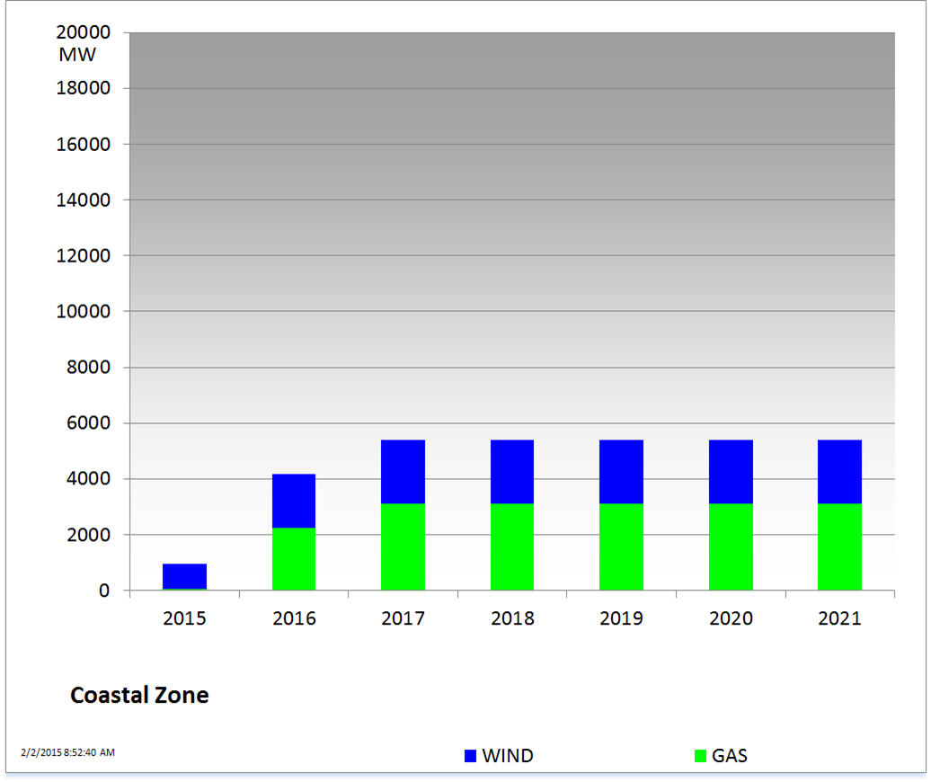
Cumulative Installed MW Capacity of Interconnection Requests by Zone – January 2015

Slide 18
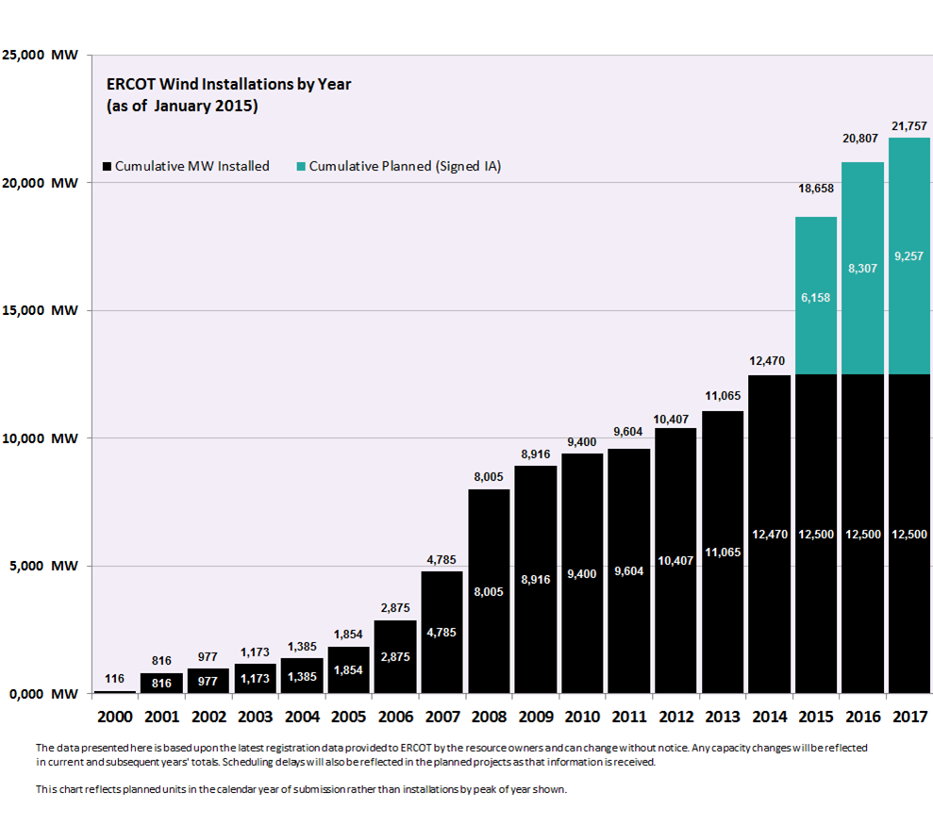
Wind Generation – January 2015

Slide 19
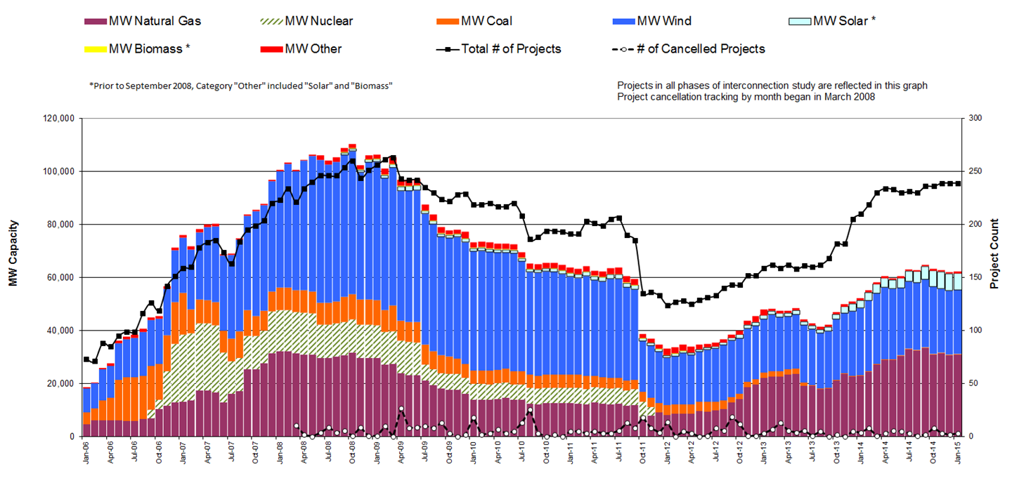
Generation Interconnection Activity by Fuel – January 2015

Slide 20
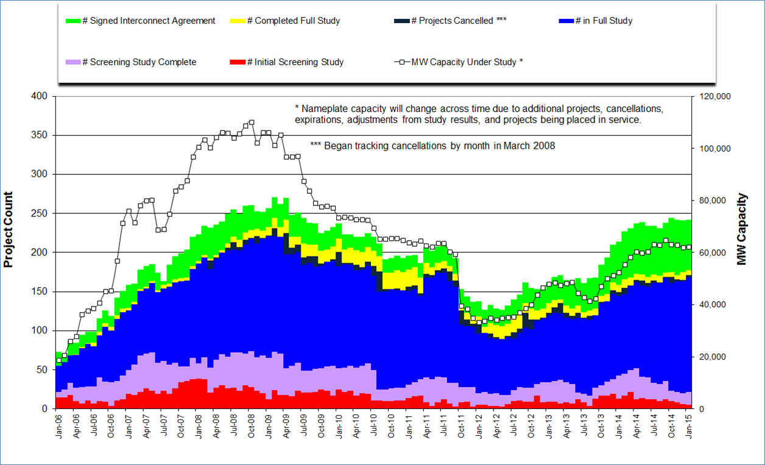
Generation Interconnection Activity by Project Phase – January 2015

Slide 21
Market Operations

Slide 22
Day-Ahead Schedule (Hourly Average) – January 2015

Slide 23
Day-Ahead Electricity And Ancillary Service Hourly Average Prices –
January 2015

Slide 24
Day-Ahead Vs Real-Time Load Zone SPP (Hourly Average) – January 2015

Slide 25
Day-Ahead Vs Real-Time Hub Average SPP (Hourly Average) – January 2015

Slide 26
DRUC Monthly Summary (Hourly Average) – January 2015

Slide 27
HRUC Monthly Summary – January 2015

Slide 28
Non-Spinning Reserve Service Deployment – January 2015
Deployment Start Time | Deployment End Time | Deployment Duration (Hours) | Max Deployment (MW) | Reason
None

Slide 29
CRR Price Convergence – January 2015

Slide 30
ORDC Price Adder (Daily Average) – January 2015

Slide 31
ERS Procurement for February 2015 – May 2015
 | BH1 | BH2 | BH3 | NBH
ERS-10 MW Procured | 598.139 | 576.648 | 570.842 | 539.822
ERS-30 MW Procured | 349.356 | 347.416 | 310.620 | 275.695
Total MW Procured | 947.495 | 924.064 | 881.462 | 815.517
Clearing Price | $15.61 | $2.63 | $11.10 | $3.00
BH1 - Business Hours 1 HE 0900 through 1300, Monday thru Friday except ERCOT Holidays
BH2 - Business Hours 2 HE 1400 through 1600, Monday thru Friday except ERCOT Holidays
BH3 - Business Hours 3 HE 1700 through 2000, Monday thru Friday except ERCOT Holidays
NBH - Non-Business Hours All other hours

Slide 32
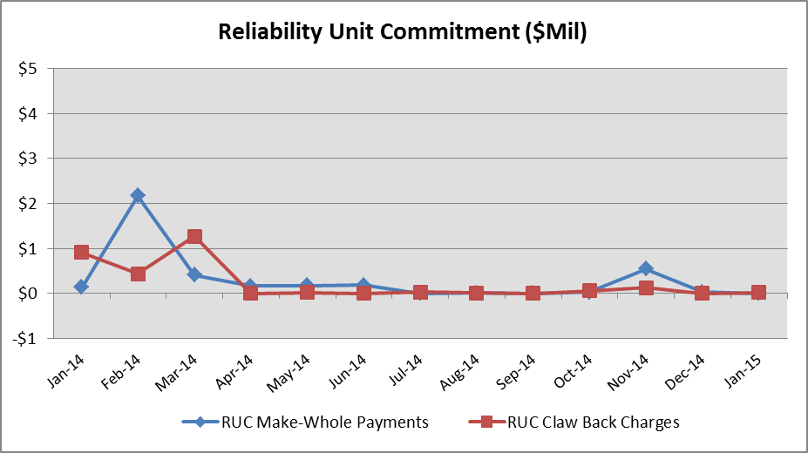
Reliability Services – January 2015
Reliability Unit Commitment (RUC) | $ in Millions
RUC Make-Whole Payments | $0.00
RUC Clawback Charges | $0.02
RUC Commitment Settlement | $0.02
RUC Capacity Short Charges | $0.00
RUC Make-Whole Uplift | $0.00
RUC Commitment Cost Allocation | $0.00
RUC Decommitment Payments | $0.00
RUC Make-Whole Payments decreased in January. RUC Clawback Charges were $0.02M.
There was $0.02M credit allocated directly to load in January 2015, compared to:
$0.00M in December 2014
$0.91M credit in January 2014

Slide 33
Capacity Services – January 2015
Capacity Services | $ in Millions
Regulation Up Service | $2.20
Regulation Down Service | $1.67
Responsive Reserve Service | $11.76
Non-Spinning Reserve Service | $1.95
Black Start Service | $0.62
Voltage Services - Reactive Power | $0.00
Voltage Services - Lost Opportunity | $0.00
Total Charges | $18.20
Capacity Services costs decreased from last month and from January 2014.
January 2015 cost was $18.20M, compared to:
A charge of $22.22M in December 2014
A charge of $30.53M in January 2014

Slide 34
Energy Settlement – January 2015
Day-Ahead Market Energy Settlement | $ in Millions
Energy Purchases | $380.04
Point to Point Obligation Purchases | $14.35
RMR Day-Ahead Revenue | $0.00
Energy Sales | ($374.85)
Day-Ahead Congestion Rent | $19.54
Day-Ahead Market Make-Whole Payments | ($0.46)
Real-Time Market Energy Settlement | $ in Millions
Energy Imbalance at a Resource Node | ($408.91)
Energy Imbalance at a Load Zone | $574.44
Energy Imbalance at a Hub | ($151.34)
Real Time Congestion from Self Schedules | $1.13
Block Load Transfers and DC Ties | ($0.99)
Impact to Revenue Neutrality | $14.33
Emergency Energy Payments | ($0.03)
Base Point Deviation Charges | $0.24
Real-Time Metered Generation (MWh in millions) | 28.78
Both Day-Ahead Market and Real-Time Market energy settlement activity increased from last month and decreased from January 2014.

Slide 35
Congestion Revenue Rights (CRR) – January 2015
 | $ in Millions
Annual Auction | ($16.35)
Monthly Auction | ($6.30)
Total Auction Revenue | ($22.65)
Day-Ahead CRR Settlement | ($17.86)
Day-Ahead CRR Short-Charges | $0.50
Day-Ahead CRR Short-Charges Refunded | ($0.50)
Real-Time CRR Settlement | $0.00
Real-Time CRR Short-Charges | $0.00
Real-Time CRR Short-Charges Refunded | $0.00
Total CRR Funding | ($17.86)
Day-Ahead Point to Point Obligations Settlement | $14.35
Real-Time Point to Point Obligation Settlement | ($16.71)
Net Point to Point Obligation Settlement | ($2.36)
Congestion Revenue Rights were fully funded and excess funds were deposited into the CRR Balancing Account Fund.
Point to Point Obligations settled with a net payment of $2.36M compared to a net charge of $2.78M last month.

Slide 36
CRR Balancing Account Fund – January 2015
CRR Balancing Account Fund | $ in Millions
Beginning Balance for the Month | $0.02
CRR Balancing Account Credit Total | $2.18
CRR PTP Option Award Charges | $0.07
Day-Ahead CRR Short-Charges Refunded | ($0.50)
Total Fund Amount | $1.77
ERCOT implemented the rolling CRR Balancing Account Fund beginning with Operating Month December 2014. The month of January 2015 closed with $1,747,349 in excess Day-Ahead congestion rent which was deposited into the Fund.
As of February 2015, the amount available in the CRR Balancing Account Fund is $1,767,929 .

Slide 37
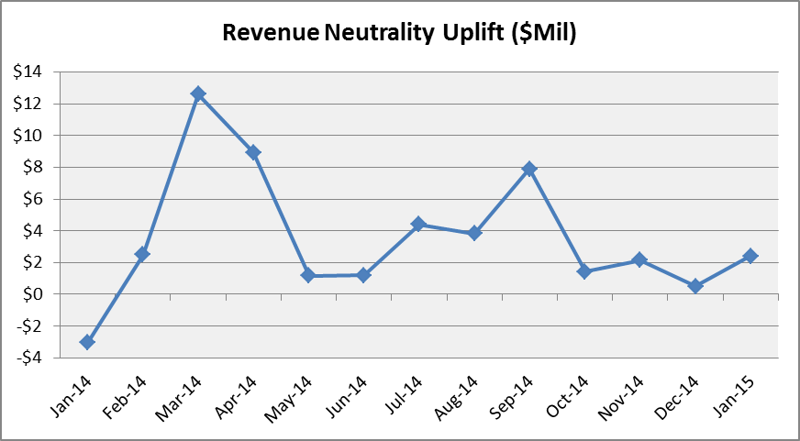
Revenue Neutrality – January 2015
Revenue Neutrality Settlement | $ in Millions
Real-Time Point to Point Obligation Settlement | ($16.71)
Real-Time Point to Point Options and Options with Refund Settlement | $0.00
Real-Time Energy Imbalance Settlement | $14.18
Real-Time Congestion from Self-Schedules Settlement | $1.13
DC Tie & Block Load Transfer Settlement | ($0.99)
Charge to Load | $2.39
Revenue Neutrality charges to load increased compared to last month and to January 2014.
January 2015 was a charge of $2.39M, compared to:
$0.51M charge in December 2014
$3.02M payment in January 2014

Slide 38
Real Time Ancillary Service Imbalance (ORDC) – January 2015
Real Time Ancillary Service Imbalance | $ in Thousands
Real-Time AS Imbalance Payment Amount | ($52.70)
Load Allocated AS Imbalance Revenue Neutrality Amount | $52.70
Total Charges | $52.70
Real-Time Ancillary Service Imbalance Settlements decreased from December 2014 to January 2015. Total payments for the month of January 2015 were $52,700 compared to a payment of $66,261 in December 2014.
15 of the 31 days in January had settlement dollars equal to $0 for the day.
All days were settled as a net credit to QSEs representing generation and as a charge to QSEs representing load.
The highest settlement occurred on January 16th. The total Real Time Ancillary Service Imbalance payments on that day were $30,336.

Slide 39
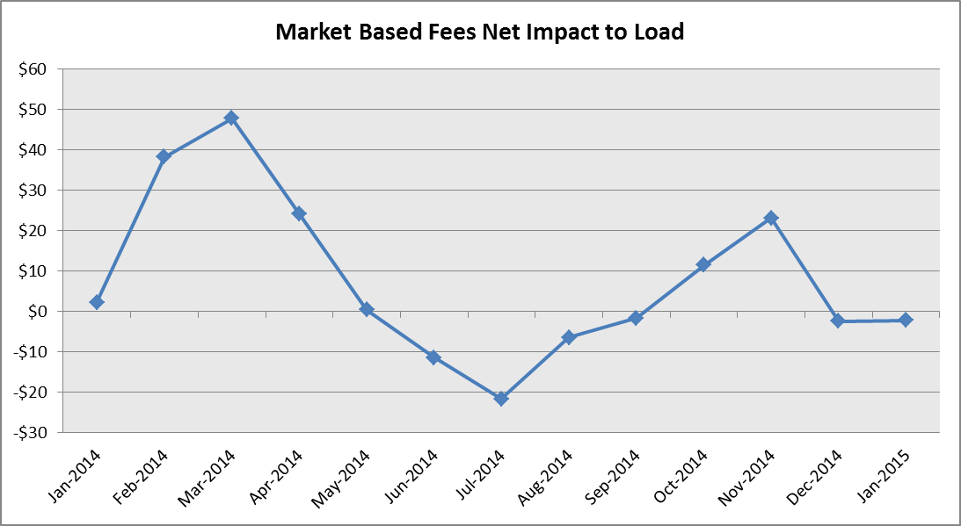
Net Allocation to Load – January 2015
Market-Based Allocation | $ in Millions
CRR Auction Revenue Disbursement Settlement | ($22.65)
Balancing Account Proceeds Settlement | $0.00
Net Reliability Unit Commitment Settlement | ($0.02)
Ancillary Services Settlement | $18.20
Reliability Must Run Settlement (incl. RMR for Capacity) | $0.00
Real-Time Revenue Neutrality Settlement | $2.39
Emergency Energy Settlement | $0.03
Base Point Deviation Settlement | ($0.24)
ORDC Settlement | $0.05
Total | ($2.24)
Fee Allocation
ERCOT Administrative Fee Settlement | $13.43
Net Allocated to Load | $11.19
The charge for the net allocation to Load increased from last month and decreased from January of 2014.
January 2015 was a charge of $11.19M, compared to:
A charge of $9.69M in December 2014
A charge of $15.32M in January 2014

Slide 40
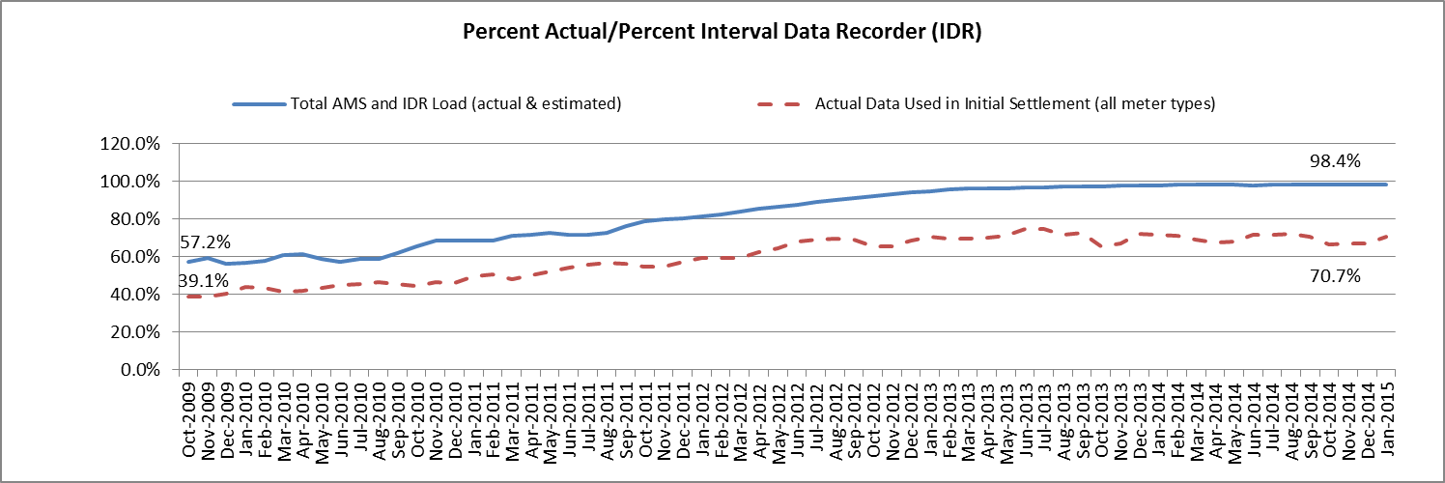
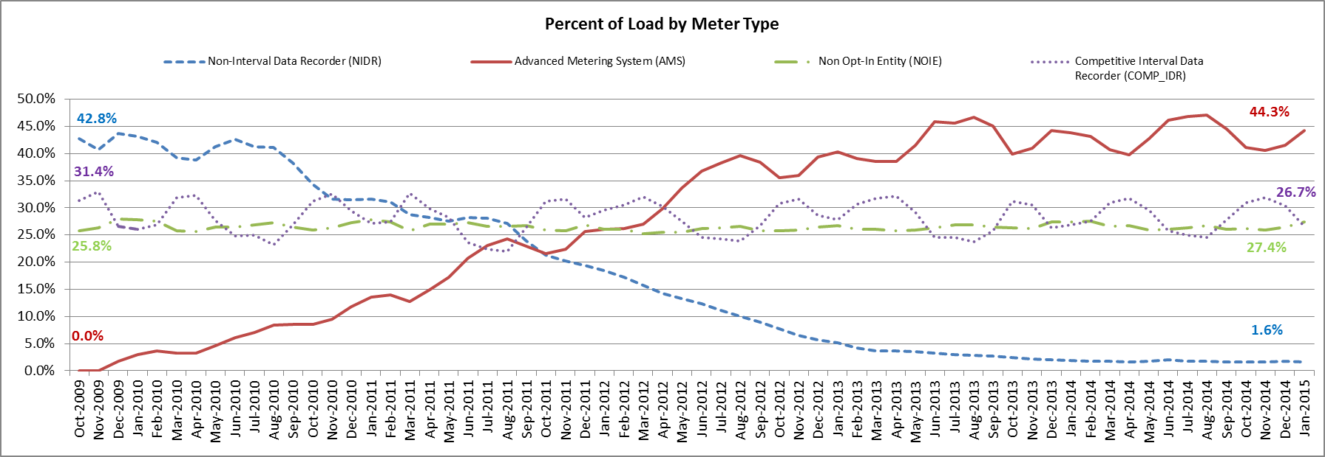
Advanced Meter Settlement Impacts – January 2015
January 2015: At month end, settling 6.7M ESIIDs using Advanced Meter data.
January 2015: 98.4% of the load in ERCOT is settled with 15-min interval data (AMS, Competitive IDR, and NOIE IDR).

Slide 41
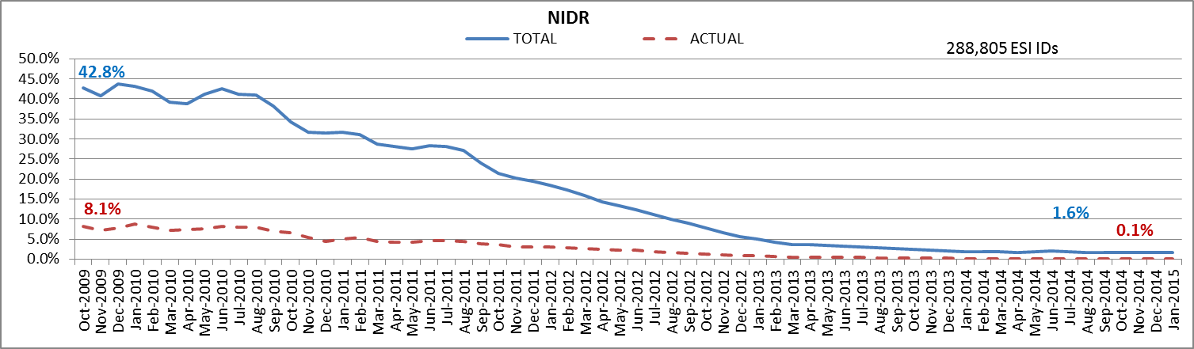
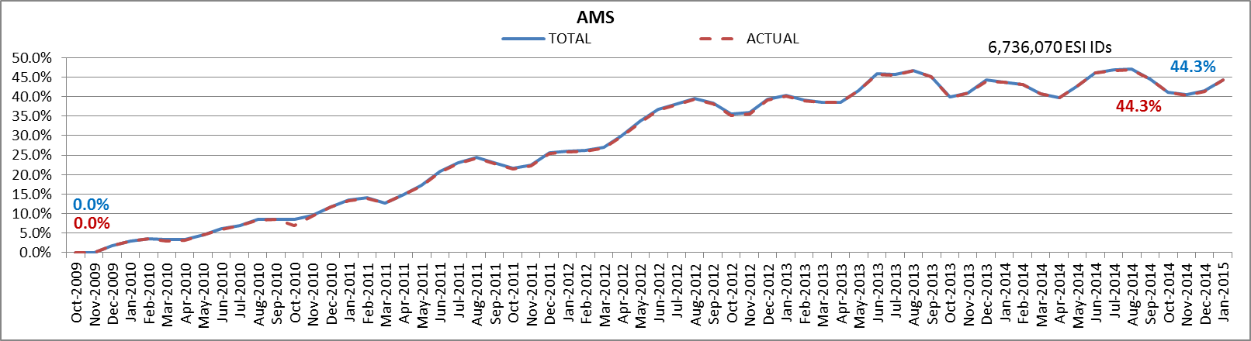
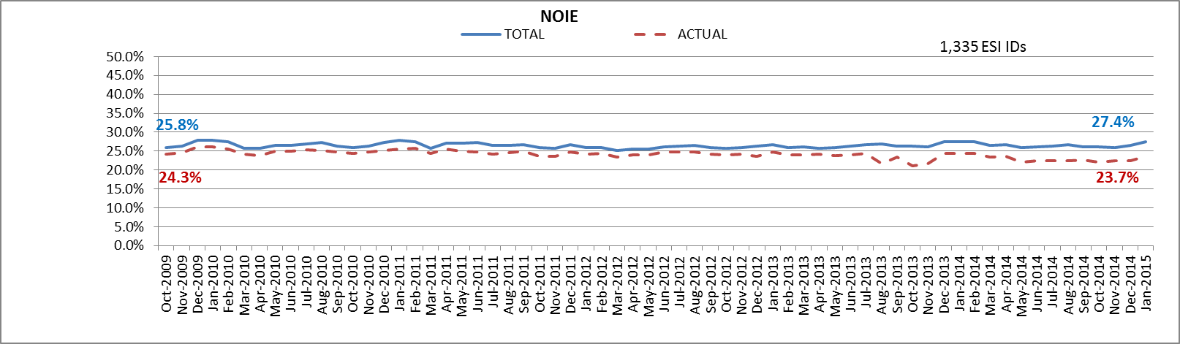
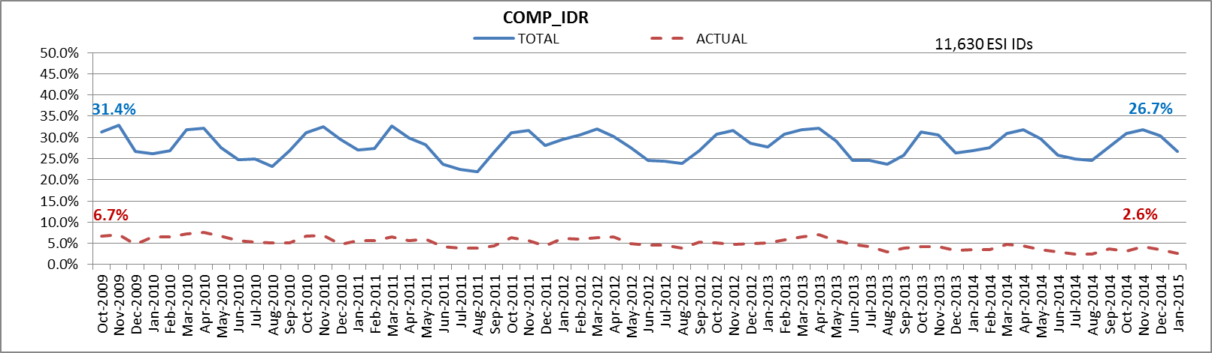
ERCOT Wide Load Volumes by Meter Type – INITIAL Settlement – January 2015

Slide 42
Retail Transaction Volumes – Summary – January 2015
 | Year-To-Date |  | Transactions Received
Transaction Type | January 2015 | January 2014 | January 2015 | January 2014
Switches | 72,885 | 86,953 | 72,885 | 86,953
Acquisition | 0 | 0 | 0 | 0
Move - Ins | 198,025 | 207,059 | 198,025 | 207,059
Move - Outs | 98,233 | 104,273 | 98,233 | 104,273
Continuous Service Agreements (CSA) | 40,420 | 34,811 | 40,420 | 34,811
Mass Transitions | 0 | 0 | 0 | 0
Total | 409,563 | 433,096 | 409,563 | 433,096

Slide 43
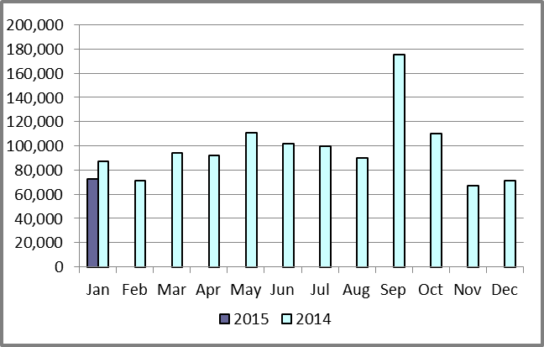
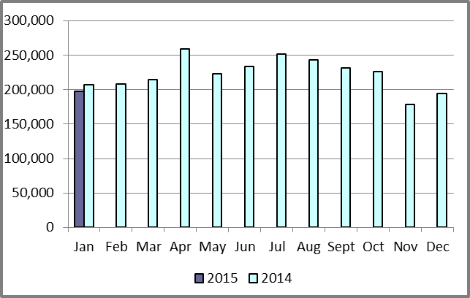
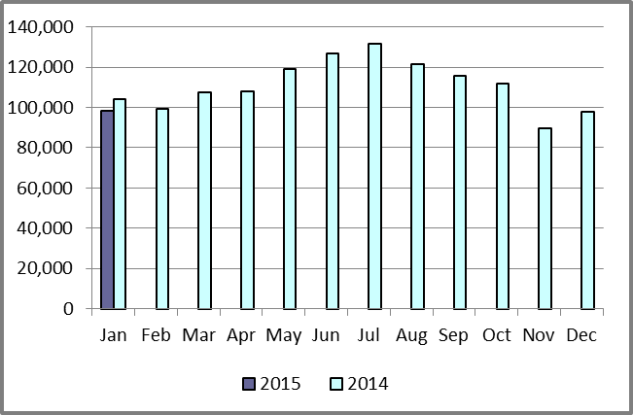
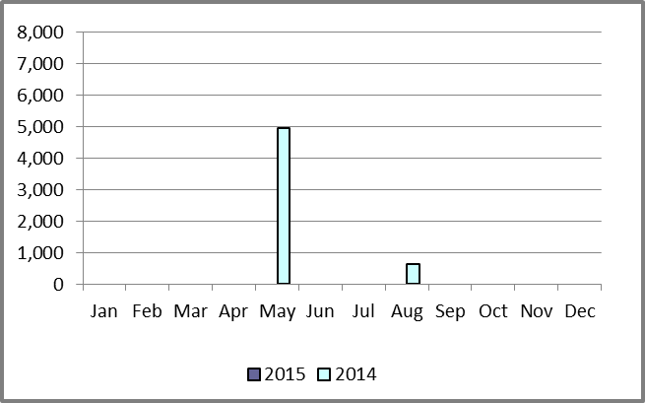
Retail Transaction Volumes – Summary – January 2015
Switches/Acquisitions
Move-Ins
Move-Outs
Mass Transition

Slide 44
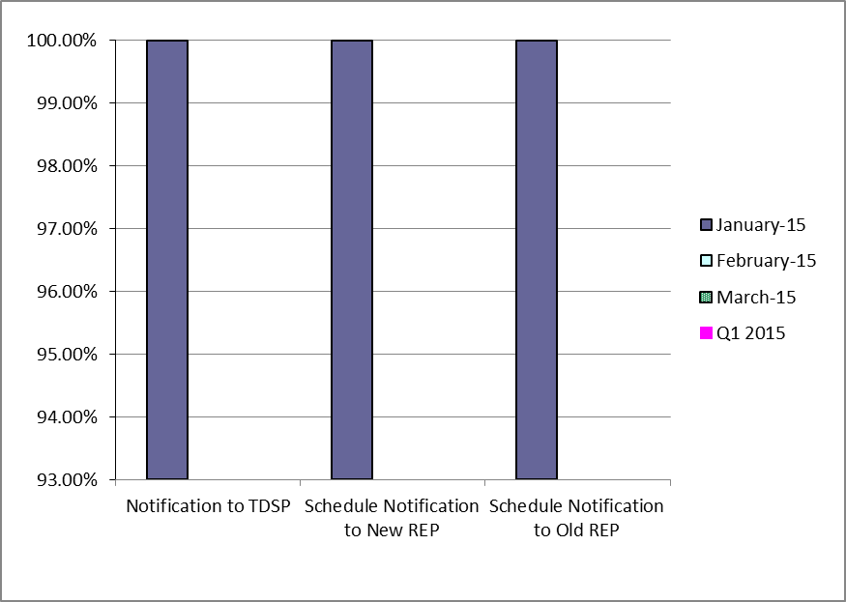
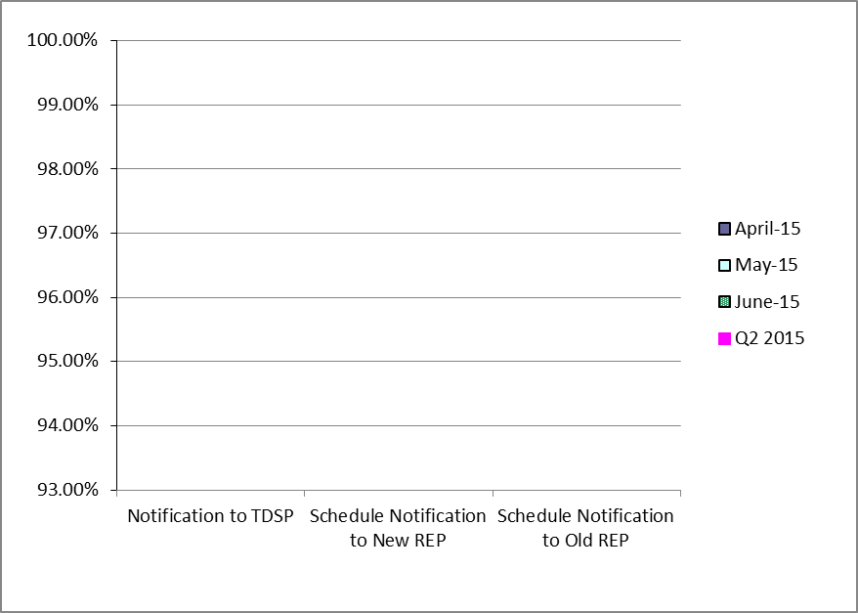
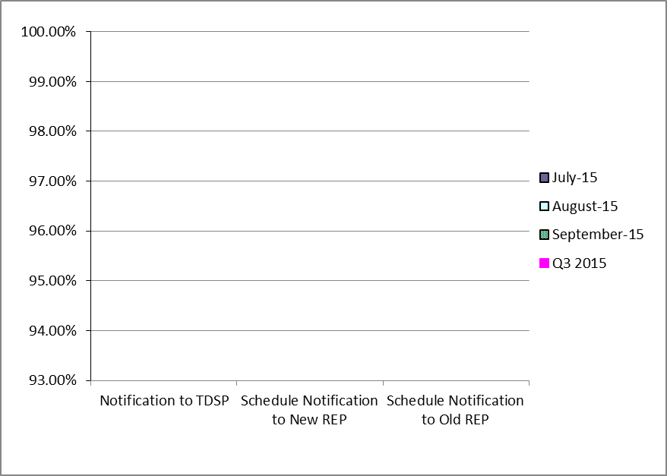
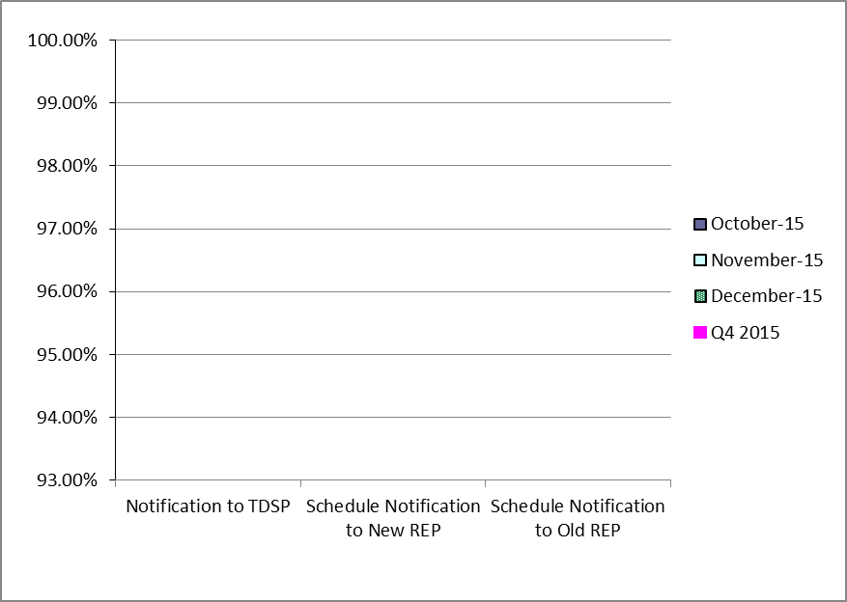
Retail Performance Measures – Switch – January 2015
1st Quarter
2nd Quarter
3rd Quarter
4th Quarter

Slide 45
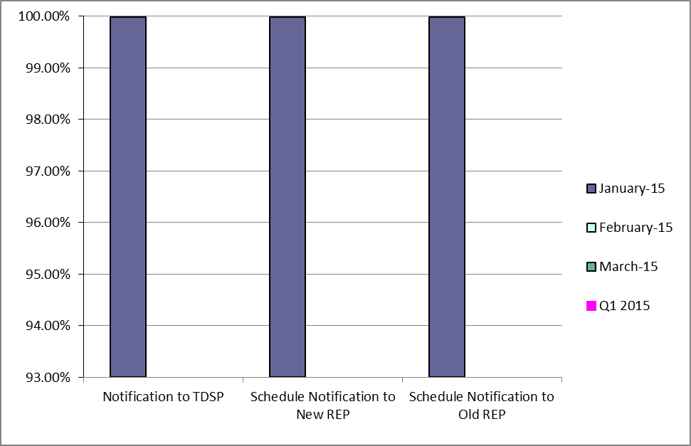
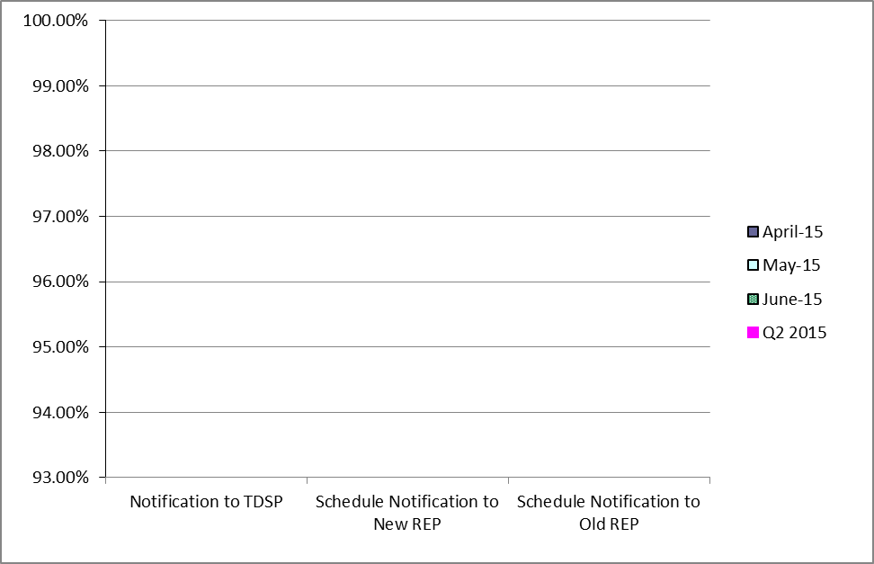
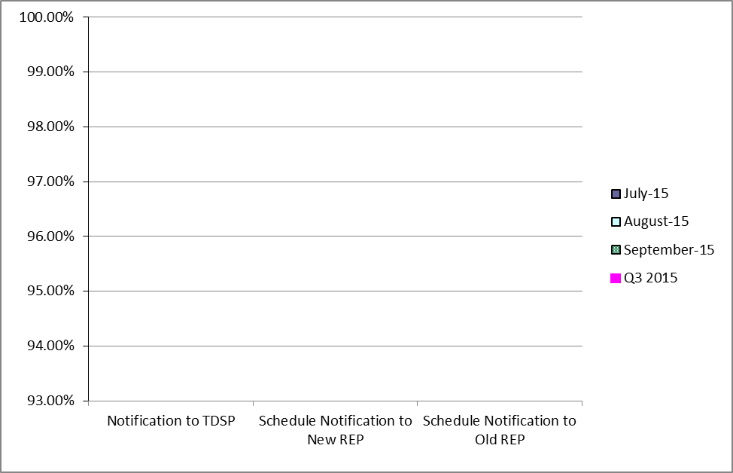
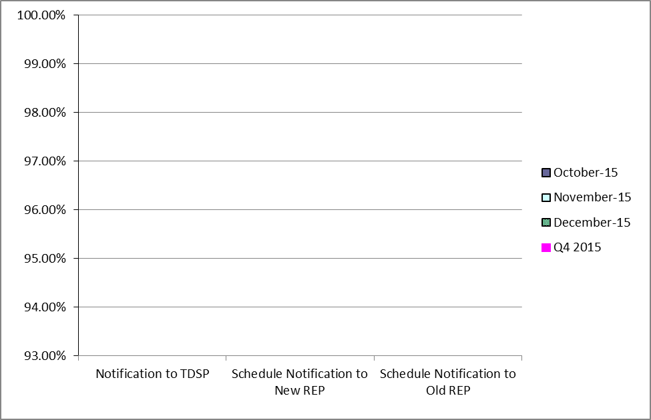
Retail Performance Measures (Same Day Move-In) – January 2015
1st Quarter
2nd Quarter
3rd Quarter
4th Quarter

Slide 46
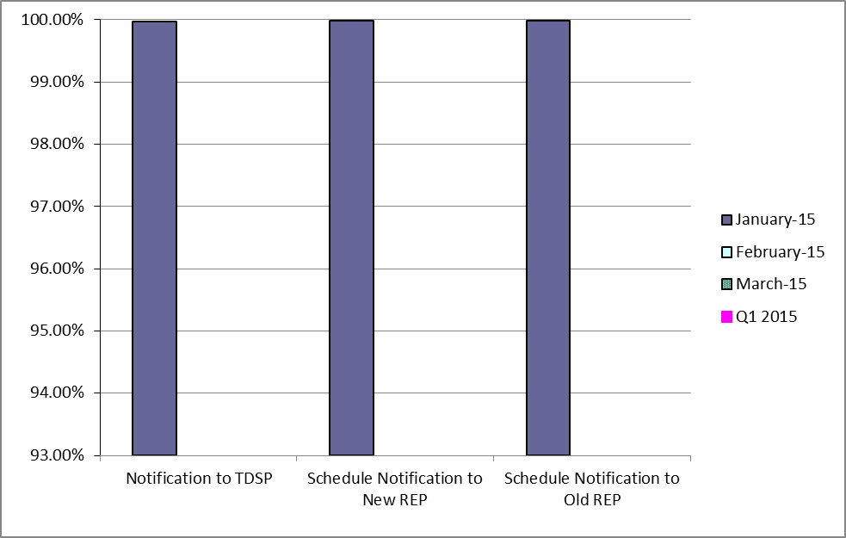
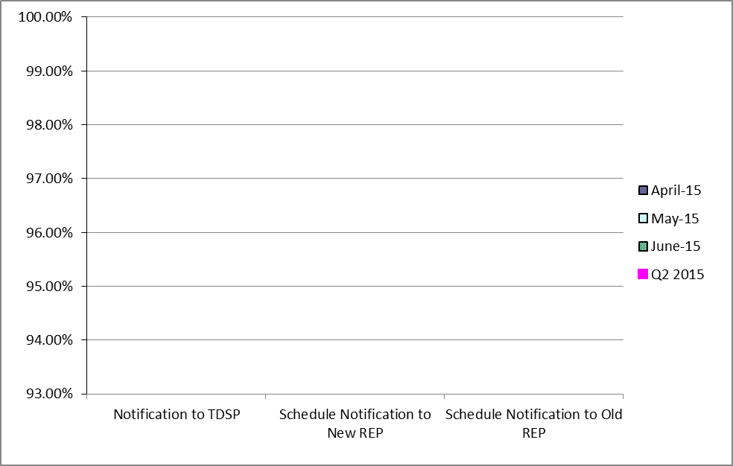
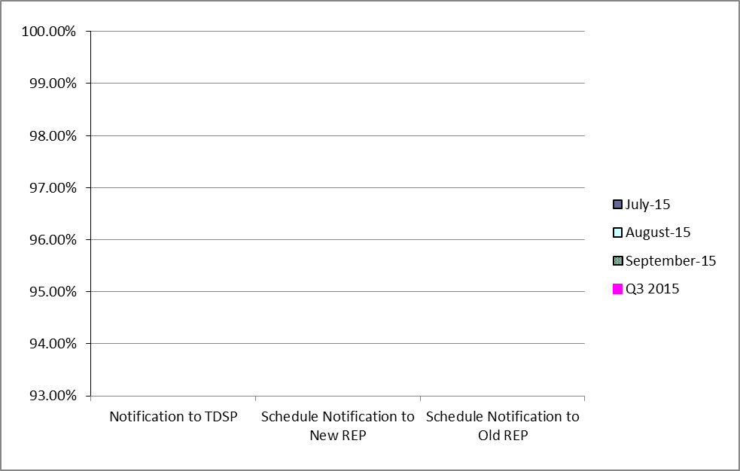
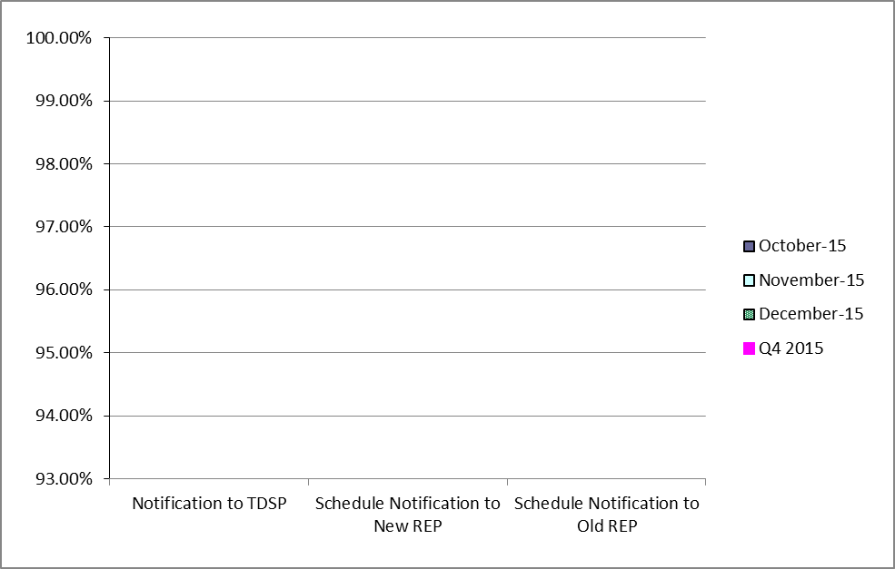
Retail Performance Measures (Standard Move-In) – January 2015
1st Quarter
2nd Quarter
3rd Quarter
4th Quarter

Slide 47
Projects Report

Slide 48
ERCOT Portfolio Stoplight Report – January 2015

Slide 49
ERCOT Portfolio Stoplight Report – January 2015

Slide 50
ERCOT Portfolio Stoplight Report – January 2015

Slide 51
ERCOT Portfolio Stoplight Report – January 2015

