Slide 1
Overview of ERCOT Outage Coordination
Woody Rickerson
Director Grid Coordination
January 2015

Slide 2
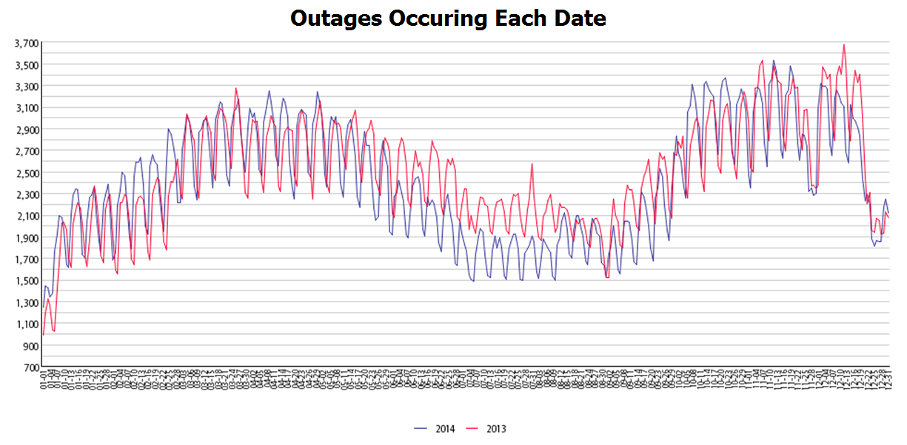
Oct. through Mid – Dec.
March through May
ERCOT processes approximately 115,000 outages annually
15 dedicated Outage Coordination ftes
Two peak outage seasons
Two off seasons
Peak for 2014 on Nov. 11 – 3481 outages on system

Slide 3
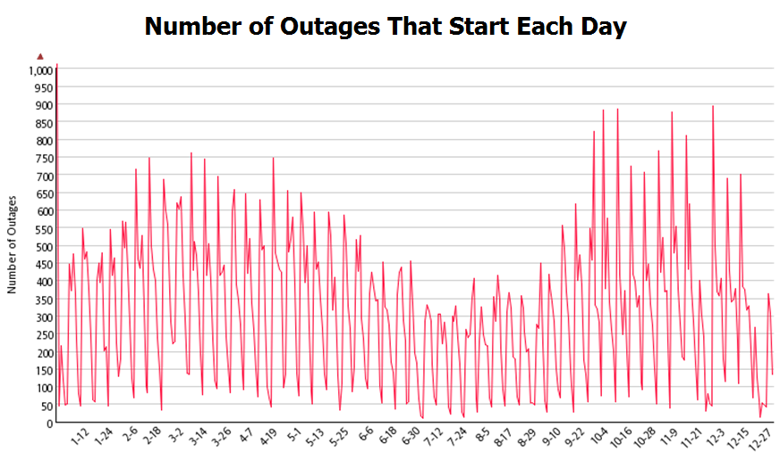
Some outages are analyzed multiple times
Late arriving outages may only be studied once before being handed off to Real-Time

Slide 4
Outage Submission Timelines
Transmission Outages
3-d
A
Resource Outages
4-day
A
TD+1
TD+3
TD+9
TD+4
Resource Outages automatically accepted
Resource Outages Require Approval
9-day
App
45-day
Approval
90-day
Approval
TD + 90
TD + 75
TD +45
TD + 30
Target Day
To Start
Outage

Slide 5
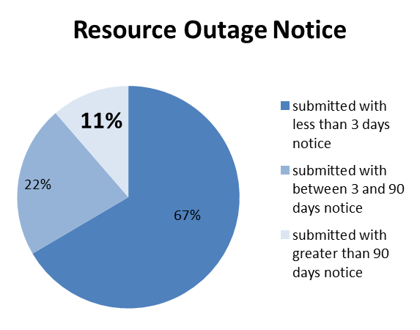
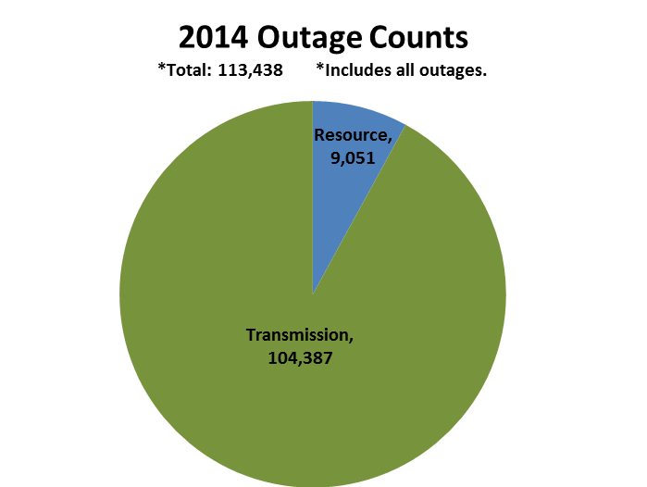
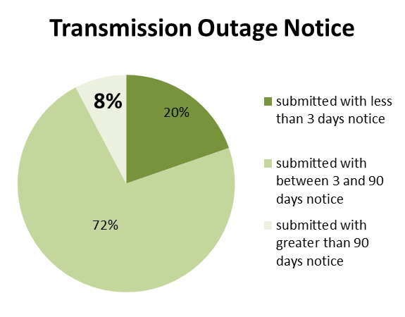

Slide 6
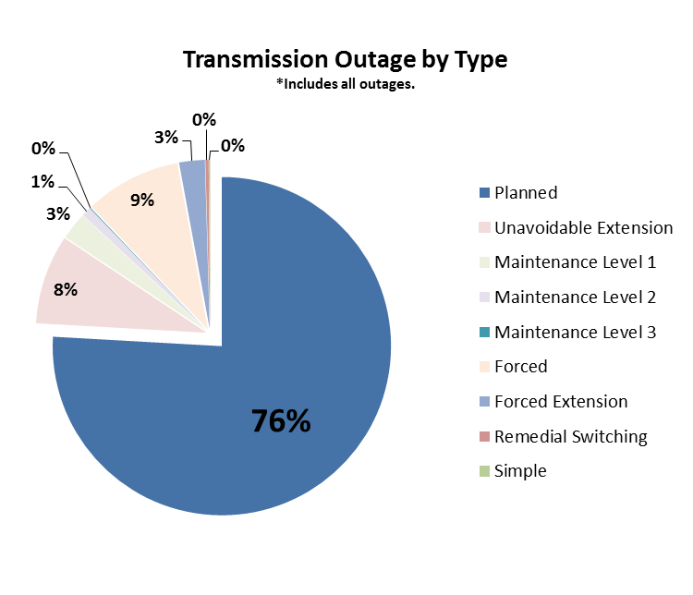

Slide 7
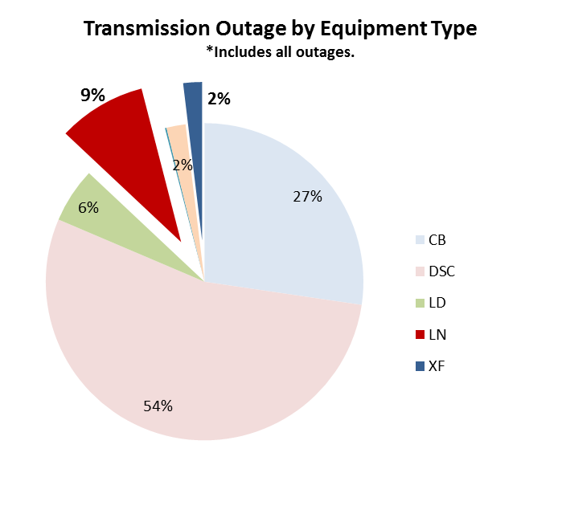

Slide 8
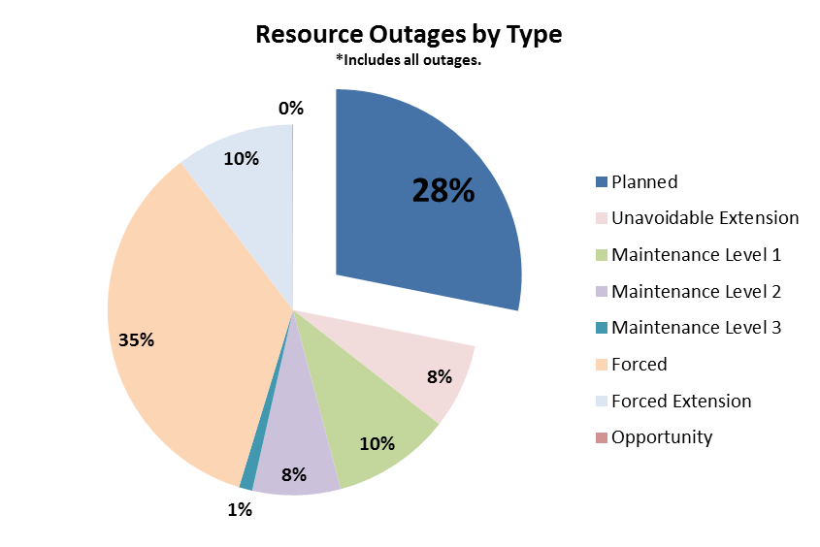

Slide 9
Outage Coordination Timelines
12 months in advance, rolling annual outage plan to be submitted
Tri-annual Planning Model Updates
90-120 days in advance NOMCRs due for Operations Model (NOMCRs)
90-day timeline
45-day timeline (Resource)
CRR Snapshot
9-day timeline
Interim Update NOMCRs
4-day
3-day
time
Real Time
Operational Model Changes
Resource Outages
CRR Models
Transmission Outages

Slide 10
Outage Coordination Study Process
Reliability Problems
Reject
No Reliability Problems
Order of Receipt
Approve
Outages Awaiting ERCOT Approval
Coordinate Outages
Modify Gen Pattern
Previously Approved or Accepted
Resource and Transmission Outages
Load Forecast
Starting Gen. Pattern
Contingency file
Wind Scenarios
CIM-derived EMS case containing
Date specific Topology

Slide 11
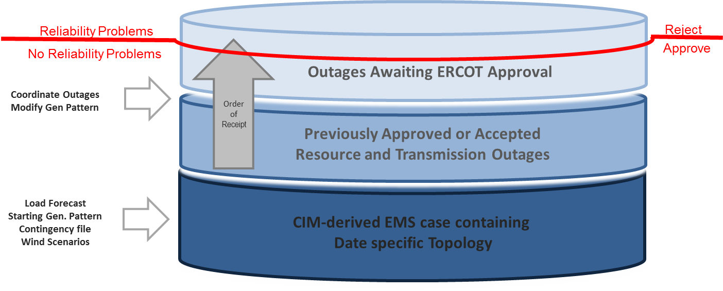
When Reliability meets Economics
Approximately 75 “High Cost” Outages were identified during the Outage Approval Process in 2014
Questionnaire:
A statement of why the work is required.
Is there a switching solution to reduce market impact?
A statement of what has been done to reduce the length of Outage.
Are you working extended hours? If not, can you submit it daily?
Is this outage scheduled during a reduced load season? If not, please explain the reason.
Can the outage be scheduled during a resource outage that would reduce market impact.

Slide 12
High Cost Outages
High Cost Outages are subjectively determined by the amount of generation that has changed from an optimal dispatch to resolve reliability violations.
Including 10 in the Rio Grande Valley area (Ajo to Rio Hondo, Lon Hill to North Edinburg, etc.) and 14 in the Houston Import area (Singleton to Tomball, etc.)

Slide 13
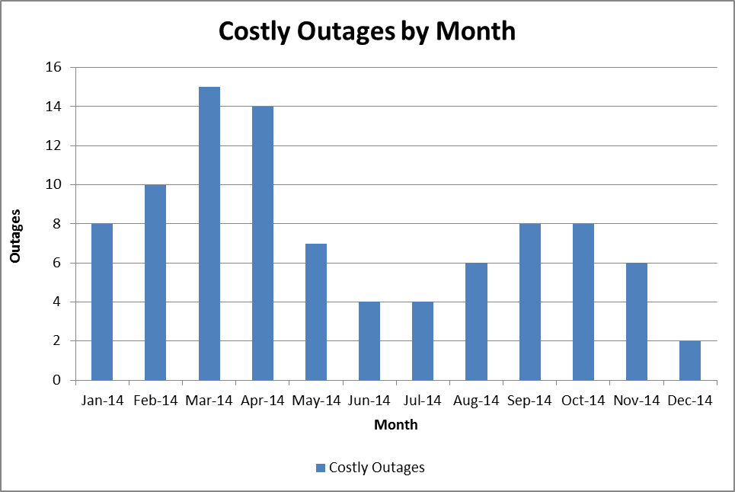
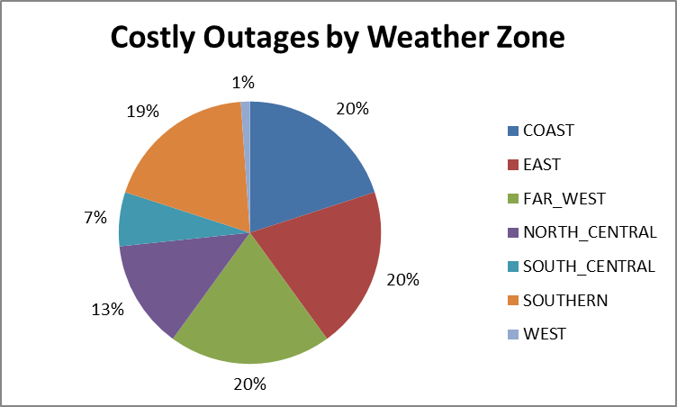
High Cost Outages

